Slide 1
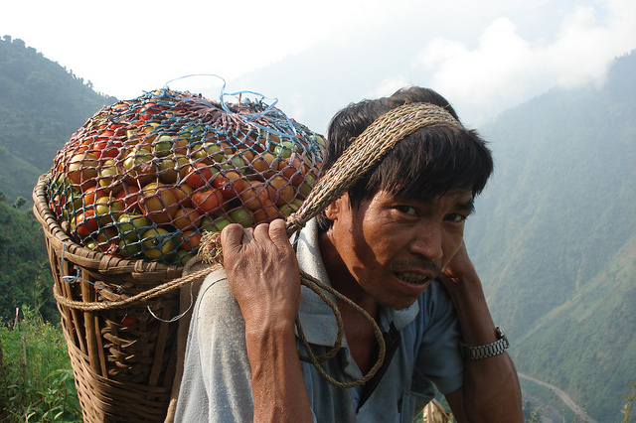
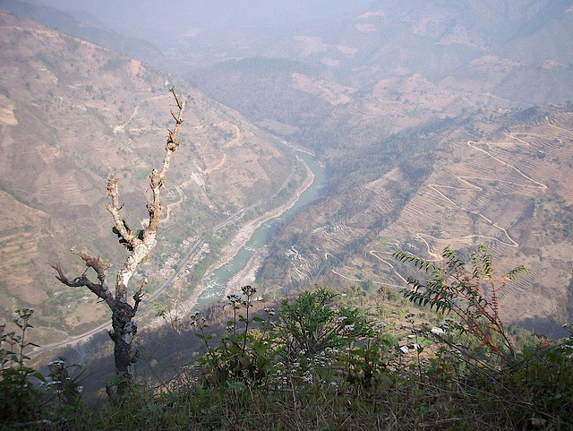
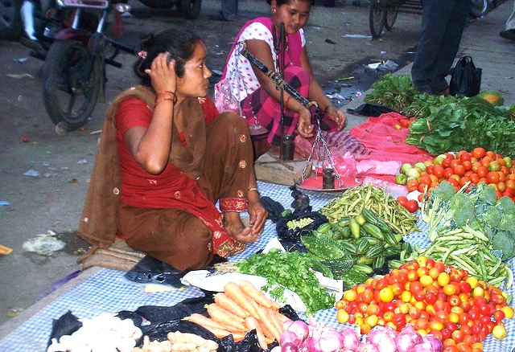
A challenge to move tomatoes down a mountainside without squashing them!

Slide 2
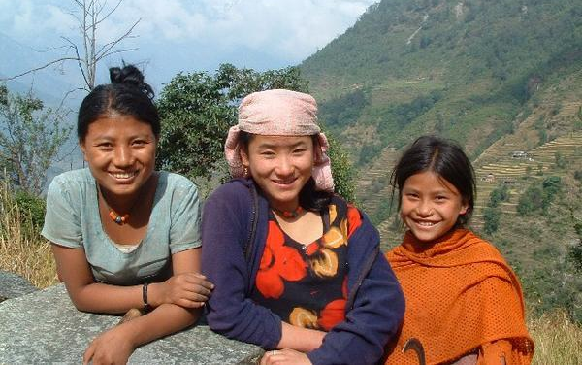
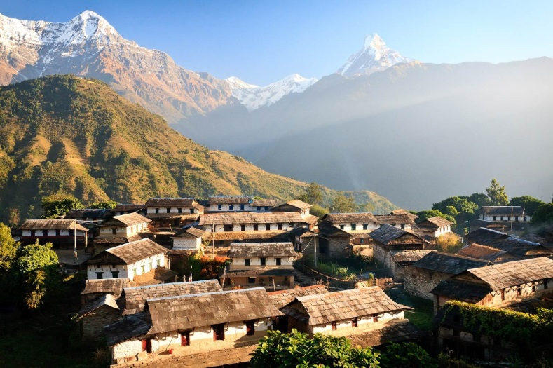
Nepal
Notes:
This challenge is set in Nepal : What do you know about the country and its people so far?
Set a short research task to find out some key facts about the country and people of Nepal.

Slide 3
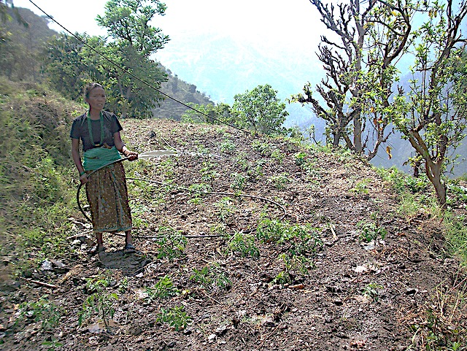
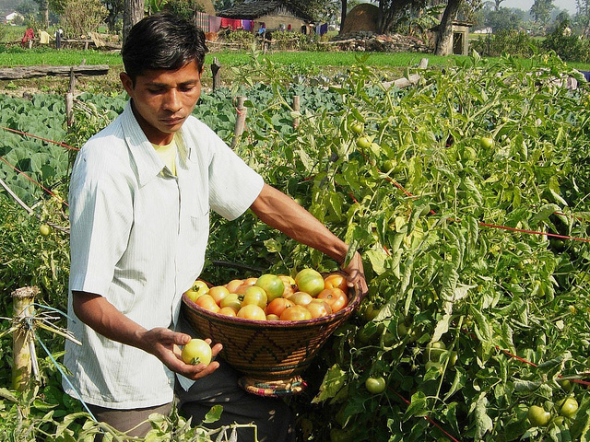
Farming in the mountains
Many families living in the fertile mountainous areas in Nepal grow a variety of crops to feed their families and to sell at local markets.
Look at the pictures given to you:
What do you see?
What might be some of the challenges for farmers who grow crops on the mountainsides in Nepal?
Notes:
Starter activity: Give each small group of 2-4 students a set of four pictures that you’ve downloaded from Flickr on the main Squashed Tomato Challenge page and ask them to consider:
What do they see in the photos and what might be some of the challenges for people living here.
What might be some of the challenges for farmers who grow crops on the mountainside in Nepal?

Slide 4
A problem for farmers…
Many farmers in Nepal grow their crops on the mountainside areas where the land is fertile.
However, the markets where farmers can get a good price for their produce (including their tomatoes) are at the bottom of the mountain on the other side of the river.
It’s often a hard three hour walk down steep and dangerous paths and the produce often gets squashed on the journey.

Slide 5
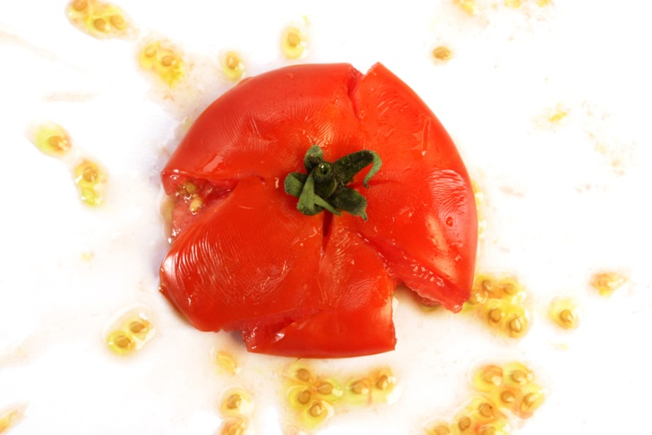
Your challenge…
Is to find a way that can help farmers in Nepal transport their tomatoes down the mountain to market.
Design, make and test a model of a system that can transport tomatoes in a way that won't squash them!
A few ground rules
The tomatoes must be transported a minimum of one metre, not touching the ground.
The tomatoes cannot be touched whilst they are moving, catapulted or flown in any way! They must be moved in a controlled way.
Notes:
As the teacher, you might decide to add a competitive element by seeing which group can transport the most tomatoes in a given time.

Slide 6
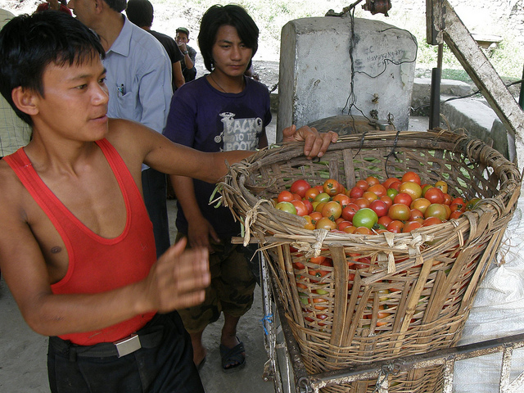
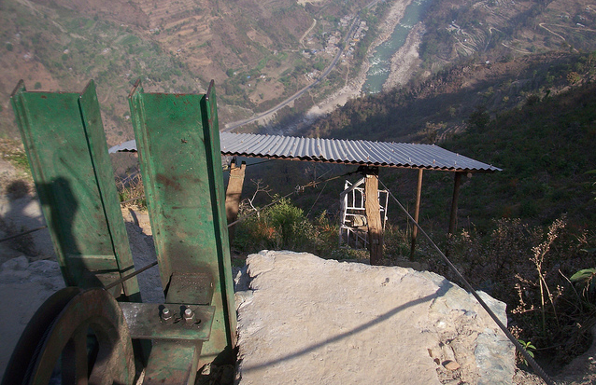
In Nepal…
Now that you’ve had a go at transporting tomatoes yourselves, we’d like to show you how Practical Action has worked with farmers in Nepal to develop aerial ropeway systems to help farmers transport their produce to market.

Slide 7
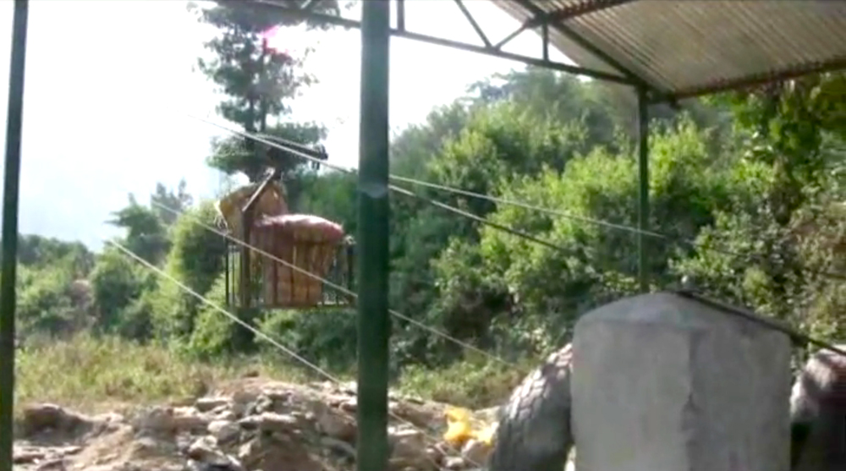
Video
How an aerial ropeway system works.
https://www.youtube.com/watch?v=YAtIBXvnWFo#t=66
Notes:
You might want to have a discussion with your students the difference this simple technology can make to peoples lives.
For students who would like more technical detail of the aerial ropeway, you’ll find a Technical brief (in the download tab) to support the project here at http://practicalaction.org/squashed-tomato-challenge-5.

Slide 8
Thank you for taking part in the
For more challenges go to:
practicalaction.org/stem

