Slide 1
EO Detective
Observing the Earth from Space

Slide 2
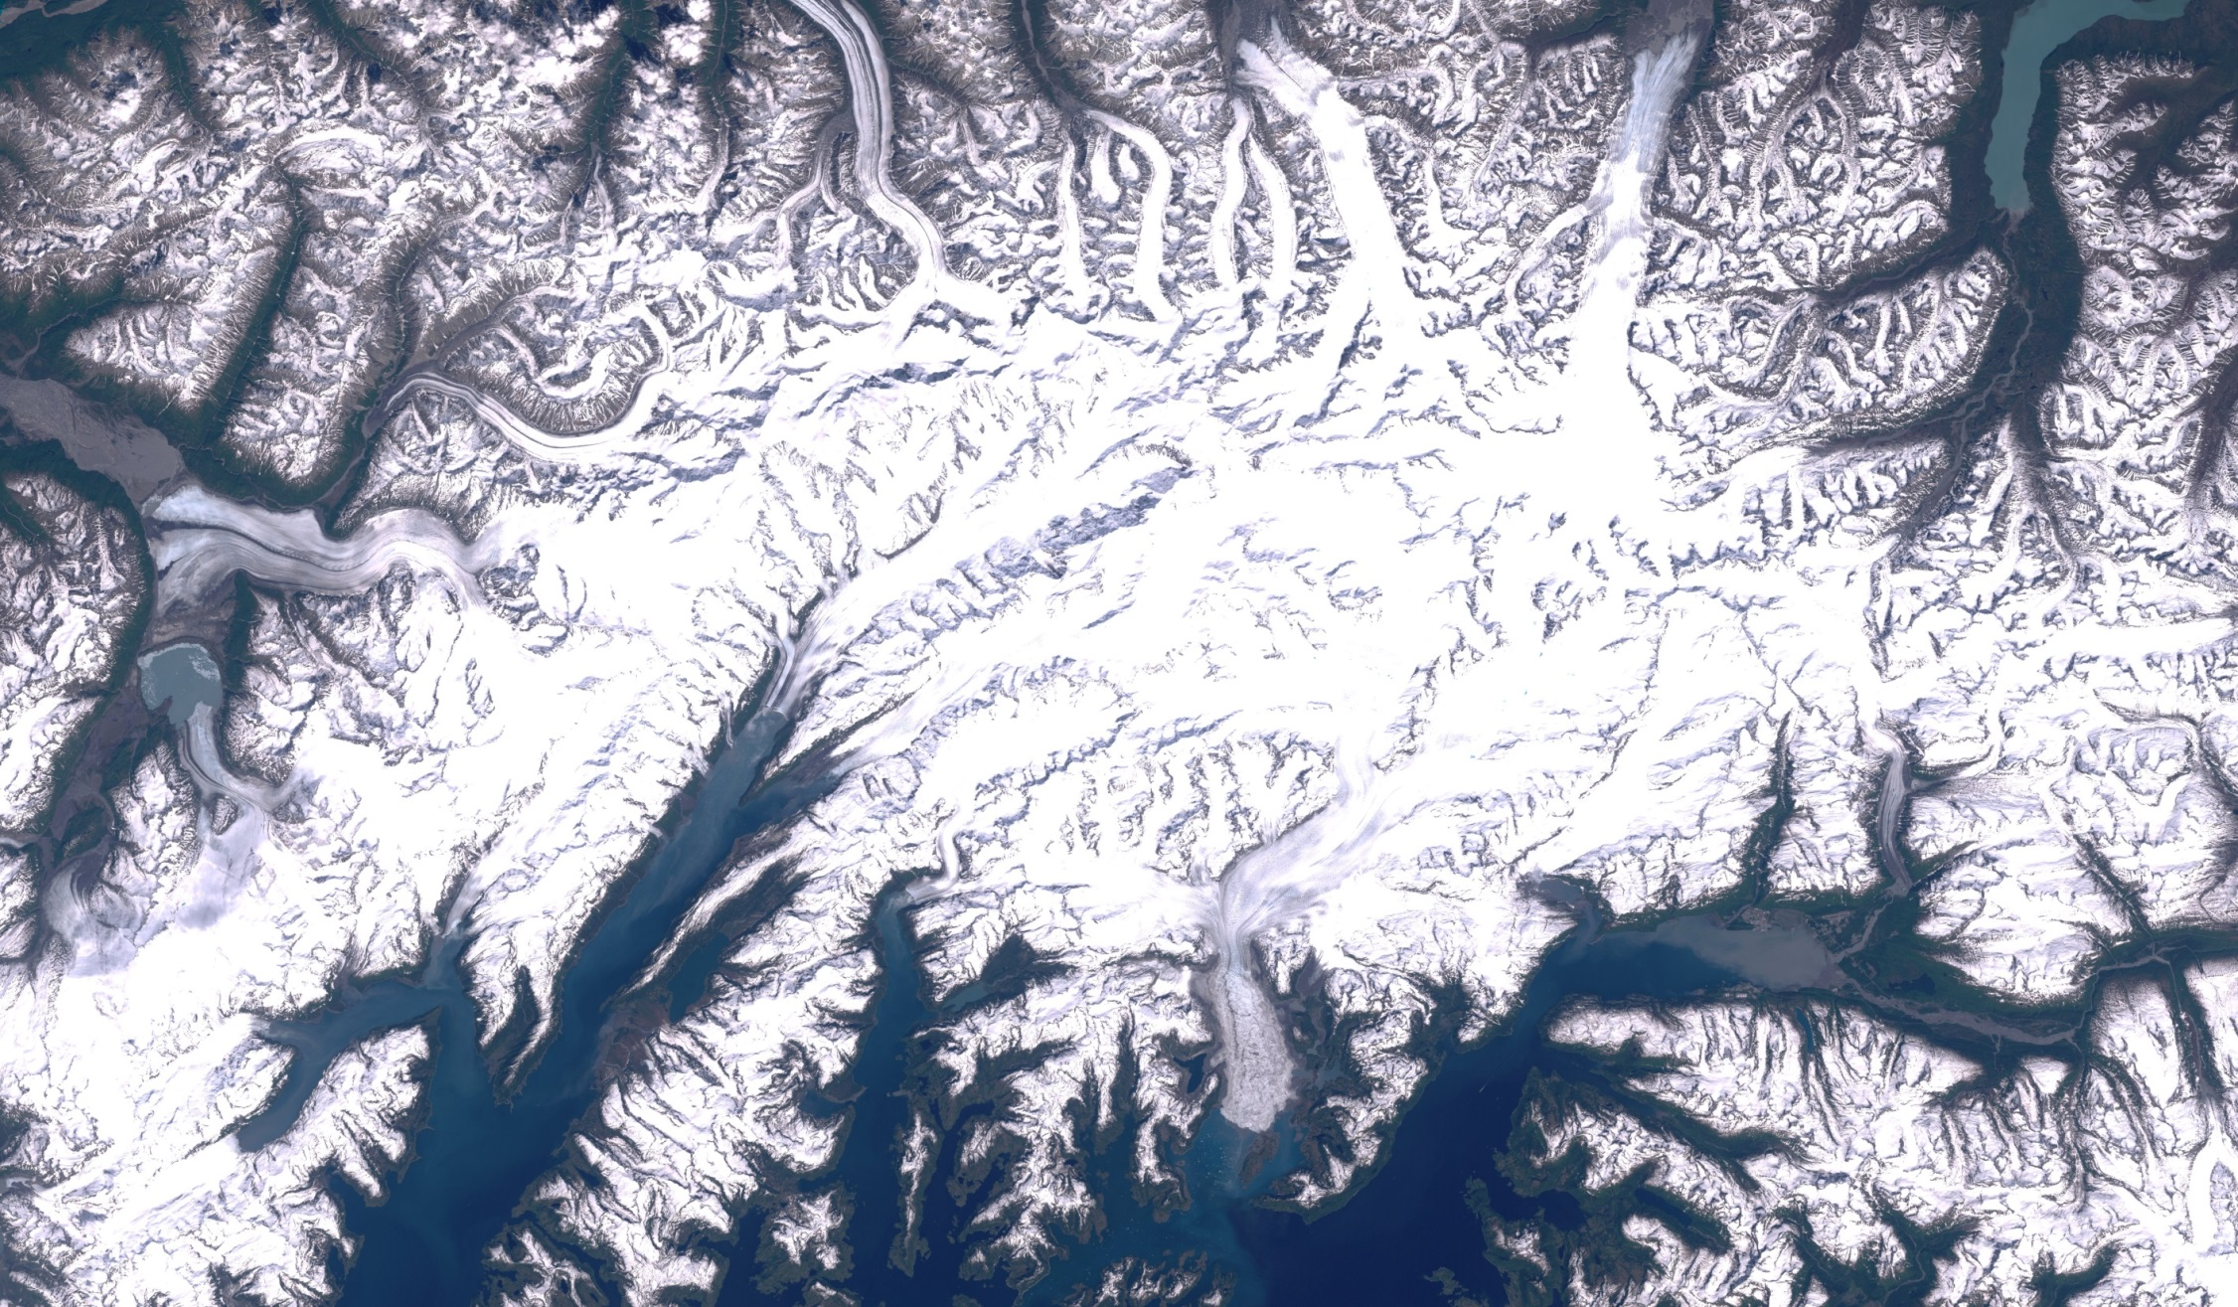
Watching a glacier
Investigating ice at the top of the world
Notes:
June 2000

Slide 3
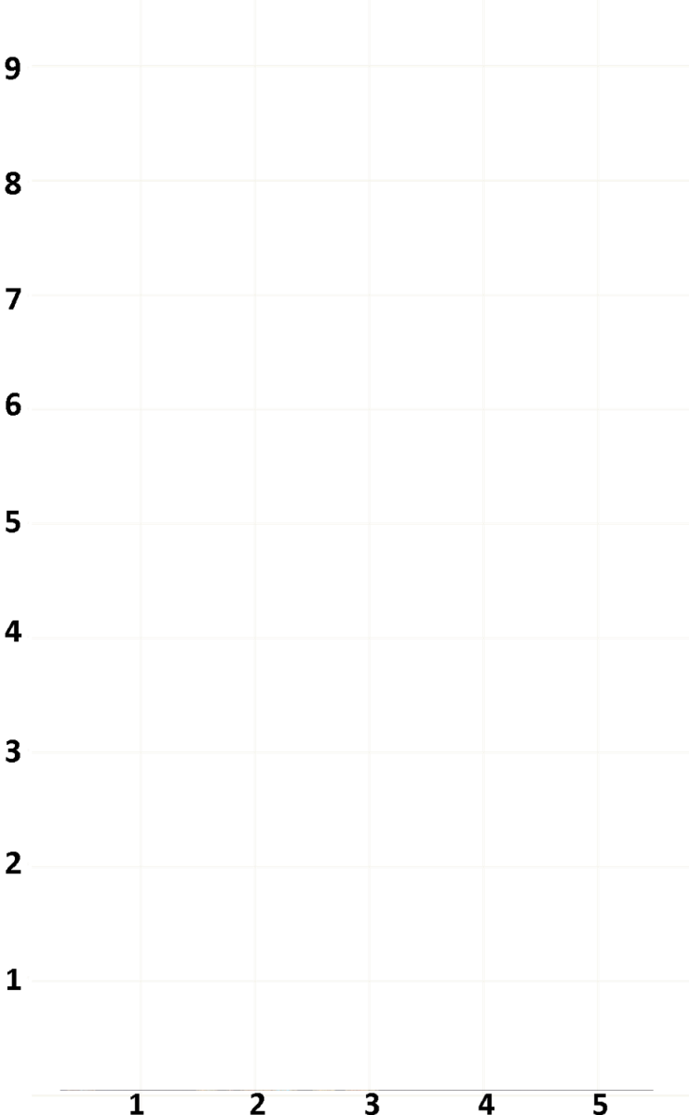
Changing colour
snow and ice
plants
sea
clouds
rocky ground
rocky ice
Notes:
June 2000

Slide 4
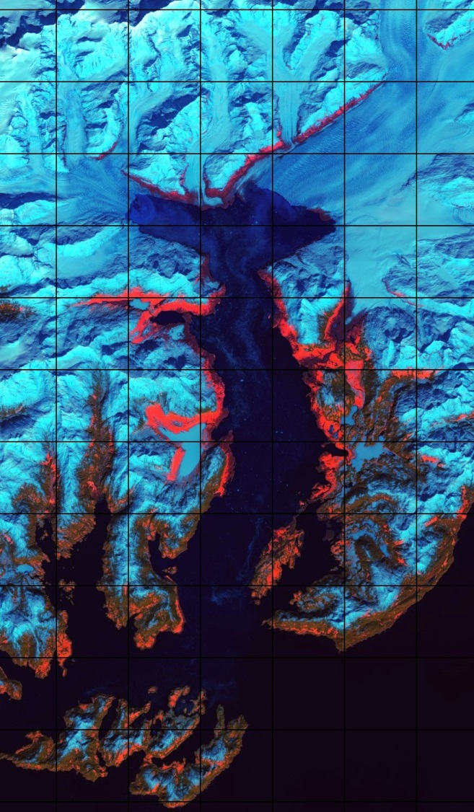
What has happened?
Each square is 4 km × 4 km
1989
2005
Why do you think there are only three pictures?
2015

