Slide 1
EO Detective
Observing the Earth from Space

Slide 2
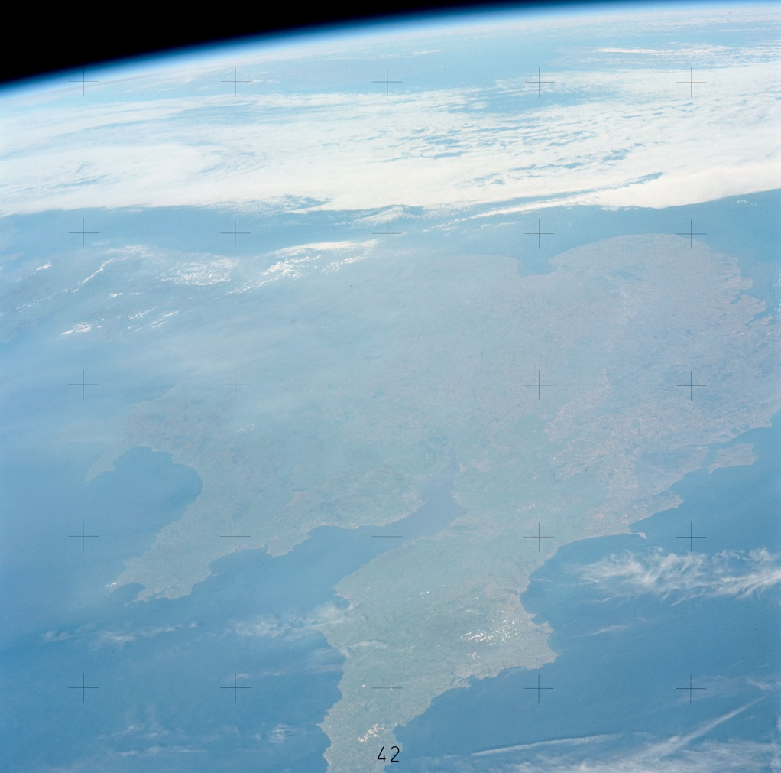
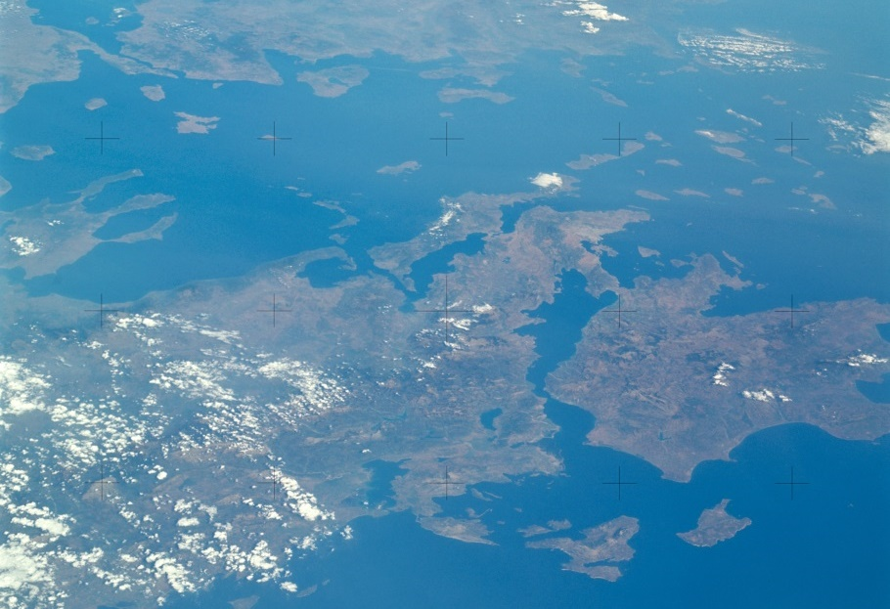
From the ground and from the sky
Astronaut photographs of Earth
Notes:
SL3-121-2445 (July-September 1973) --- An oblique view of a portion of Great Britain looking northeastward across England and Wales, as photographed by one of the Skylab 3 crewmen aboard the Skylab space station in Earth orbit. The picture was taken with a hand-held 70mm Hasselblad camera using a 100mm lens and SO-368 medium-speed Ektacrome film. The English Channel is at lower right. The Bristol Channel is at lower left. The North Sea with much cloud cover is in the background. (NASA)
SL3-121-2367 (July-September 1973) --- Skylab 3 Earth view of Greece, Albania, Athens and Peloponnesos. (NASA)

Slide 3
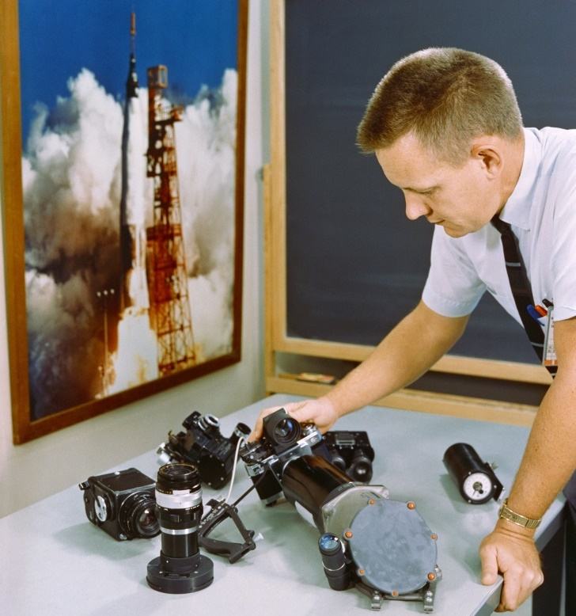
Picture 1
Taken by someone on Earth
Picture A
Taken by an astronaut on Gemini 5
Notes:
The Earth looks very different from the International Space Station.
Picture 1 and Picture A are both pictures of mountains. Picture 1 was taken by someone standing on a hillside here on Earth. Picture A was taken by an astronaut in a spacecraft called Gemini-5 in 1965.
Himalayas B Balaji https://www.flickr.com/photos/bbalaji/4637438533 (CCL)
S65-45717 (21-29 Aug. 1965) --- View of the Himalayas and Northern India photographed from the Gemini-5 spacecraft in orbit over Earth. (NASA)
S65-43482 (20 Aug. 1965) --- Table-top view of several of the optical and photographic pieces of equipment planned for use on the Gemini-5 spacecraft before installation in the spacecraft. (NASA)

Slide 4
Match the pictures
Place | Earth picture | Astronaut picture
Mountains | 1 | A
A desert
An island
A city
A lake
A river

Slide 5
Picture 2
Notes:
Downtown Dallas Susan Adams https://www.flickr.com/photos/susanad813/1803752788 (CCL)

Slide 6
Picture 3
Notes:
Confluence of the Nile joepyrek https://www.flickr.com/photos/joepyrek/8295695470 (CCL)

Slide 7
Picture 4
Notes:
Island with clear waters Chris Isherwood https://www.flickr.com/photos/isherwoodchris/3382991517 (CCL)

Slide 8
Picture 5
Notes:
OMAN Wahiba Sands Sylwia Pecio https://www.flickr.com/photos/59037616@N02/15144630176 (CCL)

Slide 9
Picture 6
Notes:
Salton Sea pano 1 Akos Kokai https://www.flickr.com/photos/on_earth/1452308744 (CCL)

Slide 10
Picture B
Notes:
S65-63150 (16 Dec. 1965) --- Eddies in stratocumulus clouds over the Canary Islands as seen from the Gemini-6 spacecraft during its 14th revolution of Earth. (NASA)

Slide 11
Picture C
Notes:
S65-34661 (3-7 June 1965) --- Among the photographs of Earth's terrain taken from the Gemini-4 spacecraft during its orbital mission was this view of the southeastern tip of the Arabian Peninsula with the Gulf of Oman at upper right. Seif dunes (sand) at lower left. This picture was taken with a modified 70mm Hasselblad camera, using Eastman color film, ASA 64 at a setting of 250th of a second at f/11. Dr. Paul Lowman Jr., NASA geologist, was in charge of the Synoptic Terrain Photography. (NASA)

Slide 12
Picture D
Notes:
AS7-06-1718 (14 Oct. 1968) --- Sudan, showing White Nile and Blue Nile rivers below Khartoum, as seen from the Apollo 7 spacecraft during its 44th revolution of Earth. Photographed from an altitude of approximately 130 nautical miles, at ground elapsed time of 69 hours and 10 minutes. Note quilted-patchwork effect created by irrigated cultivated land. (NASA) (Cropped CAF)

Slide 13
Picture E
Notes:
S65-45748 (21-29 Aug. 1965) --- Looking northeast, the Imperial Valley and Salton Sea in southern California is photographed from the Earth-orbiting Gemini-5 spacecraft. This picture was taken with a modified 70mm Hasselblad camera, using MS Ektachrome thin base film, ASA 64. (NASA) (Cropped CAF)

Slide 14
Picture F
Notes:
AS09-22-3463 (9 March 1969) --- Oblique view of the Houston, Texas area as photographed from the Apollo 9 spacecraft during its Earth-orbital mission. This picture was taken from an altitude of 103 nautical miles, at about 1:40 p.m. (CST), on March 9, 1969. Prominent features visible include highways leading out of the city, Lake Houston, San Jacinto River, Trinity Bay, Galveston Bay, Brazos River, Baytown, and Texas City. (NASA) (Cropped CAF)

Slide 15
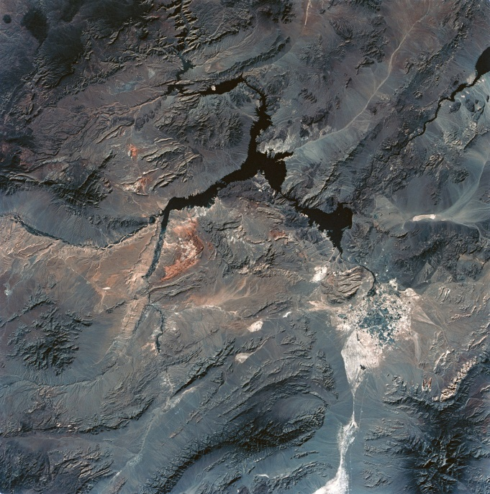
Compare two pictures
What things can you see in both pictures?
What things only show in one picture?
Which do you think is best?
Why?
Notes:
Compare an Earth picture and an astronaut picture of the same place.
SL3-28-059 (July-September 1973) --- A vertical view of the Lake Mead and Las Vegas, Nevada area as photographed from Earth orbit by one of the six lenses of the Itek-furnished S190-A Multispectral Photographic Facility Experiment aboard the Skylab space station. Lake Mead is water of the Colorado River impounded by Hoover Dam. Most of the land in the picture is Nevada. However, a part of the northwest corner of Arizona can be seen. Federal agencies participating with NASA on the EREP project are the Departments of Agriculture, Commerce, Interior, the Environmental Protection Agency and the Corps of Engineers. All EREP photography is available to the public through the Department of Interior's Earth Resources Observations Systems Data Center, Sioux Falls, South Dakota, 57198. (NASA)
Vegas Skyline Filipe Fortes https://www.flickr.com/photos/fortes/138603740 (CCL)

Slide 16
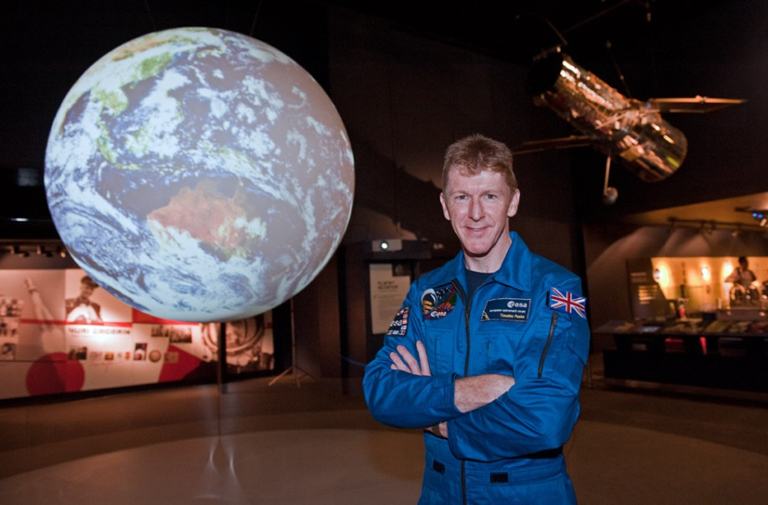
The EO Detectives
Why do you think EO Detectives often use astronaut pictures of the Earth?
Pictures of the Earth taken by astronauts show us …
In them, we can also see …
A picture taken from the ground is better if you want to …
But a picture taken from space is better if you want to …
Notes:
Tim Peake UK Space Agency https://www.flickr.com/photos/spacegovuk/8757791230 (used with permission)

