Slide 4
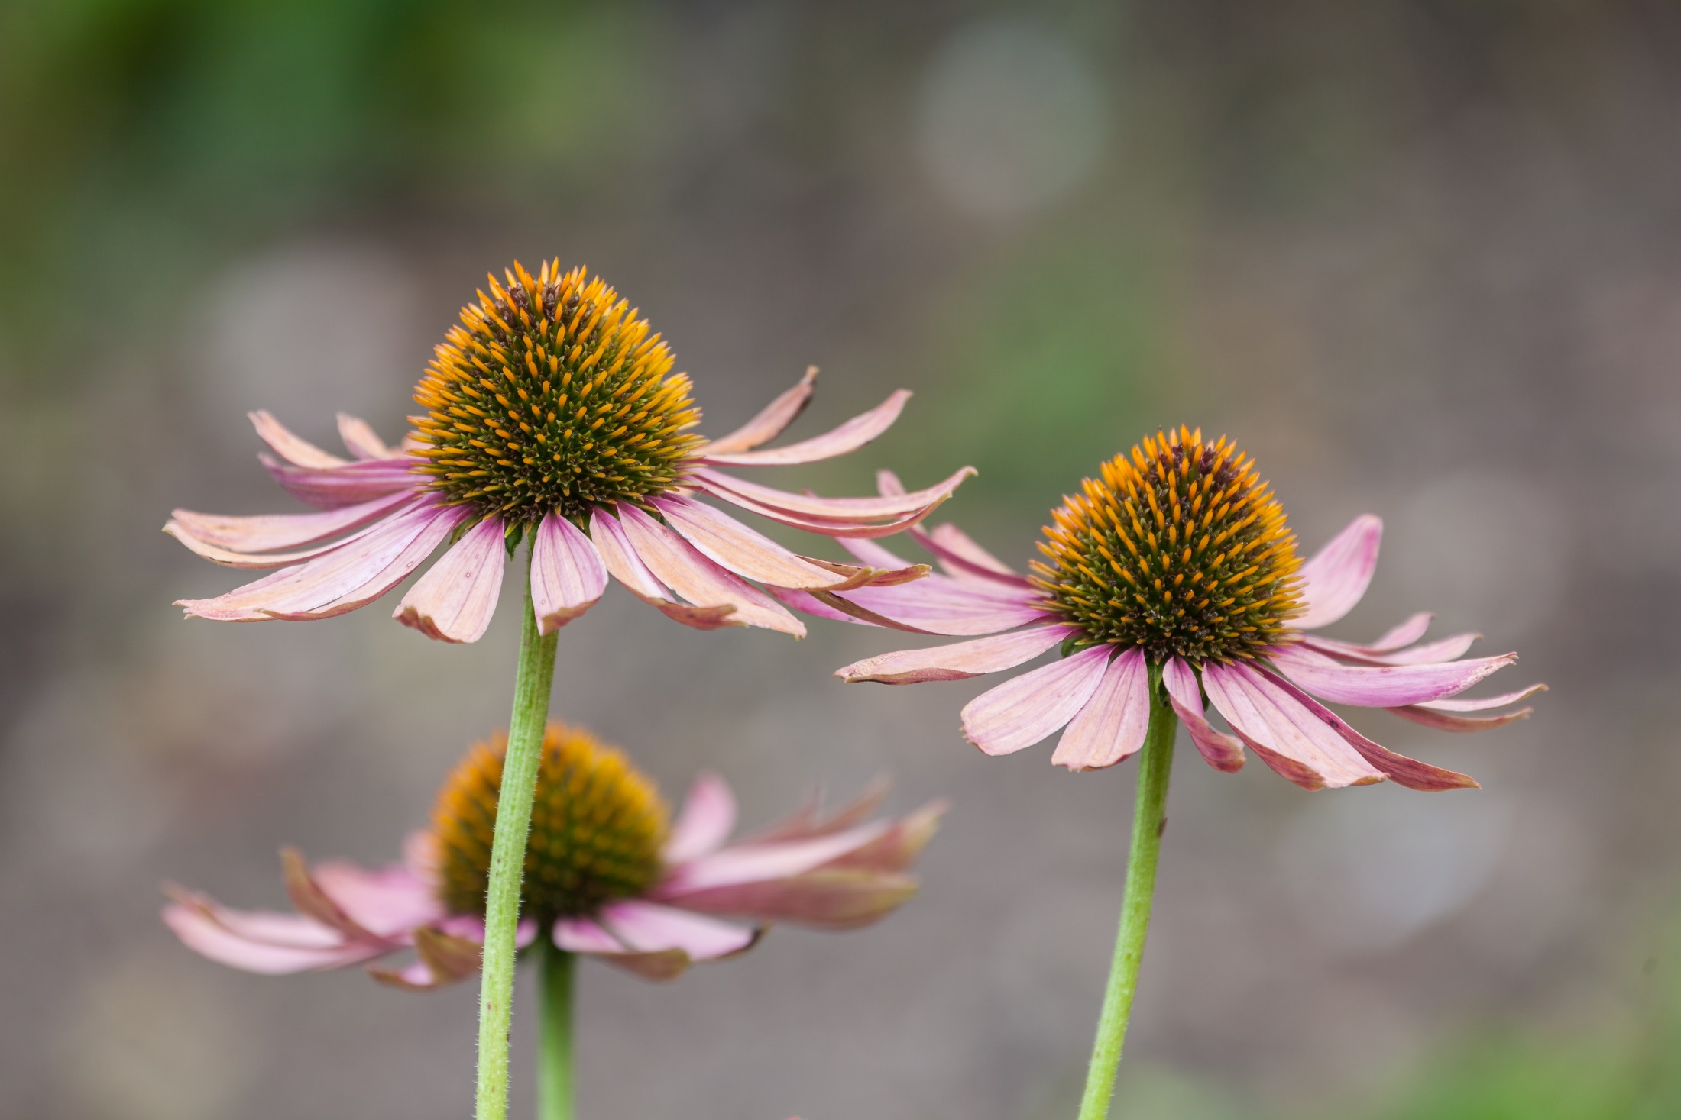

Slide 5
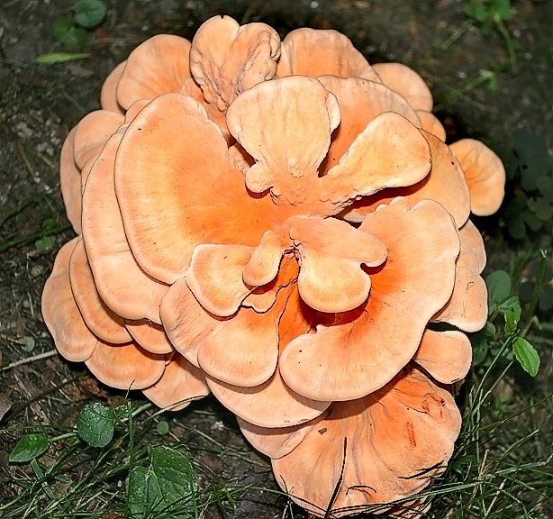

Slide 7
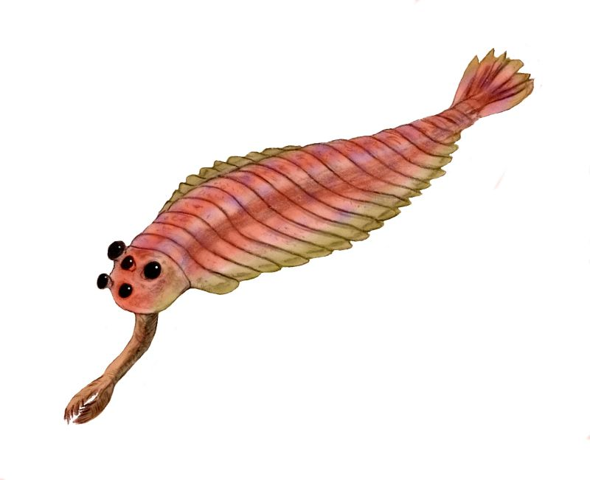

Slide 8
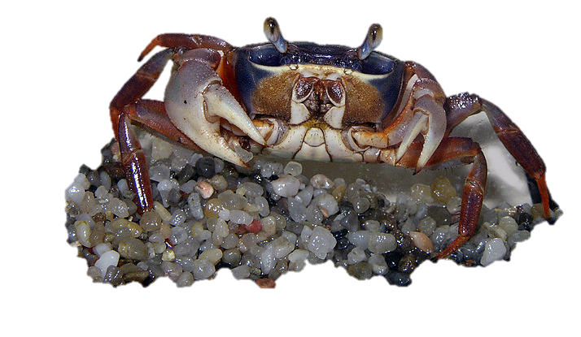

Slide 9
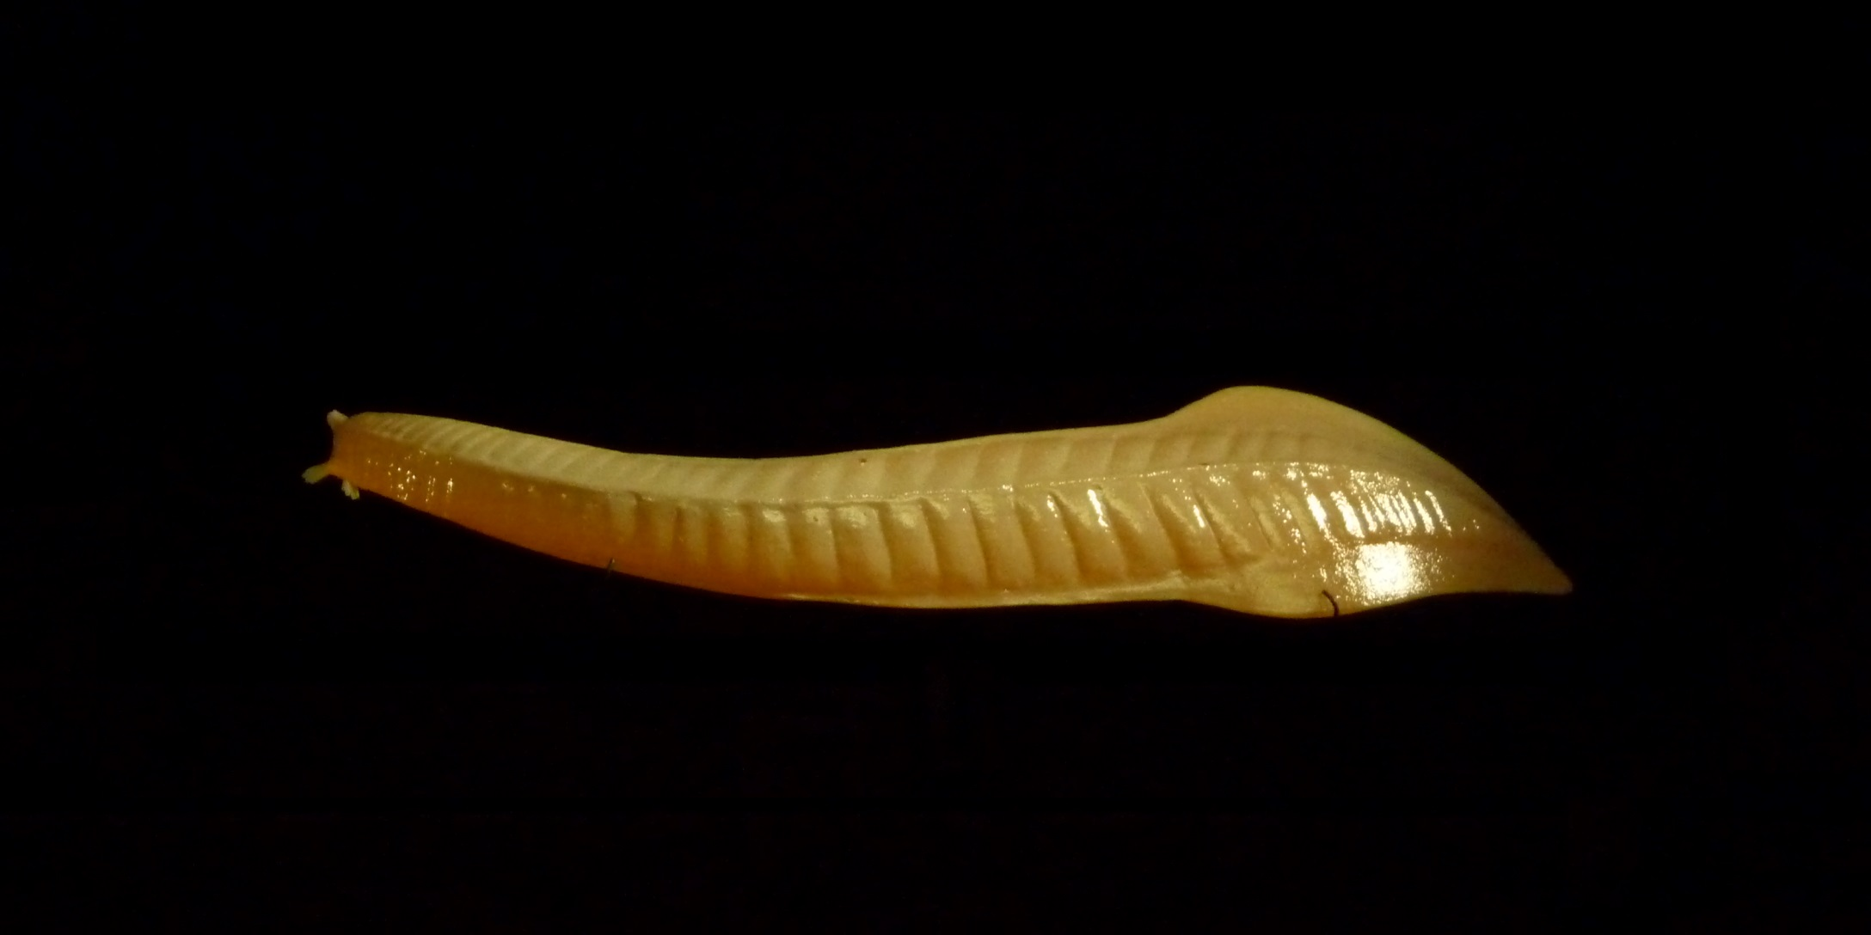

Slide 10
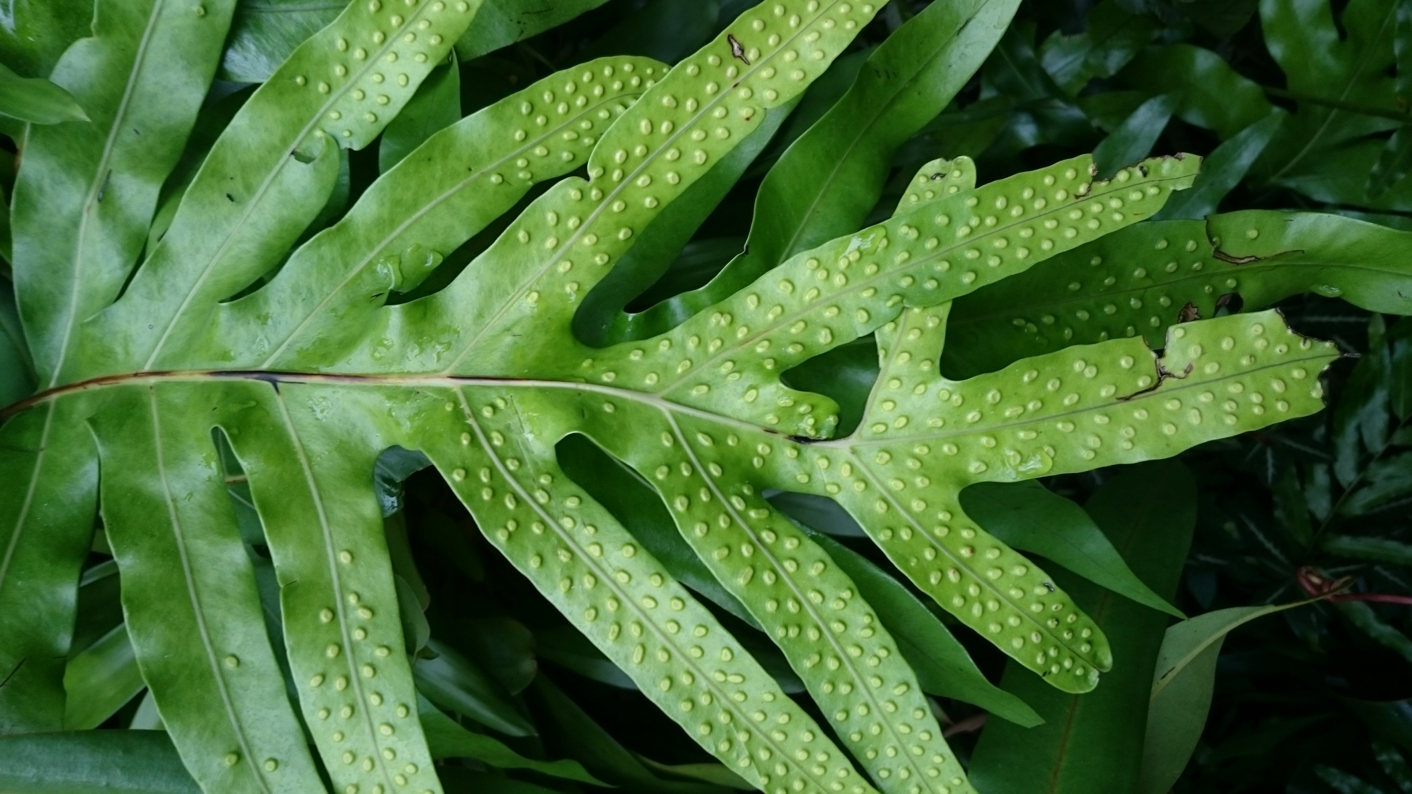

Slide 11
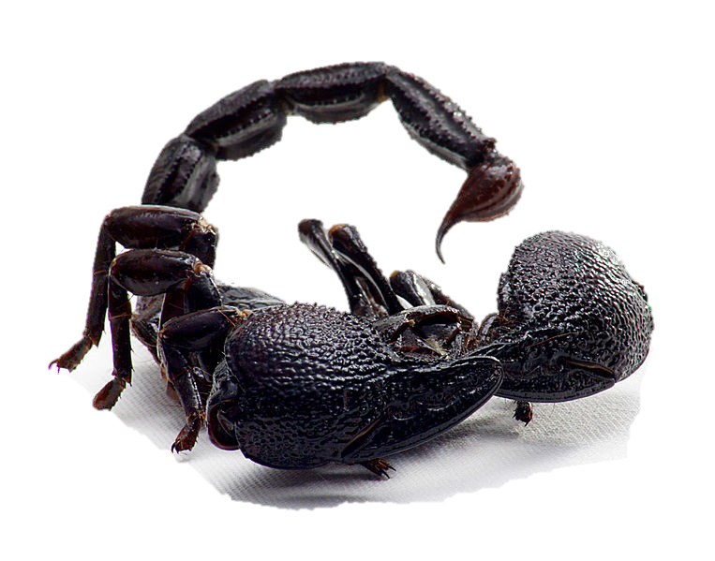
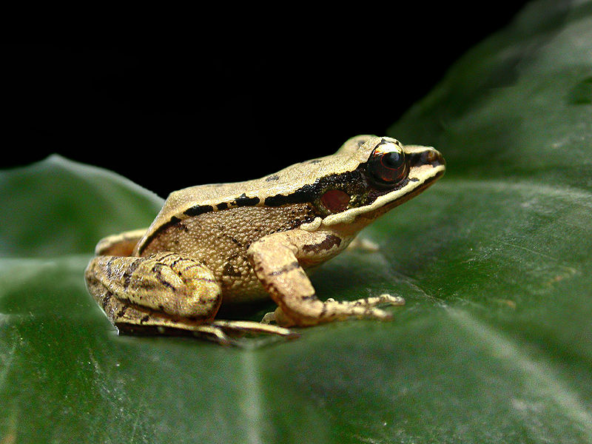
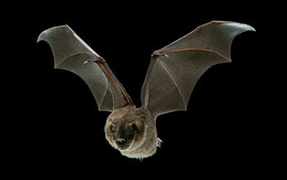

Slide 12
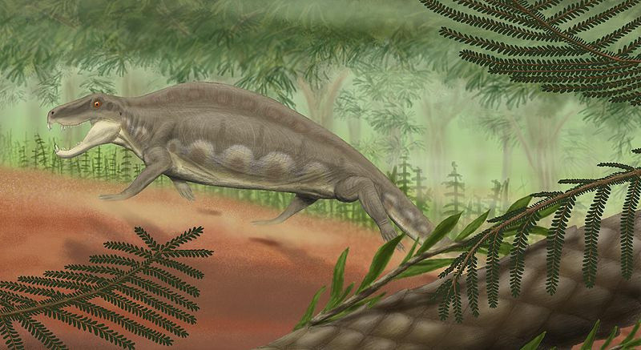
Notes:
Image by Smokeybjb

Slide 13
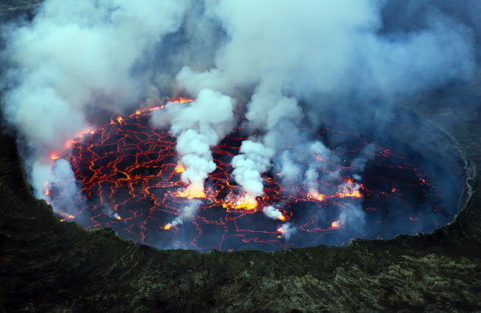
Notes:
Cai Tjeenk Willink / CC BY-SA 3.0.

Slide 14
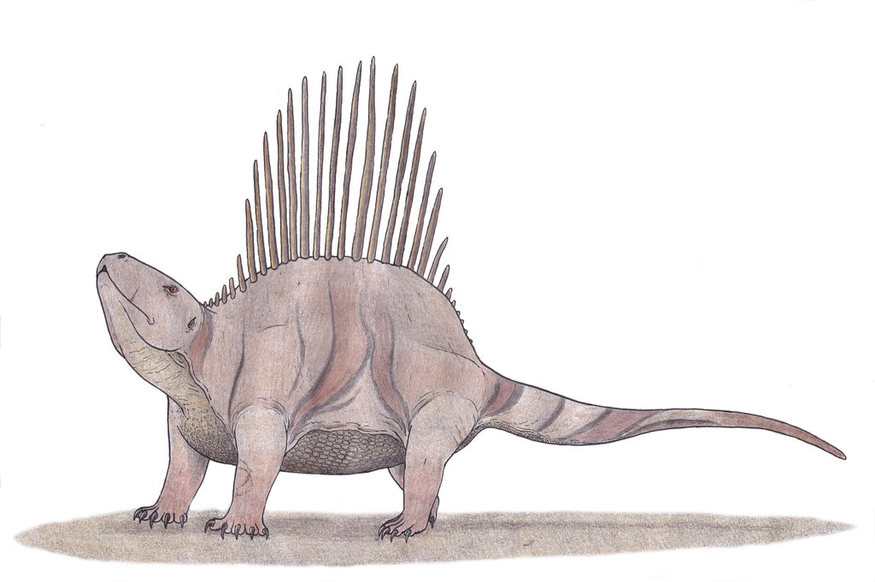

Slide 15
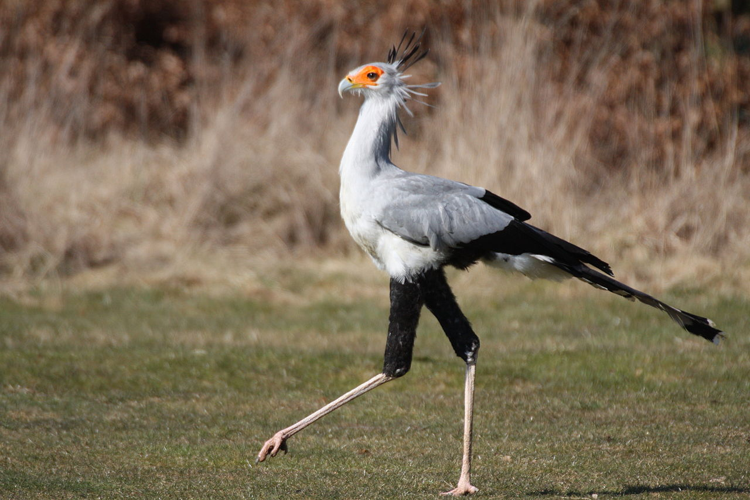
Notes:
"Secratary Bird, Strutting Stuff" by Mark Kent - originally posted to Flickr as Secratary Bird - Strutting Stuff. Licensed under CC BY-SA 2.0 via Wikimedia Commons - https://commons.wikimedia.org/wiki/File:Secratary_Bird,_Strutting_Stuff.jpg#/media/File:Secratary_Bird,_Strutting_Stuff.jpg

