Slide 1
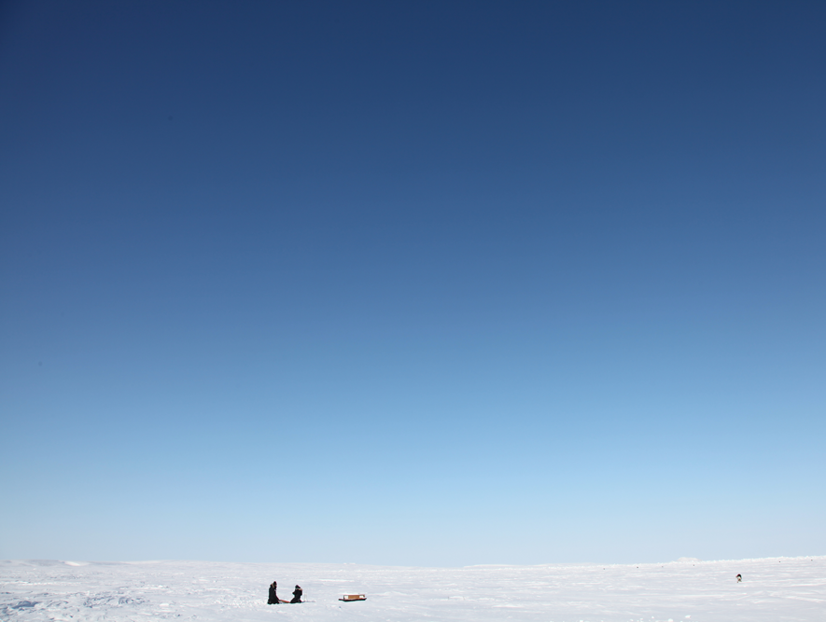
World Oceans Day: Learning about ocean acidification
Missions:
- Know what ocean acidification is
- Understand how ocean acidification affects plants and animals
- Reflect on the impact of ocean acidification on the food web
World Oceans Day

Slide 2
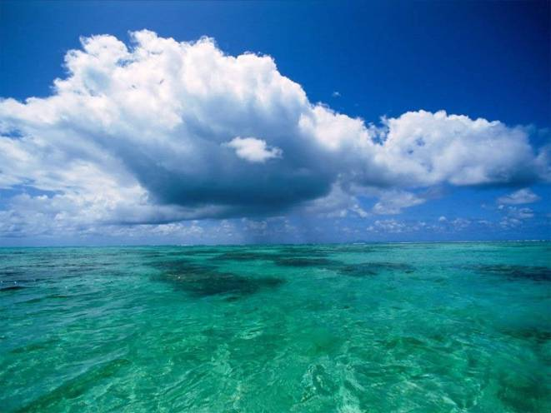
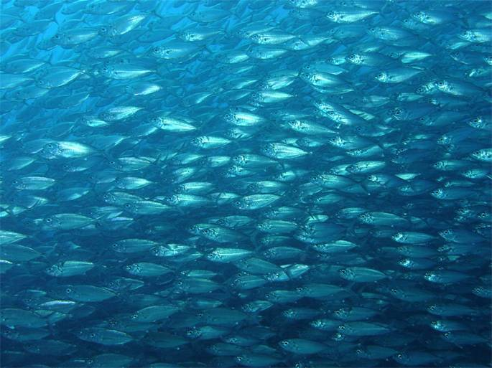
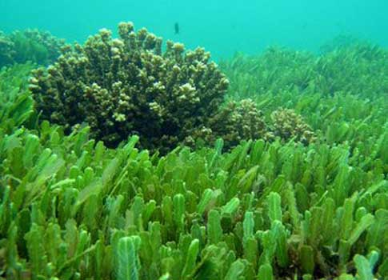
Importance of the oceans
72% of the planet’s surface is covered by oceans
The oceans provide 50% of the oxygen that we breathe
94% of all life is aquatic
90% of big fish such as tuna, swordfish and sharks have gone
Ocean acidity has increased by 30% since 1750
World Oceans Day

Slide 3
Video intro – The Acid Test
Watch Acid Test 3 min version:
http://youtu.be/aG3n1fAa7vk or https://vimeo.com/8990924
World Oceans Day

Slide 4
During this lesson you will be replicating the work of Arctic scientists
World Oceans Day

Slide 5
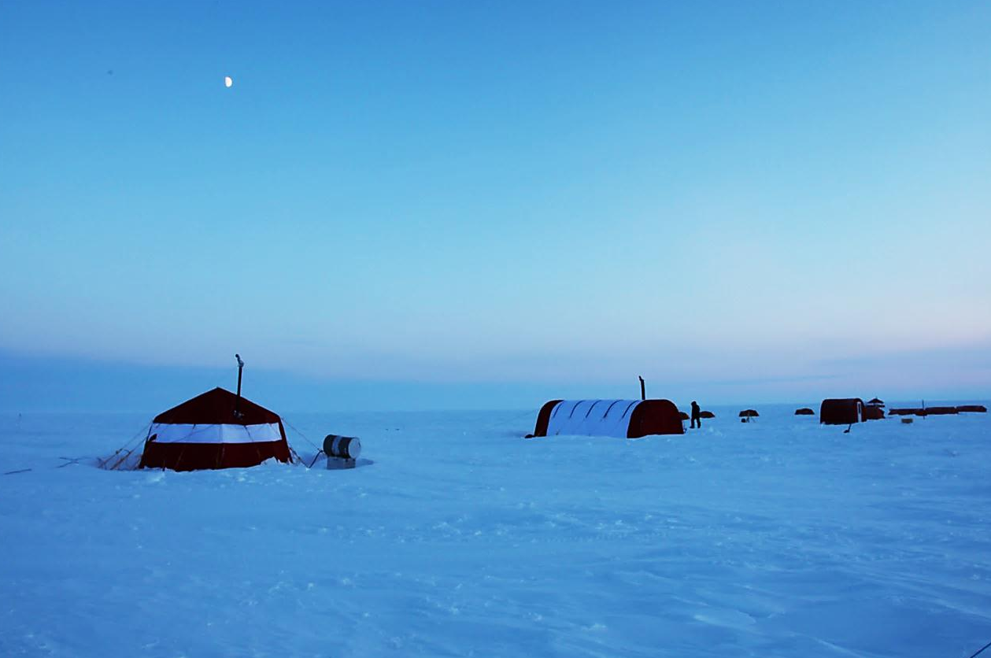
They lived in unheated tents on the frozen ocean for months
World Oceans Day

Slide 6
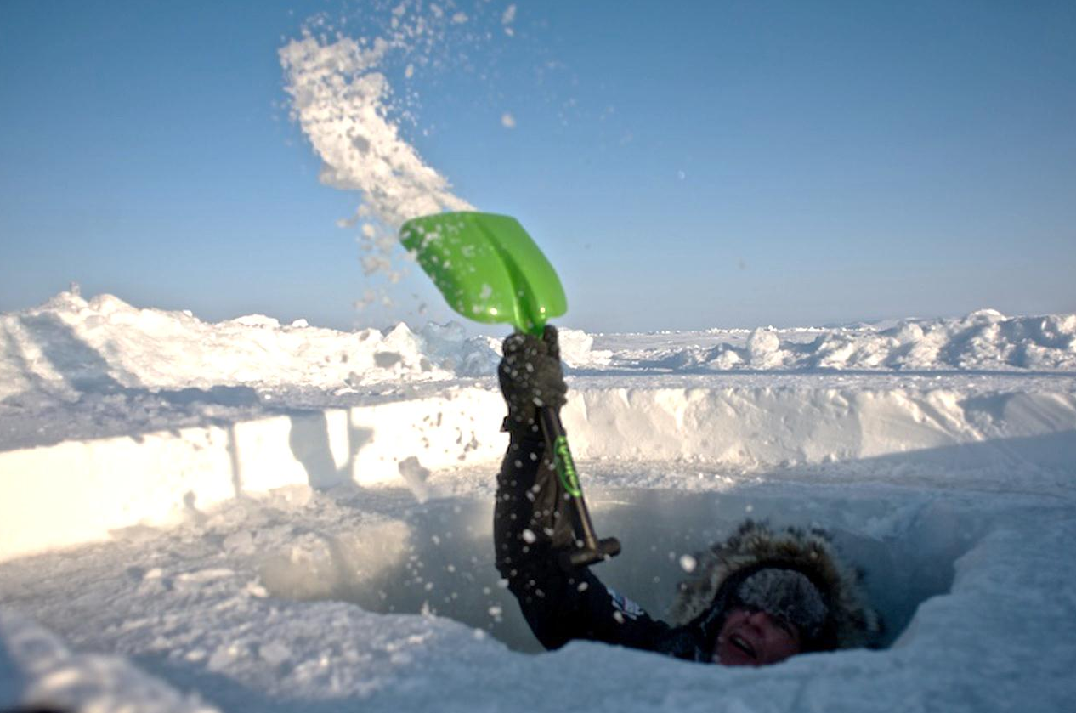
To take samples from the ocean beneath the ice, they needed to dig sampling holes
World Oceans Day

Slide 7
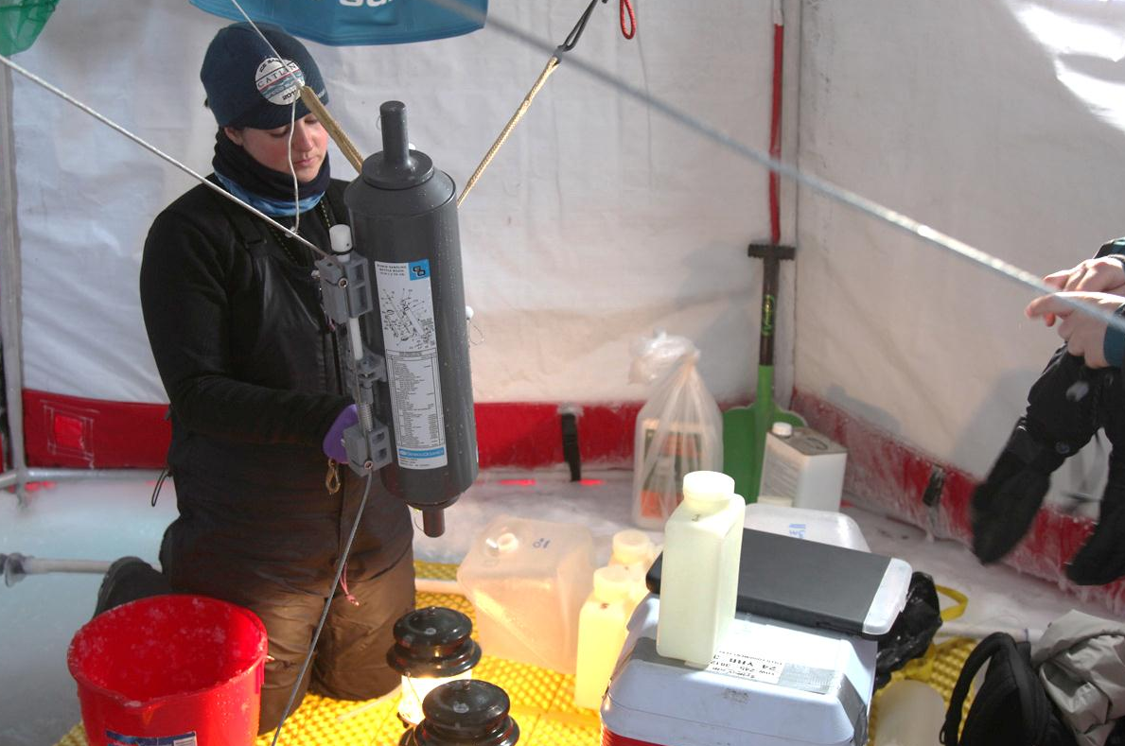
They collected ocean water samples to analyse its chemistry...
World Oceans Day

Slide 8
...and collected tiny animals (plankton) using a trawling net
World Oceans Day

Slide 9
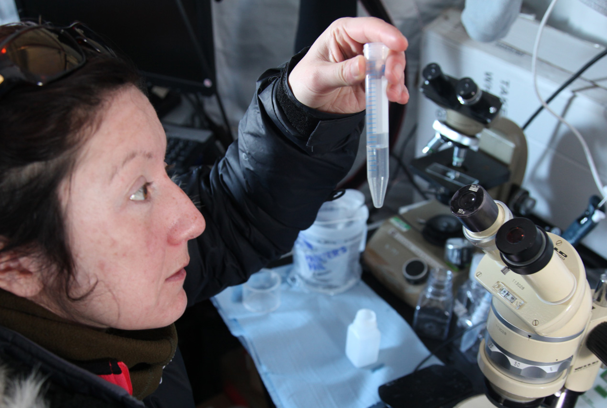
Back in their lab tent, they examined their samples...
World Oceans Day

Slide 10
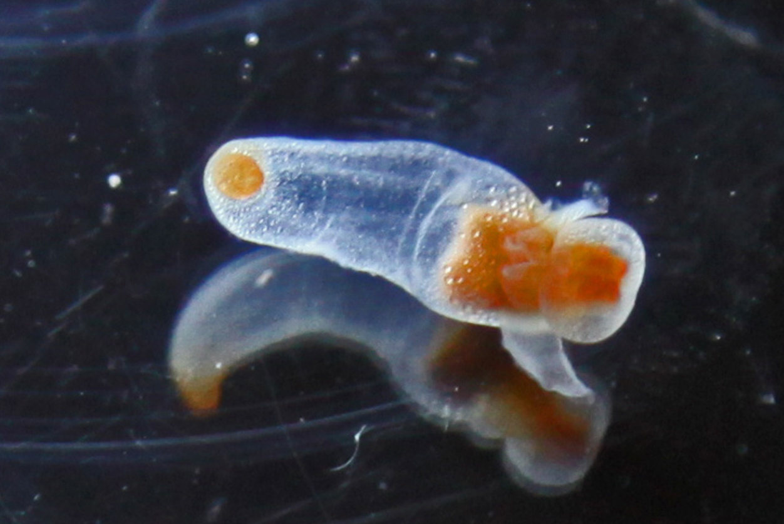
...like this pteropod or ‘sea angel’
World Oceans Day

Slide 11
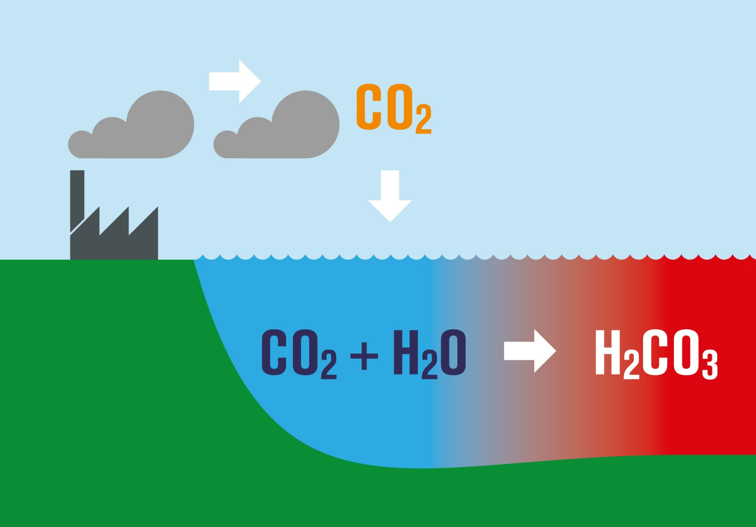
Mission 1: Know what ocean acidification is
World Oceans Day

Slide 12
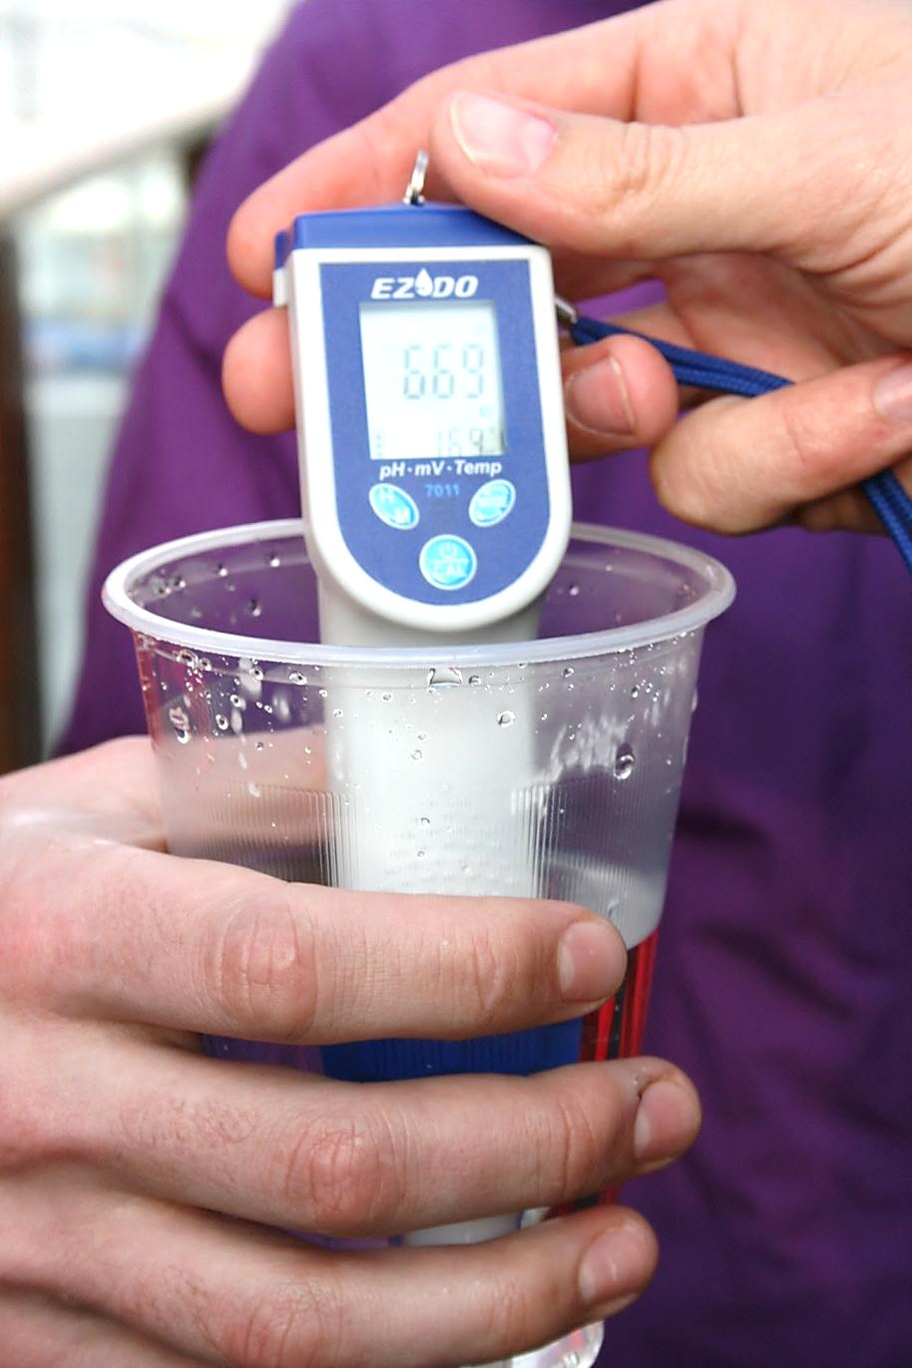
Mission 1: Experiment
Make sure that you have 2 beakers each with 200ml of water
Add 5 drops of universal indicator to each one
Using the straws blow through the water in one of the beakers
World Oceans Day

Slide 13
Mission 1: Reflect
What did you see happen to the water?
Why do you think the pH of the water changed?
What chemical reaction took place?
World Oceans Day

Slide 14
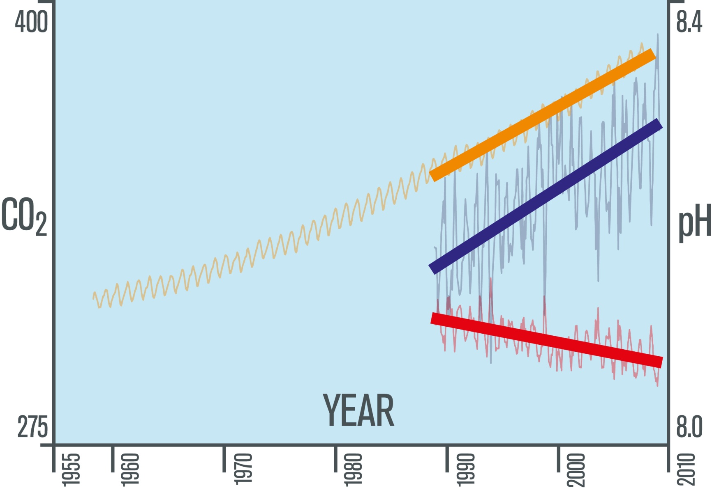
Mission 2 - Understand how ocean acidification affects plants and animals
World Oceans Day

Slide 15
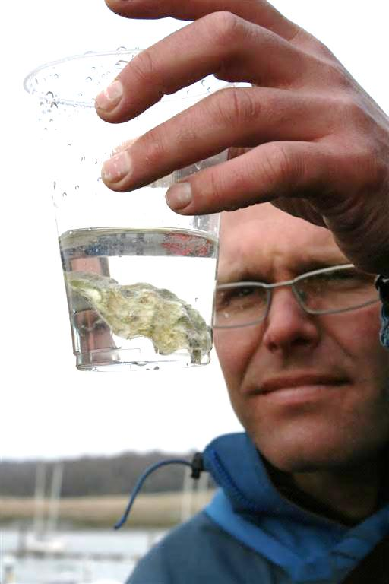
Mission 2: Experiment
Pour about 100ml of vinegar into the beaker
Drop a shell into the vinegar
Top up if the shell is not covered
Observe what happens
World Oceans Day

Slide 16
Mission 2: Reflect
What did you see happen to the shell?
Why do you think this happened?
What might happen to animals and plants with carbonate structures if the oceans continue to acidify?
World Oceans Day

Slide 17
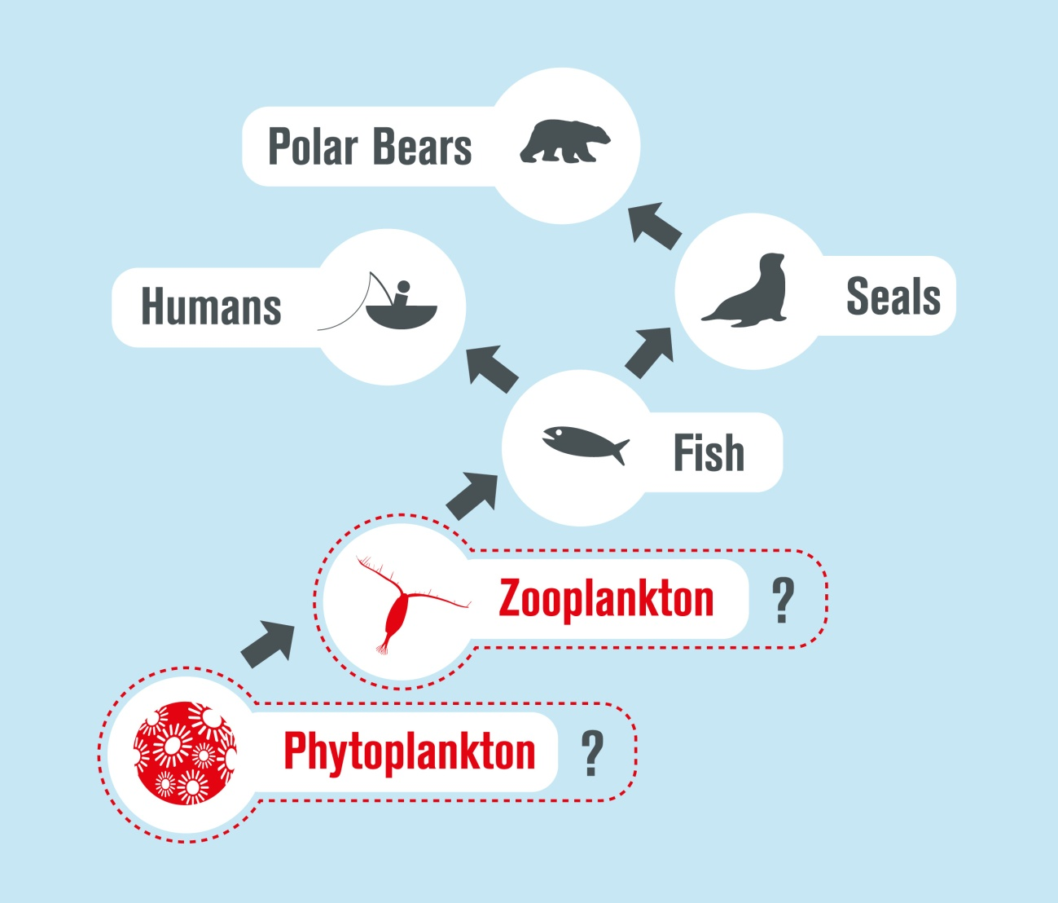
Mission 3 - Reflect on the impact of ocean acidification on the food web
World Oceans Day

Slide 18
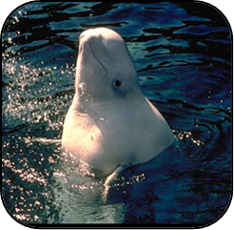
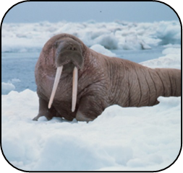
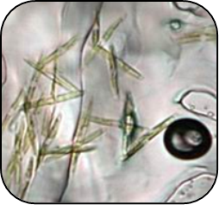
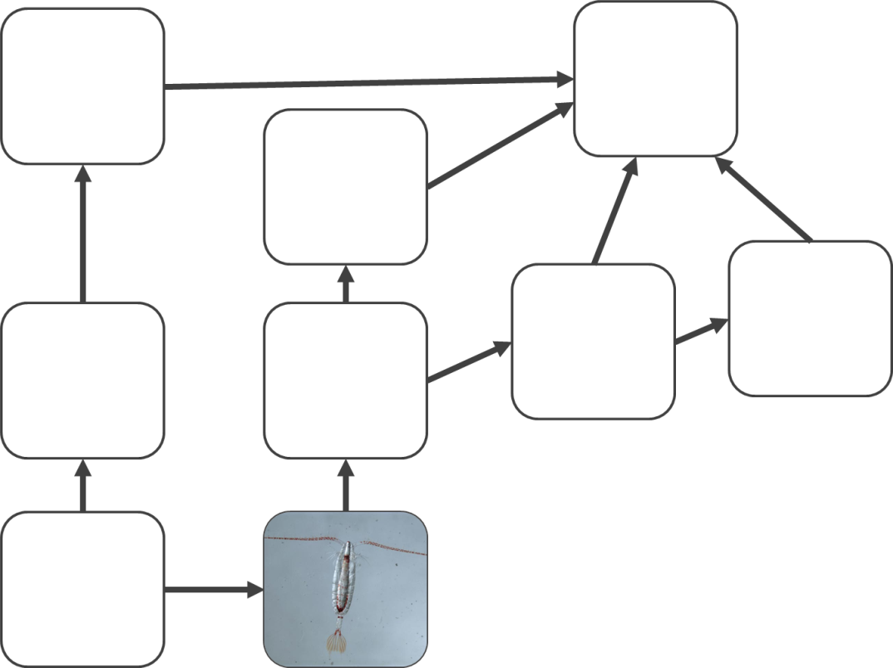
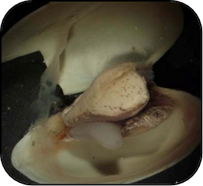
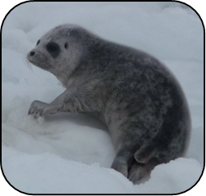
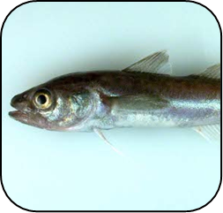
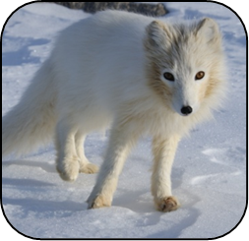
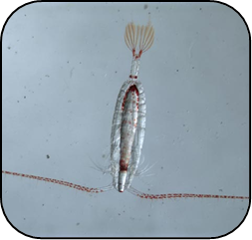
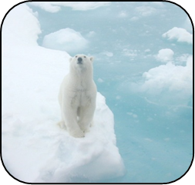
Mission 2: Activity
Beluga whale
Walrus
Algae
Clam
Ringed seal
Arctic cod
Arctic fox
Copepod
Polar bear
World Oceans Day

Slide 19
Mission 3 - Answers
World Oceans Day

Slide 20
Mission 3: Reflect
Which plants and animals are most at risk from ocean acidification?
What might happen if the numbers of copepods (an animal with a carbonate shell) decreased?
How is the health of algae related to the health of polar bears?
World Oceans Day

Slide 21
Plenary
1 thing
you can do to reduce the rate of ocean acidification
2 connections
you can make with things you already know
3 things
you learnt today
World Oceans Day

