Slide 1
A model of the system bus
Use the descriptions below to help you label the system bus on the next slide
There is a one-way connection from the I/O controller of an input device towards the data bus
There is a one-way connection from the data bus towards I/O controller of an output device
There is a two-way connection from the data bus towards I/O controller of a secondary storage device
There is a one-way connection from the processor towards the address bus (as only the processor can issue addresses)
There is a one-way connection from the address bus towards all the other components, i.e. the main memory and the I/O controllers
There is a two-way connection between main memory and the data bus
There is a one-way connection between main memory and the address bus
Notes:
Time: 10 minutes
Key outcome:
Ask students to do quic
https://isaaccomputerscience.org/api/v3.5.0/api/images/content/computer_science/computer_systems/architecture/figures/isaac_cs_sys_arch_int_components_bus_connections.svg

Slide 2
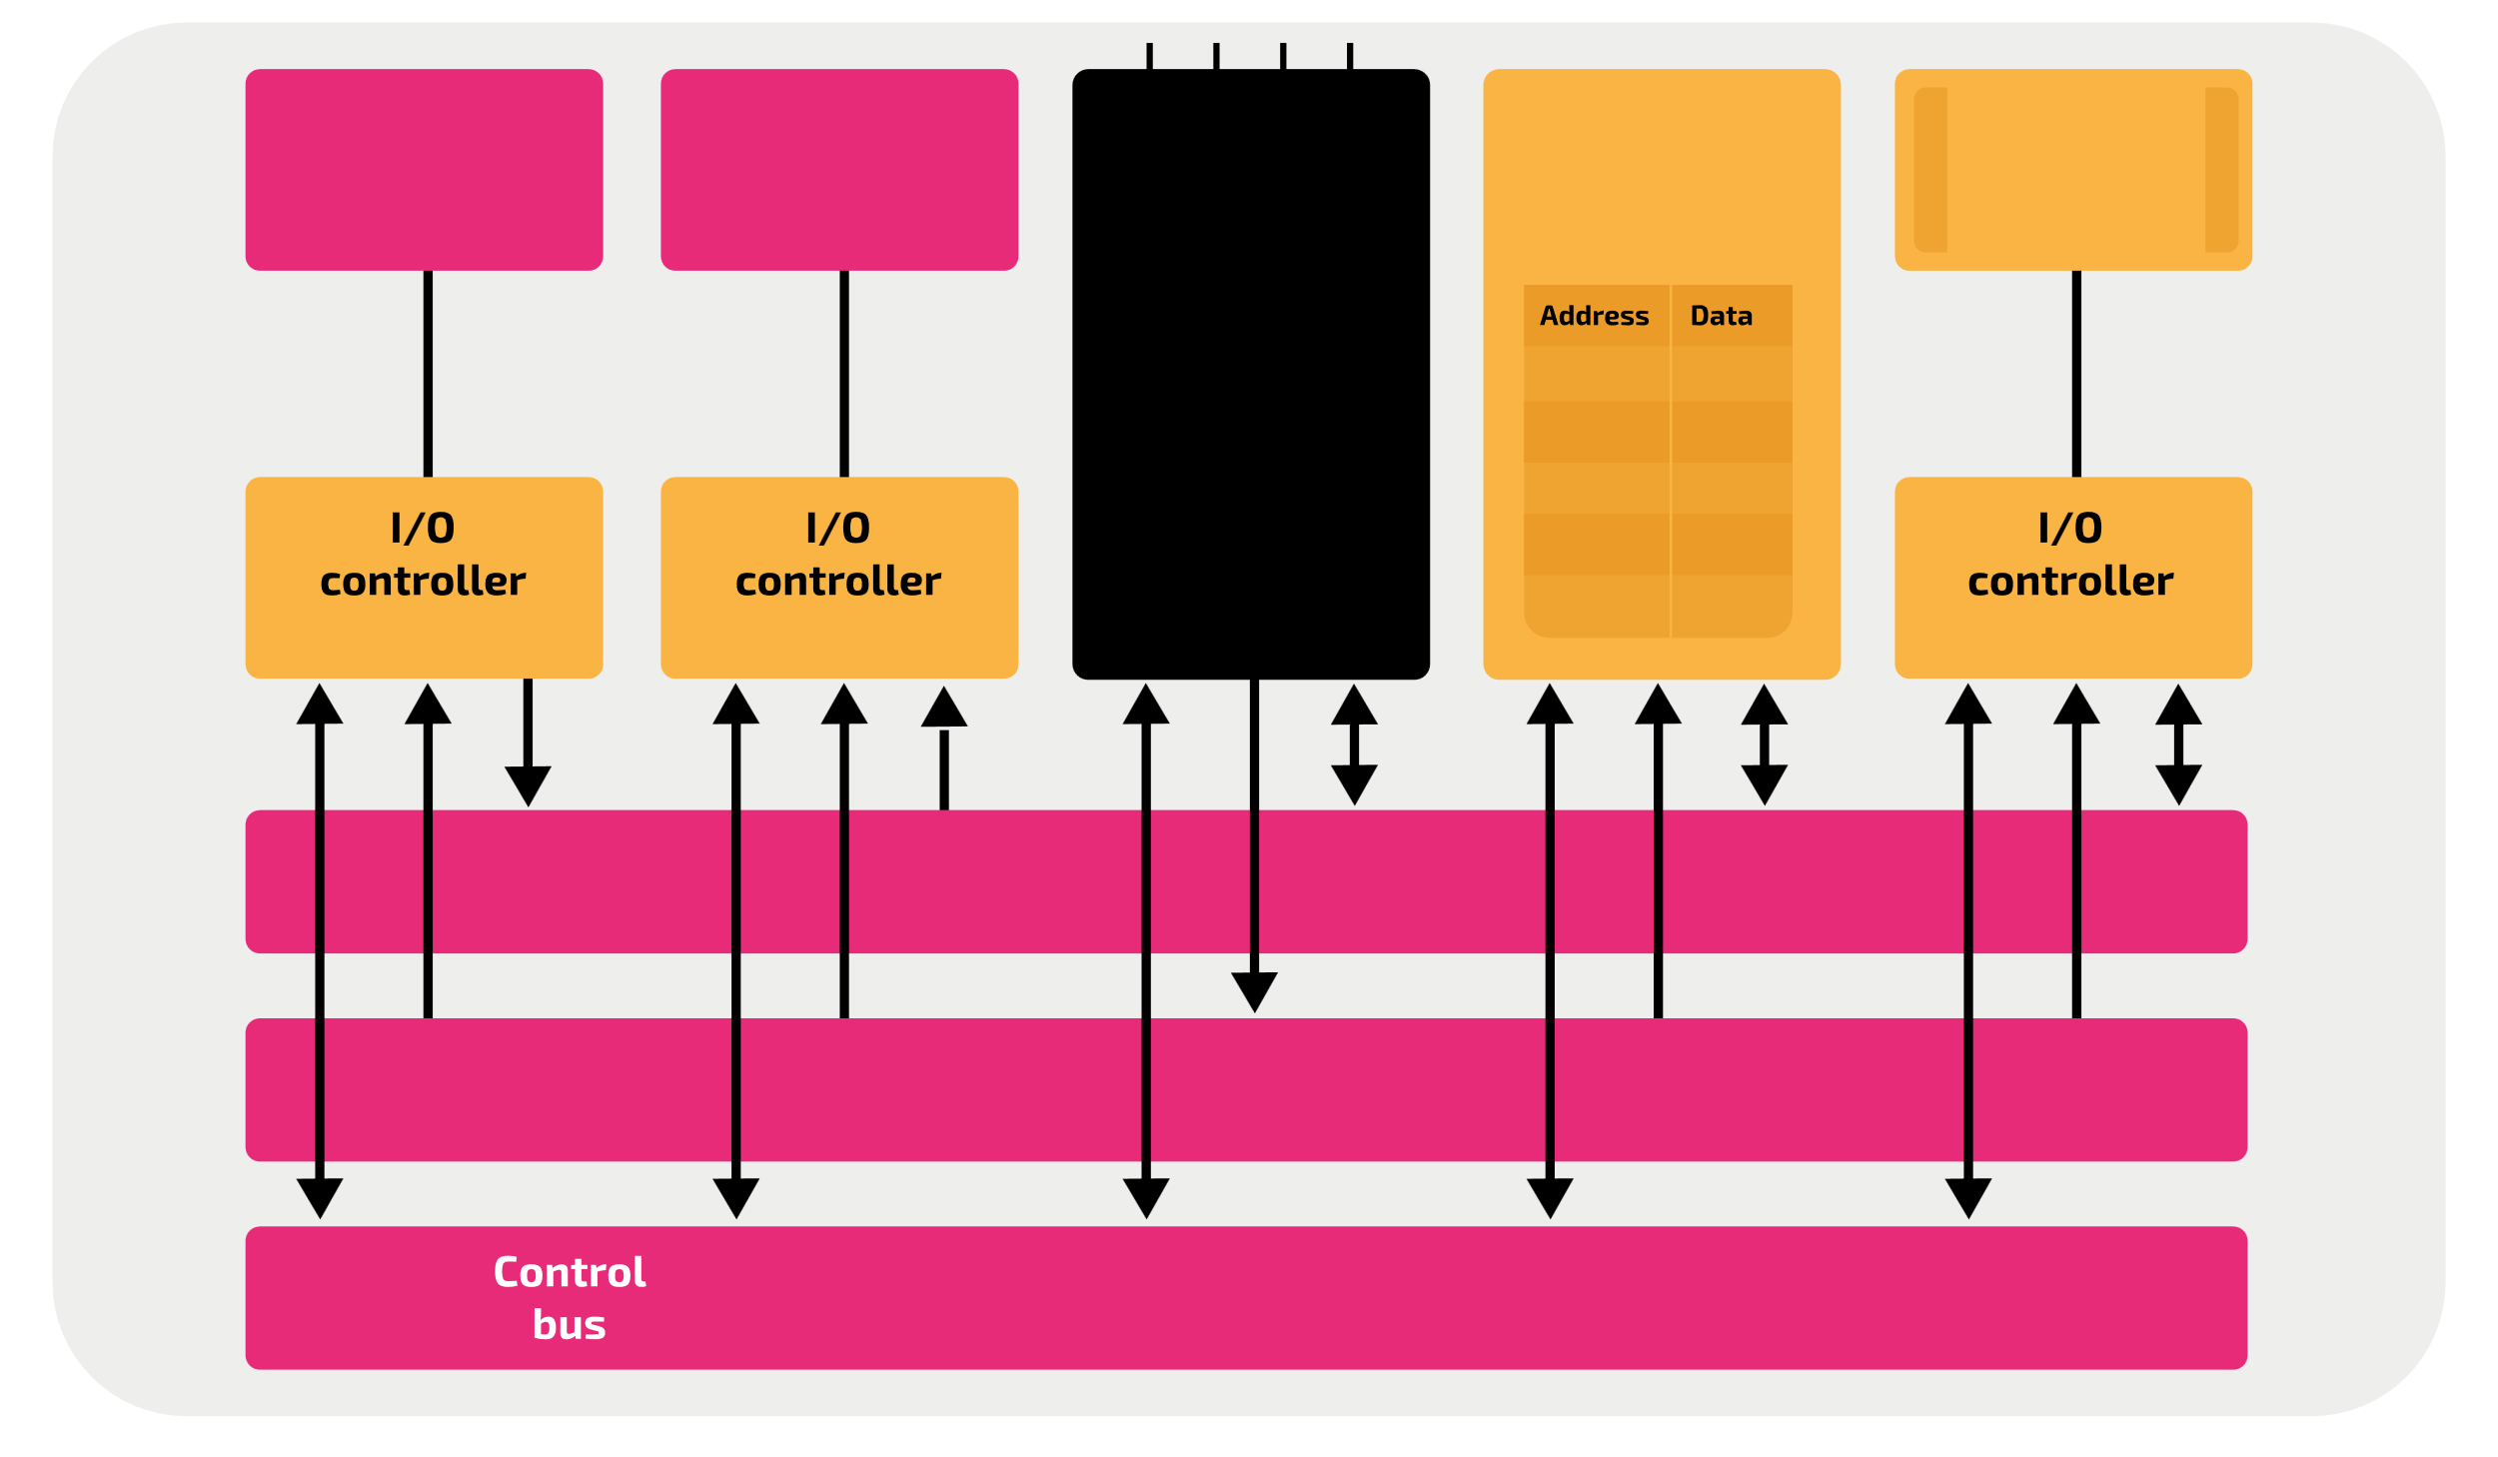
A model of the system bus
?
?
?
?
?
?
?
RAM
CPU
Output devices
Address bus
Input devices
Secondary Storage
Data bus
Notes:
Time: 10 minutes
Key outcome:
Ask students to do quic
https://isaaccomputerscience.org/api/v3.5.0/api/images/content/computer_science/computer_systems/architecture/figures/isaac_cs_sys_arch_int_components_bus_connections.svg

Slide 3
A model of the system bus
Handout 2: Label the diagram
Secondary Storage
Input devices
Output devices
CPU
RAM
Data bus
Address bus
Notes:
Time: 10 minutes
Key outcome:
Ask students to do quic
https://isaaccomputerscience.org/api/v3.5.0/api/images/content/computer_science/computer_systems/architecture/figures/isaac_cs_sys_arch_int_components_bus_connections.svg

