Slide 1

Thermal Engineering for space

Slide 2
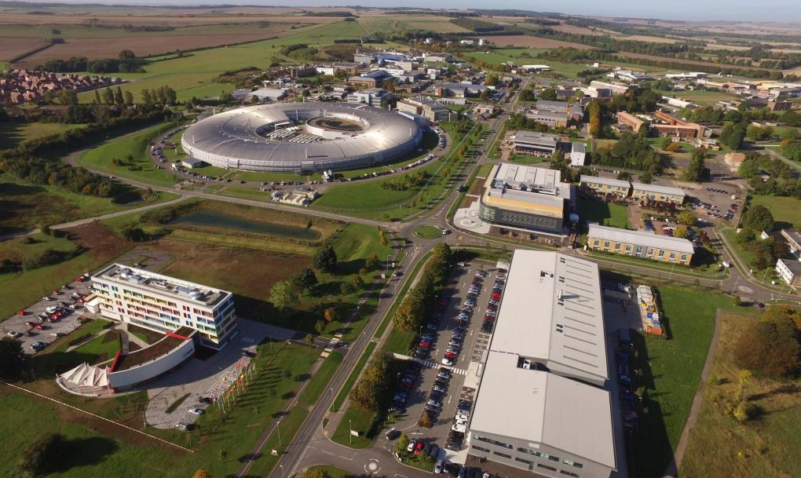
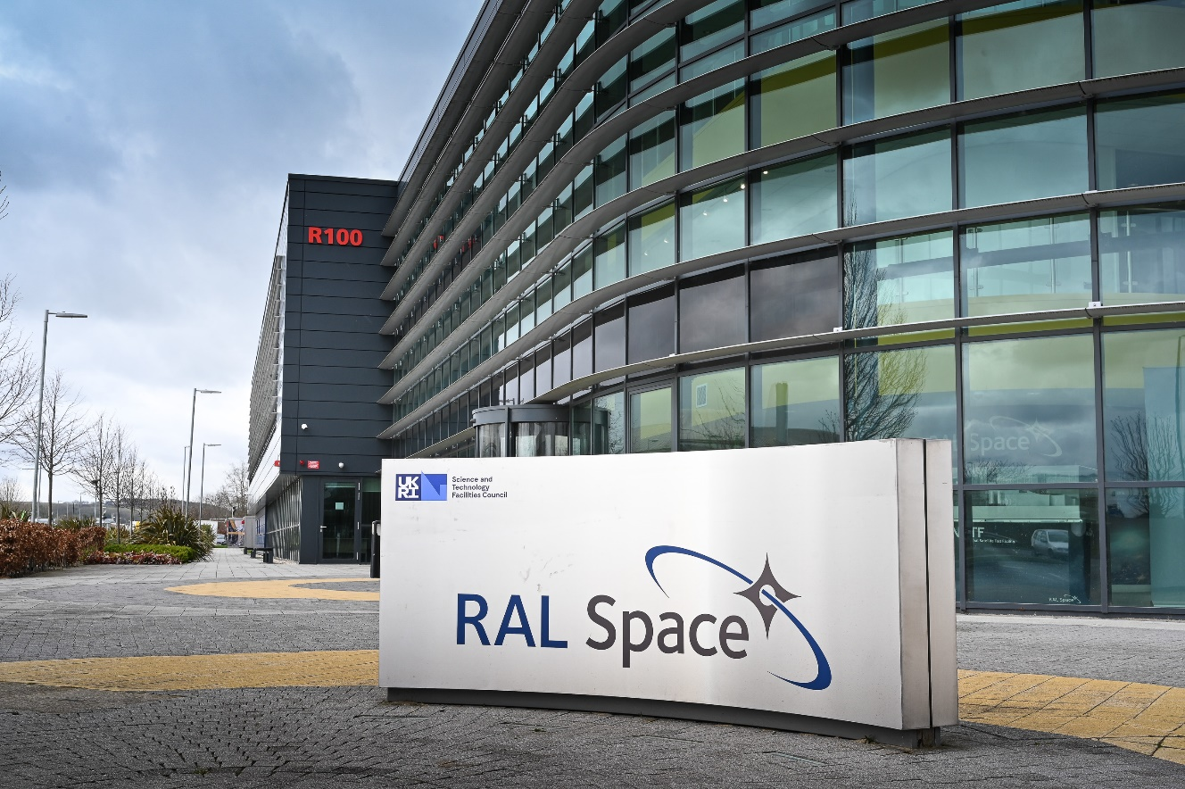
RAL Space
Based at the Rutherford Appleton Laboratory in Oxfordshire
Approximately 330 staff
“We are the UK’s national laboratory to advance the exploration of space and the environment, for the benefit of all.”
Explore inside our labs on our virtual 360 tour: https://www.ralspace.stfc.ac.uk/Virtual%20Tour/RALSpaceV1/index.aspx
Credit: STFC RAL Space

Slide 3
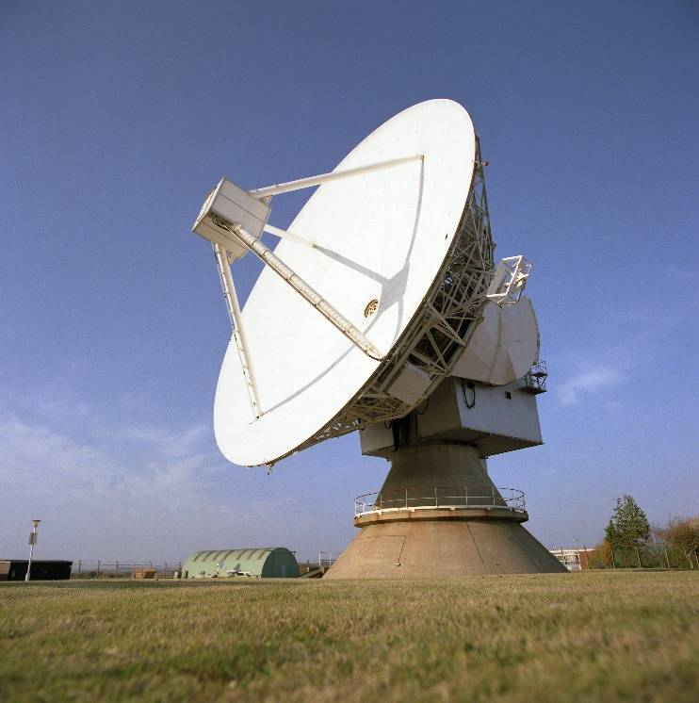
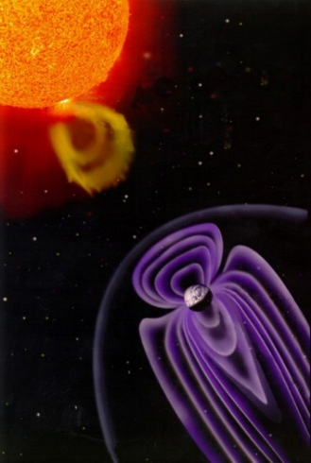
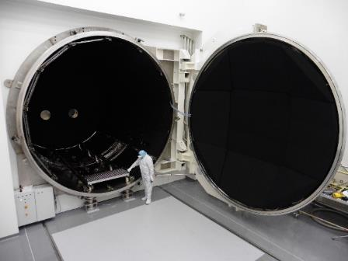
What do we do?
Design and Build - Space hardware
Science and Research - Astronomy, Solar Physics, Climate, Earth observation
Technology Development - Optics, Thermal, Electronics, Spectroscopy
Data/Information - Curation, Analysis, Dissemination
Facilities - Ground Stations, Precision machining, Calibration, Environmental Testing
Economic Impact - Spin-out, Outreach, Training
Top left: Chilbolton Observatory 25m radio dish.
Top right: space weather.
Bottom: Space test chamber. Credit: STFC RAL Space

Slide 4
What is thermal engineering and how does it apply to space?

Slide 5
Thermal engineering for space video https://stemlearning.wistia.com/medias/bghkkmlo8v

Slide 6
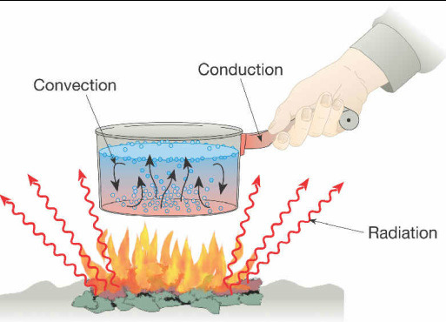
Modes of Heat Transfer
Conduction: the transfer of heat via direct contact
Convection: the transfer of heat through a fluid (liquid or gas) caused by molecular motion
Radiation: the transfer of heat via electromagnetic radiation
Thermal engineering is the study and understanding of heat transfer and controlling these processes to manage the temperature of the equipment we design, ensuring it stays within safe operating limits.

Slide 7
Why is this important for space?
Reliable, long-term performance of most spacecraft components requires them to operate within thermal ranges
  We can’t replace items once they’re in space!
We need to ensure that these temperature requirements are met for all components during all mission phases
Thermal engineers are therefore involved in the design of nearly every onboard system
Component | Operating Temperature Range (°C) | Survival Temperature Range (°C)
Electronics | 0 to 50 | -20 to 70
Batteries | 0 to 15 | -10 to 25
IR detectors | -269 to -173 | -269 to 35
Solar panels | -150 to 110 | -200 to 130
Momentum wheels | 0 to 40 | -20 to 50
Fuel | 15 to 40 | 5 to 50
Notes:
IR = infrared
Momentum wheels or reaction wheels are used to control a spacecraft’s rotation and provide stability.
Example of fuel: hydrazine

Slide 8
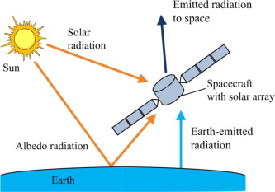
Why is this difficult?
There is no atmosphere in space so radiation is the dominant heat transfer mode between a spacecraft and its surroundings
The thermal environment is very extreme and variable
  Very cold background at about -270°C
  Intense solar radiation in direct sunlight, which disappears when the spacecraft enters the Earth’s shadow
We need to balance the extremes of hot and cold to keep the spacecraft temperature somewhere in the middle

Slide 9
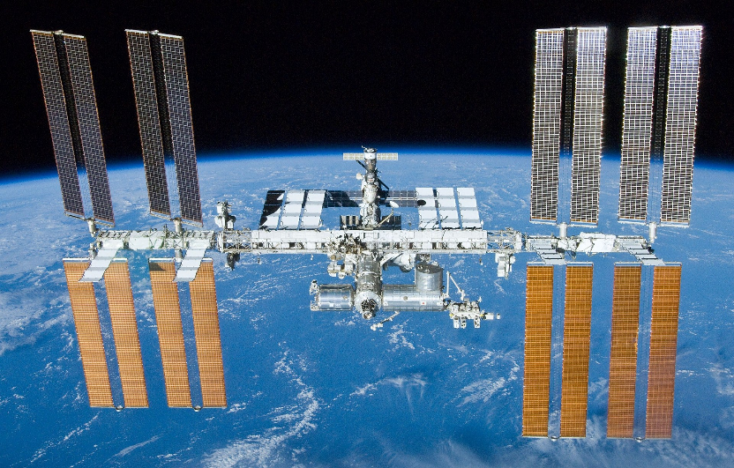
How do we do it?
Combination of passive (unpowered) supplemented by active (powered) thermal control
Passive
  Radiators to transmit heat to deep space and prevent overheating
  Insulation to limit heat absorption from the environment (or stop heat escaping)
  Specialised coatings to absorb or reflect sunlight
Active
  Heater control systems (to stop sensitive components from freezing)
  Cryogenic cooler systems
Thermal engineers prefer passive control because of limited power availability and it’s more reliable
International Space Station. Credit: NASA
Kapton heaters are small (few cm across) flexible and resilient, suitable for efficient heat transfer in spacecraft.
Solar Orbiter. Credit: ESA

Slide 10
Passive Thermal Control
Polar bears have transparent fur with black skin underneath to absorb as much sunlight as possible while trapping the heat
Fennec foxes have large ears that act as natural radiators, to maximise surface area for heat removal and stay cool

Slide 11
How do we insulate in space?
We use a special type of material called Multi-Layer Insulation (MLI)
MLI is made up of lots of very thin layers of foil separated by a spacer material
The foil is shiny, to limit radiative heat transfer, and the spacer material stops heat from conducting between layers
  And remember, there’s no air in space so no convection between the layers!
Pretty much every spacecraft uses MLI in some way – we have our own MLI manufacturing facility at RAL Space
We made novel cryogenic MLI for the Mid-Infrared Instrument onboard the Webb Telescope, to ensure it stays at 7K (-266°C) for its highly sensitive IR detectors
MLI sample. Credit: STFC RAL Space
MIRI covered in MLI blankets. Credit: STFC RAL Space

Slide 12
MLI experiment video https://stemlearning.wistia.com/medias/ej2wbikiel

Slide 13

Materials
Tin foil
3 ice cubes
Netting (from a pack of oranges/fruit)

Slide 14
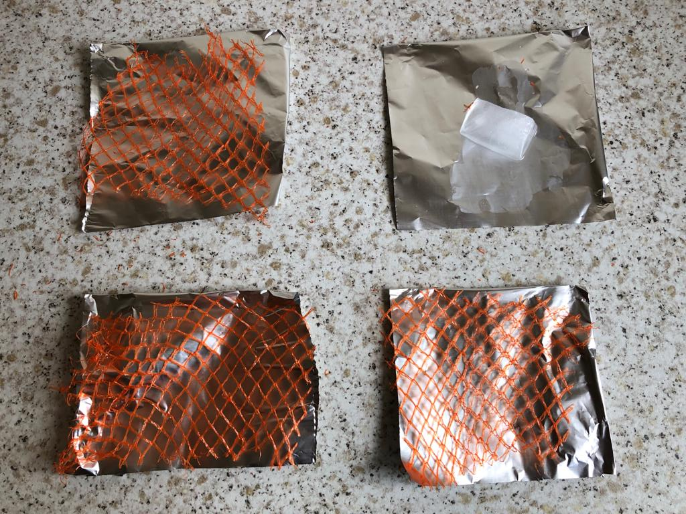
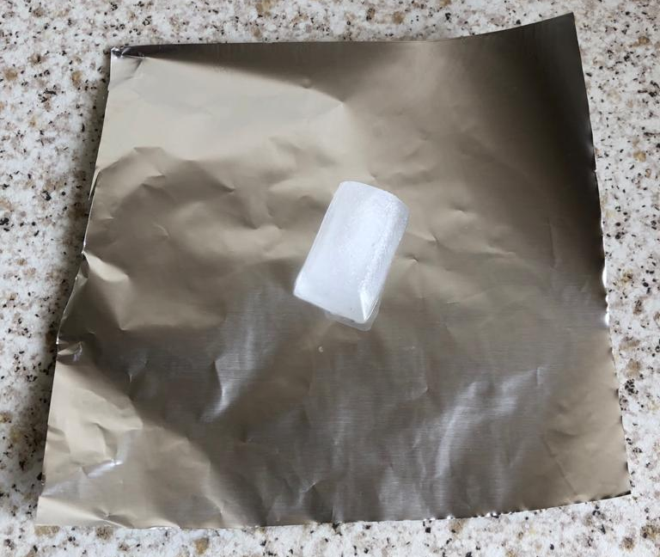
Materials
Multi Layer Insulation
Single Layer Insulation

Slide 15
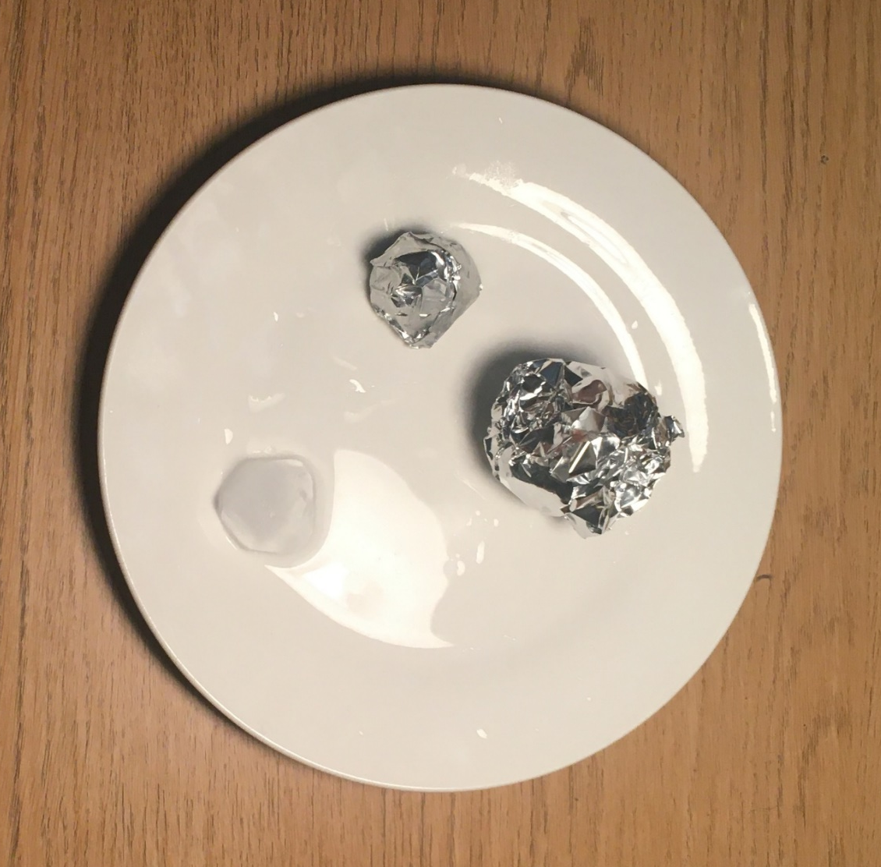
Before and after

Slide 17
Thank you
If you have any questions, get in touch via our social media channels or email ralspaceenquiries@stfc.ac.uk
ralspace.stfc.ac.uk
@RAL_Space_STFC
RAL Space
RAL Space

Slide 18
Acknowledgements
Declan Jonckers
Sam Tustain
Haider Razzaq
Vicky Stowell
Dylan Feore
Vicky Hall
Celine Elledge
Reuben Chesterman
Poppy Holford

