Slide 1
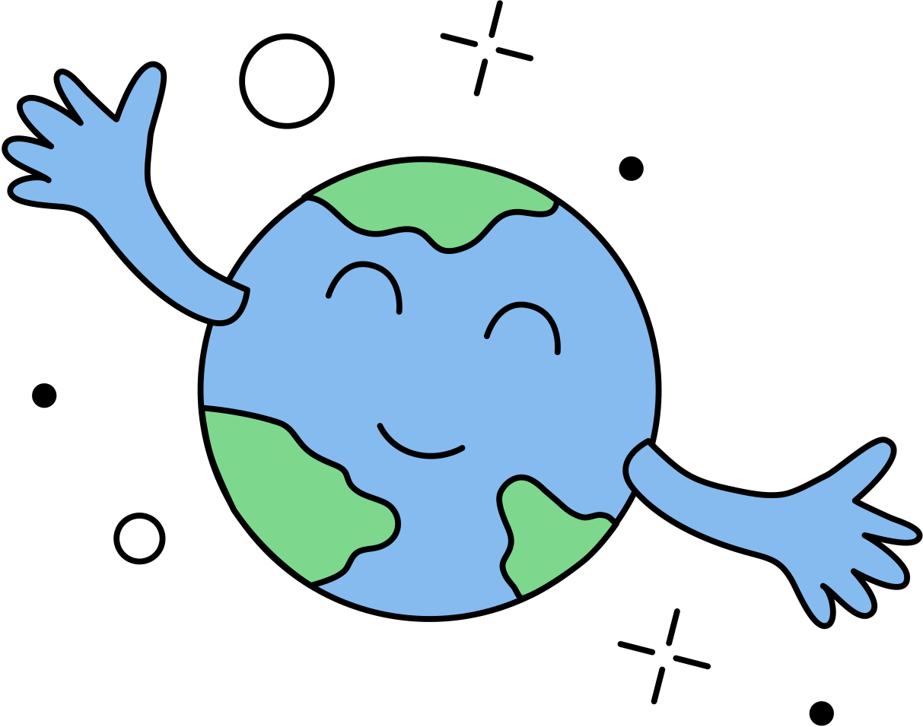
Climate Change
It’s in our hands

Slide 2
What do we know about climate change?
?

Slide 3
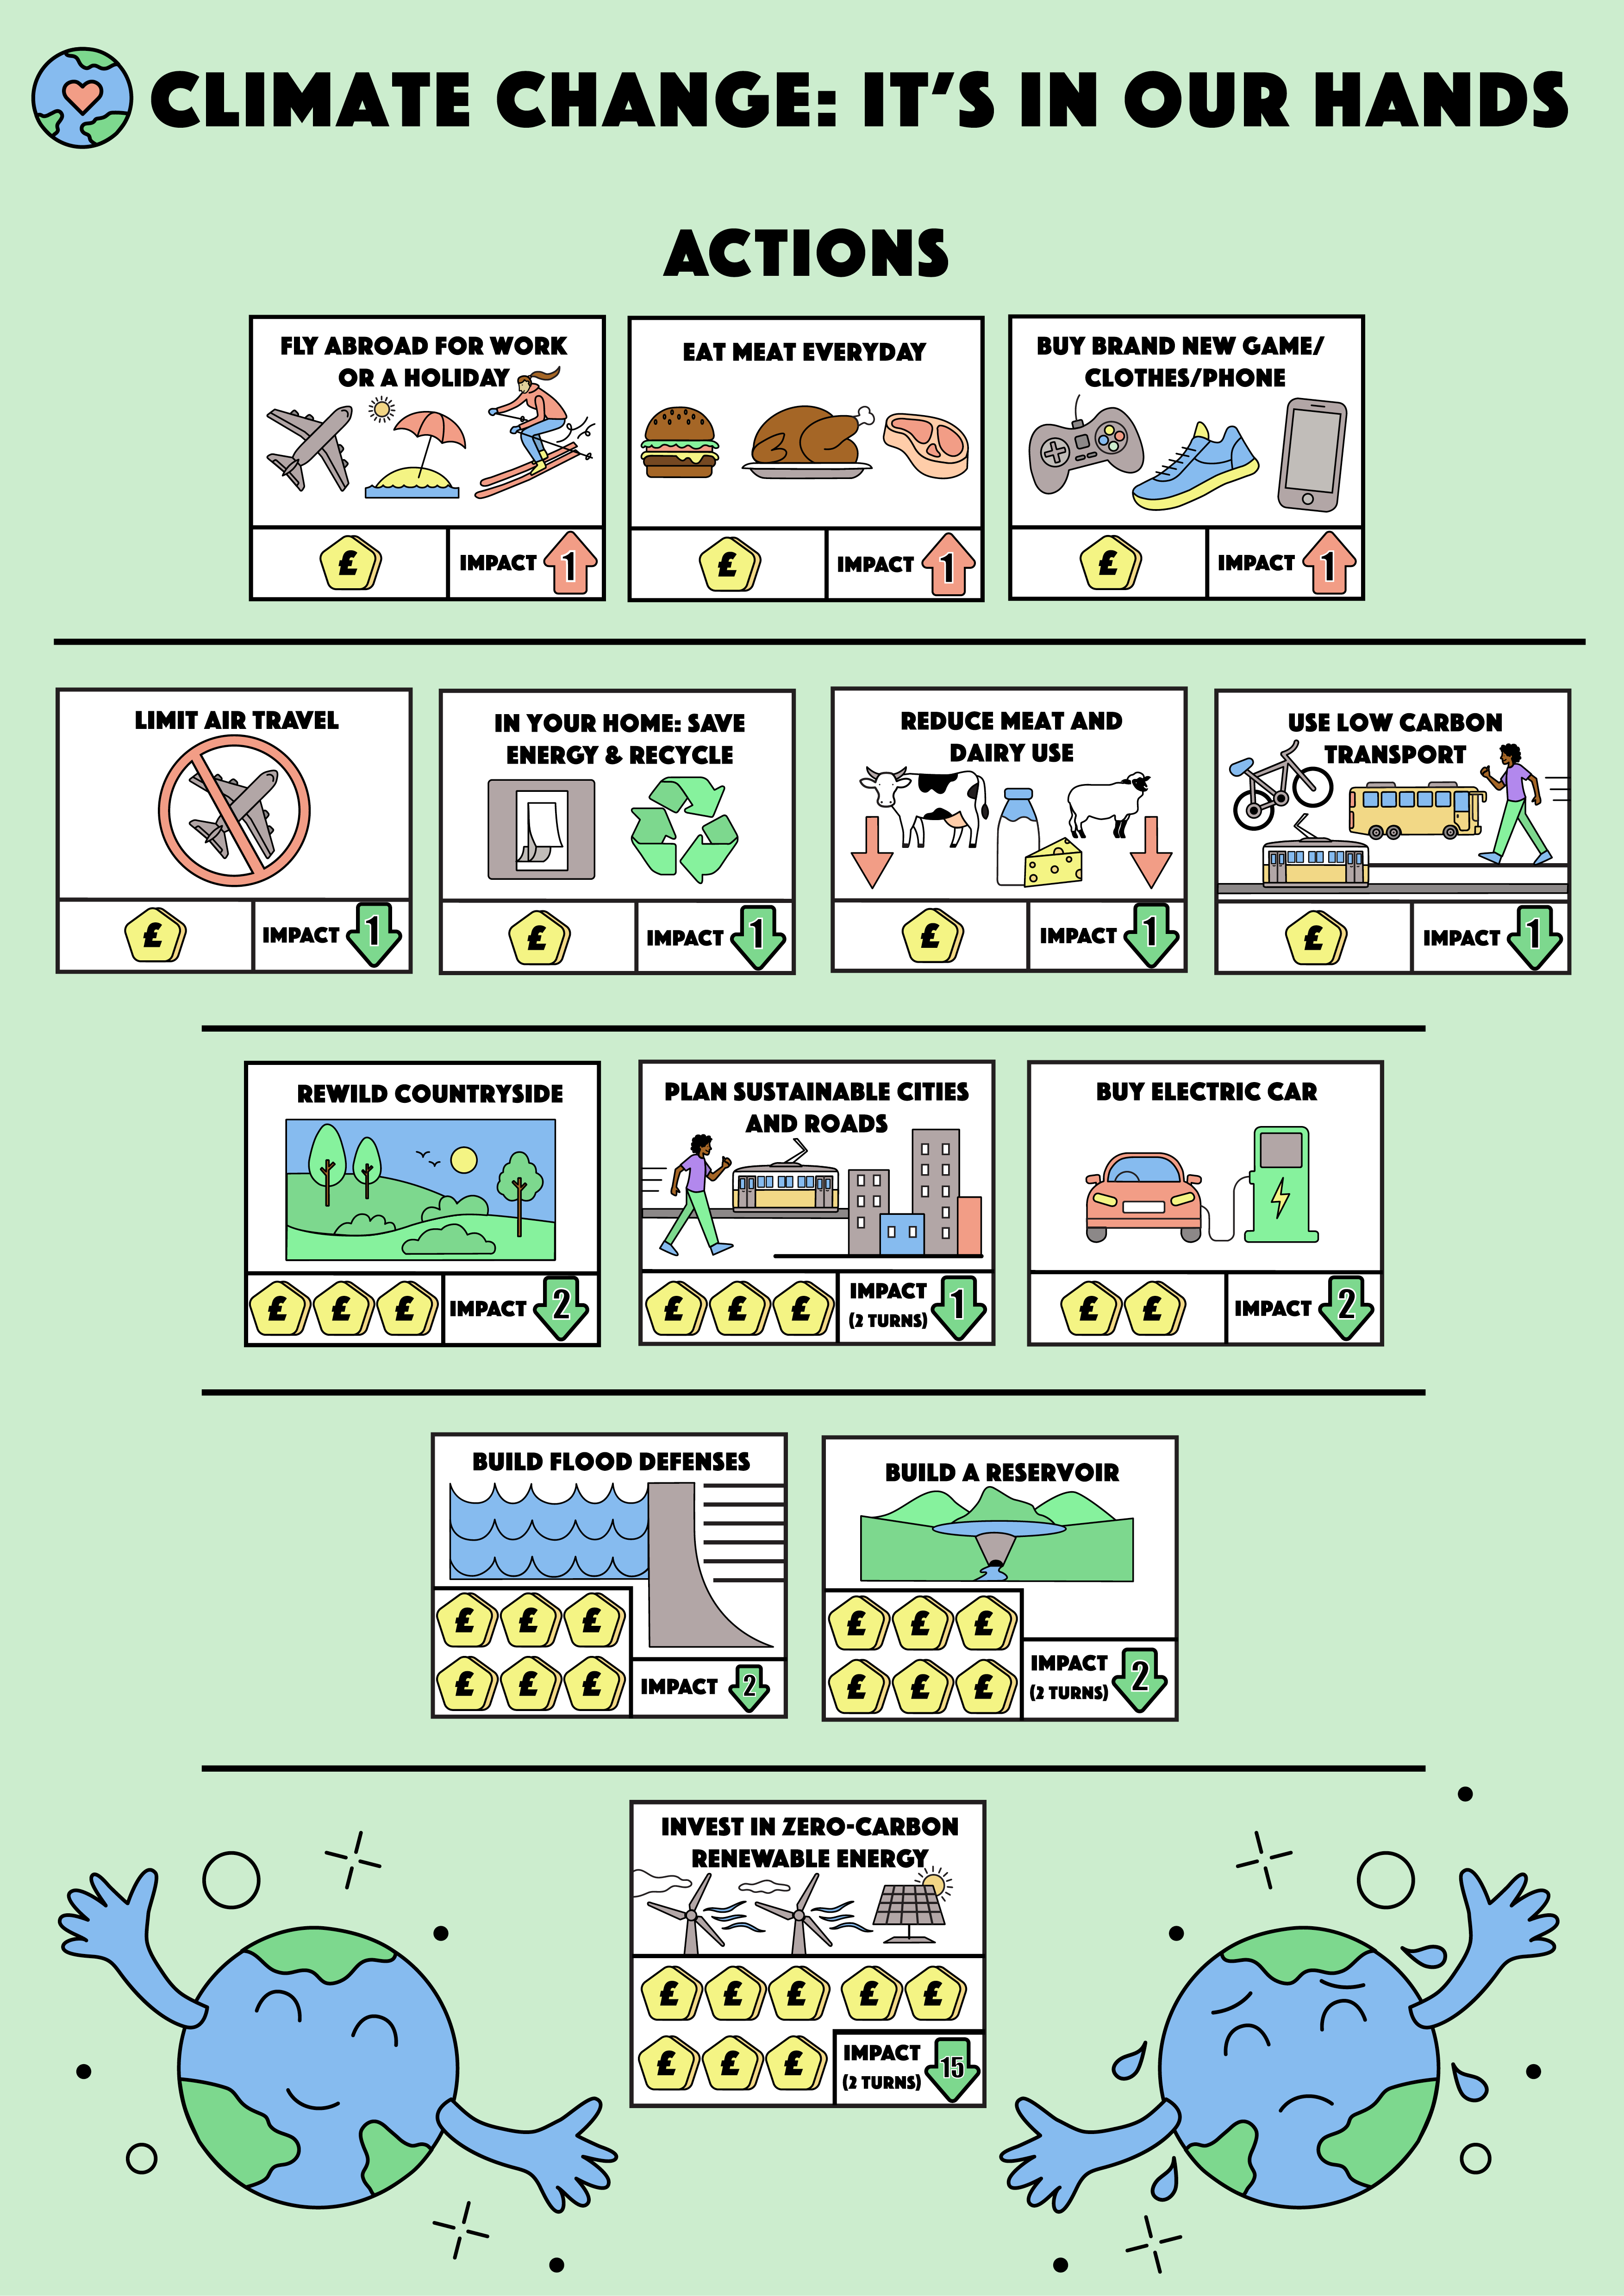
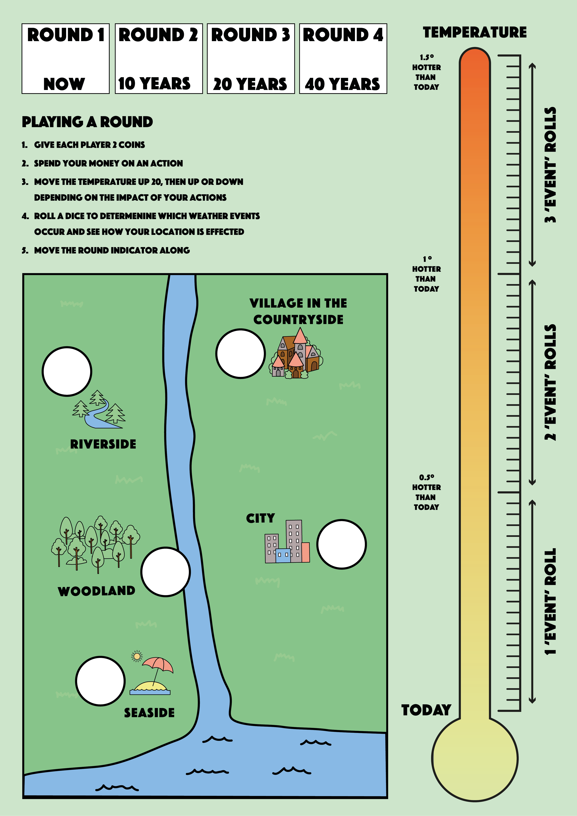
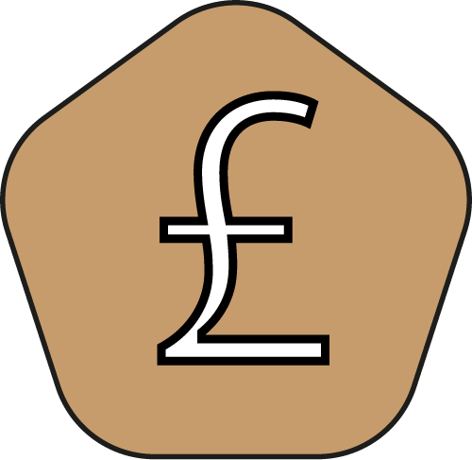
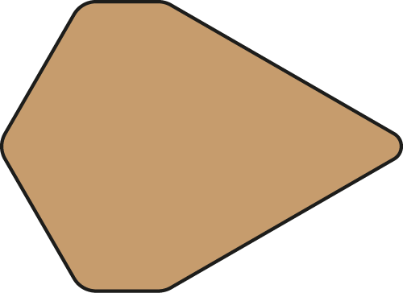
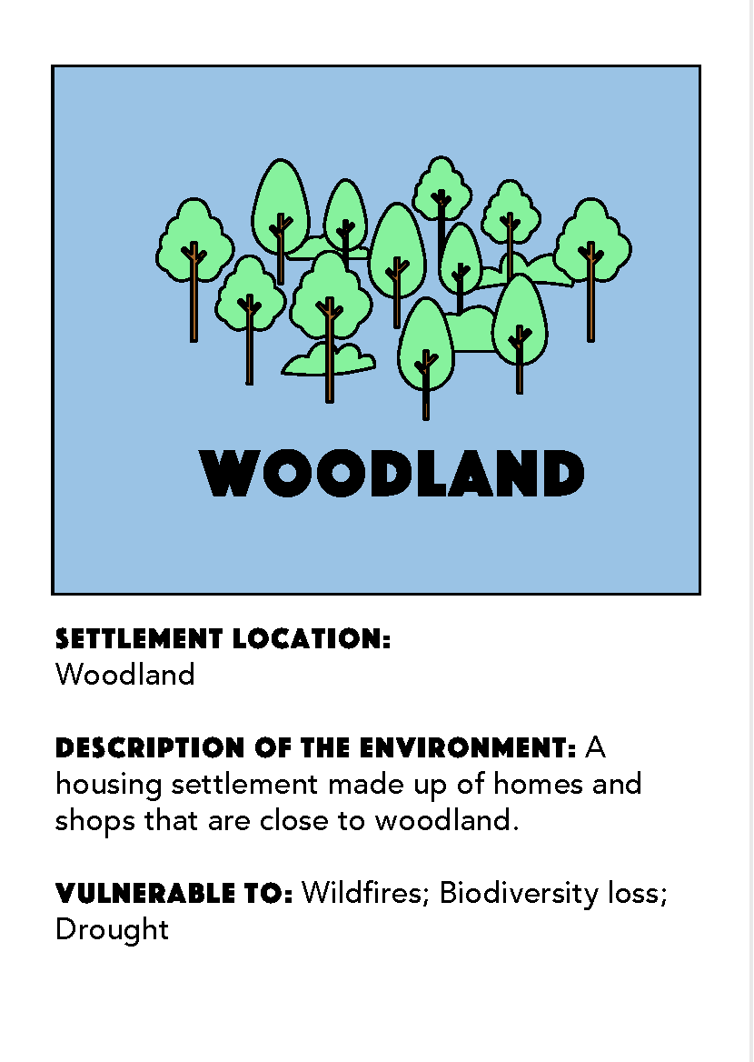
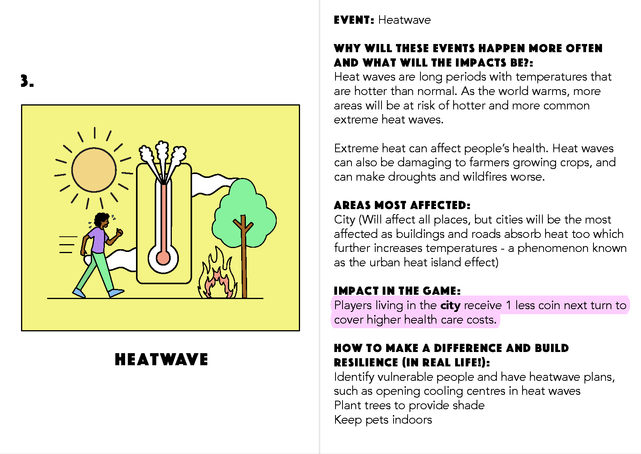
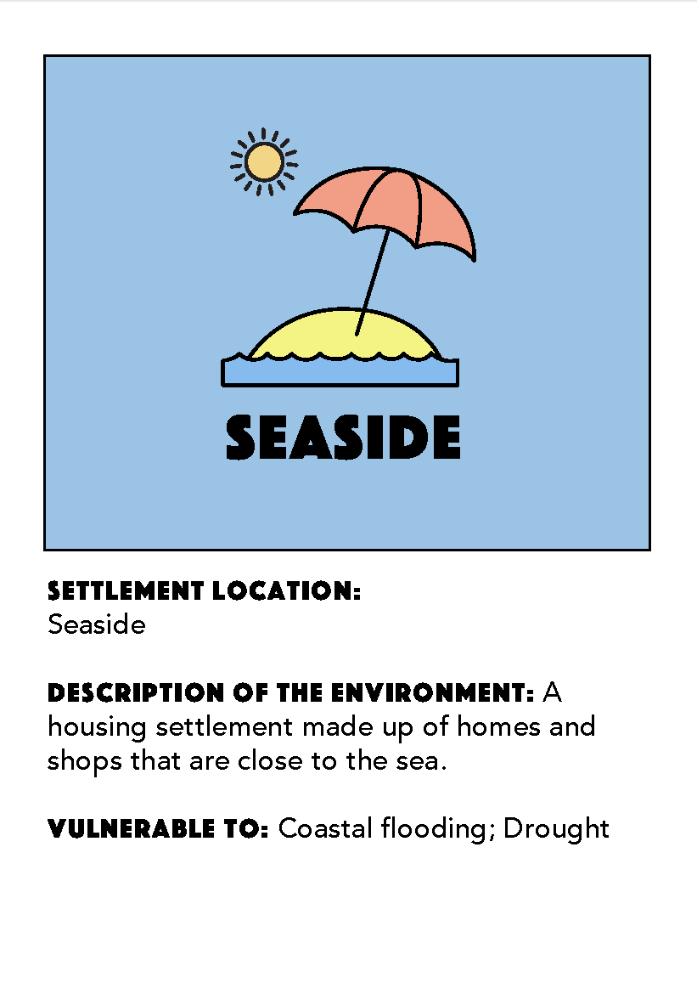
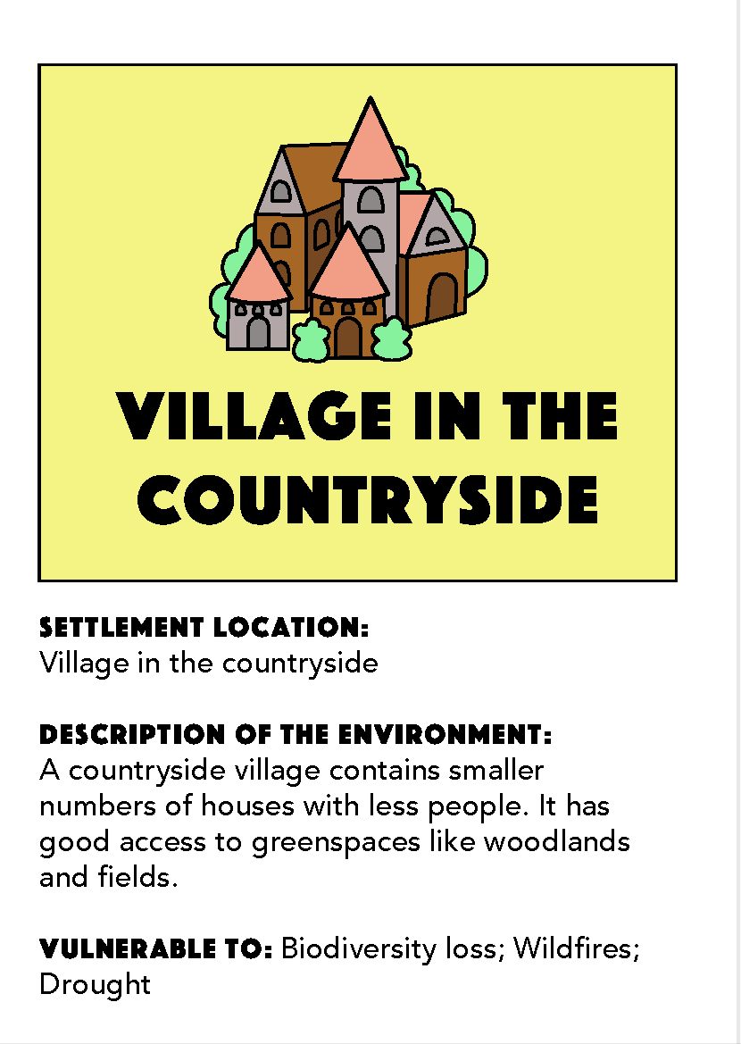
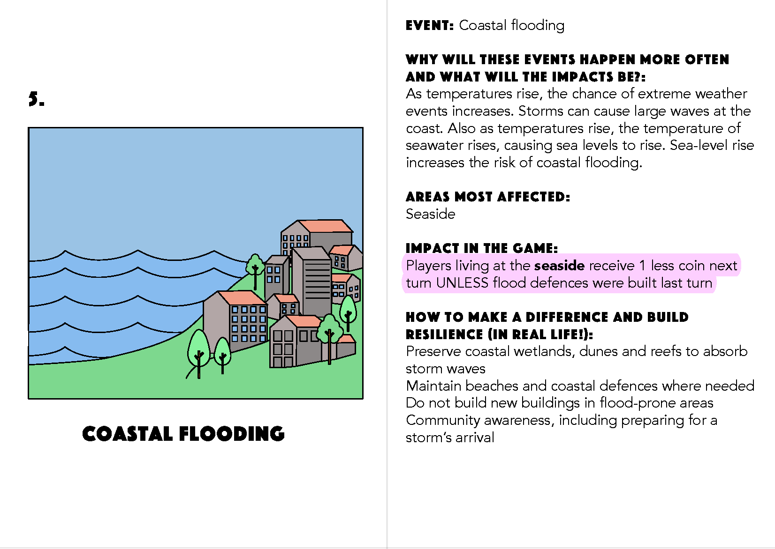
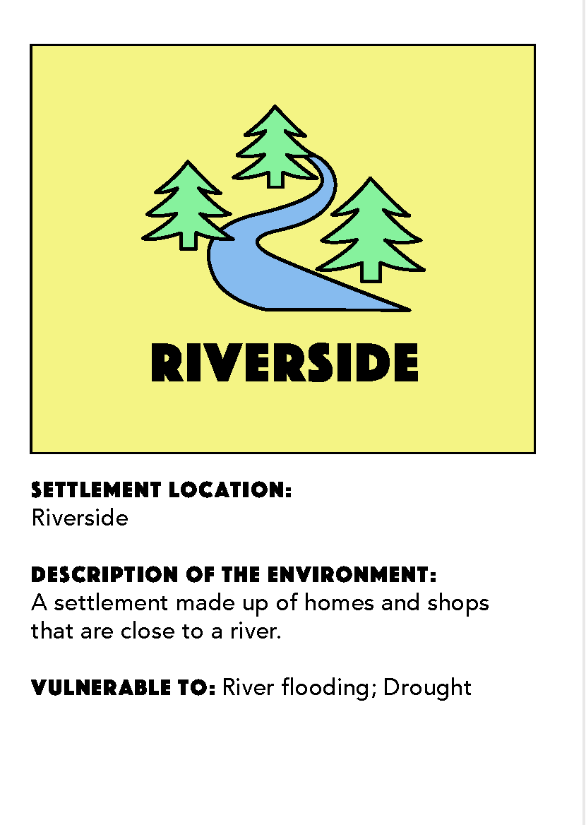
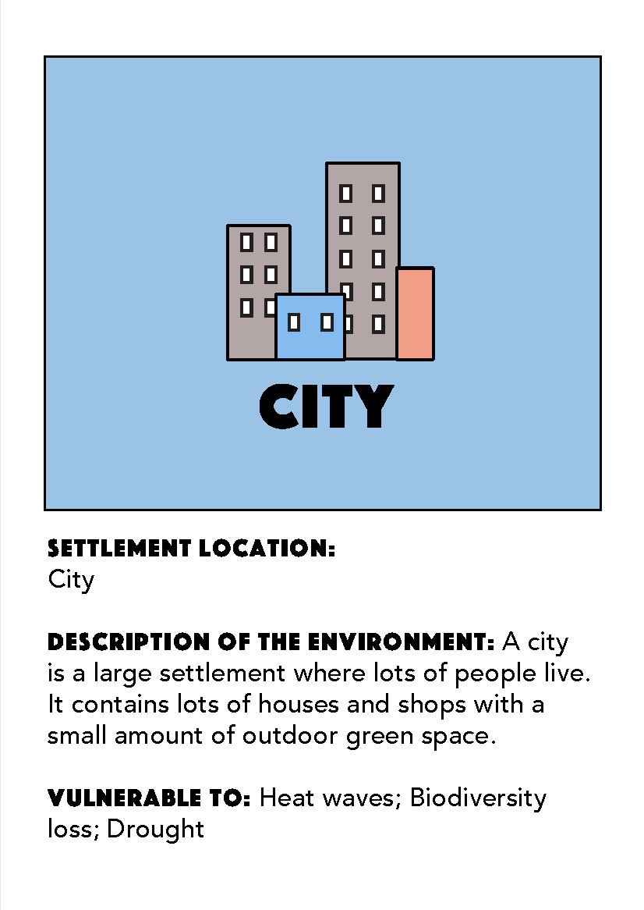
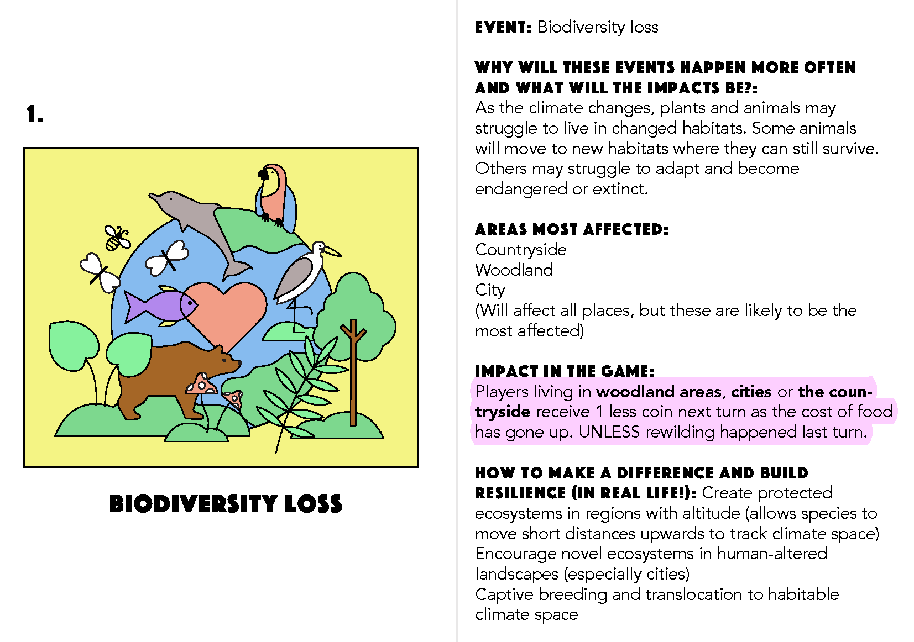

Slide 4
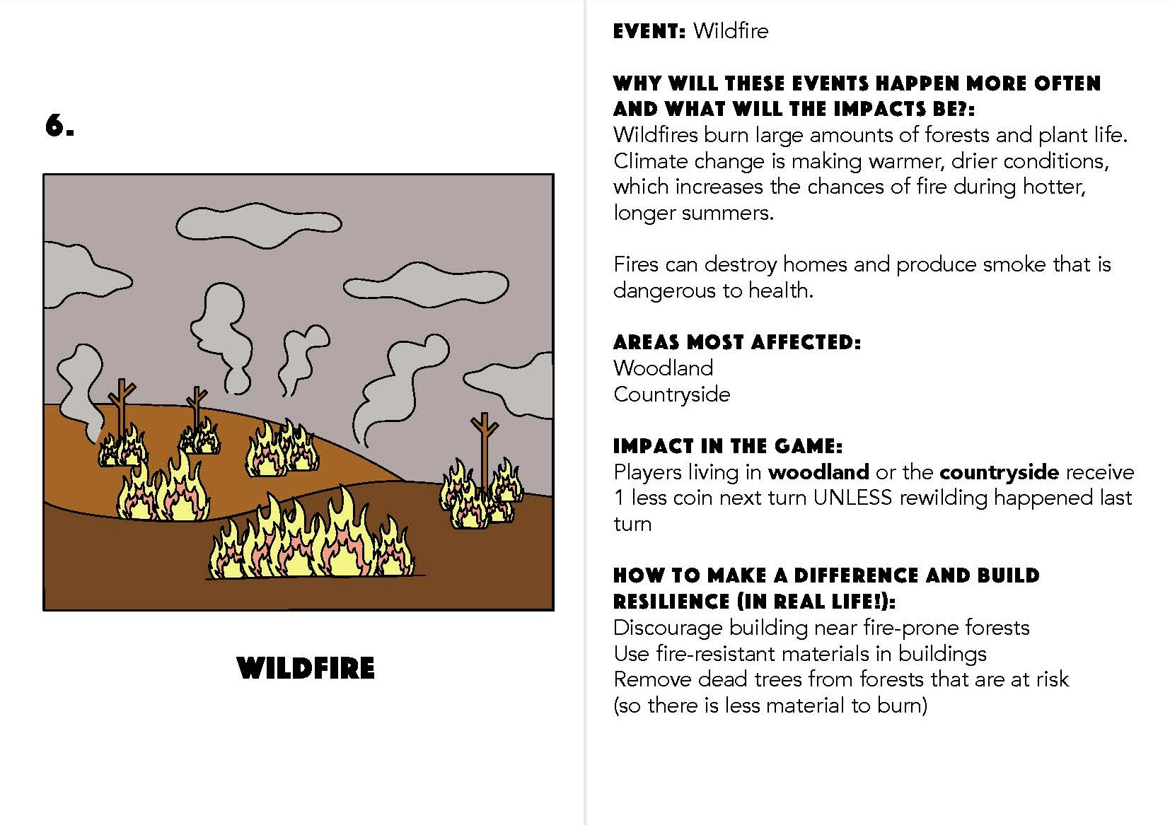
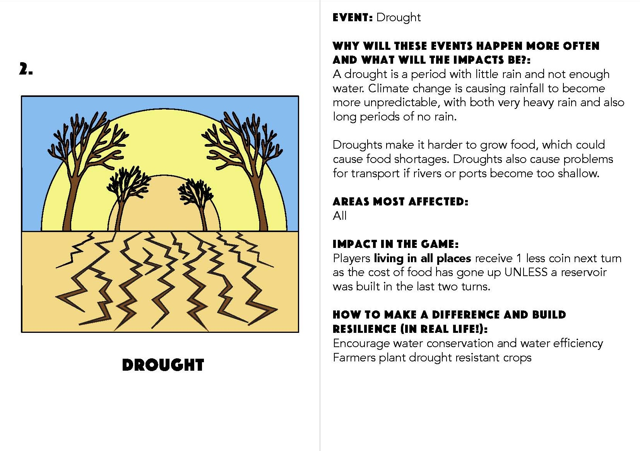
Setting up the game:
Lay out the 6 ‘Event Cards’
Each player should choose a place to live – place a token on your chosen location.
Place a counter in the Round 1: Now box, and a counter at the bottom of the thermometer.
Give each player two counters (coins).

Slide 5
Setting up the game:
Lay out the 6 ‘Event Cards’
Each player should choose a place to live – place a House on your choice.
Place a counter in the Round 1: Now box, and a counter at the bottom of the thermometer.
Give each player two counters (coins).

Slide 6
Round Counter
Setting up the game:
Lay out the 6 ‘Event Cards’
Each player should choose a place to live – place a token on your chosen location.
Place a counter in the ‘Round 1: Now box’, and a counter at the bottom of the thermometer.
Give each player two counters (coins).
Temperature Marker

Slide 7
Setting up the game:
Lay out the 6 ‘Event Cards’
Each player should choose a place to live – place a token on your chosen location.
Place a counter in the Round 1: Now box, and a counter at the bottom of the thermometer.
Give each player two coins.

Slide 8
Playing the game…
The game is played over 4 rounds, round one is now, and each round is 10 years in the future.
Your job is to work together to limit the rise in temperature that, the lower your end temperature the better you have done!

Slide 9
Each round…
Get your money, this is 2 coins per player.
Chose how to spend your money and place it on the actions.
Once everyone has placed their coins, work out the impact.
Increase the temperature.
Roll the dice to find out your weather events.

Slide 10
Each round…
Get your money, this is 2 coins per player.
Chose how to spend or save your money and place it on the actions.
Once everyone has placed their coins, work out the impact.
Increase the temperature.
Roll the dice to find out your weather events.

Slide 11
Each round…
Get your money, this is 2 coins per player.
Chose how to spend your money and place it on the actions.
Once everyone has placed their coins, work out the impact.
Increase the temperature by 20 and then add or take away your impact.
Roll the dice to find out your weather events.

Slide 12
Each round…
Get your money, this is 2 coins per player.
Chose how to spend your money and place it on the actions.
Once everyone has placed their coins, work out the impact.
Increase the temperature by 20 and then add (red – go up) or take away (green – go down) your impact.
Roll the dice to find out your weather events.

Slide 13
Each round…
Get your money, this is 2 coins per player.
Chose how to spend your money and place it on the actions.
Once everyone has placed their coins, work out the impact.
Increase the temperature by 20 and then add or take away your impact.
Roll the dice to find out your weather events.

Slide 14
Round 1 Round 2 Round 3 Round 4

Slide 15
Round 1 Round 2 Round 3 Round 4

Slide 16
Round 1 Round 2 Round 3 Round 4

Slide 17
Round 1 Round 2 Round 3 Round 4* *final round!

Slide 18
End of game 1, how well did you do?
?

Slide 19
We’re going to play again! This time talk about your strategy as a group before you play.

Slide 20
Round 1 Round 2 Round 3 Round 4

Slide 21
Round 1 Round 2 Round 3 Round 4

Slide 22
Round 1 Round 2 Round 3 Round 4

Slide 23
Round 1 Round 2 Round 3 Round 4* *final round!

Slide 24
Climate Change: It’s in Our Hands
What have you learned about our actions and how they impact on the climate?

Slide 25
What is better?
Actions Now
or
Actions Later

Slide 26
What is better?
Individual Actions
or
Collective Actions

