Slide 1
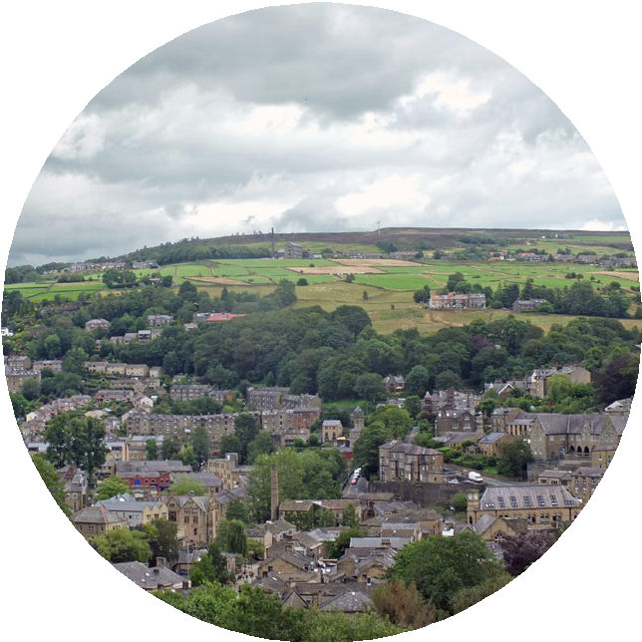
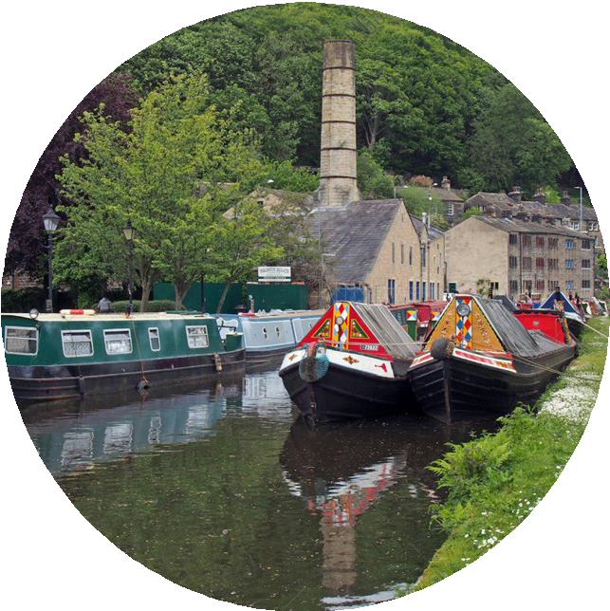
How can Stemville improve its biodiversity?

Slide 2
How can Stemville improve its biodiversity?
Date, name, job role
Notes:
Add the details of the Environment Agency Stem Ambassador, if one is present, to this slide. If possible ask the Stem Ambassador for an image of them at their work in their work clothing. Delete the slide if an Environment Agency STEM Ambassador is not available.

Slide 3
Vote – but be prepared to justify your choice
Which type of grass is better?
1. Astroturf
2. grass kept neat and tidy
3. grass left to grow wild
Notes:
Tell the pupils they are going to vote on this question, but they have to be able to justify their choice. Ask the pupils to think about this question in silence for a minute, then write the number for their answer on a sticky note or whiteboard. On your cue ask the pupils to hold up their answers. Ask some pupils to justify their answers.
The pupils will have had a clue as to what the session is going to be about from the title on the previous slides so it will be interesting to see what their answers are and how they justify them. Hopefully some of the pupils will talk about option 3 being better for biodiversity or plants and animals.
Keep a count of the numbers that voted for each option. You will be returning to this slide at the end of the session.

Slide 4
What is biodiversity?
1 minute to think 1 minute to pair
1 minute to share
Think pair share
Notes:
It may be that you can skip this slide if you are confident that pupils understand the term biodiversity, but this task is a good way to found out how much pupils do know. Ask pupils this question and get them to think about the answer for 1 minute in silence, then get them to talk for one minute with their partner about the question. Finally choose some partnerships to tell you their answers. The pupils may come up with many ideas that are in the right area. Gather the ideas together and then give the full definition on the next slide.

Slide 5
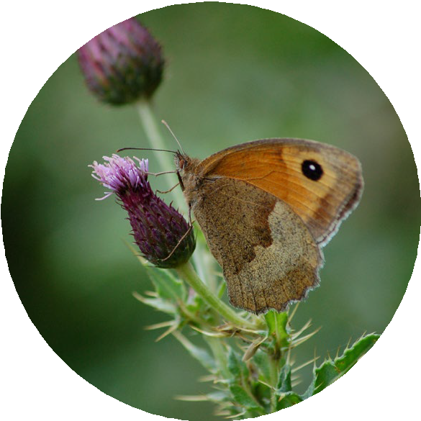
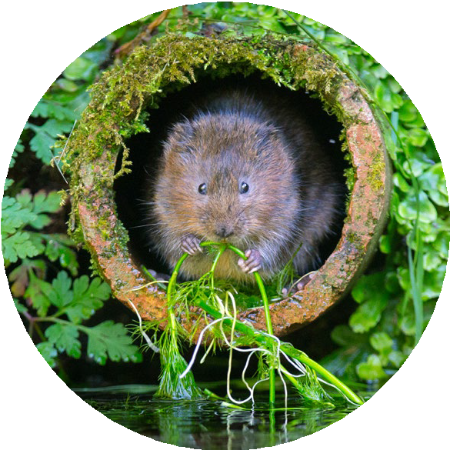
What is biodiversity?
Biodiversity is the number and variety of different species of
organisms on Earth or within an ecosystem.
Notes:
If needed you can give pupils this definition, but it may be that they have come up with this answer themselves. If so just skip this slide.

Slide 6
Why is biodiversity important?
1 minute to think 1 minute to pair
1 minute to share
Think pair share
Notes:
Ask pupils this question and get them to think about the answer for 1 minute in silence, then get them to talk for one minute with their partner about the question. Finally choose some partnerships to tell you their answers.

Slide 7
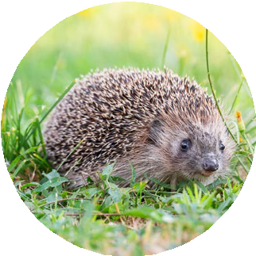
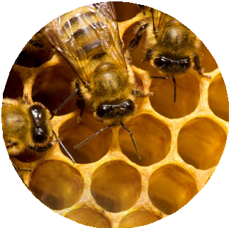
Why is biodiversity important?
High biodiversity improves the air we breathe and the variety of food we can eat. It helps to tackle climate change and its effect.
Different species in an ecosystem are interdependent. This means they depend on each other for things like food and shelter.
In an area of high biodiversity one species is less likely to depend on only one species as a source of food or shelter. Therefore, if one species dies out, the rest are more likely to survive as they have a variety of options. This makes an ecosystem stable so it is better for us and our environment.
Notes:
Use this slide to discuss with pupils the importance of biodiversity.
Focus on the fact that humans need high biodiversity. This is a difficult concept to explain. A good example is almond trees and bees. In the USA there are large areas of land dedicated to almond farming which are low in biodiversity. Almond trees produce blossom in spring that need to be pollinated by bees in order for almond nuts to grow. In spring the bees visit almond flowers to collect nectar as food for themselves and pollinate the almond flowers. However, the bees started to die out because once the almond trees had finished flowering there were no other flowers for the bees to feed on as the whole area was just almond trees. No bees equals no almonds. No almonds means no money for the farmer.
Almond farmers in the USA have identified this problem and have planted different native wildflowers among the almond trees that flower all year long, so the bees have nectar to feed on through the whole year. Bee and other insect numbers have increased as a result which has led to improved nut harvests for the farmers.

Slide 8
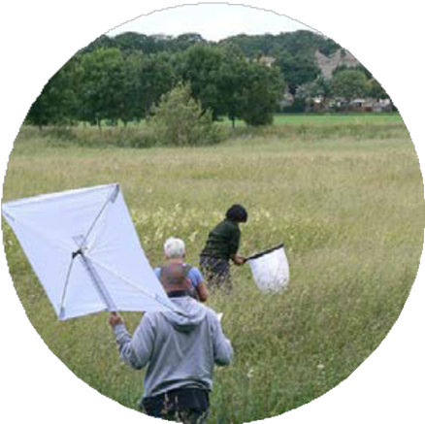
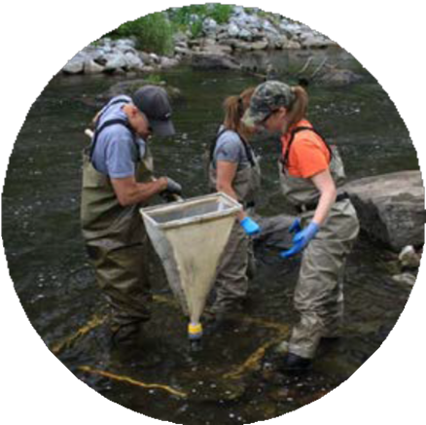
Who can help improve biodiversity?
Please watch the video:
How the Environment Agency can tackle climate change
Notes:
This video introduces an Environment Agency employee who looks at where the Environment Agency can spend money to improve the environment and how this helps plants and animals become more resilient to climate change.
If an Environment Agency STEM Ambassador is present they could explain how the Environment Agency improve biodiversity and insert some of their own slides at this point rather than show the video.

Slide 9
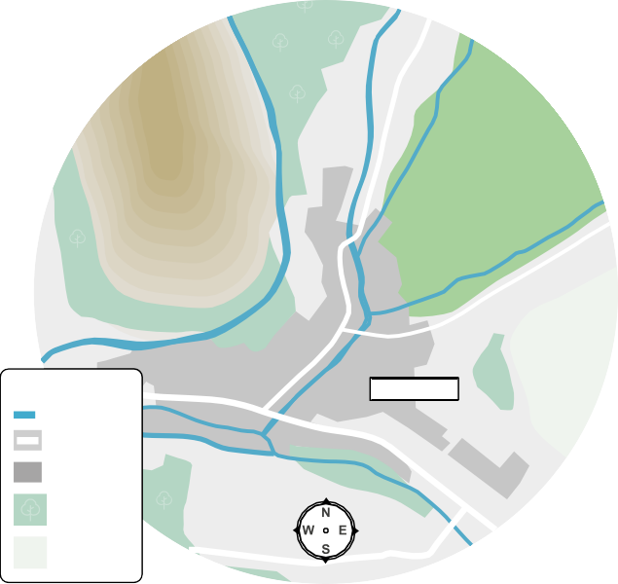
Where is Stemville?
Stemville is a town in the North of England with a population of 15,000 people.
It sits on 3 rivers: River Moore, River Crane, River Leawell.
Most of the town is surrounded by land used for farming cattle, but to the west of the town are steep hills.
River Crane
River Leawell
Steep hills
Farmland
River Road
STEMVILLE
Buildings
River Moore
Wooded area
Moorland
Notes:
Use this slide to introduce some background information to the pupils.

Slide 10
Stemville’s biodiversity
Over the centuries Stemville has grown from a few houses and farms to a large town.
This is because lots of factories were built which provided employment, so the population grew. These people needed houses so more farmland has been used for housing and roads have been built.
Trees in local woods have been cut down to create more farmland.
The biodiversity in Stemville has decreased.
Notes:
Use this slide to introduce some background information to the pupils.

Slide 11
Can you help Stemville?
The council need to improve the biodiversity in the town, and they have called in your team of ecologists to help.
Next steps:
First step:
Find out about the various methods to increase biodiversity from the information cards
Decide which methods you will use to help Stemville
You must choose a package of methods which you can afford within a £1.5 million budget to be spent over a 5 year period
Create a short pitch to the council, explaining which methods you have chosen and why

Slide 12
Biodiversity improvement score
The biodiversity improvement score is an indication out of 10 as to how well the method improves biodiversity. The higher the score the better the method is at improving biodiversity.
Notes:
This slide is for use with the standard version of the lesson where pupils are given a biodiversity improvement score on the biodiversity improvement method cards. This version assists pupils with assessing which measures would have to biggest impact on improving biodiversity.

Slide 13
What is in a pitch?
You will be graded on the following things, so consider them in your planning:
Numeracy skills – Ensure your costing is correct and within the £1.5 million budget over 5 years
Justify your choices of biodiversity improvement methods
Use a good range of biodiversity improvement methods
Communication skills - Explain your plan clearly
Answer follow up questions confidently

Slide 14
Let’s hear your pitch!
Tell us the total cost of your plan
Tell us why you have chosen these methods
Tell us which methods you have chosen

Slide 15
Vote – but be prepared to justify your choice
Which type of grass is better?
1. Astroturf
2. grass kept neat and tidy
3. grass left to grow wild
Notes:
The pupils vote again. Compare the numbers that vote for each option with the numbers from the start of the lesson. If they are different find out which pupils have changed their minds and why.

Slide 16
What factors and actions affect biodiversity?
(extension task)
Look at the information of the biodiversity improvement method cards.
What factors and actions affect levels of biodiversity?
Explain why these factors affect biodiversity.
Can you think of any other factors which affect biodiversity not mentioned on the cards?
Which biodiversity improvement method could be beneficial where you live?
Notes:
This extension activity gets pupils thinking exactly how various factors and actions affect biodiversity. The final question gets them thinking about other factors that could affect biodiversity which are not mentioned on the cards. Climate change has a large effect on biodiversity and hopefully more able pupils will realise this. For example global warming is causing sea ice to melt in the Artic. This makes it harder for polar bears to feed themselves and their cubs as less ice makes it harder to catch their main prey, seals. Polar bears numbers are declining rapidly.

Slide 17
© Environment Agency 2022. This content is available under Open Government Licence v3.0.

