Slide 1
Make a model hydraulic boat lift
Making a model of a hydraulic boat lift using syringes

Slide 2
Stay safe
Whether you are a scientist researching a new medicine or an engineer solving climate change, safety always comes first. An adult must always be around and supervising when doing this activity. You are responsible for:
ensuring that any equipment used for this activity is in good working condition
behaving sensibly and following any safety instructions so as not to hurt or injure yourself or others
Please note that in the absence of any negligence or other breach of duty by us, this activity is carried out at your own risk. It is important to take extra care at the stages marked with this symbol: ⚠

Slide 3
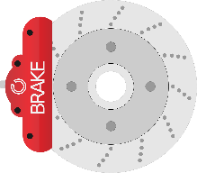
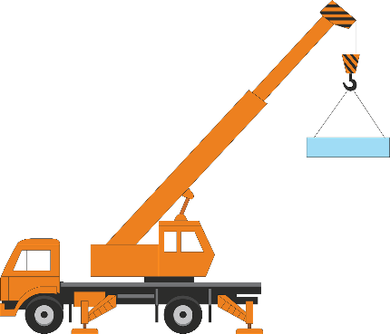
Hydraulic Systems
Hydraulic systems use liquids under pressure to create movement
They are used to move things such as cranes, car brakes and office chairs

Slide 4
Anderton Boat Lift
The Anderton boat lift raises boats from the river up to the canal
It was restored by a multi-company collaboration including Fairfield Control Systems
Canal
River
Notes:
Fairfield website: https://www.fairfields.co.uk/

Slide 5
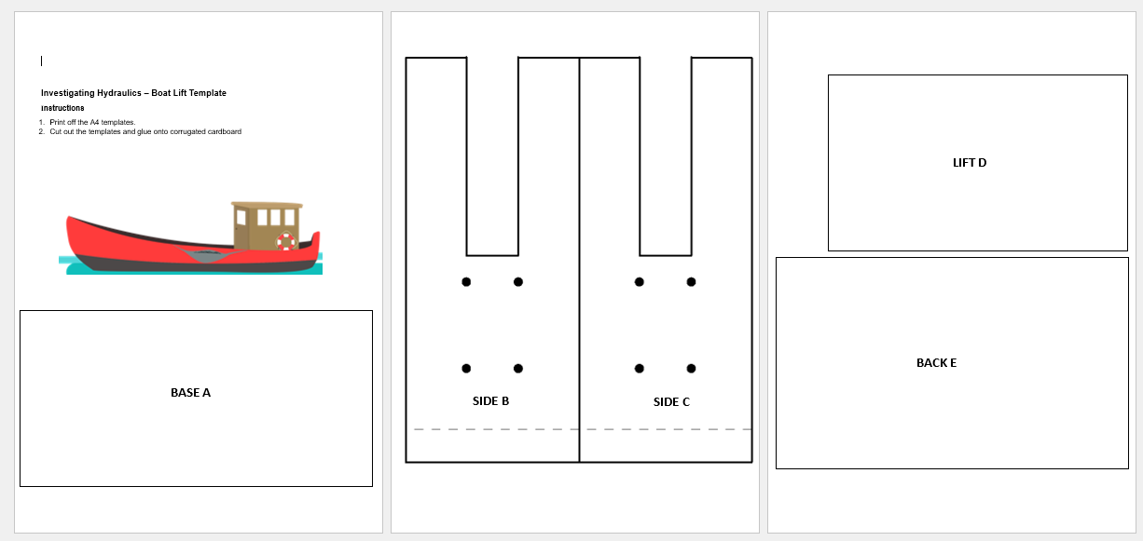
Step 1 - Boat Lift Model
⚠
Print out the model templates
Safely cut out each template using scissors
Notes:
Always take care when using scissors.

Slide 6
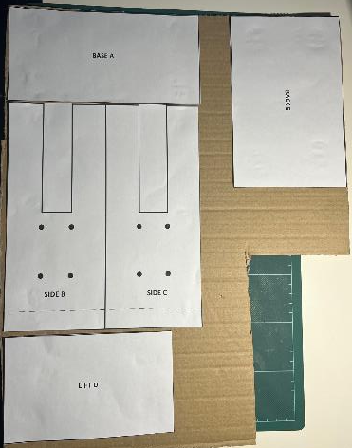
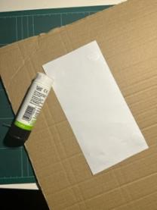
Step 2
⚠
Dab a glue stick in each corner of each template
Stick each onto corrugated cardboard

Slide 7
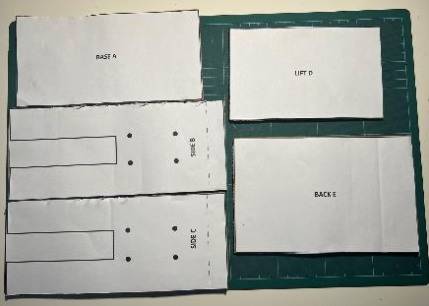
Step 3
⚠
Safely cut out each template using scissors
Get an adult to help to cut out the slots on Sides B and C
Notes:
Always take care when using scissors.

Slide 8
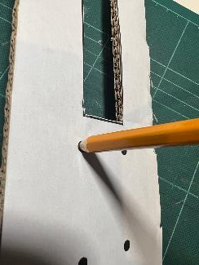
Step 4
⚠
Make the eight holes shown in the template using a sharp pencil and sticky tack

Slide 9
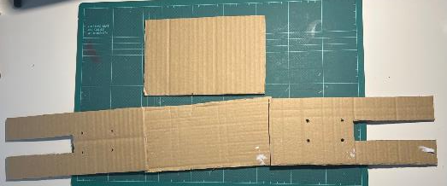
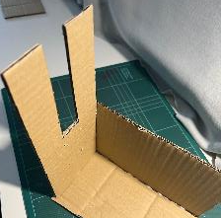
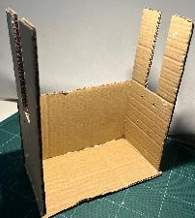
Step 5
⚠
Remove the paper templates
Glue Side B to Base A
Glue Back D to Side B and Base A
Glue Side C
D
B
A
C

Slide 10
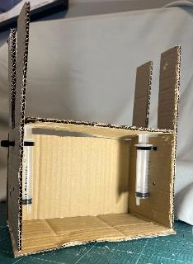
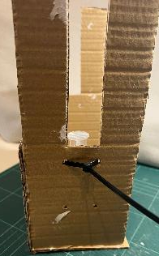
Step 6
⚠
Attach the 10 ml syringes with cable ties to Sides B and C
Glue Lift E to the syringe tops

Slide 11
Step 7
⚠
Cut two 120 mm lengths of 3 mm clear plastic tube
Attach tube to two syringes and pull out the plungers
Attach clear tubes to the lift syringes
Cut out the boat picture
Test the model by pressing in the plungers
Does the lift work?

Slide 12
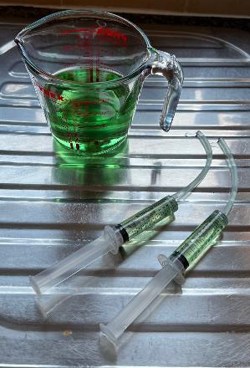
Step 8
⚠
Using air in the syringes is called a pneumatic system
Air is compressible
To increase the power of the lift we can use a hydraulic system
Water is a non-compressible liquid. We can put it in the syringes
Use food dye to colour the water

Slide 13
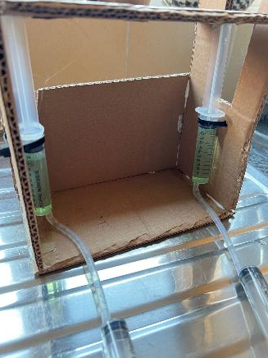
Step 9
⚠
Reattach the water filled syringes to the lift syringes
Re-test the boat lift
You should notice a smoother operation

Slide 14
Extension
Investigate how much weight the boat lift can move by gradually increasing the weight lifted. Record your results.

