Slide 1
Investigate why boats float
Using Archimedes’ principle to investigate why boats float

Slide 2
Stay safe
Whether you are a scientist researching a new medicine or an engineer solving climate change, safety always comes first. An adult must always be around and supervising when doing this activity. You are responsible for:
ensuring that any equipment used for this activity is in good working condition
behaving sensibly and following any safety instructions so as not to hurt or injure yourself or others
Please note that in the absence of any negligence or other breach of duty by us, this activity is carried out at your own risk. It is important to take extra care at the stages marked with this symbol: ⚠

Slide 3
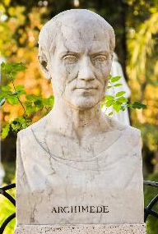
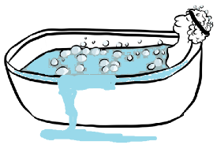
Archimedes
Archimedes was a mathematician and physicist in ancient Greece
During a bath, he noticed that water spilled over the sides when he got in
He then realised the relationship between volume and mass

Slide 4
What is Density?
Density is the amount of mass something has per unit volume
If two things are the same size, the one that is more dense is heavier
The cubes are the same size
High density
Low density

Slide 5
Archimedes’ principle
The Archimedes’ Principle is a scientific law. It explains why some objects sink and some objects float.
Things that are denser than water will sink
Things that are less dense than water will float (be buoyant)

Slide 6
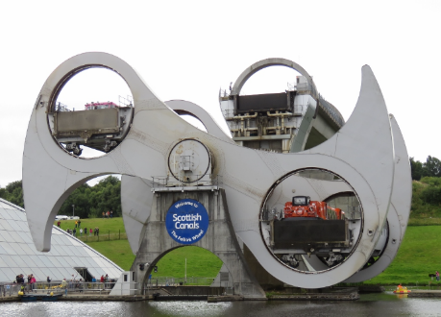
Falkirk Wheel
The Falkirk wheel lifts boats up 11 m, from one canal to another canal
The Archimedes’ principle allows the wheel to work
The control system was designed by Fairfield Control Systems
Notes:
Fairfield website: https://www.fairfields.co.uk/

Slide 7
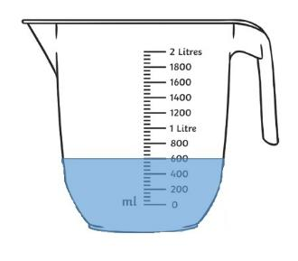
Step 1
Fill the jug with 600 ml of water
Roll a 50 g piece of modelling clay into a ball
Place the ball into the jug
Does the ball float or sink?
Ball approx.
50 g
Notes:
The ball should sink as it is denser than the water.

Slide 8
Step 2
The level of the water will now have raised to about 650 ml
Write down the displacement of the water
Why has the ball sunk?
Notes:
The ball should sink as it is denser than the water.

Slide 9
Step 3
Mould the modelling clay ball into a small boat shape
Place the boat into the jug
The displacement (height of the water when the modelling clay is added) is the same as the weight has not changed
The density is less so the modelling clay floats!
Notes:
Now the shape has heavy round sides and air in the middle. It’s overall average density is less, so it will float. The displacement is the same as the weight has not changed. This is Archimedes’ principle in action.

Slide 10
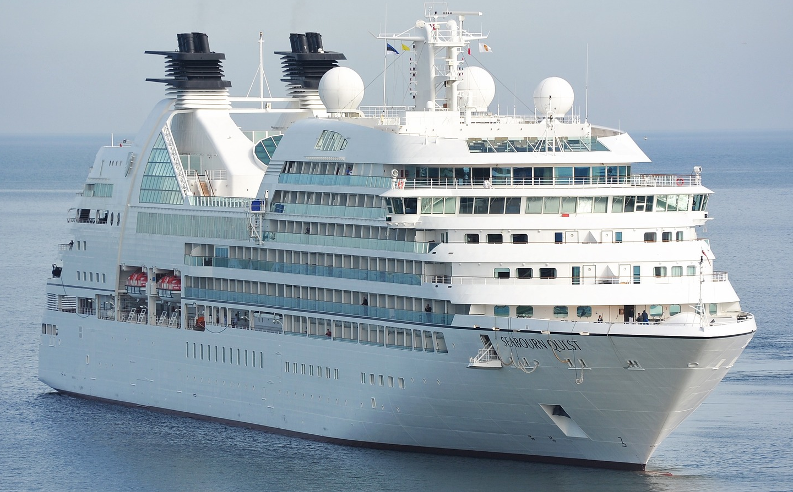
Why do boats float?
Large ships like cruise ships have wide U-shaped hulls
These displace huge volumes of water, but are mainly hollow
This decreases the effective density of the ship and helps keep it afloat, even when it is full with cargo and passengers

Slide 11
Extension
Try adding small items into the modelling clay boat. How much weight it can carry before it sinks?
Calculate the density of the ball and the boat shape made from modelling clay.

