Slide 1
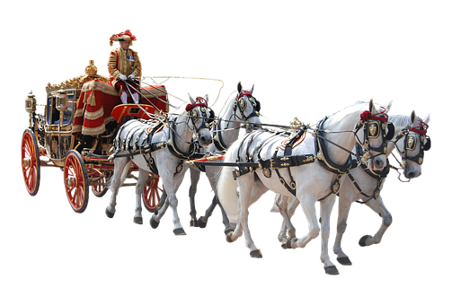
Design a Royal carriage
Designing a new royal carriage that is electrically powered

Slide 2
Stay safe
Whether you are a scientist researching a new medicine or an engineer solving climate change, safety always comes first. An adult must always be around and supervising when doing this activity. You are responsible for:
ensuring that any equipment used for this activity is in good working condition
behaving sensibly and following any safety instructions so as not to hurt or injure yourself or others
Please note that in the absence of any negligence or other breach of duty by us, this activity is carried out at your own risk. It is important to take extra care at the stages marked with this symbol: ⚠

Slide 3
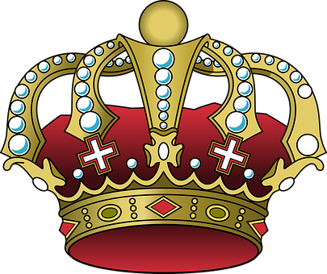
King’s Coronation
A coronation is a ceremony where the crown is placed on a new monarch’s head
The coronation for King Charles III and his Queen Consort will take place at Westminster Abbey on Saturday 6th May 2023
There will be a bank holiday to honour the event on 8th May
Notes:
Discuss the Coronation with learners, what this involves and its importance in the United Kingdom.

Slide 4
Design brief
The original royal carriage, known as the Gold State Coach, has been used as part of the coronation of every British monarch since 1762
It is now very old and could do with being brought up to modern standards
Your task is to design a new royal carriage for the coronation of King Charles III
The carriage must be electrically powered
Notes:
Share and discuss the design brief with learners.
Learners could research the history of the existing Gold State Coach and consider its benefits and limitations as a Royal carriage.

Slide 5
Design criteria
The new Royal carriage must:
Be electrically powered so it has a low carbon footprint
Show the King’s Cypher in a prominent location
Reflect the history and traditions of the United Kingdom and the royal family
Include features to improve comfort when riding inside the carriage
Make use of modern, lightweight materials
Notes:
Discuss the design criteria with learners and how they might meet them with their designs.

Slide 6
Royal carriage design
Use this space to sketch your idea for your new Royal carriage.
Don’t forget to annotate your design to show how it meets the design criteria!
Notes:
Learners could use this sheet to present their design idea and annotations, or use blank paper.
These links could help when producing the designs:
https://www.rct.uk/resources/pdf-pack-design-a-carriage-activity-sheet
https://www.rct.uk/sites/default/files/Design%20a%20Carriage.pdf

Slide 7
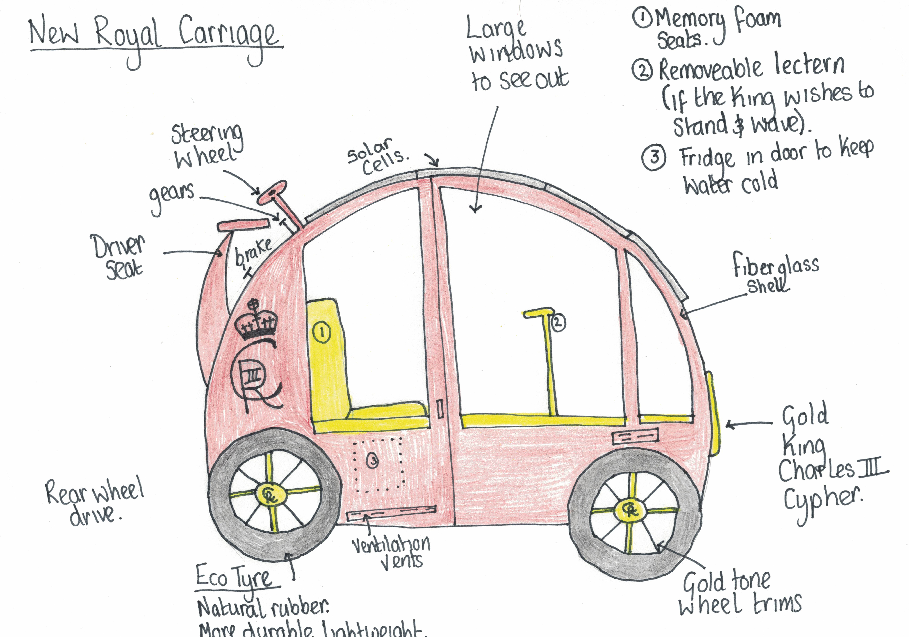
Example design
Notes:
This is a pupil example that could be shared with learners.

Slide 8
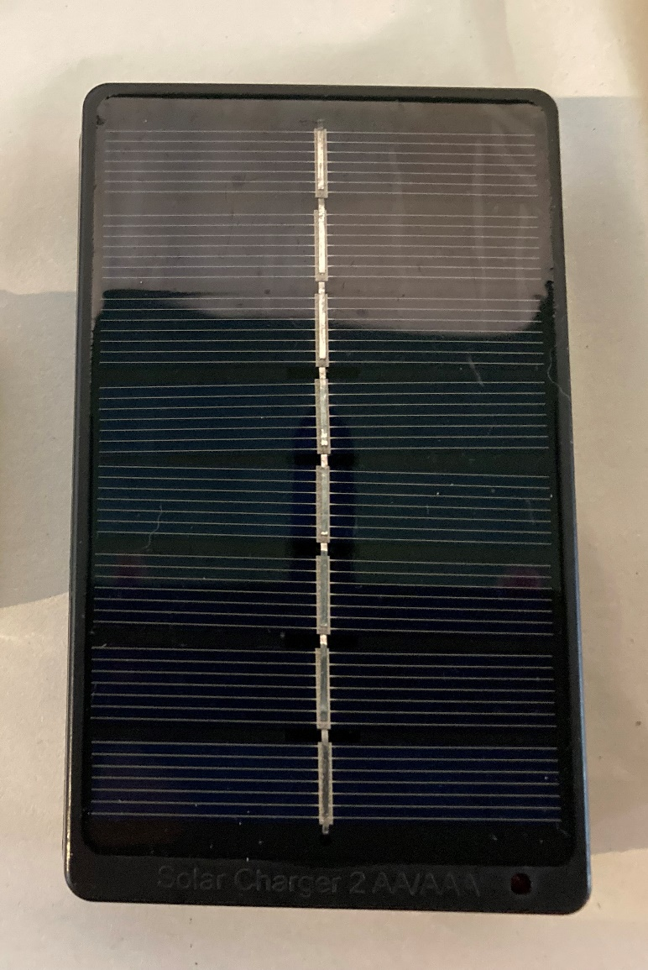
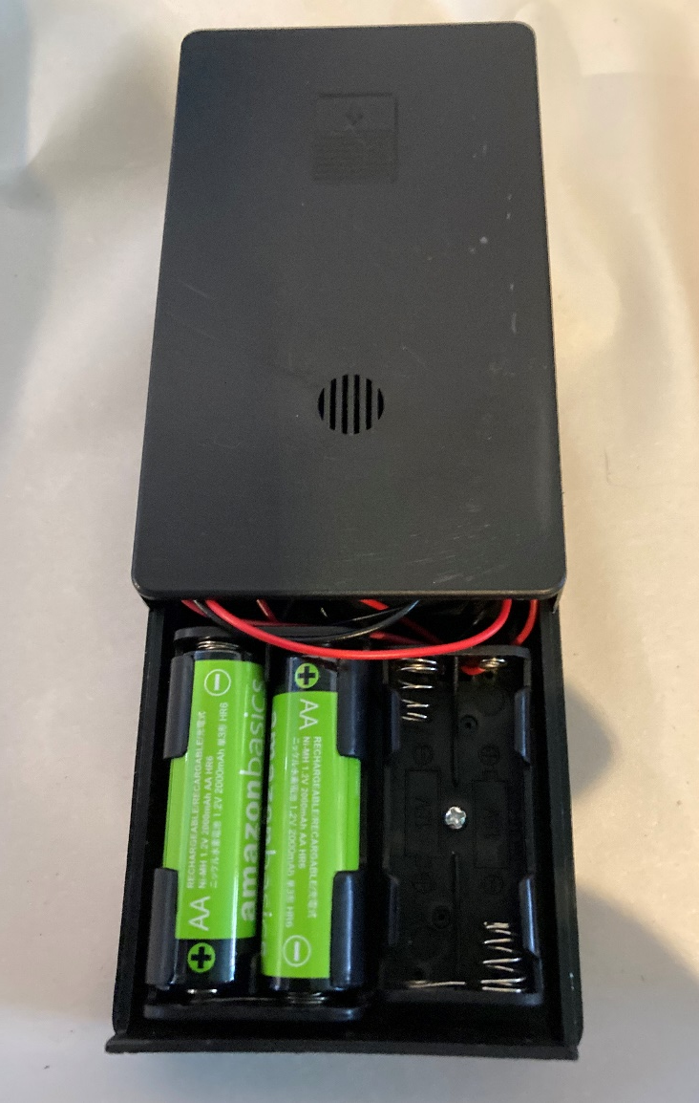
Using a solar battery charger
⚠
To provide electrical power a solar battery charger could be used
Try charging two rechargeable AA batteries and then connect them to a 3 V motor
Use the wiring diagram on the next slide to help
Notes:
As an additional activity learners could try charging batteries using a solar cell and use them to power a motor. They could then discuss how this system could be modified to create a two or even four wheel drive system for the carriage.
A solar charger such as this could be used: https://www.amazon.co.uk/gp/product/B073W8VLTN
2 x 1.5 V AA batteries will power a 3 V motor. An alternative rated motor can be used as long as the power supply used provides the correct voltage for it to function correctly and safely.
Always take care when working with electrical power supplies and components, even at low voltages.

Slide 9
Wiring diagram
⚠
2 x AA rechargeable battery pack
3 V motor
+
-
Batteries charged from solar panel
Notes:
This wiring diagram can be used to help when connecting solar charged batteries to a motor to produce the drive for the carriage.
Always take care when working with electrical power supplies and components, even at low voltages.

Slide 10
Extension
Design a mechanical system to convert the rotary motion from the motor to the movement of the carriage (e.g. driving two or four wheels)
Produce a functional scale model of your proposed design and test how well it works

