Slide 1
Design a Coronation Throne
Design a throne for use by the new King
which includes modern technologies

Slide 2
Stay safe
Whether you are a scientist researching a new medicine or an engineer solving climate change, safety always comes first. An adult must always be around and supervising when doing this activity. You are responsible for:
ensuring that any equipment used for this activity is in good working condition
behaving sensibly and following any safety instructions so as not to hurt or injure yourself or others
Please note that in the absence of any negligence or other breach of duty by us, this activity is carried out at your own risk. It is important to take extra care at the stages marked with this symbol: ⚠

Slide 3
Design brief
The coronation of King Charles III will take place on Saturday 6 May 2023
There will be a bank holiday on Monday 8 May
Lots of public events will take place to celebrate this historic event
Your task:
Design a throne for use by the new King that incorporates modern technologies

Slide 4
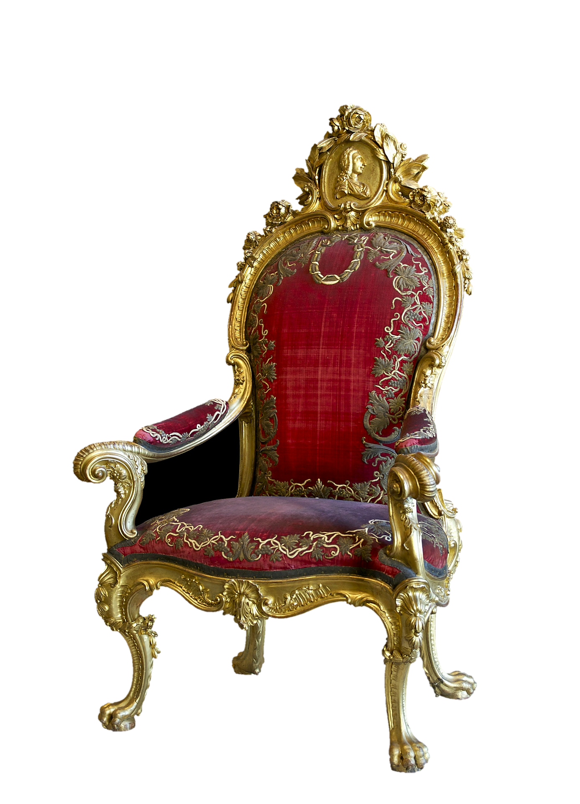
Design criteria
Design a throne for King Charles III that must:
be suitable for the King to sit on comfortably
include modern technologies
be aesthetically appealing

Slide 5
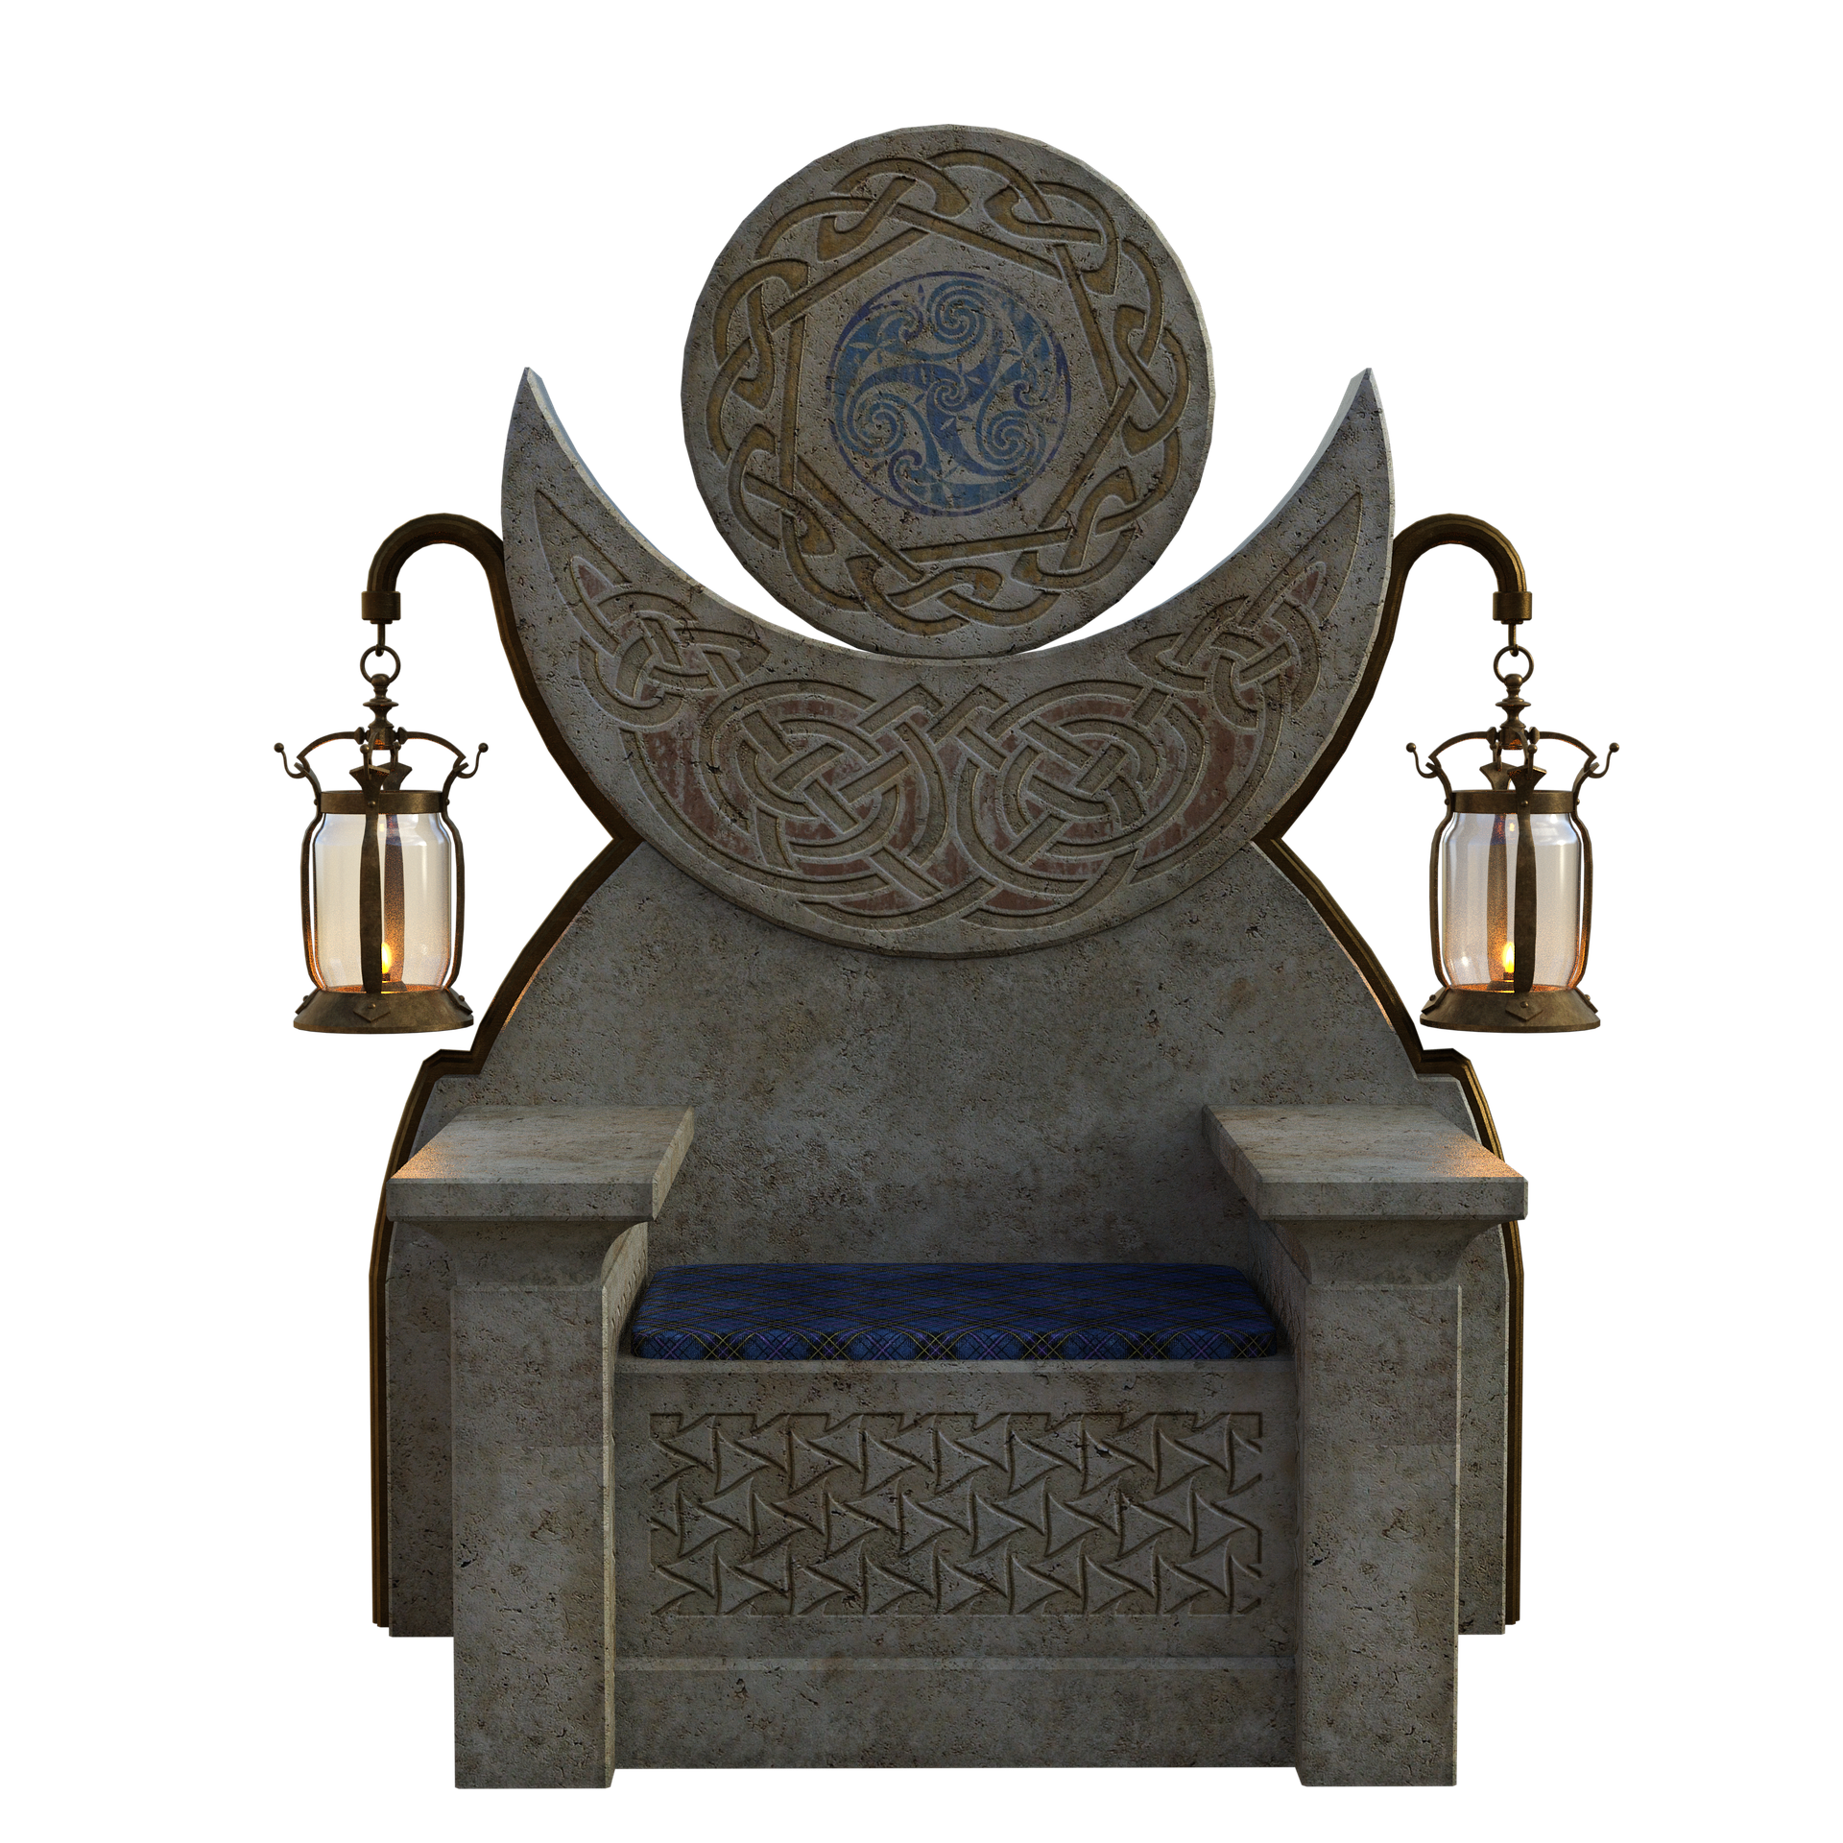
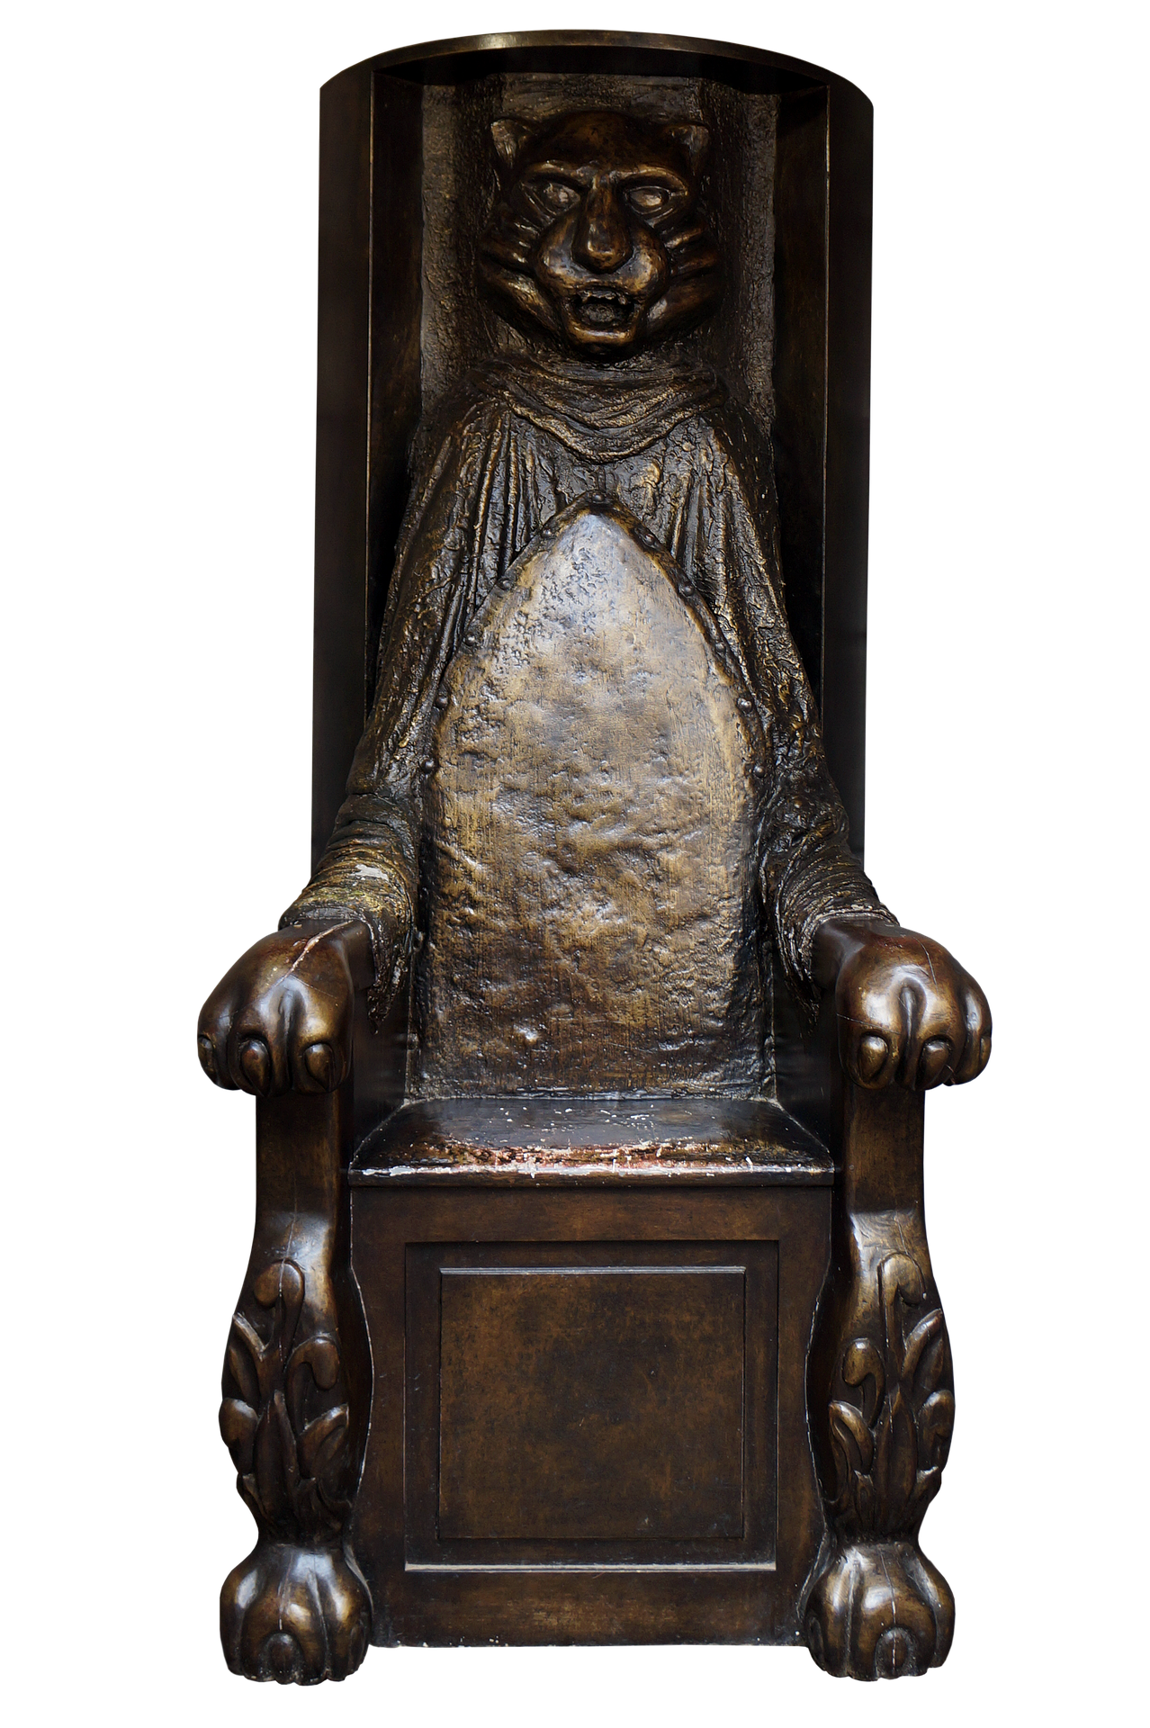
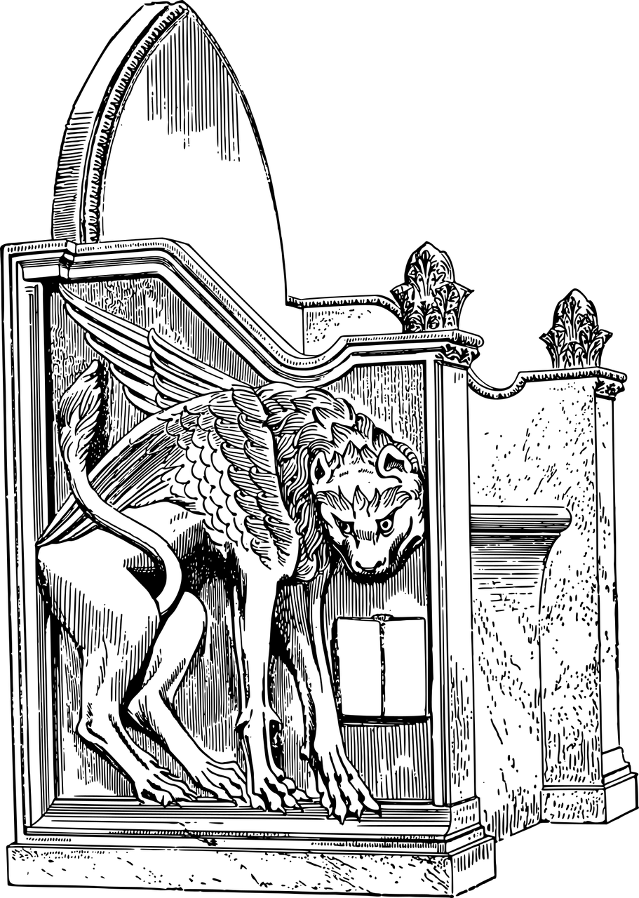
Examples of thrones

Slide 6
Examples of modern technologies
Your design could include, for example:
new materials such as carbon fibre and lightweight metals
lighting, using colourful light emitting diodes (LEDs)
Built-in speakers
heating
the ability to hover, using magnetic levitation, rockets or powerful fans
wheels to let the throne drive around
monitor screens and cameras
robotic arms
USB charging ports

Slide 8
Peer review
Ask three people to suggest one improvement each to your design.
Select one of these suggested improvements and use it to update your design.

Slide 9
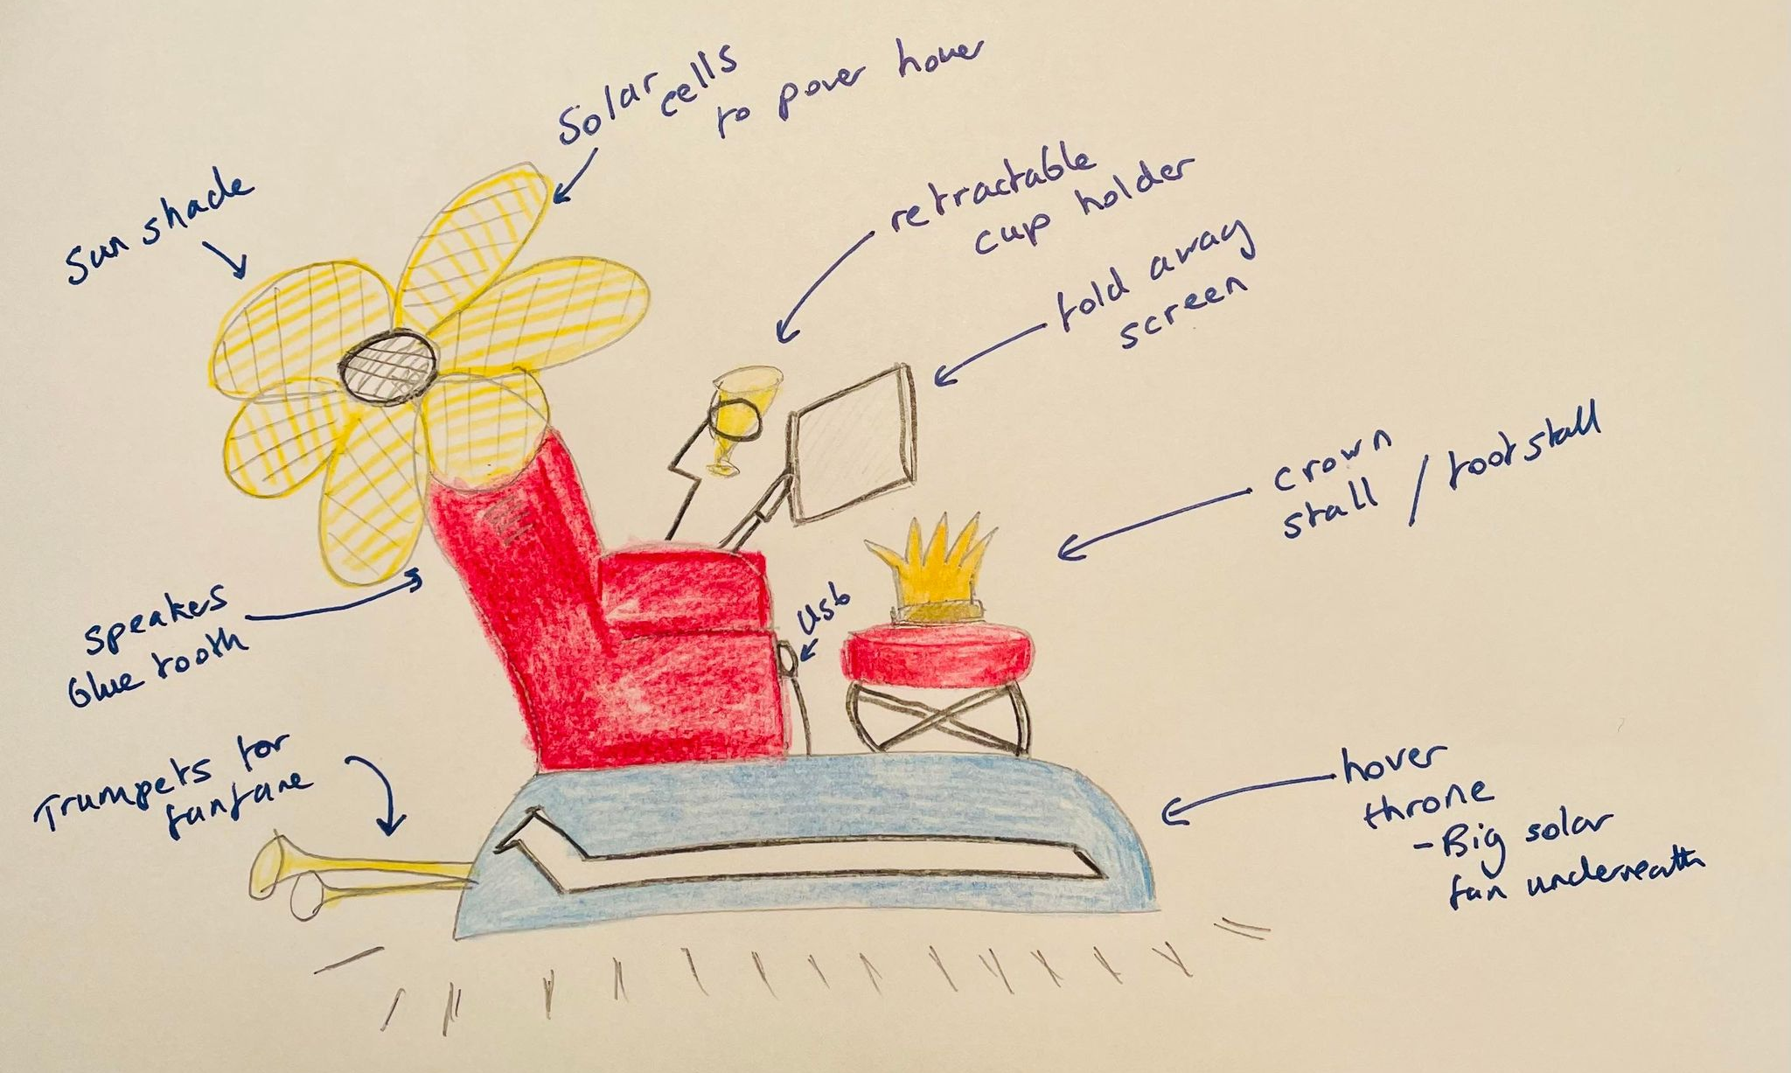
Example
(with thanks to Sammie)

