Slide 1
Key concept PSL7.1: More than light
Learning focus
EM radiation is made of vibrating electric and magnetic fields that can travel through a vacuum. Light and other types of EM radiation are organised in order of frequency across the EM spectrum.
As students’ conceptual understanding progresses they can:
C o n c e p t u a l p r o g r e s s I o n
Describe the relationships between speed, frequency and wavelength for light waves.
Describe the nature of light as a form of electromagnetic radiation.
Compare infrared radiation and light.
Compare ultraviolet radiation and light.
Explain why there is a spectrum of electromagnetic radiation.
Diagnostic questions
Red light
What’s light?
Beyond red
Beyond violet
Beyond ‘beyond’
Different colours
Detecting infrared
Response activities
Emitting infrared
Ultraviolet lamp
P
Prior understanding from earlier stages of learning.
Run the slide show to activate the clickable boxes.
Useful information can be found in the slide notes.
B
Bridge to later stages of learning.
Notes:
The boxes containing the titles of the diagnostic questions and response activities are clickable links that will take you to the starting slide for each activity in this presentation.
In edit mode, hold down the Ctrl key and left-click the box.
In slide show mode, simply left-click the box.
Click the ‘Home’ button at the top right of the final slide of each activity to return here.

Slide 2
Section 1: Diagnostic questions
Use diagnostic questions to identify quickly where your students are in their conceptual progression, and what preconceptions and misunderstandings they may have.
Then decide how to best focus and sequence your teaching.
Use further diagnostic questions and response activities to move students’ understanding forwards.
A zip file containing all the resources for this key concept can be downloaded from
www.BestEvidenceScienceTeaching.org
The zip file provides:
Teacher guidance for this key concept, including a summary of the research evidence on relevant preconceptions and misunderstandings.
A full set of editable and printable student sheets and teacher notes for each diagnostic question. The teacher notes include a summary of research evidence, guidance for using the activity, expected answers and suggestions of how to respond to students’ misunderstandings.

Slide 3
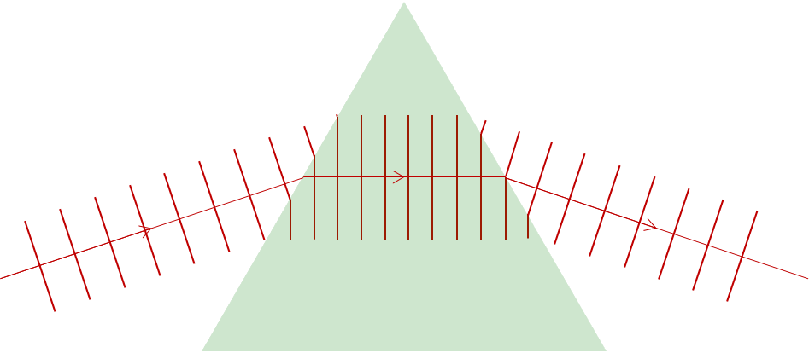
Red light
Red light is shone through a glass prism.
v
=
f
x
λ
The red light wave is refracted as it enters the prism, and again when it leaves.
Notes:
From key concept PSL7.1: students should be able to describe the relationships between speed, frequency and wavelength for light waves.
Common misunderstandings: in the equation v = f x λ all three terms are inter-dependent variables.
Student sheets and teacher notes for this activity contain printable and editable worksheets, together with teacher support materials.

Slide 4
Red light
Home
What property of red light stays the same as it moves through a glass prism?
v
=
f
x
λ
A
Its speed (v) is constant.
B
Its frequency (f) is constant.
C
Its wavelength (λ) is constant.
D
None – its speed, frequency and wavelength all change.
Notes:
Expected answer: B
A breakdown of what each choice tells you about students’ understanding or misunderstanding can be found in the teacher notes for this activity.

Slide 5
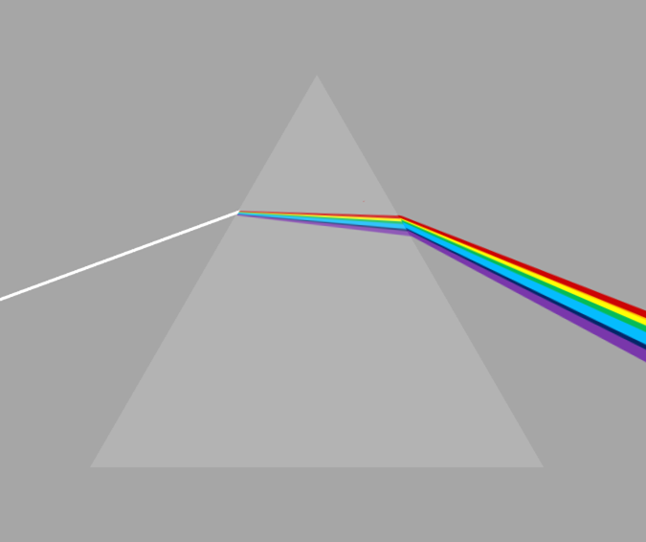
Different colours
Red and blue light are refracted differently by a glass prism.
v
=
f
x
λ
Notes:
From key concept PSL7.1: students should be able to describe the relationships between speed, frequency and wavelength for light waves.
Common misunderstandings: in the equation v = f x λ all three terms are inter-dependent variables; and it is only the material each frequency of light travels through that affects its speed (and not its frequency).
Avoid saying: like all waves …
Do say: electromagnetic waves are different to other types of wave, and moving through a medium their speed depends on frequency (as well as the medium).
(Note for teachers: essentially, the greater the density of charged particles in a medium, the greater the influence of frequency on the speed of EM waves – with no such effect in a vacuum.)
Student sheets and teacher notes for this activity contain printable and editable worksheets, together with teacher support materials.

Slide 6
Different colours
Home
How do red and blue light waves compare?
I am sure this is right
I think this is right
I think this is wrong
I am sure this is wrong
What do you think about each statement?
A
In glass, blue travels slower than red.
B
Blue always has a higher frequency than red.
C
The frequency of blue light does not change.
Notes:
Expected answers: Statements A, B and C are correct.
A breakdown of what each choice tells you about students’ understanding or misunderstanding can be found in the teacher notes for this activity.

Slide 7
What’s light?
Light occurs naturally.
Light can also be made artificially.
Notes:
From key concept PSL7.1: students should be able to describe the nature of light as a form of electromagnetic radiation.
Common misunderstandings: light is different to radiation; EM radiation is the same as radiating particles; and all radiation is artificial and a result of technological process.
Student sheets and teacher notes for this activity contain printable and editable worksheets, together with teacher support materials.
Image by PIRO4D from Pixabay

Slide 8
What’s light?
Home
What are some properties of light?
I am sure this is right
I think this is right
I think this is wrong
I am sure this is wrong
What do you think about each statement?
A
Light can travel through a vacuum.
B
Light can make objects radioactive.
C
Light is a type of electromagnetic radiation.
Notes:
Expected answers: Statements A and C are right, and statement B is wrong..
A breakdown of what each choice tells you about students’ understanding or misunderstanding can be found in the teacher notes for this activity.

Slide 9
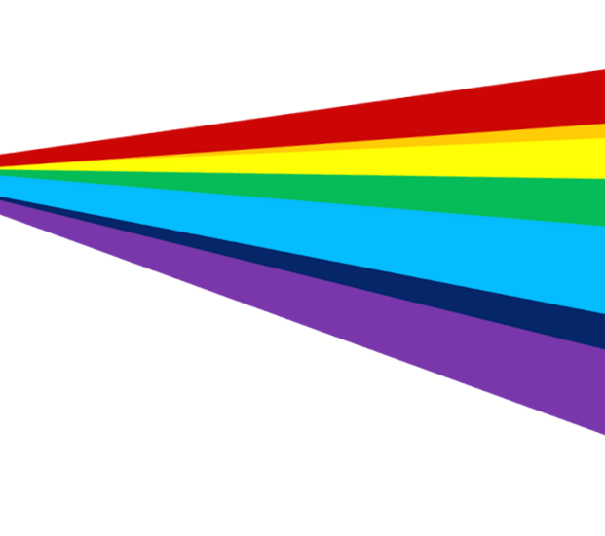
Under red
The Sun emits more than just light.
Infrared radiation is also given off by the Sun.
Infrared can be detected next to red light.
sunlight
Infrared radiation
Notes:
From key concept PSL7.1: students should be able to compare infrared radiation and light.
Common misunderstandings: light is not a form of EM radiation; and infrared radiation is visible.
Avoid saying: infrared radiation is heat (or heat energy).
Do say: infrared radiation can transfer energy and cause heating.
Student sheets and teacher notes for this activity contain printable and editable worksheets, together with teacher support materials.

Slide 10
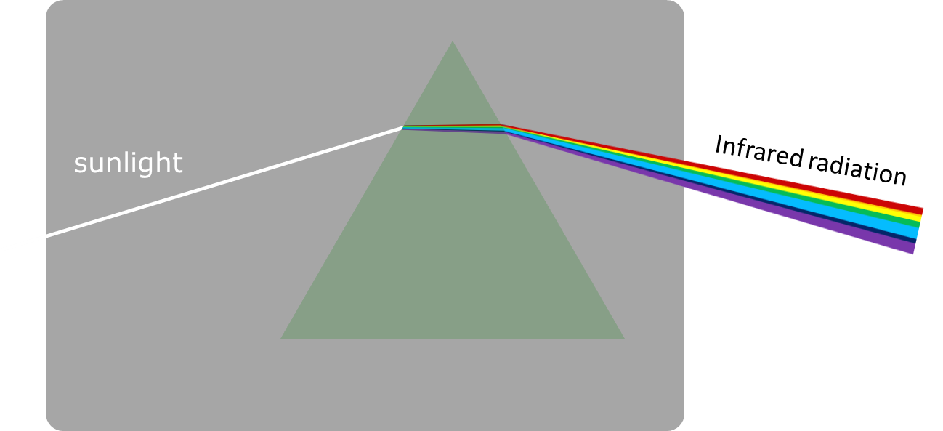
Under red
To do: fill in the gaps to compare infrared radiation and light.
You should only use the words infrared, light or infrared and light.
Infrared radiation and light
There are several types of electromagnetic
radiation that include __________________.
Blue light has a higher frequency than __________________.
We can see __________________ with our eyes.
The visible spectrum includes __________________.
The electromagnetic spectrum includes __________________.
Notes:
Answers are revealed by clicking on the mouse.

Slide 11
Under red
Home
Answers: compare infrared radiation and light.
Infrared radiation and light
There are several types of electromagnetic
radiation that include __________________.
Blue light has a higher frequency than __________________.
We can see __________________ with our eyes.
The visible spectrum includes __________________.
The electromagnetic spectrum includes __________________.
infrared and light
infrared and light
light
light
infrared and light
Notes:
Answers are revealed by clicking on the mouse.
More information can be found in the teacher notes for this activity.

Slide 12
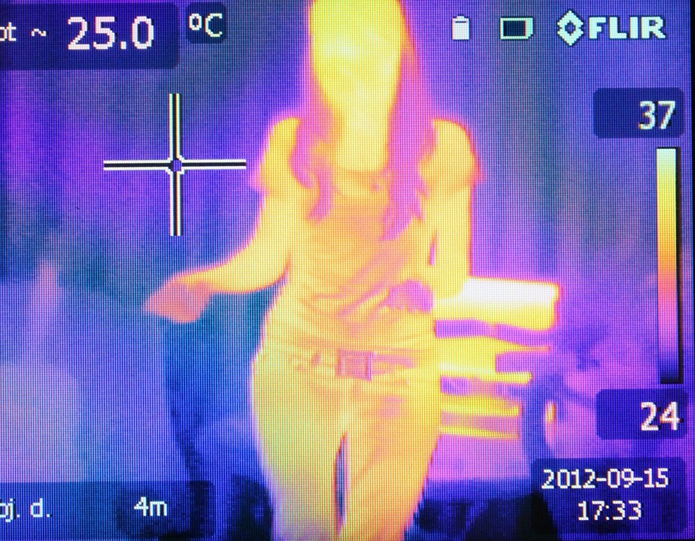
Detecting infrared
A thermal imaging camera can detect infrared radiation.
The camera shows infrared radiation as different colours so that we can ‘see’ it.
A thermal image showing the temperature of objects between 24 ºC and 37 ºC.
Notes:
From key concept PSL7.1: students should be able to compare infrared radiation and light.
Common misunderstandings: light is not a form of EM radiation; and infrared radiation is visible.
Avoid saying: infrared radiation is heat (or heat energy).
Do say: infrared radiation can transfer energy and cause heating.
Student sheets and teacher notes for this activity contain printable and editable worksheets, together with teacher support materials.
Image by byrev from Pixabay

Slide 13
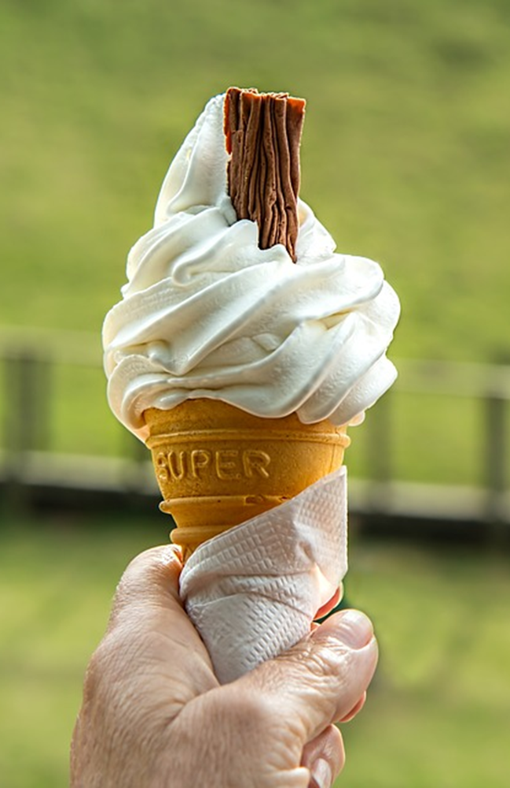
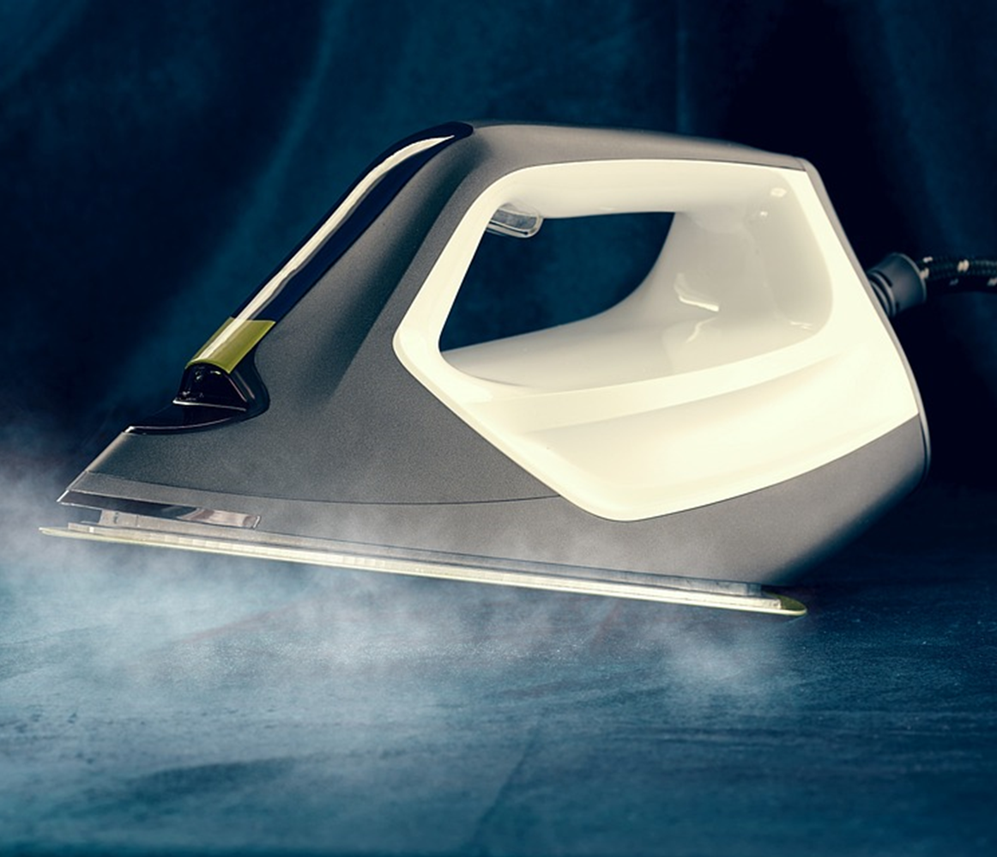
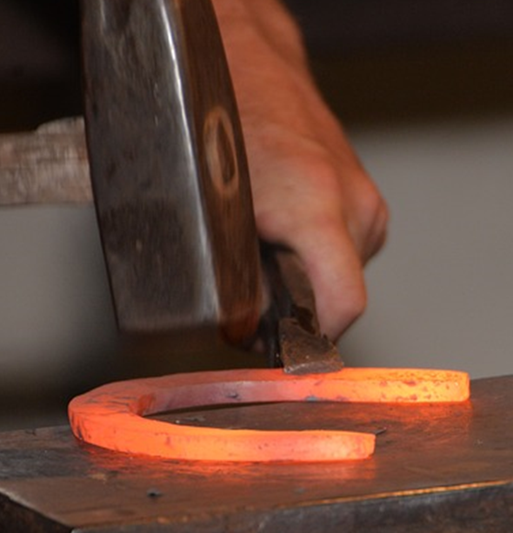
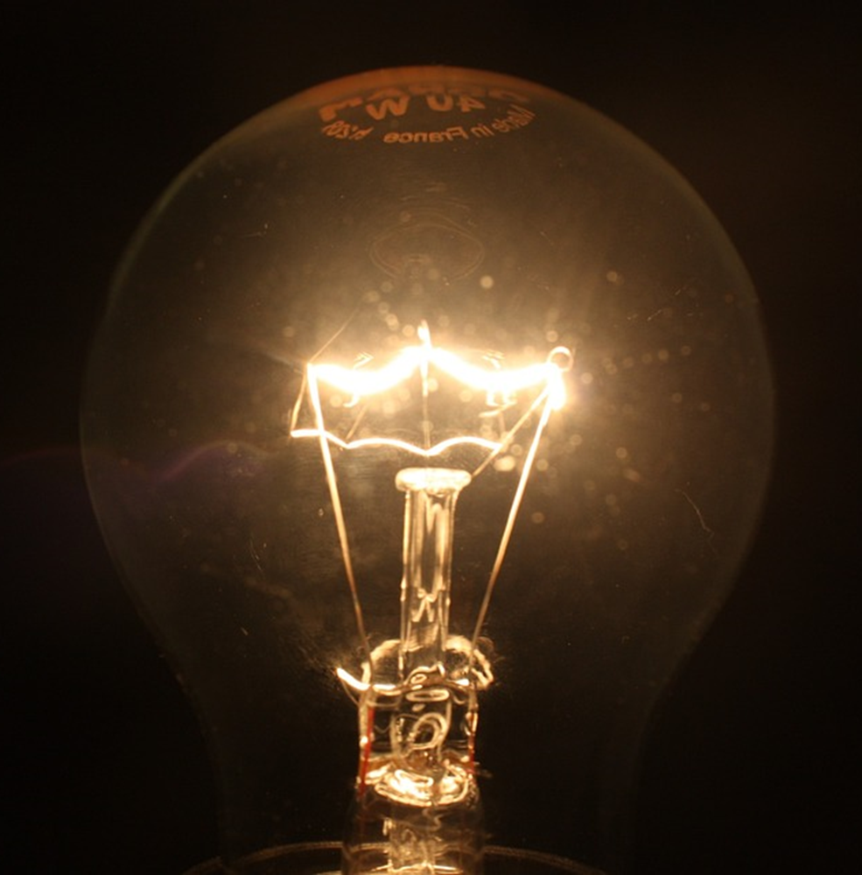
Detecting infrared
Home
Which of these objects are emitting infrared radiation?
Choose all the correct answers.
A
B
C
D
Ice cream
Electric iron
Horse shoe
Filament bulb
Notes:
Expected answer: All of them.
A breakdown of what each choice tells you about students’ understanding or misunderstanding can be found in the teacher notes for this activity.
Images by stevepb (icecream), ThomasWolter (electric iron), cyremille (horse shoe) and dengri (filament bulb) are all from Pixabay.

Slide 14
Beyond violet
The Sun emits more than just light and infrared radiation.
Ultraviolet radiation is also given off by the Sun.
Ultraviolet radiation can be detected next to violet light.
sunlight
Ultraviolet radiation
Notes:
From key concept PSL7.1: students should be able to compare ultraviolet radiation and light.
Common misunderstandings: light is not a form of EM radiation; the Sun is the only source of UV; UV radiation is visible; it is possible to see objects in the presence of UV alone; and UV is both invisible and a blue/violet colour.
Student sheets and teacher notes for this activity contain printable and editable worksheets, together with teacher support materials.

Slide 15
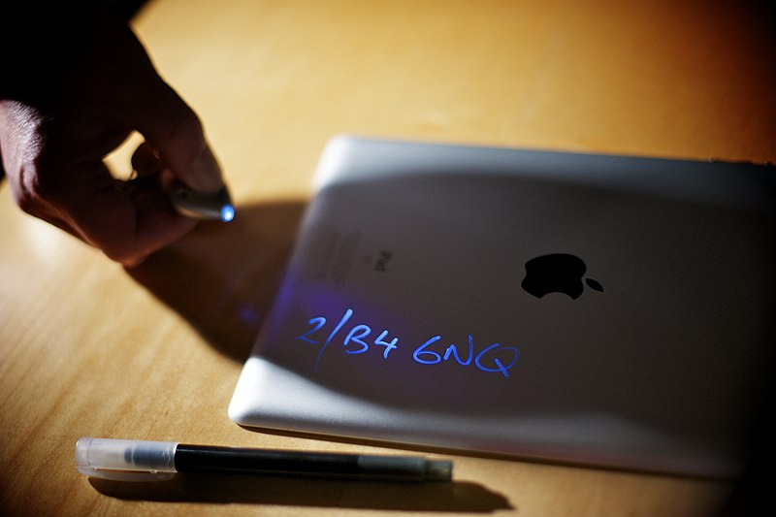
Beyond violet
An ultraviolet marker can add invisible identification marks to belongings.
Ultraviolet radiation makes them visible.
Ultraviolet marker with ultraviolet led lamp
Notes:
Student sheets and teacher notes for this activity contain printable and editable worksheets, together with teacher support materials.
Image by West Midlands Police from Wikimedia Commons

Slide 16
Beyond violet
Home
What makes the identification marks visible?
A
The ink reflects ultraviolet radiation.
B
The ink reflects ultraviolet light.
C
The ink uses energy from ultraviolet radiation to make light.
Notes:
Expected answer: C
A breakdown of what each choice tells you about students’ understanding or misunderstanding can be found in the teacher notes for this activity.

Slide 17
Beyond ‘beyond’
Infrared, visible light and ultraviolet are types of electromagnetic (EM) radiation.
The table provides information about each of these.
EM radiation | Approximate frequency | Speed in a vacuum (empty space)
Infrared | 0.3-400 THz | 3 x 10⁸ m/s
Visible light | Red, 400-480 THz | 3 x 10⁸ m/s
 | Violet, 670-790 THz | 3 x 10⁸ m/s
Ultraviolet | 790-30000 THz | 3 x 10⁸ m/s
1 THz = 1 terahertz
= 1 000 000 000 000 Hz
= 1 x 10¹² Hz
Notes:
From key concept PSL7.1: students should be able to explain why there is a spectrum of electromagnetic radiation.
Common misunderstandings: students tend not to be familiar with infrared, microwave and gamma as types of radiation.
Student sheets and teacher notes for this activity contain printable and editable worksheets, together with teacher support materials.

Slide 18
Beyond ‘beyond’
Home
What do you think about EM radiation?
I am sure this is right
I think this is right
I think this is wrong
I am sure this is wrong
What do you think about each statement?
A
There are more than 3 types of EM radiation.
B
All EM radiation travels at the same speed.
C
All EM radiation travels through glass.
Notes:
Expected answers: Statement A is right, and statements B and C are wrong.
A breakdown of what each choice tells you about students’ understanding or misunderstanding can be found in the teacher notes for this activity.

Slide 19
Section 2: Response activities
Response activities encourage students to talk and think about what they’re thinking (metacognition).
This challenges students’ misunderstandings, facilitates meaning-making, and develops and consolidates their scientific understanding.
A zip file containing all the resources for this key concept can be downloaded from
www.BestEvidenceScienceTeaching.org
The zip file provides:
Teacher guidance for this key concept, including a summary of the research evidence on relevant preconceptions and misunderstandings.
A full set of editable and printable student sheets and teacher notes for each response activity. The teacher notes include a summary of research evidence, guidance for using the activity and expected answers.

Slide 20
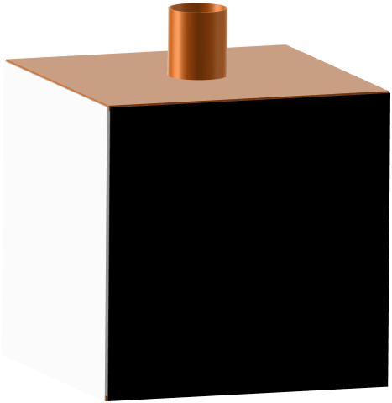
Emitting infrared
A hollow metal cube is filled with hot water from a kettle.
It has four different coloured surfaces.
It can be used to investigate what surface emits infrared radiation most quickly.
Matt black
Shiny silver
Matt white
Shiny black
Notes:
From key concept PSL7.1: students should be able to compare infrared radiation and light.
Common misunderstandings: light is not a form of EM radiation; and infrared radiation is visible.
Avoid saying: infrared radiation is heat (or heat energy).
Do say: infrared radiation can transfer energy and cause heating.
Student sheets and teacher notes for this activity contain printable and editable worksheets, together with teacher support materials.

Slide 21
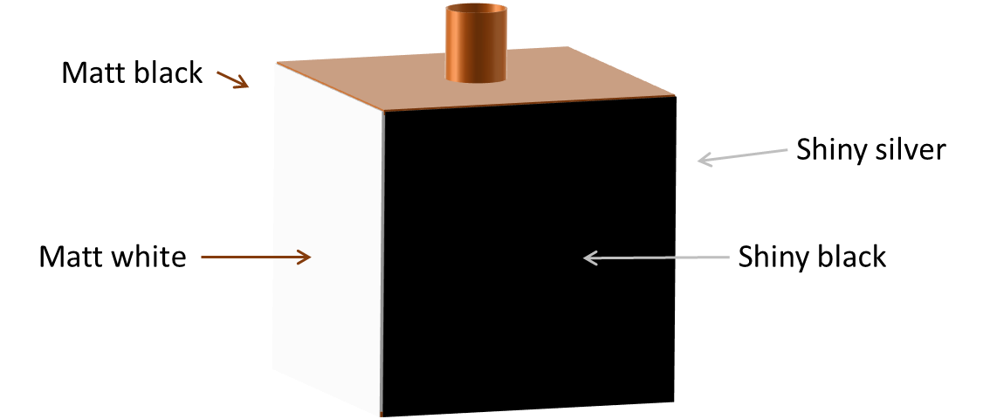
Emitting infrared
Light reflects most off the shiny silver surface.
Light is absorbed best by the matt black surface.
Predict
Which colour surface do you think emits infrared radiation the most quickly?
Explain
Explain why you think this colour emits infrared most quickly?

Slide 22
Emitting infrared
Home
Observe which colour surface emits infrared radiation most quickly.
Observe
Record measurements of infrared radiation emitted from each colour surface.
Explain
Were your prediction and explanation correct?
Try to improve your first explanation to explain what happened more clearly.
Notes:
Expected answer: Infrared radiation is emitted most quickly by the matt black surface, followed by shiny black, matt white and then shiny silver.
A more detailed answer, with an explanation can be found in the teacher notes for this activity.

Slide 23
Ultraviolet lamp
Banknote, driving licences and bank cards have invisible security markings.
The markings can be seen using an ultraviolet lamp.
Notes:
From key concept PSL7.1: students should be able to compare ultraviolet radiation and light.
Common misunderstandings: light is not a form of EM radiation; the Sun is the only source of UV; UV radiation is visible; it is possible to see objects in the presence of UV alone; and UV is both invisible and a blue/violet colour.
Student sheets and teacher notes for this activity contain printable and editable worksheets, together with teacher support materials.
Image by Chetvorno from Wikipedia Commons

Slide 24
Ultraviolet lamp
Home
Some students are talking about looking at a banknote with the ultraviolet lamp.
Sidney: We see ultraviolet reflecting off the invisible markings.
Tegan: The UV ink glows in the ultraviolet.
Verity: We can’t see the ultraviolet.
Umar: The ultraviolet is a pinky-purple colour.
To answer:
Who is right about ultraviolet?
Explain your answer
Who is wrong about ultraviolet?
What would you say to help them understand?
Notes:
Expected answers: Tegan and Verity are right; and Sidney and Umar are wrong.
A more detailed answer, with a discussion of what the statements reveal about students’ understanding can be found in the teacher notes for this activity.

