Slide 1
Key concept PEM8.3: Transmitting electricity
Learning focus
Transmission lines dissipate less power when they transfer power with a higher transmission voltage and lower current. When current is lower there is a smaller drop in voltage along their length.
As students’ conceptual understanding progresses they can:
C o n c e p t u a l p r o g r e s s I o n
Describe the heating effect of current on a conducting wire.
Predict changes to current through transmission lines using P = I x V.
Calculate power dissipated by a wire using P = I² x R.
Explain the difference between transmission voltage and voltage drop along a wire.
Explain how the equation P = V²/R applies to transmission lines.
P
B
Diagnostic questions
Hot line
Transmission current
Power dissipation
The right voltage
The right power
Response activities
Transmission lines
Talking volts
P
Prior understanding from earlier stages of learning.
Run the slide show to activate the clickable boxes.
Useful information can be found in the slide notes.
B
Bridge to later stages of learning.
Notes:
The boxes containing the titles of the diagnostic questions and response activities are clickable links that will take you to the starting slide for each activity in this presentation.
In edit mode, hold down the Ctrl key and left-click the box.
In slide show mode, simply left-click the box.
Click the ‘Home’ button at the top right of the final slide of each activity to return here.

Slide 2
Section 1: Diagnostic questions
Use diagnostic questions to identify quickly where your students are in their conceptual progression, and what preconceptions and misunderstandings they may have.
Then decide how to best focus and sequence your teaching.
Use further diagnostic questions and response activities to move students’ understanding forwards.
A zip file containing all the resources for this key concept can be downloaded from
www.BestEvidenceScienceTeaching.org
The zip file provides:
Teacher guidance for this key concept, including a summary of the research evidence on relevant preconceptions and misunderstandings.
A full set of editable and printable student sheets and teacher notes for each diagnostic question. The teacher notes include a summary of research evidence, guidance for using the activity, expected answers and suggestions of how to respond to students’ misunderstandings.

Slide 3
Hot line
A big current flows through power lines.
The bigger the current, the hotter the wires.
When the wires are hotter, they dissipate more power.
Notes:
From key concept PEM8.3: students should be able to describe the heating effect of current on a conducting wire.
Common misunderstandings: all the electrons in a current flow from the battery (or generator).
Avoid saying: electrons flow from the generator.
Do say: outer electrons move very quickly in all directions – and overall move slowly in the direction of current (in this case an alternating current).
Student sheets and teacher notes for this activity contain printable and editable worksheets, together with teacher support materials.
Image from Shutterstock

Slide 4
Hot line
Home
Why does a bigger current heat up the power lines?
I am sure this is right
I think this is right
I think this is wrong
I am sure this is wrong
What do you think about each statement?
A
Electrons are causing metal ions to vibrate faster.
B
Electrons are moving along the wire more quickly.
C
More electrons are moving through the wire.
Notes:
Expected answers: Statements A and B are right; and statement C is wrong.
A breakdown of what each choice tells you about students’ understanding or misunderstanding can be found in the teacher notes for this activity.

Slide 5
Transmission current
A wind turbine has a power of 2 MW (2 000 000 W).
The voltage across it is 1000 V.
Power lines connect the wind turbine to the national grid.
A step-up transformer makes the transmission voltage 275 000 V
Notes:
From key concept PEM8.3: students should be able to predict changes to current through transmission lines using P = I x V.
Common misunderstandings: the bigger the transmission voltage, the bigger the transmission current; and the voltage drop across the length of a transmission line is the same as the transmission voltage.
Avoid saying: voltage or potential difference
Do say: transmission voltage
Student sheets and teacher notes for this activity contain printable and editable worksheets, together with teacher support materials.
Image by PublicDomainPictures from Pixabay

Slide 6
Transmission current
Home
What happens to current when transmission voltage is increased?
A
Current decreases.
B
Current stays the same.
C
Current increases.
Notes:
Expected answer: A
A breakdown of what each choice tells you about students’ understanding or misunderstanding can be found in the teacher notes for this activity.

Slide 7
Power dissipation
The power an electrical device has is calculated using P = I x V.
The resistance of the device is calculated using R = .
V
I
Rearranging the resistance equation:
Substituting this into the power equation:
Which gives:
V = I x R
P = I x (I x R)
P = I² x R
V is the voltage across the device.
I is the current through the device.
R is the resistance of the device.
P is the power of the device.
Notes:
From key concept PEM8.3: students should be able to calculate power dissipated by a wire using P = I² x R.
Common misunderstandings: the voltage drop across the length of a transmission line is the same as the transmission voltage.
Avoid saying: electrical energy or electrical power.
Do say: energy and power.
Student sheets and teacher notes for this activity contain printable and editable worksheets, together with teacher support materials.

Slide 8
Power dissipation
A transmission line has a resistance and is heated by current.
It is warmer than its surroundings and dissipates power.
1. What happens to the amount of power dissipated if the current through a transmission line is tripled?
2
P = I x R
A
Three times more power is dissipated.
B
Six times more power is dissipated.
C
Nine times more power is dissipated.
Notes:
Expected answer: C
A breakdown of what each choice tells you about students’ understanding or misunderstanding can be found in the teacher notes for this activity.
Image from Shutterstock.

Slide 9
Power dissipation
Home
2. What happens to the amount of power dissipated if the current through a transmission line is halved?
P = I x R
2
A
Four times more power is dissipated.
B
The same amount of power is dissipated.
C
Four times less power is dissipated.
Notes:
Expected answer: C
A breakdown of what each choice tells you about students’ understanding or misunderstanding can be found in the teacher notes for this activity.

Slide 10
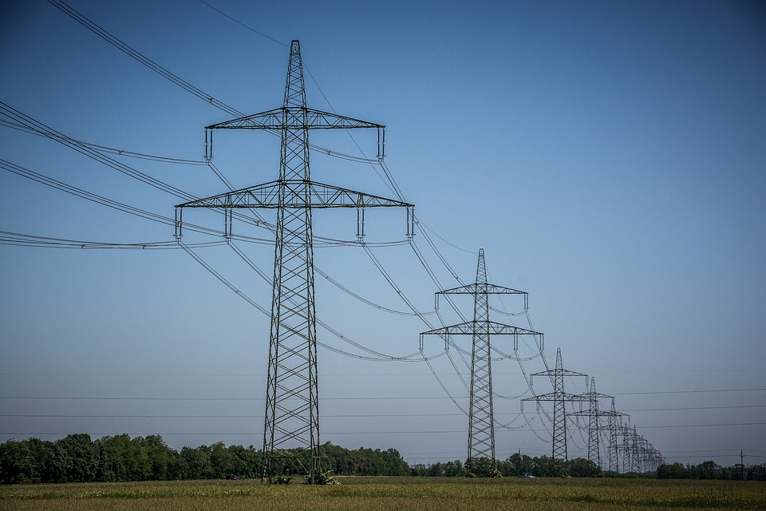
The right voltage
The transmission voltage at the start of these power lines is 400 kV.
(400 kV = 400 000 V)
Notes:
From key concept PEM8.3: students should be able to explain the difference between transmission voltage and voltage drop along a wire.
Common misunderstandings: the voltage drop across the length of a transmission line is the same as the transmission voltage.
Student sheets and teacher notes for this activity contain printable and editable worksheets, together with teacher support materials.
Image by Silberfuchs from Pixabay.

Slide 11
The right voltage
Home
What is the transmission voltage at the end of the transmission lines?
?
Step-down
transformer
400 kV
Step-up transformer
A
Exactly 400 kV.
B
A little less than 400 kV.
C
About 200 kV.
D
Exactly 0 kV.
Notes:
Expected answer: B
A breakdown of what each choice tells you about students’ understanding or misunderstanding can be found in the teacher notes for this activity.

Slide 12
The right power
The power an electrical device has is calculated using P = I x V.
The resistance of the device is calculated using R = .
V
I
V
Rearranging the resistance equation:
Substituting this into the power equation:
Which gives:
I =
P = x V
P =
R
V
R
V²
R
Notes:
From key concept PEM8.3: students should be able to explain how the equation P = V²/R applies to transmission lines.
Common misunderstandings: the voltage drop across the length of a transmission line is the same as the transmission voltage.
Student sheets and teacher notes for this activity contain printable and editable worksheets, together with teacher support materials.

Slide 13
The right power
Home
V²
How do the variables in P = relate to a transmission line?
R
Step-down
transformer
400 kV
Step-up transformer
I am sure this is right
I think this is right
I think this is wrong
I am sure this is wrong
What do you think about each statement?
A
P = power transferred along a wire.
B
V = voltage drop across the length of a wire.
C
R = resistance of the whole length of a wire.
Notes:
Expected answers: Statements B and C are right; and statement A is wrong.
A breakdown of what each choice tells you about students’ understanding or misunderstanding can be found in the teacher notes for this activity.

Slide 14
Section 2: Response activities
Response activities encourage students to talk and think about what they’re thinking (metacognition).
This challenges students’ misunderstandings, facilitates meaning-making, and develops and consolidates their scientific understanding.
A zip file containing all the resources for this key concept can be downloaded from
www.BestEvidenceScienceTeaching.org
The zip file provides:
Teacher guidance for this key concept, including a summary of the research evidence on relevant preconceptions and misunderstandings.
A full set of editable and printable student sheets and teacher notes for each response activity. The teacher notes include a summary of research evidence, guidance for using the activity and expected answers.

Slide 15
Transmission lines
In this model, transformers make the transmission voltage high and the current low.
50
turns
600
turns
600
turns
50
turns
Step-up transformer
Step-down transformer
The model is safe because:
It uses a low voltage a.c. supply of no more than 2 V
The voltage in the transmission lines is no more than about 28 V
The step-down transformer is connected the right way round.
Notes:
From key concept PEM8.3: students should be able to predict changes to current through transmission lines using P = I x V; and to calculate power dissipated by a wire using P = I² x R.
Common misunderstandings: the bigger the transmission voltage, the bigger the transmission current; and the voltage drop across the length of a transmission line is the same as the transmission voltage.
Avoid saying: voltage; and electrical energy or electrical power.
Do say: transmission voltage; and energy or power
Student sheets and teacher notes for this activity contain printable and editable worksheets, together with teacher support materials.

Slide 16
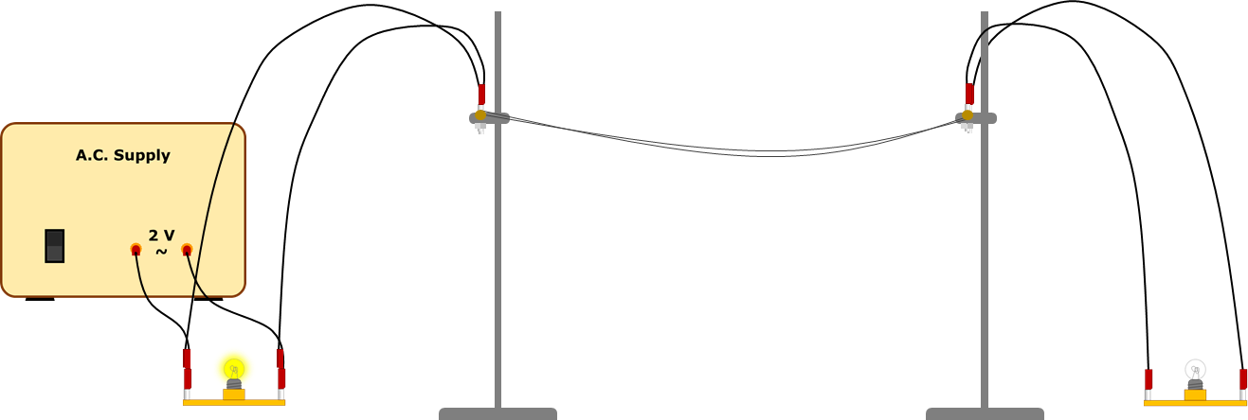
Transmission lines
Predict
How bright the second bulb will be:
with the transformers
without the transformers.
Explain
In each case, why do you think the bulb will be this bright?

Slide 17
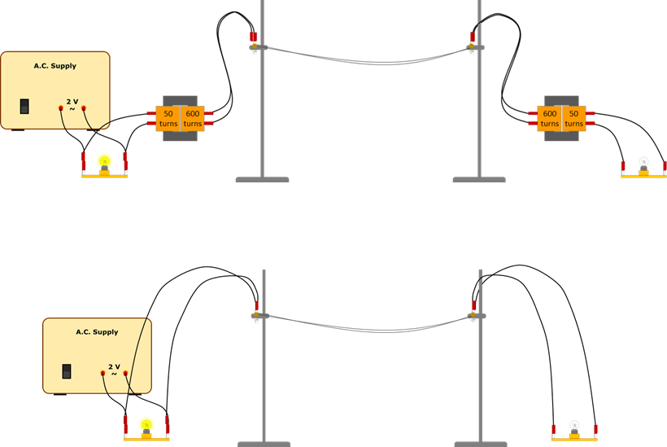
Transmission lines
Home
Watch a demonstration of the transmission lines.
Observe
How bright is the second bulb:
with the transformers?
without the transformers?
Explain
Were your prediction and explanation correct?
Try to improve your first explanation to explain what happened more clearly.
Notes:
Expected answer: with the transformers the second bulb is bright, and without the transformers it is very dim (or unlit).
A more detailed answer, with an explanation can be found in the teacher notes for this activity.

Slide 18
Talking volts
Two different voltage measurements relate to transmission lines:
transmission voltage
voltage drop along the length of a transmission line.
390 kV
Step-down
transformer
400 kV
Step-up transformer
1 kA through each line
(1 kA = 1000 A)
Notes:
From key concept PEM8.3: students should be able to explain the difference between transmission voltage and voltage drop along a wire; and explain how the equation P = V²/R applies to transmission lines.
Common misunderstandings: the voltage drop across the length of a transmission line is the same as the transmission voltage.
Student sheets and teacher notes for this activity contain printable and editable worksheets, together with teacher support materials.

Slide 19
Talking volts
Some students are talking about calculations they can make for the transmission lines using different voltage measurements.
Keeley: The power dissipated is about 1000 A x 10 000 V.
Jasper: The power transmitted is about 400 000 x 1000.
Leon: The resistance of a transmission line can be calculated using R = P/I².
Mya: Resistance of a transmission line is about 0.1 Ω.

Slide 20
Mains power
Home
Some students are talking about calculations they can make for the transmission lines using different voltage measurements.
Jasper: The power transmitted is about 400 000 x 1000.
Keeley: The power dissipated is about 1000 A x 10 000 V.
Leon: The resistance of a transmission line can be calculated using R = P/I².
Mya: Resistance of a transmission line is about 0.1 Ω.
To answer:
Who is right about the calculations?
Explain your answer
Who is wrong about the calculations?
What would you say to help them understand?
Notes:
Expected answers: All the students are right
A more detailed answer, with a discussion of what the statements reveal about students’ understanding can be found in the teacher notes for this activity.

