Slide 1
Key concept PEM8.2: Paying for electricity
Learning focus
The amount of energy that an electrical appliance transfers is proportional to time; and its power is proportional to the potential difference across it and the current through it.
As students’ conceptual understanding progresses they can:
C o n c e p t u a l p r o g r e s s I o n
Describe the difference between energy transferred and power.
Describe how the power of an electric circuit depends on current through it.
Explain why the power of a component depends on the potential difference across it.
Explain the relationships I = Q/t and V = E/Q.
Calculate energy transferred by electrical appliances using P = E/t.
P
P
Diagnostic questions
Calculating energy
Power and current
Power and p.d.
Defining current
Mystery circuit
Defining p.d.
Response activities
Rope power
Dotty rope
Mains power
P
Prior understanding from earlier stages of learning.
Run the slide show to activate the clickable boxes.
Useful information can be found in the slide notes.
B
Bridge to later stages of learning.
Notes:
The boxes containing the titles of the diagnostic questions and response activities are clickable links that will take you to the starting slide for each activity in this presentation.
In edit mode, hold down the Ctrl key and left-click the box.
In slide show mode, simply left-click the box.
Click the ‘Home’ button at the top right of the final slide of each activity to return here.

Slide 2
Section 1: Diagnostic questions
Use diagnostic questions to identify quickly where your students are in their conceptual progression, and what preconceptions and misunderstandings they may have.
Then decide how to best focus and sequence your teaching.
Use further diagnostic questions and response activities to move students’ understanding forwards.
A zip file containing all the resources for this key concept can be downloaded from
www.BestEvidenceScienceTeaching.org
The zip file provides:
Teacher guidance for this key concept, including a summary of the research evidence on relevant preconceptions and misunderstandings.
A full set of editable and printable student sheets and teacher notes for each diagnostic question. The teacher notes include a summary of research evidence, guidance for using the activity, expected answers and suggestions of how to respond to students’ misunderstandings.

Slide 3
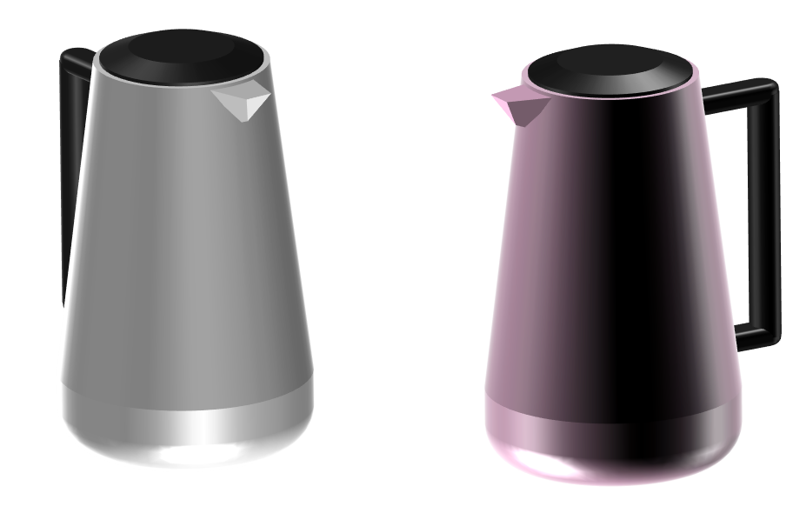
Calculating energy
Kettle 1 and kettle 2 are identical.
They both have the same power rating.
Kettle 1
(2000 W)
Kettle 1
(2000 W)
Notes:
From key concept PEM8.2: students should be able to describe the difference between energy transferred and power.
Common misunderstandings: most students do not discriminate sufficiently between current, voltage, energy and power.
Avoid saying: electrical energy or thermal energy; the kettle uses (up) energy, or the kettle uses (up) power.
Do say: energy; the kettle transfers energy; and the kettle has power.
Student sheets and teacher notes for this activity contain printable and editable worksheets, together with teacher support materials.

Slide 4
Calculating energy
1. Kettle 1 is filled with two times the amount of water as kettle 2.
How long do the kettles take to boil?
Kettle 1
Kettle 2
A
Kettle 2 takes two times as long to boil.
B
They both take the same time to boil.
C
Kettle 1 takes a little bit longer to boil.
D
Kettle 1 takes two times as long to boil.
Notes:
Expected answer: D
A breakdown of what each choice tells you about students’ understanding or misunderstanding can be found in the teacher notes for this activity.

Slide 5
Calculating energy
Home
2. Which two equations are correct?
Kettle 1
Kettle 2
A
Power = Energy x time (P = E x t).
B
Power = Energy / time (P = E / t).
C
Energy = Power x time (E = P x t).
D
Energy = Power / time (E = P / t)
Notes:
Expected answers: B and C
A breakdown of what each choice tells you about students’ understanding or misunderstanding can be found in the teacher notes for this activity.

Slide 6
Power and current
An electric circuit is a device for doing work of some kind.
In this circuit a bulb is transferring energy to the surroundings.
The rate of energy transfer is the power of the circuit.
The unit of power is a watt (W).
One watt is equal to one joule per second.
Notes:
From key concept PEM8.2: students should be able to describe how the power of an electric circuit depends on current through it.
Common misunderstandings: most students do not discriminate sufficiently between current, voltage, energy and power; the amount of current provided by a battery is always the same no matter what circuit it is connected to; and a circuit can be analysed sequentially moving around a circuit in one direction, so changes to components ‘further around a circuit’ do not affect earlier parts of the circuit.
Avoid saying: electrical energy or light energy; the bulb uses (up) energy, or the bulb uses (up) power.
Do say: energy; the bulb transfers energy; and the bulb has power.
Student sheets and teacher notes for this activity contain printable and editable worksheets, together with teacher support materials.

Slide 7
Power and current
a. Which electric circuit has the most power?
A
B
C
D
All the same
All bulbs in the circuits are identical.
Notes:
Expected answer: C
A breakdown of what each choice tells you about students’ understanding or misunderstanding can be found in the teacher notes for this activity.

Slide 8
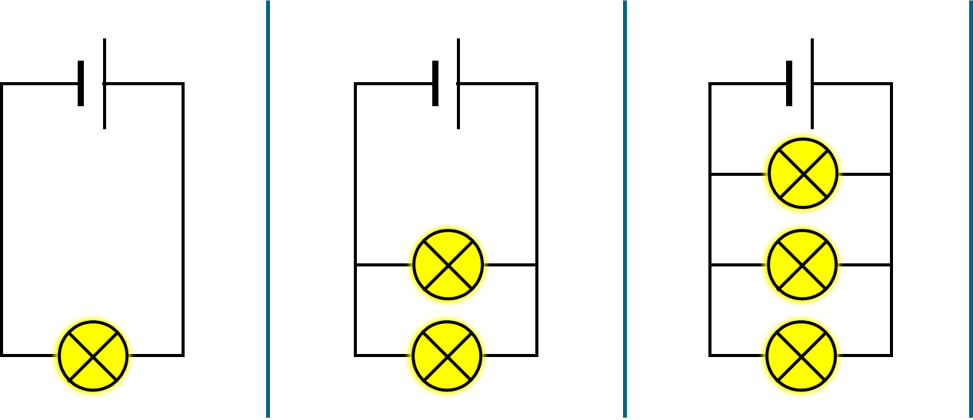
Power and current
Home
b. What is the best reason for your answer to part a?
All the same
A
Current from the battery is the same in all the circuits.
B
Current from the battery is biggest in this circuit.
C
Current through each bulb is the same in all the circuits.
D
Current through each bulb is biggest in this circuit.
Notes:
Expected answer: B
A breakdown of what each choice tells you about students’ understanding or misunderstanding can be found in the teacher notes for this activity.

Slide 9
Power and p.d.
Each circuit contains the same type of bulb, but each one is different.
The bulbs are chosen so that the current in each circuit is the same.
Bulb 1
Bulb 2
Bulb 3
The current in each circuit is the same.
Notes:
From key concept PEM8.2: students should be able to explain why the power of a component depends on the potential difference across it.
Common misunderstandings: most students do not discriminate sufficiently between current, voltage, energy and power; the amount of current provided by a battery is always the same no matter what circuit it is connected to; a bulb or appliance gets the energy ‘it demands’ regardless of the potential difference of the source; and a circuit can be analysed sequentially moving around a circuit in one direction, so changes to components ‘further around a circuit’ do not affect earlier parts of the circuit.
Avoid saying: electrical energy or light energy; the bulb uses (up) energy, or the bulb uses (up) power.
Do say: energy; the bulb transfers energy; and the bulb has power.
Student sheets and teacher notes for this activity contain printable and editable worksheets, together with teacher support materials.

Slide 10
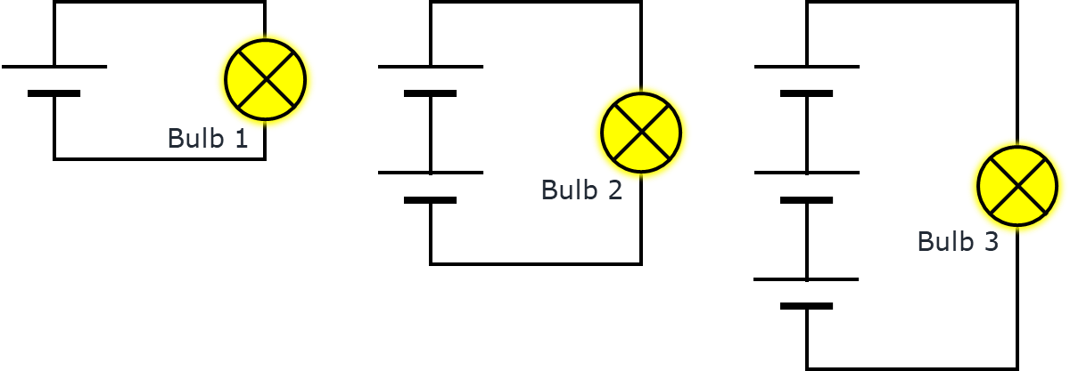
Power and p.d.
Home
The statements are about the three different bulbs.
The current in each circuit is the same
I am sure this is right
I think this is right
I think this is wrong
I am sure this is wrong
What do you think about each statement?
A
The brightness of each bulb is the same.
B
The p.d. across each bulb is the same.
C
The p.d. is biggest across bulb 3.
Notes:
Expected answers: Statement C is right; and statements A and B are wrong.
A breakdown of what each choice tells you about students’ understanding or misunderstanding can be found in the teacher notes for this activity.

Slide 11
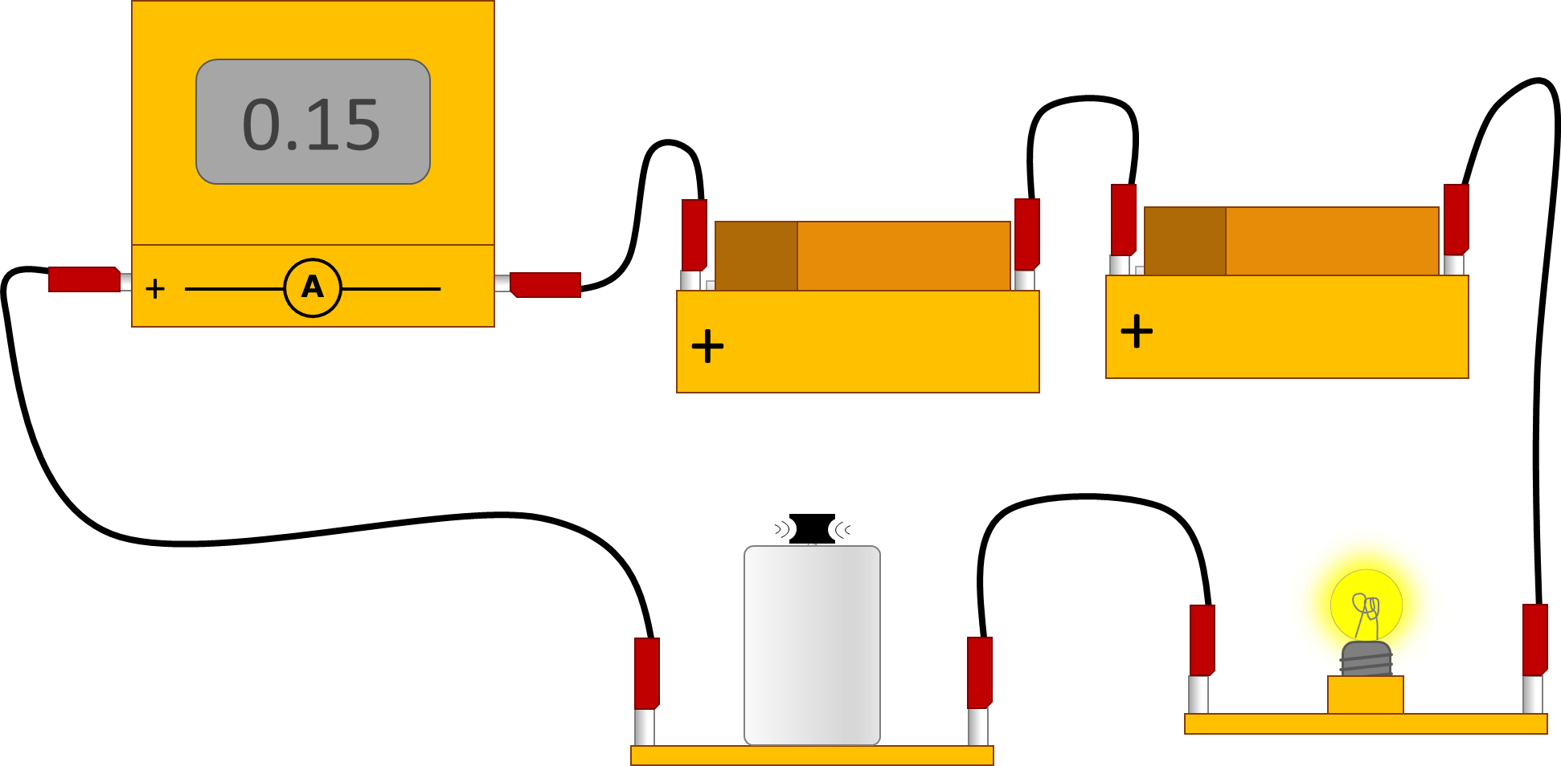
Defining current
Electric current is measured with an ammeter.
It is measured in amps (A).
An electric current flows through a complete circuit.
Notes:
From key concept PEM8.2: students should be able to explain the relationships I = Q/t and V = E/Q.
Common misunderstandings: most students do not discriminate sufficiently between current, voltage, energy and power; and an understanding of the microscopic model of current is not needed in order to use electricity equations correctly in novel situations (and that relying on the recall of equations is sufficient).
Avoid saying: current from the battery.
Do say: current through the circuit.
Student sheets and teacher notes for this activity contain printable and editable worksheets, together with teacher support materials.

Slide 12
Defining current
Home
Each statement is a definition of electric current.
I am sure this is right
I think this is right
I think this is wrong
I am sure this is wrong
What do you think about each statement?
A
The amount of energy transferred in 1 s.
B
current = charge x time (I = Q x t)
C
The rate at which charge flows in a circuit.
Notes:
Expected answers: Statement C is right; and statements A and B are wrong.
A breakdown of what each choice tells you about students’ understanding or misunderstanding can be found in the teacher notes for this activity.

Slide 13
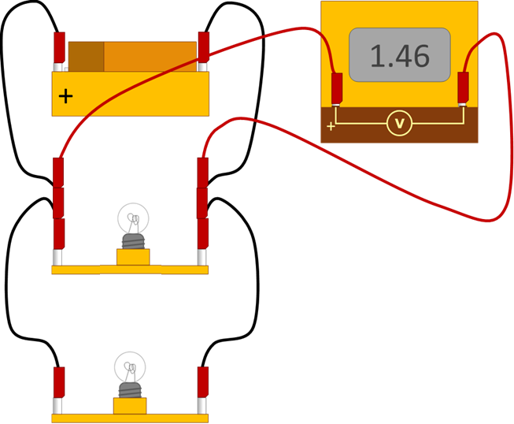
Defining p.d.
Potential difference (p.d.) is measured with a voltmeter.
It is measured in volts (V).
In this circuit the potential difference is being measured across a bulb.
Notes:
From key concept PEM8.2: students should be able to explain the relationships I = Q/t and V = E/Q.
Common misunderstandings: most students do not discriminate sufficiently between current, voltage, energy and power; and an understanding of the microscopic model of current is not needed in order to use electricity equations correctly in novel situations (and that relying on the recall of equations is sufficient).
Avoid saying: potential difference of a component.
Do say: potential difference across a component.
Student sheets and teacher notes for this activity contain printable and editable worksheets, together with teacher support materials.

Slide 14
Defining p.d.
Home
What happens when the potential difference across a bulb is bigger?
Bulb 1
p.d. = 230 V
current = 0.2 A
(A household bulb)
Bulb 2
p.d. = 3 V
current = 0.2 A
(A torch bulb)
The current through each bulb is the same
I am sure this is right
I think this is right
I think this is wrong
I am sure this is wrong
What do you think about each statement?
A
The force pushing charge through bulb 1 is bigger.
B
Bulb 1 is transferring energy faster than bulb 2.
C
More charge passes through bulb 1 each second.
D
p.d.= energy transferred ÷ charge (V = E/Q)
Notes:
Expected answers: Statements A, B and D are right; and statement C is wrong.
A breakdown of what each choice tells you about students’ understanding or misunderstanding can be found in the teacher notes for this activity.

Slide 15
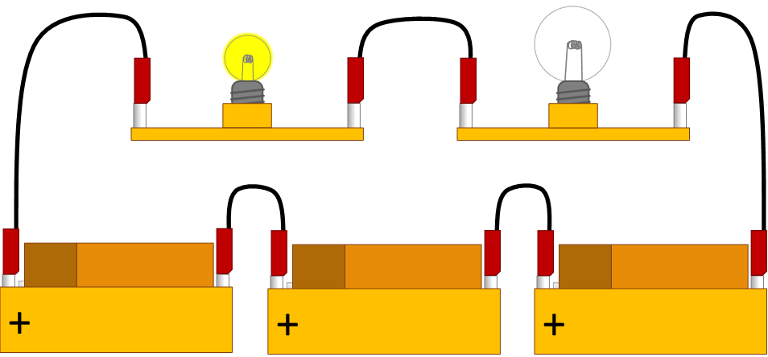
Mystery circuit
Two different bulbs (of the same type) are connected in a circuit.
One bulb lights up and the other does not.
Notes:
From key concept PEM8.2: students should be able to explain why power of a component can be calculated using P = I x V.
Common misunderstandings: current is used up by a component; and an understanding of the microscopic model of current is not needed in order to use electricity equations correctly in novel situations (and that relying on the recall of equations is sufficient).
Avoid saying: current from the battery or to a bulb; and potential difference of a component.
Do say: current through the battery or bulb; and potential difference across a component.
Student sheets and teacher notes for this activity contain printable and editable worksheets, together with teacher support materials.

Slide 16
Mystery circuit
Home
Why does bulb 1 light up, but not bulb 2?
Bulb 1
Bulb 2
I am sure this is right
I think this is right
I think this is wrong
I am sure this is wrong
What do you think about each statement?
A
Bulb 2 is broken.
B
Bulb 2 has a much lower resistance.
C
There is more current through bulb 1.
D
The p.d. across bulb 1 is bigger.
Notes:
Expected answers: Statements B and D are right; and statements A and C are wrong.
A breakdown of what each choice tells you about students’ understanding or misunderstanding can be found in the teacher notes for this activity.

Slide 17
Section 2: Response activities
Response activities encourage students to talk and think about what they’re thinking (metacognition).
This challenges students’ misunderstandings, facilitates meaning-making, and develops and consolidates their scientific understanding.
A zip file containing all the resources for this key concept can be downloaded from
www.BestEvidenceScienceTeaching.org
The zip file provides:
Teacher guidance for this key concept, including a summary of the research evidence on relevant preconceptions and misunderstandings.
A full set of editable and printable student sheets and teacher notes for each response activity. The teacher notes include a summary of research evidence, guidance for using the activity and expected answers.

Slide 18
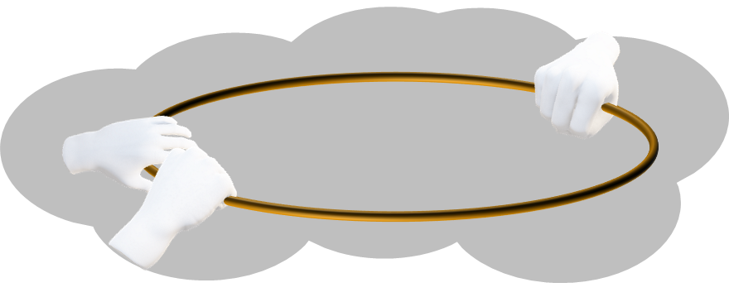
Rope power
Home
A group of students want to model the power of an electric circuit.
They use a loop of rope.
‘bulb’
‘battery’
‘electric charge’
How could they use the model to show how energy is transferred by an electric circuit?
How could they use the model to show the effect of increasing current on the power of a circuit?
How could they use the model to show the effect of increasing p.d. on the power of a circuit?
Notes:
From key concept PEM8.2: students should be able to describe how the power of an electric circuit depends on current through it and explain why the power of a component depends on the potential difference across it.
Common misunderstandings: most students do not discriminate sufficiently between current, voltage, energy and power; the amount of current provided by a battery is always the same no matter what circuit it is connected to; a bulb or appliance gets the energy ‘it demands’ regardless of the potential difference of the source; and a circuit can be analysed sequentially moving around a circuit in one direction, so changes to components ‘further around a circuit’ do not affect earlier parts of the circuit.
Avoid saying: electrical energy or light energy; the bulb uses (up) energy, or the bulb uses (up) power.
Do say: energy; the bulb transfers energy; and the bulb has power.
Student sheets and teacher notes for this activity contain printable and editable worksheets, together with teacher support materials.

Slide 19
Dotty rope
Home
A group of students mark a loop of rope with dots.
The dots represent equal amounts of electric charge.
‘bulb’
‘battery’
‘electric charge’
How could they use the model to demonstrate I = Q/t?
How could they use the model to demonstrate V = E/Q?
Notes:
From key concept PEM8.2: students should be able to explain the relationships I = Q/t and V = E/Q.
Common misunderstandings: most students do not discriminate sufficiently between current, voltage, energy and power; and an understanding of the microscopic model of current is not needed in order to use electricity equations correctly in novel situations (and that relying on the recall of equations is sufficient).
Avoid saying: current from the battery or potential difference of a component.
Do say: current through the circuit and potential difference across a component .
Student sheets and teacher notes for this activity contain printable and editable worksheets, together with teacher support materials.

Slide 20
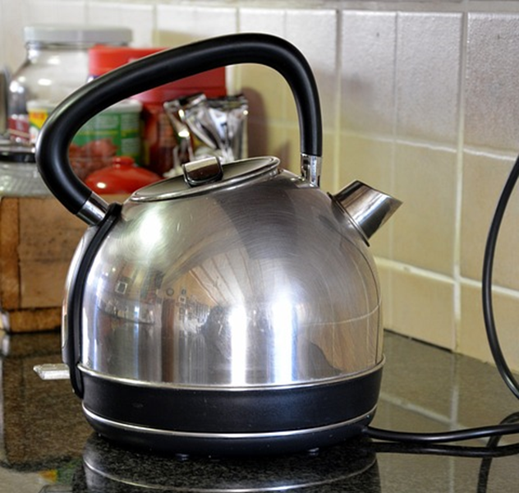
Mains power
A kettle and a lamp are plugged into the same mains circuit.
Main fuse
230 V (AC)
Power = 2000 W
Power = 10 W
Notes:
From key concept PEM8.2: students should be able to explain why power of a component can be calculated using P = I x V.
Common misunderstandings: current is used up by a component; and an understanding of the microscopic model of current is not needed in order to use electricity equations correctly in novel situations (and that relying on the recall of equations is sufficient).
Avoid saying: current from the mains or to the kettle; and potential difference of the kettle.
Do say: current through the kettle; and potential difference across the kettle.
Student sheets and teacher notes for this activity contain printable and editable worksheets, together with teacher support materials.
Images: kettle by Agnali from Pixabay; lamp by OpenClipart-Vectors from Pixabay.

Slide 21
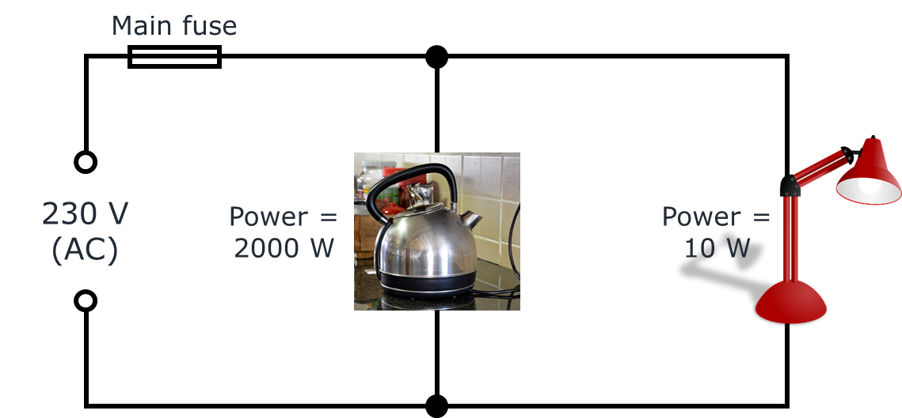
Mains power
Some students are talking about why the kettle has more power than the lamp.
Finn: Each coulomb of charge transfers more energy to the kettle than the lamp.
George: A bigger current flows through the kettle than the lamp.
Isla: Charge is pushed through the kettle with a bigger force.
Halima: The kettle has more power because it has a bigger resistance.

Slide 22
Mains power
Home
Some students are talking about why the kettle has more power than the lamp.
Finn: Each coulomb of charge transfers more energy to the kettle than the lamp.
George: A bigger current flows through the kettle than the lamp.
Halima: The kettle has more power because it has a bigger resistance.
Isla: Charge is pushed through the kettle with a bigger force.
To answer:
Who is right about why the kettle has more power?
Explain your answer
Who is wrong about why the kettle has more power?
What would you say to help them understand?
Notes:
Expected answers: George is correct; and Finn, Halima and Isla are wrong.
A more detailed answer, with a discussion of what the statements reveal about students’ understanding can be found in the teacher notes for this activity.

