Slide 1
Key concept PEM8.1: Electrical safety
Learning focus
Fuses, circuit breakers and earth connections, used correctly, can prevent excess mains current and electric shocks.
As students’ conceptual understanding progresses they can:
C o n c e p t u a l p r o g r e s s I o n
Describe the effects of an electric shock on a person.
Explain why there are no standard mains sockets in a bathroom.
Explain how electric circuits are wired in a home, with circuit breakers for safety.
Explain the effects of a short circuit in an appliance or in a mains circuit.
Explain how earth wires can protect people from electric shock.
Diagnostic questions
Shocking!
Resisting a shock
Consumer unit
Short circuit
Metal case
Mains circuits
Response activities
Shocking calculations
A working fuse
Earthing
P
Prior understanding from earlier stages of learning.
Run the slide show to activate the clickable boxes.
Useful information can be found in the slide notes.
B
Bridge to later stages of learning.
Notes:
The boxes containing the titles of the diagnostic questions and response activities are clickable links that will take you to the starting slide for each activity in this presentation.
In edit mode, hold down the Ctrl key and left-click the box.
In slide show mode, simply left-click the box.
Click the ‘Home’ button at the top right of the final slide of each activity to return here.

Slide 2
Section 1: Diagnostic questions
Use diagnostic questions to identify quickly where your students are in their conceptual progression, and what preconceptions and misunderstandings they may have.
Then decide how to best focus and sequence your teaching.
Use further diagnostic questions and response activities to move students’ understanding forwards.
A zip file containing all the resources for this key concept can be downloaded from
www.BestEvidenceScienceTeaching.org
The zip file provides:
Teacher guidance for this key concept, including a summary of the research evidence on relevant preconceptions and misunderstandings.
A full set of editable and printable student sheets and teacher notes for each diagnostic question. The teacher notes include a summary of research evidence, guidance for using the activity, expected answers and suggestions of how to respond to students’ misunderstandings.

Slide 3
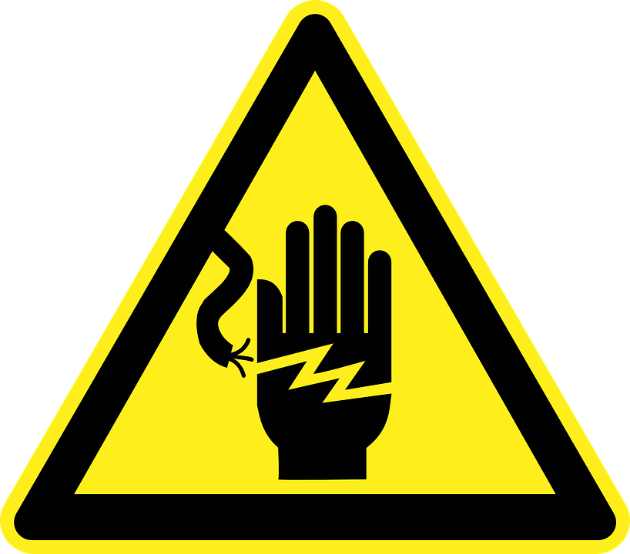
Shocking!
Mains electricity in the UK is 230 V.
This is high enough to cause an electric shock.
The bigger the current, the more harmful an electric shock could be.
Notes:
From key concept PEM8.1: students should be able to describe the force acting on a current carrying wire in a uniform magnetic field.
Common misunderstandings: the size of an electric shock is dependent only on the size of the voltage; and currents needed to give electric shocks are as large as those carried in mains circuits.
Student sheets and teacher notes for this activity contain printable and editable worksheets, together with teacher support materials.
Image by Openicons from Pixabay

Slide 4
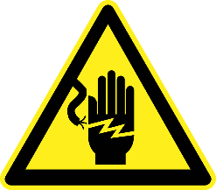
Shocking!
Home
Read the descriptions of electric shocks.
Match each description to the current that can cause it.
●
0.0005 A
1
Shock that is just felt.
●
●
0.005 A
2
Shock that is painful.
●
0.01 A
●
3
Shock that contracts muscles and a grip can’t be released.
●
●
0.1 A
●
1 A
4
Shock that can cause a heart attack or serious burns.
●
●
10 A
N.B. Getting an electric shock is different from being electrocuted.
A person is electrocuted by an electric shock that kills them.
Notes:
Expected answers: 1 0.0005A; 2 0.005 A; 3 0.01 A; 4 0.1A
A breakdown of what each choice tells you about students’ understanding or misunderstanding can be found in the teacher notes for this activity.

Slide 5
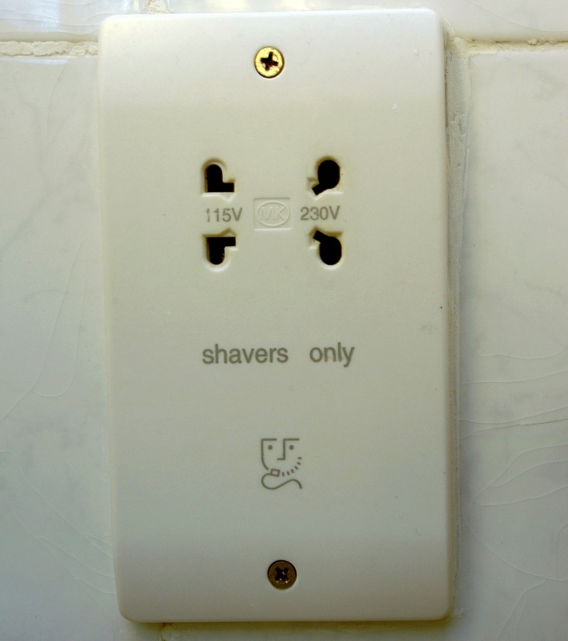
Resisting a shock
Standard mains sockets should not be found in a bathroom.
A shaver socket contains an extra safety device that makes it safe.
Notes:
From key concept PEM8.1: students should be able to explain why there are no standard mains sockets in a bathroom.
Common misunderstandings: the size of an electric shock is dependent only on the size of the voltage.
Student sheets and teacher notes for this activity contain printable and editable worksheets, together with teacher support materials.
Image from shutterstock

Slide 6
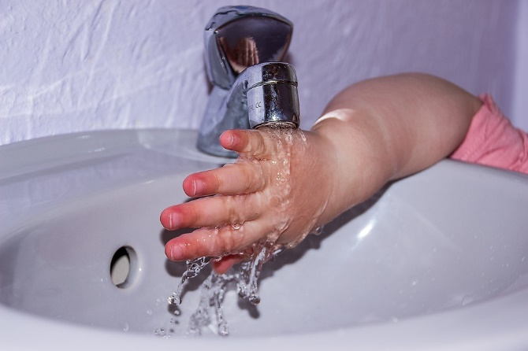
Resisting a shock
Home
Wet skin has a much lower resistance than dry skin.
Why are standard mains sockets dangerous in a bathroom?
A
Wet skin increases the voltage of a shock.
B
Wet skin increases the current from a shock.
C
Wet skin increases the voltage of a shock and current from it.
Notes:
Expected answer: B
A breakdown of what each choice tells you about students’ understanding or misunderstanding can be found in the teacher notes for this activity.
Image by Myriams-Fotos from Pixabay

Slide 7
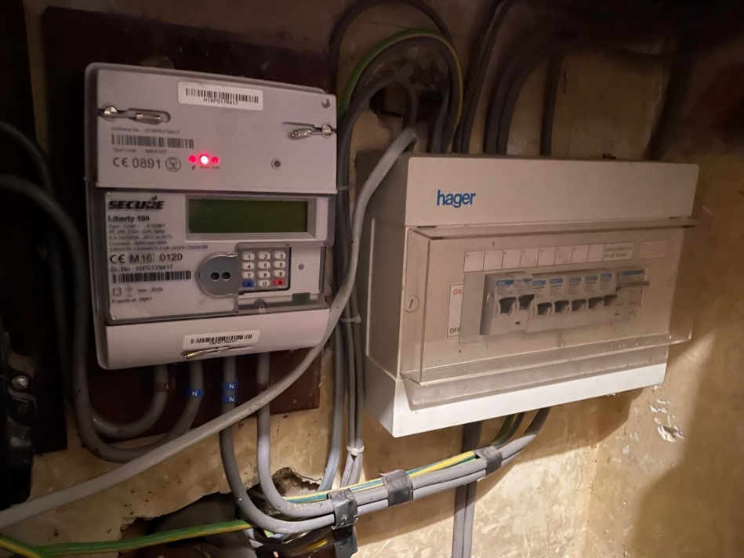
Consumer unit
Electricity enters a house at one point.
It passes through an electricity meter and a consumer unit.
All the electrical wiring in a house is connected to the consumer unit.
In houses, most fuse boxes have been replaced with consumer units.
Consumer units use circuit breakers (or RCCBs) instead of fuses.
Notes:
From key concept PEM8.1: students should be able to explain how electric circuits are wired in a home, with circuit breakers for safety.
Common misunderstanding: each light or electric socket in a house is connected individually to the consumer unit (fuse box) in its own circuit.
Avoid saying: fuse box that contains fuses (most have now been removed and replaced with a consumer unit).
Do say: consumer unit that contains circuit breakers or residual current circuit breakers (RCCBs).
Student sheets and teacher notes for this activity contain printable and editable worksheets, together with teacher support materials.

Slide 8
Consumer unit
Home
A consumer unit contains circuit breakers.
If too much current flows through a circuit breaker, it turns off and stops the electrical current.
These statements are about the circuit breakers in a consumer unit.
What do you think about each one?
I am sure this is right
I think this is right
I think this is wrong
I am sure this is wrong
A
Each circuit breaker turns off one light or one socket.
B
Each circuit breaker turns off several lights or sockets.
C
Each circuit breaker turns off one circuit in the house.
Notes:
Expected answers: Statements B and C are correct; and statement A is wrong.
A breakdown of what each choice tells you about students’ understanding or misunderstanding can be found in the teacher notes for this activity.

Slide 9
Mains circuits
All lights and electric sockets in a house are wired up to a consumer unit.
Notes:
From key concept PEM8.1: students should be able to explain how electric circuits are wired in a home, with circuit breakers for safety.
Common misunderstanding: each light or electric socket in a house is connected individually to the consumer unit (fuse box) in its own circuit.
Avoid saying: fuse box that contains fuses (most have now been removed and replaced with a consumer unit).
Do say: consumer unit that contains circuit breakers or residual current circuit breakers (RCCBs).
Student sheets and teacher notes for this activity contain printable and editable worksheets, together with teacher support materials.

Slide 10
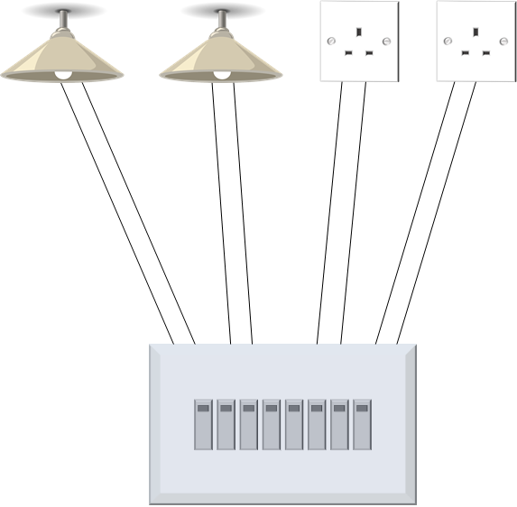
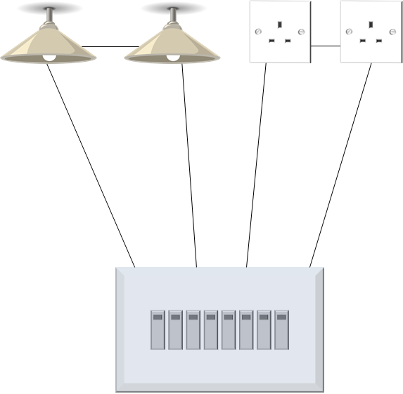
Mains circuits
Home
How are the electric circuits in a house wired up?
A
B
C
Consumer unit
Consumer unit
Consumer unit
Separate circuits for each light or socket.
Series circuits for groups of lights or sockets.
Parallel circuits for groups of lights or sockets.
Notes:
Expected answer: C
A breakdown of what each choice tells you about students’ understanding or misunderstanding can be found in the teacher notes for this activity.
Image of lamp by OpenClipart-Vectors from Pixabay

Slide 11
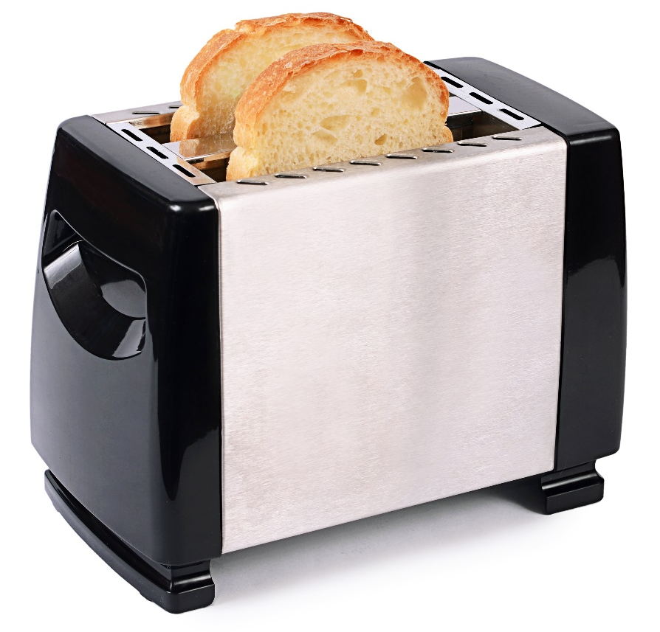
Short circuit
This toaster has stopped working.
The fault is a short circuit.
Notes:
From key concept PEM8.1: students should be able to explain the effects of a short circuit in an appliance or in a mains circuit.
Common misunderstandings: a short circuit is a circuit with disconnected wires; a short circuit is a circuit in which one or more component has stopped working; and a short circuit is a circuit in which components have been damaged by a current that is too big.
Student sheets and teacher notes for this activity contain printable and editable worksheets, together with teacher support materials.
Image from Shutterstock

Slide 12
Short circuit
Home
What causes a short circuit?
A
A loose wire makes a new circuit with very low resistance.
B
A loose wire makes a gap in the circuit.
C
A very big current damages a component.
D
A component wears out and stops working.
Notes:
Expected answer: A
A breakdown of what each choice tells you about students’ understanding or misunderstanding can be found in the teacher notes for this activity.

Slide 13
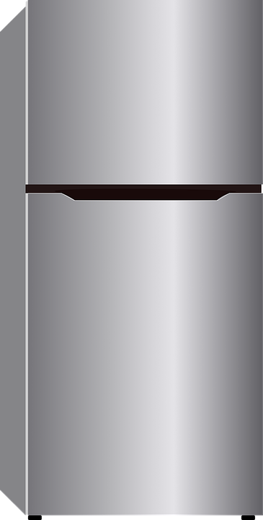
Metal case
This refrigerator has a metal case.
It has an earth wire connected to the metal case.
The earth wire is not part of the main circuit.
Notes:
From key concept PEM8.1: students should be able to explain how earth wires can protect people from electric shock.
Common misunderstanding: excess current flows and a fuse melts to make a faulty appliance safe only when a person touches it.
Student sheets and teacher notes for this activity contain printable and editable worksheets, together with teacher support materials.
Image by buntom from Pixabay

Slide 14
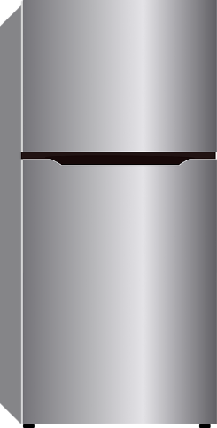
Metal case
Home
The mains cable of the fridge has been pulled and the live wire is loose.
It touches the metal case.
I am sure this is right
I think this is right
I think this is wrong
I am sure this is wrong
What do you think will happen?
A
A big current flows through the earth wire at once.
B
The fuse melts when someone touches the fridge.
C
The fridge stops working.
Notes:
Expected answers: Statements A and C are correct; and statement B is wrong.
A breakdown of what each choice tells you about students’ understanding or misunderstanding can be found in the teacher notes for this activity.

Slide 15
Section 2: Response activities
Response activities encourage students to talk and think about what they’re thinking (metacognition).
This challenges students’ misunderstandings, facilitates meaning-making, and develops and consolidates their scientific understanding.
A zip file containing all the resources for this key concept can be downloaded from
www.BestEvidenceScienceTeaching.org
The zip file provides:
Teacher guidance for this key concept, including a summary of the research evidence on relevant preconceptions and misunderstandings.
A full set of editable and printable student sheets and teacher notes for each response activity. The teacher notes include a summary of research evidence, guidance for using the activity and expected answers.

Slide 16
Shocking calculations
In the UK mains voltage is 230 V.
An electric shock is more dangerous when current is bigger.
The size of the current often depends on the resistance of skin.
Neutral
Live
Earth
Current through the heart can cause a heart attack.
Notes:
From key concept PEM8.1: students should be able to explain why there are no standard mains sockets in a bathroom.
Common misunderstandings: the size of an electric shock is dependent only on the size of the voltage.
Student sheets and teacher notes for this activity contain printable and editable worksheets, together with teacher support materials.
Image based on figure 1 in Goodenough (2007)

Slide 17
Shocking calculations
Home
For each situation, calculate the current through the body.
Which currents are dangerous to life?
Description | Resistance* | Current / A | Dangerous to life?
Dry skin | 50 kΩ
Sweaty skin | 2 kΩ
Moist skin | 300 Ω
Skin after soaking in a bath | 100 Ω
Mains voltage in the UK is 230 V.
Extension question:
How do you think this idea could be used to make a lie detector machine?
* The resistance depends on skin condition at two different points of contact and on other factors.
Notes:
Expected answers: Dry: 0.0046 A (would be felt and probably painful), sweaty: 0.115 A (this current is potentially dangerous to life, especially if the current passes through the heart), moist: 0.77 A (dangerous to life), soaked: 2.3 A (dangerous to life).
(Strictly speaking it is impedance that is measured rather than resistance.)
A more detailed answer, with an explanation can be found in the teacher notes for this activity.

Slide 18
A working fuse
In the UK, electric plugs contain a fuse on the live wire.
If current is dangerously big, a fuse melts and turns off the electricity.
This helps prevent fire and further damage to an appliance.
Fuses turn off appliances to make them safe.
Fuses do not prevent electric shocks if a wire is cut by mistake (perhaps with a lawn mower or hedge cutter).
Notes:
From key concept PEM8.1: students should be able to explain how electric circuits are wired in a home, with circuit breakers for safety; and explain the effects of a short circuit in an appliance or in a mains circuit..
Common misunderstandings: a short circuit is a circuit with disconnected wires; a short circuit is a circuit in which one or more component has stopped working; and a short circuit is a circuit in which components have been damaged by a current that is too big.
Student sheets and teacher notes for this activity contain printable and editable worksheets, together with teacher support materials.
Image from Shutterstock

Slide 19
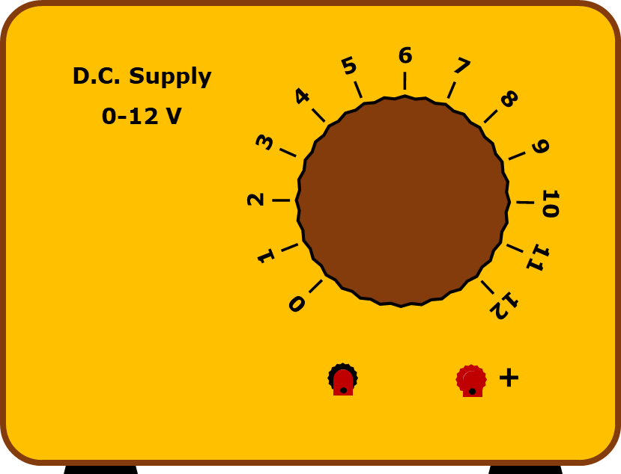
A working fuse
1. Effect of excessive current.
What happens to a piece of paper placed against the hot wire?
Notes:
Expected answer: With excessive current, a short length of constantan wire will burn through a piece of paper – the paper may be set alight.

Slide 20
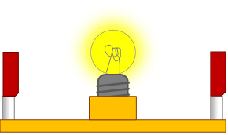
A working fuse
2. A fuse in a circuit.
Short length of fuse wire
This circuit is working normally.

Slide 21
A working fuse
Home
To answer: What happens if the red wire makes a short circuit?
?
?
Short circuits are often caused by pulling on mains leads.
A wire can become loose and move inside a plug or appliance.
Notes:
Expected answer: A large current flows through the fuse because there is less resistance along this route; the bulb goes out; the fuse wire melts; the circuit is broken and no electricity flows at all.

Slide 22
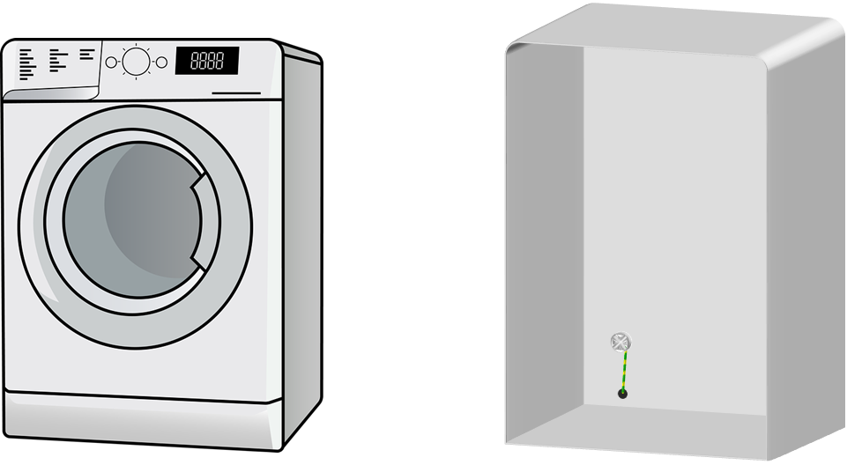
Earthing
The case of this washing machine is made of metal.
An earth wire is screwed onto the inside of the metal case.
The earth wire completes a circuit only if a live wire touches the metal case.
Notes:
From key concept PEM8.1: students should be able to explain how earth wires can protect people from electric shock.
Common misunderstanding: excess current flows and a fuse melts to make a faulty appliance safe only when a person touches it.
Student sheets and teacher notes for this activity contain printable and editable worksheets, together with teacher support materials.
Image of washing machine by Lerele from Pixabay.

Slide 23
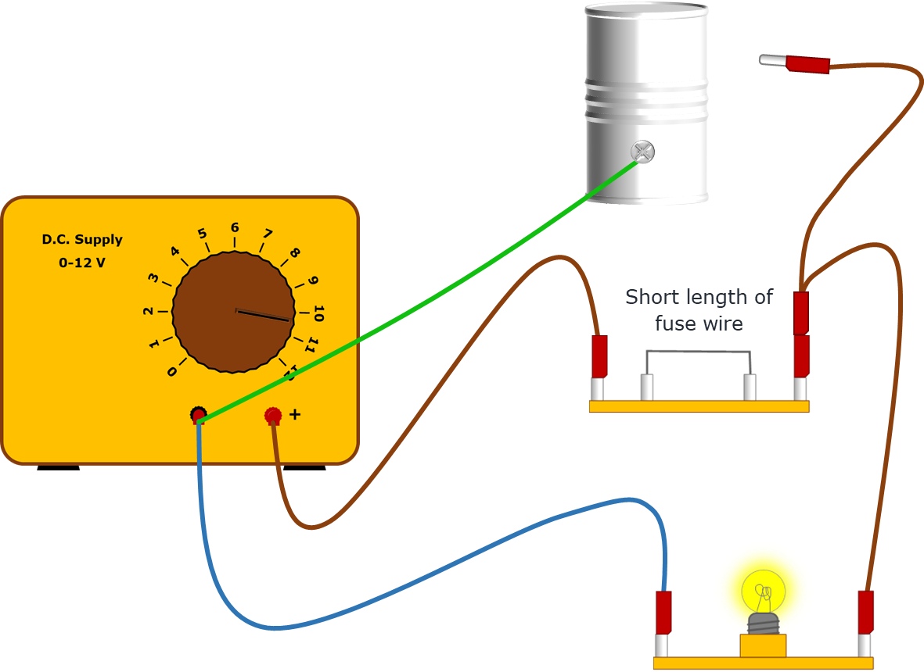
Earthing
This is a model of the circuit connected to the washing machine.
The tin can represents the metal case of the washing machine.
An earth wire is coloured green and yellow.

Slide 24
Earthing
Predict
What will happen if the loose wire touches the metal case?
Explain
Why do you think this will happen?

Slide 25
Earthing
Home
Observe what happens when the loose wire touches the metal case.
Observe
What happens?
Explain
1. Were your prediction and explanation correct?
Try to improve your first explanation to explain what happened more clearly.
2. What would happen if there was no earth wire when the loose wire touches?
Notes:
Expected answers: 1. The fuse melts and the bulb goes out; and 2. The bulb does not go out and anyone touching the metal case could get an electric shock.
A more detailed answer, with an explanation can be found in the teacher notes for this activity.

