Slide 1
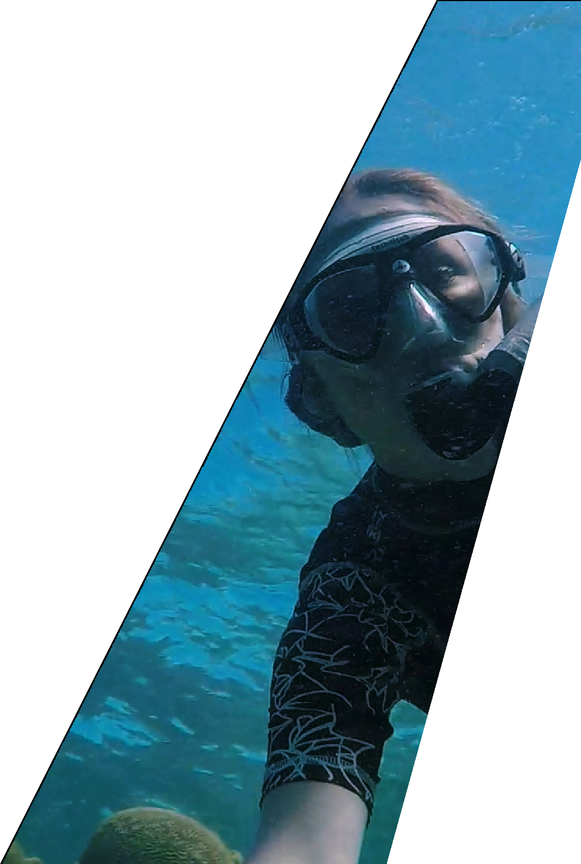
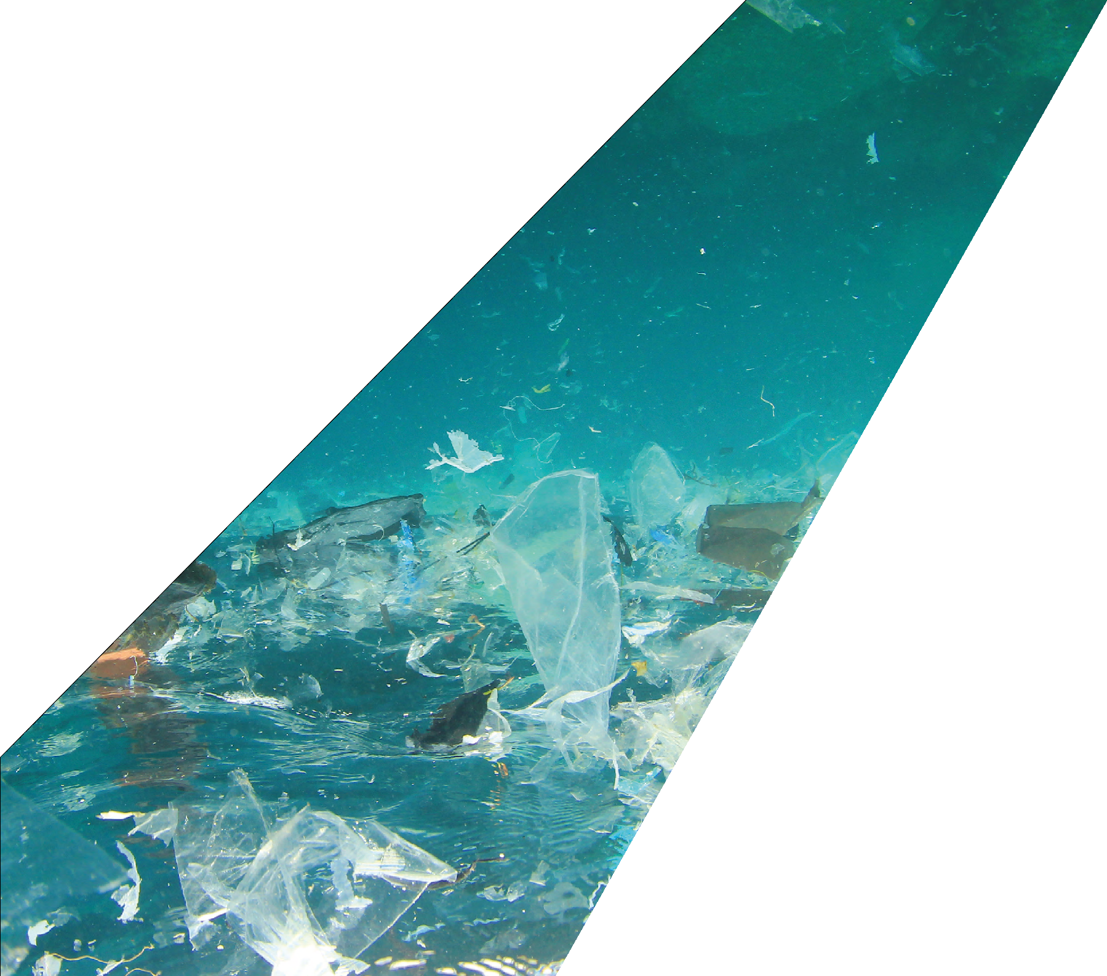
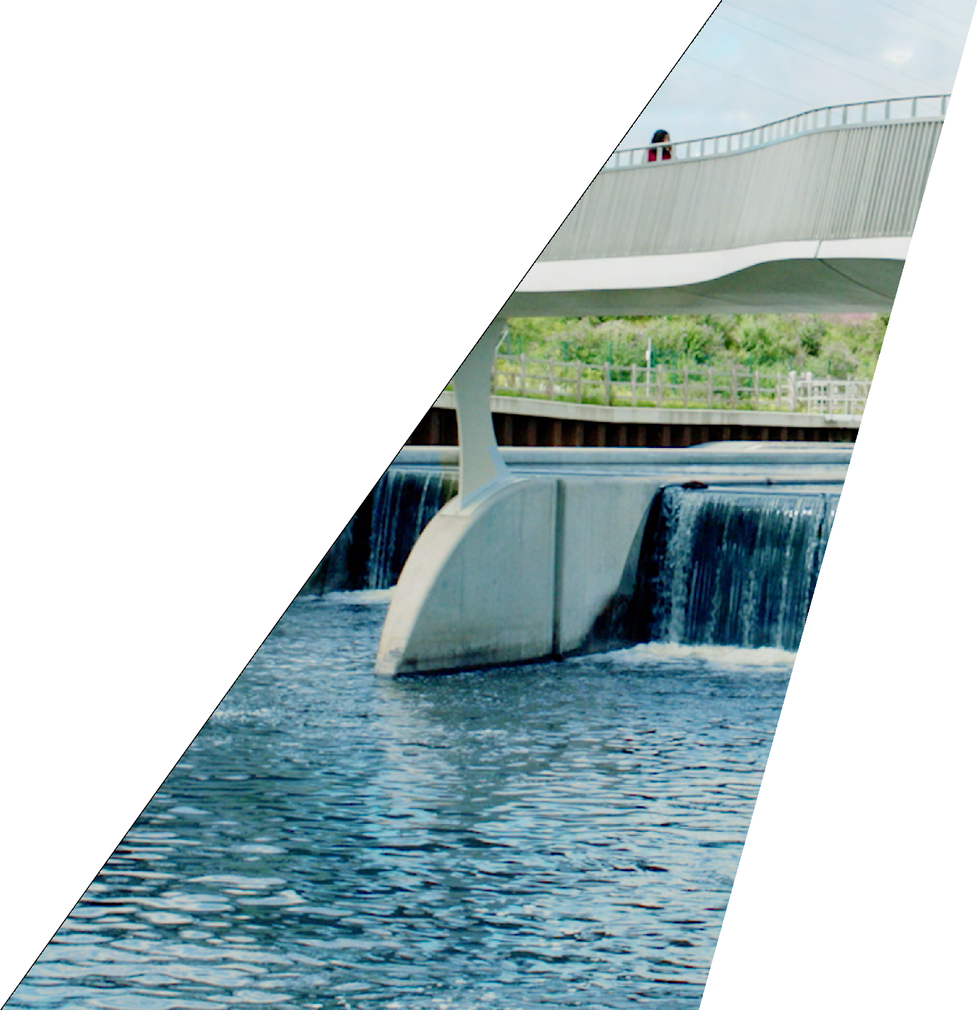
WATER
Some of the biggest challenges we face stem from how we interact with our environment,
_{and engineering} is at the heart of finding sustainable solutions. ^{Working with water is}
particularly important when thinking about the environment because water sustains all
_{life and is essential to} the survival of the planet. Find stories of inspiring engineer^{s and}
bring the work that they do ^{into your home or classroom.}

Slide 2
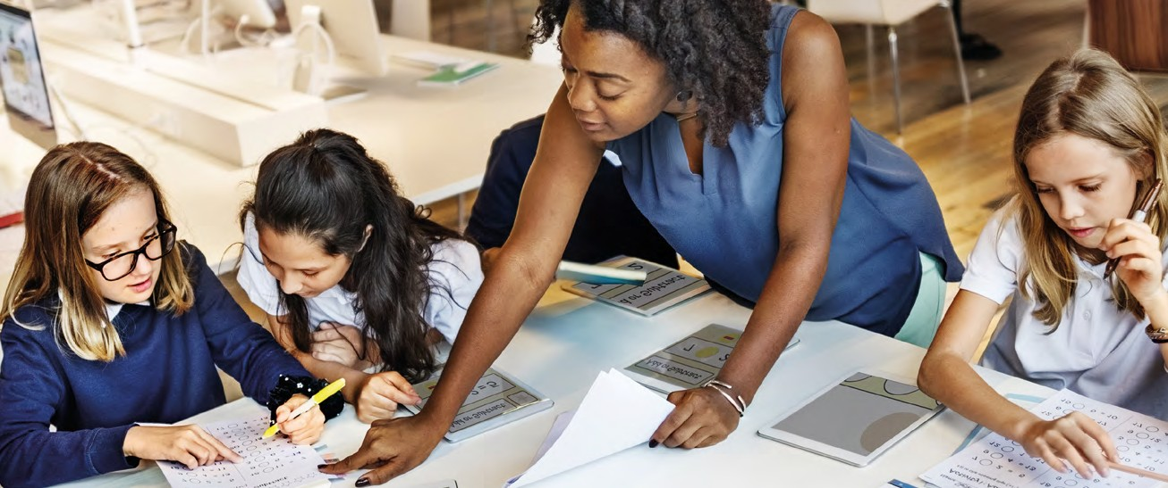
About this resource
Teacher notes
Some of the biggest challenges we face stem from how we interact with our environment, and engineering is essential to finding
sustainable solutions.
Working with water is particularly important when thinking about the environment because water sustains all life and is essential to the planet’s survival. Water is critical for healthy ecosystems, socio- economic development and the survival of humans and nature.
The challenges in this STEM resource invite learners to explore some of these important and pressing problems that society faces, encouraging them to act and think like engineers to find their own solutions to a sustainable innovation design challenge.
Through a series of creative and collaborative challenges, students will develop enquiring minds and teamworking skills and are encouraged to find imaginative approaches to problem-solving, understanding the role STEM-based learning plays in real-world engineering scenarios.
This is Engineering: Water asks young learners to express and share their thoughts and ideas, to be curious, experiment, find their own passions and interests, and to understand, change and make a difference in the world around them.
Tell us what you think...
Take our short survey for a chance to win £500 of robotics/coding equipment for your school.
Scan the QR code on your phone, or go to
stemresources.raeng.org.uk/teacher-survey
This resource is designed to provide practical and contextualised applications where students and teachers can see the role that STEM-based learning plays in real-world engineering scenarios.
Each of the activities and challenges have links across science, maths and design technology. However, some activities will be more heavily weighted towards one subject.
Don’t worry! Experience or subject knowledge about engineering and STEM subjects is not required. The resource has been designed to allow students to learn independently and at their own pace, with your support as a facilitator, not a subject expert.
What do I need for the activities in this resource?
We want to make the resource as inclusive and accessible as possible. Although we provide some physical hands-on materials, most of the challenges can be adapted to use items that are easy to find around the house or in most classrooms.
Both the student and teacher guide are available online for free:
http://stemresources.raeng.org.uk/this-is-engineering-water
Any teacher who is part of our Connecting STEM Teachers programme will receive hard copies of the resource and the physical materials that are included for free.
Any teachers, anywhere in the UK can join without any cost at any stage.
Find out more about the programme at https://stemresources.raeng.org.uk/connecting-stem-teachers
2 THIS IS ENGINEERING: WATER

Slide 3
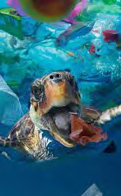
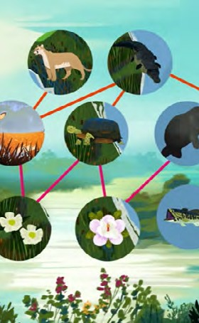
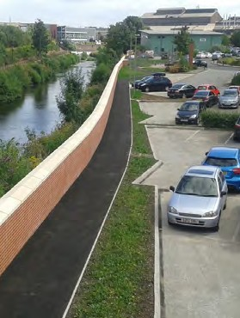
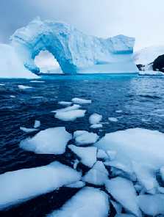
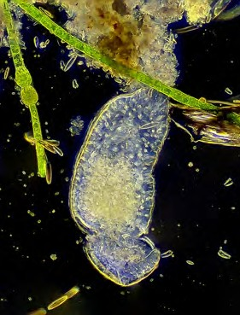
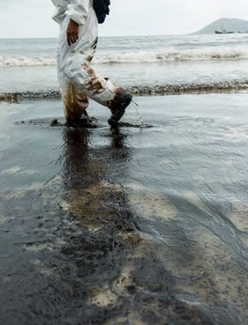
challenges
Plastics from waste
How does plastic end up in our oceans? Degradable, biodegradable or compostable? Test biodegradable plastic.
Making potato plastic toys. Making biodegradable cutlery.
Protecting rivers and oceans Explore the impact of invasive species on an ecosystem.
Model biodiversity and use a biodiversity index to find out to show ‘species rich’ a habitat is.
Lucy
Flood defence and the environment Build a flood defence to protect a house. Investigate river restoration.
Try town planning using natural flood defences.
Water and renewable energy
How do water levels change when ice melts?
Design and build a water turbine.
Milly
What’s in our water?
Use a microscope to become a water detective.
Create and test different filtering systems.
Soap and water
Use properties of water and soap to create soap-powered boats.
Build a boom to clean an oil spill. Make a floating compass.
Wenliang Li
Sustainable Futures Innovation Challenge 2022–2023!
Find the ‘Water Innovation Challenge’ booklet at
http://stemresources.raeng.org.uk/this-is-engineering-water
Competition
Innovation
Challenge
THIS IS ENGINEERING: WATER 3

Slide 4
Curriculum Links
The activities and challenges bridge several subjects across the science, technology, engineering and mathematics (STEM) curriculum. However for ease of reference, these have been linked to one or two specialisms only.
Age group is given as a guide and activities can be extended or broken down depending on the group.
More information about the national curriculum in England can be found here. More information about the Scottish Curriculum for Excellence can be found here. More information about the Curriculum for Wales can be found here.
More information about the Northern Ireland Curriculum can be found here.
Activity
Subject
Age group
Curriculum links
Plastics from waste
Science
11 to 14
By contributing to investigations into familiar changes in substances to produce other substances, I can describe how their characteristics have changed.
I can recognise a variety of materials and suggest an appropriate material for a specific use.
I can analyse how lifestyles can impact on the environment and Earth’s resources and can make suggestions about how to live in a more sustainable way.
Design technology
9 to 11
9 to 14
Protecting rivers and oceans from invasive species
Science
11 to 14
I can sample and identify living things from different habitats to compare their biodiversity. I can relate physical and behavioural characteristics to their survival or extinction.
I can create and evaluate a simple formula representing information contained in a diagram, problem or statement.
I can understand the impact of invasive species on ecosystems, and the human, economic and social problems this causes. I can use Simpson’s Diversity Index to show the biodiversity of a habitat.
Maths 11 to 14
Geography 11 to 14
Natural flood defence
Geography
9 to 14
I can name different strategies to manage floods including how the natural environment can be used to reduce flood risk.
Flooding and climate change
Geography
Design technology
11 to 14
9 to 15
I can investigate the relationship between climate and weather to be able to understand the causes of weather patterns.
I explore and discover engineering disciplines and can create solutions.
What’s in our water
Science
9 to 14
9 to 14
Using a microscope, I have developed my understanding of a variety of microorganisms.
I have investigated different water samples from the environment and explored methods that can be used to clean and conserve water and I am aware of the properties and uses of water.
Soap and water
Science
Design technology
9 to 11
9 to 14
By investigating forces on toys and other objects, I can predict the effect on the motion of objects.
I explore and discover engineering disciplines and can create solutions.
4 THIS IS ENGINEERING: WATER

Slide 5
Engineering Habits of Mind
The activities presented in this resource are designed to be
interactive, open-ended, encourage discussion and promote the engineering habits of mind (EHoM).
The EHoM encourage the use of a pedagogical approach that cultivates problem-solving skills, creativity, making mistakes, reviewing, and planning.
There is no prescriptive teaching method, and it is up to you as a teacher, educator or STEM club leader to decide on which direction you wish to take each activity and where you may wish to spend more time.
Read the full report Thinking like an engineer here.
Adapting
10
9
8
7
6
5
4
3
2
1
0
Creative
Problem-finding
problem-solving
Engineering habits quiz
In the student booklet, we have called the EHoM ‘engineering habits’ and have included student statements that
aim to bring the EHoM to life for young learners.
Students can take the engineering habits quiz to identify what engineering habits they are using, and perhaps ones they would like to work on.
Once students complete the quiz, they can see their results on the EHoM spider diagram and can easily pick out their engineering strengths.
Results are not fixed! We encourage young learners to complete the quiz several times.
They might find that different engineering habits are stronger depending on the type of activity or challenge they are doing.
We have included all the EHoM student statements for both you and young learners for reference and to use in different lessons and activities.
Find the engineering habits quiz on the This is Engineering: Water page on our resource hub.
Improving
Systems thinking
Visualising
THIS IS ENGINEERING: WATER 5

Slide 6
Engineering Habits – Student Statements
I AM GOOD AT...
Creative problem-solving
Improving
Problem-finding
Adapting
Visualising
Systems thinking
Coming up with lots of new and good ideas
Making what I have done better
Thinking about the world around me and how it could be better
Deciding how something could be done differently
Thinking out loud when I am being imaginative
Spotting patterns and working out what comes next
Working successfully in a group
Experimenting with things just to see what happens
Finding out why something does not work
Explaining how well I am doing to my teachers or friends.
Making a plan before I start work
Using ideas from one subject in another
Taking on board other people’s ideas and using them
Working hard and practising to get better, even when it’s tricky
Practising something in my head before doing it for real
Finding mistakes in mine and other people’s work
Evaluating how good something is
Putting things together to make something new
Making detailed mind maps
Behaving appropriately in different settings
Explaining my ideas to other people so they understand
Working out what I need to do to improve
Checking and checking again until I am happy
Spotting similarities and differences between things
Thinking first before doing something
Asking lots of questions to make sure I understand
Sticking up for what I think when talking with other people
Sticking at doing something until it’s the best it can be
Making models to show my ideas
Working out the possible
consequences of
something before they happen
The quiz and student statements are based on EHoM research supported by the Royal Academy of Engineering and published in Hanson, J., Hardman, S., Luke, S., Maunders, P. & Lucas, B. (2018) Engineering the future: training today’s teachers to develop tomorrow’s engineers. London: Royal Academy of Engineering.
6 THIS IS ENGINEERING: WATER

Slide 7
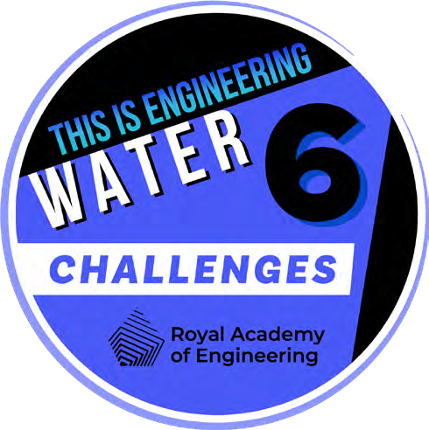
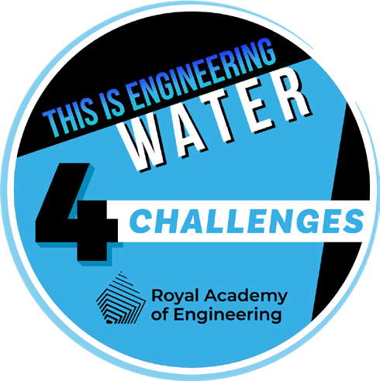
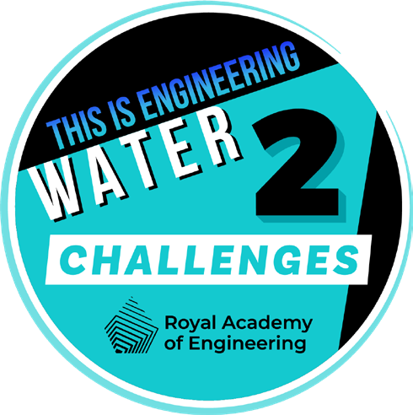
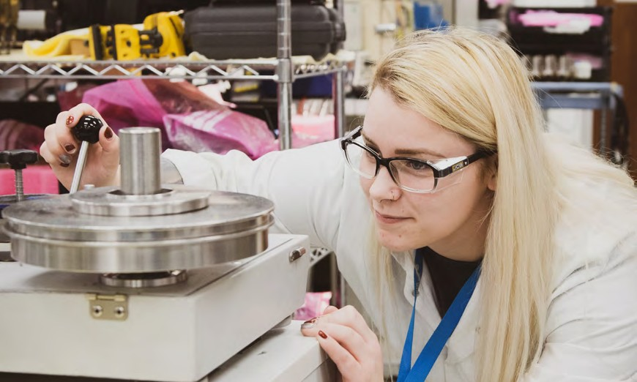
STEM Badges
How do students collect badges?
For each challenge they are working on, students mark up to three engineering habits they have been using on the STEM badge tracker.
Once they have completed three activities, they can come and share what they have been working on with you,
their teacher.
Then it’s easy. Visit our online platform where you can tell us what challenges your students have completed and share one or two examples of their work with us.
Visit rae.mindsetsonline.co.uk to submit your students’ work and apply for badges.
Students show you their work.
Fill in the form on the website for each student.
Attach supporting evidence, e.g. photos or presentation. This is optional, however we always like to see student’s work, especially when creative problem solving
is involved!
Submit forms for approval. You can submit for several students at the same time.
Once your badges have been approved, we will send them to you via email to share with your students.
Digital STEM badges reward learners for their commitment to STEM.
The activities in the student booklet require students to demonstrate their engineering habits.
For each activity they complete from this booklet, we want them to think about which engineering habits they think they have been using and mark it on the STEM badge tracker.
Once they have completed enough of the activities and challenges, they can cash them in for STEM badges.
The badges are digital so they can link them to their online profiles and applications and they won’t lose them!
By completing the ‘This is Engineering: Sustainable Futures’ activities and claiming the badges, your students can quickly progress to Global STEM Awards from STEM Without Borders.
More activities, pathways and information on progression at http://globalstemaward.org.
Innovation
Challenge
THIS IS ENGINEERING: WATER 7

Slide 8
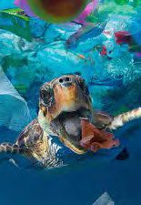
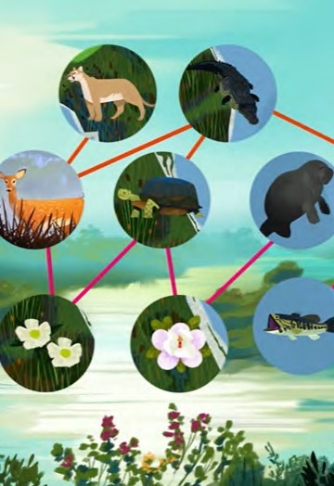
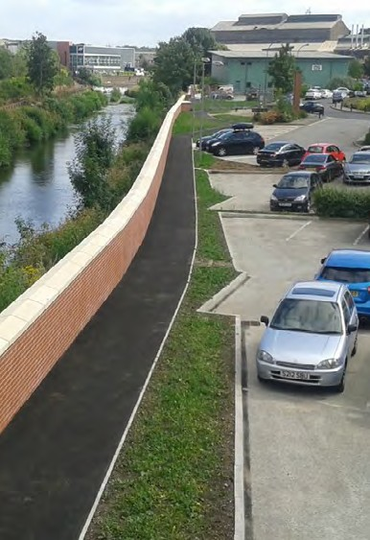
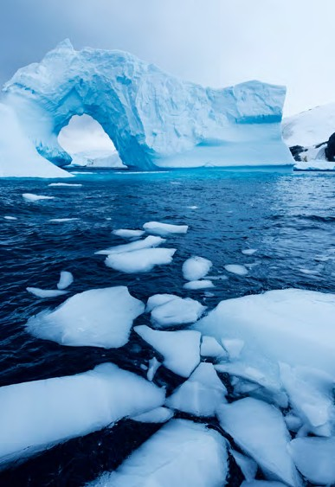
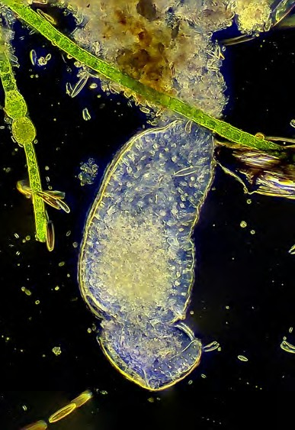
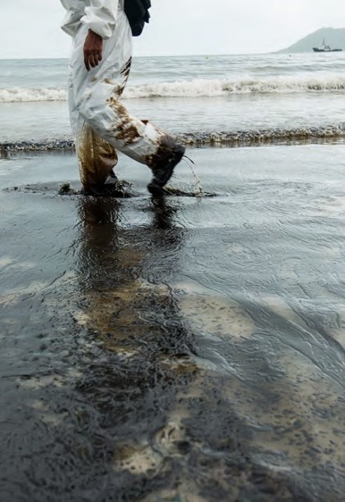
STEM BADGE Tracker
Name:
Plastics from waste Protecting rivers and oceans Flood defence and the environment
Water and renewable energy
What’s in our water?
Soap and water
8 THIS IS ENGINEERING: WATER

Slide 9
Solutions and further investigation
Degradable, biodegradable and compostable plastic – what’s the difference?
Page 10
The image shows microplastics
Non-stick spray – It is extremely important to use the non-stick spray; otherwise the aluminium foil moulds cannot be removed from the bioplastic.
Drying – While you can dry the moulds in the open air, drying the moulds in a controlled temperature
environment is faster and gives more repeatable results.
Good drying methods are to set an oven at 65° C or use a food dehydrator.
species behave, interact, and their numbers. They can detect activity outside of the norm.
Underwater robots designed to hunt certain invasive fish species.
Infrared cameras have been used to capture tigers.
Chemicals have been used to control invasive species, but they can sometimes harm other plants and animals.
Insects have sometimes been introduced, but sometimes they themselves can become invasive.
Testing biodegradable plastic
Page 10
Young learners might predict that the potato (natural polymer made of starch) will biodegrade more easily than the conventional plastic bag (man-made polymer made from hydrocarbons derived from oil), with bioplastic
(if used) somewhere in between. Older children may notice that by adjusting availability of microbes, oxygen, or changing the temperature, they can increase the appearance of decay in the potato.
Invasive species game
Page 16
Time to reflect
Why are invasive species a problem? See table overleaf.
Economic problems
Invasive species affect agriculture, forestry and fishing, and can even damage buildings and infrastructure. Economic impacts include: lower crop productivity, livestock harmed, soil quality degraded.
Environmental problems
Invasive species affect biodiversity in ecosystems and threaten native species by outcompeting for food and habitat. Invasive species alter and degrade the environment. Environmental impacts include: reduced biodiversity, water shortages, increased frequency of wildfires and flooding, increased pollution caused by overuse of chemicals to control infestations.
Human/social problems
In some regions, invasive species are a major threat to the incomes and livelihoods of the people who live in the areas affected. They can also have an effect on human health. Social impacts include: income reduced, food security decreased, risk to human and animal health, recreational and social opportunities limited.
What does this have to do with engineers/engineering?
Part of an engineer’s role is to make life better for people and the improvement. They solve problems that we face. Invasive species are part of this problem.
Technology and systems that are in place and have been engineered have become a partial cause of invasive species.
Making bioplastics
Page 11
Expected Outcomes:
Substrate – Gelatine substrate tends to produce the strongest material. Results can vary depending on the brand of gelatine used.
Plasticizer – Increasing the amount of plasticizer increases the flexibility of the final product. If
no plasticizer is added, the substrates produce brittle material.
The amount of plasticizer necessary to make the best bioplastic depends on the brand of the substrate and the drying conditions.
Time to research
What can be done to eradicate invasive species? How can technology help?
An invasive rat species was eradicated by using GPS equipment and setting traps in specific places.
An invasive cat species was given a virus that it could not fight.
Artificial intelligence and machine learning has been used to monitor data sets which show how different
THIS IS ENGINEERING: WATER 9

Slide 10
Habitat and other information
Measuring biodiversity
Page 20
Example table calculating ‘Simpson’s Diversity Index’.
Species
Why it is important?
What threat are they under/causing?
Atlantic salmon | A large fish, the Atlantic salmon is found in rivers, mostly in the north and west and at sea (anadromous). They return to spawn in the same stretch of river or stream in which they hatched. | The health and abundance of Atlantic salmon is seen an indicator of the health of the water environment. They support many jobs across the UK and contribute to the economy. They support the ecosystem around many other fish and wildlife. | Mitten crab eat salmon eggs when they are in rivers. They are also damaging river beds where eggs are spawning.
Brown trout (Salmo trutta) | The brown trout is a widespread species found throughout the UK. It lives in streams, rivers, lakes and salt water habitats. | The health and abundance of brown trout is seen an indicator of the health of the water environment. They support many jobs across the UK and contribute to the economy. They support the ecosystem around many other fish and wildlife. | Mitten crab eat trout eggs when they are in rivers. They are also damaging river beds where eggs are spawning.
White- clawed crayfish | White-clawed crayfish prefer to live in streams and rivers where the water is clear, shallow and fast flowing, although they can also be found in ponds and lakes. | They have important roles in the freshwater environment because of their diet and they provide food for other animals such as fish, herons and otters. White-clawed crayfish are important indicators of good water quality as they are intolerant of pollution. | The mitten crab has devastating effects on white-clawed crayfish through competition and spreading disease. The white-clawed crayfish has suffered massive decline in recent years.
Native oysters | The European native oyster (Ostrea edulis) is a bivalve mollusc that is typically associated with shallow, subtidal coastal and estuarine habitats. | Native oysters are known as ‘ecosystem engineers’ because they create the conditions for other species to thrive – stabilising shorelines, filtering water and providing vital food and habitat for coastal wildlife. | Mitten crabs eat native oysters. They have reduced by 90% in UK water.
Mitten crab | The Mitten crab is a medium-sized crab species, which can be easily identified by the bristly hairs (setae) on its claws. | Mitten crabs are the only freshwater crab in the UK. If you or your students ever spot these, then you should report it. You can report your sightings through the Natural History Museum. | Mitten crabs are highly damaging to environments where they are not naturally present. They outcompete native species of crustaceans for food, and can strip the bait in pots for more commercially valuable species. In its natural environment, this species burrows into riverbanks. In some areas the burrowing behaviour of mass numbers of mitten crabs has exacerbated problems with erosion, causing riverbanks to collapse in some areas, and even caused structures such as dams to become unstable. Huge downstream migrations of mitten crabs have also blocked water intakes and turbines in dams.
Habitat A
Species | n (total from your sample)
White | 21 | 21/95 = 0.2211 | 0.2211² = 0.0489
Red | 15 | 15/95 = 0.1579 | 0.1579² = 0.0249
Green | 12 | 12/95 = 0.1263 | 0.1263² = 0.016
Grey | 17 | 17/95 = 0.1789 | 0.1789² = 0.032
Blue | 11 | 11/95 = 0.1158 | 0.1158² = 0.0134
Yellow | 19 | 19/95 = 0.2 | 0.2² = 0.04
 | 95 | 1 | 0.1752
Students could consider what this column represents (proportion of each colour).
D = 1 ˗ 0.1752 = 0.8248
Simpson’s Diversity Index is a measure of diversity which takes into account the number of species present, as well as the relative abundance of each species. As species richness and evenness increase, so diversity increases. The value of D ranges between 0 and 1.
Further questions
How could the group model the effects of invasive species in the river?
What does the effect of one or two rare species have?
10 THIS IS ENGINEERING: WATER

Slide 11
Natural flood defence
Page 26
Flooding and climate change
Page 29
Glaciers melting and sea levels rising
During this challenge, young learners will test a misconception around melting icebergs contributing to sea levels rising.
Icebergs are already floating in the ocean, so melting will not raise sea level. Melting of land-based ice (such as glaciers) will raise sea level.
Water and renewable energy
Page 30
This is a good activity to test using different size pulleys.
They should find that the larger the pulley, the slower it will turn, but the more torque (force that causes rotation) it will produce. The smaller the pulley, the faster it will turn, but the less torque it will produce.
Challenge – complete the mini glossary
Impermeable means… not allowing fluid to pass.
Urbanisation is… the increase in the proportion of people living in towns and cities.
A floodplain is… a generally flat area of land next to a river or stream.
A storm surge is… an abnormal rise of water generated by a storm, over and above the predicted astronomical tides.
What’s in our water
Page 32
Instructions around how to assemble the microscope are provided in the kit.
Try using the microscope for everyday items first so they can get an idea of the scale of enlargement.
Fresh water vs. salty water
An important part of this experiment is asking learners to hypothesise as to what they think will happen.
Time to research
What do we mean by natural flood defence?
In small groups, come up with three examples of natural flood defence.
Some examples of natural flood defence could include:
Catchment woodlands
Run-off pathways
Roof gardens
Floodplain restoration
River restoration
Some interesting ideas with graphics can be found on the
‘Natural Flood Management’ Research programme.
What is happening?
Salty water is more dense than freshwater. So in the cup containing salty water, even the cold, melted ice stays at the top of the cup. As the ice melts and stays at the top of the cup, it keeps the top cold, slowing down the melting process.
In the cup containing freshwater, the melted ice is colder and more dense than the freshwater so it sinks to the bottom.
Image one – Laser print
Image three – Pencil on paper
Image five – Bond wires in LED
Image two – Leaf Image four – Thread Image six – Craft knife
In theory, they might be able to spot everything on page 33 except for bacteria in their water samples.
Cleaning up our act
Page 34
Stage 1 – flocculation
This is a simple experiment where young learners can quickly see the impact of flocculation using calcium carbonate.
If you have the physical kit, calcium carbonate is included.
The flocculated water sample can be used in the next filtering activity.
Fresh water
Salt water
Stage 2 – filtering
Young learners should see the difference that different absorbent materials have on filtering the water. There are interesting differences in speed and effectiveness between different materials (for example a J-cloth and blue cloth).
THIS IS ENGINEERING: WATER 11
The ice that has melted stays at the top of the cup, keeping the ice that has not melted cold.

Slide 12
Thank you
This STEM teaching and learning resource has been developed by the Royal Academy of Engineering
as part of its national Connecting STEM Teachers (CST) programme.
CST is a support network for teachers across all STEM subjects ensuring they have the knowledge and confidence to engage a greater number and wider spectrum of school students with STEM. The programme operates across all regions of England, and in Scotland, Wales and Northern Ireland.
The programme, founded by the Royal Academy of Engineering, would not be possible without the generous support of its funders:
The Royal Academy of Engineering is harnessing the power of engineering to build a sustainable society and an inclusive economy that works for everyone.
In collaboration with our Fellows and partners, we’re growing talent and developing skills for the future, driving innovation and building global partnerships, and influencing policy and engaging the public.
Together we’re working to tackle the greatest challenges of our age.
What we do
Talent & diversity
We’re growing talent by training, supporting, mentoring and funding the most talented and creative researchers, innovators and leaders from across the engineering profession.
We’re developing skills for the future by identifying the challenges of an ever-
We’re building global partnerships
that bring the world’s best engineers from industry, entrepreneurship and academia together to collaborate on creative innovations that address the greatest global challenges of our age.
Special thanks to our strategic partner Shell, for significant support of the programme.
Policy & engagement
changing world and developing the skills
We’re influencing policy through the
CST is also generously supported by: Amazon, Boeing, and the estate of the late Mr. John Gozzard.
and approaches we need to build a resilient National Engineering Policy Centre –
and diverse engineering profession.
providing independent expert support to policymakers on issues of importance.
Innovation
We’re driving innovation by investing in
We’re engaging the public by opening their eyes to the wonders of engineering and inspiring young people to become
some of the country’s most creative and
exciting engineering ideas and businesses. the next generation of engineers.
Royal Academy of Engineering Prince Philip House
3 Carlton House Terrace London SW1Y 5DG
Tel: +44 (0)20 7766 0600
www.raeng.org.uk
Registered charity number 293074

