Slide 1
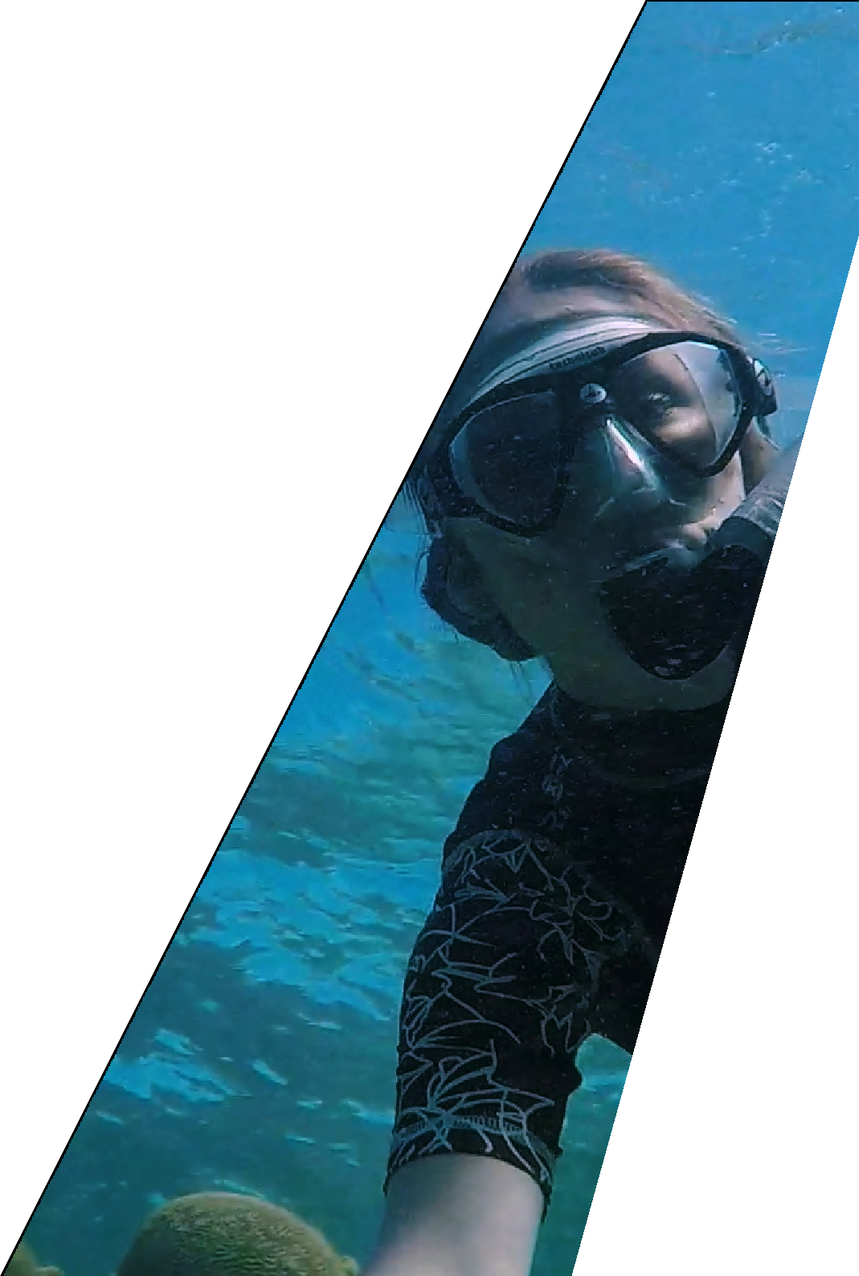
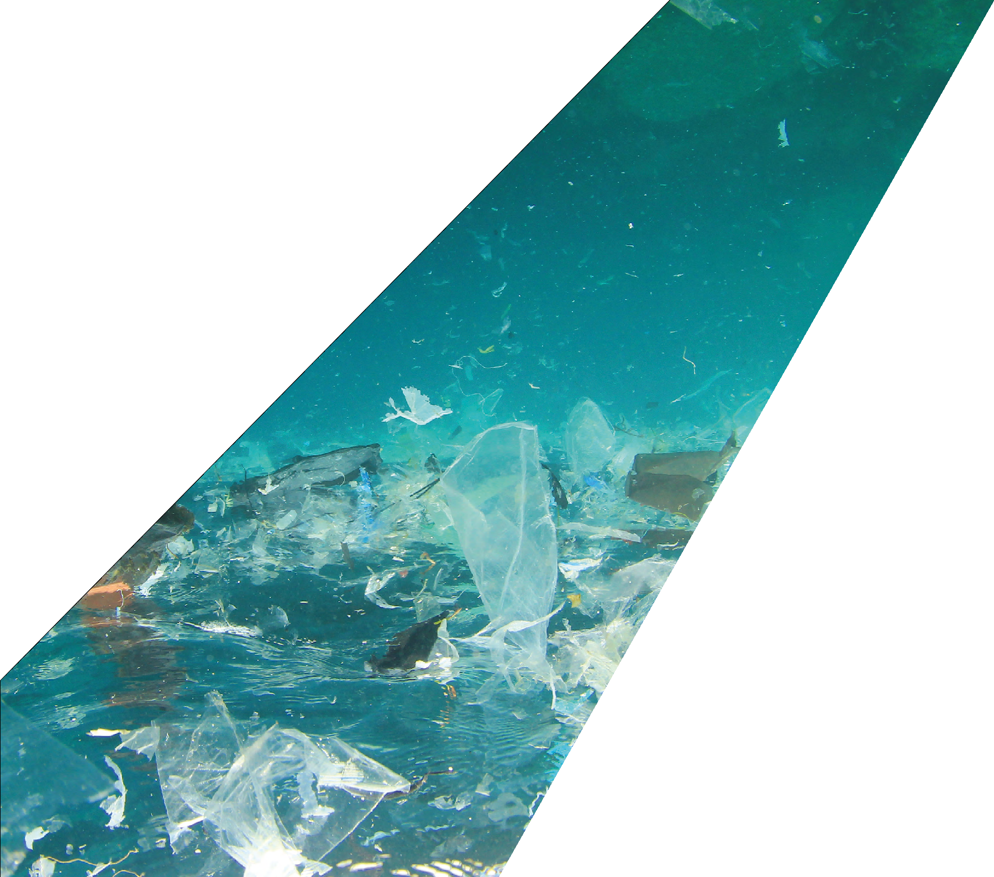
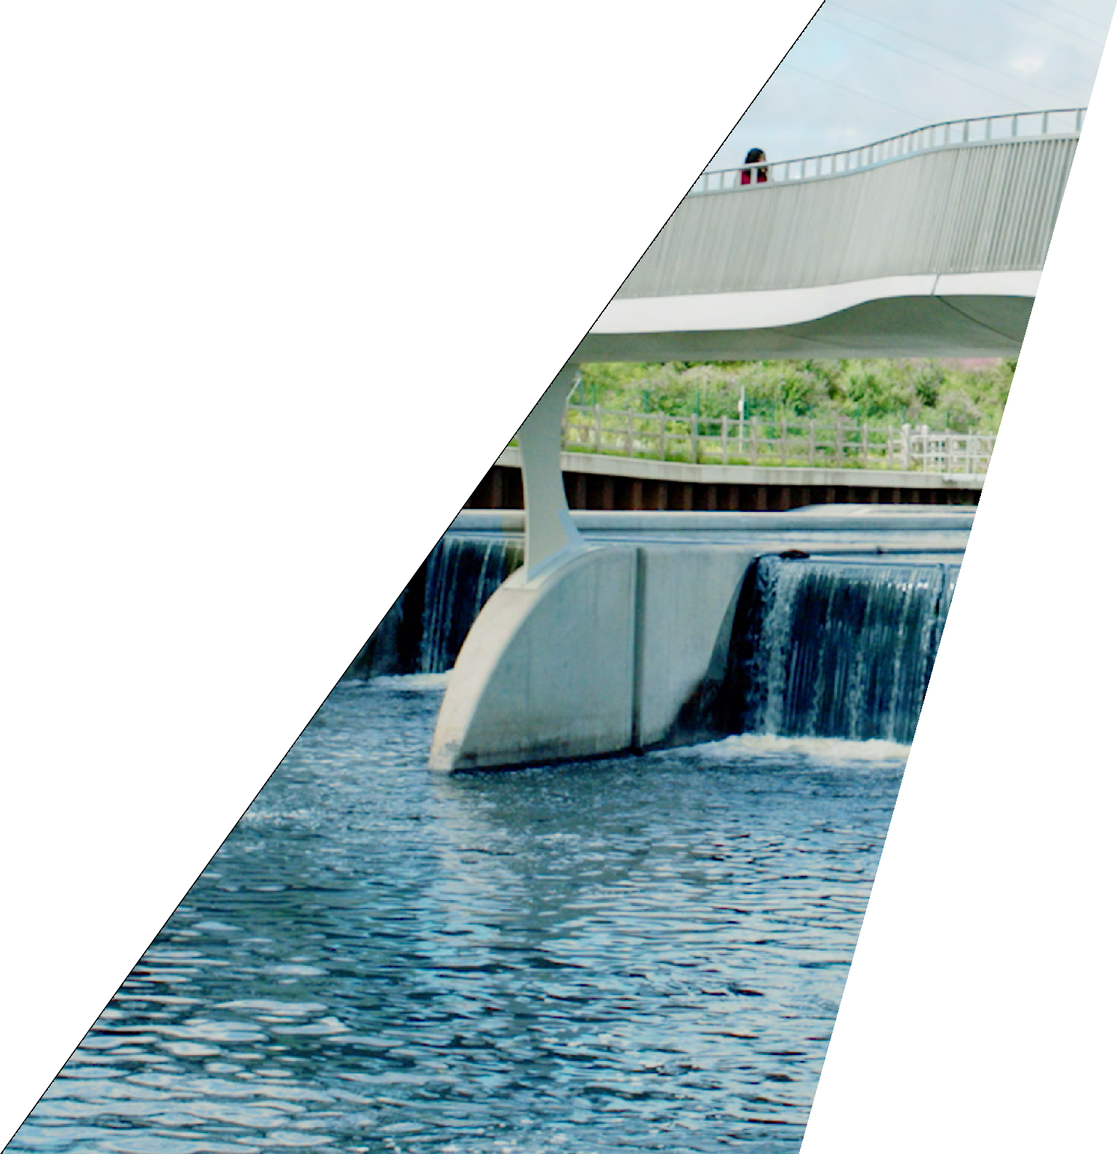
WATER
Some of the biggest challenges we face stem from how we interact with our environment,
_{and engineering} is at the heart of finding sustainable solutions. ^{Working with water is}
particularly important when thinking about the environment because water sustains all
_{life and is essential to} the survival of the planet. Find stories of inspiring engineer^{s and}
bring the work that they do ^{into your home or classroom.}

Slide 2
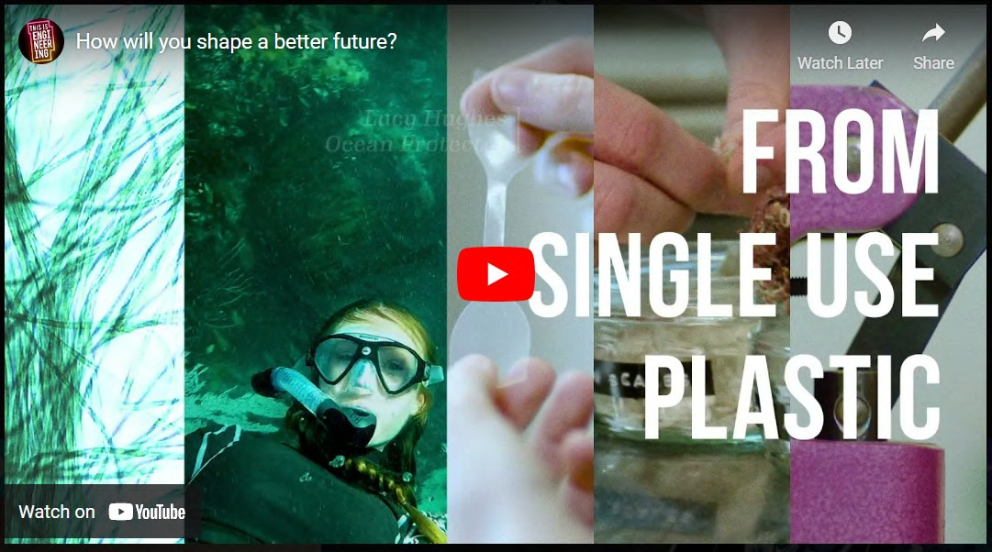
INTRODUCTION
Some of the biggest challenges we face stem from how we interact with our environment. Engineering is at the heart of finding sustainable solutions.
Working with water is particularly important when thinking about the environment because water sustains all life and is essential to the survival of the planet.
Water is critical for healthy ecosystems, socio-economic development and the survival of humans and nature.
How will you shape a better future?
Whatever change you want to make, choose engineering and be the difference.
Check out www.thisisengineering.org.uk and meet engineers who have followed their passions into a rewarding career.
Museum of Engineering INNOVATION
Engineering is everywhere – but often we don’t notice it.
The planes flying overhead, the food on our tables, and the inside of your fridge are just some of the engineering innovations that make life easier every day.
Engineers are also problem-solvers, tackling the world’s biggest challenges and shaping the future.
Energy experts and chemical engineers are developing solutions to the climate crisis. Mechanical engineers are working on wind turbines and solar panels. Civil engineers are making buildings greener worldwide.
This is Engineering celebrates the engineering that shapes the world and shows how engineers make a difference in our lives.
Visit the Museum of Engineering Innovation online to discover more about these inventions and the engineers who are building a sustainable future.
Scan the QR code to visit the Museum of Engineering Innovation for more stories of engineers that are making a difference to our every day lives.
2 THIS IS ENGINEERING: WATER

Slide 3
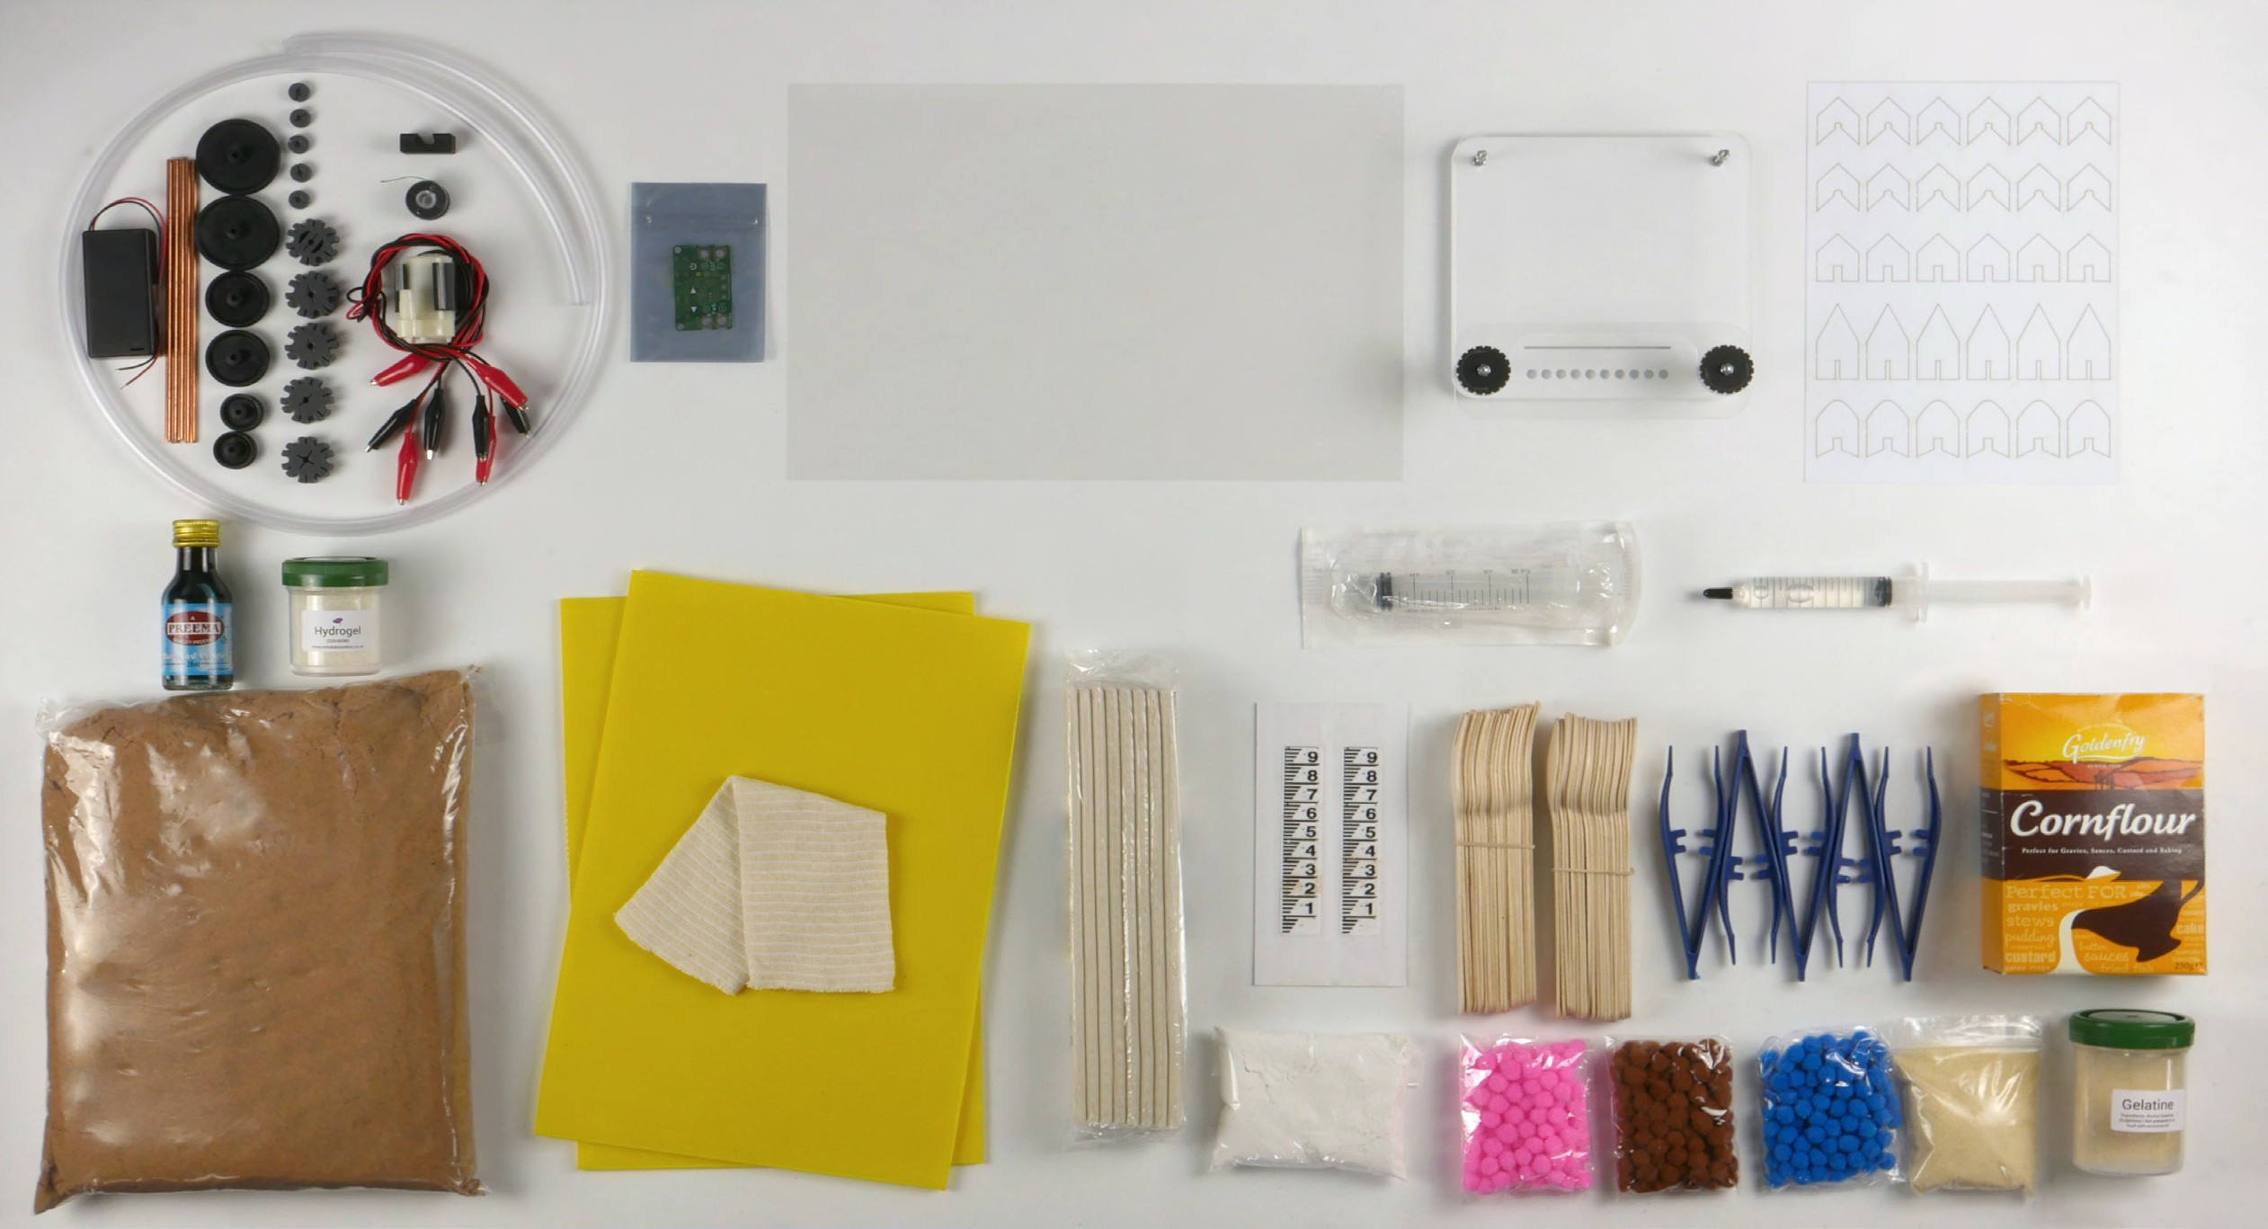
What’s in the box?
Cold forming plastic
Microscope stand (kit)
Soapy boat template
Food colouring
Hydrogel
8
Sand
Flood defence materials
Syringe for collecting water sample Syringe with glycerine
Water level sticker
13
Invasive species game Cornflour
Calcium carbonate Agar-agar
Gelatine
9
10
11
12
14
15
16
17
1
Water turbine materials and river forming pump
Speed control for pump
2
1
2
3
4
5
10
11
6
7
9
9
12
13
14
13
8
9
13
13
15
16
17
THIS IS ENGINEERING: WATER 3

Slide 4
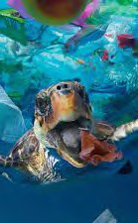
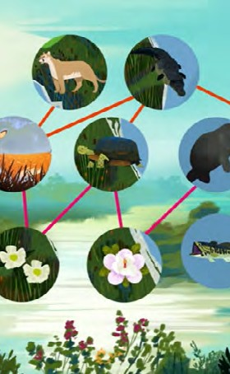
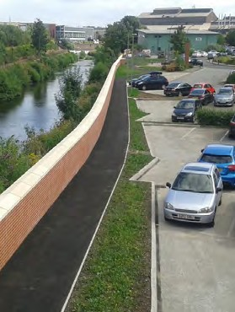
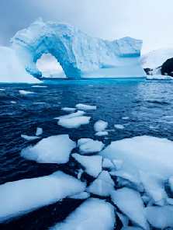
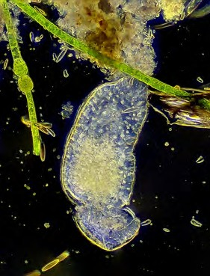
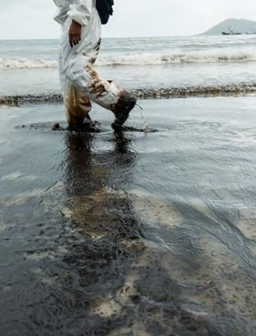
challenges
Plastics from waste
How does plastic end up in our oceans? Degradable, biodegradable or compostable? Test biodegradable plastic.
Making potato plastic toys. Making biodegradable cutlery.
Page 9
Protecting rivers and oceans
Explore the impact of invasive species on an ecosystem.
Model biodiversity and use a biodiversity index to find out how ‘species rich’ a habitat is.
Page 17
Lucy
Flood defence and the environment Build a flood defence to protect a house. Investigate river restoration.
Try town planning using natural flood defences.
Page 26
Water and renewable energy
How do water levels change when ice melts?
Design and build a water turbine.
Page 29
Milly
What’s in our water?
Use a microscope to become a water detective.
Create and test different filtering systems.
Page 32
Soap and water
Use properties of water and soap to create soap-powered boats.
Build a boom to clean an oil spill. Make a floating compass.
Page 36
Wenliang Li
Sustainable Futures Innovation Challenge 2022–2023!
Find the ‘Water Innovation Challenge’ booklet at
http://stemresources.raeng.org.uk/this-is-engineering-water
Competition
Innovation
Challenge
4 THIS IS ENGINEERING: WATER

Slide 5
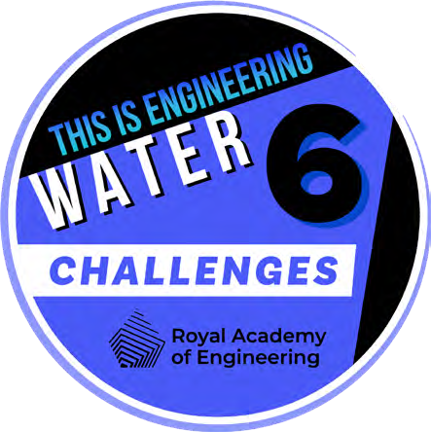
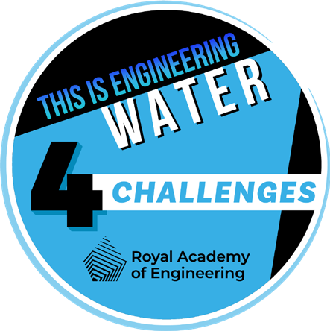
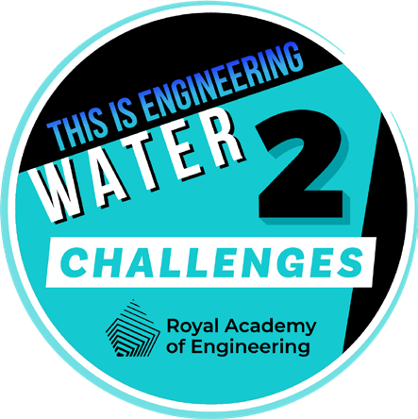
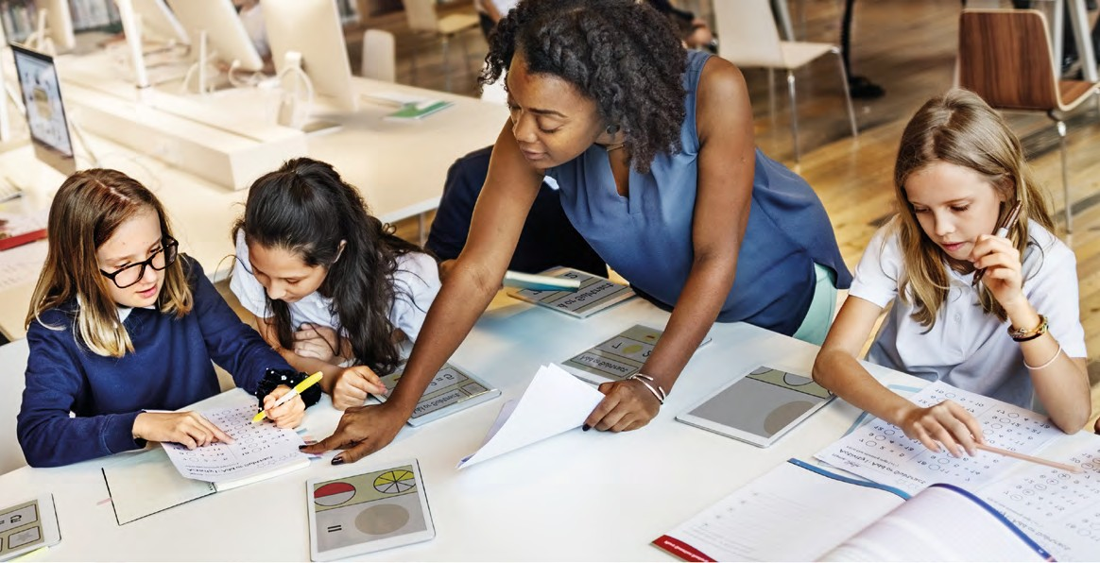
STEM Badges
How to collect
STEM Badges reward you for your commitment to STEM.
Complete SIX
challenges
For each activity you complete from this booklet, think about which engineering habits you are using and mark this out on the STEM badge record sheet.
Once you have completed enough of the activities and challenges, cash them in for your STEM badges!
The badges are digital so you can link them to your online profiles and applications and you can’t ever lose them.
Show and tell your teacher what challenge you have been working on and answer these questions:
What problem did you solve?
Which engineer or area of engineering does this challenge relate to?
What did you discover by working on this challenge?
Which engineering habits did you use?
Did you work in a team or independently?
What worked well?
How could you improve this?
Complete FOUR
challenges
How to collect your badges
For each challenge, mark out up to three ‘engineering habits’ you have been using on the following page.
Complete TWO
challenges
Tell us what you think...
Take our short survey for a chance to win £500 of robotics/coding equipment for your school.
Scan the QR code on your phone, or go to stemresources.raeng.org.uk/student-survey
THIS IS ENGINEERING: WATER 5

Slide 6
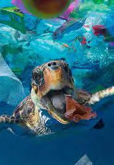
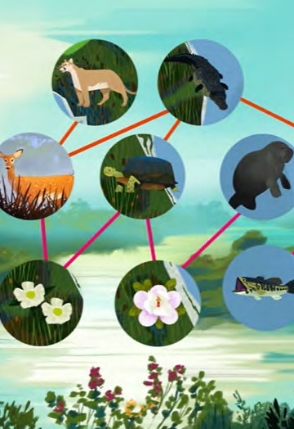
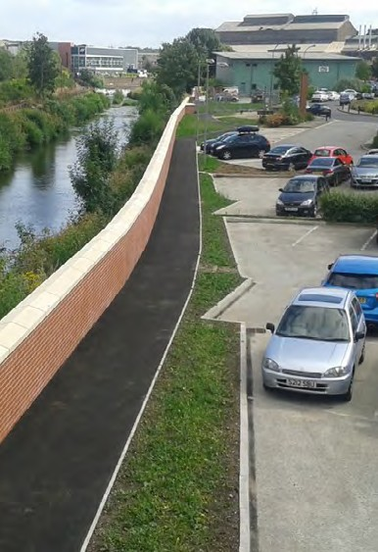
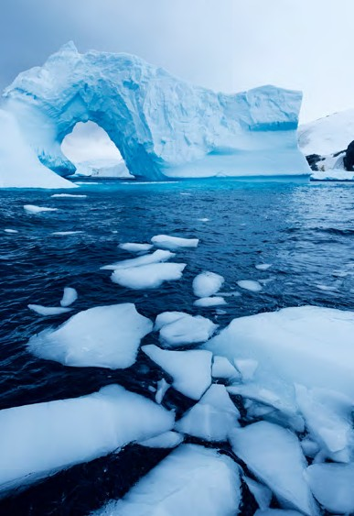
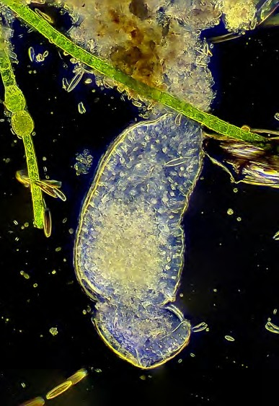
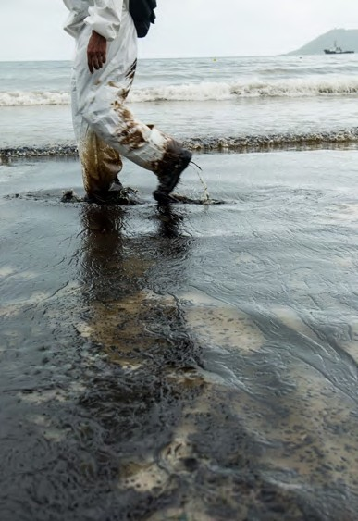
STEM BADGE Tracker
Name:
Plastics from waste Protecting rivers and oceans Flood defence and the environment
Water and renewable energy
What’s in our water?
Soap and water
6 THIS IS ENGINEERING: WATER

Slide 7
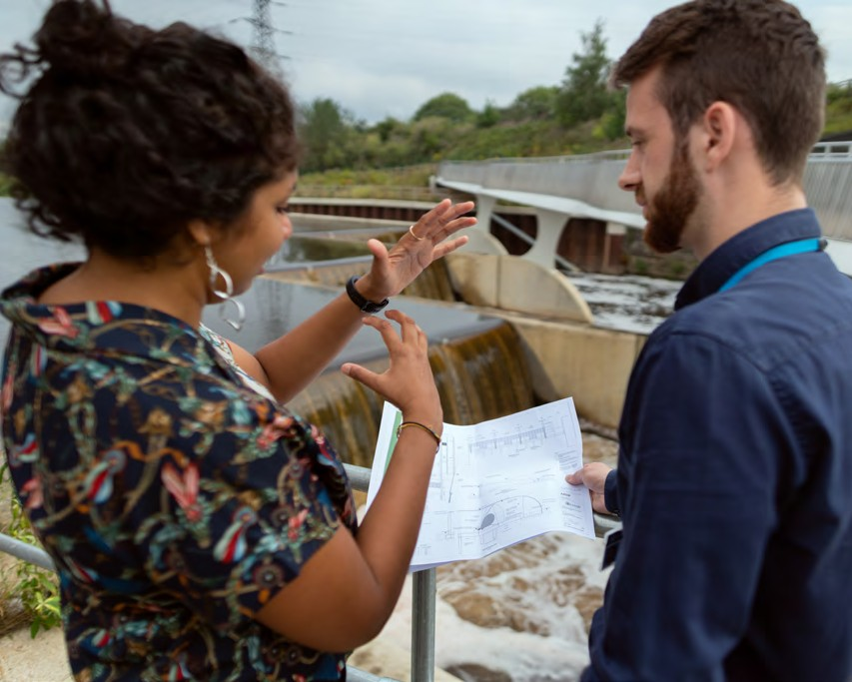
Engineering habits
Engineers make ‘things’ that work or make ‘things’ work better. But they do this in particular ways.
The ‘engineering habits’ describe the way engineers think and act.
How do you think and act like an engineer?
Take the quiz at This is Engineering: Sustainable Futures to discover your ‘engineering habits’.
But remember, results are not fixed! If you take the quiz several times, you might find that different engineering habits are stronger depending on the type of activity or challenge you are doing.
Engineering is all about having a diverse group of people and skills, so having different engineers with different habits of mind in any team is always important!
I AM GOOD AT...
Creative problem-solving
Improving
Problem-finding
Adapting
Visualising
Systems thinking
Coming up with lots of new and good ideas
Making what I have done better
Thinking about the world around me and how it could be better
Deciding how something could be done differently
Thinking out loud when I am being imaginative
Using ideas from one subject in another
Working successfully in a group
Experimenting with things just to see what happens
Finding out why something does not work
Explaining how well I am doing to my teachers and friends
Making a plan before I start work
Putting things together to make something new
Find the full quiz on the ‘This is Engineering: Water’ page on our STEM resource hub.
THIS IS ENGINEERING: WATER 7

Slide 8
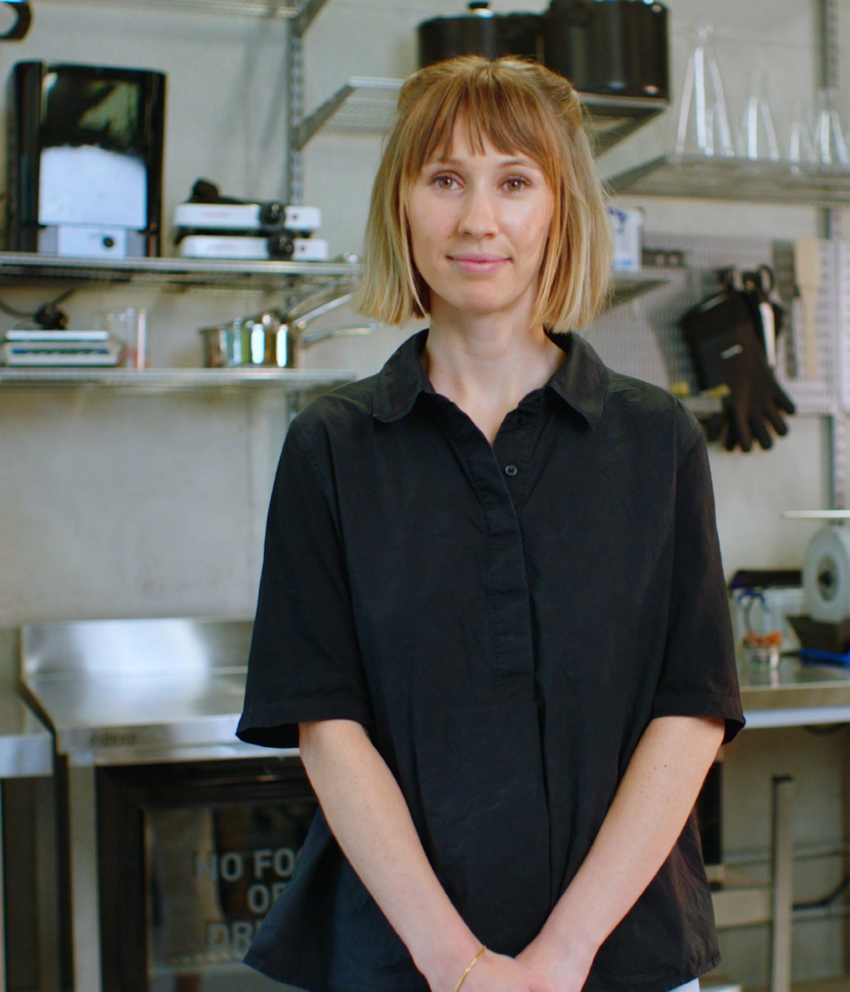
About me
I love the ocean. I live by it, I dive in it, and I want to protect it. Wanting to care for the ocean is also why I founded MarinaTex, where I create biodegradable plastic to help reduce single-use plastic waste.
While studying product design at university, I was led to engineering and the idea of circular economy.
“We know the ocean is suffering from plastic pollution, so it’s great that my engineering is helping to solve
this problem.”
I started a project to find value in waste products and this led me to looking at a fish processing plant and the waste produced there. I started experimenting with fish scales and algae and I fell down a rabbit hole learning about proteins. I ended up creating a plastic-like material similar to the plastic found in supermarket bags. I didn’t mean to invent a plastic but combining engineering and product design created a new solution.
Now I am my own boss which gives a lot of freedom and I can control my routine.
Engineering is really varied and versatile. It spans so many things, from idea to creation. One day I might be in the lab, experimenting with recipes and testing strength and
stretch of a formula, the next day I might be at a workshop or webinar, learning something new. Engineering means you’re always learning.
Find out more about Lucy by visiting the This is Engineering website
Lucy Hughes
Ocean Protector
Product designer and founder of MarinaTex

Slide 9
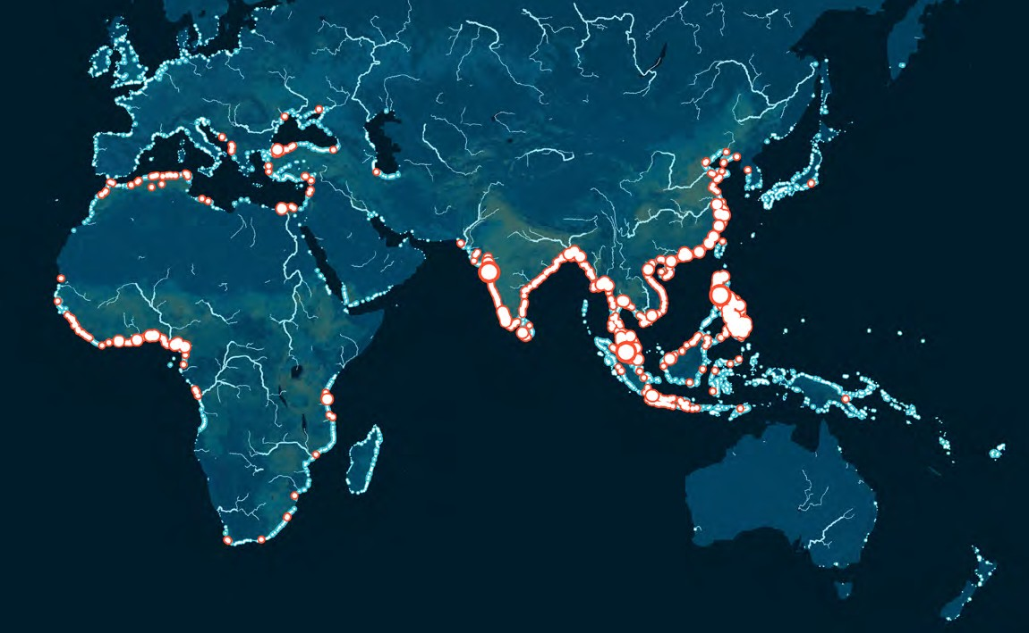
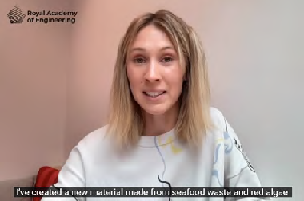
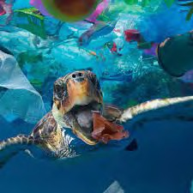
Plastic from waste
Time to reflect
How do you think plastic ends up in our oceans and rivers?
Explore this interactive map from ‘The Ocean Cleanup’. What does it show us?
Where does most of the plastic enter the ocean? Why do you think that is?
Lucy’s engineering is helping to solve a huge problem with plastics in the ocean.
Less plastic will enter the ocean if we move to biodegradable plastic alternatives, and any plastic that does get there can’t damage the ocean life as it is made from natural marine ingredients.
Lucy’s work was inspired by the idea of a circular economy. A circular economy is based on designing out waste and pollution, keeping products and materials in use, and regenerating natural systems.
Try our, ‘Circular economy’ interactive activity.
Plastics here there and everywhere
Plastic is an incredibly versatile material made from polymers. It can be made into packaging, cars, machines, clothing, medical equipment and countless other products we use every day. Plastic is virtually everywhere.
Plastic-like materials have been around for thousands of years, and we used to make it using natural materials.
Today, most plastic is made from chemicals derived from petroleum, a non-renewable resource. Synthetic
materials are designed to be strong and durable, however this has also meant that they do not easily breakdown.
This makes the plastic pollution cluttering rivers, seas and beaches, all the more harmful to animals and the environment.
Watch this video from Lucy Hughes telling you about her innovation creating single-use plastic from natural materials found in
the ocean.
Check out our resource This is Engineering: Sustainable Futures for more activities
on plastics.
THIS IS ENGINEERING: WATER 9

Slide 10
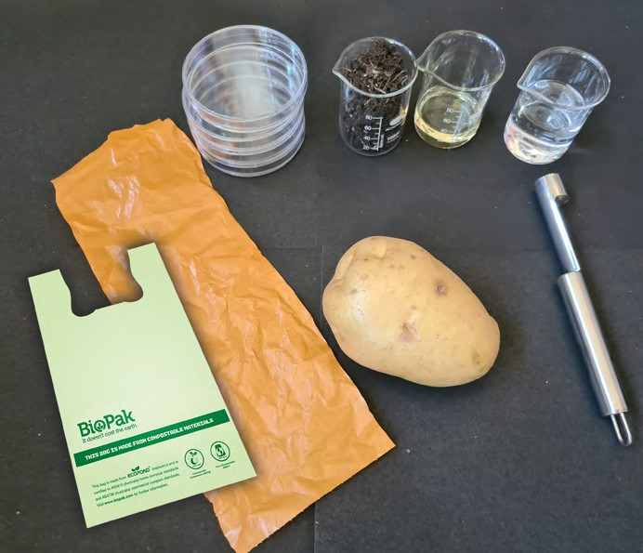
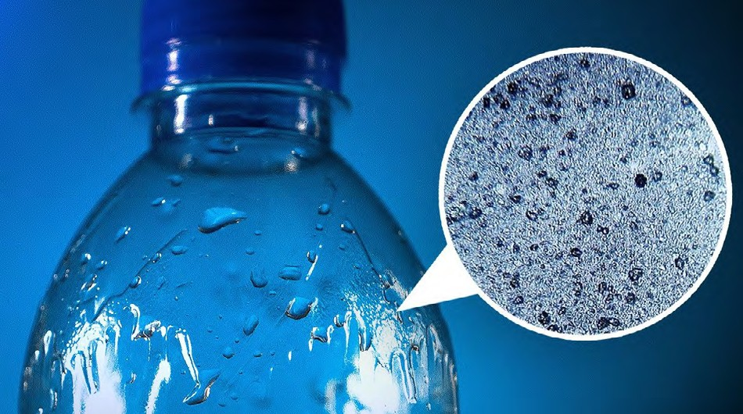
Degradable, biodegradable and compostable plastic – what’s the difference?
Testing biodegradable plastic
What terms have you heard used when you hear people talking about plastic?
Degradable plastic
The word degradable simply means something can be broken down. Technically, all plastic is degradable. You can break it up with a hammer, or some plastics react with the sun making them brittle and crumble.
What do you think happens to the small pieces of plastic left? Have you seen products advertised as ‘degradable’? Do you think that this is good for the environment?
Biodegradable plastic
Biodegradable plastic can be broken down by the metabolism of bacteria and fungi. However, the breakdown of biodegradable material buried in landfills can be slowed down or even stopped because many of these processes need oxygen and water, and there is little to none in landfills.
Compostable plastic
Compostable products are biodegradable products that degrade in a reasonable time in a compost pile. Compostable plastic degrades by composting to yield CO₂, water, inorganic compounds and biomass. Environmental conditions effecting compostability include temperature, moisture level, pH, oxygen, and the microorganisms present.
Compare how plastic and potato (a proxy for starch-based bioplastic) degrade in different conditions.
Materials
Baking potato
Plastic carrier bag
Biodegradable plastic bag
Apple corer
Knife
Chopping board
4 x petri dishes
Soil (optional)
Salt water (optional)
Oil (optional)
Use the corer to remove four cylinders of potato.
Cut all four pieces of potato the same length.
Place each potato cylinder into a separate petri dish.
Cut out four squares of plastic carrier bag into the same sized squares.
Add a plastic carrier bag square and a bioplastic square to each of the four petri dishes already containing a potato cylinder.
Change the environment for each petri dish (temperature, oxygen availability, moisture). This can be done by putting one near a radiator to increase temperature, tape one closed to reduce oxygen, or placing one under compost to change several conditions at once.
Leave your samples for a fixed time. Use the table on the next page as a guide.
Return to your samples and make your observations.
What do you think this image shows?
10 THIS IS ENGINEERING: WATER

Slide 11
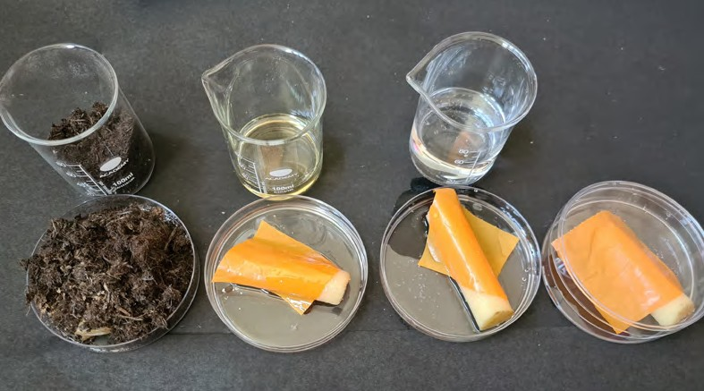
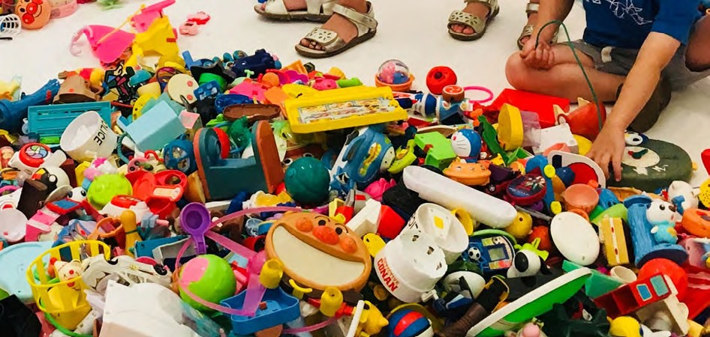
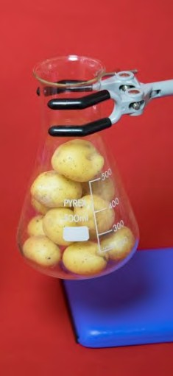
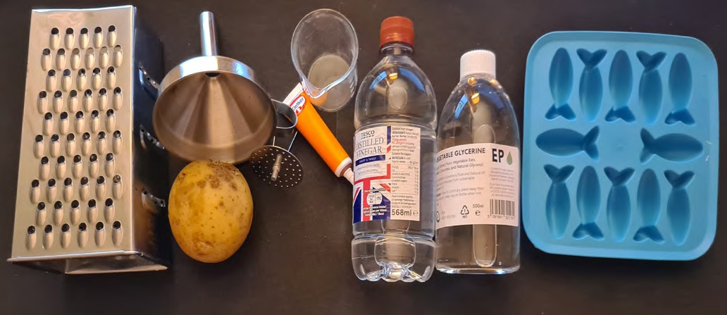
Sample observations
Activity Reduce oxygen
Increase temperature
Cover in soil
Cover in water
One day
One week
Two weeks
Three weeks
Health and safety
Work with an adult when using a knife, the apple corer and a grater.
Work with an adult when using a hob or Bunsen burner.
Wear goggles and heatproof gloves when using a hob or Bunsen burner.
What is happening at each observation point?
Test your materials in different environments.
What factors increase the rate of degradation?
From your investigation, which factor(s) caused the most degradation?
Potato plastic
Spotlight
Find out more about engineers who are turning potato peel into sustainable bioplastics for the fashion and interior design industries
at the Museum for Engineering Innovation.
Did you know you can make plastic from potatoes? Potato Plastic is a biodegradable material, made of potato starch. This means that it will decompose to nutrients for the soil in only two months when it ends up in nature. Potato Plastic can be used for products such as cutlery, straws and even toys!
Materials
Potato
Grater
Funnel
Muslin/filter
Heatproof beaker
Food colouring
Citric acid (or
any other acid
e.g. vinegar)
Glycerol or glycerine
Hob or Bunsen burner
Stirrer
Jelly mould
THIS IS ENGINEERING: WATER 11

Slide 12
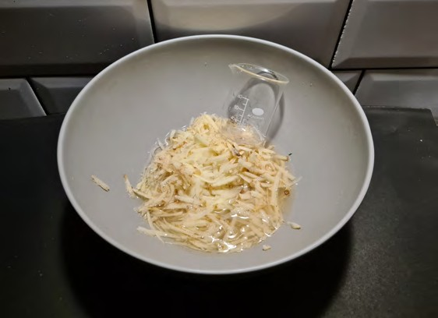
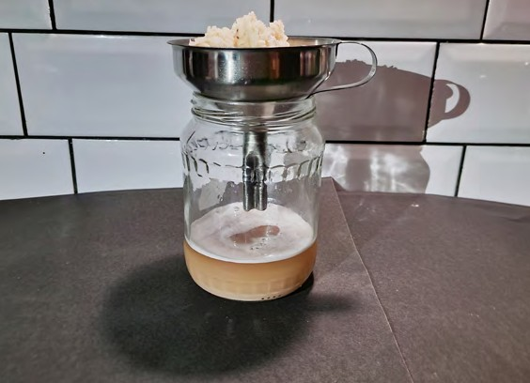
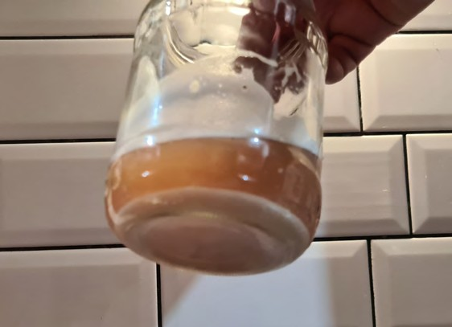
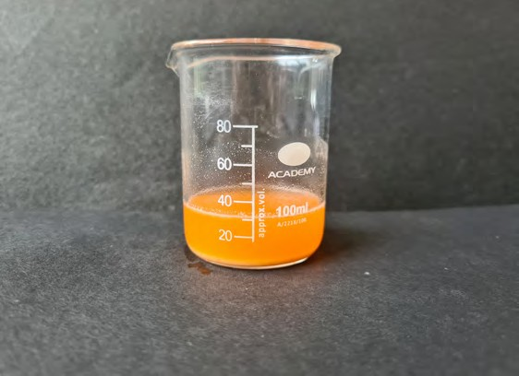
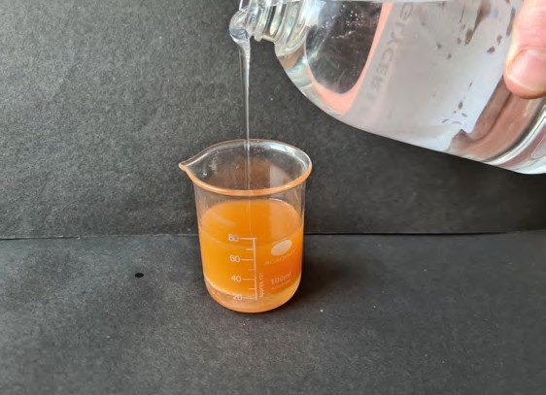
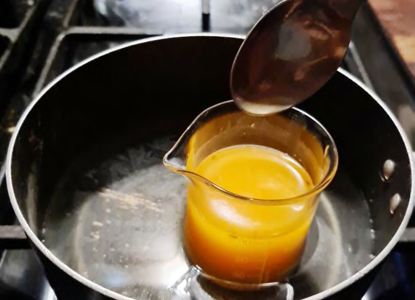
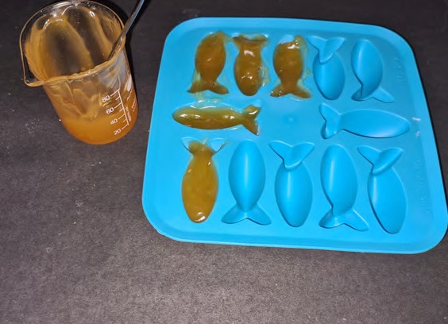
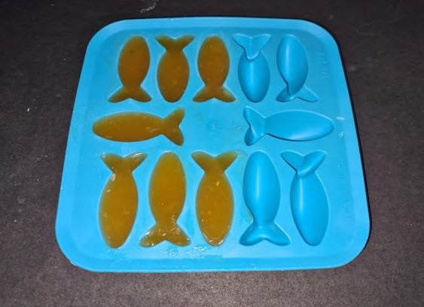
Make your own potato plastic toy
Grate your potato into a bowl
Add water (approx. 200ml) and stir. This is to extract as much starch away as possible.
Pour the mixture through a funnel with a muslin or other filter to separate the starchy juice from the solids.
Let the starch settle. Pour away the juice.
To the starch left, add 30ml of water and stir. Pour the solution into a clean heatproof beaker.
Add a few drops of food colouring.
Add 30ml of citric acid.
Add 15ml of glycerol or glycerine.
Heat the solution on a Bunsen burner whilst constantly stirring. Do not let it boil.
The solution should thicken and then become liquid again.
Pour solution into your mould.
Leave at room temperature for three hours. Or put the moulds in a dehydrator if you have one!
Experiment with different amount of glycerol or glycerine and different types of citric acids.
What other designs can you create for your toys?
1
2
Grate a potato into a bowl. Add approx 200ml water.
Pour the mixture through a funnel with a filter.
3
4
Let the starch settle.
Add 30ml of water and food colouring to the starch.
5
6
Stretch and challenge
The chemistry…
Potatoes are a natural polymer made of starch. Acid causes the branch structure of starch to break down. It turns into long chains and becomes elastic.
When the solution cools, these chains become stacked together, turning into a dense mass. The evaporation of water also assists the formation of a dense material.
When glycerol is added, the toy does not crack. The glycerol molecules fit between the starch molecules, maintaining its elastic state – the toy does not crumble like a cookie.
Investigate further with a similar experiment at ‘The Royal Society of Chemistry’ –
Making plastic from potato starch.
Add 30ml of citric acid and 15ml of glycerol.
Heat the solution. You must use googles and heatproof gloves.
7
8
Make your own mini-glossary
A polymer is….
Using forceps, heatproof gloves
and a spoon if needed, pour mixture into mould.
Leave mixture to set.
12 THIS IS ENGINEERING: WATER

Slide 13
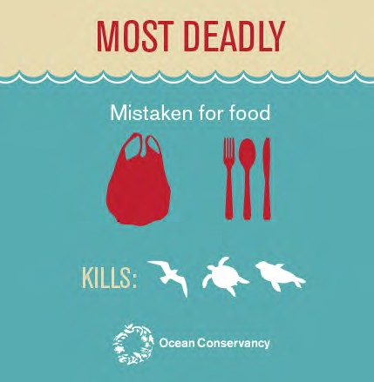
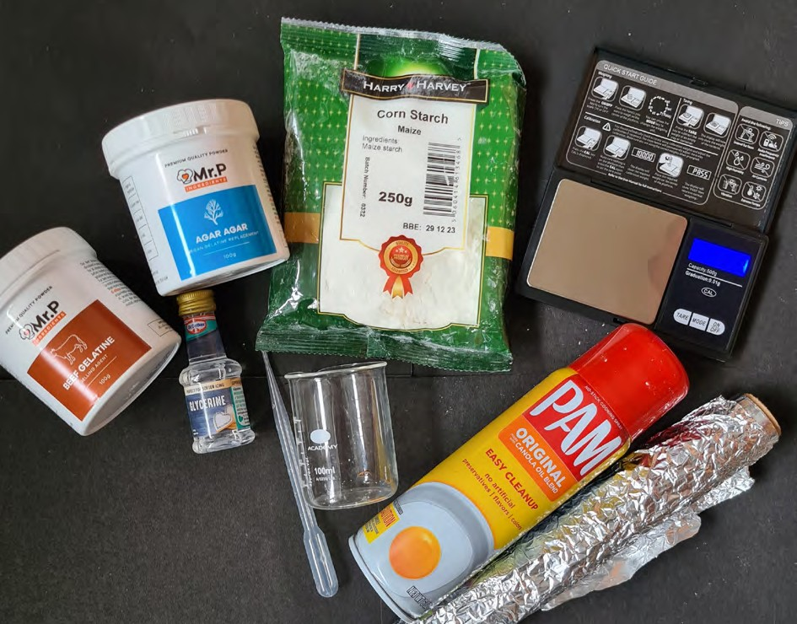
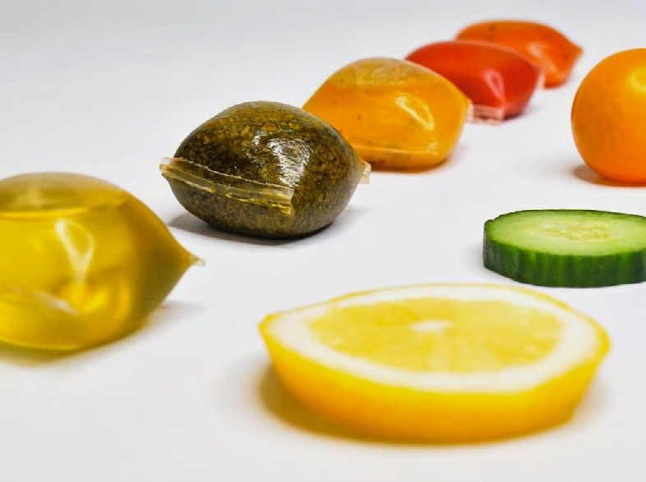
Making more bioplastics
If we move to biodegradable plastic alternatives, such as those made from natural marine ingredients, if they make it to the ocean, they should not cause damage ocean life.
Every year, billions of forks, knives, and spoons are thrown away. The Ocean Conservancy lists cutlery as among the items “most deadly” to sea turtles, birds, and mammals, and alternatives have proven particularly difficult to come by, though not impossible.
Have a go at making your own bioplastic cutlery handles. Test different bioplastic solutions for their strength and flexibility.
Part 1: Building the moulds
Create nine moulds using aluminium foil in the shape of cutlery handles, with the approximate dimensions of 1cm x 2cm x 10cm.
Ensure that they are leak proof.
Number each mould with a sharpie.
Spray the moulds with non-stick spray.
Spotlight
Check out ‘Notpla’, edible packaging which is being used as a replacement for plastic packaging at the Museum for Engineering Innovation.
Materials
Aluminium foil
Non-stick spray
Bio-based base layer
Corn-starch
Unflavoured gelatine
Agar-agar (seaweed vegetation)
Plasticiser (glycerine)
Heat-resistant beakers
Heatproof gloves
Mixer
Pipette
Teaspoon
Measuring jug
Accurate scales (mass scales)
THIS IS ENGINEERING: WATER 13

Slide 14
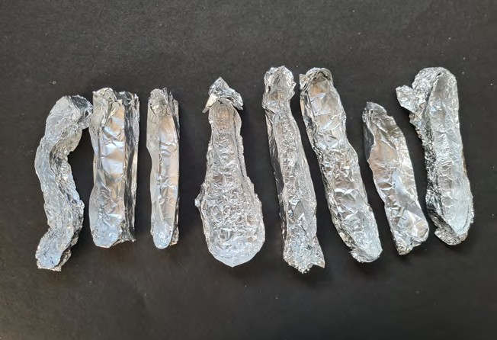
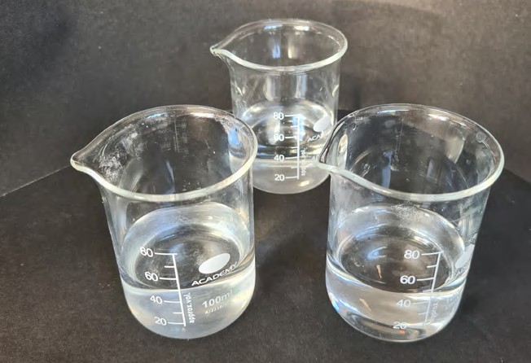
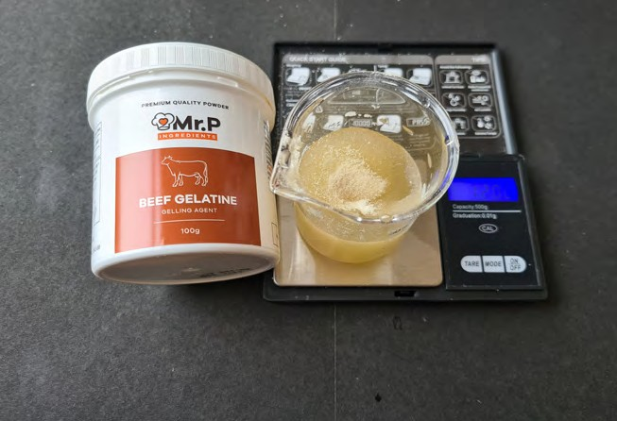
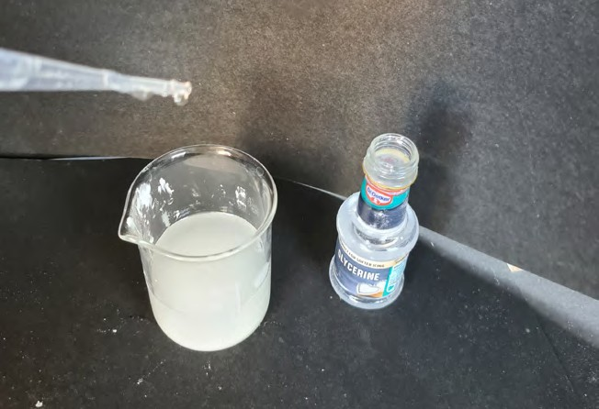
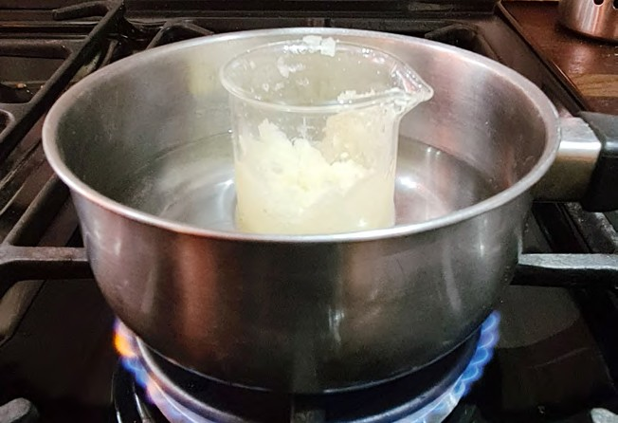
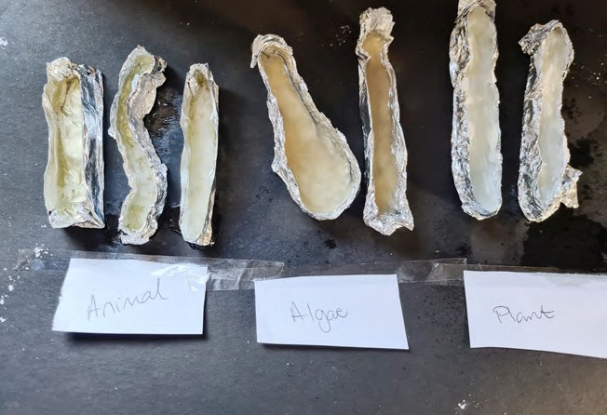
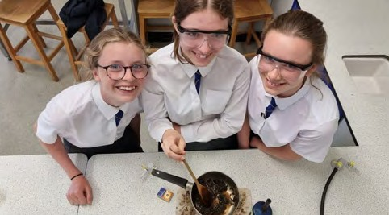
Part 2: Making the bioplastic
Create three plastic moulds for each source of base layer you have.
1
2
Source type
Base layer
Amount
Water
Plasticiser (glycerine)
Animal | Gelatine | 12g | 50ml | 5 drops
Algae | Agar-agar | 3g | 50ml | 2.5 drops
Plant | Corn-starch | 9g | 50ml | 5 drops
Make the moulds
Prepare three heatproof beakers with 50ml of water.
For each of the three sources, mix tap water, the base layer and glycerine in a heatproof cup using the proportions given in the chart. Stir each solution until there are no clumps.
Heat each mixture separately using a bunsen burner, hot plate, or water bath if your science department has one.
Carefully remove the cup using heatproof gloves.
Pour each mixture into three moulds. Try and pour the plastic to the same thickness.
Leave the mixture to dry in a warm place. This should take between three to five days. If your school has a dehydrator then you can use that to speed up the process!
Once the handles have completely dried, use the multiple samples you made to test the different base layer materials characteristics. Use the table to help record your results.
3
4
Add the base layer to the water to create three solutions.
Add glycerine to each solution.
5
6
Stretch and challenge
How much water and plasticizer would you need if you were just using 1g of gelatine?
What about agar-agar?
What about corn-starch?
Heat the solutions
Pour the solutions into your cutlery moulds.
Check out Sustainable Futures: Innovation Challenge winners who developed a reusable, edible container made from seaweed.
Health and safety
Work with an adult when using any heating equipment. Do not leave solutions unattended. If using a microwave, do not put anything metal in.
Wear heatproof gloves when working with your heated solutions. Wear goggles when working with your solutions.
14 THIS IS ENGINEERING: WATER

Slide 15
Part 2: Making the bioplastic
Score each of the base layers based on the different characteristics. Use this space to make any other observations about the different bioplastics.
Characteristic Corn starch Agar-agar Gelatine
Colour and opacity: Can you see light through the material?
Flexibility: 1 = cracks; 2 = stiff; 3 = somewhat flexible; 4 = very flexible
Freezing: Freeze a sample then rate its flexibility.
Heat: Heat a sample up to 45°C under a lamp or in an oven. Rate its flexibility.
Stain resistance: Place a drop of coffee/ mustard/Ribena on the plastic. Does it wipe clean?
Tensile strength: Tape pennies one at a time, on to the end of each sample. How many pennies can you tape before it breaks?
Part 3: Design improvements
Based on your initial results, which base material would make the best bioplastic for your cutlery?
What do you think the role of the plasticiser (glycerine) is in your solution?
How would you improve your bioplastic? What adjustments could you make to the ratios in your solution?
4. What else could you use your plastic-like material for?
This challenge has been adapted from the ‘Fork it over!’ challenge created by Oregon State University.
THIS IS ENGINEERING: WATER 15

Slide 16
Protecting rivers and oceans
from invasive species
Non-native species (also called invasive or alien species) in the marine environment cause big problems to our ecosystems.
Invasive species are said to have doubled in the last 50 years as we move more things and people around the planet.
Marine invasive species can have a devastating impact on biodiversity, ecosystems, fisheries, human health, tourism and coastal development and are very difficult and expensive to tackle.
For example:
shipping – through ballast water (water held in the cargo holds of ships) and biofouling (the collection of plants, algae, microorganisms, or small animals on wet surfaces) of ship hulls
navigational canals – transporting species via inland waterways
aquaculture – escape/overspill of non- native species introduced for farming
aquarium trade – deliberate and accidental release of exotic species
plastic pollution – transport of invasive species attached to plastic waste.
Information taken from oceanprotect.org.
What is an invasive species?
An invasive species is one that has been introduced by human activity – deliberately or accidentally – to
geographic areas outside its native range and caused ecological or economic impacts in that location.
Watch this Ted-Ed video about ‘The threat of invasive species’.
Time to reflect
Why do you think invasive species are a problem? Think of some examples using the table.
What do you think this problem has to do with engineers and engineering?
See the teacher guide for some ideas.
Economic problems
Environmental problems
Human health problems
How do we end up with marine invasive species?
Advances in technology, more travel and increased trade of food and goods with other countries has meant that marine invasive species are introduced through a number of different ways.
16 THIS IS ENGINEERING: WATER

Slide 17
Unstoppable species
Continue with the mitten crab until two of the native species are extinct.
*Adapt the time depending on your group or setting.
Pollutions in the atmosphere – what happens?
What about an ecosystem with pollution. Try these variations of the game:
Pollution can remove nutrients. Remove some of the pom-poms after a few rounds.
Pollution as a poison. Have one colour be a poison each round.
Work in groups of three. Two players choose two of the native fish species and play both roles at the same time.
Invasive species spread in different ways. Have a go at this game ‘Unstoppable species’ and explore the effects an invasive species has on an ecosystem.
Scoring
Each fish starts off with three lives. Each team should create a score card.
At the end of each round, each fish needs five pom- poms to survive.
For every three pom-poms beyond the first five, the fish produces one off-spring which counts as an extra life.
For example
After round one, the Atlantic salmon has collected nine pom-poms. The Atlantic Salmon does not lose a life as they caught five. The Atlantic Salmon also gains an extra life as they have three additional pom-poms.
Once the fish is out of lives, they become extinct. That player joins the Mitten Crab player, collecting pom-poms with tweezers.
Invasive species should try and eliminate native species. Think about tactics that might do this!
What happened?
Were you able to compete with the other native species for resources necessary to your survival and reproduction?
Were you able to compete with the invasive species for resources necessary to your survival and reproduction? Why? What made the Mitten Crab so successful?
What could the consequences be of organisms entering an ecosystem that have a competitive advantage over the native species?
What you need to play the GAME
Three different pom- pom colours
Wooden spoons
Wooden forks
Tweezers
Paper cups
Counters (optional)
Timer
Time to research
Working in pairs or threes, find out more about each of the invasive and native species. Use the table on page 19 to help with your research.
Find out about other invasive species. What impact are they having to the environment?
What is being done to combat invasive species? What role can engineering play?
Set-up
Working in groups of up to five. Each member of the group chooses a species of fish to represent. Each species will eat certain food, but can only do so in a particular way.
See page 18 to find out what and how each species eats their food.
Randomly distribute the pom-poms around a table. These represent the food.
Each species has a cup to collect their food. This cup must stay upright and in a fixed position.
Each of the native fish will have 30 seconds* per round to collect food using one hand and their assigned tool.
At the end of each round, the native species food returns back to the ecosystem.
After three rounds, the invasive species’ (mitten crab) arrives.
After each round, the invasive species returns half of their food back to the ecosystem.
Watch this video about the ‘Salmon Cannon’, designed to help Salmon get over dams, but also to remove invasive species!
This activity has been adapted from ‘Invasive Species Game’, The University of Toledo.
THIS IS ENGINEERING: WATER 17

Slide 18
Image
Species
What they eat
How they eat
 | Atlantic salmon |  | Spoon with one hand only
 | Brown trout (Salmo trutta) |  | Fork with one hand only
 | White-clawed crayfish |  | Spoon with one hand only
 | Native oysters |  | Fork with one hand only
 | Mitten crab | Eat anything | Uses tweezers with one hand only. You can add another invasive species to the game. What tool could they use?
18 THIS IS ENGINEERING: WATER

Slide 19
Image
Species
Habitat and other information
Why it is important?
What threat are they under/causing?
 | Atlantic salmon
 | Brown trout (Salmo trutta)
 | White-clawed crayfish
 | Native oysters
 | Mitten crab
THIS IS ENGINEERING: WATER 19

Slide 20
Measuring biodiversity
Invasive species alter and degrade the environment, and have a negative effect on native plant and animal species.
The environmental impacts of invasive species include:
Reduced biodiversity
Water shortages
Increased frequency of wildfires and flooding
Pollution caused by overuse of chemicals to control infestations
Biodiversity is essential for the processes that support all life on Earth, including humans.
Without a wide range of animals, plants and microorganisms, we cannot have the healthy
ecosystems that we rely on to provide us with the air we breathe, the food we eat, and the infrastructures in which we need to live.
Modelling biodiversity
Scientists and engineers carry out studies to find out what is happening in the environment and with biodiversity. They sometimes do this ‘for real’ out in nature, or they create models to replicate the
real world. They will also use ‘samples’ for information rather than gathering data about an entire area.
Measure biodiversity... in cake sprinkles!
MATERIALS
Materials
Three different types of cake sprinkles
Tray
Forceps (in the kit)
One square frame 3cm x 3cm with a 1cm x 1cm square hole in the middle. This is your model quadrat.
Glue stick
Calculator
A4 Graph paper (can be found on
this booklet)
Sample A Use 5g
Sample B Use 5g
Sample C Use 15g
Possibly magnifying glass/ microscope
You can use different cake sprinkles, but each sample must be different from the other two.
20 THIS IS ENGINEERING: WATER

Slide 21
Measuring biodiversity
Habitat C – meadow or grassland
Setup
Habitat A – River
Lay the graph paper on a flat surface.
Number along the x-axis and y-axis starting from 1 in the top left hand corner.
Use a random number generator to tell you where to take your sample.
Habitat A – river
Using a glue stick, create a ‘model’ freshwater habitat by covering a strip of graph paper with glue roughly diagonally across the sheet from bottom left to right.
This will represent a stream or river. This will be habitat ‘A’.
Lay the sheet of paper in the tray provided.
Pour sample A over the paper so the pieces stick to the ‘river’. Ensure the river is completely covered.
Collect any loose balls and add them back to your container.
Habitat B – Trees and shrubs
Quadrat
Habitat B – trees and shrubs
Apply about 7 or 8 blobs of glue, each about 1 cm², to remaining parts of the graph paper. These will be habitat ‘B’.
Pour sample B over the blobs of glue until they are completely covered.
What does each sample of sprinkles represent?
a population
a community
a habitat
an ecosystem?
Have a go at pollution, water system contamination, or invasive species on your biodiversity model?
Collect any loose balls and add them back to your container.
Habitat C – meadow or grassland
Pour sample C gently over the remaining graph paper. This will be habitat ‘C’.
Take samples of habitats A, B and C
What colours are present in each habitat?
Using your quadrat, cover sections of habitat A, B and C. Use the tweezers to pick up and put down your quadrat.
Count how many of each ‘species’ are present in the quadrat. This is your sample. Collect 5 samples for each habitat.
This activity has been adapted from ‘How rich is your habitat?’ by the Linnean Society.
A quadrat is usually square and used to mark out a small area. It is used to sample a larger area.
THIS IS ENGINEERING: WATER 21

Slide 22
 |  | Habitat A
Sample | Grid reference | Number in sample
 |  | White | Red | Green | Grey | Blue | Yellow
1 | (4, 5) | 3 | 6 | 0 | 5 | 4 | 5
2
3
4
Habitat A – Sample one
 |  | Habitat B
Sample | Grid reference | Number in sample
 |  | White | Pink | Yellow | Red | Orange | Grey
1 | (6, 2) | 1 | 3 | 1 | 3 | 1 | 0
2
3
4
Habitat B – Sample one
Sample 1 | Grid reference (4, 12) | Habitat C
 |  | Number in sample
 |  | Pink Yellow Orange White
 |  | 1 | 2 | 1 | 0
2
3
4
Habitat C – Sample one
22 THIS IS ENGINEERING: WATER

Slide 23
Stretch and challenge
Calculating Simpson’s Diversity Index
Simpson’s Diversity Index is a measure of the biodiversity of a habitat. It takes into account both species richness and species evenness.
The formula for Simpson’s Diversity Index (D):
Habitat A
Species | n (total from your sample)
White
Red
Green
Grey
Blue
Yellow
n = number of individuals of a particular species
N = total number of individuals of all species
The value of D ranges between 0 and 1. With this index, 1 represents infinite diversity and 0, no diversity.
Time to reflect
Do you think that a habitat could score 0? Do you think a habitat could score 1?
What do your results show you?
Habitat A =
Habitat B =
Habitat B
Species | n (total from your sample)
White
Pink
Yellow
Red
Orange
Grey
Habitat C
Species | n (total from your sample)
Pink
Yellow
Orange
White
Habitat C =
What do you think this symbol means?
This symbol is called ‘Sigma’. It means ‘sum up’.
THIS IS ENGINEERING: WATER 23

Slide 24
Support sheet – Graph paper

Slide 25
About me
Growing up, I lived in Sri Lanka and the UK, then settled in Manchester to do my GCSEs. I loved maths and wanted a job that would help people, and decided to be an engineer.
Now I work as a civil engineer, keeping people safe from flooding.
I decided to study engineering because I liked the idea of what engineering could achieve. I went to the University of Cambridge and studied Civil and Environmental Engineering.
While at university I volunteered with Engineers Without Borders UK. I learnt about engineers working in developing countries and how they help people access clean water and improve health with safe sanitation and drains, among many other things! I realised this was how I wanted to
use my engineering because I could see the impact that engineering had on people’s lives.
“I love that my work has value to people and that I have an impact on the world.”
I am now a civil engineer in the water engineering team at Arup, where I work on projects to keep people safe from flooding.
I design drainage systems and work with other experts to manage flood risk to communities. I work with nature, from rivers and lakes, to trees to manage rainwater in storms.
I work to make sure my designs are sustainable, with minimal negative impact on the environment. My work keeps people and houses dry and safe after large storms.
Find out more about Milly by visiting the This is Engineering website
Milly Hennayake
Flood fighter
Civil engineer at Arup

Slide 26
Flood defence
Time to observe
What do you think of this flood defence?
Milly works around the world developing innovative flood mechanisms.
Her work focuses on sustainability and community. How can she protect people, but also look after the environment and improve public living space?
What is a flood?
A flood is a “sudden onset event” where normally dry land is inundated with an overflow of accumulated water that it is unable to absorb.
What different types of floods can you name?
Challenge – build a flood defence to protect a town
One side of your tray represents a town, the other side is where floodwater will build up.
What materials could you use to build your barrier?
How could you use these different materials?
What are the advantages and disadvantages of the different materials.
Place a cardboard house at one end of your tray. Pour water into the other half of your tray.
What happens? What happens if you add more water?
In the kit there is hydrogel. This is a super absorbent smart material. Can you create sandbags using this material?
Milly is finding sustainable solutions to flood defence.
What sustainable materials could you use as part of your flood defence?
Time to observe
What do you think of this flood defence?
MATERIALS
Gratnells tray or similar
Hydrogels are materials that can swell in water, holding a large amount whilst still maintaining its structure.
They are often used in medicine to produce contact lenses, hygiene products and wound dressings.
Corriflute
Plasticine
Cardboard to make house
Sand
Hydrogel*
Tubing (to make sandbags)
What other materials could you use for flood defence?
26 THIS IS ENGINEERING: WATER

Slide 27
Natural flood defence
Image taken from ‘The river restoration centre – why restore?’.
What causes a flood?
Many factors can go into the making of a flood. There are weather events (heavy or prolonged rains, storm surge, sudden snowmelt), and then there are the human-driven elements, including how we manage our waterways (via dams, reservoirs, etc.) and the changes
we make to land. Increased urbanisation, for example, adds pavements and other impermeable surfaces, changes natural drainage systems, and often leads to more homes being built on floodplains.
at the natural flow of rivers to the role of trees, bushes and wetlands and wild grasslands, which naturally slow down water and help soil to absorb rainfall. When they are removed, it can increase flooding.
Why do engineers use river restoration as a natural flood defence?
What do we mean by ‘hard engineering’ and ‘soft engineering’?
Time to investigate
What happens when river flows down a slope?
Recreate this using sand and a water pump and see what happens to the water flow.
Is it affected by the steepness of the slope?
River restoration
Milly has been spending time within her role looking at how we can use the natural environment as a flood defence mechanism. This could involve looking
Challenge – complete the mini glossary
Impermeable means…
Urbanisation is… A floodplain is… A storm surge is…
THIS IS ENGINEERING: WATER 27

Slide 28
Natural flood defence
Challenge – Replanning a city with floods in mind
Create a plan for a small town that includes these natural flood defences.
MATERIALS
Gratnells tray or similar
Sand
Water
Water pump
River formation cut-out
3-6V
PWR OUT
POT
Diagram to help with wiring up the water pump.
Setup
1
2
3
This town plan is a birds eye view.
How could this plan be improved to include more natural flood defences?
Watch the video for some clues!
Fill a gratnell tray (or similar half with sand). Set up the water pump and stand system.
Elevate one half of the tray. Fill with water.
Activate the pump.
Watch what happens to river formation.
Time to research
What do we mean by natural flood defence?
In small groups, come up with three examples of natural flood defence.
28 THIS IS ENGINEERING: WATER

Slide 29
Flooding and climate change
More and more flooding factors are linked to climate change.
One result of climate change and increased temperatures is the melting of glaciers and loss of Greenland and Antarctica’s ice sheets. By the end of the century, it is predicted that sea levels could rise by more than one metre. This would put serious strain on coastal towns and cities.
If all the ice that currently exists on Earth in glaciers and sheets melted, sea levels would rise by 65 metres
Time to investigate –
glaciers melting and sea levels rising
What happens to sea levels as glaciers melt on land? What about icebergs at sea?
Set up
1
2
3
4
Fill two lunch boxes or Tupperware with water and put in the freezer until frozen.
Using two gratnell trays (or similar), fill half with sand and half with water.
In one tray, put one of your glaciers on the sand. In the other tray, put your ice berg in the water.
What happens to the water levels in each tray? What does this tell you?
Time to investigate – freshwater vs. salty water
Does ice melt faster in fresh water or salty water?
Before you carry out this experiment, everyone in the class should make a prediction.
“I think an ice cube will melt faster in fresh water.”
“I think an ice cube will melt faster in salty water.”
Set-up
Fill an ice cube tray with water.
Add food dye.
Once the water has frozen to become ice, drop one ice cube into a glass of salty water and one ice cube into a glass of freshwater.
What happens?
What does the food dye show?
Two cups with ice cubes. One with freshwater and one with salty water.
Which is which?
THIS IS ENGINEERING: WATER 29

Slide 30
Water and renewable energy
Water can be used to generate renewable energy*.
Water turbine challenge
Build a water turbine that will lift 5g of plasticine off the ground using 1L of water. Test this water turbine with different size pulleys.
MATERIALS
Stainless steel axle
Small hub with slots
Other hub without slots
3 x different size pulleys
Cold forming plastic
Scissors
1L water
Plasticine
Small scale
Thread
Recycled material such as water bottle, bottle caps, cardboard box, milk cartons.
1
2
3
Cut and shape the cold- forming plastic for your turbine blades.
Assemble your turbine blades.
Build a structure that will hold your turbine blades and a pulley.
Time to build
The cold-forming plastic can be shaped by hand at room temperature to form bends. Use this property to design your own turbine blades.
Attach the turbine blades to the small hub.
Could you add any other material to the turbine blades to improve their efficiency?
Thread the hub with the blades through the steel axle.
Attach one of the pulleys to the end of your axle. Secure the plasticine to the pulley using the thread.
Cold-forming plastic is a smart material that can be shaped by hand at room temperature.
It is a shape-memory polymer, so it will return to its original shape when heated – e.g. in hot water or with a hair dryer.
Time to test
Pour water onto your water turbine. What happens?
What adaptions or improvements could you make?
What happens when you use a different size pulley?
What voltage?
Use a motor and a
DataHive to measure voltage from your water turbine.
Do you think the smaller size or larger size will be most effective?
Get creative with your designs and materials!
Build a structure that will hold and elevate your turbine blades. You can use the other hubs to secure the axle.
*Check out our resource ‘Power Up’ for more on energy stores and transfers.
30 THIS IS ENGINEERING: WATER

Slide 31
About me
I am a PhD student at Cranfield University researching and developing new ways we can test water. I am part of a research team investigating a low-cost paper-based method of detecting antimicrobial resistance in water.
Antimicrobial resistance is when bacteria, viruses, fungi and parasites change over time and no longer respond to medicines making infections harder to treat. This means we are at greater risk of disease spread, severe illness, and death.
My PhD research has been a great way to see real life application to my science lessons and degree.
“It is exciting to be part of
something that will help society in such a huge way.”
I became interested in science and engineering during my first chemistry lesson at junior high school and immediately I fell in love. I found chemistry so interesting, there is always more to explore and to learn. It is a magical world.
I spend most of my day carrying out experiments in a lab. Eventually, my lab results will be used to develop new innovations in water testing. It is never boring doing research.
In the future people will be able to purchase these kits and test water quality for themselves!
Find out more about Wenliang Li by visiting Cranfield University
Wenliang Li
Water Warrior
PhD Student at Cranfield University

Slide 32
What’s in our water?
Engineers such as Wenliang Li are developing technology that can tell us what is in our water and what this can tell us about our health and the environment.
Water testing has been able to help us detect outbreaks of COVID-19 as well uncover serious health problems such as antimicrobial resistance.
This is where the medicine (antibiotics) that we and animals take ends up in our water supply. This can mean that the bacteria and fungi can become resistant to the medicine designed to kill it.
Under the lens
These are screen shots taken from a camera with the microscope attached.
What do you think each one is?
What are you looking for?
Within every drop of pond water in particular, lives an invisible world alive with a huge variety of microscopic creatures. You could find simple life forms such as bacteria, oxygen-producers like algae, microscopic animals like water bears and alien-like protozoa.
1
2
Time to investigate – water detective
Use the DIY phone microscope in your kit – assembly instructions are in the kit.
3
4
What can you detect in different water samples?
Sample ideas
Tap water
River water
Pond water
Sea water
Muddy water
What do you notice? What can you see?
How do you know if something in your sample is alive?
5
6
Health and safety
Work with an adult when visiting water sources. Collect water from a safe access point.
Wear gloves when collecting your sample
Wash your hands with soap after working with any water samples.
Have a go at taking your own close up shots and asking your classmates to guess what they are.
32 THIS IS ENGINEERING: WATER

Slide 33
Can you spot anything from this table?
Group
Key features
Bacteria |  | Single celled, dots or strands, just visible with strongest magnification, cyanobacteria are larger
Protozoa |  | Single celled, with tiny hairs or pseudopodia
Algae |  | Single celled, mostly green, sometimes yellow-brown
Rotifers |  | Wheel-like, hairy appendages, transparent, free swimming or attached 0.2 - 1 mm
Gastrotrichs |  | Two tails, hairy, round mouth opening 0.1 - 0.5 mm
Worms |  | long thin body, many non related forms
Bryozoa |  | Plant-like or jelly-like colony, crown of tentacles Individuals: 0.25 - 5 mm
Hydra |  | Green brown or colourless, body and tentacles contract and stretch Extended: 20 mm
Water bears (Tardigrades) |  | 8 stumpy legs, slow moving <1 mm
Arthropods |  | Jointed limbs; many groups e.g. crustaceans (‘water fleas’), mites
Other arthropods: Insect stages |  | Wide variety of forms
Citizen science
Ask your teacher to sign you up to this ‘Citizen Science’ project.
Find your local water source and take temperature and pH readings.
Upload your findings along with nearly 1,700,000 other people at: https://www.monitorwater.org/
THIS IS ENGINEERING: WATER 33

Slide 34
Cleaning up our act
Public drinking water systems use different water treatment methods to provide safe drinking water for communities.
Public water systems often use a series of water treatment steps that include:
Coagulation ■ Flocculation
Sedimentation ■ Filtration
Disinfection
Put a teaspoon of flocculant in one of your cups.
What happens?
Compare this to the cup that does not have the flocculant.
Why do you think this is happening?
Time to research
Can you find out what these different stages mean?
What can you see happening in the ‘Water treatment steps’ image?
1
Stage 1 – Flocculation
Flocculation is a water treatment technique in which particles combine to create bigger
clusters, or flocs, which are then removed from the water.
Time to flocculate
Prepare the water pollutant
Ideally, try and do this a day or two before you make your water filter devices.
In a jug, mix all your ingredients together to make a solution of polluted water.
Mix the solution thoroughly.
Divide your sample between two cups.
Divide your pollutant between the two cups.
2
What happens when you add the flocculant?
Image taken from https://www.cdc.gov/healthywater/drinking/ public/water_treatment.html
34 THIS IS ENGINEERING: WATER

Slide 35
Stage two – filtering
After flocculation, this water is then treated using water filters.
Investigate different types of water filters.
Use either the water from your flocculation experiment or new samples to build a filtering system.
1
Mini-glossary
Capillary action is the movement of water upwards against gravity.
What do you think is happening in the photo?
Set up your water filtering system.
Challenge – Build and test your own simple water filtering system using ‘capillary action’.
Mix a dirty water sample. For example, mixing soil and water.
Make your own water filtering system using any absorbent cloth material.
Handy hints: What absorbent materials do you know?
How about an all-purpose cloth or paper towels? Compare different materials. Does one work better than the other?
Can you add another stage to your filtering system?
2
Set up your water filtering system.
3
Compare different materials. What do you notice?
Absorbent filter material
Speed of filtering
Observations
DataHive Edition
Try a different water filtering activity in ‘This is Engineering: Sustainable Futures’.
Visit https://data.redfern.uk/ to find an interactive you can do with this challenge along with the DataHive Green.
THIS IS ENGINEERING: WATER 35

Slide 36
Soapy boats
Soap or detergent has an interesting effect on water which has been used to clean up oil spills.
Soap is made of long molecules with ends that behave differently: one end of the molecule is attracted to water and the other is repelled by it. The “detergent” action of soap comes from its ability to attach to oily, grimy surfaces at its hydrophobic (“water- hating“) end, which breaks up molecules at that surface.
Water molecules are attracted to each other (cohesion). This can be weakened by the addition of soap/detergent. The attraction between water particles at the water’s surface produces surface tension. The soap reduces the surface tension of the water around it.
You can use cohesion to make a boat powered by surface tension.
Either use one of the boats from the kit if you have it, or make your own using cardboard.
Place the boat on the surface of the water.
Gently touch the back of the boat with a small amount of soap.
What happens?
Try this with floating particles such as pepper or oregano. What happens?
Try this with different liquids such milk and vinegar. What happens?
Try using different boat designs. How does the size and shape of the affect its ability to move?
Look closely at the water/liquid when
you run this experiment. What do you see happening?
Power your boats
Add a thin layer of water to a tray.
1
2
3
About this experiment
This experiment can only be carried out once. The water will then need to be changed. All surface tension will already have been broken.
Fill your tray with a thin layer of water.
Carefully drop your boat in the water. Touch the back of the boat with some soap.
Try again but scattering pepper, oregano or other small particles.
36 THIS IS ENGINEERING: WATER

Slide 37
Cleaning up an oil spill
What happens when you add oil to water? Try it for yourself!
Oil and water don’t mix.
A chemical engineer would say oil is hydrophobic, or not attracted to water. Oil is also usually less dense than water, so it floats.
Oil in water behaves differently if you add a surfactant. This is a compound that lowers the surface tension between the two liquids, allowing the oil to break down in very small droplets than can then be dispersed through the water. Soap can act as a surfactant.
Challenge – build an oil boom to manage the spread of oil
Booms are floating, physical barriers to oil, made of plastic, metal, or other materials, which slow the spread of oil and keep it contained.
1
2
MATERIALS
Gratnells tray or similar
Cooking oil
Food colouring
Washing up liquid
Spoon
What is an oil spill and why is it bad for the environment?
Much of the oil we use for machinery, vehicles and industry is extracted from deep below the surface of the Earth, oftentimes in the middle of the ocean. When oils rigs, tankers or machinery malfunction or break, thousands of tons of oil can seep into the environment. Oil spill effects on environments and habitats can be catastrophic: they can kill plants and animals, pollute air and water and more.
Drop some oil into a pan of water. What happens?
Add some washing up liquid. What happens?
Boom building materials
Sponge
Straws
Cotton balls
Foam
Paper towels
Aluminium foil
Cotton buds
Tubular fabric
Time to report
Research an oil spill that happened in the last 30 years.
Where did it happen?
What were the consequences?
How long did it take to clean up.
Write a short news report about this oil spill.
What materials could you use to clean up
this oil spill?
A brown pelican coated in oil struggles on East Grand Terre Island, Louisiana. Image taken from National Geographic.
THIS IS ENGINEERING: WATER 37

Slide 38
Cleaning up an oil spill
Setting up your oil spill
Using a gratnell tray or similar, fill about 1/3 of your tray with sand.
Pour water into the other 2/3 of the tray, enough to touch but not cover the sand.
Build your boom using any materials that are accessible to you.
Pour around three tablespoons of oil into a measuring cup. Mix with a few drops of food colouring. Make a note of how much oil there is.
What do you think the oil and food colouring represent?
Place your boom on top of the water.
Does it float? Can you secure it?
Pour your oil in the water behind the boom.
Does your oil boom contain the oil? Does it absorb it?
Lift your tray slightly at the end with water.
Does any of the oil reach the beach?
Add a squirt of dish washer soap to the water.
What happens to the oil? What happens to the food colouring?
Use a spoon to carefully scoop out as much as oil as possible. Pour it back in your measuring cup.
How much are you able to remove?
Lift and shake your tray slightly to simulate waves.
What happens to the oil and food colouring?
38 THIS IS ENGINEERING: WATER

Slide 39
Floating compass
Earth’s Magnetic Field
Although soap can be used to clean oil spills, there are concerns around the impact it could have on the coral reefs and other marine life.
North Magnetic
Pole
Geographic South Pole
To combat this, engineers have developed a soap that responds to magnets. The soap is composed of iron rich salts dissolved in water, that respond to a magnetic field.
This means that they can control soaps to increase their ability to dissolve oils in water and then remove them from the system.
MATERIALS
Needle or pin
Magnet
Thick cardboard, or cork (something that will float and you can pierce with your needle)
Bowl of water
Time to magnetise
No matter where you stand on Earth, you can hold a compass in your hand and it will point toward the North Pole. Even if you are in the middle of the ocean, and all you can see if water in every direction, a compass will still tell you which way is North!
This works because planet Earth is a magnetic field.
A magnetic compass is made using a small, lightweight magnet balanced on a nearly frictionless pivot point.
Needles are usually made from steel which contains iron. Iron particles can be magnetised when stroked with a magnet.
Once you have magnetised your needle, it will try and point North if you remove as much friction as possible. You can use this to create a floating compass!
Set up
Stroke the needle with one end of your magnet in one direction.
Repeat this for approximately one minute. You have now magnetised your needle!
How could you test this?
Cut out a circular piece of card or find a circular piece of cork.
Pierce this with your needle. It must float.
What happens?
How can you check whether your needle is pointing North?
Improve your water compass so that it easily shows which way is North, East, South, and West.
Geographic South Pole
South Magnetic Pole
How can you tell which way is North on this floating compass?
THIS IS ENGINEERING: WATER 39

Slide 40
The Royal Academy of Engineering is harnessing the power of engineering to build a sustainable society and an inclusive economy that works for everyone.
In collaboration with our Fellows and partners, we’re growing talent and developing skills for the future, driving innovation and building global partnerships, and influencing policy and engaging the public.
Together we’re working to tackle the greatest challenges of our age.
What we do
Talent & diversity
We’re growing talent by training, supporting, mentoring and funding the most talented and creative researchers, innovators and leaders from across the engineering profession.
We’re developing skills for the future by identifying the challenges of an ever-
We’re building global partnerships
that bring the world’s best engineers from industry, entrepreneurship and academia together to collaborate on creative innovations that address the greatest global challenges of our age.
Policy & engagement
changing world and developing the skills
We’re influencing policy through the
and approaches we need to build a resilient National Engineering Policy Centre –
and diverse engineering profession.
providing independent expert support to policymakers on issues of importance.
Innovation
We’re driving innovation by investing in
We’re engaging the public by opening their eyes to the wonders of engineering and inspiring young people to become
some of the country’s most creative and
exciting engineering ideas and businesses. the next generation of engineers.
Royal Academy of Engineering Prince Philip House
3 Carlton House Terrace London SW1Y 5DG
Tel: +44 (0)20 7766 0600
www.raeng.org.uk
Registered charity number 293074

