Slide 1
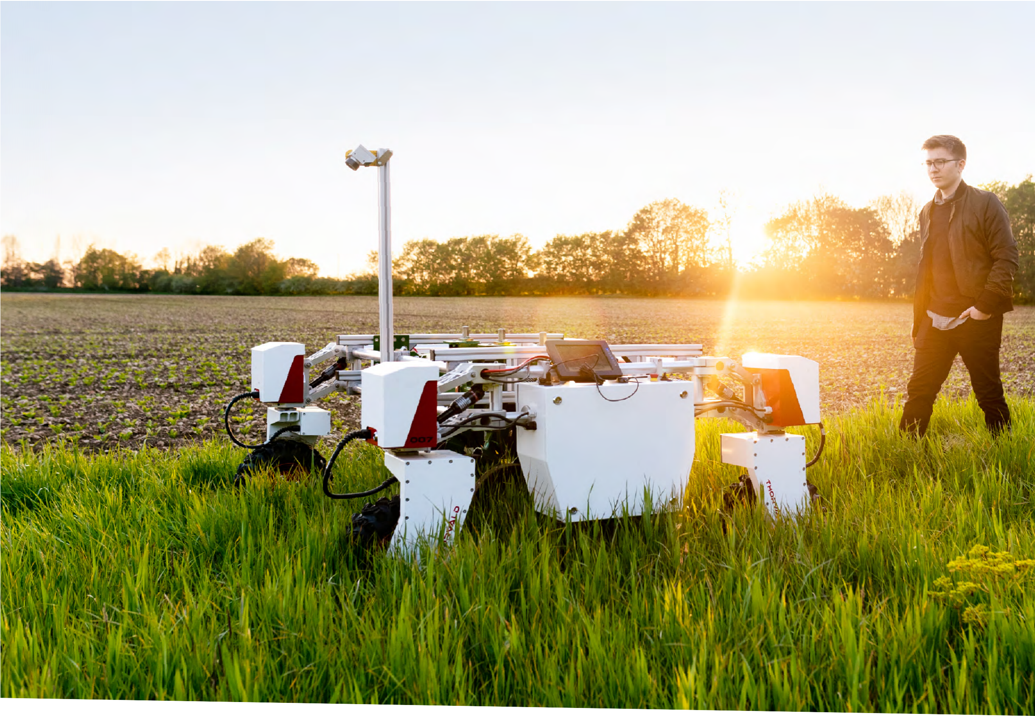
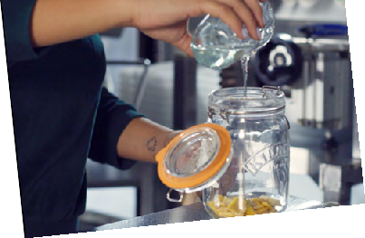
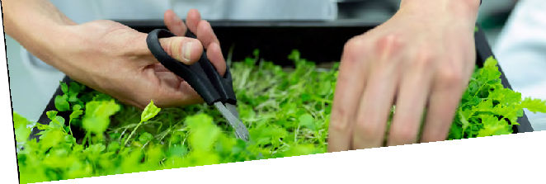
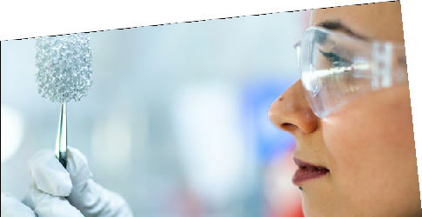
SUSTAINABLE
Student
Guide
Some of the biggest challenges we face
FUTURES
stem from how we interact with our
environment, and engineering is at the heart
of finding sustainable solutions.
Find stories of inspiring engineer^{s and}
bring the work that they do into ^{your home}
or classroom.

Slide 2
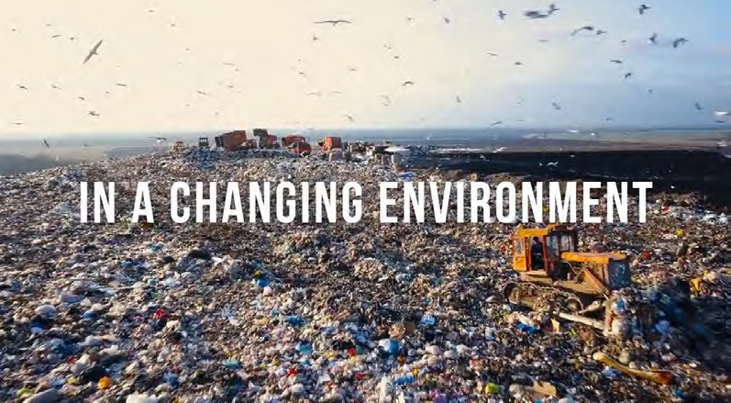
Introduction
Museum of Engineering INNOVATION
Engineering is everywhere – but often we don’t notice it.
Some of the biggest challenges we face stem from how we interact with our environment, and engineering is at the heart of finding sustainable solutions.
From renewable power to recycling, to making our homes more energy efficient, engineering is a vital field.
In a changing environment, what makes a hero?
Whatever change you want to make, choose engineering and be the difference.
Check out ‘Help the environment – This is Engineering’ at: https://www.thisisengineering.org.uk/what-interests-you/ the-environment/
The planes flying overhead, the food on our tables, and the inside of your fridge are just some of the engineering innovations that make life easier every day.
Engineers are also problem-solvers, tackling the world’s biggest challenges and shaping the future.
Energy experts and chemical engineers are developing solutions to the climate crisis. Mechanical engineers are working on wind turbines and solar panels. Civil engineers are making buildings greener world-wide.
This is Engineering celebrates the engineering that shapes the world and shows how engineers make a difference in our lives.
Visit the Museum of Engineering Innovation online to discover more about these inventions, and the engineers who are building a sustainable future.
Scan the QR code to visit the Museum of Engineering
Innovation for more stories of
engineers that are making a difference to our every day lives.
2 THIS IS ENGINEERING: SUSTAINABLE FUTURES

Slide 3
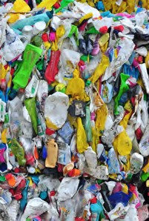
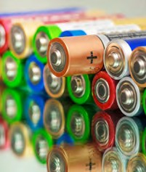
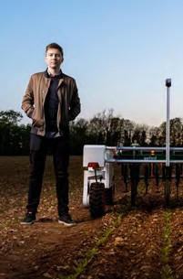
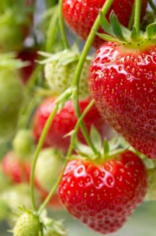
Choose your challenge
The problem with plastics
Investigate how much plastic there is in the products we use every day.
Explore the good and bad of plastics. The seven types of plastics fact sheet.
Sorting plastics using electrostatic charge.
Page 10
Waste not, want not
What do we mean by circular and linear economy?
How long does it take to decompose?
Packaging for a circular economy.
Page 15
Olivia
Battery power
Investigate how much charge is left in your batteries.
Make and test your own lemon battery.
Page 20
Energy efficiency
Discuss accessing electricity.
Make your home more energy efficient.
Page 23
Enass
Optimum growing conditions
What are the acid and alkaline levels of your soil?
Do your plants need watering?
Where is the best place for your plants to get the sunlight they need.
Page 27
Just ripe
Create a test that will tell you how ripe your fruit is.
Page 33
Halvard
Sustainable Futures Innovation Challenge
Find the ‘Sustainable Futures Innovation Challenge’ booklet at
http://stemresources.raeng.org.uk/this-is-engineering-sustainable-futures
Competition
Innovation
Challenge
THIS IS ENGINEERING: SUSTAINABLE FUTURES 3

Slide 4
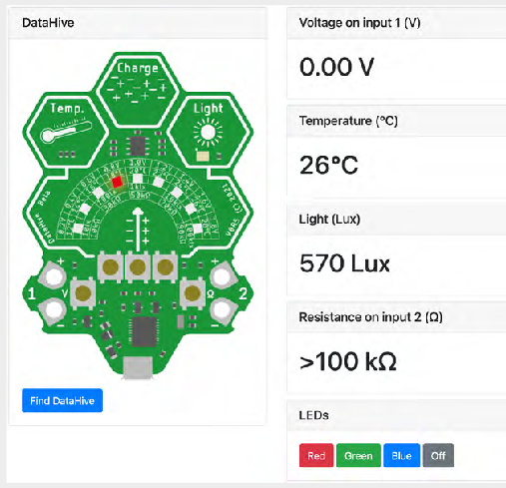
The DataHive Green
The DataHive Green is a device which has multiple sensors
to measure:
  Temperature (°C)
  Light (Lux)
  Voltage (V)
  Resistance (Ohm Ω)
  Electrostatic charge
The DataHive is used for many of the challenges in this booklet. Keep an eye out for images of the DataHive.
The DataHive can be powered by a coin cell battery* (included) or by connecting it to a computer or laptop using a Micro-USB (not included).
You can view data from the DataHive in a number of different ways.
The DataHive has a clock, which will automatically set to the correct date and time.
The DataHive has many more applications than the activities in this booklet. We want you to explore, experiment and come up with your own ideas for how it can be used.
4 THIS IS ENGINEERING: SUSTAINABLE FUTURES
Instant data
You can get an instant reading when you have the coin cell battery in the DataHive and press the corresponding button for the different sensors.
Live data
Connect your DataHive to a computer or laptop using a Micro-USB and visit data.Redfern.uk. Use Chrome or Microsoft Edge.
Click ‘Connect’ to connect the DataHive. You will see live data for each of the five sensors.
You can also turn on all the LED lights red, green or blue using the LED light controller.
*Coin cell batteries are small and can be easily swallowed. Take care when using these, especially with smaller children.

Slide 5
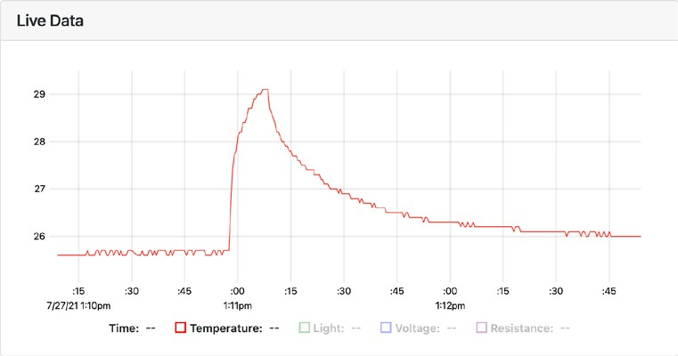
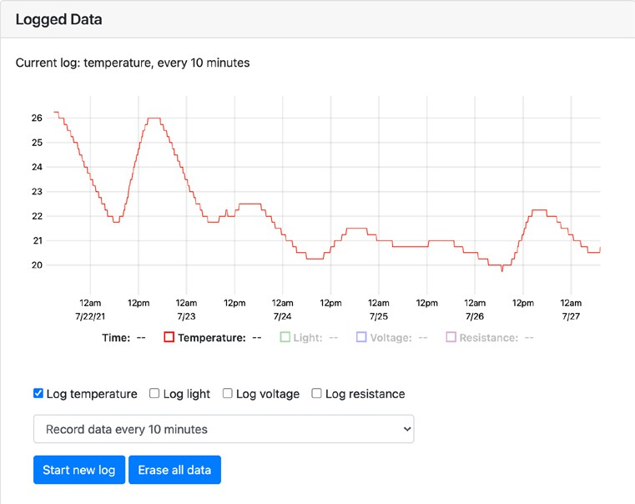
Graphing live data
You will see data displayed live for all the sensors except for the electrostatic charge sensor on a graph.
The x-axis represents time.
You can select which of the four sensors data you would like to view on the graph.
Logging data
If your DataHive is connected to power (either the coin cell battery or connected to a computer or laptop), it can record temperature, light, voltage, and resistance*.
You can view your logged data by connecting to a computer or laptop and visiting data.Redfern.uk.
You can select how regularly you would like to record data. You can also select what data you would like to record.
Once the memory is full, it will start overriding historical data. You can also delete historical data manually by visiting
data.Redfern.uk.
THIS IS ENGINEERING: SUSTAINABLE FUTURES 5

Slide 6
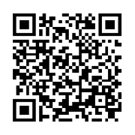
STEM Badges
How to collect
G
N
I
STEM Badges reward you for your commitment to STEM.
S
E
N
I
E
6
E
S
R
I
I
Complete SIX
challenges
H
N
T
G
For each activity you complete from this booklet, think about which engineering habits you are using and mark this out on the STEM badge record sheet.
you have been using on the following page.
Show and tell your teacher what challenge you have been working on and answer these questions:
  What problem did you solve?
  Which engineer or area of engineering does this challenge relate to?
  What did you discover by working on this challenge?
  Which engineering habits did you use?
  Did you work in a team or independently?
  What worked well?
  How could you improve this?
CHALLENGES
S
S
U
E
S
R
T
U
A
T
I
U
N
F
A
E
B
L
4
Once you have completed enough of the activities and challenges, cash them in for your STEM badges!
Complete FOUR
challenges
CHALLENGES
S
S
U
E
S
R
T
U
A
T
I
U
N
F
A
E
B
The badges are digital so you can link them to your online profiles and applications and you can’t ever lose them.
L
2
CHALLENGES
Complete TWO
challenges
How to collect your badges For each challenge, mark out up to three ‘engineering habits’
S
S
U
E
S
R
T
U
A
T
I
U
N
F
A
E
B
L
Tell us what you think...
Take our short survey for a chance to win £500 of robotics/coding equipment for your school.
Scan the QR code on your phone, or go to stemresources.raeng.org.uk/student-survey
6 THIS IS ENGINEERING: SUSTAINABLE FUTURES

Slide 7
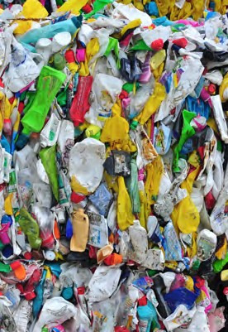
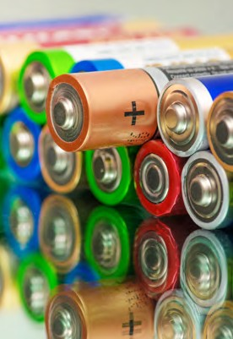
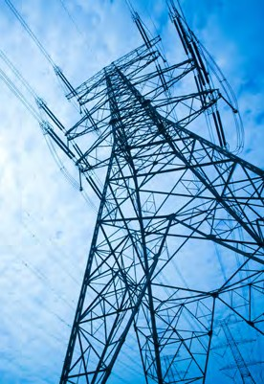
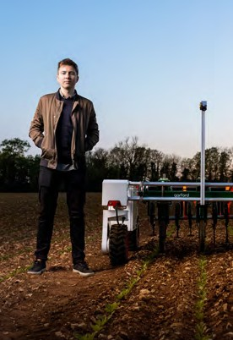
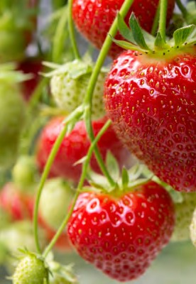
STEM BADGE Tracker
Name:
The problem with plastics Waste not, want not Battery power
energy efficiency
Optimum growing conditions
Just ripe
THIS IS ENGINEERING: SUSTAINABLE FUTURES 7

Slide 8
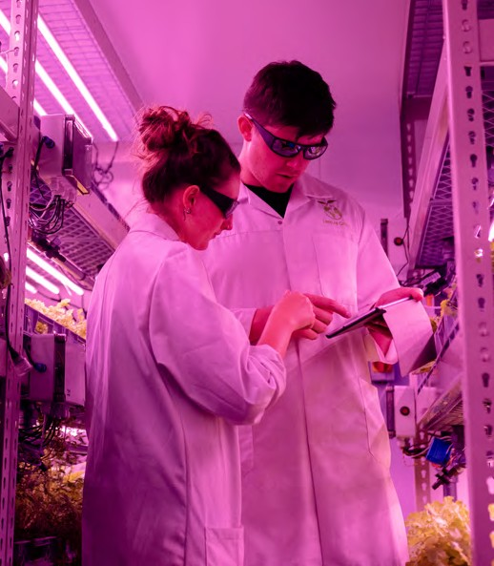
Engineering habits
Engineers make ‘things’ that work or make ‘things’ work better. But they do this in particular ways.
The ‘engineering habits’ describe the way engineers think and act.
But remember, results are not fixed! If you take the quiz several times, you might find that different engineering habits are stronger depending on the type of activity or challenge you are doing.
How do you think and act like an engineer?
Take the quiz at This is Engineering: Sustainable Futures to discover your ‘engineering habits’.
Engineering is all about having a diverse group of people and skills so having different engineers with different habits of mind in any team is always important!
I AM GOOD AT...
Creative problem-solving
Improving Problem-finding Adapting Visualising
Systems thinking
Coming up with lots of new and good ideas
Working successfully in a group
Making what I have Thinking about the Deciding how Thinking out loud Using ideas from done better world around me and something could when I am being one subject in
how it could be better be done differently imaginative another
Experimenting with
things just to see Finding out why Explaining how well Making a plan Putting things what happens something does I am doing to my before I start work together to make
not work teachers and friends something new
Find the full quiz on the ‘This is Engineering: Sustainable Futures’ page
on our STEM resource hub.
8 THIS IS ENGINEERING: SUSTAINABLE FUTURES

Slide 9
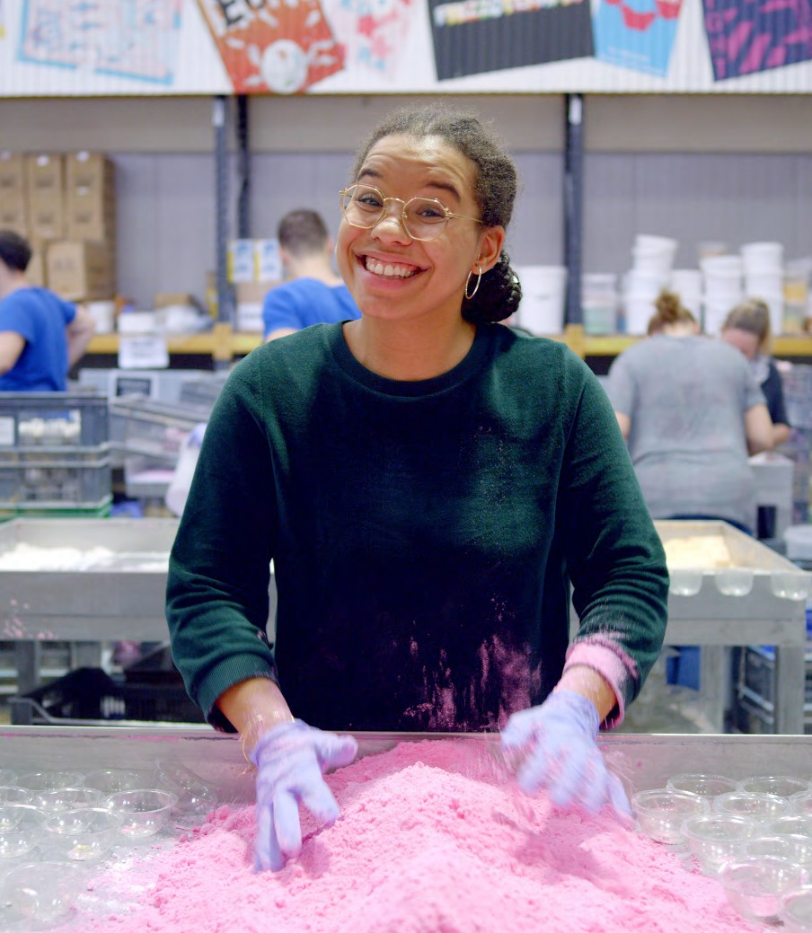
About me
Reduce, reuse, recycle – I grew up hearing these words since primary school and am passionate about creating a waste-free world.
“Engineers are part of the modern world and help make dreams become reality with their problem-solving skills.”
My house was a blend of science and art thanks to my parents. I did A-Levels in Music and English literature as well as maths and chemistry. Doing a degree in chemical engineering allowed me to follow my passion for sustainable choices in a tangible way.
After completing my degree, I started working for cosmetics company Lush. Working there and sourcing and creating chemicals in a sustainable way has given me the power to make a difference.
For me, chemical engineering means you can end up creating anything based on your own curiosity.
Olivia
Fragrance Finder
I now work for a sustainable waste consultancy – Resource Futures. My passion and interest for the circular economy led me to this role.
Find out more about Olivia by visiting the This is Engineering website

Slide 10
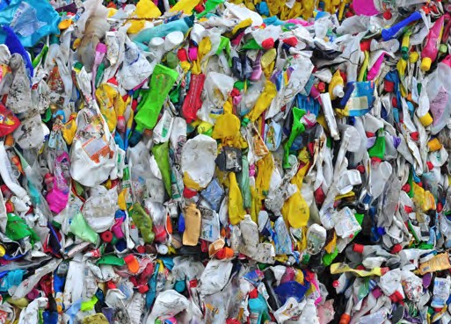
The problem with plastics…
CHALLENGE
Olivia’s role, both at Lush and at Resource Futures involves investigating the materials we use, where they come from, how they are produced and, most importantly, what we throw away.
We use plastics in:
And one of the biggest resources we consume globally is of course plastic!
with plastics – especially plastic packaging.
One minute plastic challenge
Individually, write down as many things as you can that are made from or use plastic.
After one minute, share answers with your group. Did you have something that no one else had? Did any of the answers surprise you?
Plastics everywhere
Plastics are everywhere. They are an integral part of our modern life. Their use has increased by twenty-fold in the last 50 years and is expected to double again in the next 20.
Packaging
Clothing
Health & Beauty PRODUCTS
Today, nearly everyone, everywhere, every day comes into contact
Mini-glossary
Plastics are a group of materials, either synthetic or naturally occurring, that may be shaped when soft and then hardened to retain the given shape.
Plastics are polymers.
A polymer is a substance made up of many repeating units.
Electronics
Healthcare
Construction
In your small groups, come up with more than one example where plastic is used for each category.
Transport
10 THIS IS ENGINEERING: SUSTAINABLE FUTURES

Slide 11
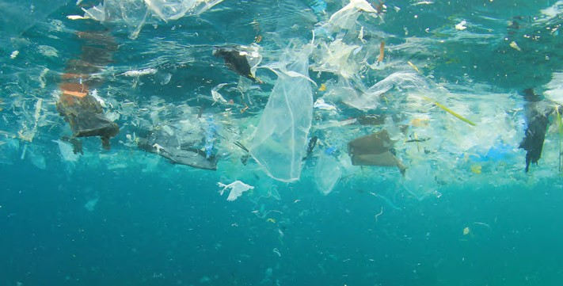
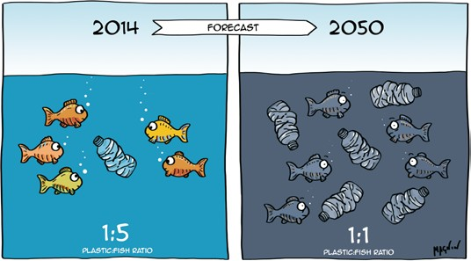
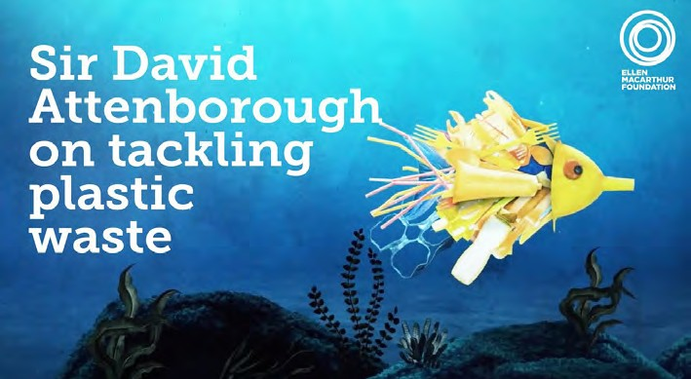
Time to reflect
Stretch and challenge
Take one small sample of the ocean. From 2014 to 2050, predictions show that there will be an additional 200 pieces of plastic. How much plastic was in that sample in 2014?
Time to research
It can feel like a bit of a minefield out there with so many types, uses and recycling properties of different plastics.
Time to get some questions answered and get ‘clear on plastic’.
Visit https://clearonplastics.com and find out about one of the following:
  What happens to plastic in our tea bags?
  Why is plastic used in our health and beauty products? How can we stop this?
  Why can’t we replace plastic with other materials such as glass or paper?
  Is recycling worth it?
  What about bio-plastics, biodegradable and compostable plastics?
Once you have carried out your research, share your findings with the rest of your group.
Check out this video which explains types of plastics and what they are used for: https://clearonplastics.com/what-are-the-types- of-plastic-and-what-are-they-used-for/
The good and the bad Individually, or in small groups discuss the following:
  What are some of the benefits and what are some of the drawbacks of using plastic?
  Is all plastic the same?
  Do you know of any innovative approaches to how plastic has been used?
There are of course many benefits to using plastic; however we need to make some big changes around how we make, use and dispose of plastic.
If we carry on as we are, research suggests that by 2050 there will be more plastic than fish in the sea.
Time to calculate
In 2014, for every 100 fish, how much plastic was there? Use the diagram shown below for the ratios.
The
The
good?
bad?
Watch ‘Solving Plastic Pollution’ video, by the Ellen MacArthur Foundation and narrated by Sir David Attenborough. to find out more about plastic pollution.
Illustration by Alexandre Magnin: www.sustainabilityillustrated.com
THIS IS ENGINEERING: SUSTAINABLE FUTURES 11

Slide 12
The seven types of plastic – fact sheet
Not all plastics are made the same.
The type used will depend on what they are being used for.
Some can be really flexible, others brittle, others withstand heat and some are extremely lightweight.
Some plastics can be recycled, whereas some are really difficult to recycle. And some plastics will contaminate other plastics if recycled in the same batch.
Polyethylene terephthalate (PETE)
What products is it used in?
Clear bottles, food trays.
What does it look like?
A tough plastic which discolours if you bend it.
Can it be recycled?
One of the most commonly recycled plastics.
High-density polyethylene (HPDE)
What products is it used in? White milk bottles, cleaning products, shampoo bottles and some bottle caps.
What does it look like?
A thick tough plastic which will spring back if bent, caps can usually be flexed.
Can it be recycled?
Very commonly recycled.
Polyvinyl chloride (PVC - U)
What products is it used in? Clear bottles (look for a line on the bottom of the bottle), food trays, toys, piping, wire insulation.
What does it look like?
More fragile and will crack and/ or stay bent if stressed, bottles make a ‘crinkle’ cracking sound if squeezed.
Can it be recycled?
Rarely recycled. It can also contaminate other recycling.
Low-density polyethylene (LPDE)
What products is it used in? Carrier bags, bin liners, and packaging film.
What does it look like?
Can be thin to thick, but is known as flexi-plastic and is easily torn.
Can it be recycled?
Very difficult to recycle. You can reuse bags or some
supermarkets might have specific collection points.
Polypropylene (PP)
What products is it used in? Margarine tubs, clear fresh soup containers, some bottle caps, microwaveable meal trays, also produced as fibres and filaments for carpets and vehicle upholstery.
What does it look like?
Will shatter into stripes if compressed. Caps will usually be too hard to flex. Can usually in the microwave and freezer.
Can it be recycled?
Not generally recycled.
Polystyrene or styrofoam (PS)
What products is it used in? Yoghurt pots, insulated disposable cups, some trays, parcel packaging. Also used for insulating material in construction industry.
What does it look like?
Will tear or pull apart depending on the form.
Can it be recycled?
Not generally recycled.
Other
What products is it used in? Reading glasses, crisp packets. DVDs and their cases, electrical connections and wiring, general household plastics.
What does it look like?
The majority of these plastics are very tough and are likely to shatter if pressure is applied.
Can it be recycled?
Not generally recycled.
12 THIS IS ENGINEERING: SUSTAINABLE FUTURES
Images courtesy of: https://www.open.edu/openlearn/science-maths-technology/chemistry/the-seven-types-plastic

Slide 13
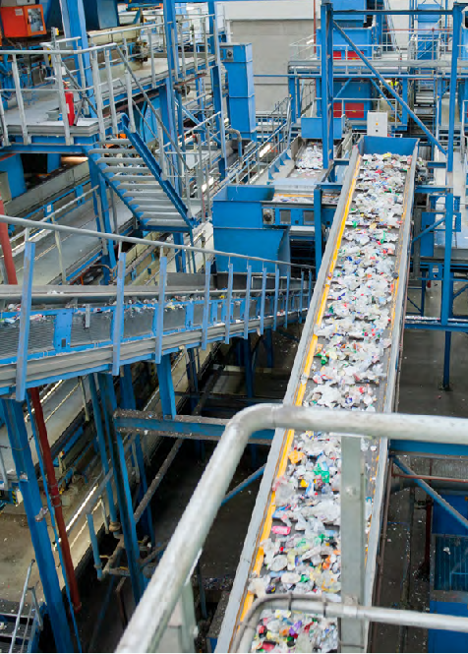
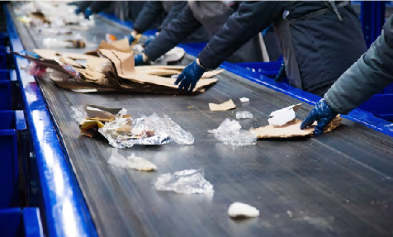
Sorting plastics
This is called a triboelectric series.
What’s in your bins?
What about the plastic we throw away? What happens to that? Are we recycling correctly?
Check your bins and recycling for any plastic.
Do they have the labels that you could see on the fact sheet?
Visit www.recyclenow.com/what-
to-do-with and find out what can be recycled and how.
Sorting plastics using electrostatic charge
Different plastics have different properties and so have different uses. In order for waste plastic to be recycled, it needs to be separated. There are many different
technologies used for sorting plastics. These
will often be carried out using programmed machines. One method used to sort plastics is by their electrostatic properties.
When two non-conducting materials are rubbed together, electrons migrate from one material to the other, leaving one material with a positive charge and the other with a negative charge. By rubbing different combinations of materials together and recording which
one become positively charged and which
one becomes negatively charged, you can start ordering the plastics based on their electrostatic charge.
Your DataHive has a electrostatic charge sensor which can measure positive and negative charge. Use this to find the electrostatic properties of different plastics.
Find a piece of plastic and identify it using the fact sheet on page 12. Using your DataHive, press the button for the electrostatic charge function, move the DataHive towards the plastic and read the LED gauge to find out the electrostatic charge of your plastic.
Now rub the plastic with a cloth, or a
t-shirt, jumper or another piece of plastic. Now hold down the button again and move towards the plastic.
  What do you notice?
  Does it work the same if you do this with different materials?
  What do the fabrics have in common
that transfer an electrostatic charge?
Try rubbing different materials together. Can you find any similarities between different plastics and different materials? Experiment with materials such as glass, hair and cardboard.
  Do all of them build up electrostatic charge?
  Do some build up more electrostatic
charge than others?
THIS IS ENGINEERING: SUSTAINABLE FUTURES 13

Slide 14
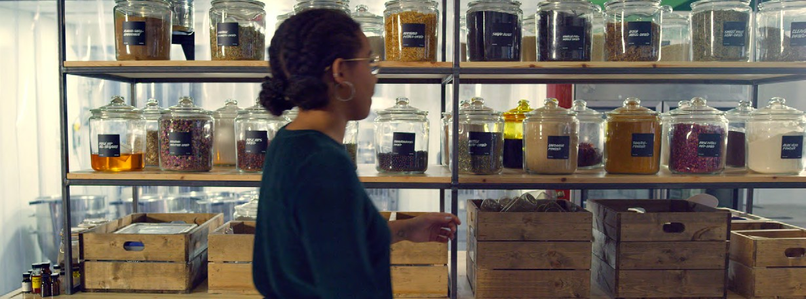
Use the table below to help you sort the plastics and find out which are most likely to gain or lose positive or negative charge.
Material A Material B
Move towards sample
Press and hold charge button
LED gauge will move to the left if negative charge is detected, or to the right if positive charge is detected.
Positive
Negative
14 THIS IS ENGINEERING: SUSTAINABLE FUTURES

Slide 15
Waste not, want not
CHALLENGE
Time to reflect
What do you think is happening here?
Olivia spends a large part of her job investigating what we throw away, and what happens to our rubbish and recycling after it has left our homes.
Poor waste management has devastating effects on the environment. Waste that gets into our water systems and soil can contaminate them. Air pollution can also be a major problem, with landfills and waste burning facilities producing large amounts of harmful chemicals contributing to the serious issues of climate change.
A linear economy follows the ‘take-make- dispose’ journey. This means that raw materials are collected, and then transformed into products that are used until they are finally discarded as waste.
Circular economy
What if we had a model that was ‘circular’, and kept products and materials circling within the system, removing waste from the equation completely?
Olivia works on how we can move from a
linear economy to a circular economy.
Time to reflect
Can you think of an example of somewhere you have seen circular economy in action?
Not on my doorstep
We put our rubbish in bins, recycling or into compost. In many countries around the world, rubbish and recycling collection does not exist in the same way. Sometimes our rubbish and recycling is taken to countries with poor waste management, which means we don’t have to think about it, but it has a huge impact on other communities.
A circular economy is based on designing out waste and pollution, keeping products and materials in use, and regenerating natural systems.
Watch the YouTube video, ‘Explaining the circular economy’ made by the Ellen MacArthur Foundation.
Linear economy
Although there are many plastics and other materials that we use that can be recycled, approximately one quarter of our waste goes straight to landfill. This is called a ‘linear economy’.
THIS IS ENGINEERING: SUSTAINABLE FUTURES 15

Slide 16
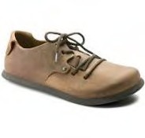
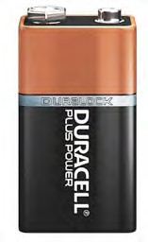
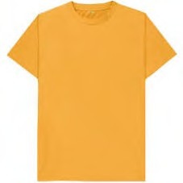
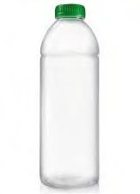
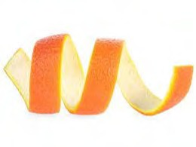
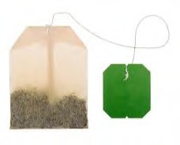
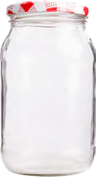
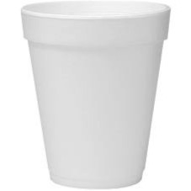
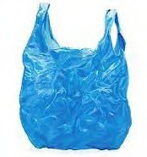
Waste timeline
Put the items on the timeline* depending on how long you think they take to decompose.
Leather shoe | Battery | T-shirt | Plastic bottle | Orange peel
Tea bag | Glass | Styrofoam | wet wipes | Plastic bag
One month
One year
One thousand years
One million years
Six months
Ten years
Ten thousand years
1,000,000
*Timeline not to scale
0
16 THIS IS ENGINEERING: SUSTAINABLE FUTURES

Slide 17
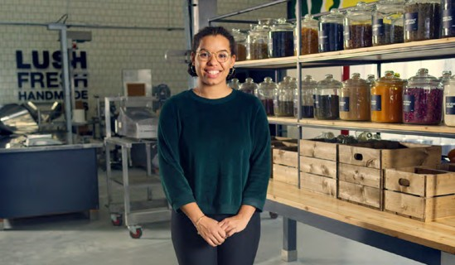
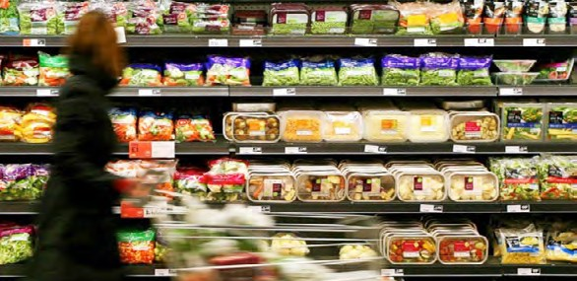
Packaging for a circular economy
A pair of glasses made from Parblex: bioplastic from potato waste
One example of a circular economy is an engineer who has been turning potato peel into sustainable bioplastics for the fashion and interior design industry.
Another example of circular economy in action is how Olivia, during her time at Lush, developed a new facial cleanser using waste banana skins.
Time to reflect
Think about a food item that you have recently bought. Or an electrical item you have recently purchased. Maybe a game. Or clothes, make
up or health and beauty products. Visit your
local supermarket, what does the fruit and vegetable aisle look like?
Innovation
Challenge
Sustainable Futures Innovation Challenge
You might want to think about the circular economy when working on your
‘Sustainable Futures Innovation Challenge’. You can also expand on an idea that you have started as part of this challenge for your competition entry.
At the heart of many of many engineering solutions working towards a more sustainable future is ensuring that we
do not create more harmful waste and work towards a ‘circular economy’. When designing a new product, it is important to think about not just what happens to the packaging, but what actually happens to that product once you no longer need it.
Lush are also a good example of working within a circular economy not just in their products, but their packaging.
Over 50% of their products have been designed in such a way so that there is no packaging at all.
  Is there any packaging?
  What is the purpose of the packaging material?
  Can the packaging be reused or recycled?
Read more about Lush’s sustainability plan at: https://weare.lush.com/lush-life/our- impact-reports/go-circular/
Use the fact sheet on page 12 to help identify different types of plastic and whether they can be recycled.
The plastic problem
Some companies have made and are making big changes to how they deliver their products. But there is still along way to go.
Most plastic packaging has a life-span of mere minutes. Every year about 8 million tonnes of plastic escape into the oceans from coastal places. Plastics can take up to 500 years to breakdown.
Watch the YouTube video,
‘The Sachet Challenge’
What do you see here?
made by the Ellen MacArthur
Foundation to get you started.
THIS IS ENGINEERING: SUSTAINABLE FUTURES 17

Slide 18
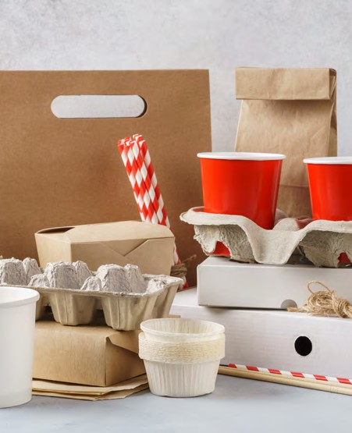
Rethinking packaging
Materials
  The product you want to rethink the packaging for, ideally in its original package.
  Post-it notes and large paper
  Coloured pens
  Scissors and glue
  Recycled cardboard, newspaper and scrap paper
  And anything else you can come across!
In groups choose a product that you know the packaging cannot be easily recycled or reused, and redesign the packaging. Ideally choose something that you can actually bring in and test. For example a food item, or a health and beauty product.
What are the pros and
How can we design packaging for .................... that .......................................
and is still fit for a
circular economy?
Brainstorm as many ideas as you can think of.
cons of the existing
Write a list of the
packaging?
things your packaging
needs to do:
Share your ideas.
What was the initial problem you were tackling?
The idea we have
Lets start prototyping!
Use any recycled material you can and get making.
It doesn’t have to be perfect, make and test different options.
chosen to explore
further and
prototype is...
This activity was inspired by ‘Redesigning Plastics’ activity from the Ellen MacArthur Foundation.
The product we have chosen is .................................................. because ...................................................
18 THIS IS ENGINEERING: SUSTAINABLE FUTURES

Slide 19
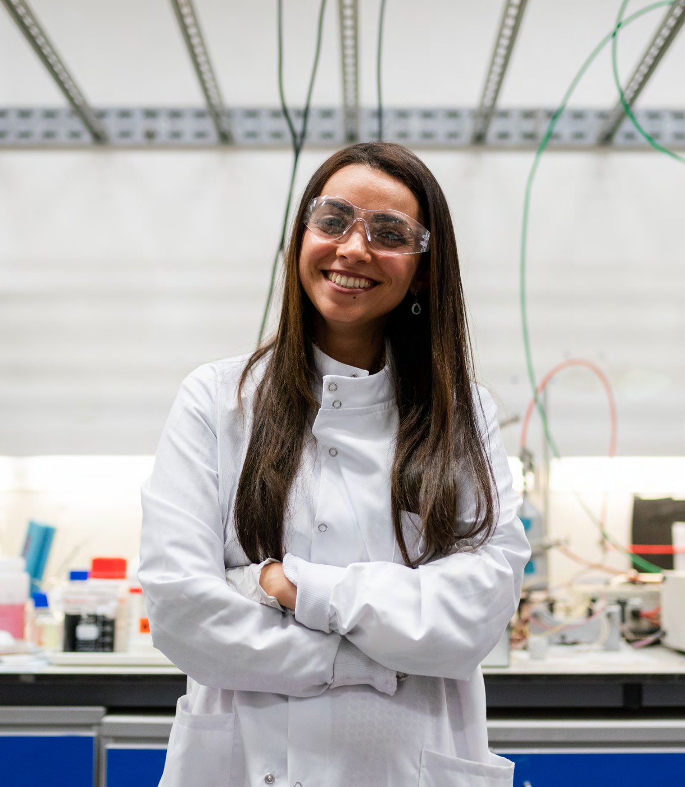
About me
I have always been an activist at heart. From a young age, I thought about air pollution, climate change, and the effects of burning oil and gas for energy on the environment.
After a trip abroad during my PhD, I realised how much of a luxury electricity was, with hospitals in some places only receiving electricity for
half the day.
“For me, engineering is simply about wanting to solve a problem and having the passion and the imagination to create a solution.”
I saw this as a problem that engineering could fix, and in the process, help save lives and the environment too.
I founded my company straight out of the University of Cambridge – focusing on
developing a hydrogen battery that would be able to store clean and renewable energy in countries without an electrical grid.
Find out more about Enass by visiting
Enass
Power Pioneer
the This is Engineering website

Slide 20
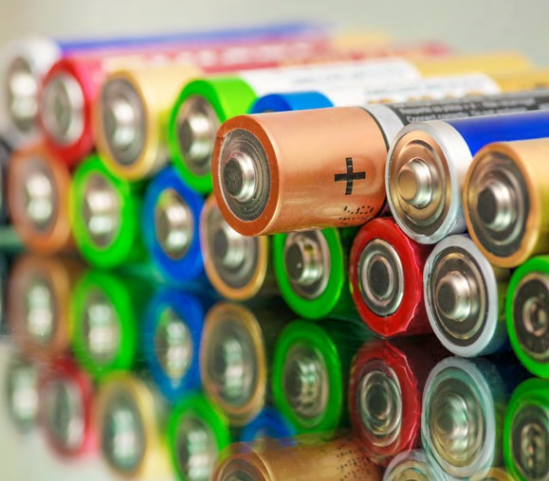
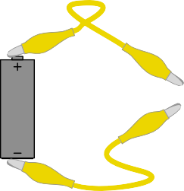
Battery power
CHALLENGE
There are many different types of batteries that have different uses.
Although many of the electronic devices we use have rechargeable Lithium Ion (Li- ion) batteries, single-use Alkaline batteries are still used in many of the devices we come across.
Time to reflect
  What devices do you use that use single-use or ‘disposable’ batteries?
  What do you think the problem with
using single-use batteries is?
The solution
Batteries can be disposed of at a ‘battery bank’ where they should hopefully go on to be recycled. Valuable materials can be captured from the old batteries and any toxic waste can be captured. Unfortunately, it has been recorded that 97% of single-use batteries end up in landfill.
But if we could reduce the amount of batteries that we dispose of in the first place, then we could at least start to reduce the amount that end up in landfill.
Test your batteries
Your DataHive has a voltmeter at ‘Input 1’. Attach the two croc leads to the positive and negative pads on the DataHive. Find a battery that you think is fully charged, and find another that you think is dead. Hold the croc leads at either end of the positive and negative end of the battery and push the voltmeter button.
Which way round do you think you need to connect the croc leads to get a reading on the voltmeter?
The LED gauge will show you the voltage of the battery. A standard AA battery is a 1.5 Volt cell. But different batteries have different voltages and different battery chemistry.
As the battery is discharged (using energy),
Connect battery to input 1 (note
+ and -)
Press button to show voltage on input 1
Sometimes new and old batteries will become mixed and it is difficult to tell which ones still have power so we
end up disposing of batteries that still
have energy stored. Or once we think a single-use battery has run out of energy, we will dispose of it even if it still has energy stored.
The problem
Single-use batteries contain many hazardous metals and chemicals. If batteries end up in general waste, and onto landfill this has serious damaging effects to our environment, with the potential for this toxic waste to end up in our water supply.
20 THIS IS ENGINEERING: SUSTAINABLE FUTURES

Slide 21
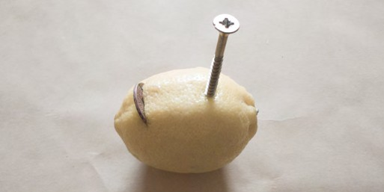
Make and experiment with your own battery
the voltage decreases and so we can use this as an indicator of remaining energy.
Test the batteries in different electronic devices. Some products are more efficient than others, and will use more of the available energy because they can keep functioning at lower voltages.
Do you have a device that has stopped working because you think the battery has died?
Does the battery still have energy stored?
Can this battery be used in a different device?
Time to make
It can be tricky to attach croc leads to batteries and measure their voltage.
Make a device that will hold AA and AAA batteries to make it easier for people to test their batteries.
But what are batteries?
Batteries are containers that store chemical energy, which can be transferred electrically.
They depend on an electrochemical reaction to do this. The reaction typically occurs between two pieces of metal, called electrodes, and a liquid or
paste, called an electrolyte. Once these are in place
ions (atoms with too few or too many electrons) are formed from the materials in the electrodes.
At the same time, electrons move from one electrode to another. For a battery to work, the electrodes must be made from two different conducting materials. One of the materials ‘likes’ to give up electrons, the other likes to receive them. This difference is what produces electricity.
Connect the two electrodes with a material that can
conduct electricity well (called a conductor). This allows the chemical reactions and the battery to produce electricity!
Materials
  Two different metals to use as the electrodes. For example, a copper coin or a steel nail.
  Croc leads (a good conductor)
  A juicy lemon (lemon juice is an
electrolyte)
  Knife (ask for adult help when using a knife)
  DataHive to measure the voltage
Staying safe
In this experiment, you will be making a very low-voltage battery. The amount of electricity produced by this homemade battery is safe, and you will even be able to test it by touching your finger to it and feeling the weak current. Higher voltages of electricity, however, can be very dangerous and even deadly; you should not experiment with commercial batteries or wall outlets.
Making your battery
  We are using a screw and a copper coin as our two electrodes
  Insert a penny into a cut on one
side of the lemon. Part of the penny should be in contact with the lemon juice. The lemon juice is what acts as the electrolyte.
  Push a screw into the other side of
the lemon. The screw and penny must not touch.
Your battery will generate electricity only once the electrodes are in contact with something that conducts electricity.
Connect a croc lead to the screw and another croc lead to the copper coin. Connect the croc leads to the pads at Input 1 on the DataHive and press the voltage button.
You have just made a battery! Otherwise known as a cell.
Hint: If it’s not showing a reading, you might need to swap the croc leads round.
It has two electrodes of different metals and an electrolyte separating them.
What is the voltage of your lemon battery? Which electrode is positive, and which is negative? How can you tell?
THIS IS ENGINEERING: SUSTAINABLE FUTURES 21
What do you think is missing so that your battery generates electricity?

Slide 22
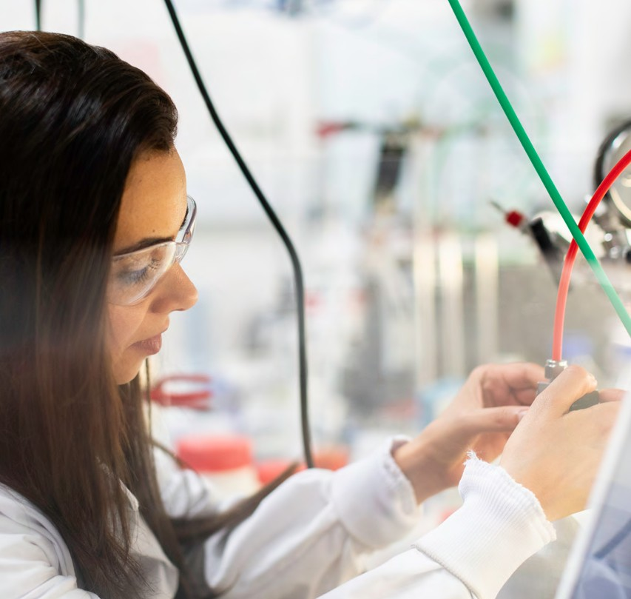
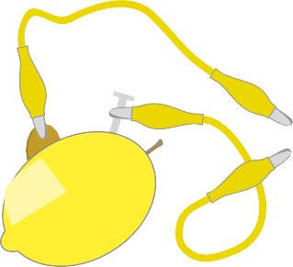
Taking it further
Try changing the electrolyte by using different fruit and vegetables.
Do all of them work? What do you think is common about those that did work? Does the voltage change?
Try using different electrodes by changing the metal you use. Do all of them work? Does the voltage change?
More juice, more power
Make several individual batteries (called cells) and wire them together.
*Check out our resource ‘Power Up’ for more on energy stores and transfers.
Can you use the same piece of fruit to make several cells?
What happens to the voltage or current if you wire them in series? What happens if you wire them in parallel?
Most red LEDs need 2v before they conduct electricity. How many lemons do you need to light an LED?
Press button to show voltage on input 1
22 THIS IS ENGINEERING: SUSTAINABLE FUTURES

Slide 23
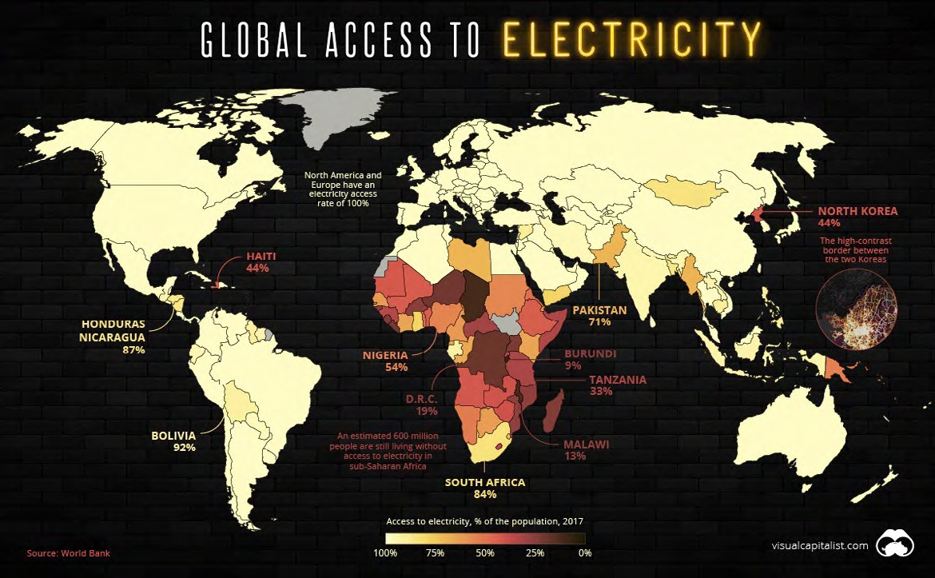
Accessing electricity
CHALLENGE
We rely heavily on appliances, devices and technology that are powered by electricity.
Image and fact source: https://www. visualcapitalist.com/
mapped-billion-people- without-access-to- electricity/
  How do we use electricity? Think of as many ways as you can.
In 1879 Thomas Edison was able to produce a reliable, long-lasting electric light bulb which revolutionised industry across the world!
  How has the way we use electricity changed over the last 150 years?
  How do you think the we use electricity will change in the next 50 years?
1.2 billion people around the world have no reliable access to electricity!
After travelling and visiting other countries, Enass realised that there are many people around the world who see electricity as a luxury. This inspired and motivated her to want to tackle this problem of ensuring that everyone around the world has regular access to reliable, clean and safe energy.
Time to reflect
  What impact do you think having limited access to electricity has on people’s lives?
  What do you think affects access to reliable electricity?
  How do you think Enass’s innovation of a hydrogen battery that stores energy tackles the problem of ensuring that people in remote places have access to clean, renewable and reliable energy?
THIS IS ENGINEERING: SUSTAINABLE FUTURES 23

Slide 24
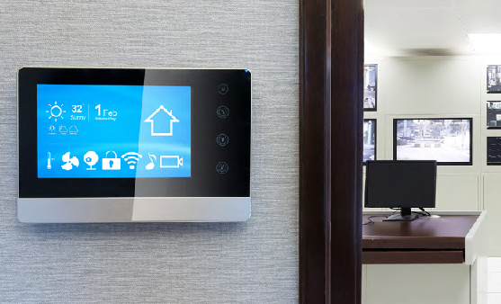
Energy efficiency at home
Measure the temperature in different rooms around your home.
When moving to a new location, wait a few minutes for the sensor to read accurately.
Press button to show the current temperature
Even if our homes are lucky enough to have access to instant energy,
it is important for us to be mindful
of how we use both electricity and gas around our homes, schools and workplaces.
Are you heating some rooms too high? Are you heating some rooms you don’t use? Is the heating on and the windows open in some rooms?
The DataHive can record temperature over a long period of time.
The environmental impact of being energy efficient at home is significant. In the UK, it is said that 40% of emissions come from households*.
Visit data.Redfern.uk and connect the DataHive to the computer using a USB. Follow the instructions on the website so you can set the DataHive to log temperature.
The UK also has plans to phase out gas boilers, and banning them completely from new homes by 2025. This means will become more dependent on electrical energy sources.
Put the DataHive in a room at home or at school for 24 hours. After this period, collect the DataHive and connect to the computer again.
What is the benefit of using electricity as an energy source?
Visit data.Redfern.uk where you will be able to view the recorded data as a graph for this period.
How hot is your home?
The DataHive has a temperature sensor. Push the temperature sensor button and the LED gauge will
give you a reading. The central LED
shows 20°C.
What do you notice? How energy efficient was this room? How can you tell? What changes might you make after seeing this data?
What is the approximate temperature of the room you are in?
*According to the Committee on Climate Change in 2014.
The higher the temperature we use to heat our homes, the more energy we are using.
24 THIS IS ENGINEERING: SUSTAINABLE FUTURES

Slide 25
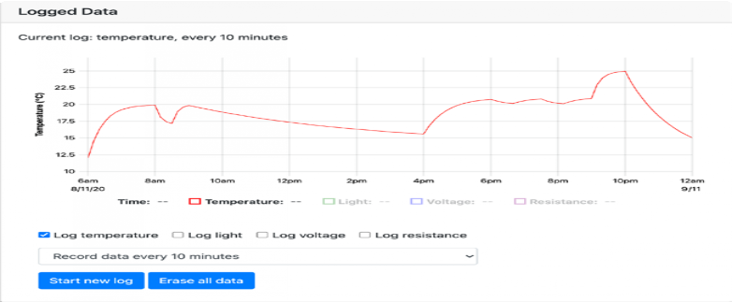
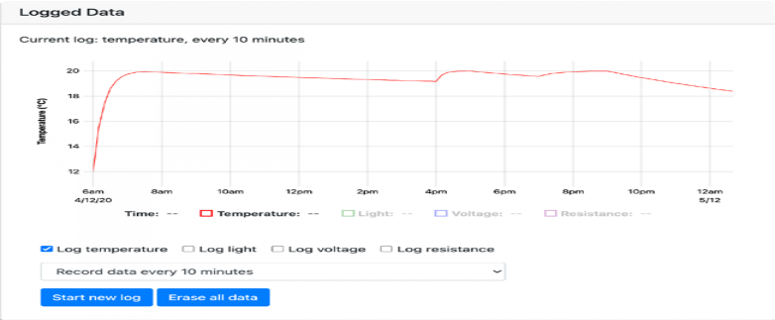
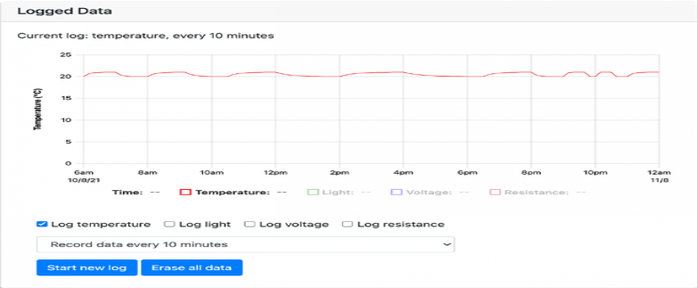
Match the house heating scenario to the graph
A
B
House heating scenarios
House A
Well insulated, thermostat between 19 and 20 degrees.
House B
Heating on all the time
House C
Poorly insulated in the winter.
House D
Door left open in the morning, heating turned up to 25°C in the evening.
  Create your own scenario and matching graph.
  Show your classmates the
graph. Can they work out what the scenario is?
Time to analyse
  What do you notice about the scales on each graph?
  How does the impact what the temperature change looks like?
  How much does the temperature drop between 9am and 4pm on graph A?
  What about the same time on graph B, graph C, and graph D?
C
D
THIS IS ENGINEERING: SUSTAINABLE FUTURES 25

Slide 26
About me
I grew up in Norway surrounded by farms and playing with Lego. As a Robotics Engineer,
I combine my love for nature and putting things together to create robots that will revolutionise farming.
I decided to study mechanical engineering so I could invent and create my own robots. I now
work for Saga Robotics creating agricultural robots, that do everything from ploughing and weeding to picking strawberries and testing the soil.
“I like to solve problems and love that mechanical engineering can be anything from making toys to aeroplanes – to robots that can help feed the world.”
For me, feeding the planet is important. With the world population growing, more food and crops will be needed.
The better we are at using the land, keeping plants and fields healthy and sustainable, the more people we can feed.
Find out more about Halvard by visiting the This is Engineering website
Halvard
Robot Maker

Slide 27
Optimum growing conditions
CHALLENGE
The robots that Halvard designs are equipped with sensors and
gadgets to make sure that they have the optimum conditions
for growing different crops.
The robots test the soil, find the perfect space to grow different crops, they plough and weed and pick different fruit and vegetables.
By using the robots, crops can be farmed in the most effective and sustainable way. Efficient farming methods is one solution for sustainable farming.
The story beneath the soil
Soil is the loose upper layer of the Earth’s surface where plants grow. Soil consists of a mix of organic material (decayed plants and animals) and broken bits of rocks and mineral. Soil contains nutrients that plants use to grow.
Farmers must know as much as possible about their land, especially the soil properties. Halvard’s SAGA robots are able to test the properties of the soil, rather than having to send it off to labs. The robots can detect the acidity or alkalinity of the soil, and soil nutrients such as nitrogen (N), phosphorus (P), and potassium (K).
Testing the pH level of soil
Certain plants can only access the soil nutrients if the pH (potential hydrogen) levels are within a certain range. Soil pH tests how many hydrogen ions are in the soil. The pH scale ranges from
0 to 14, with a pH of seven representing a neutral
level (see image of the pH scale).
A pH less than seven is acidic, seven is neutral,
and anything higher than seven is alkaline.
Most plants prefer soil that is neutral, or slightly
acidic with a pH level between 6 and 7. Some
plants prefer more acidic soil, such as blueberries
and strawberries, and others prefer soil that is
alkaline such as asparagus.
THE PH SCALE
THIS IS ENGINEERING: SUSTAINABLE FUTURES 27

Slide 28
Testing for alkaline or acidity
Distilling water
Materials
  Hand shovel/trough (something to collect your soil sample with)
  500ml water
  125ml wine vinegar
  3 tablespoons of baking powder
The water from our taps is rarely neutral. It will contain minerals such as calcium or magnesium making it alkaline, or metal
ions such as copper, lead or
zinc making it more acidic. Distillation will leave you with pure, clean water.
Distillation is the method we see every day in nature.
Distillation involves boiling the water to produce vapour, leaving behind any and all contaminants (which have a higher boiling
THE WATER CYCLE
Time to test
Collect a soil sample from your garden or somewhere around the outside of your school. Dig around 15cm deep. Put your sample in a glass bowl.
Remove stones, sticks and any other debris. Break up any large clumps.
Add around 150ml of tap water to your sample.
Add enough water to turn the soil into a muddy texture.
Add 125ml of white vinegar
If it fizzes, you have alkaline soil. If it does not fizz, then repeat steps 1 and 2.
Add the 150ml of distilled water.
Add 3 tablespoons of baking soda.
If it fizzes you have acidic soil. If nothing happens, your soil is neutral with a pH of 7.
point than H 0).
2
Once the water entirely vaporises, that vapour is put into a clean container where it condenses back into pure water.
How to distill water at home
  Fill a large pan (ideally with a non-flat lid) approximately ½ full with water
  Place a smaller glass bowl (it
should float) in the pan
  Place the lid on the pan upside down
  Place a handful of ice cubes
on the lid (this is used to speed up the process).
Make sure you are working with a responsible adult when using the hob for this activity.
  Turn up the heat and watch the magic happen!
  The water will start to vaporise. Once it reaches the cool lid, it will convert back to water to form water droplets which will start collecting in your glass bowl.
Soil sample with water and vinegar
This is our soil sample after adding baking powder. Do you think our soil sample is acidic or alkaline?
28 THIS IS ENGINEERING: SUSTAINABLE FUTURES

Slide 29
Make a red cabbage pH indicator
Materials
  Red cabbage
  Water jug
  Vinegar
  Baking powder
  Lemonade
  Sugar solution
  Lemon
  Tomato
  Surface cleaner
  Test tubes or tall glasses
  Blender
  Strainer
These are just the items we have used. You can find your own items to make your own pH cabbage indicator.
The test on page 28 tells us whether our soil is alkaline or acidic. But what if we want more detail than that?
If we have a better idea of what level pH our soil is this might help us to know how to make
it more or less acidic/alkaline if we need to.
Take three or four leaves of your red cabbage and cut into pieces. Put the pieces in the blender.
Add approximately 500ml of water to the blender and blend the two together to create a cabbage juice.
Strain the juice into a large glass. This is your red cabbage indicator.
In a test tube, cup or other vessel, put a small amount of each of your solutions. Label each vessel so you know what is in it.
Add red cabbage juice in each vessel.
Arrange them in order of their pH using the pH scale on the next page. Number each solution with the correct pH number.
You can now use your scale as a reference point when testing your soil samples.
Time to test your soil
Put teaspoons of garden soil in a jar and cover with the red cabbage juice.
Wait 20/30 minutes and check the colour.
Match the colour with your pH indicators. What is the pH level of your soil?
Test the pH levels of other ingredients you have around the house. For example:
  Black tea
  Cows milk
  Lime
  Coffee grounds
  Tap water – what do you notice? Is it neutral? How might this have affected your soil testing?
Adjust your pH levels Depending on what is growing, we might need to change the pH level of soil.
Try changing the pH level of your soil using the information you know about substances that are alkaline and acidic.
  What do you need to add to make your sample more acidic?
  What do you need to add to make your sample more alkaline?
1
Mini-glossary
Optimum condition in farming means the best condition for something to grow.
Nitrogen is needed Phosphorous is vital
Potassium is associated with the movement of
water, nutrients and
carbohydrates in plant tissue.
for plant growth. It to plant growth.
gives plants their green It promotes root colour and is involved growth, flowering and in creating food for setting seed.
the plant.
THIS IS ENGINEERING: SUSTAINABLE FUTURES 29

Slide 30
Grow your own
2
3
Taking care of crops and plants isn’t just for large farms and agriculture. We can all get growing in our homes.
From herb gardens, to fruit and vegetables, to flowers and house plants. And to grow at home, we need to be able to look after our plants
by watering, feeding and providing them with enough sunlight.
Aurelia, who works at Twitter, developed an app that measures moisture in plant soil. Can you make something similar?
Is it time to water?
Use the DataHive to set up a system which will notify you when your plant needs watering.
The DataHive has a ohm (Ω) metre which measures resistance at input 2. Resistance is a measure of how difficult it is for electrical current to flow through a material.
Blend cabbage leaves and water
Strain the cabbage mix
4
5
Put solutions in different vessels and label Solutions with cabbage juice poured in
6
A RED CABBAGE PH INDICATOR
Time to reflect
What materials do you think have a high electrical resistance? What materials do you think have a low electrical resistance?
Using the DataHive, test different materials for their electrical resistance. Connect the crocodile clips to the pads at input 2.
Find materials and touch the material with the other end of the crocodile clips.
30 THIS IS ENGINEERING: SUSTAINABLE FUTURES

Slide 31
Time to reflect
Why not try…
Keep it watered
Many farms will now have irrigation systems in place. Either to keep a steady flow of water reaching the soil or to control the moisture levels. Machines have been programmed to monitor the water levels in the soil.
Create a system that will either keep the soil moist or hold in the moisture for longer. Test this using the DataHive.
To test whether your system works, log the data over a longer period of time.
Visit data.Redfern.uk and connect the DataHive to the computer using a USB. Follow the instructions on the website so you can set the DataHive to log electrical resistance (Ohms).
Place the DataHive in a plant that is using your moisture holder device for 24 hours. Compare this to another similar plant that does not have a moisture holding device.
After this period, collect the DataHive and connect to the computer again. Visit data.Redfern.uk where you will be able to view the recorded data as a graph for this period.
  What do you notice?
  Compare your results to your classmates?
  Who has the most effective device?
  How can you tell?
  Graphite pencil
  Metal spoon
  Cardboard
  Painted metal object
  Damp cardboard
  Tap water
What do you think the different readings tell you about the electrical resistance of the materials you have tested?
Press button to show resistance on input 2
Set-up the DataHive so that it measures the moisture of a plant at home or at school. This way you can find out when the soil is dry and your plant needs watering.
What would you expect the electrical resistance to be when the soil is dry?
  Find a plant at home or at school and use the DataHive to test the moisture levels.
  Using two metal paperclips,
straighten these out and stick them into the soil making sure that they are not touching.
  Connect the crocodile clips which are
already connected to the DataHive
to the paperclips
Visit thisisengineering.org.uk and find out more about Aurelia, Code Creator.
What is the electrical resistance reading on the LED gauge?
How can you use this to monitor your plant and find out when you need
to water it?
THIS IS ENGINEERING: SUSTAINABLE FUTURES 31

Slide 32
Sunlight levels
Lux
Description
 | 50,000 | British summer sunshine
 | 5,000 | Overcast sky
 | 500 | Well-lit office
 | 300 | Minimum for easy reading
 | 50 | Passageway/ outside working area
 | 15 | Good main road lighting
 | 10 | Sunset
 | 5 | Typical side road lighting
 | 2 | Minimum security risk lighting
 | 1 | Twilight
Plants rely on energy in sunlight to produce the nutrients they need.
Even around the house, at school or in outside spaces, we need to find the best place to place our plants where they will get the right levels of sunlight.
The DataHive has a light sensor. Find and press the light sensor button.
How much light is in the room or space you are in?
The LED gauge tells you how much light is falling on the DataHive as a measure in Lux. Lux is a measure of illuminance. It is equal to one lumen per square metre. The lux scale is logarithmic, which is a way of
displaying numerical data over a very wide range of values in a compact way.
These are three different plants which have different sunlight needs (see images, right). Use the DataHive to find the best place for each one.
Decide on how much light we mean by direct, medium and small light.
Visit data.Redfern.uk and connect the DataHive to the computer using a USB. Follow the instructions on the website so you can set the DataHive to log light levels.
Find a spot to place the DataHive, and keep it there for 24hours. After this period, collect the DataHive and connect to the computer again. Visit data.Redfern.uk where you will be able to view the recorded data as a graph for this period.
What do you notice? How can you tell?
Repeat this for a different spot where you think one of the plants would be best suited.
What do you notice? How can you tell?
Compare results with your classmates. As a group, can you decide on the three best places for your three plants.
Direct sunlight Sunflower
Medium sunlight Moth orchid
The light sensor measures illuminance in Lux on a logarithmic scale
Press button to show the illuminance (light)
Shade/minimal sunlight
Spider plant
32 THIS IS ENGINEERING: SUSTAINABLE FUTURES

Slide 33
Just ripe
CHALLENGE
Materials
  Bags
  Plastic wrap
  Fruit
  Boxes
Halvard’s robots are designed to pick fruit and vegetables, only once they are ready. They are able to detect whether they are ready to be harvested or eaten.
Fruits naturally produce gas ethylene that causes fruit to ripen. Climacteric fruits continue to ripen after they are picked and non- climacteric fruits will slowly rot after they are separated from their host plant.
Grocery stores will buy climacteric fruit and store it in a temperature-controlled warehouse until they are ready to send the product to stores.
Then they’ll release ethylene gas into the room and the fruit will start to ripen again. Delayed ripening is one approach to reducing food waste whilst providing consumers with ripe fruit.
Slow the ripen
Create a prototype that can delay and speed up the ripening process of fruit.
  Where have you seen fruit and vegetables ripen quickly?
  Where have you seen them last longer and ripen slowly?
Design and create a prototype for a device that will slow down the ripening and extend the life of fruit.
  Will the same design work for all fruit?
THIS IS ENGINEERING: SUSTAINABLE FUTURES 33

Slide 34
Is it ripe?
Wavelength in nanometres
700
600
580
550
Colour is just one way to tell if a fruit or vegetable is ready to be harvested or eaten.
Using your DataHive, build a circuit that uses light and colour to detect whether something is red
or green.
Visible light come in all the colours of the rainbow (which is measured by the wavelength of the light) and are part of the electromagnetic spectrum.
Light behaves in different ways depending on what objects it meets. Almost all objects absorb light to some extent.
If an object is white, all colours are reflected; if it is black, many of the colours are absorbed. An object that we see as red reflects mostly red light and absorbs the other colours.
Using this information use your DataHive to test whether a tomato is ripe and ready to eat.
Radio waves
Microwaves Infrared
Visible
light
475
Ultraviolet
450
X-rays
400
Gamma rays
Beam of white Reflected light absorbed red light
All colours reflected
Check out our resource ‘Light saver’ for more activities on the electromagnetic spectrum and the properties of light.
34 THIS IS ENGINEERING: SUSTAINABLE FUTURES

Slide 35
Materials
  Small box (you might need to build one)
  A tomato (or a red object)
  A green tomato (or a green object)
  DataHive
  USB cable
  Computer
What colour light would a red tomato absorb?
What do you notice? What does this tell you?
  Connect the DataHive to a computer. Visit data.Redfern.uk to view live data from the DataHive.
  Try this with a green unripe tomato (or a green object)
What do you notice? What does this tell you?
  Put a red tomato (or red object) and the DataHive in a box. This is so that you can do this experiment in a dark space and reduce the amount of interference from other light sources.
You can change the colour of the LED from data.Redfern.uk. Find ways to test different fruit.
What colour LEDs would you need to test whether a banana is ripe?
  Push the button that will turn on all the red LEDs.
What colour LEDs would you need to test whether different colour peppers are ripe?
  Check the reading on the graph at
data.Redfern.uk
THIS IS ENGINEERING: SUSTAINABLE FUTURES 35

Slide 36
The Royal Academy of Engineering is harnessing the power of engineering to build a sustainable society and an inclusive economy that works for everyone.
In collaboration with our Fellows and partners, we’re growing talent and developing skills for the future, driving innovation and building global partnerships, and influencing policy and engaging the public.
Together we’re working to tackle the greatest challenges of our age.
What we do
Talent & diversity
We’re building global partnerships
that bring the world’s best engineers from industry, entrepreneurship and academia together to collaborate on creative innovations that address the greatest global challenges of our age.
We’re growing talent by training, supporting, mentoring and funding the most talented and creative researchers, innovators and leaders from across the engineering profession.
We’re developing skills for the future by identifying the challenges of an ever- changing world and developing the skills and approaches we need to build a resilient and diverse engineering profession.
Policy & engagement
We’re influencing policy through the National Engineering Policy Centre – providing independent expert support to policymakers on issues of importance.
Royal Academy of Engineering Prince Philip House
3 Carlton House Terrace London SW1Y 5DG
Tel: +44 (0)20 7766 0600
www.raeng.org.uk
Registered charity number 293074
Innovation
We’re driving innovation by investing in some of the country’s most creative and exciting engineering ideas and businesses.
We’re engaging the public by opening their eyes to the wonders of engineering and inspiring young people to become the next generation of engineers.

