Slide 1
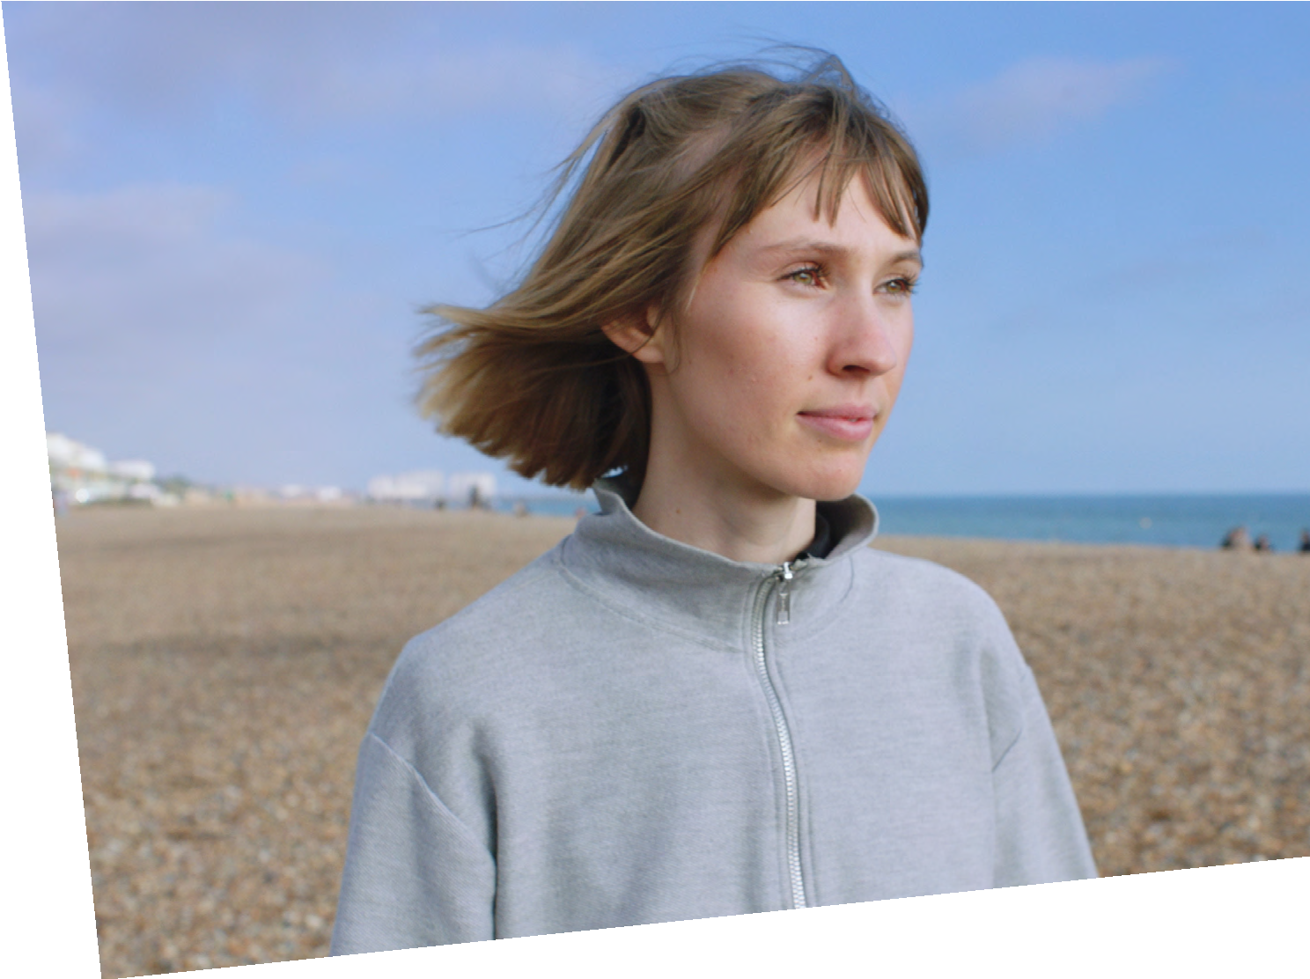
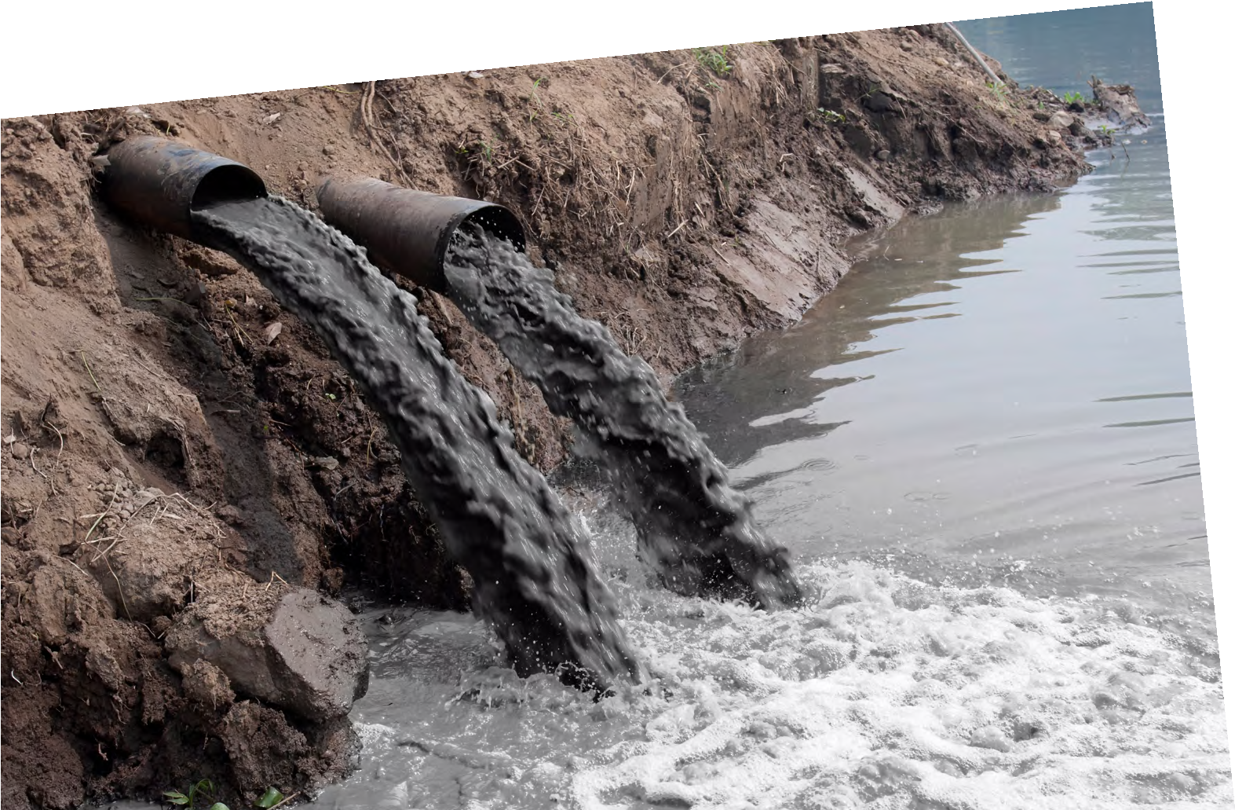
SUSTAINABLE FUTURES
DATAHIVE GREEN EDITION
Polluted water
LUCY HUGHES
Ocean Protector
I love the ocean, I live by it, I dive in it, and I want to protect it. Wanting to care for the ocean is also why I founded MarinaTex, where I create biodegradable plastic to help reduce single-use plastic waste.
Find out more about Lucy by visiting
thisisengineering.org.uk

Slide 2
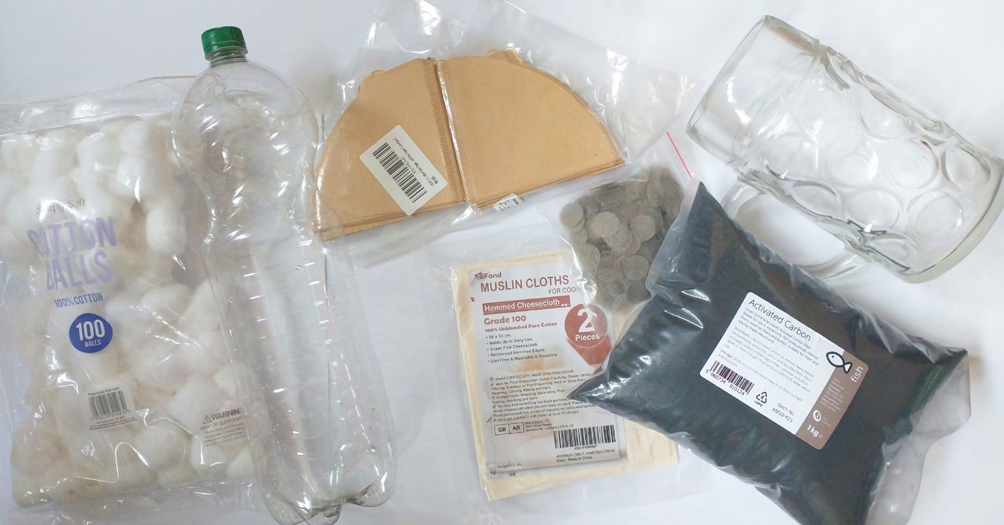
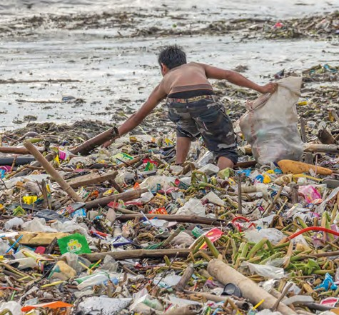
Polluted water
Materials
Each group needs:
For the class to share:
2-litre recycled plastic bottle cut horizontally
Filter materials such as filter paper, coffee paper, cotton balls, cups of soil, cup of small pebbles, cup of sand, cup of activated charcoal
Measuring cups
Large jugs for making polluted water mix
Polluted water made by mixing (you can come up with your own pollutants too!)
Water pollution can have disastrous effects on the environment.
There are many sources of water pollution.
Time to reflect
What do you think some of the major causes of water pollution are?
Environmental, chemical, and civil engineers work together to improve existing water treatment systems and design new ones to ensure that we have clean water both now and in the future.
Time to build a water filtration system
You are working as part of a team of engineers who have been asked to design a new water filtration system for a small community with a polluted water supply using limited materials.
There are different ways and steps to treat water, but for this challenge, you will look at water filtering.
You will look at different types of filter material to determine which ones work well and design a filtering system to clean polluted water.
Small square of mesh or muslin
Rubber band
Stirring utensil
Materials needed for groups to test different materials that could be used as filters.
Lucy has been working to create a biodegradable plastic alternative
HOW TO MAKE YOUR POLLUTED WATER
Water (fill jug 3/4 full)
Green food colouring
Soil
Organic matter (e.g. grass clippings)
Cut up newspaper
Baking soda
Dishwashing soap
Pieces of polystyrene
A man collecting plastic waste from the coast of the Philippines
2 THIS IS ENGINEERING: SUSTAINABLE FUTURES DATAHIVE GREEN EDITION

Slide 3
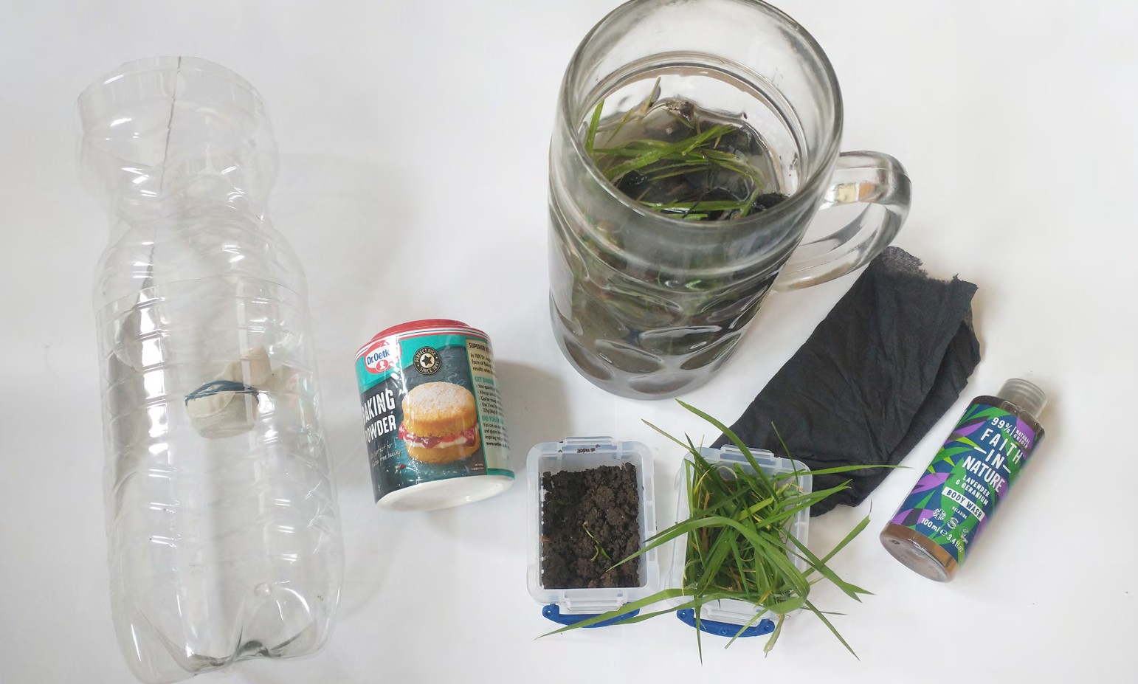
Time to prepare the pollutant
You need to do this a day or two before you make your water filter devices.
In two jugs, mix all your ingredients together to make two solutions of polluted water.
Let the solutions ripen for a day or two.
Place the mechanical stirrer/aerator in one of the samples. Let it sit overnight.
Mix the solutions thoroughly
Polluted water mix example (you could use different pollutant materials) and water bottle cut in half horizontally with muslin attached to bottle neck opening.
Time to test your water filters
Prepare your 2-litre bottles by cutting them in half horizontally (get help from an adult with this part).
Place your mesh or muslin over the bottle opening and secure it with a rubber band.
In your group, take 100–200 ml sample of one of the polluted water mixtures (not aerated).
Observe your solution and make notes on your data collection sheet.
What does your sample look like? How does it smell?
Divide the different filters out amongst all the groups so each group is testing one filter. One group should not have a filter and test just the mesh/muslin.
Make predictions around what you think your filter will do.
What do you think makes a good filter?
Stir the polluted water and gently pour it through your filter.
What happens during the filtration? What does your filtered water look like?
Record this information on your data collection sheet.
Repeat the investigation so that between the whole class, you have tested all water filters. Record the results of the whole class.
Could you create an improved filter system by combining some of the filter materials?
Treatment | Pollutants removed | Other observations
Mesh filter only
Cotton balls
Pebbles
Filter paper
THIS IS ENGINEERING: SUSTAINABLE FUTURES DATAHIVE GREEN EDITION 3

Slide 4
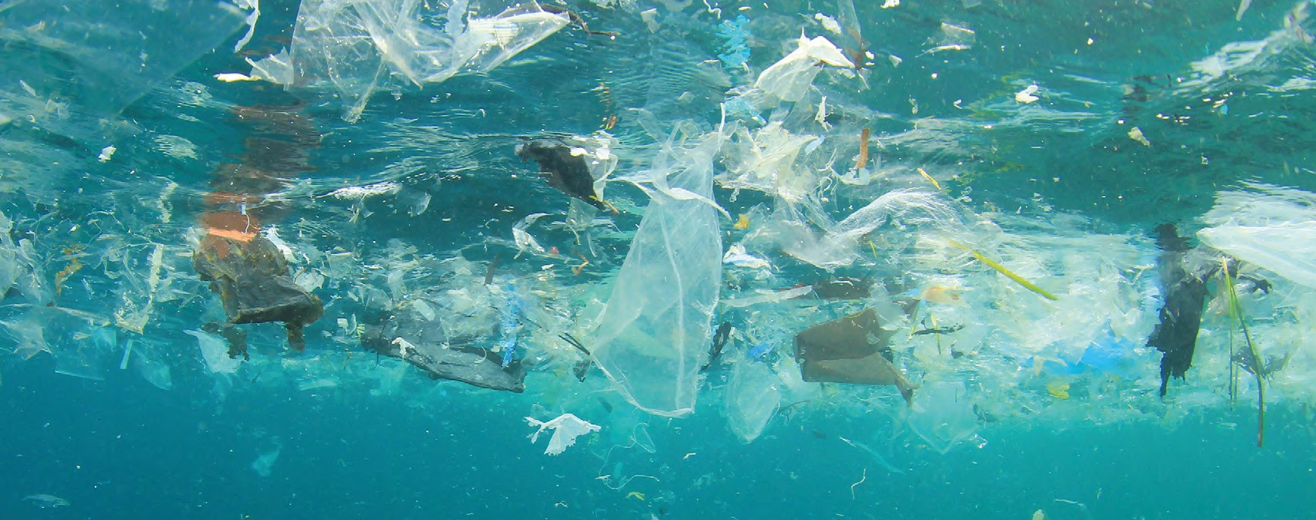
Test pollution levels with your DataHive
Engineers will use different ways to carry out tests to find out how successful the systems and projects they are working on are and what still needs development.
For this challenge, you will use the properties of light and your DataHive Green to test the pollution levels of your water and find out how successful your filters are.
Connect your DataHive to a computer and visit data.Redfern.uk.
Secure your DataHive to a clear beaker of unfiltered clean water.
What is the light intensity?
Turn all the LED lights.
What colour do you get? What is the light intensity now?
Repeat with your polluted water sample
Repeat with your filtered water sample
Record your results on your data recording sheet.
What happens if you try just using the blue LED? What about the red LED?
Visit data.Redfern.uk where you can find the ‘Polluted water’ project page which includes an interactive guide for this investigation, sliders for the LED lights, a table to record your results and a graph plotting function.
DataHive secured to a beaker of clean water
DataHive secured to a beaker of polluted water
DataHive secured to a beaker of filtered water
Plastic rubbish pollution in an ocean environment
4 THIS IS ENGINEERING: SUSTAINABLE FUTURES DATAHIVE GREEN EDITION

Slide 5
Polluted water – data collection sheet
Our polluted water sample was made up of:
Observations of our polluted water sample:
I predict that ...................................... (filter type) will remove ................................................................................................
when we pour the polluted water through it because . . . . . . . . . . . . . . . . . . . . . . . . . . . . . . . . . . . . . . . . . . . . . . . . . . . . . . . . . . . . . . . . . . . . . . . . . . . . . . . . . . . . . . . . . . . . . . . . . . . . . . . . . . . . . . . . . . . . . . . .
We tested filter ........................................... and found that ................................................................................................
Observations of our filtered water sample:
Investigating water pollution levels with your DataHive Green.
What we noticed when testing water pollution levels with our DataHive.
Water type tested | LED light used | Light intensity
THIS IS ENGINEERING: SUSTAINABLE FUTURES DATAHIVE GREEN EDITION 5

