Slide 1
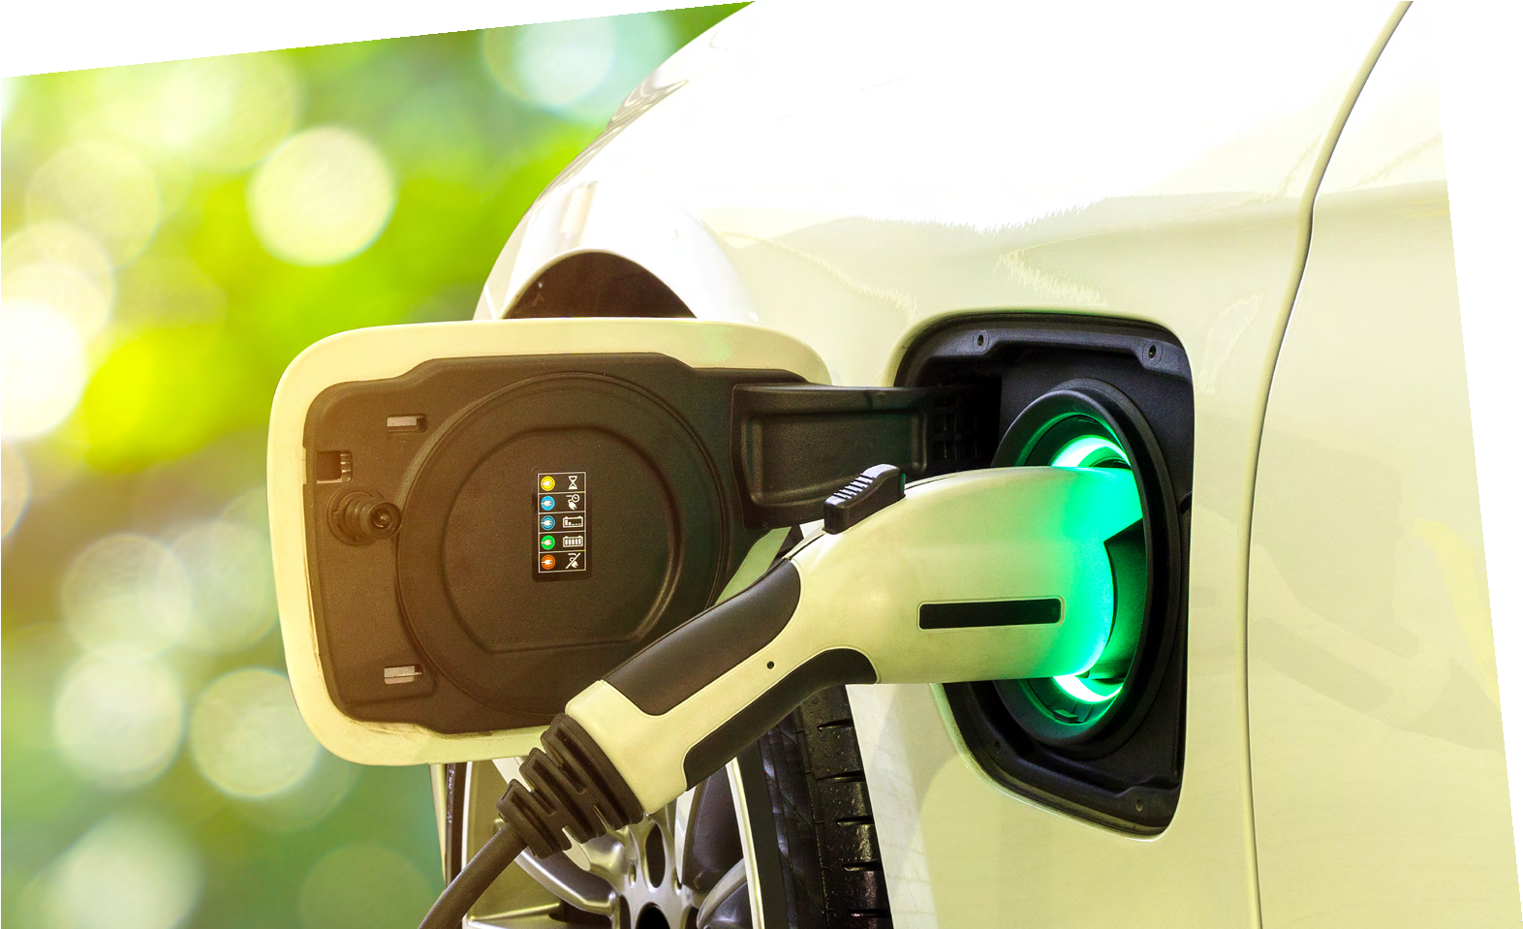
SUSTAINABLE FUTURES
DATAHIVE GREEN EDITION
Investigating
electric charge
George Imafidon
Race car reinventor
I grew up fixing bikes and racing go-karts, always loving a competition and seeing how fast I could go. Now
I design Extreme-E race cars with Sir Lewis Hamilton’s
electric racing team, making race cars faster, better, and more sustainable.
Find out more about George by visiting
thisisengineering.org.uk

Slide 2
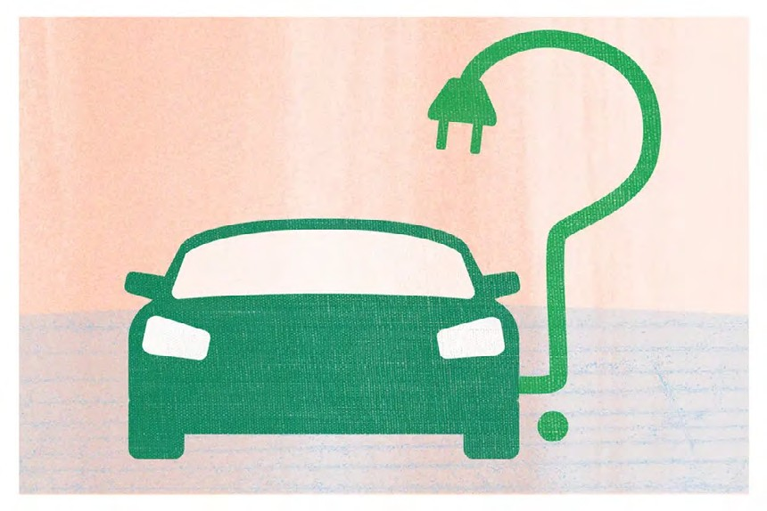
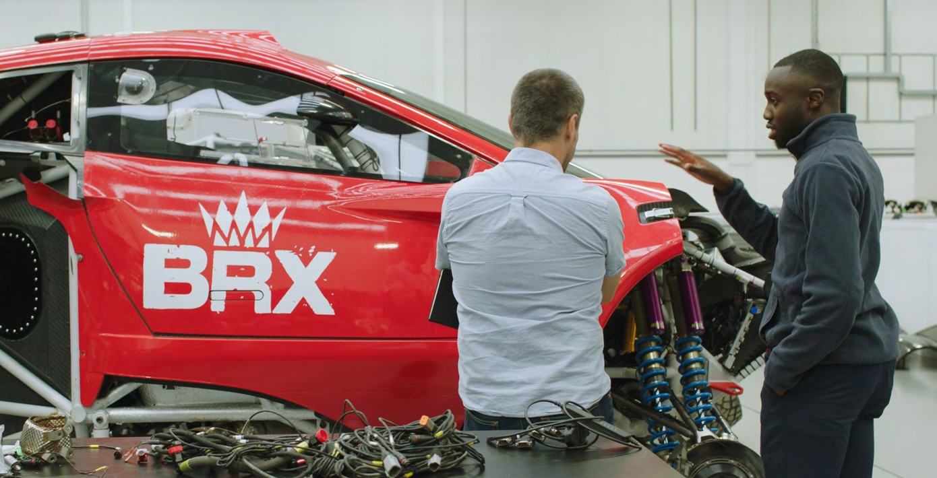
Investigating electric charge
Electric cars and the environment
George is passionate about motorsports and tackling climate change. The two don’t always go hand- in-hand. But he is making that link happen through his work developing electric racing cars.
He is part of a team that bring electric racing to some of the most remote corners of the planet to
highlight the climate change challenges faced by different ecosystems.
Time to reflect
Electric cars are said to be much better for the environment than diesel or petrol cars.
But what makes them more environmentally friendly? And could they also have negative effects on the environment?
Choosing the greenest car
George discusses design modifications with a colleague
Check out this interactive tool at
carboncounter.com/#!/explore
Which vehicle costs the least and has the fewest greenhouse gas emissions?
Which petrol car has the fewest greenhouse gas emissions?
Look at the table (right) comparing an electric car and a petrol car.
Which car would be more economical over its 12-year lifetime?
Can you travel 1,000 miles a day in an electric vehicle?
Using a computer/laptop/tablet/smartphone research how far electric vehicles can now travel?
What do you think impacts their travel distance?
Table comparing an electric car and a petrol car
Electric car |  | Petrol engine car
Cost (£) | 27,000 | 15,000
Running cost per year (£) | 250 | 2,000
Average lifetime (years) | 12 | 12
2 THIS IS ENGINEERING: SUSTAINABLE FUTURES DATAHIVE GREEN EDITION

Slide 3
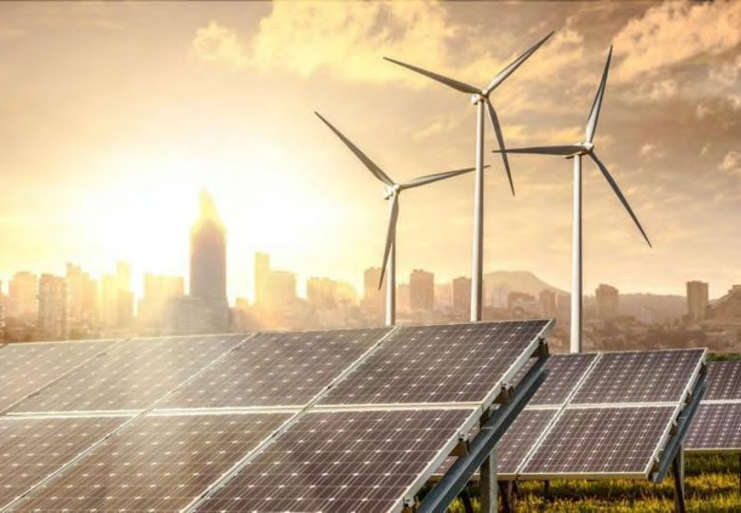
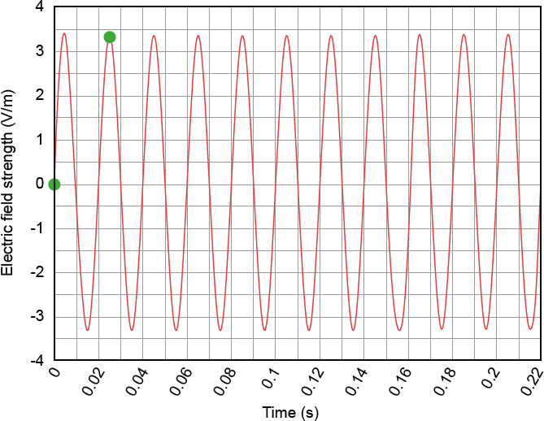
Investigating electric charge
We rely heavily on electricity
It has improved our standard of living since it was invented over 200 years ago.
The great thing about using electricity over other energy sources is that electricity has the potential to be carbon neutral through harnessing energy from wind, sunshine and water.
Electric fields
Using the ‘Charge’ sensor on your DataHive, use this to identify any ‘live wires’ (current carrying wires) around your home or school.
What happens to the LED gauge when the DataHive is close to a live wire (try using a plug socket)?
What do you think this tells you?
The DataHive is measuring the electric field. An electric field (or electrostatic field) describes the area near any electrically- charged object.
The LED gauge is moving from left to right because the mains electricity is alternating current (otherwise known as AC).
Check out our resources This is Engineering: Sustainable Futures and Power up! for more on electricity and the environment.
DataHive sample Electric field
Diagram showing an electric field surrounding a positive and negative charge.
Image taken from: https://en.wikipedia. org/wiki/Electric_field
Using the ‘Electrostatic charge’ sensor, move your
DataHive close to a plug socket.
Graph showing electric field and sample from DataHive Green
THIS IS ENGINEERING: SUSTAINABLE FUTURES DATAHIVE GREEN EDITION 3

Slide 4
Aliasing graph
The graph shows the electric field strength around a live wire.
In the UK, mainland Europe and some other parts of the world, the frequency of mains electricity is 50 hertz.
This means that there are 50 cycles per second. Each cycle lasts for 1/50th of
a second.
Electric footsteps
Did you know we build up electrostatic charge with every step we take?
Rub your shoe on carpet. Using the ‘Electrostatic charge’ sensor on your DataHive, move your device close to the spot on the carpet where your shoe had been.
What happens? Why do you think this is?
This build up of electrostatic charge could become dangerous within certain industries such as aerospace, semiconductor manufacturing, electrical engineers, battery manufacturing, computer equipment manufacturing, medical industry, hospitals, where there is a risk that the static shock could trigger a fire or explosion.
People working in these industries are encouraged to wear antistatic or ESD shoes, both of which are conductive safety footwear.
What material do you think ESD shoes could be made from?
Using the ‘Electrostatic charge’ sensor, hold your DataHive
Green close to where someone has just walked.
Write 1/50th of a second in decimal form (hint: use the graph to help you!).
How many cycles happen in 0.1s?
The LED gauge on your DataHive should have shown the same frequency as
the graph.
But the LED gauge on your DataHive
does not move at that frequency. Let’s explore why this is.
Detecting an electric field with your DataHive
Instruments that measure digitally take readings repeatedly one after the other, rather than continuously. This is called discrete data.
On the graph, mark out a reading every 0.025s.
The first two have been done for you. Join the dots.
What do you notice? What do you think that this shows?
An engineer walking on a electrostatic control floor
What do we mean by…
Frequency is the rate at which something happens over a given period of time.
Hertz (Hz) is the unit of frequency and is known as one cycle
per second.
4 THIS IS ENGINEERING: SUSTAINABLE FUTURES DATAHIVE GREEN EDITION

