Slide 1
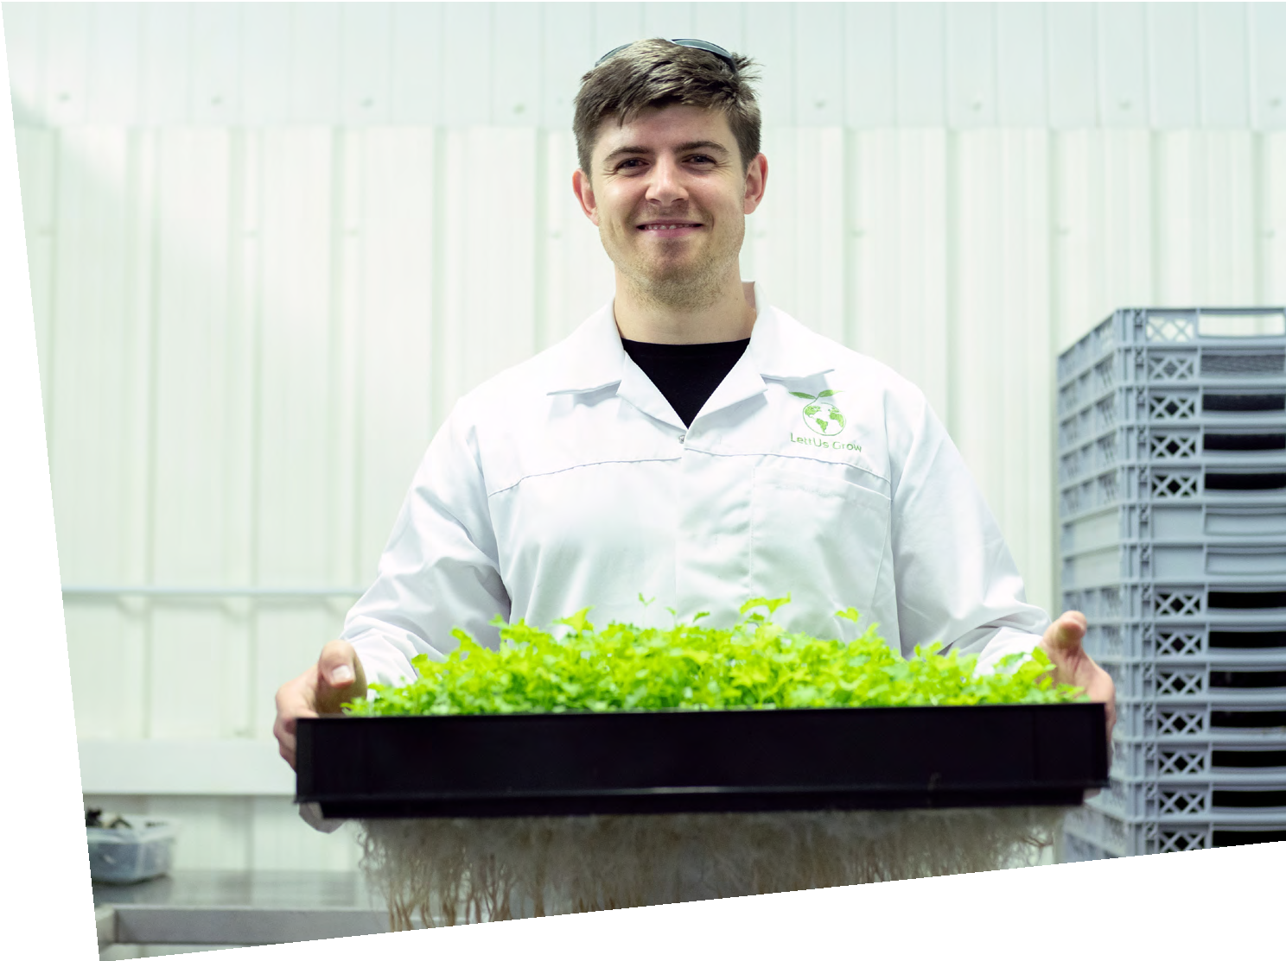
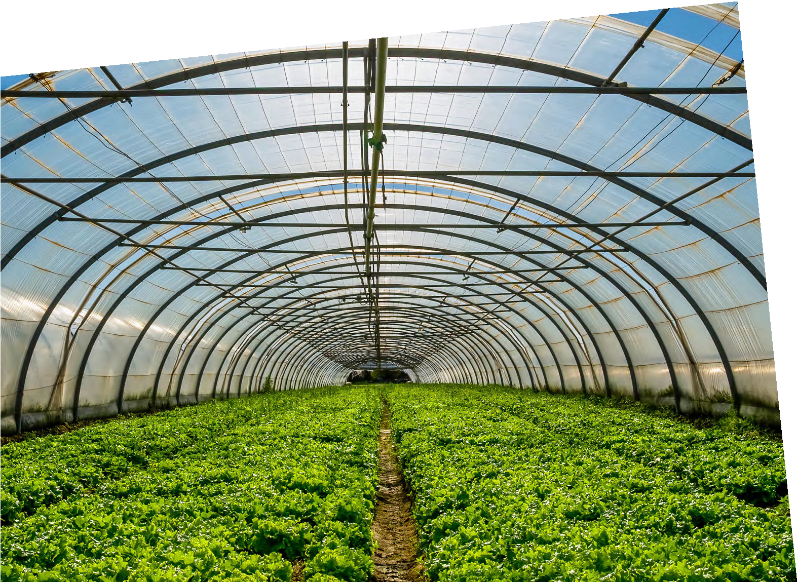
SUSTAINABLE FUTURES
DATAHIVE GREEN EDITION
The greenhouse effect
BEN Crowther
Farming Futurist
Through my passion for the environment and love of engineering and design, I have developed a new way to farm using less water to feed more people and reduce the carbon footprint of farming.
Find out more about Ben by visiting
thisisengineering.org.uk

Slide 2
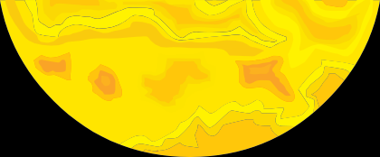
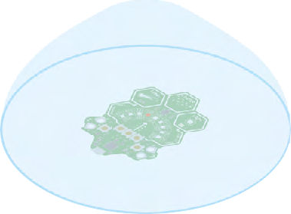
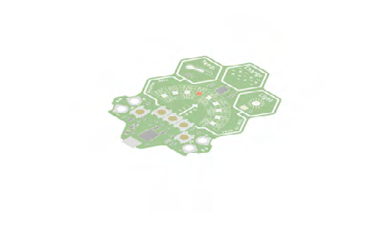
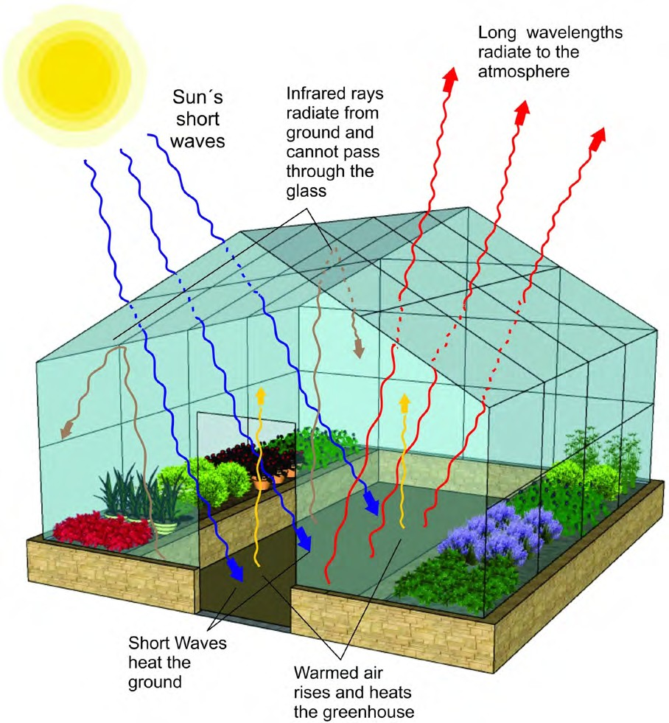
The greenhouse effect
Ben is interested in ‘greenhouse farms’
A greenhouse is sometimes known as a forcing structure, that is, an artificial
environment in which plants are “forced” to grow, despite the harsh outside climate.
How does a greenhouse work?
Every greenhouse operates on a simple physical principle called “the greenhouse effect”.
Sunlight (short waves) passes through transparent or translucent materials such as glass or plastic.
When it strikes an opaque surface inside (plant leaves, greenhouse floor, planters) some of the light energy is changed into heat.
The darker the surface, the more heat is generated. The greenhouse panels are good at transmitting light, but not heat. Therefore, most of the heat stays inside.
Once the short waves hit the ground, they warm it up. Then the warmed air rises and heats up the greenhouse. Then long waves radiate to the atmosphere.
Investigate greenhouses using the DataHive Green
Investigate what happens to the temperature and light intensity when you place your DataHive under a transparent jar or glass.
Using two DataHives at the same time, place one under a jar, glass or bowl and one without any cover.
Leave the DataHives in the same place, outside or somewhere where they will get sun exposure, ideally for 24 hours.
Collect your DataHives and connect them to a computer. Visit data.Redfern.uk.
DataHive logging data with no cover.
DataHive logging data under a transparent glass bowl.
Here you can view logged data. Check out the temperature and light intensity graphs.
Time to reflect
What do you notice? What do you think is happening?
Can you use this information to explain how greenhouses work?
Why do you think you need to use DataHives at the same time to get the best results for this investigation?
Time to research
Research what we mean by “the greenhouse effect”.
How does this link to greenhouses we use for growing fruit and vegetables?
How does a greenhouse work?
Image taken from: https://www.backyardgardenlover.com/how- does-a-greenhouse-work/
2 THIS IS ENGINEERING: SUSTAINABLE FUTURES DATAHIVE GREEN EDITION

Slide 3
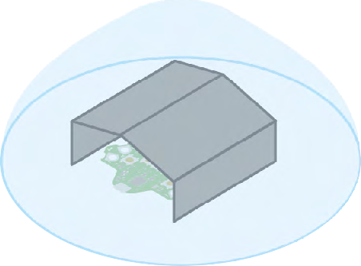
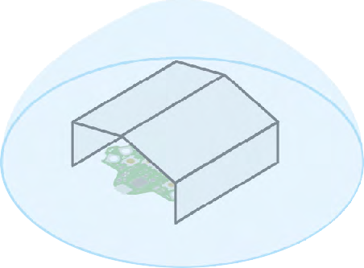
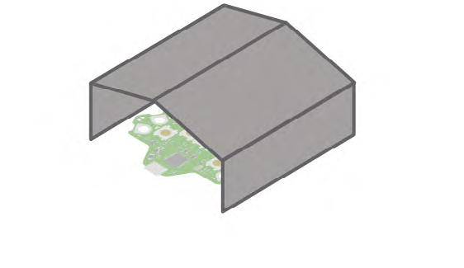
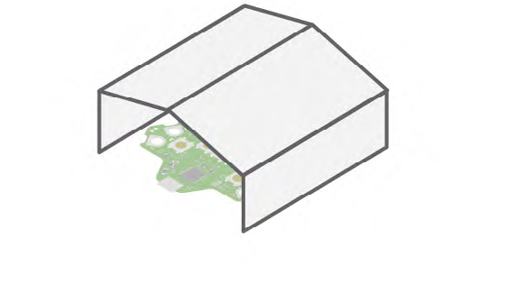
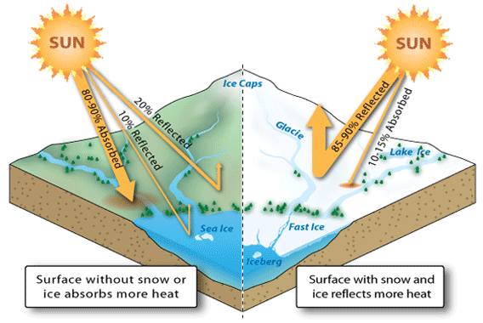
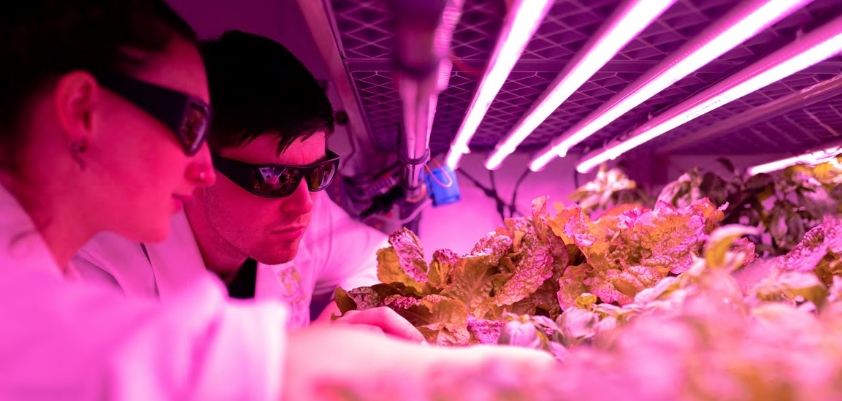
The darker the surface, the more heat generated
Lets investigate this statement using your DataHives.
Using two DataHives at the same time, place both under a jar, glass or bowl.
Create a shield using black cardboard for one DataHive, and a shield using white cardboard for the other.
Leave the DataHives in the same place, ideally for 24 hours.
Collect your DataHives and connect them to a computer. Visit data.Redfern.uk.
Here you can view logged data. Check out the temperature and light intensity graphs.
DataHive under a transparent bowl with a black shield.
DataHive under a transparent bowl with a white shield.
Time to reflect
What do you notice? What do you think is happening?
Can you use this information to explain how greenhouses work?
Shrinking ice caps, rising temperatures
What do you think some of the environmental impacts are of melting sea ice and land ice?
What do you think the difference is between sea ice and land ice?
*Hint: What do you know about absorption and reflection?
How do you think melting sea and land ice contribute to global warming? How can your DataHive Green experiment show this?
Time to reflect
What do you think the image below shows?
Ben monitors crops in a sustainable indoor farm
Image taken from: https://forces.si.edu/arctic/02_02_00.html
THIS IS ENGINEERING: SUSTAINABLE FUTURES DATAHIVE GREEN EDITION 3

Slide 4
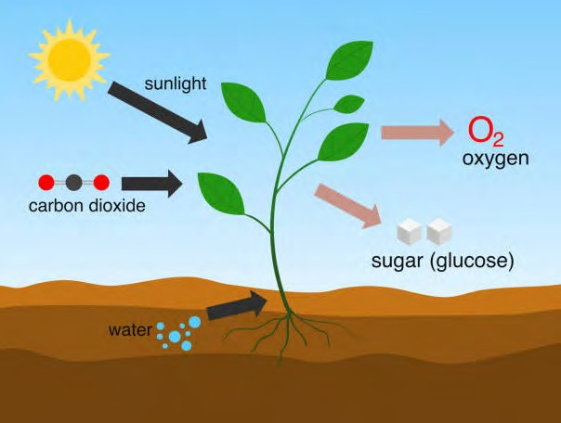
Investigating photosynthesis
Materials
Pond weed (easy to buy online from an aquatic shop)
A thin transparent beaker (such as a science beaker or olive jar)
Photosynthesis is a great example of a highly efficient biological process that is good for the environment.
Engineers can use a solid understanding of such biological processes to design more efficient and less environmentally damaging ways of meeting our needs.
In order for plants to grow they make their own food using photosynthesis. It is important for engineers working in food production to know how this process works. We are also learning from the process of photosynthesis to help develop clean fuels and sources of renewable energy.
Photosynthesis is the process used by plants, algae and certain bacteria to turn sunlight, carbon dioxide (CO₂) and water into food (sugars) and oxygen.
What do plants eat? Yes, that’s right, just like us, plants also need food to grow!
Plants make their own food using photosynthesis. The food that plants produce is important, not only for the plants themselves, but for the other organisms that feed on the plants.
A lamp with an LED bulb
A ruler/tape measure
Bicarbonate of soda (sodium hydrogen carbonate – formula NaHCO₃
DataHive Green
Diagram showing photosynthesis
Setting up your investigation
Time to reflect
What is in the air we breathe? What components of air does our body need? Where do we get this from?
The rate in which photosynthesis happens depends on light intensity, temperature and carbon dioxide concentration.
We can investigate the effect of light intensity on photosynthesis using pond weed (such as Elodea or Cabomba)
4 THIS IS ENGINEERING: SUSTAINABLE FUTURES DATAHIVE GREEN EDITION

Slide 5
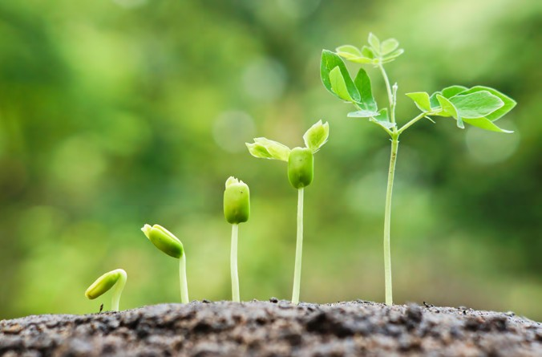
Investigating photosynthesis
Fill your beaker with water, but a leave a gap at the top. Make a note of the volume of water in your beaker.
Place a strip of the pond weed into your breaker, ensuring that there is about a few centimetre gap between the surface of the water and your pond weed. Use forceps to pick up your pond weed so you do not contaminate your sample. Make a note of the length of your pond weed.
Add a teaspoon (stretch and challenge: or 1% of the volume of your water) of bicarbonate of soda to the water to create a new solution.
Place the lamp 5cm away from the beaker. Allow the beaker to stand for five minutes.
Turn on your light source.
Use your DataHive Green to measure the light intensity at the beaker. Make sure that the sensor is facing the light source. Record this data on your table.
Set a timer for one minute, and count the number of bubbles emerging from the cut end of the stems in this time. You can use your DataHive Green to do this.
Repeat this five times. Record your results.
Take an average number of bubbles produced per minute.
What do you think will happen as you increase the distance between the light source and the beaker?
Repeat the experiment at different distances away from the light source.
Table to record results of photosynthesis investigation
Distance | Rate (average number of bubbles per minute)
5cm
Graph to record your results for the photosynthesis investigation
Number of bubbles per minute
Distance between pondweed and light in cm

