Slide 1
Mars
Our new home?
Image credit: shaulliv via CC 2.0

Slide 2
Mars from Earth: typical view through an amateur telescope
You can see how people used to think there was vegetation!
Image credit: Gustaaf Prins via CC 2.0

Slide 3
Mars from Hubble Space Telescope

Slide 4
Mars from Mars orbit

Slide 5
Mars looking at us?
Surface feature photographed by a Viking orbiter

Slide 6
Relative sizes of Earth, Mars and the Moon

Slide 7
Mars Facts
Length of day 24 h 37 mins
Length of year 1.9 Earth yrs
Volume 0.15 Earth
Mass 0.11 Earth
Surface area ~ Earth land area
Surface gravity 0.38 g
Closest to Earth 54 million km
Furthest from Earth 401 million km
Image credit: NASA
Notes:
Contrast with the variation in distance
Earth to the Sun: 147 million km, 152 million km
Mars to the Sun: 249 million km, 206 million km

Slide 8
Mars Orbit
Both planets have elliptical orbits
Mars’ orbit is more elliptical than Earth’s
Closest distance
Earth at furthest distance from Sun
Mars at closest distance to Sun
Furthest distance
Earth at closest distance to Sun
Mars at furthest distance from Sun
Confusingly…
Closest approach – called opposition
Furthest distance – called conjunction
Image credit: NASA

Slide 9
Hubble Space Telescope images
These pictures taken from 1994 - 1995
Show seasonal variations and the effect of distance changing the disk size!
Again, people used to think that variations in vegetation growth

Slide 10
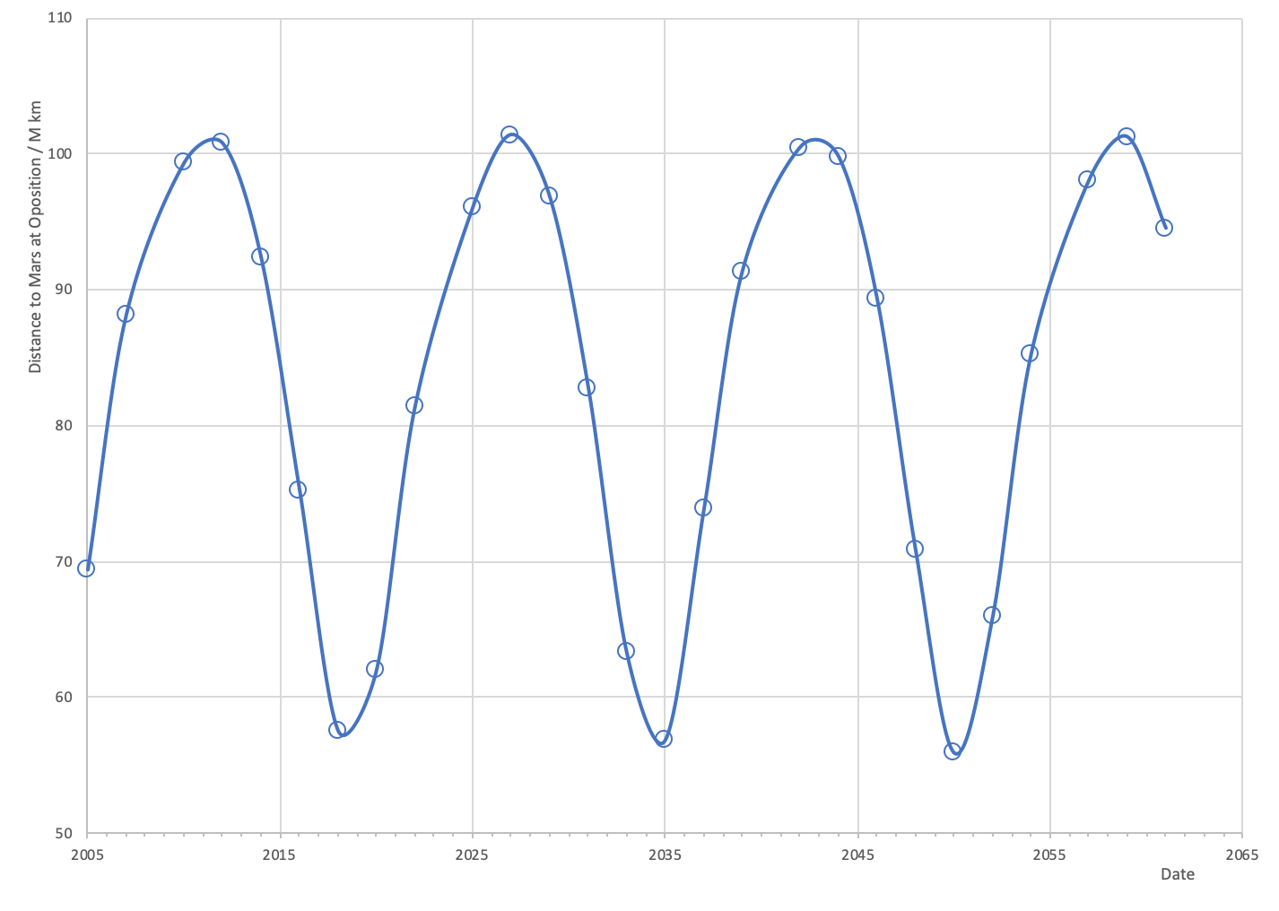
Elon Musk 2nd mission planned
Elon Musk 1st mission planned
Projected NASA manned orbital mission
Distance to Mars at closest approach over time

Slide 11
Mars climate
Surface pressure 0.006 atmos
96% CO₂; 1.9% Ar; 1.9% N₂; 0.1% O₂
Surface temperature
Max ~ 30⁰ C
Min ~ -110⁰ C
Solar panel temperatures over time, Spirit rover (2004 – 2010)

Slide 12
Spirit rover during testing. Name chosen after student essay competition

Slide 13
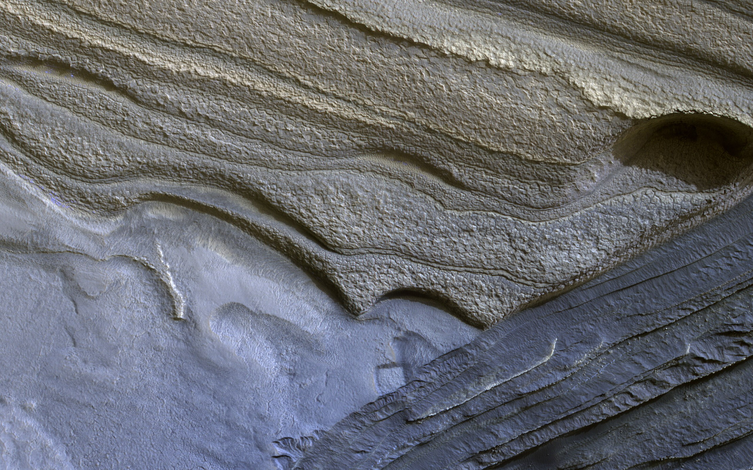
Summer and winter
Axial tilt 25⁰ (Earth 23.5⁰)
Seasons like Earth, but longer
Water ice North pole in winter
Southern Pole permanent CO₂ ice
North polar region of Mars
Image credit: NASA/JPL-Caltech/Univ. of Arizona

Slide 14
Martian dust devil filmed by the Spirit rover (click to start video)
Caused by a rotating column of warmer air rising through cold air. The spin coupled with friction causes forward movement
Image credit: NASA

Slide 15
First ever picture of Earth from the surface of another planet
Mars Spirit rover March 2004
Image credit: NASA

Slide 16
Mars’ moons: Phobos (right) & Deimos (left)
Image credit: Spirit rover, NASA
(click to start video)

Slide 17
Phobos
Deimos
Image credits: NASA / JPL-Caltech / University of Arizona

Slide 18
Mars with (right, July 2001) and without (left, June 2001) a global dust storm
Probable explanation of why people used to think there was seasonal vegetation on Mars
Image credit: Jim Secosky picked out this NASA image NASA/JPL/MSSS
Notes:
Mars’ atmosphere is much thinner than the atmosphere on Earth, but still creates winds. When these winds pick up the fine, dry particles of dust on Mars, a dust storm can occur. Most dust storms cover an area for a few days and carry small particles of dust at speeds of 33 (53 kph) to 66 (106 kph) miles per hour.
As Mars is so dry, dust blown up into the atmosphere can stay suspended longer than on Earth, where rain tends to wash it out
More common when Mars is closer to the Sun, as 40% more sunlight
Dust storms can last weeks.

Slide 19
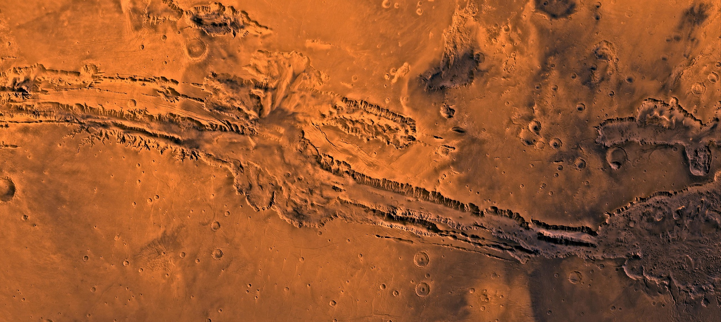
Valles Marineris
Olympus Mons
550 km across
Tharsis Volcanoes
Valley is 2 500 km long, 240 km wide and up to 10km deep
Grand Canyon (Earth) 446 km long, 29 km wide, 1.6 km deep

Slide 20
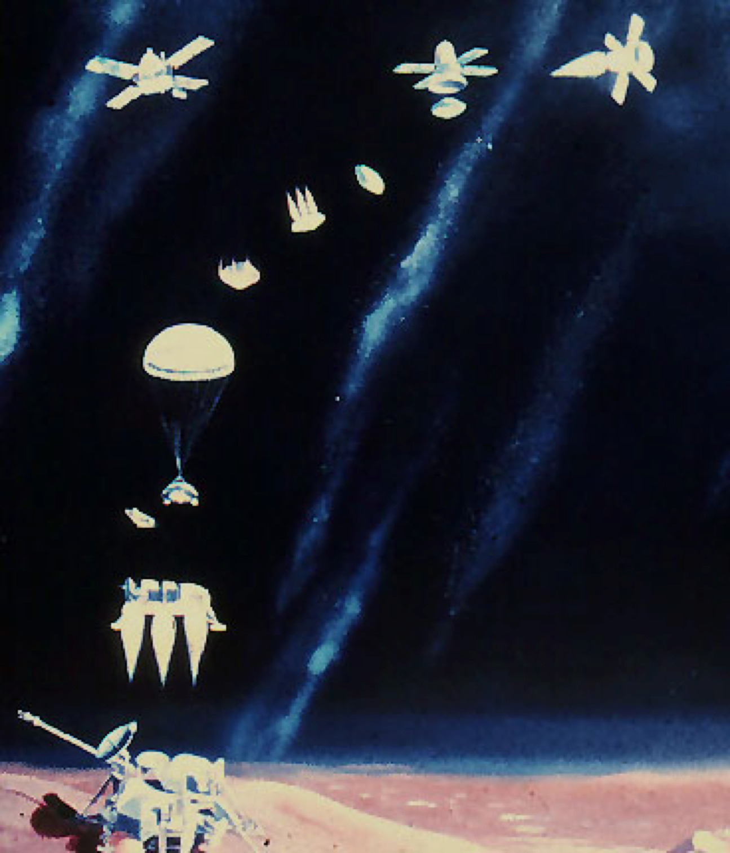
Viking missions
2 missions launched 1975
Two parts - orbiter and lander
Two landers touched down in 1976
Lander parachuted from 6 km
1.5 km fired rockets for soft landing
Image credits: NASA

Slide 21
Viking lander
First picture from surface
Lander sampled atmosphere
Sampled soil and tested for life
Took surface pictures

Slide 22
Viking surface images
Image credits: NASA

Slide 23
Pathfinder
First lander, with a rover – first roving vehicle on another planet
Operated for 84 days
Image credit: NASA

Slide 24
Pathfinder
Sojourner rover on the lander
Note the airbags!
Bounced for 100 s
First bounce over 4 stories high
15 subsequent bounces
Rolled for 95 s before coming to a stop
Image credits: NASA

Slide 25
Pathfinder
Featured in the film and book, The Martian
Image credits: NASA

Slide 26
Day and night

Slide 27
Mars Global Surveyor - in orbit since Sept 1977
Stopped transmissions to Earth in 2006

Slide 28
Mars Missions
Mars Reconnaissance Orbiter (MRO)
Went into orbit March 2006
Multi-purpose
Exploration of Mars from orbit
As seen by MRO
Cydonia region as imaged by Viking orbiter
Image credits: NASA

Slide 29
Mars Missions
Curiosity rover
Landed August 2012
Car-sized roving vehicle
Still operational
Mission objectives
Determine if Mars could ever have supported life
Role of water
Study climate
Study geology
Self-portrait of Curiosity rover the at the "Big Sky" site
Image credits: NASA

Slide 30
Evidence for water
Mud slides
Morning clouds in a crater

Slide 31
Cross-bedding seen in the layers of this Martian rock is evidence of movement of water recorded by waves or ripples of loose sediment the water passed over.
Image credit: NASA / JPL Curiosity rover

Slide 32
Afternoon clouds over Tharsis

Slide 33
Water, water everywhere…?
Liquid water cannot exist on the surface due to low atmospheric pressure
except at the lowest elevations for short periods
Water ice at the South Pole, if melted, would cover the surface to a depth of 11 m
Water frozen into permafrost layer under surface
Frost on Mars, as seen by one of the Viking landers on the surface at Utopia Planitia, 1979
Image credit: NASA/JPL

Slide 34
Water, water everywhere…?
Surface features strongly suggest that liquid water once existed on the surface:
outflow channels cut across the surface in about 25 places
erosion seen caused by the release of water from subsurface aquifers
crater and canyon walls show thousands of features that appear similar to terrestrial gullies (might be sand-formed)
Some researchers think that much of the low northern plains were once covered with an ocean hundreds of meters deep
Gullies on wall of crater on Mars
Image credit: Jim Secosky modified NASA image

Slide 35
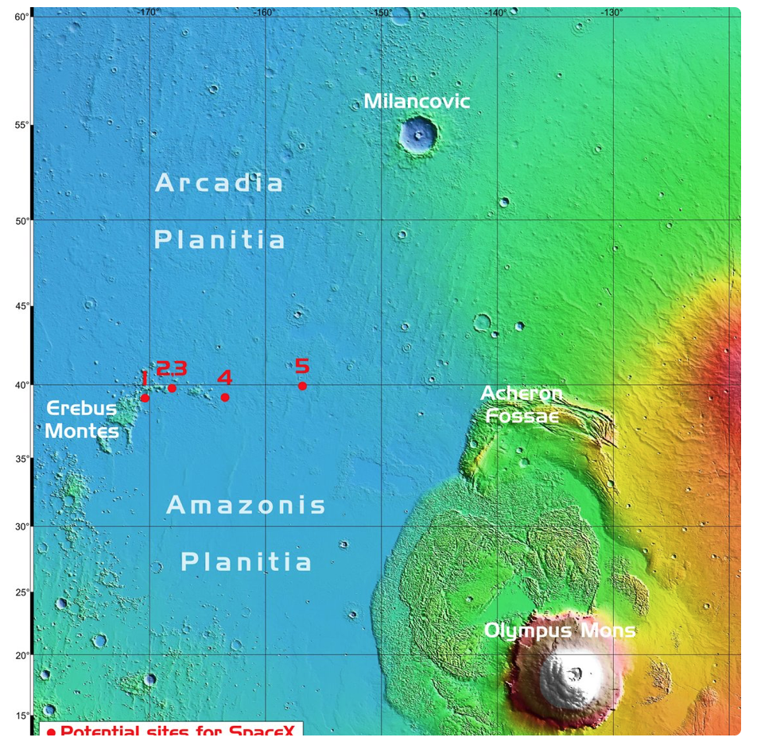
Why is water important?
Mars might once have supported (primitive) life
Microbe evidence may be present
Regions of Mars suitable for bases if water present under the surface
Elon Musk’s SpaceX company suspected to be considering potential landing sites for mid 2020s
Landing site map from: https://www.humanmars.net/2019/09/candidate-sites-for-spacex-starship.html

