Slide 1
Elon Musk and the Colonisation of Mars
“You want to wake up in the morning and think the future is going to be great - and that's what being a spacefaring civilization is all about. It's about believing in the future and thinking that the future will be better than the past. And I can't think of anything more exciting than going out there and being among the stars.”
— ELON MUSK, SPACEX

Slide 2
Elon Musk
Born June 1971
South African, Canadian, and U.S. citizenship
Co-founder of PayPal
Bought by eBay for $1.5 billion in 2002
Net worth $19.4 billion (estimated 2019)
Companies:
Space X – founder, CEO and chief designer
Tesla – co founder, CEO and product architect
Neuralink – founder
The Boring Company – founder
OpenAI – co founder and co chairman
Elon Musk in 2018
Image credit: Duncan Hull via CC 4.0

Slide 3
SpaceX
Company mission statement:
To enable the space flight capabilities necessary to make human life multiplanetary - or more specifically enable a self-sustaining human civilization on Mars.
On the job application documents:
SpaceX was founded under the belief that a future where humanity is out exploring the stars is fundamentally more exciting than one where we are not. Today SpaceX is actively developing the technologies to make this possible, with the ultimate goal of enabling human life on Mars.
SpaceX company headquarters California

Slide 4
SpaceX
Developing launch capabilities
Place satellites in orbit for other companies
Send supplies to the International Space Station
Developed the Dragon crew capsule
Delivering crew to the ISS
Steadily developing the capability to go to the Moon / Mars
An unmanned Dragon test capsule approaching the ISS

Slide 5
Falcon Heavy
Highest payload capacity rocket currently in service
Designed and developed by SpaceX
Second only behind the Saturn V Moon Rocket
Can lift 64 tonnes to low Earth orbit
Partially re-usable (to save costs)
Core stage – lands under power
Side boosters – land under power
Second stage and payload – to orbit
Falcon Heavy Rocket on Launch Pad 39-A in Cape Canaveral, Florida

Slide 6
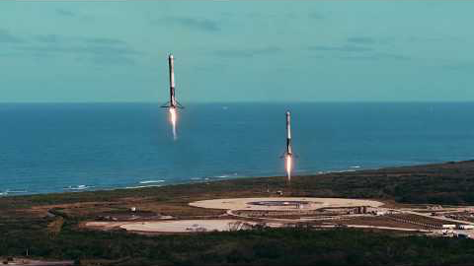
Assembly and launch
1min 52sec

Slide 7
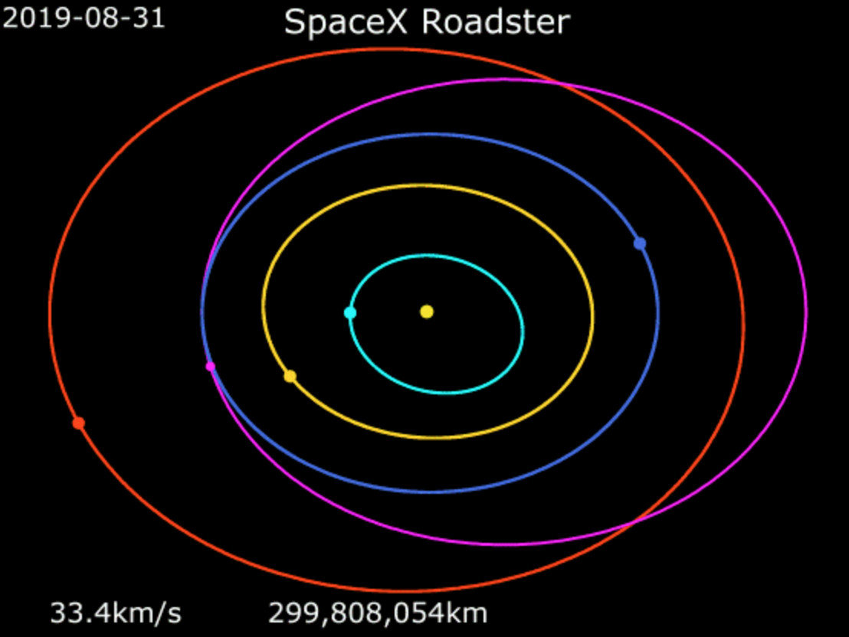
Starman’s flight

Slide 8
Super Heavy
Artists impression of Starship separating from the Super Heavy first stage
Next generation rocket being developed by SpaceX
Fully reusable
Second stage called Starship
Artists impression of a Super Heavy launch

Slide 9
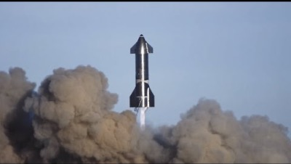
Starship
The final Starship design will have six engines. Three will be optimized to work best in our planet’s atmosphere at sea level, and the other three will be designed to work best in the vacuum of space.
Notes:
The SN8 test flight did not end in a successful landing, but many of the mission objectives were achieved . This video shows the various phases of the flight and the specialist maneuvers carried out.

Slide 10
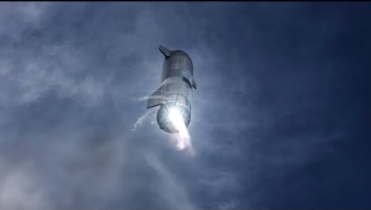
SN10 successful test flight

Slide 11
Design
Making Life Multiplanetary (SpaceX Website)

Slide 12
Making Life Multiplanetary (SpaceX Website)

Slide 13
Moon tourism
On September 17, 2018, SpaceX announced that fashion innovator and art curator Yusaku Maezawa will be the company’s first private passenger to fly around the Moon in 2023
To date, only 24 people have visited the Moon, with the last of them flying in 1972
This first private lunar passenger flight, featuring a fly-by of the Moon as part of a weeklong mission, will help fund development of SpaceX's Starship and Super Heavy:
Space X suggest that this is an important step in enabling access for everyday people who dream of flying to space

Slide 14
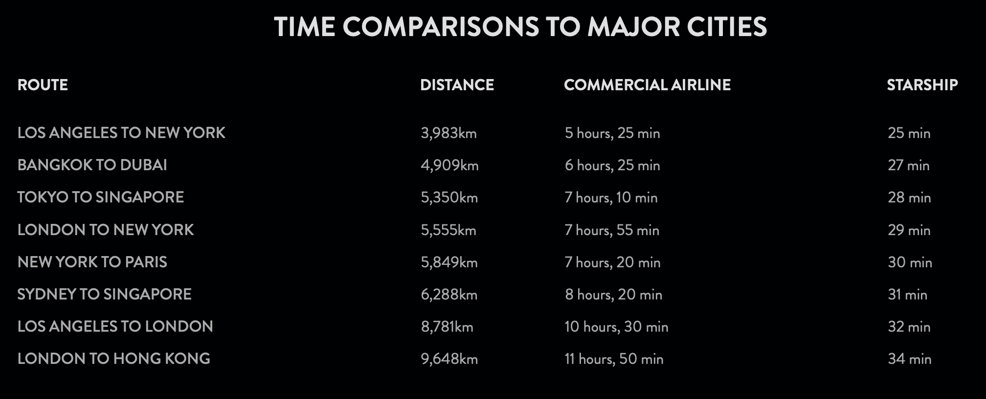
Plan to use Starship Intercontinentally
“With Starship and Super Heavy, most of what people consider to be long distance trips would be completed in less than half an hour. In addition to vastly increased speed, one great benefit about traveling in space, outside of Earth’s atmosphere, is the lack of friction as well as turbulence and weather. Consider how much time we currently spend travelling from one place to another. Now imagine most journeys taking less than 30 minutes, with access to anywhere in the world in an hour or less.”

Slide 15
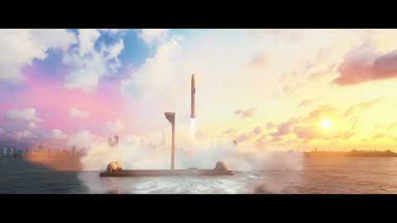

Slide 16
Musk on Mars
“Once that (Starship) has been built and there is a means of getting cargo and people to and from Mars as well as to and from the Moon and other places in the solar system then I think that’s really where a tremendous amount of entrepreneurial resources will be needed because you’ve got to build out the entire base industry,”
“Mars will need everything from iron foundries to pizza joints to nightclubs,” Musk said. “Mars should definitely have great bars,”
“The Mars bar.”
Artists impression of Starship landing on Mars
“It kind of reads like Shackleton’s ad for Antarctic explorers: Difficult, dangerous, a good chance you’ll die, excitement for those who survive,”
“I think there’s not many people who will actually want to go in the beginning because all those things are true. But there will be some for whom the excitement of the frontier and the exploration exceeds the considered danger.”

Slide 17
Our aspirational goal is to send our first cargo mission to Mars in 2022.
The objectives for the first mission will be to confirm water resources, identify hazards, and put in place initial power, mining, and life support infrastructure.
A second mission, with both cargo and crew, is targeted for 2024, with primary objectives of building a propellant depot and preparing for future crew flights.
The ships from these initial missions will also serve as the beginnings of the first Mars base, from which we can build a thriving city and eventually a self-sustaining civilization on Mars.
SpaceX website
Note: no initial plans to bring the explorers back….
Eventually some will bring the ships back to leverage their reusability

Slide 18
Mars base

Slide 19
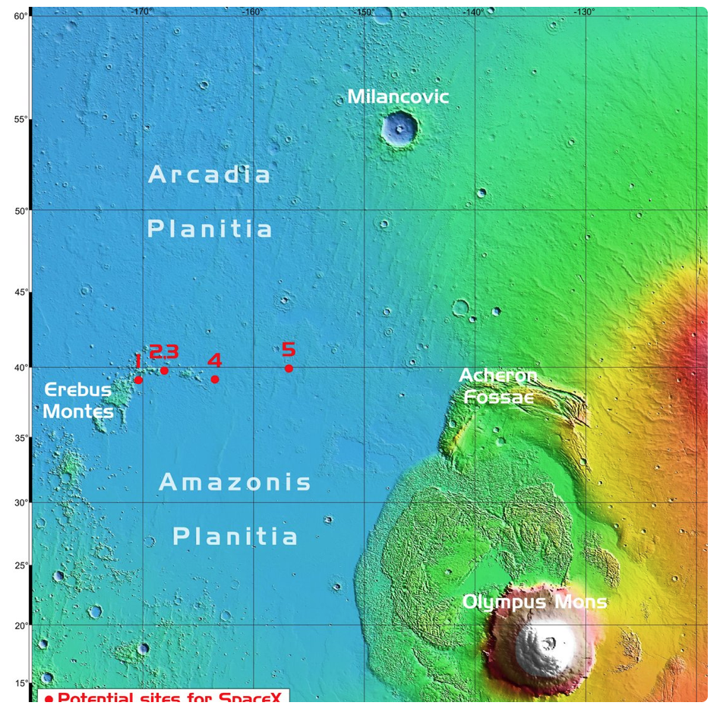
Prime Landing site
As of September 2019 – Alpha Base landing region
Previous research:
plains could be covered in abundant amounts of shallow ice at low altitudes
water for subsistence and rocket fuel
plains would be comparatively easy to land in lack of large rocks or mountains
Arcadia Planitia is warmer, with a milder climate than other regions of Mars.
Low altitude also means slightly elevated air pressure
Lava tunnels in the area could be used as habitats
Provide natural radiation shielding
Landing site map from: https://www.humanmars.net/2019/09/candidate-sites-for-spacex-starship.html

Slide 20
Will SpaceX get the first humans to Mars?
Elon Musk at the SpaceX control center

