Slide 1
The Universe
A brief tour of creation

Slide 2
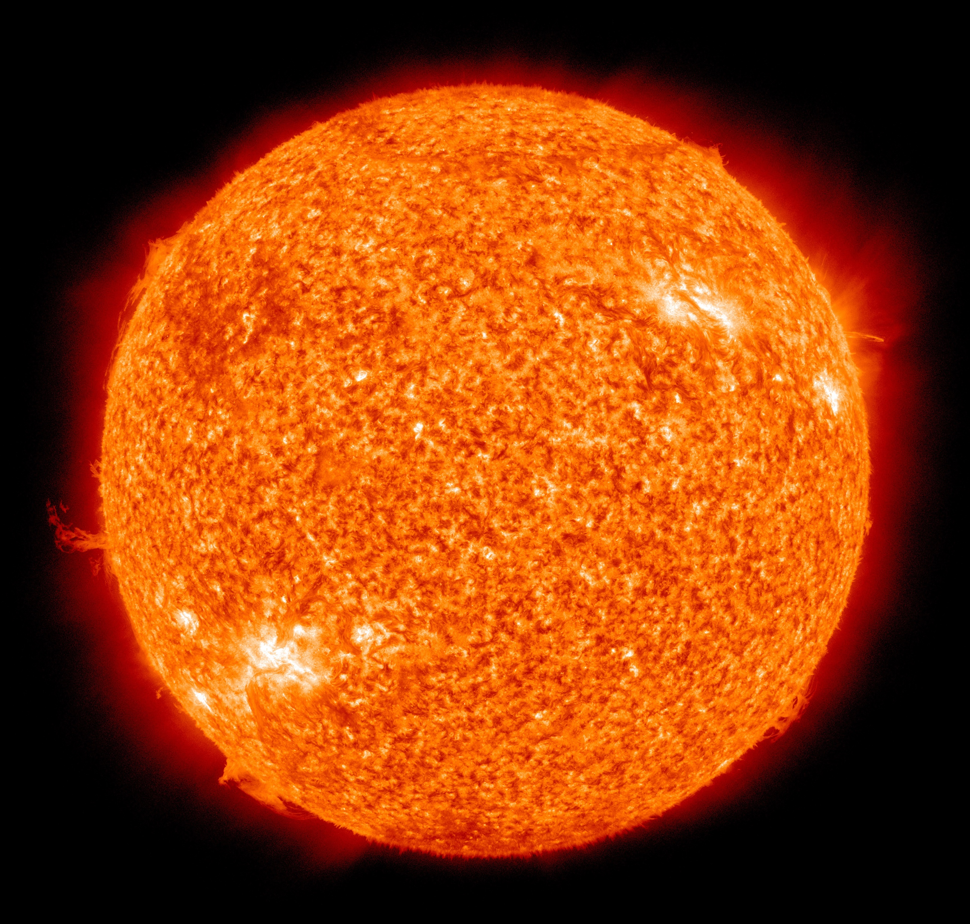
Our Sun
A typical star
A super-hot ball of gas
Mostly hydrogen
Powered by nuclear reactions
Core temperature 16 million degrees
Roughly 4.5 billion years old
Will last about another
4.5 billion years
The Sun in false colour UV {image credit NASA}
Notes:
The Sun is a giant ball of gas held together by its own gravity. As such, it is not solid. It does rotate on its own axis, like the Earth, but the Sun’s ‘day’ depends on where you are. As the Sun is not solid, it takes about 25 days to rotate at the equator, but nearer to 36 days at the pole.
The output power, 4x10²⁶ W, is the total amount of energy that the Sun produces every second. In comparison, a typical coal fired power station on Earth produces about 500 x 10⁶ W.
Notice the large solar flair at the bottom left hand corner of the image. This is a burst of super-hot gas that has been thrown out of the sun. It is on an arced path as the gas follows one of the magnetic field lines coming from the Sun.
NOTE: the unit of power used in science is the watt, W (as in a 60W light bulb). The unit of energy is the Joule. The watt corresponds to 1 Joule of energy produced every second over a period of time.
About 150 million km away from Earth
333 thousand times more massive than the Earth
1390 million meters in diameter

Slide 3
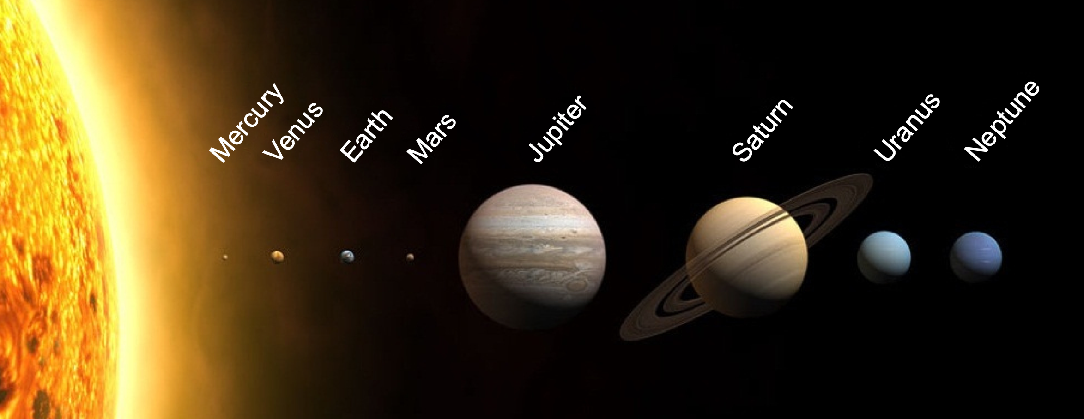
Our Solar system
In this image, the planets are in the right sequence and their relative sizes are correct (note the size of the sun!)
The distances have been compressed

Slide 4
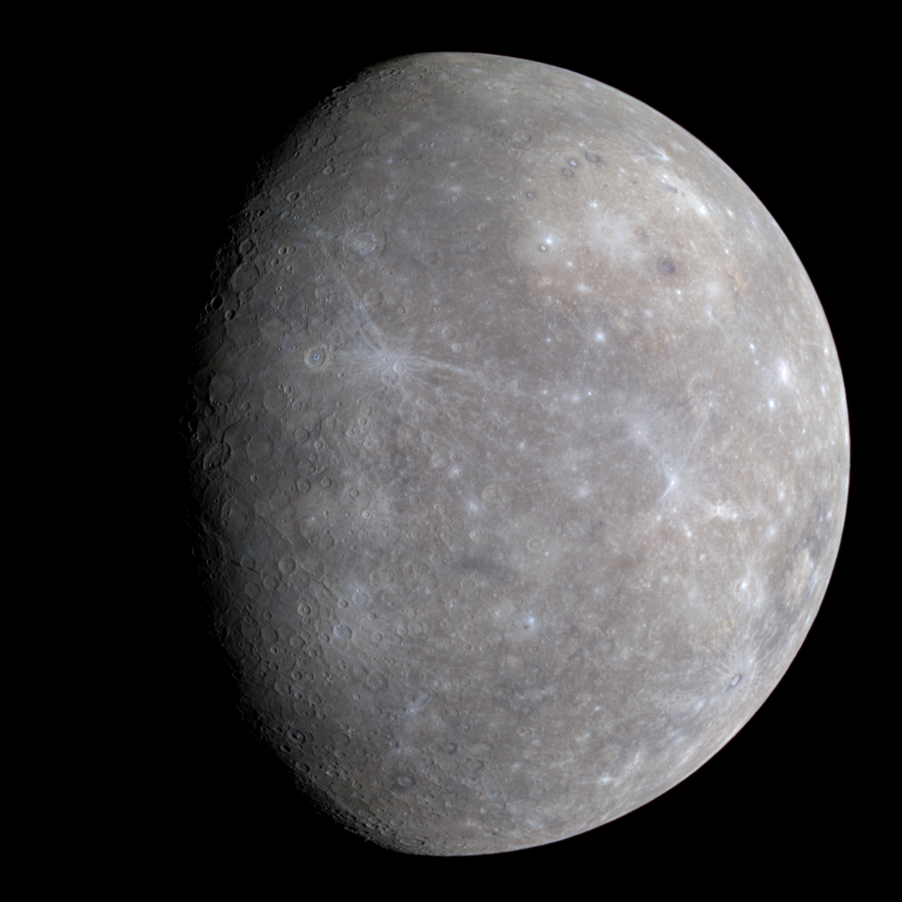
Mercury
0.4 times the diameter of Earth
No atmosphere worth mentioning
Average Surface temperature 170 ⁰C
Takes 88 days to orbit the Sun and
58 days to turn on its axis
Distance from the Sun is about 0.4 times that of Earth
Surface gravity 0.38g
True Colour Image of the Planet Mercury
{ image credit: NASA/Johns Hopkins University Applied Physics Laboratory/Carnegie Institution of Washington}
Notes:
Mercury’s orbit is very non-circular and it precesses round the sun in a way that cannot completely be explained by Newton’s theory of gravity. It was thought at one stage that another planet closer to the Sun (sometimes called Vulcan) explained this, but actually Einstein’s modified theory of gravity explains the odd features of Mercury’s orbit without this.

Slide 5
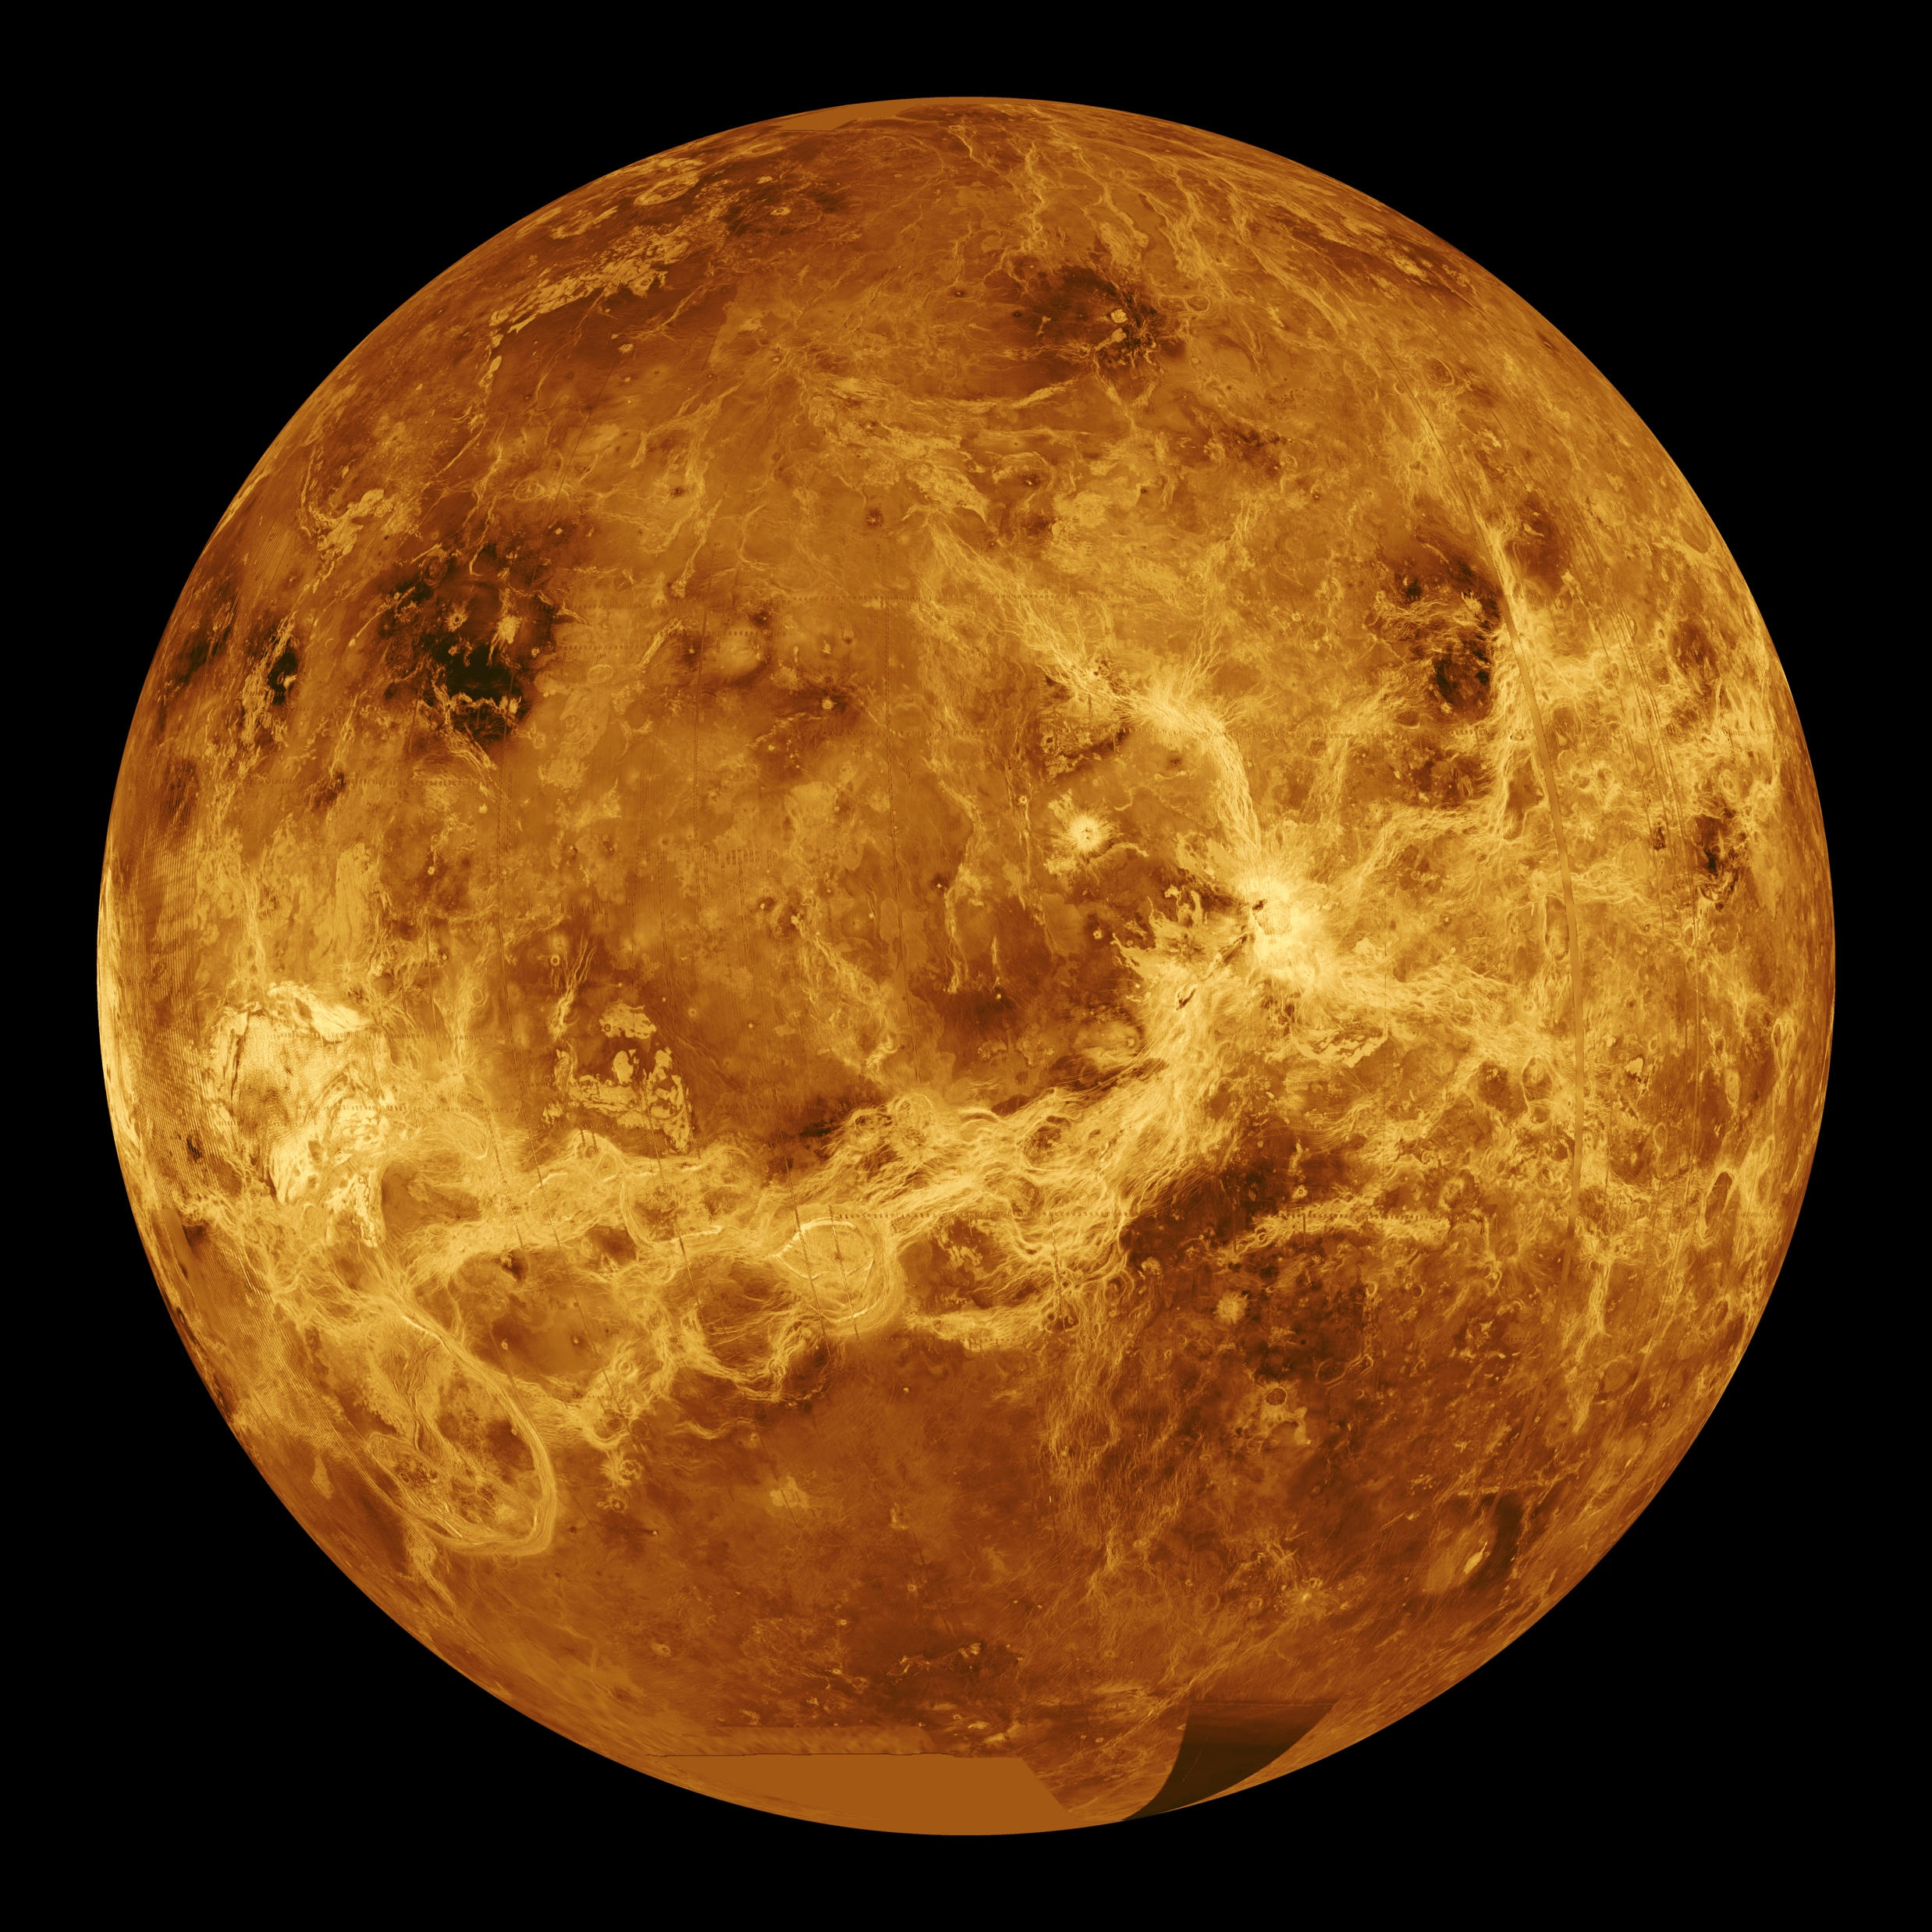
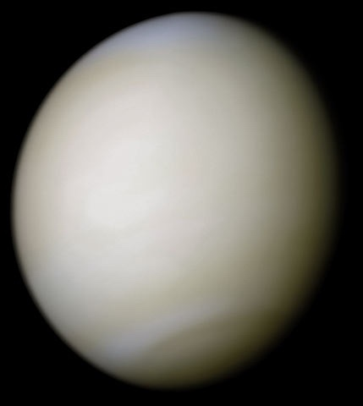
Venus
Atmospheric Clouds so thick unable to see the surface
Venus is bright object in the sky as the clouds reflect light
Greenhouse effect makes surface hot (460⁰ C)
Atmospheric pressure 90 times that of Earth
Acid rain
Surface features mapped by radar by orbiting probe
Diameter 0.95 Earth
Day: 243 days; year: 225 days
True Colour Image
Radar Map of Surface
{image credits NASA}
Notes:
The first image shows the thick atmosphere of Venus. Click again, and a second image replaces it.
This image was produced using data from the Magellan satellite. Venus’ atmosphere is far too thick to see the surface features so this image is produced from a radar map - bouncing radio waves off the surface and timing how long they take to return tells us about the height of that part of the surface.
Venus is about the same size as the Earth, but is unusual in that the Venusian ‘day’ is 243 Earth days and its ‘year’ is 224 Earth days - hence Venus’ day is longer than its year. You can amuse the students talking about how their birthday’s would be affected by this.
The atmosphere is mostly carbon dioxide, which has given Venus a ‘greenhouse effect’ much higher than that on Earth. This has lifted the surface temperature about 400⁰C higher than one might expect given its distance from the Sun.
Venus’ clouds are composed of Sulphur dioxide and sulphuric acid droplets.

Slide 6
Guess where?
Notes:
The image is actually a composite of hundreds of pictures made by the orbiting DMSP satellites. What you can see are the electric lights of population centers.

Slide 7
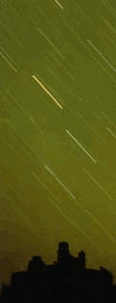
Meteorites
Lumps of rock from space that generally burn up in the atmosphere
Some large ones make it to the surface and can cause damage
Notes:
In the image of a meteorite burning up in Earth’s atmosphere, the cloud of dust left behind after can be seen billowing out from the final explosion.

Slide 8
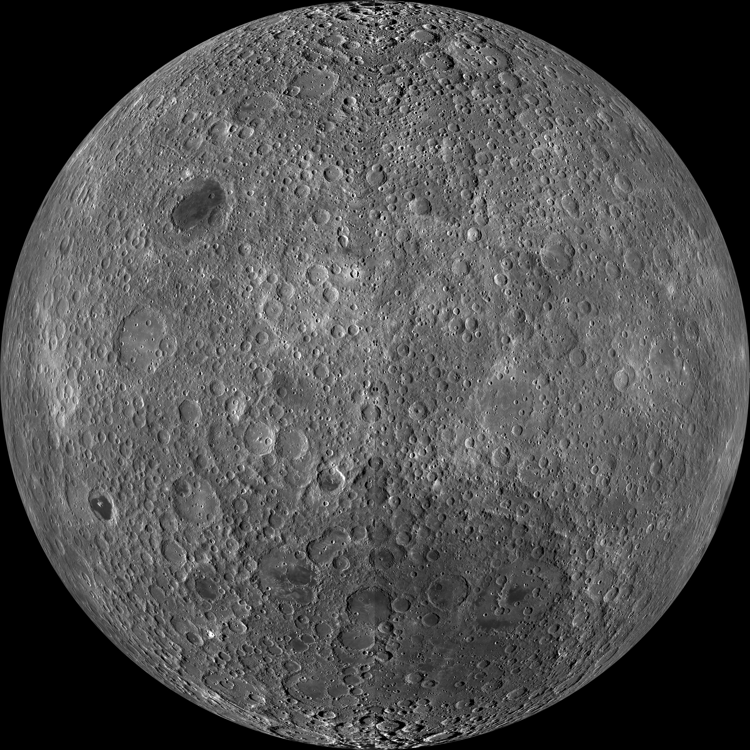
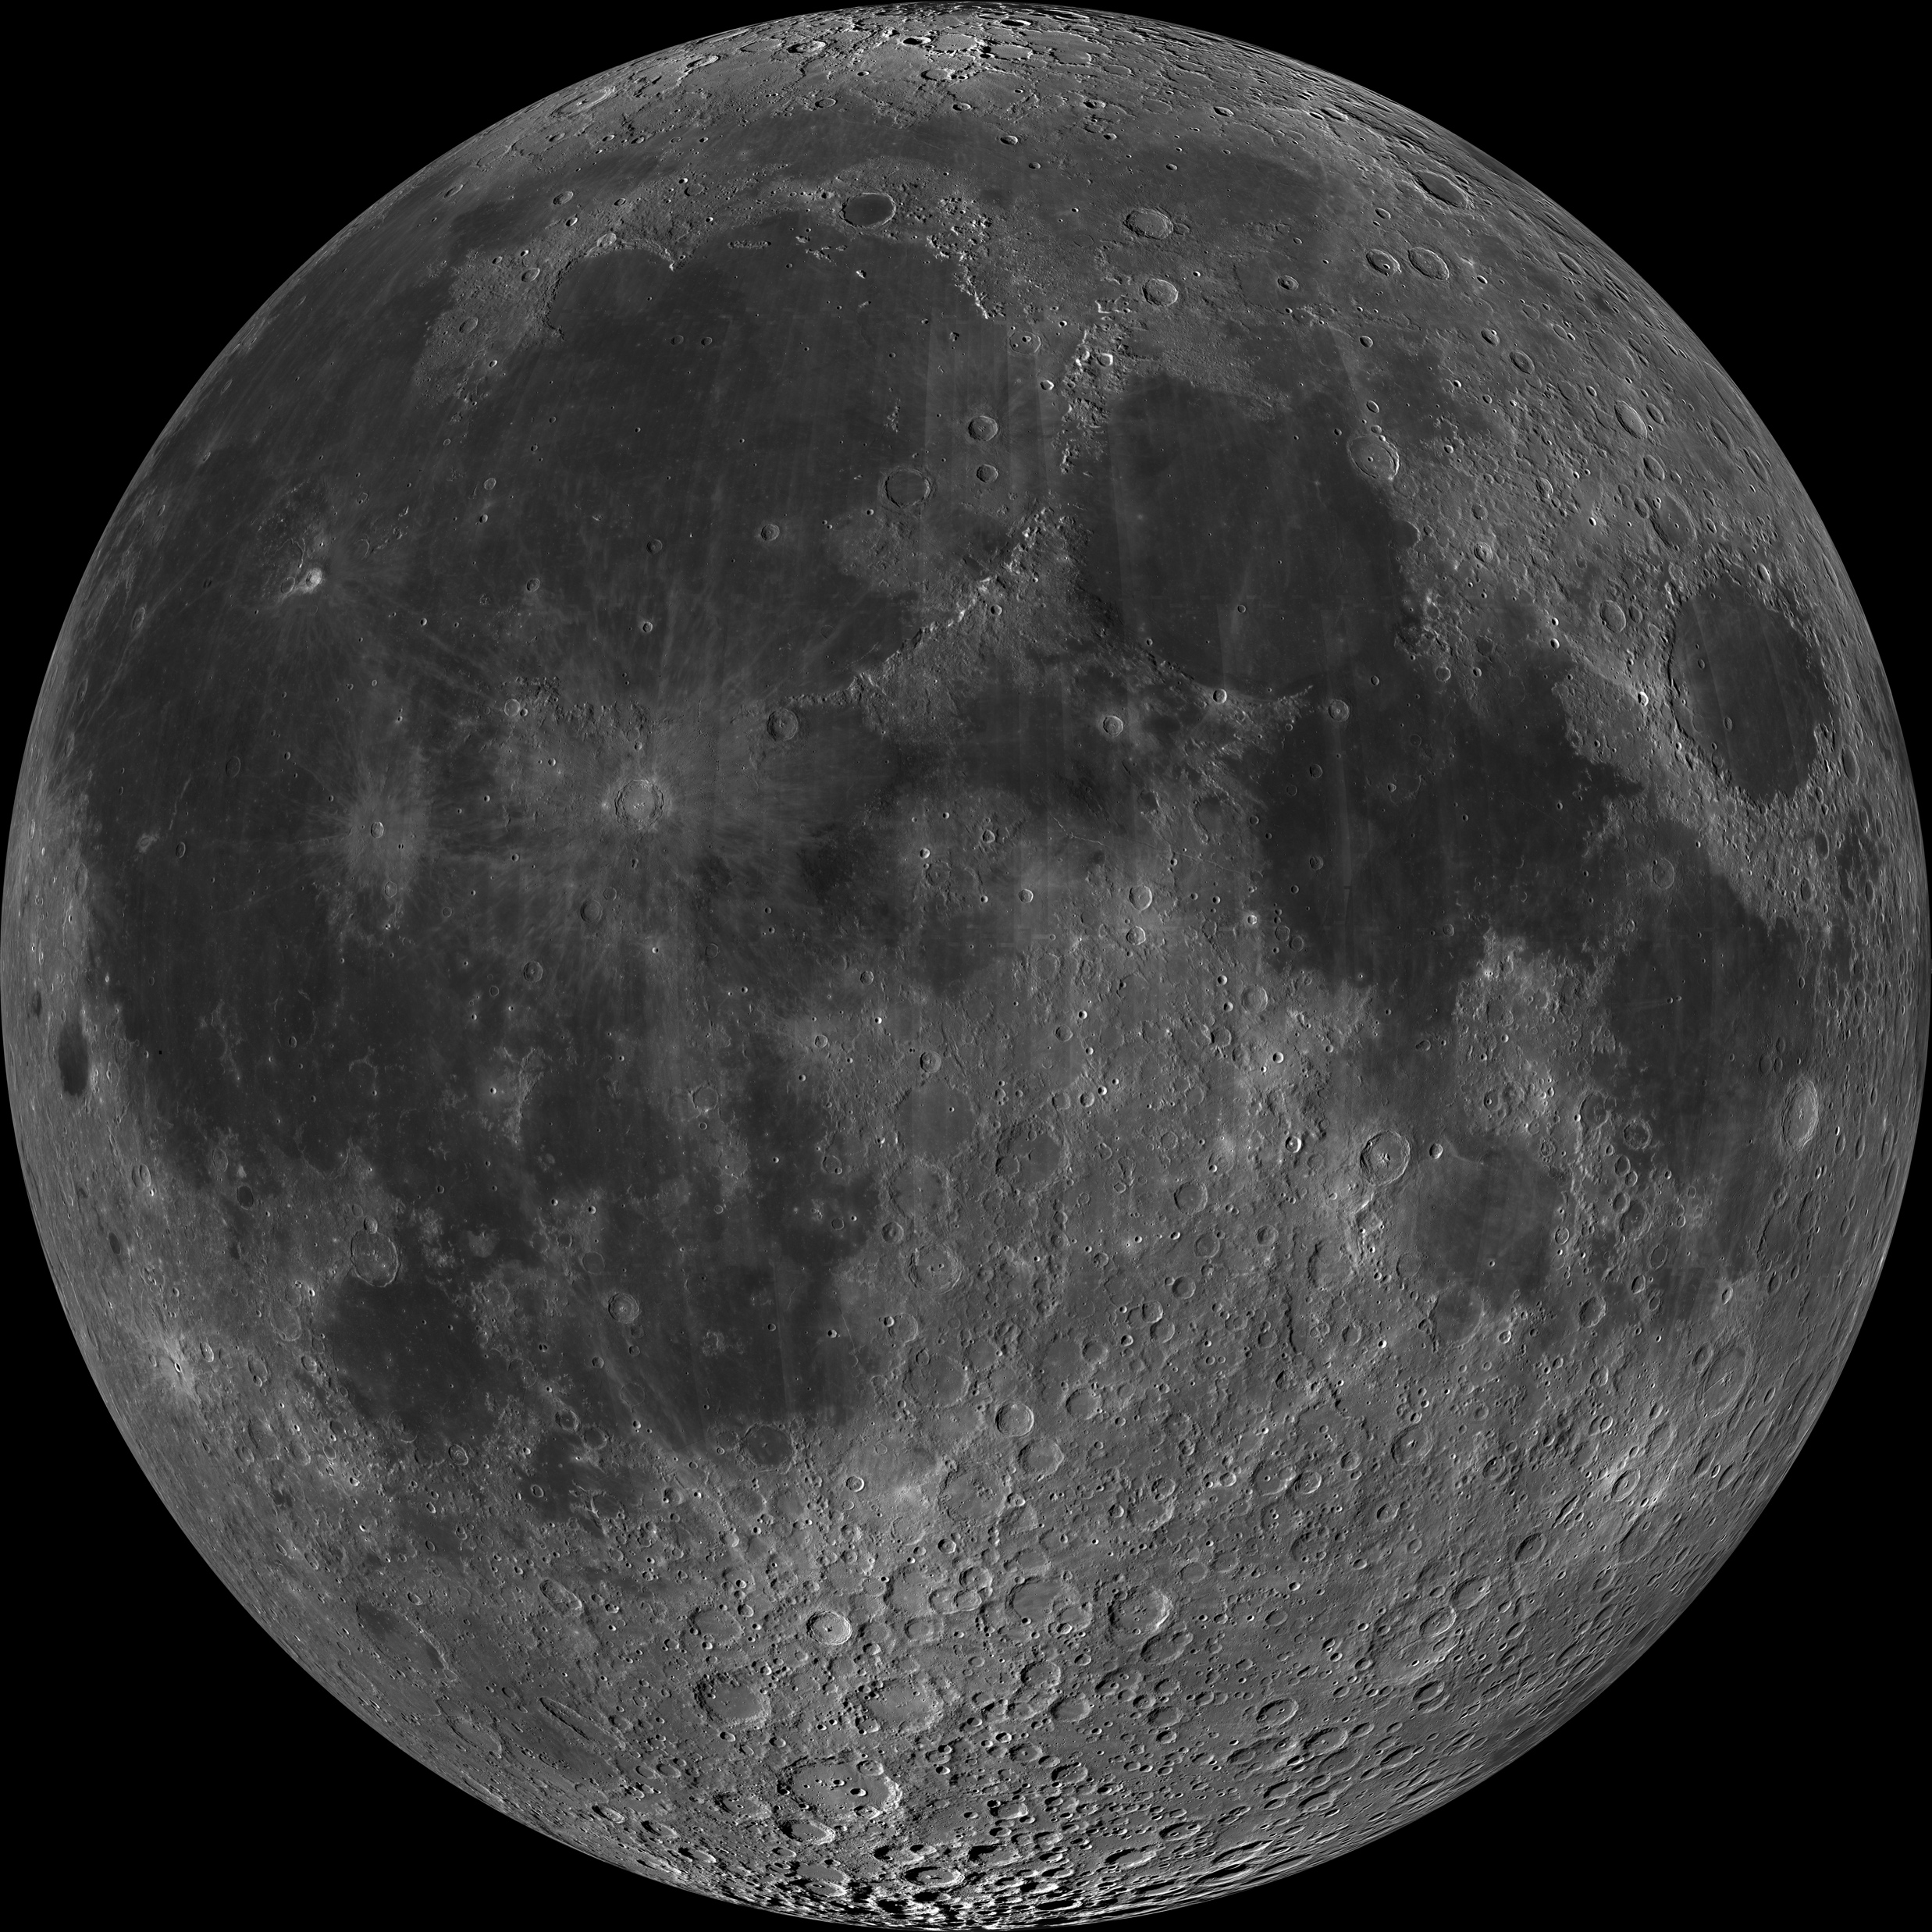
The Moon
Lunar farside
Lunar nearside
Orbits the Earth
No atmosphere
Some water, as ice, at poles
Craters due to being hit by meteorites
Probably made when a giant meteor hit the Earth and blasted part of the crust into space
{image credit: NASA/GSFC/Arizona State University}
Notes:
Note that the Moon does not quite show exactly the same face to the Earth at all times, and also that the size of the Moon varies as it orbit takes it slightly nearer and further away.

Slide 9
Phases of the Moon
The Moon keeps the same face to the Earth
This only works as the Time it takes to turn on its axis, is the same as the time taken to orbit Earth
The Phases are due to the angle that we look at the side of the Moon that is lit up by the Sun.
Phases of the Moon

Slide 10
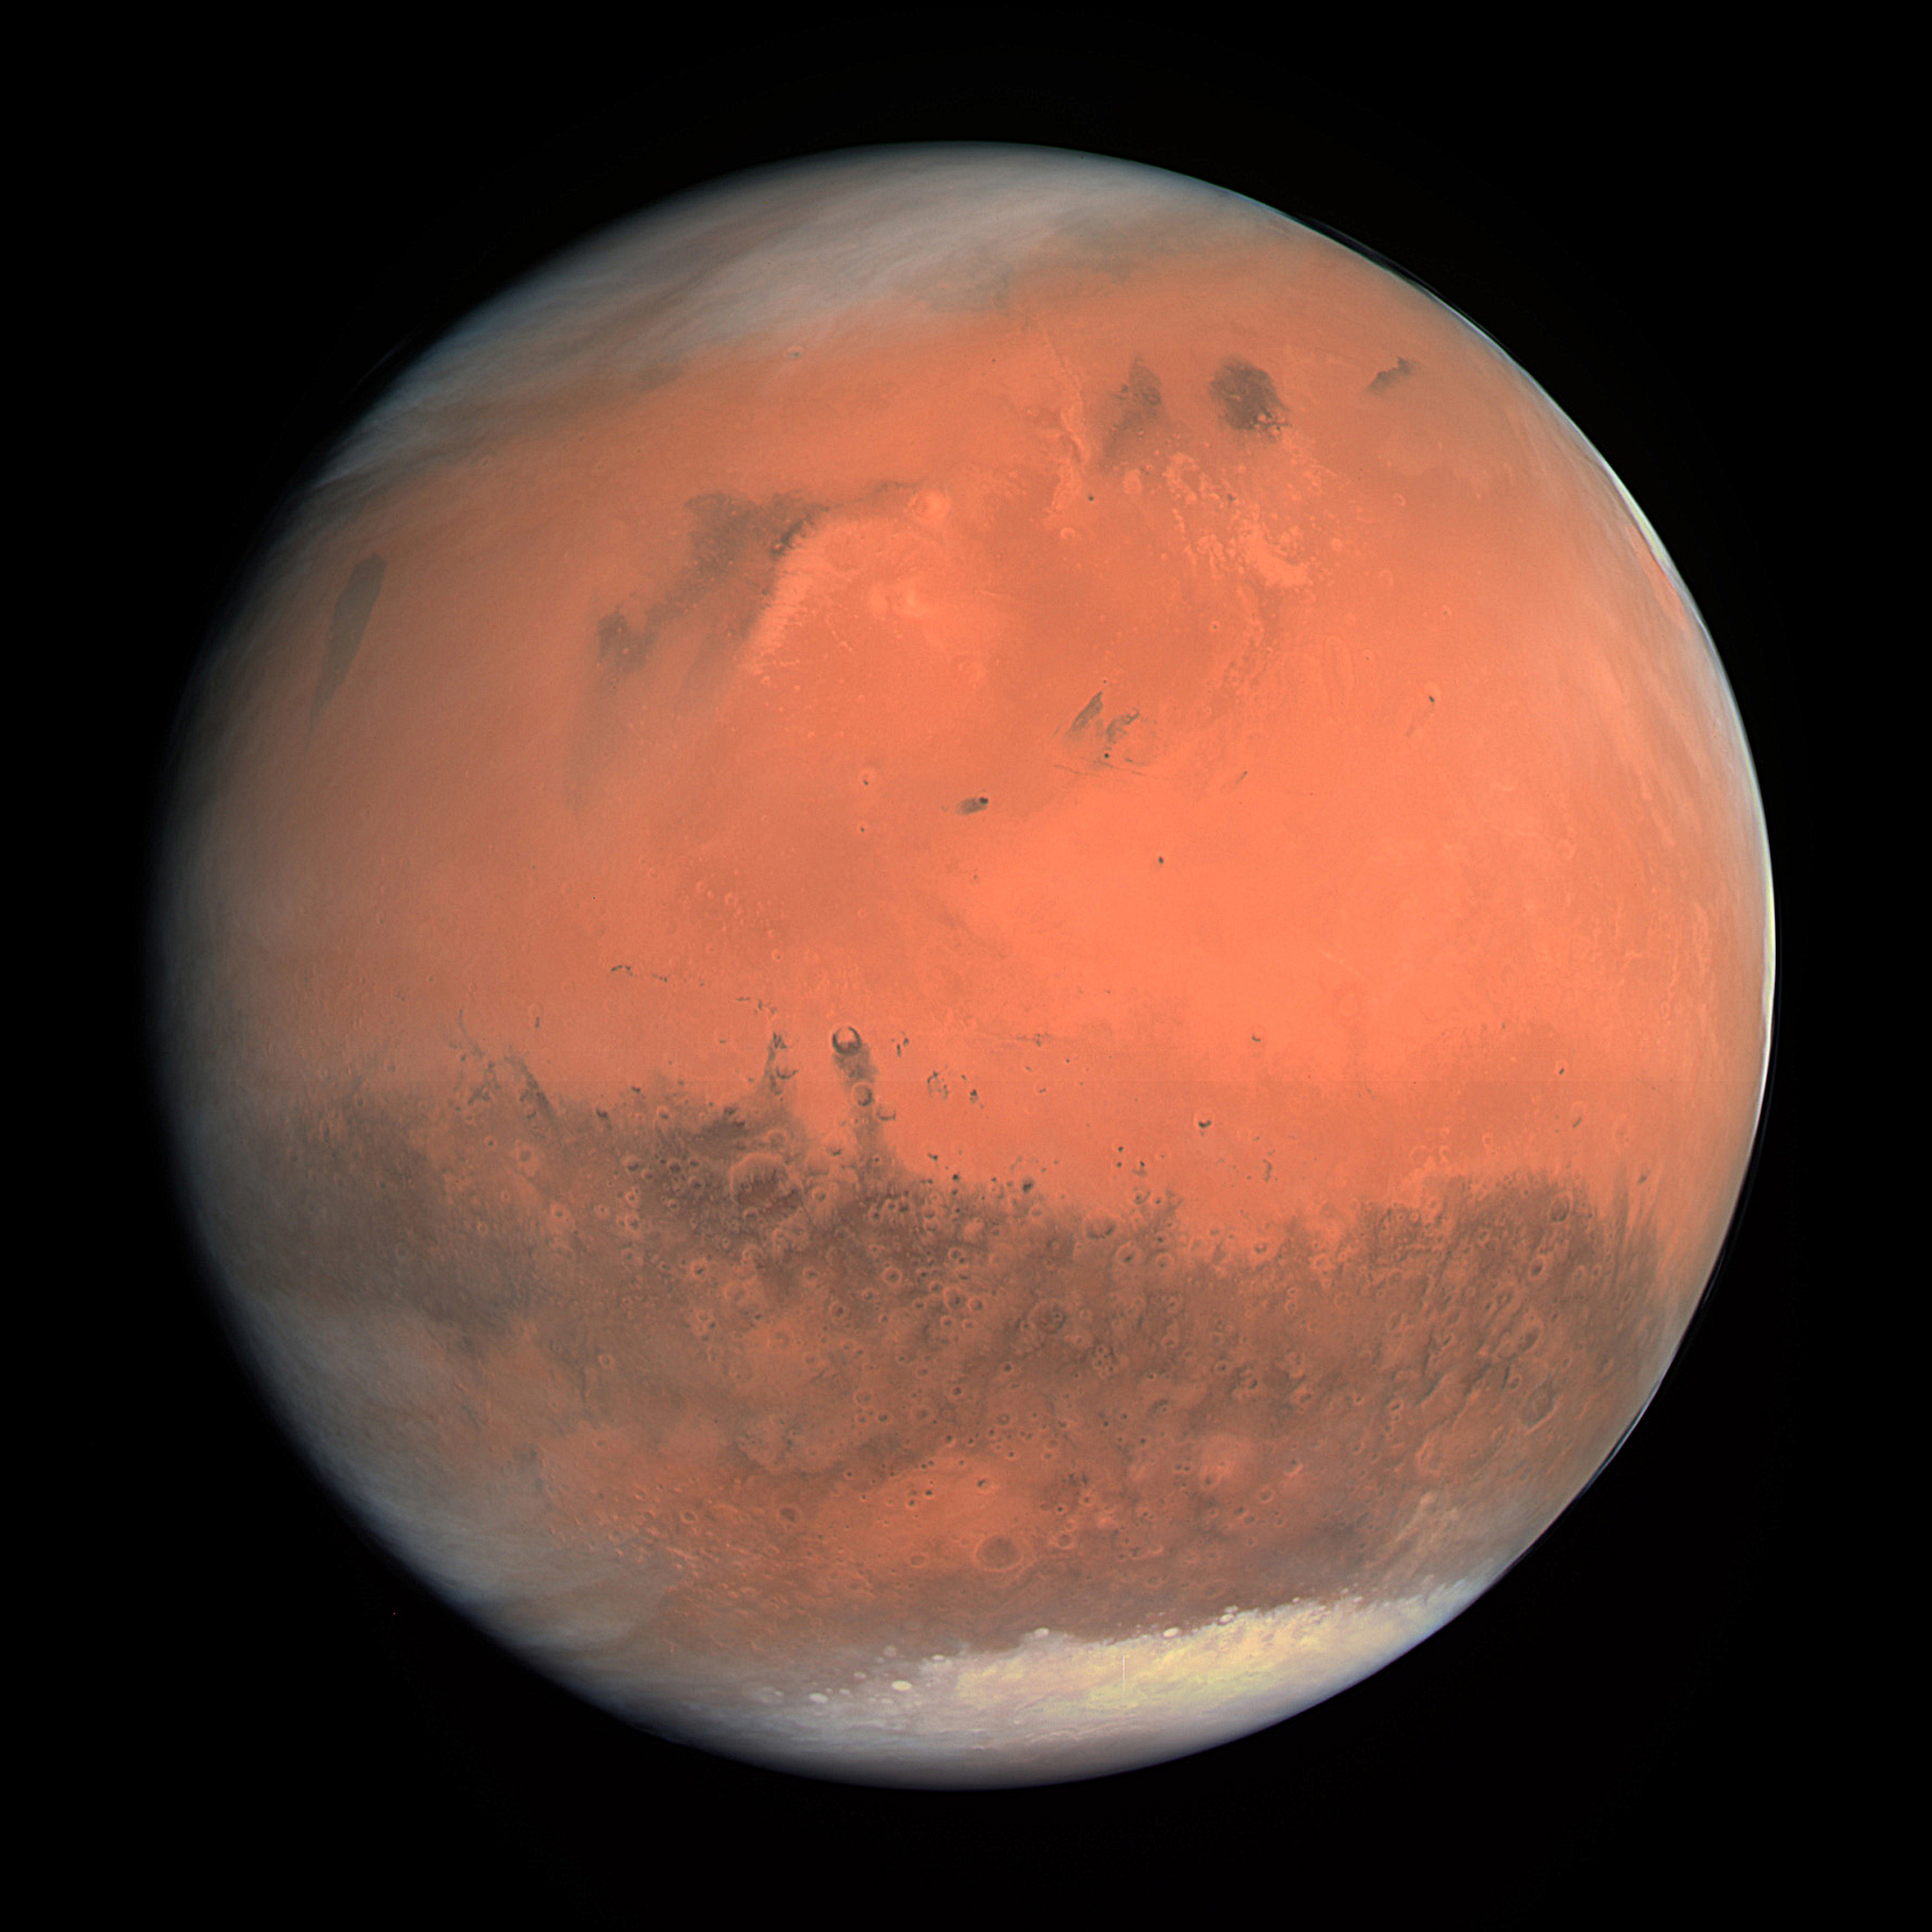
Mars
True Colour Image
Atmosphere is carbon dioxide
Atmospheric pressure is 0.75% of Earth’s
Smaller than Earth, but about the same size of land area
Being well explored by unmanned probes
Surface gravity: 0.38g
Day: 24 h 37 m Year: 687 days
{image credit: ESA - European Space Agency & Max-Planck Institute for Solar System Research for OSIRIS Team ESA/MPS/UPD/LAM/IAA/RSSD/INTA/UPM/DASP/IDA}
Notes:
Mars boasts the largest volcano known in the solar system - Olympus Mons is 27 miles high (3 times that of (Mount Everest). Olympus Mons is located in the Tharsis Bulge, a huge swelling in the Martian surface that bears numerous other large volcanic features.
The broad feature across the center of the planet is Valles Marineris or the scar of Mars, which is 4000 km long and 7 km deep.

Slide 11
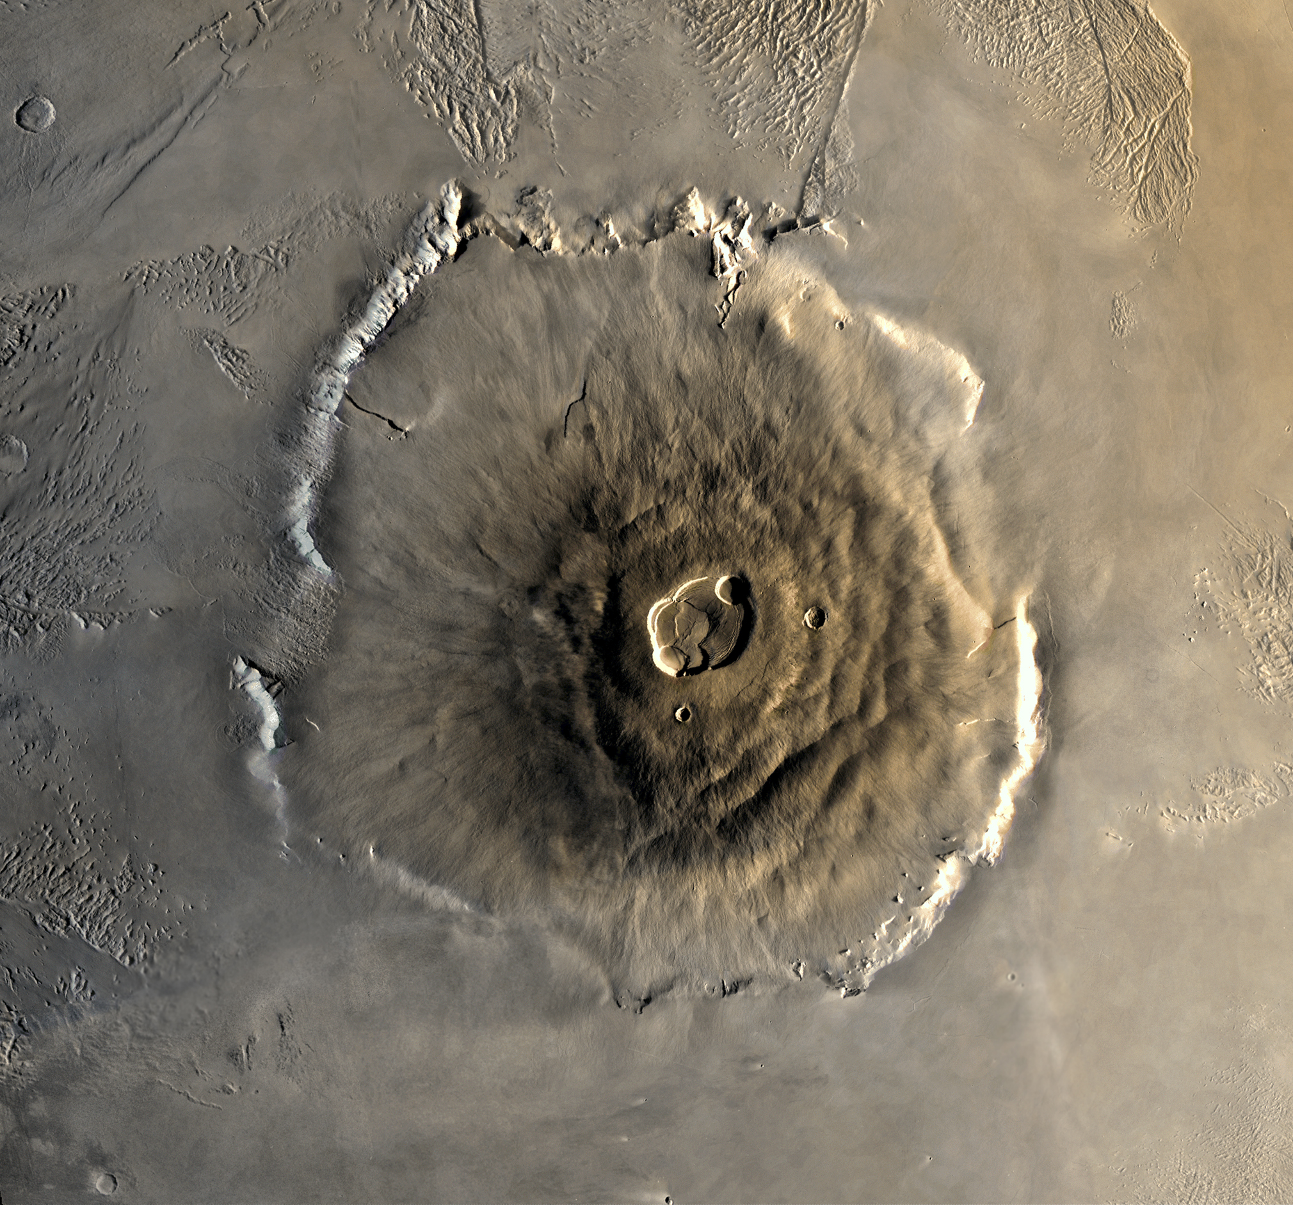
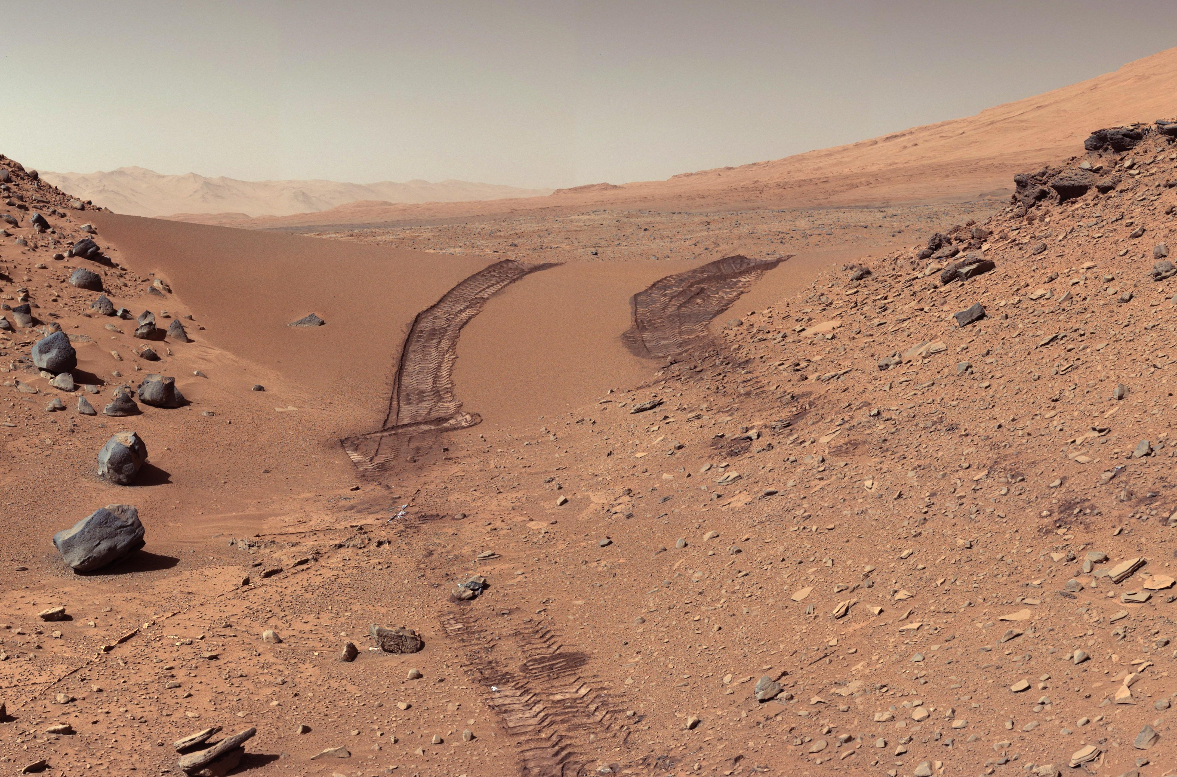
Martian Surface
Olympus Mons Volcano
{Image Credit: NASA/JPL-Caltech/MSSS}
Surface Image from Curiosity Rover
{Image credit: Image by NASA, modifications by Seddon}
Notes:
Both these images are from the Pathfinder mission which landed a small roving vehicle (about the size of a large tea tray) on the surface.
The brownish tint to the Martian sky is due to fine dust suspended in the atmosphere.
Mars is barren, but there is convincing evidence that water once flowed freely on parts of the surface. It is likely that this water is now in the form of frost under the surface. It is possible that future explorers could tap this water.

Slide 12
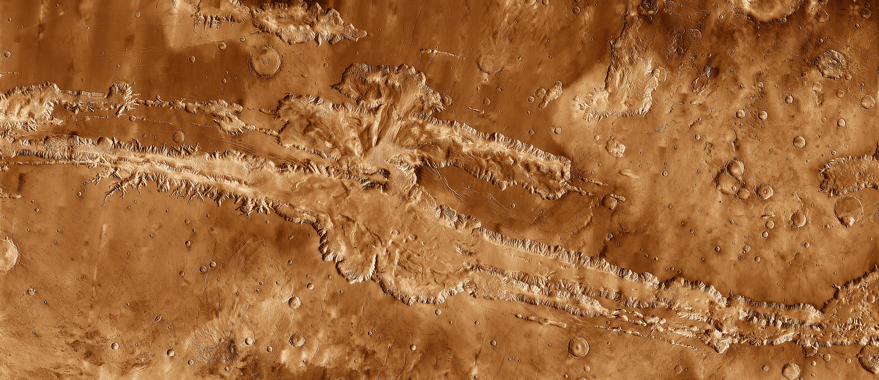
Valles Marineris
4 000 km long; 7 km deep
Grand canyon on Earth: 446 km long; 2 km deep
{Image Credit: NASA / JPL-Caltech / Arizona State University}

Slide 13
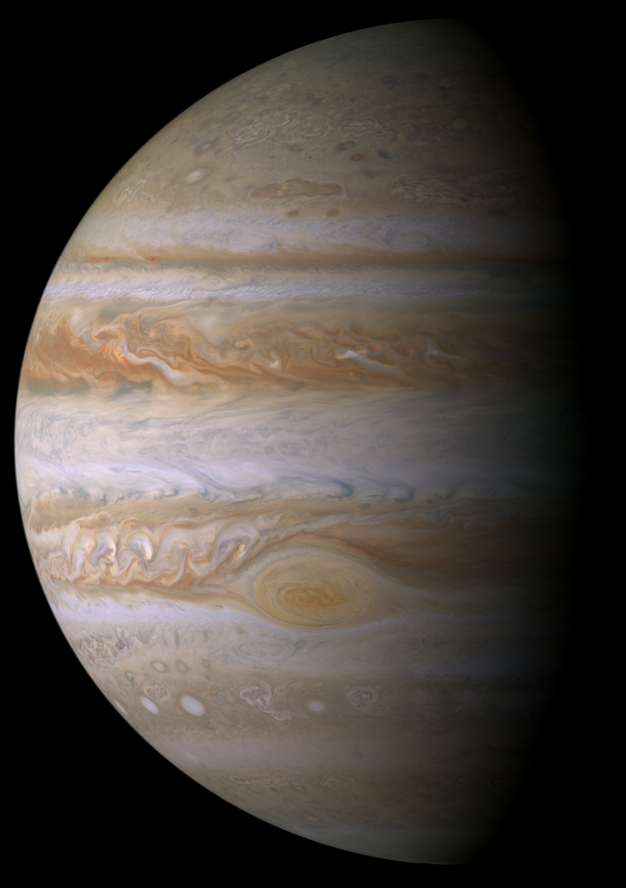
Jupiter
Largest planet in the solar system
Composed entirely of gas (mostly Hydrogen)
Large red spot is a hurricane - bigger than Earth
11 times the diameter of Earth and 318 times more massive
Day: 9.9 hours; Year: 11.9 years
Surface Gravity: 2.5g
Jupiter from the Cassini Space Probe
{Image Credit: NASA/JPL/Space Science Institute}
Notes:
This true color image of Jupiter, taken by NASA's Cassini spacecraft on December 7th, 2000.
Different chemical compositions of the cloud particles lead to different colors.
The cloud patterns reflect different physical conditions -- updrafts and downdrafts -- in which the clouds form. The bluish areas are believed to be regions devoid of clouds and covered by high haze.
The Great Red Spot (below and to the right of center) is a giant atmospheric storm as wide as two Earths and over 300 years old, with peripheral winds of 483 kilometers per hour (300 miles per hour). This image shows that it is trailed to the north by a turbulent region, caused by atmospheric flow around the spot.
The bright white spots in this region are lightning storms, which were seen by NASA's Galileo spacecraft when it photographed the night side of Jupiter.
When spacecraft went there for the first time, they discovered that Jupiter also has a ring system - but too thin and faint to be seen on this image.
Despite Jupiter's huge size, it rotates on its axis in about 10 hours. As it is not solid, the different latitudes rotate at different speeds - hence the swirling cloud patterns.
Takes 12 years to orbit the Sun.

Slide 14
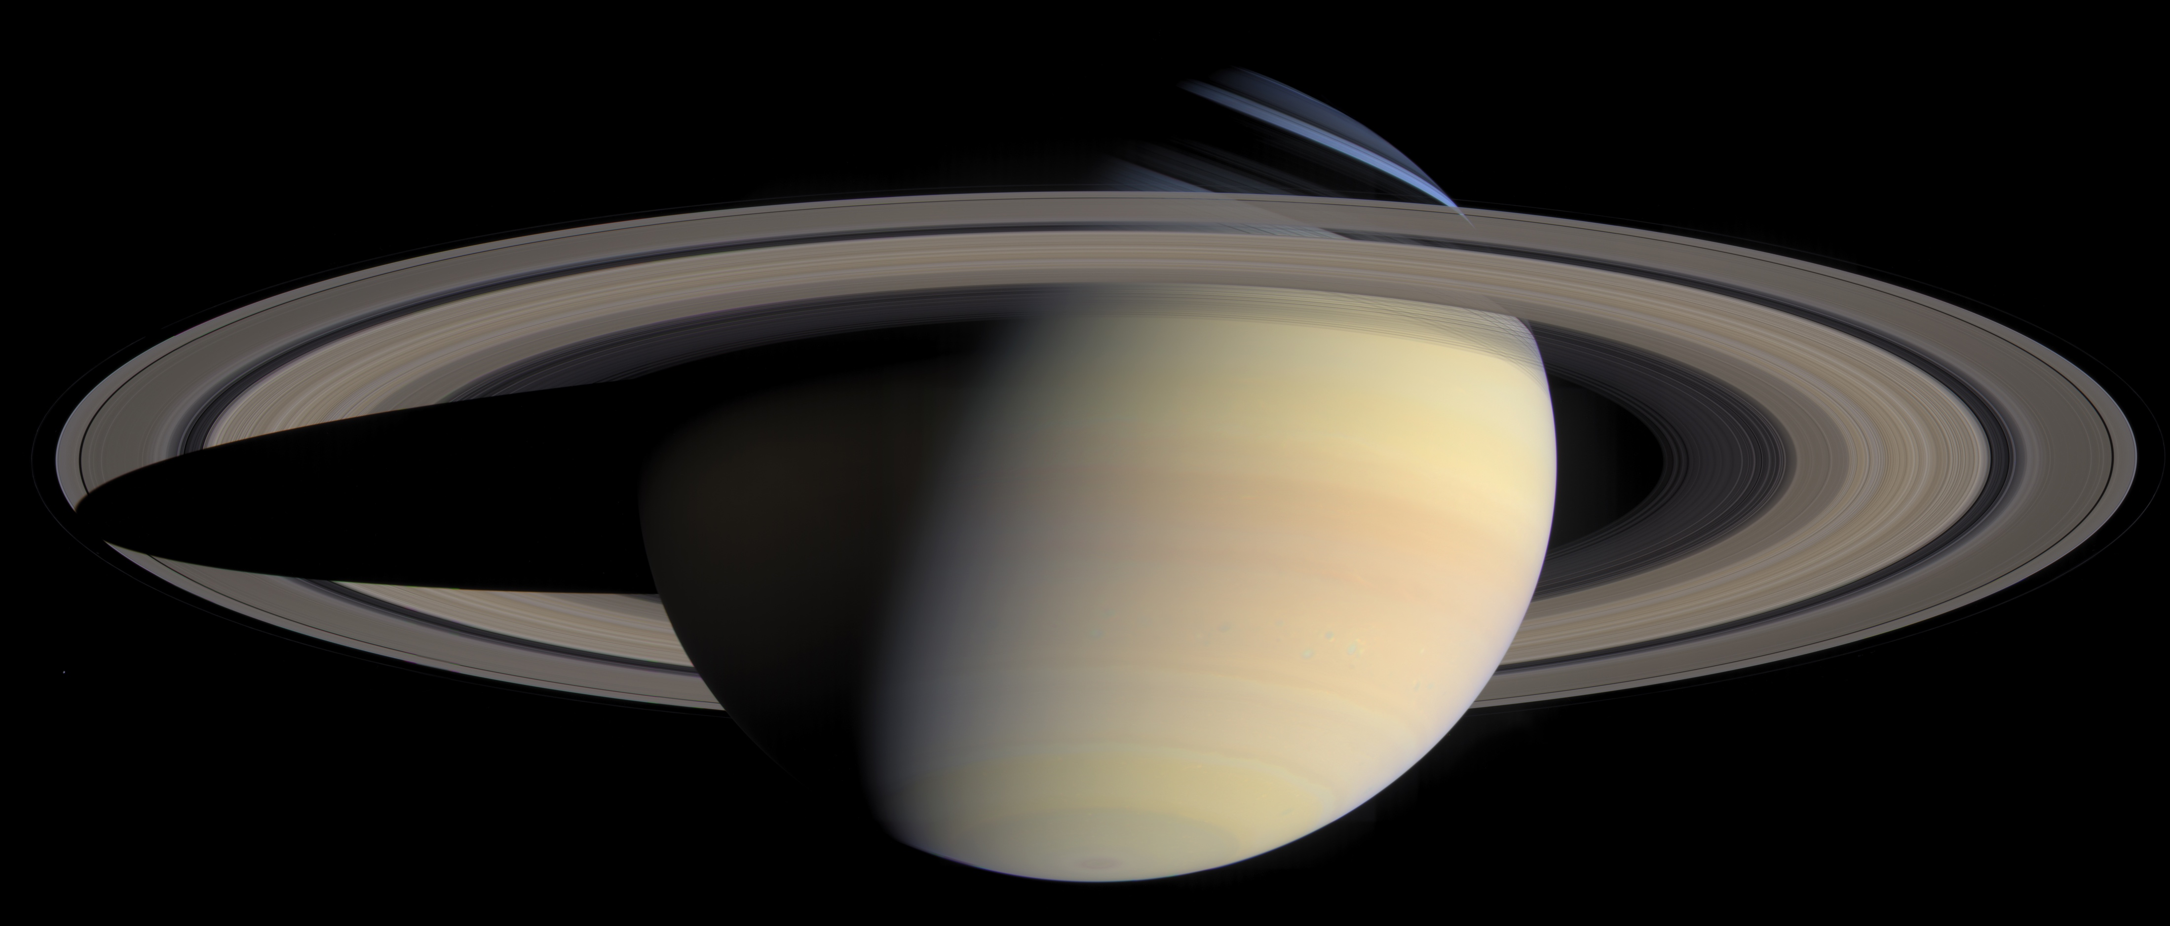
Saturn
True Colour Image from Cassini Space Probe
Commonly thought to be the most beautiful of the planets
Gas giant Nearly as big as Jupiter
Ring system can clearly be seen from Earth with even a small telescope
Day: 10 h 33 m; Year: 29.5 years
Surface Gravity: 1.06g
Planet is less dense than water!
{Image Credit: ASA/JPL/Space Science Institute}
Notes:
Second image from:
A Cassini image taken from 30 million miles away as the spacecraft approached Saturn (27th March 2004).
The rings are not solid, but tiny particles orbiting the planet.
Takes 29 years to orbit the Sun and 10 hours to turn on its axis.

Slide 15
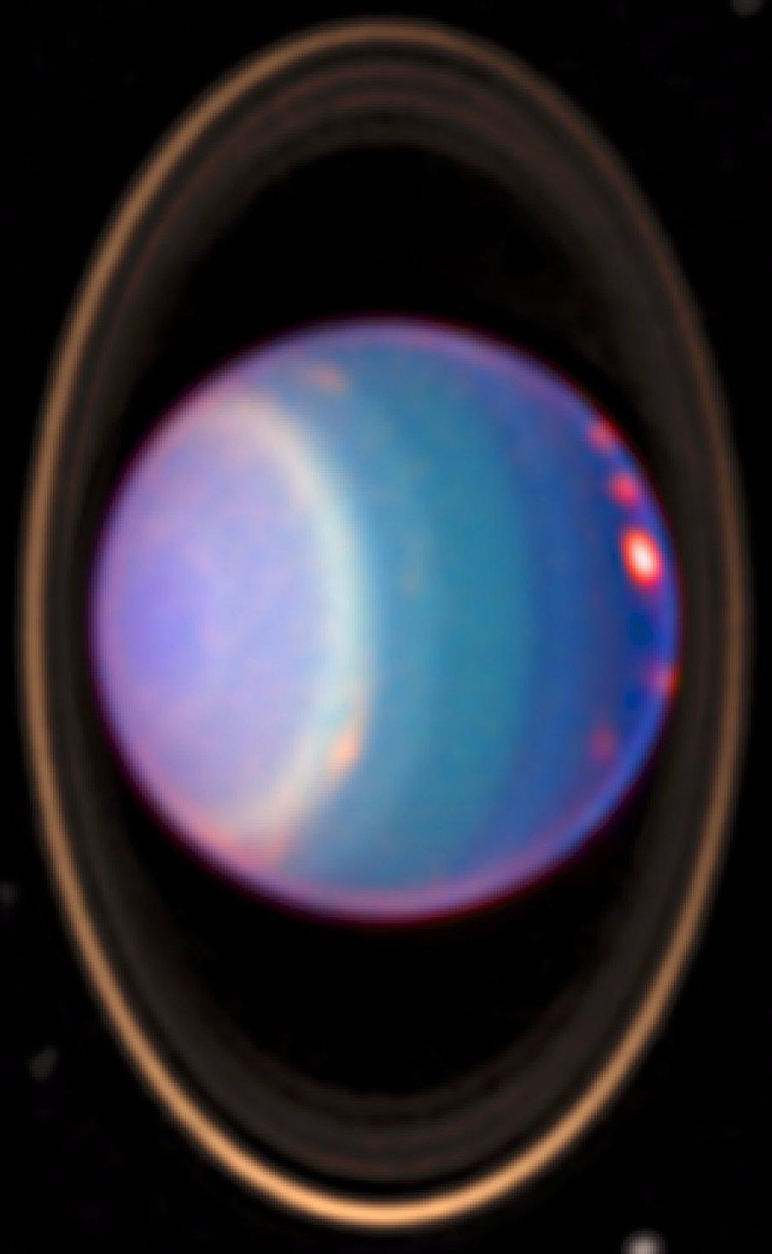
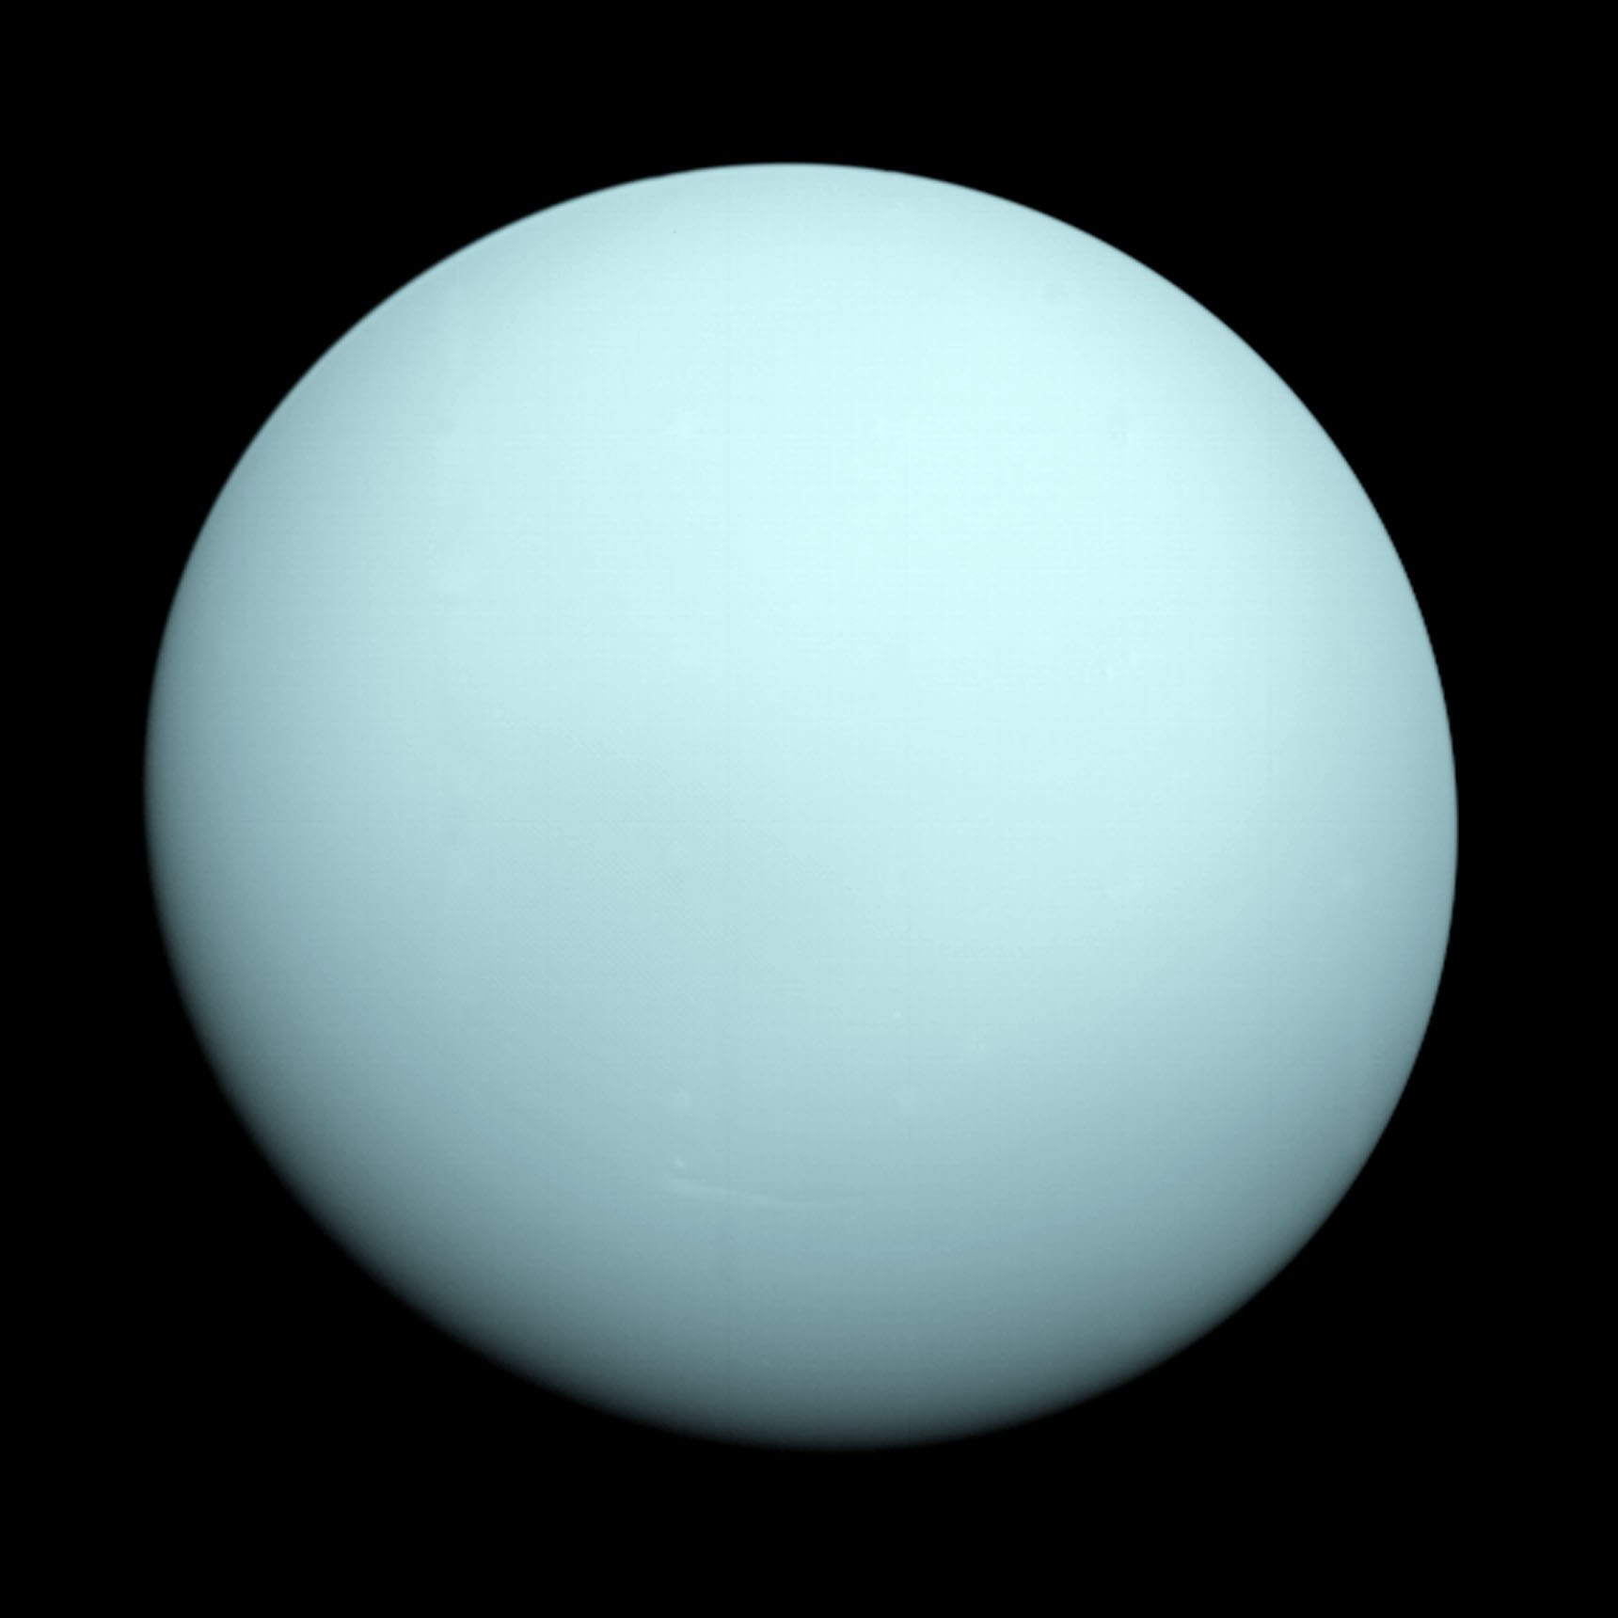
Uranus
True colour image makes Uranus seem bland
Infra-red image from the Hubble Space telescope shows more activity and the thin ring system
Also that Uranus rotates on it side - so it ‘rolls’ around the Sun, unlike the other plants
Day: 17 h 14 M; Year: 84 years
Surface Gravity: 0.89g
{Image Credit: NASA / HST}
{Image Credit: NASA/JPL-Caltech}
Notes:
Pronounced with the accent on the ‘U’ not the ‘a’…
Text comes up in sequence, followed by the HST image and then more text.
Uranus is another ‘gas giant’ but much of the cloud activity is obscured by high altitude haze. At the center of the planet there is thought to be an ice covered rocky core.
Takes 85 years to orbit the Sun and 17 hours to turn on its axis.

Slide 16
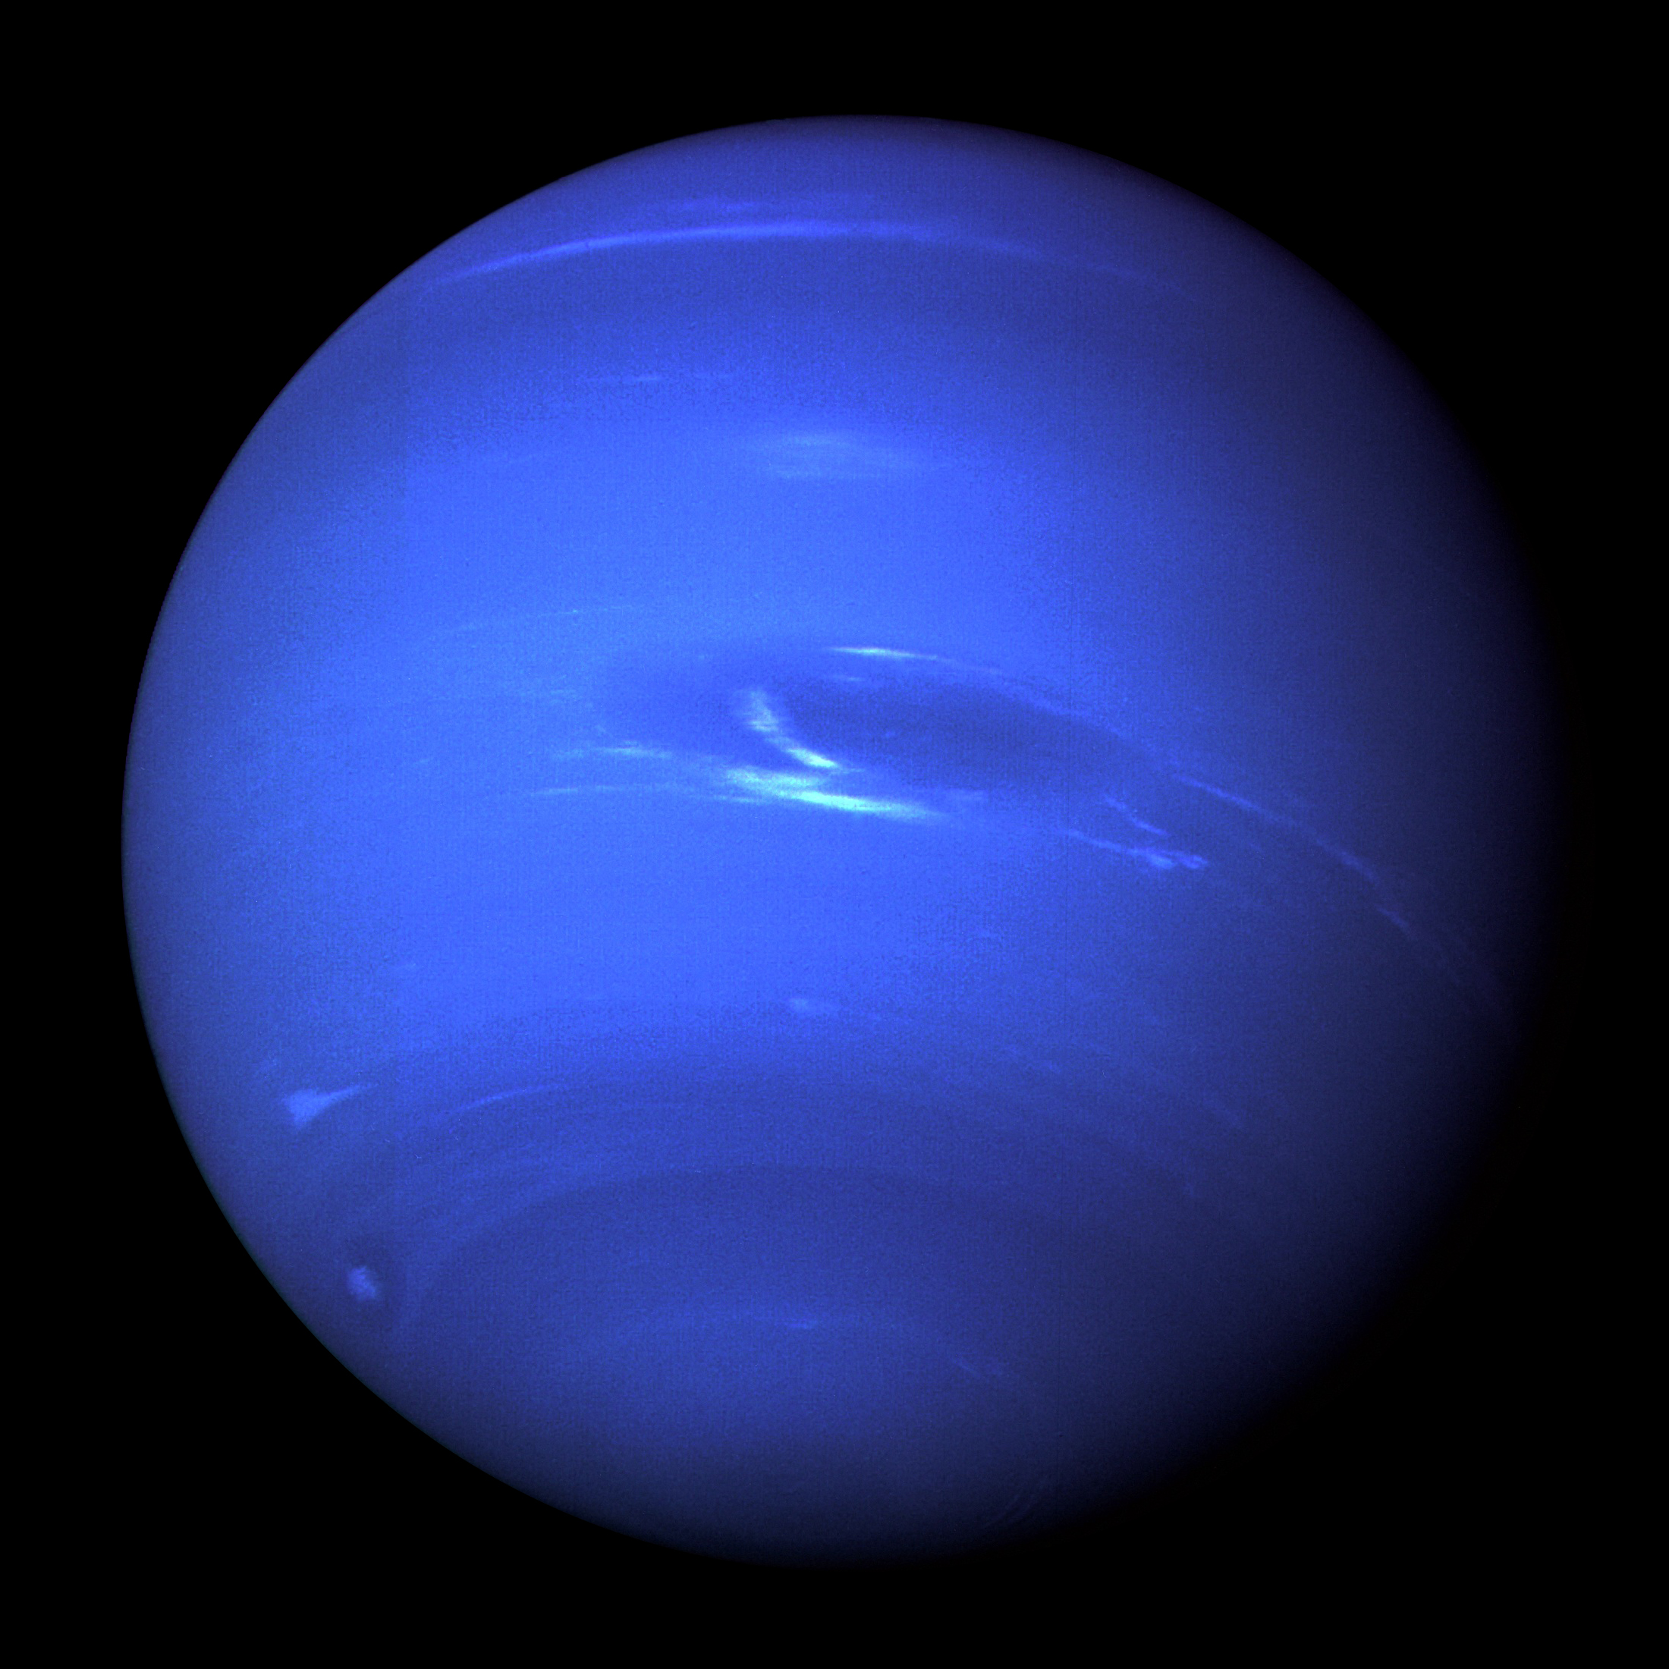
Neptune
Last of the gas giants
Similar in size to Uranus
Great dark spot was a storm system
High altitude ‘wispy’ clouds can also be seen
Day: 16 h 6 m; Year: 165 years
Surface Gravity: 1.14g
{Image Credit: NASA / JPL}
Notes:
Neptune is clearly more active than Uranus. It is thought to have its own internal source of heat due to matter falling under gravity towards the center. Like Uranus is thought to have an ice covered rocky core.
Takes 164 years to orbit the Sun and 16 hours to turn on its axis.

Slide 17
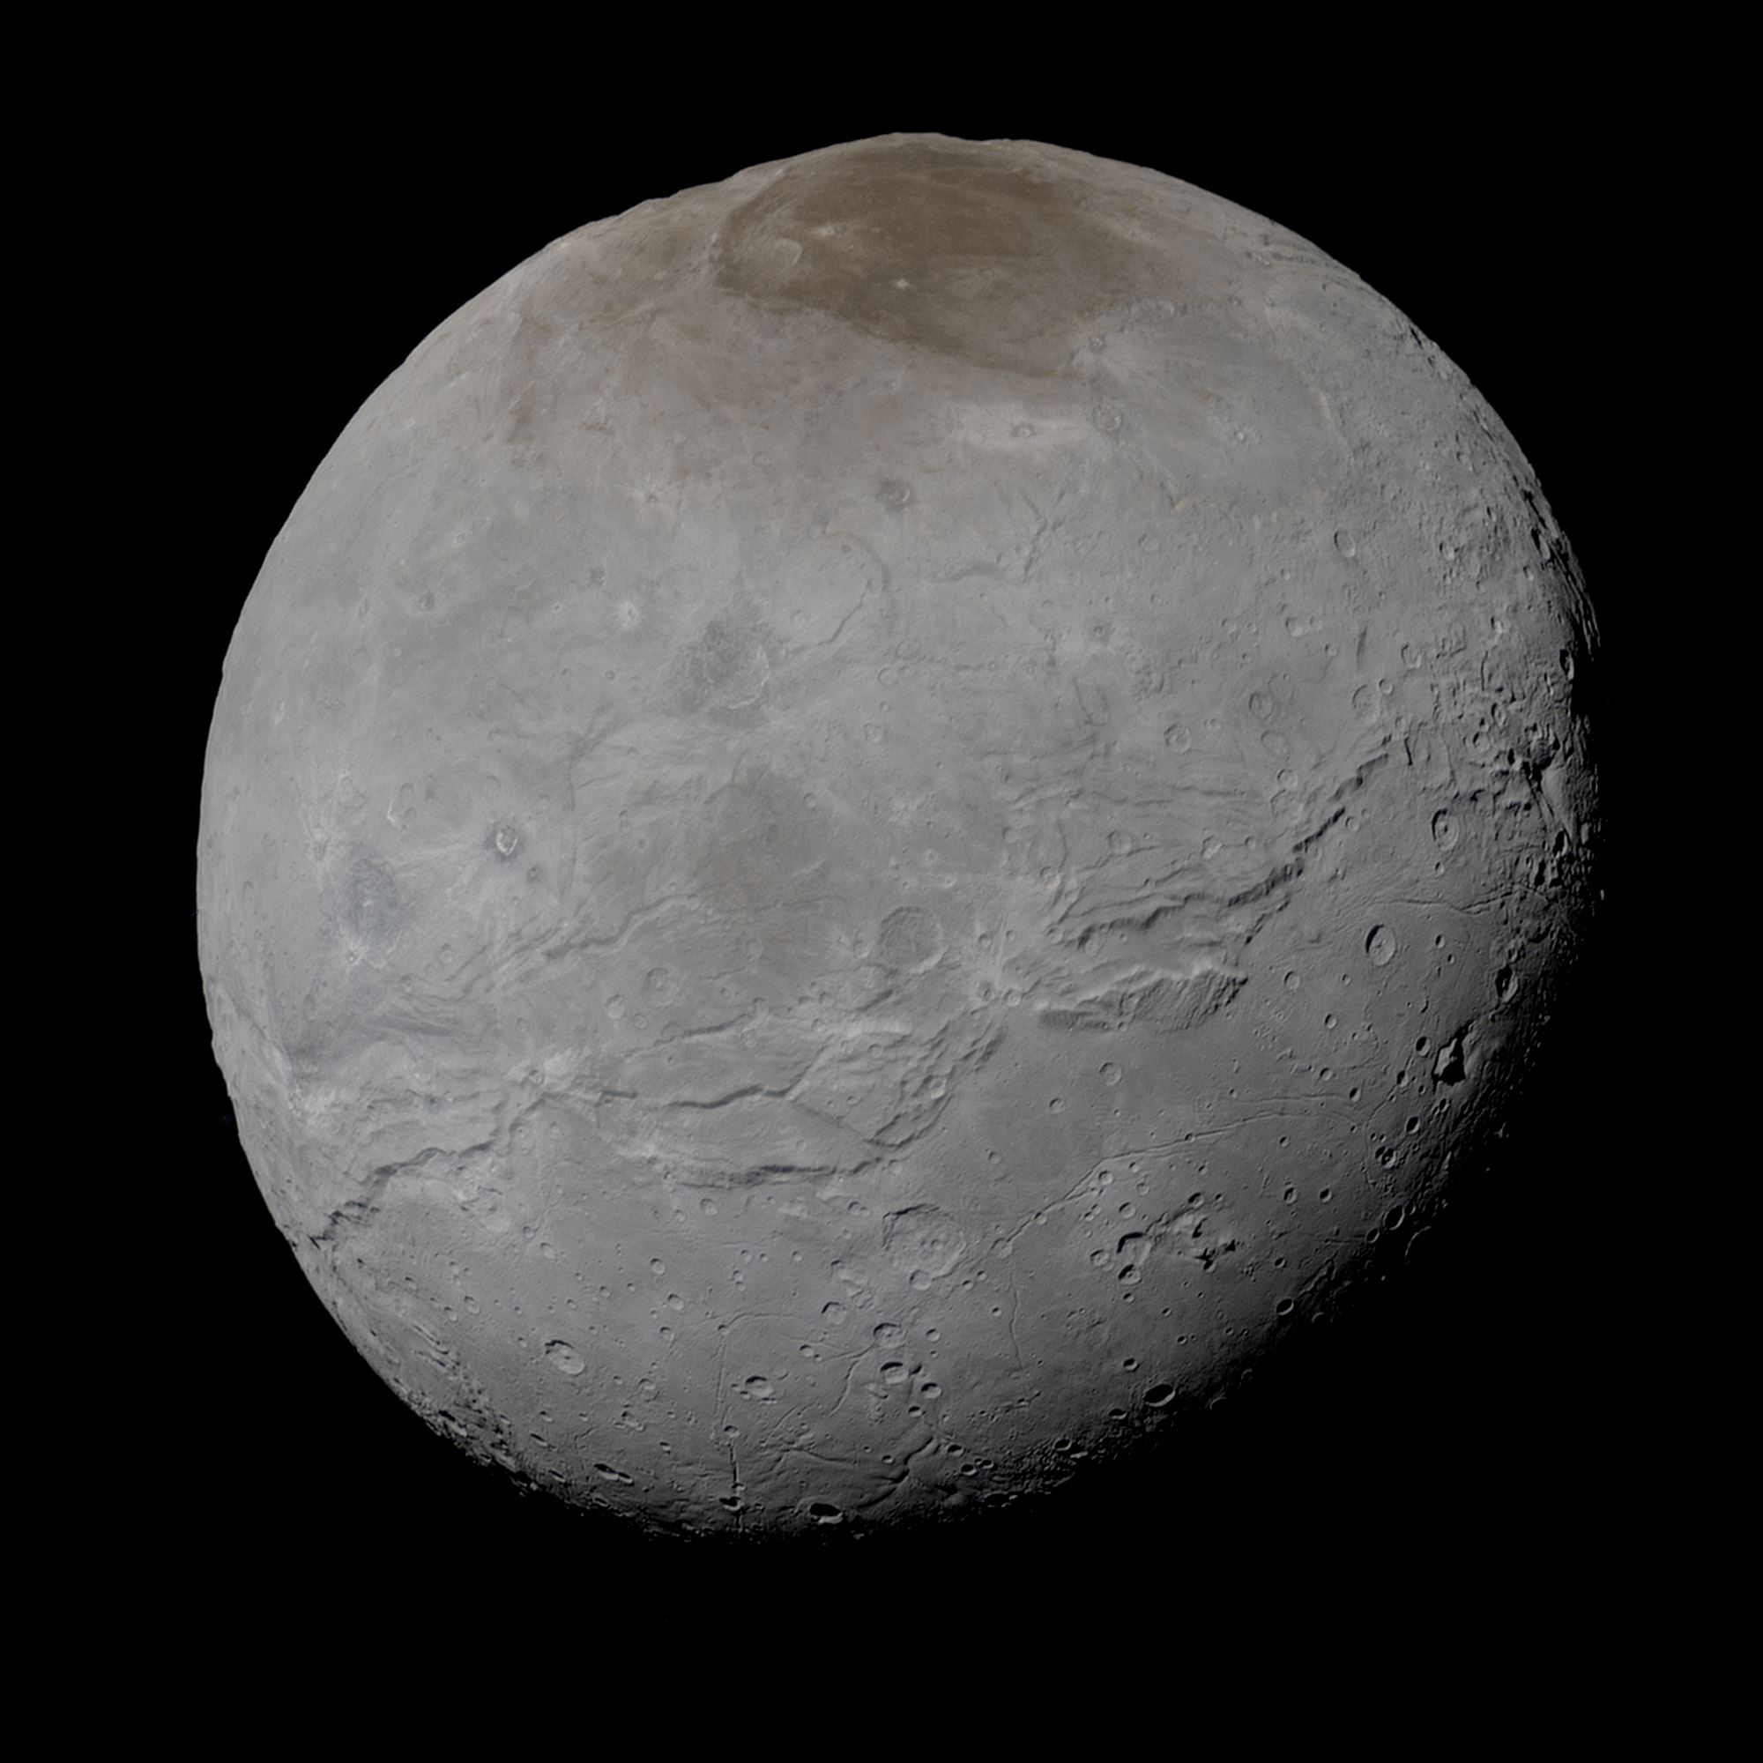
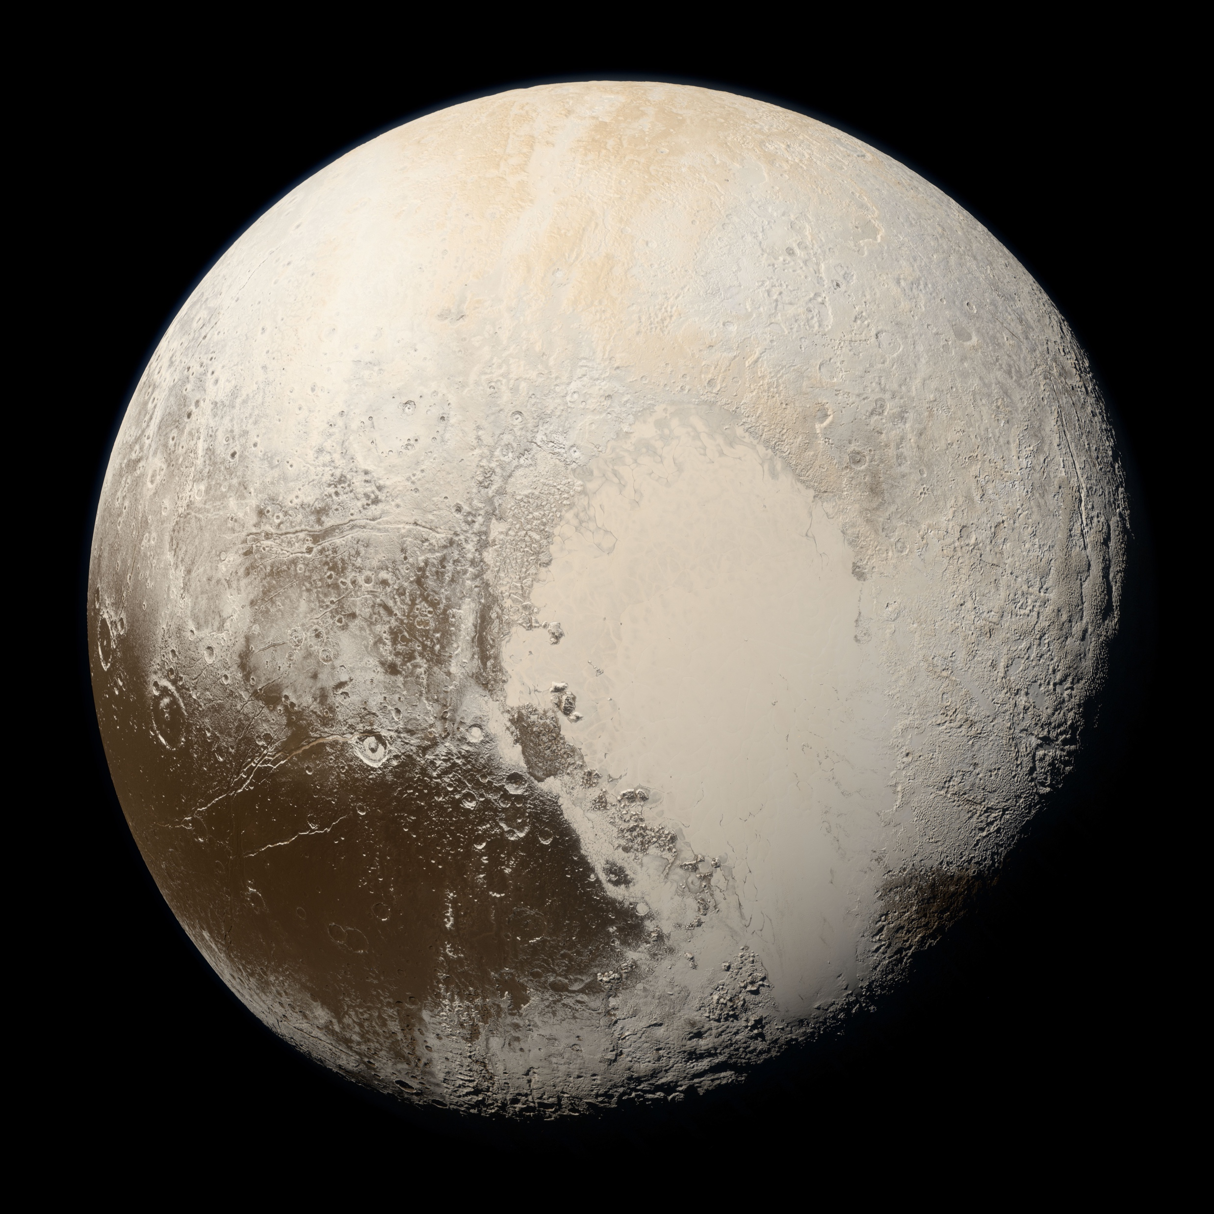
Pluto
True colour image of Pluto
Charon: Moon of Pluto
2006 reclassified as a minor planet
Pluto’s orbit crosses that of Neptune
Also highly angled with respect to the other planets
Pluto’s moon Charon was discovered in 1978
Pluto actually has 5 moons
Charon is about ½ diameter of Pluto
{Image Credit: NASA/Johns Hopkins University Applied Physics Laboratory/Southwest Research Institute/Alex Parker}
Notes:
Takes 248 years to orbit the Sun and 6 days to turn on its axis. Pluto is smaller than Earth’s Moon.

Slide 18
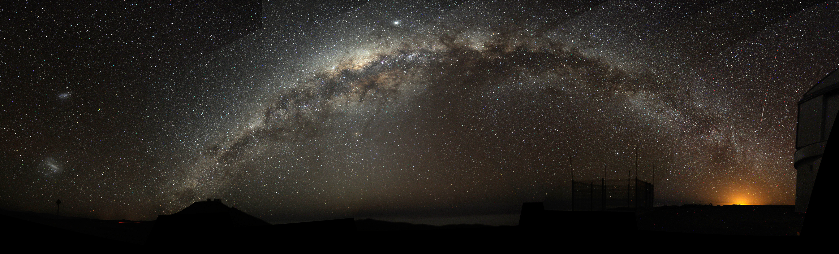
The Milky Way: Our Galaxy
The arch of the Milky Way over an observatory in Chile
{Image Credit: Bruno Gilli/ESO CC 4.0}
Notes:
Our own galaxy can be seen on a dark night and a ‘milky’ band of stars across the sky.
The galaxy is a flattened disk with a bulge at the centre. We are out towards one of the edges of the disk, so if we look towards the center of the galaxy, we see this band of stars. On this image, which is actually of the southern sky, we can also see the dark ‘lanes’ of dust that circulate in the disk of the galaxy.
The bright ‘star’ towards the center below one of the dark lanes is actually the planet Mars.

Slide 19
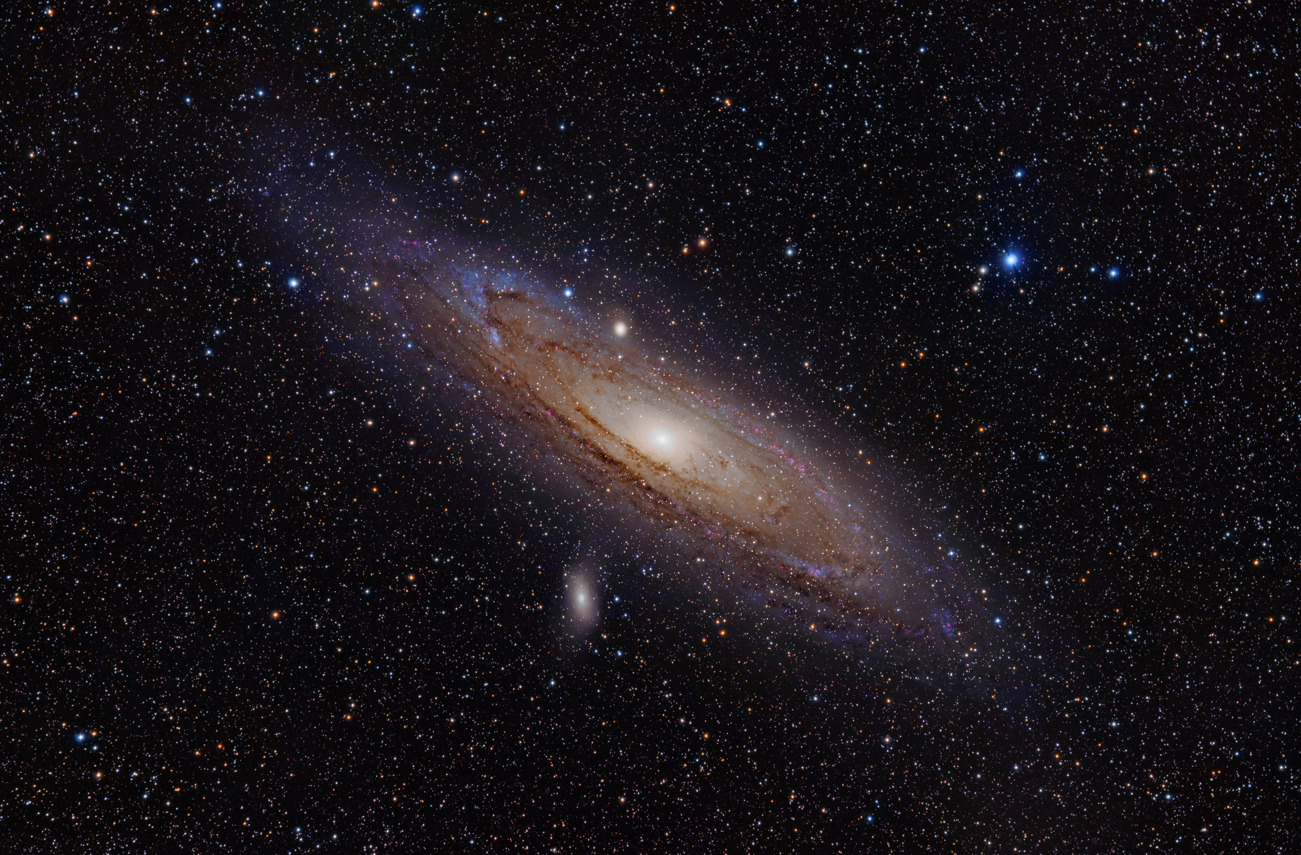
Andromeda Galaxy
Nearest galaxy to the Milky Way
About 3 million light years away
In about 3 billion years, Andromeda will collide with our galaxy
Can be seen with the naked eye on a dark night
{image credit: Adam Evans CC 2.0}
Notes:
The Andromeda Galaxy (also known as Messier Object 31, M31, or NGC 224) is a giant spiral galaxy in the local group, together with the Milky Way. It is at a distance of approximately 2.9 million light years.With a mass of about 1.5 times more than the Milky Way, it is the dominant galaxy of the local group, which consists of about 30 small galaxies plus three large spirals: Andromeda, Milky Way and M33.
A star map will point out the location of Andromeda. It seems very small to the naked eye as only the bright central part is visible to the unaided eye. In fact, the whole galaxy is actually 7 times larger than the Moon from this distance!

Slide 20
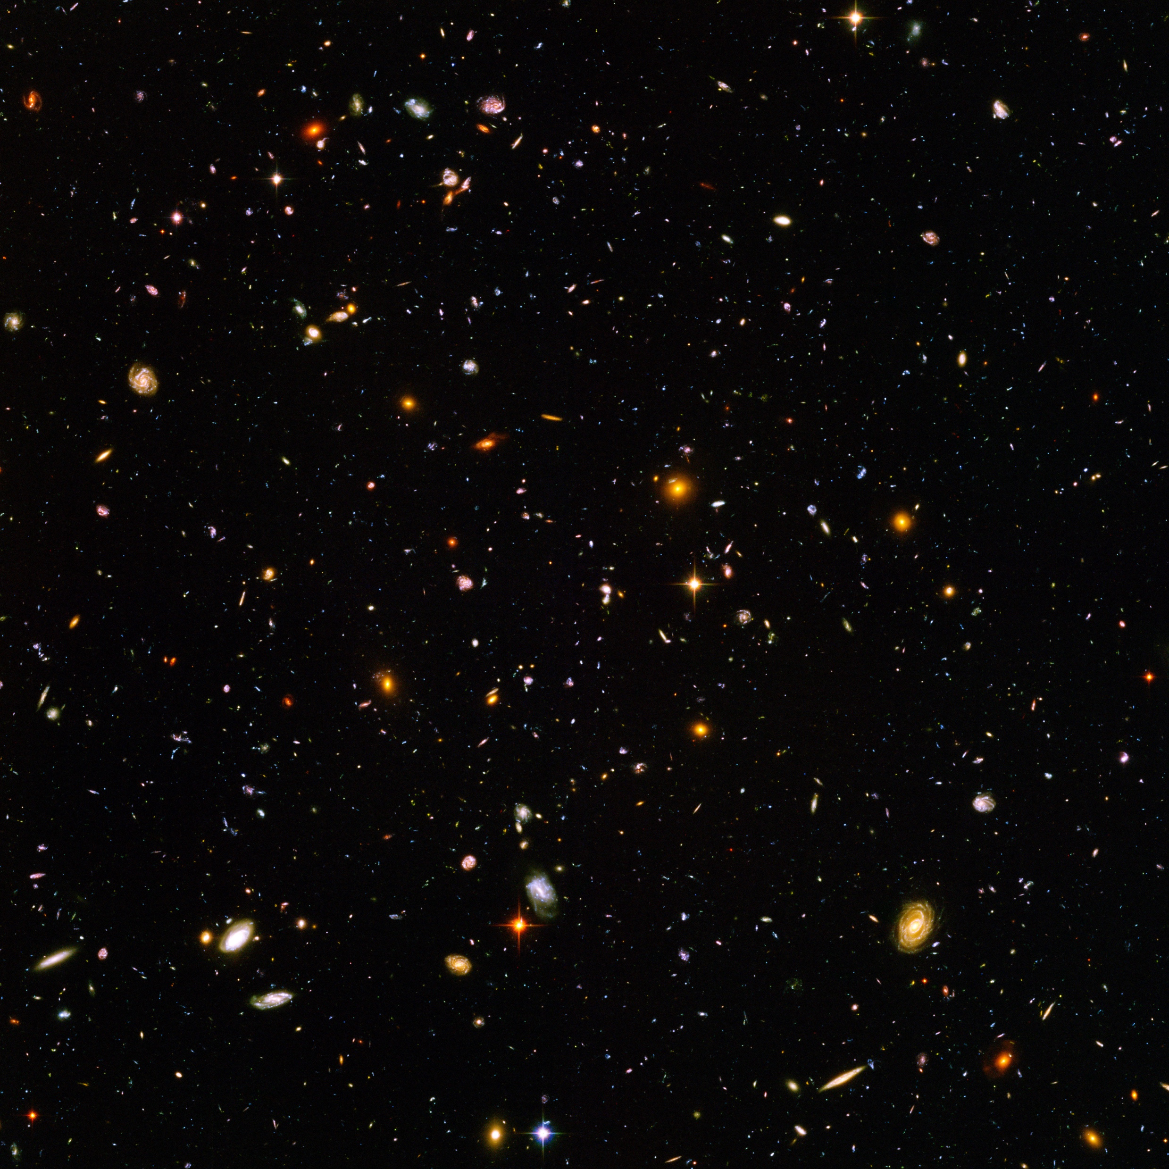
Ultra Deep Field
One of the most important pictures ever taken by the Hubble space telescope
Closeup image of a patch of space 1/10 diameter of the full moon
Over 10 000 galaxies in this image
{Image Credit: NASA and the European Space Agency}
Notes:
This rather ordinary looking photograph is actually the extra-ordinary Hubble Ultra Deep Field, was assembled from data taken between September 2003 and January 2004.
It is a photograph of a small region of space about 1/10th of the diameter of the full Moon. The image contains an estimated 10 000 galaxies. Some them are the oldest objects seen, dating back to within 800 million years of the Big Bang.

