Slide 1
BIOFUELS:
Future fuel?

Slide 2
Biofuels
Engage
In this phase you will reflect on what you know and what your interests are in relation to biofuels.
Notes:
Phase 1: Engage
In this phase you will reflect on what you know about biofuels and what some of the big questions are around biofuel research and development.

Slide 3
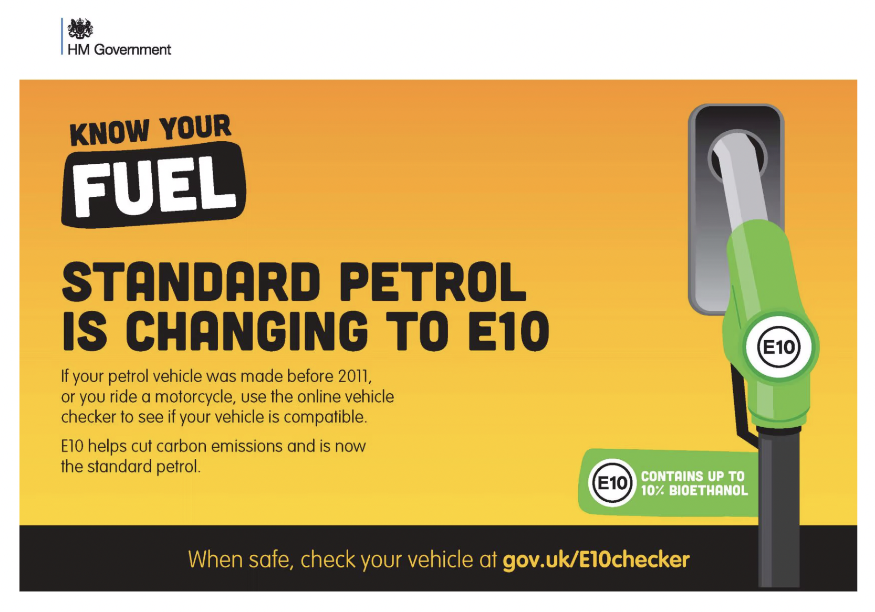
Notes:
Activity 1: Introduction to biofuels
Ask students
Have you seen the E10 label at UK petrol pumps?
In 2021, E10 became the new standard fuel in the UK, containing a mixture of petrol and bioethanol.
The government claimed that it could cut transport carbon dioxide emissions by 750,000 tonnes a year – the equivalent of taking 350,000 cars off the road, or all the cars in North Yorkshire (although they do note that this switch has little impact on emissions associated with air quality and public health).
What do you know about where the fuel comes from? Discuss where the fuel comes from - both the petrol and the bioethanol, tracking it back to its origins.
Think about all the emissions along the way - what processes produce carbon dioxide?
Why might biofuels cause controversy?
Prompt students to think about emissions from extraction and transportation of fossil fuels, and those associated with nutrients and transport of biofuels, as well as from combustion. They might also identify issues with land use, using food as fuel, amongst other issues.

Slide 4
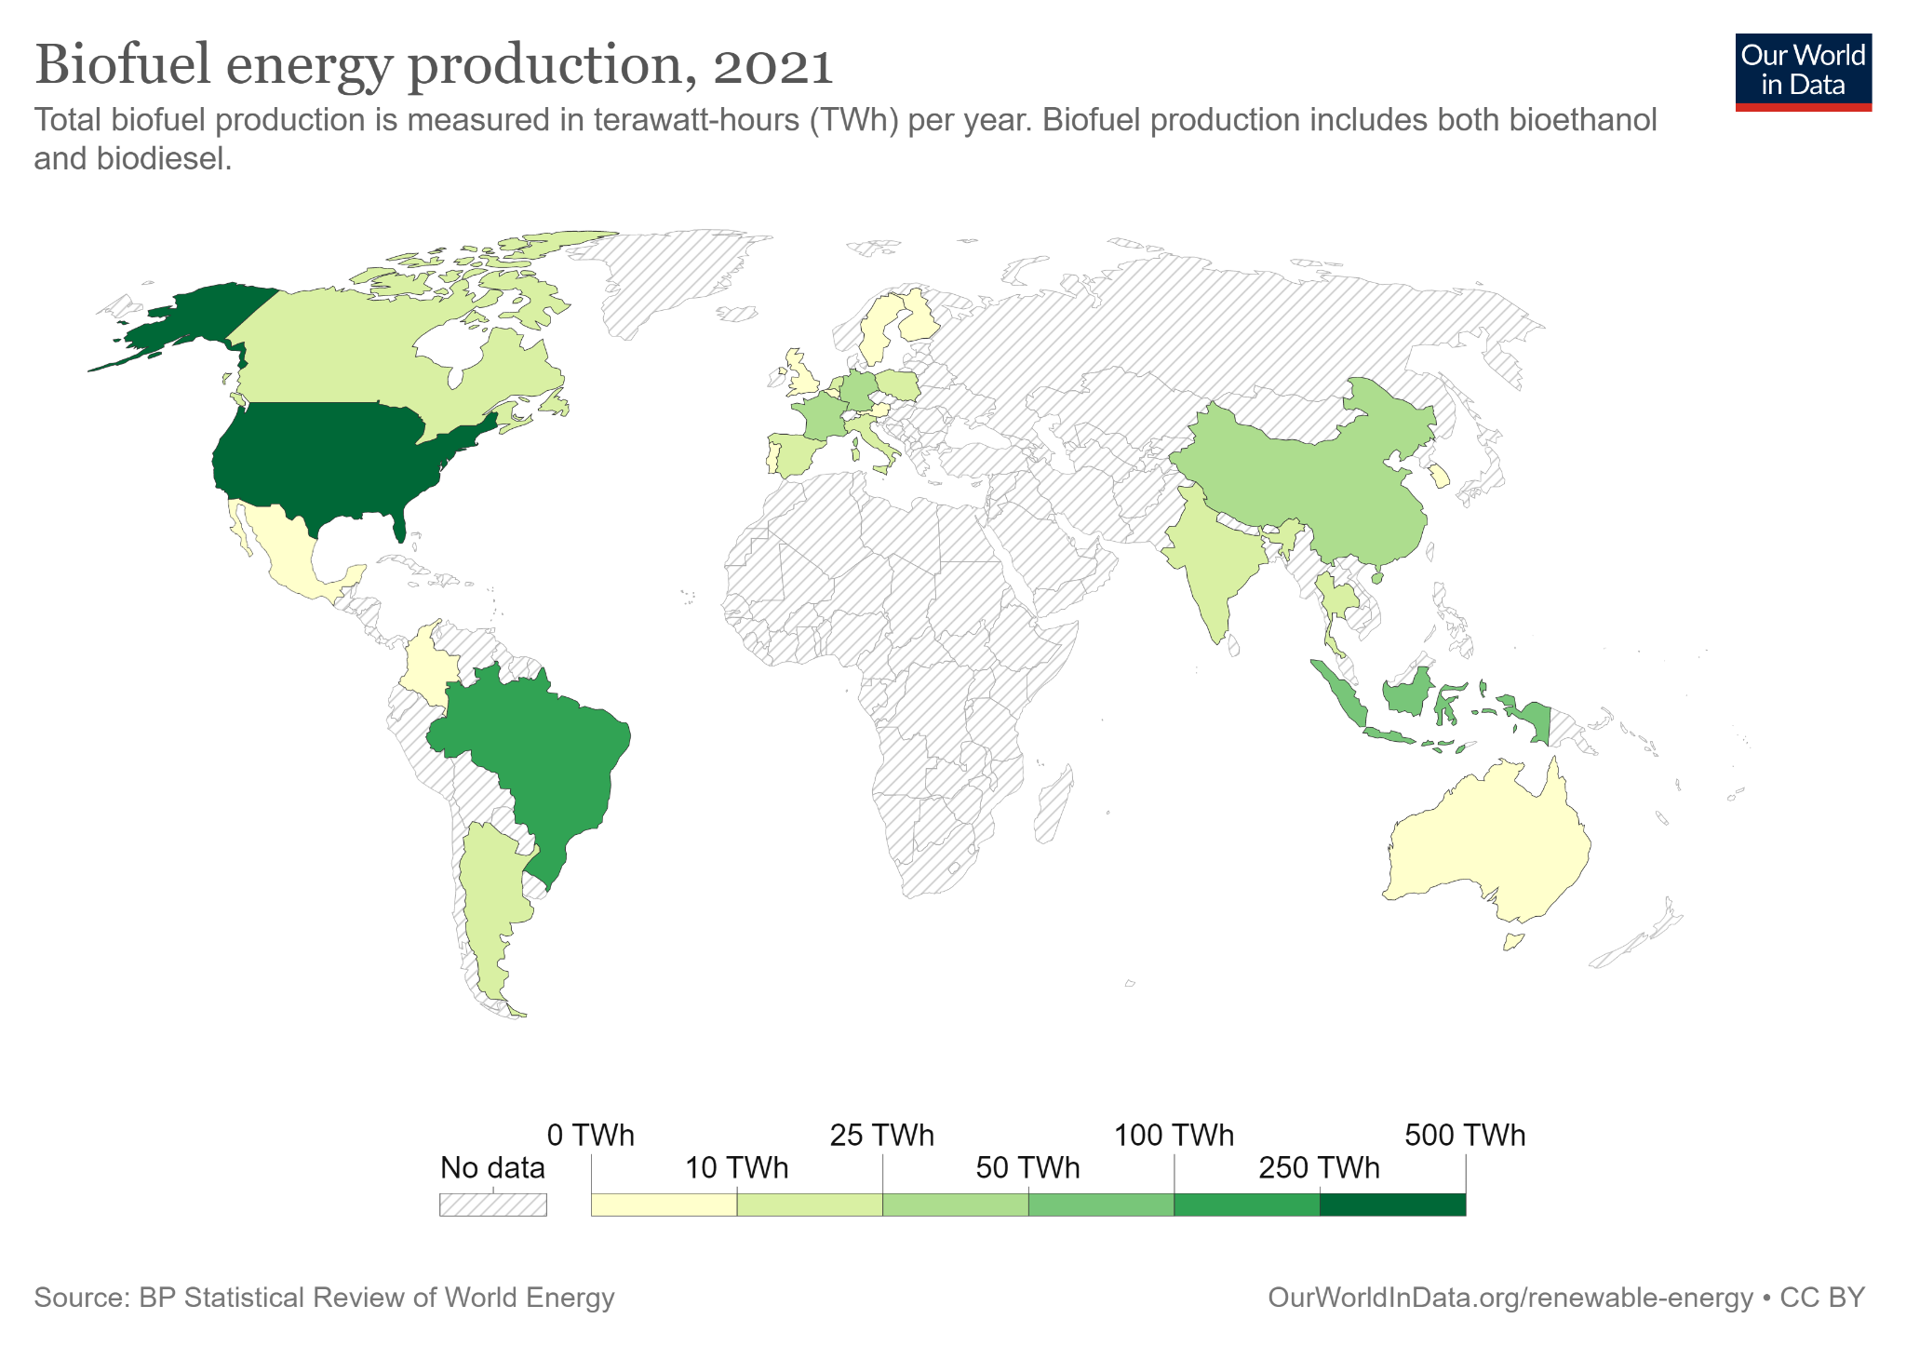
Notes:
Activity 1 ctd: Introduction to biofuels
Biofuels production around the world.
Look at this map.
Which countries are the largest (known) producers of biofuels?
What questions occur to you from this image? What questions occur to you about the source of the image?
This unit will ask you to engage critically with biofuel research and development and to identify power relationships that exist in relation to biofuel production.
Note to teachers: you might collect students’ questions and use them as a prompt in phase 2, and at the end of the unit.
Information and map available at: https://ourworldindata.org/grapher/biofuel-production
For reference, the UK used a total of 294.4 terawatt-hours in 2021. Vanuatu used less than 0.1 terrawatt-hour.

Slide 5
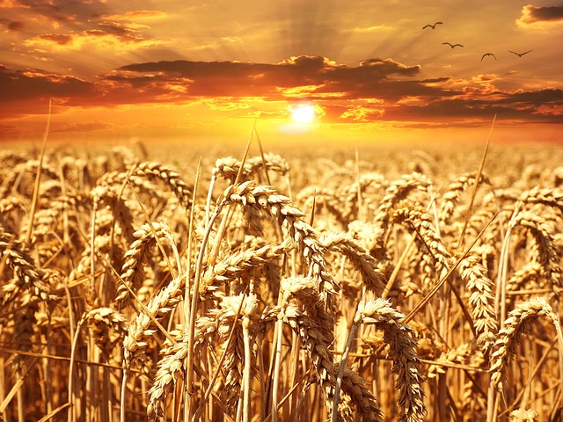
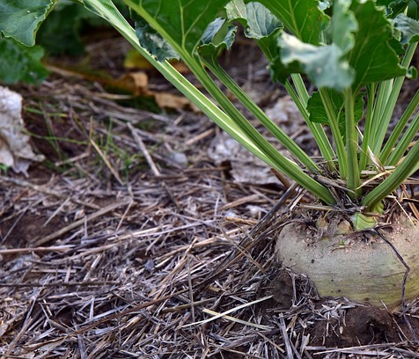
First generation
Food crops
Notes:
Activity 1 ctd: Introduction to biofuels
Bioethanol used in E10 in the UK is produced from wheat and sugar beet. These are first generation biofuels because they are made from edible food crops.
Wheat: Image by Petra from Pixabay
Sugar beet: Image by Ulrike Leone from Pixabay

Slide 6
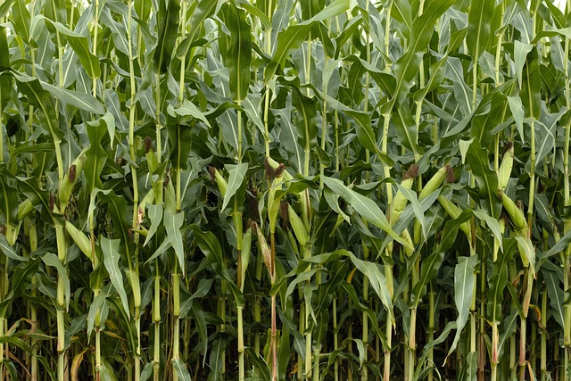
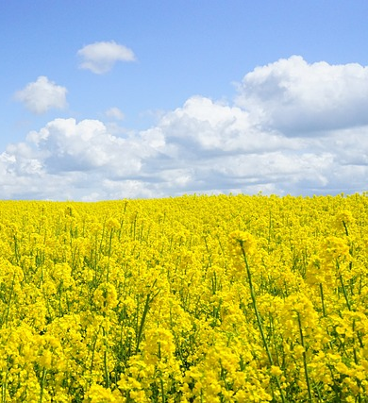
First generation
Food crops
Notes:
Activity 1 ctd: Introduction to biofuels
Other sources of bioethanol include corn and oilseed rape.
Corn: Image by Cassi from Pixabay
Oilseed rape: Image by Hans from Pixabay

Slide 7
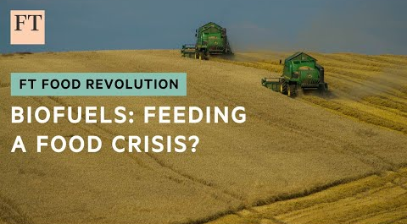
Click to play
Who created the video?
What message do they want you to leave with?
What information would you need to have to take a stance on biofuels?
Notes:
Activity 1 ctd: Introduction to biofuels
This video from the Financial Times outlines some of the issues with biofuels.
(For a different perspective, see https://www.youtube.com/watch?v=lTjln_lBYh0 )
Before watching the video, share the following questions:
Who created the video?
What message do they want you to leave with? Which perspectives are presented and prioritised in the video(s)?
What information would you need to have to take a stance on biofuels?
After watching, lead a discussion to explore answers to these questions

Slide 8
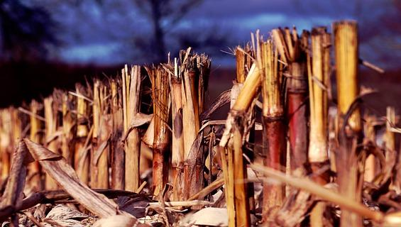
Second generation
Woody waste
Notes:
Activity 1 ctd: Introduction to biofuels
One issue that scientists have tried to address relates to the use of food crops as fuels.
In the past 15 years, arguments for biofuels have been challenged by calling attention to their potential effects on land dedicated to food production, and consequently on food supplies, price of food, and scarcity of food. Second generation biofuels are a response to these challenges.
In second generation biofuel production, the non-edible parts of the plant are used. Enzymes are needed to convert cellulose in these woody parts of plants into sugars which can then be used to produce bioethanol.
However, second generation biofuels also raise questions around:
Producing or perpetuating monocultures (producing first and second generation biofuels from the same crop)
Water use
Specific enzymes need to be developed
Loss of soil fertility
Labour conditions
New forms of social inequality and exclusion

Slide 9
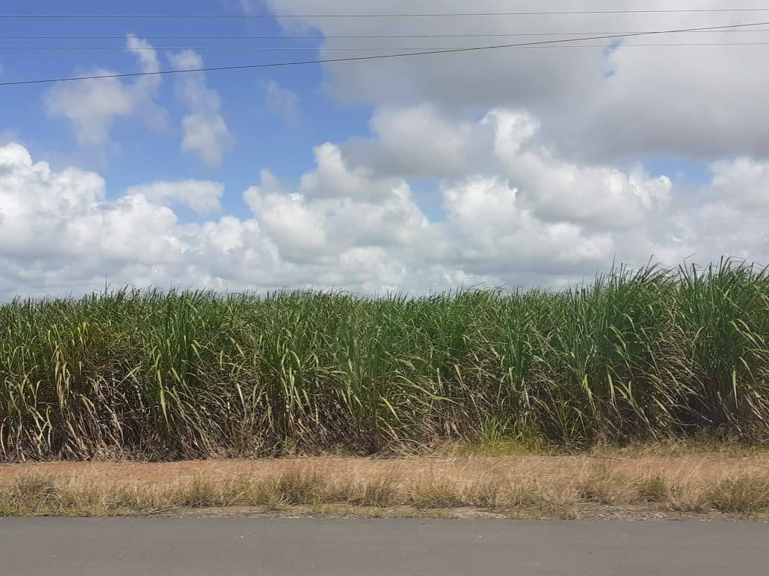
Second generation
Woody waste from food crops
Notes:
Activity 1 ctd: Introduction to biofuels
Second generation biofuels are sometimes produced alongside first generation biofuels. In this site, in Brazil, the sugar cane is used as a first generation biofuel, with the waste material (bagasse) used as a second generation biofuel.
In recent years, there has been a move away from food crops to find other ways of producing biofuels.
Find out more about these fuels here: https://theconversation.com/new-zealand-has-announced-a-biofuel-mandate-to-cut-transport-emissions-but-that-could-be-the-worst-option-for-the-climate-189960
Image credits: Joshua Kirshner

Slide 10
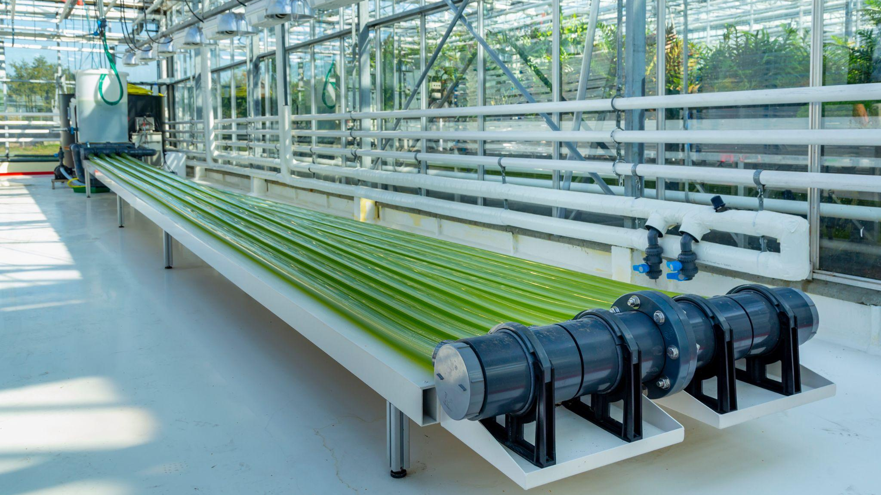
Third generation
Algae
Notes:
Activity 1 ctd: Introduction to biofuels
Third generation biofuels involve a move away from food crops to the use of algae to produce bioethanol.
This image shows unit for algae production as sustainable alternative biomass to produce fuel, oil and protein.
Algae are used in a number of ways to produce biofuels. One way is to dehydrate the algae and extract energy rich lipids using a solvent.
The growth of microalgae relies on a large volume of water, and nutrients (phosphorus and nitrogen) and depends on the intensity of light and temperature, among other factors.
Research is ongoing, with fossil fuel corporations and the EU investing in research and development.
In the next phase you will explore supply chains and power relations in biofuel research, development and use.
Further reading:
https://thebiologist.rsb.org.uk/biologist-features/algal-biofuel-in-bloom-or-dead-in-the-water
https://theconversation.com/biofuel-how-new-microalgae-technologies-can-hasten-the-end-of-our-reliance-on-oil-176723
https://theconversation.com/biofuel-breakthroughs-bring-negative-emissions-a-step-closer-82513
https://theconversation.com/algal-biofuel-production-is-neither-environmentally-nor-commercially-sustainable-82095
https://theconversation.com/sustainable-oil-from-algae-the-technology-is-ready-but-what-about-the-politics-44969

Slide 11
Biofuels
Explore
In this phase you will explore the biofuel industry and the strengths, weaknesses, opportunities and challenges with a biofuel future.
Notes:
Phase 2: Explore
In this phase you will create actor network maps to explore power relationships at play in the production of biofuels.

Slide 12
Actor network mapping
You are going to research biofuels.
You will create an
actor network map to show how different parts of industry and society are connected.
This will help you think about where decisions are made, who has power, and where the opportunities for influence are.
Notes:
Activity 2: Actor network mapping
In this phase you will work in groups to research biofuels.
You will create an ‘actor network map’ to show how different parts of the industry and society are connected.
The relationships are different depending on the generation. At least one group should tackle first generation biofuels, one group should tackle second generation biofuels and one group should tackle third generation biofuels.
The next slide shows an example of an actor network for a different topic.

Slide 13
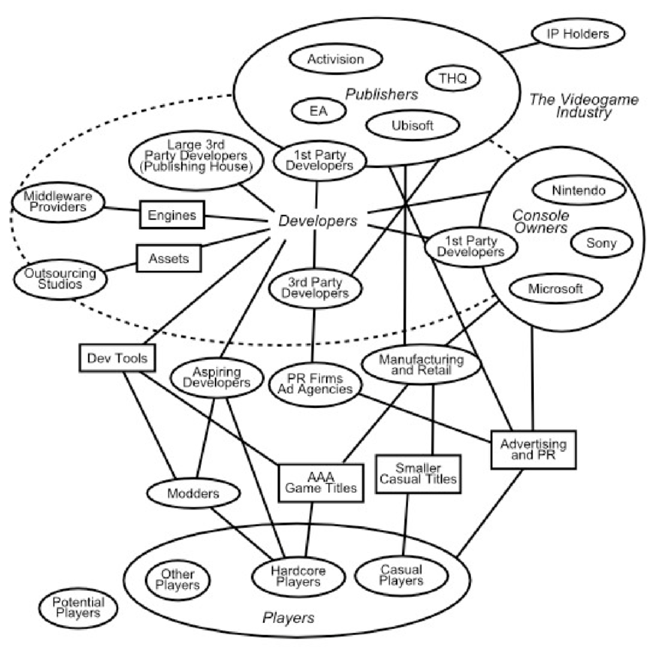
Example
Here’s an example of an actor network map of the video game industry.
Source: Christiansen, 2013. https://www.researchgate.net/figure/Actor-network-map-of-the-mainstream-videogame-industry_fig10_277132868
Notes:
Activity 2 ctd: Actor network mapping
This is an actor network map of the video game industry. It gives an overview of the different actors (people and things that can affect a system) and how they are connected.
Ask students to discuss in small groups and then with the class:
What is good about this?
Students might discuss the number of actors identified, they have been organised into groups, potential actors have been included, there are links between actors.
What could be improved?
Actors with more and less power could be indicated (e.g. size, colour coding), the nature of the connections could be indicated in words, with more and less influence indicated, and the direction of influence indicated
You can find more detailed guidance on good and bad environmental actor network maps here.

Slide 14
Group task
Research biofuels using a range of sources. Look for specific examples in different parts of the world.
Create an actor network map to show how different parts of the biofuels industry are connected.
You can include human and non-human (e.g. other technologies) elements.
You can add notes on lines to explain connections.
Group 1:
First generation biofuels
Group 2:
Second generation biofuels
Group 3:
Third generation biofuels
Notes:
Activity 3:
Actor network maps can also be called system maps, stakeholder maps and ecosystem maps. They provide an overview of all the actors with a role in a system. It helps to identify what or who has power in a system and to identify points where change can happen or the system can be influenced.
You might do this on paper with post it notes and connecting lines, or on a digital board such as miro.
What to do:
Research your biofuel generation. Decide on one specific case/location (e.g. second generation biofuels in Brazil). Make this your central actor.
As you explore, list the actors (one per post it note, so you can move them). Remember these can be people, organisations and things.
Group your actors according to the effect they have on biofuels, or that biofuels have on them - think about direct and indirect effects.
Draw lines where there are connections between actors. Label the lines. You might also use arrows to identify the direction of influence.
Provide a key.
Prepare to present your map to others.

Slide 15
Biofuels
Explain
In this phase you will share what you have learnt in the explore phase.
Notes:
Phase 3: Explain
In this phase you will share what you have learnt in the explore phase, and hear about all three generations of biofuels.
Remind each group about the qualities they identified in Phase 2 Activity 1 that describe a good actor network map.

Slide 16
Case 1: First generation biofuels
Presentation of actor network map
Notes:
Activity 4: Review of actor network maps
Groups responsible for researching first generation biofuels present their actor network map.

Slide 17
Case 2: Second generation biofuels
Presentation of actor network map
Notes:
Activity 4 ctd: Review of actor network maps
Groups responsible for researching second generation biofuels present their actor network map.

Slide 18
Case 3: Third generation biofuels
Presentation of actor network map
Notes:
Activity 4 ctd: Review of actor network maps
Groups responsible for researching third generation biofuels present their actor network map.

Slide 19
SWOT analysis of biofuel production
STRENGTHS
WEAKNESSES
S
W
OPPORTUNITIES
THREATS
O
T
Notes:
Activity 4 ctd: Review of actor network maps
Reflect on your learning through the production and presentation of your actor network maps.
Do an initial individual SWOT analysis of biofuels. You will use this in the final phase of this topic.
Identify and note the strengths, weaknesses, opportunities and threats of biofuel production.

Slide 20
Biofuels
Elaborate
In this phase you will apply what you have learnt to produce a policy brief for a government funder.
Notes:
Phase 4: Elaborate
In this phase you will apply what you have learnt through the actor network mapping and SWOT analysis to produce a policy brief for a government funder.

Slide 21
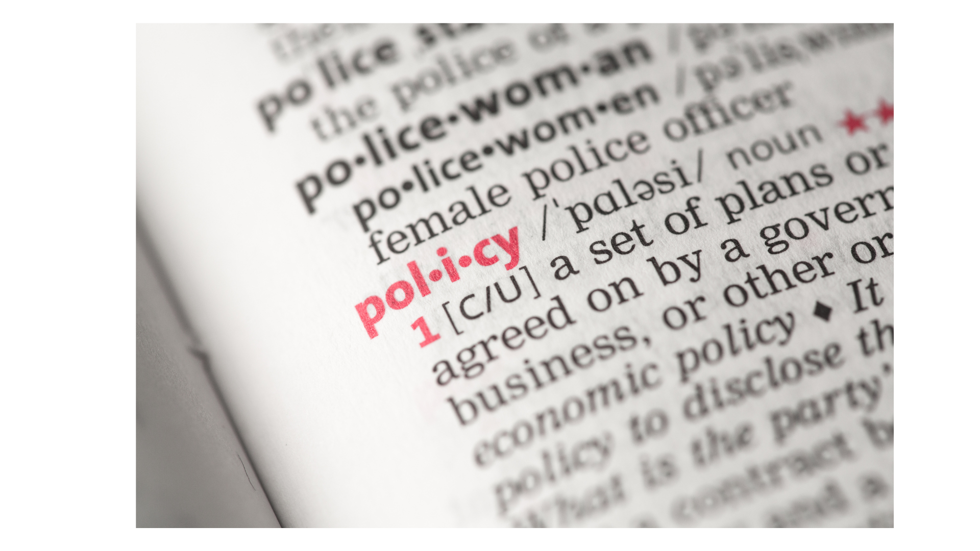
What is a policy brief?
What is a policy brief?
Who is it for?
How is it written?
What are the key features?
Notes:
Activity 5: Policy brief
Share the three examples of policy briefs provided in the resources. Give students 10 minutes to skim and identify similarities and differences. Ask them not to read in detail, but look at structure and presentation.
Ask students what they think a policy brief is, and what it is for, having seen some examples. What did they have in common? What were better and worse examples and why?
Highlight that policy briefs present recommendations from research to people who make decisions or policies.
Decision makers and policy makers should have access to the best evidence, but research is not always accessible so there is a need to make it easy for policy makers to find, read and use.
Policy briefs are written for a non-specialist audience
Clear and simple language is used.
Policy briefs are usually short (2-4 pages) in a professional presentation - consider boxes, diagrame, case studies.
For more support on writing a policy brief, see https://post.parliament.uk/how-to-write-a-policy-briefing/

Slide 22
Your policy brief
Using your research on biofuels, your task is to produce a policy brief to a government funder to help them decide on future funding decisions.
Working in a team, discuss the key message you would have for a government funding body - should they support research into biofuels? Why/why not? Are some biofuel generations preferable to others?
Audience
Create your policy brief for a government funder.
Purpose
To influence policy - what should be prioritised in relation to biofuels
Message
Consider the key message you want to communicate
Notes:
Activity 5 ctd: Policy brief
Place students into groups of 3.
Introduce the task: to produce a policy brief for a government funder.
Ask students to discuss what they have learnt in the previous phases and identify the key message they would like to communicate to a funder.

Slide 23
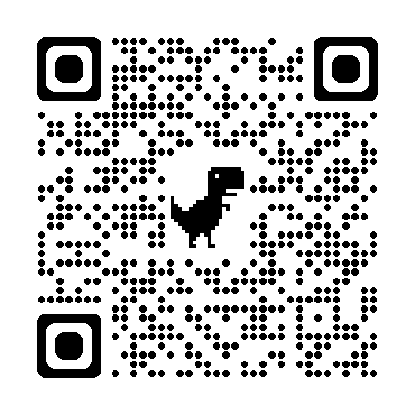
Writing a policy brief: guide
Link to canva.com
Title
Short and catchy, do it at the end
Executive summary
100 words
Engage your audience
Present the problem and the solution
Problem and context
200 words
Explain what the problem is
Explain why your audience should care
Evidence
200 words
Explain your method (how you identified your sources)
Summarise what you have found out - what evidence there is.
Identify implications
Recommendations
200 words
2 or 3 recommendations
Concrete things the audience can do
Say why these actions will be beneficial
Say what change will result
Presentation
Make it smart - consider a publishing programme such as canva, or create and use infographics
Notes:
Activity 6: Writing a policy brief
Share guidance with students – as a word document with topic resources. Word counts are approximate for the maximum length of each section.
Perhaps students could use a collaborative platform such as Google docs for drafting, and then complete the design in canva.

Slide 24
Write
Edit
Review
Take a section each, set a time/deadline
Edit the section(s) you did not write
The brief, discuss further changes and add title
Notes:
Activity 6 ctd: Writing a policy brief
If completed in class:
In groups of 3, one student takes the context, one takes the evidence and one takes the recommendations. Write a draft of this in 10 minutes (in silence). This is not the final version so does not have to be perfect.
After a 10 minute alarm, each student looks at the section(s) they did not write and makes edits in ‘suggesting’ (Google) or ‘track changes’ (Microsoft), and adds comments and questions. Set a 10 minute alarm for this task.
Review the briefing, discuss actions and enter as many phases of writing and editing as needed to complete your policy briefing. At this stage, write the executive summary and give the briefing a title.
When you are happy with your text, consider presentation. You might do this in canva or using another publishing platform.
If completed between classes:
In groups of 3, one student takes the context, one takes the evidence and one takes the recommendations. Set a deadline for this.
On the deadline, contact students and ask them to look at the section(s) they did not write and make edits in ‘suggesting’ (Google) or ‘track changes’ (Microsoft), and add comments and questions. Set a deadline for this.
On the deadline, ask students to look at the edited version, and edit their own section in light of this.
In the next classroom session, allow time for final review and edits.

Slide 25
Biofuels
Evaluate
In this phase, you will look at your policy briefs and peer-assess your learning.
Notes:
Phase 5: Evaluate
In this phase, you will look at your policy briefs and peer-assess your learning.

Slide 26
Self and peer evaluation
Knowledge
After reading this policy brief, I can see that you know…
Skills
I can see from this policy brief that you know how to…
Next time
The next time you create a policy brief, I think you should…
Something I want to know
After reading this policy brief, I want to know…
Notes:
Activity 7: Self- and peer-evaluation
In this phase, students self- and peer-review their learning on the unit. This slide is used to structure the feedback. Remind students to focus on the brief, not the people, to be specific, realistic and write it as they would like to read it.
Share access to the policy briefs. Allow 10 minutes to read each one, and 5 minutes for feedback.
Once all policy briefs have been reviewed, each group discusses the feedback, and if the ‘next time ...’ and ‘something I want to know ...’ are actionable, they edit their policy briefs.

Slide 27
Last words
This unit has been about biofuels. Are they the future of fuels? What are your last words (for now!) on this question?
Notes:
Activity 8: Last words
In this last words task, we round up by asking students for their last words on the topic.
Begin with the prompt: are biofuels the future of fuels? Allow every student to speak or pass.

