Slide 1
Digital Photography
Making digital art

Slide 2
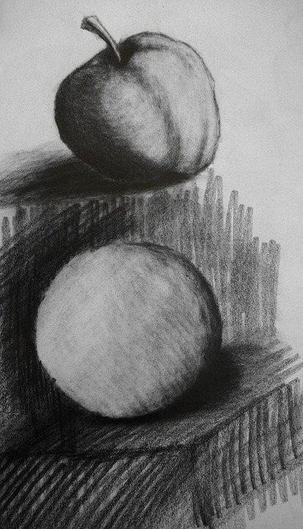
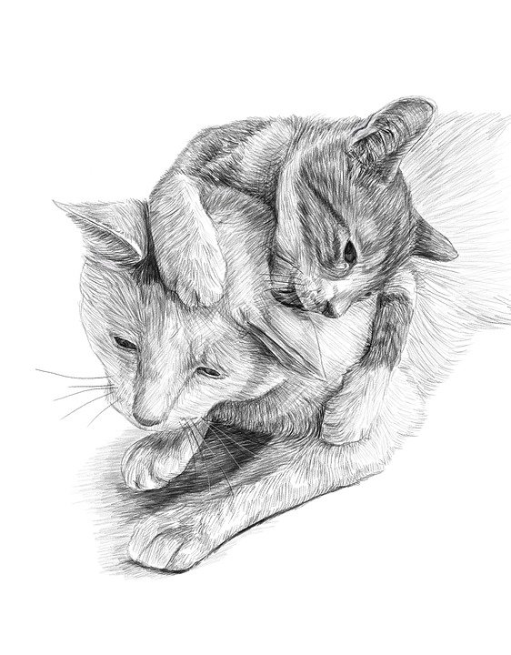
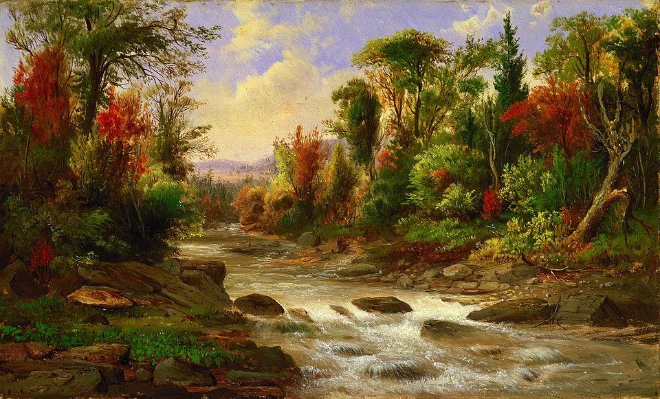
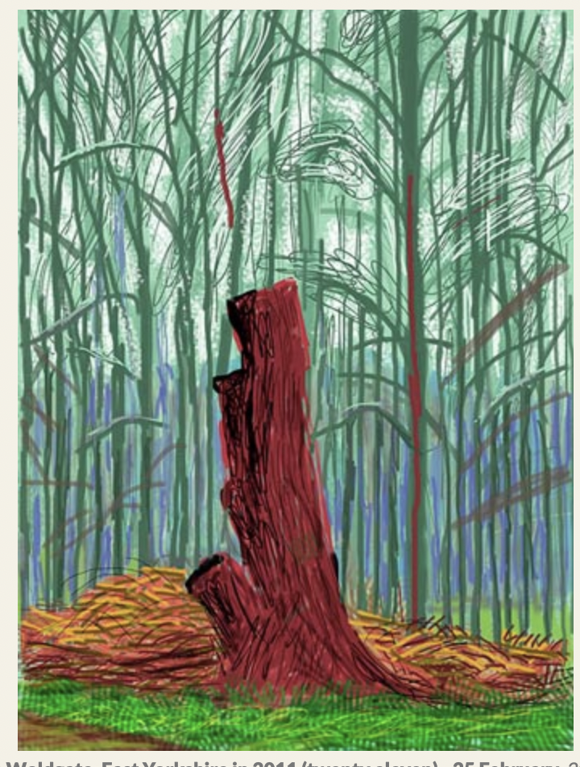
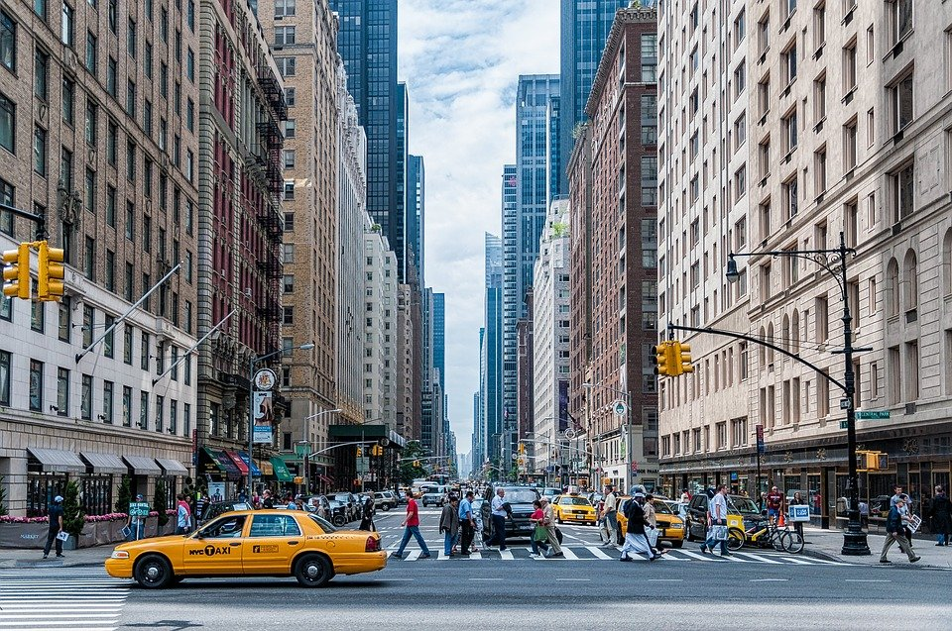
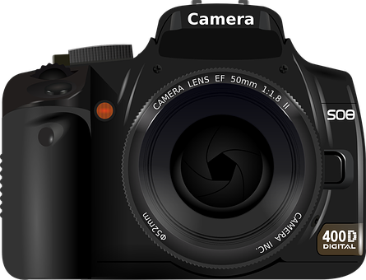
Look at these pieces of art.
How do you think they were created?
Match the art to the method!
Pencil (tonal)
Painting
Charcoal
Camera
iPad
Notes:
Go through each one (top row) and ask class which matches with one from the bottom row - answers on next slide

Slide 3
Did you get them all right?
Pencil (tonal)
Painting
Charcoal
Camera
iPad

Slide 4
Technology in art
We will be using technology to create our own art…
However, first let’s discover how technology has helped to change the way we make art today!
Notes:
Run this as a slide show in order for the animations to work.

Slide 5
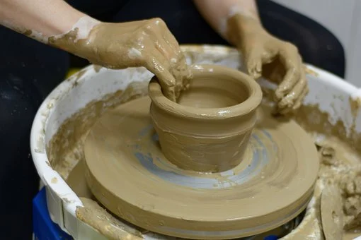
Technology in Art
1937
First Disney animated movie released
(Snow White)
17th century
Camera obscura
used as a drawing aid
2015
Apple pencil invented- active stylus
4000BC
Pottery wheel created
751 AD
Paper is invented
Early 19th century
The camera is invented
2011
National Gallery puts oil paintings online
Notes:
Links to websites for illustrative images:
https://en.wikipedia.org/wiki/History_of_the_camera
https://comics.ha.com/itm/animation-art/production-drawing/snow-white-and-the-seven-dwarfs-good-friends-all-painting-original-art-walt-disney-new-york-graphics-society-1947/a/7196-96048.s
https://artuk.org
https://www.apple.com

Slide 6
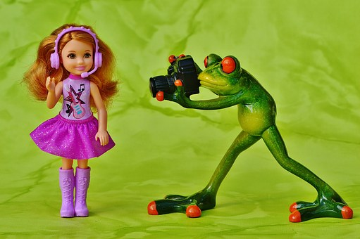
Photos
Some art is created by taking photos.
These photos can then be edited.
Remember, don’t take a photo of someone with out their permission!
Notes:
Discuss where photos would be taken in real-life scenarios. Consider the role of different photographers;
Wedding
Events
Magazine
Newspapers
Sports etc.

Slide 7
What is wrong with this photo?
Notes:
Allow learners to discuss in pairs/groups or as a class. Pick a pupil/use a random name generator/class register.

Slide 8
What is wrong with this photo?
The photo is blurry (out of focus/ pixilated)
The bottom is cut off

Slide 9
What is wrong with this photo?
Notes:
Allow learners to discuss in pairs/groups or as a class. Pick a pupil/use a random name generator/class register.

Slide 10
What is wrong with this photo?
The top of the photo is missing

Slide 11
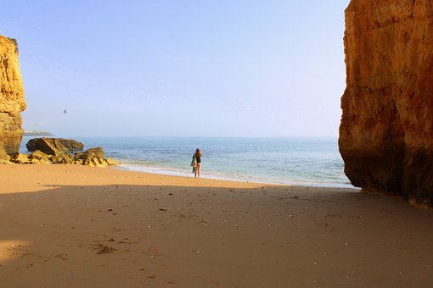
What is wrong with this photo?
Notes:
Allow learners to discuss in pairs/groups or as a class. Pick a pupil/use a random name generator/class register.

Slide 12
What is wrong with this photo?
The subject of the photo is too far away

Slide 13
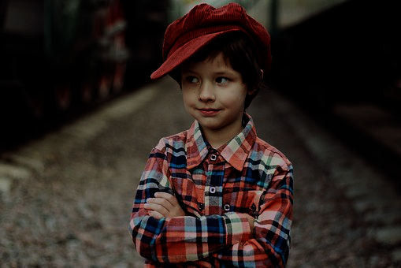
What is wrong with this photo?
Notes:
Allow learners to discuss in pairs/groups or as a class. Pick a pupil/use a random name generator/class register.

Slide 14
What is wrong with this photo?
TOP TIP
Think about turning on the flash or finding a spot with more daylight.
It is too dark

Slide 15
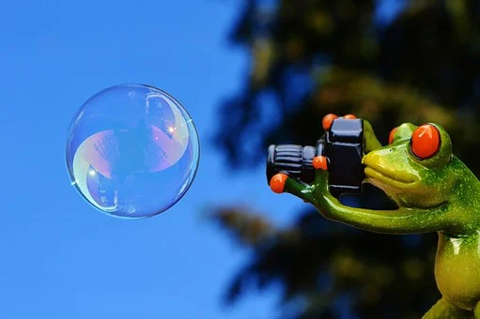
We must be careful how
we position our camera
✓Position
✓ Lighting
CLICK!
Notes:
Can pupils recall any other factors that must be taken into consideration when taking a photo?

Slide 16
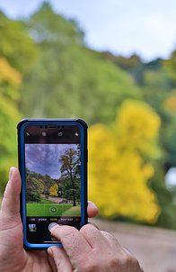
Landscape or portrait?
Landscape
Portrait
Portrait
Upright
Landscape
Sideways
Notes:
Discuss with class. When is it appropriate to use either? You may be able to link the orientation to a Microsoft Word document. Both landscape and portrait can be used in Word. Go to Layout > Orientation

Slide 17
Landscape or portrait?
Sort these images!
Landscape | Portrait
Notes:
Class can vote whether the image is landscape or portrait. Answers are on the next slide.

Slide 18
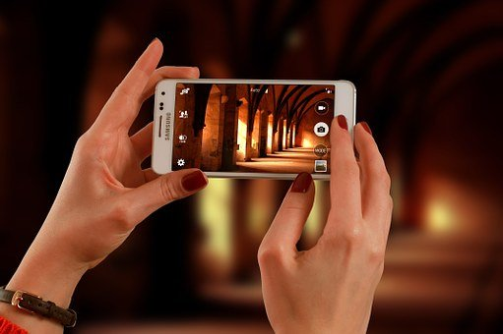
Landscape or portrait?
Sort these images!
Landscape | Portrait

Slide 19
Landscape or portrait?
Sort these images!
Landscape | Portrait

Slide 20
Landscape or portrait?
Sort these images!
Landscape | Portrait

Slide 21
Landscape or portrait?
Sort these images!
Landscape | Portrait

Slide 22
Landscape or portrait?
Sort these images!
Landscape | Portrait
Did you get them all right?

Slide 23
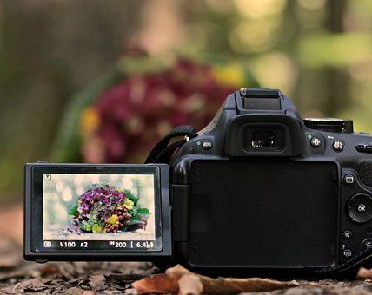
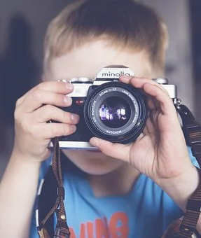
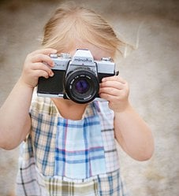
How do we take a good photo?
Some art is created by taking photos.
These photos can then be edited.
Point the lens at your subject.
Make sure the subject is in the shot by looking through your viewfinder or screen.
Move the camera around until you are happy with the shot.
Hold your camera with both hands. Make sure it’s not wobbling around.
Click the button and capture your photo!
Notes:
Talk through taking a good photo. If you have cameras learners can practice taking photos. Do learners have any experience of taking photos using a smartphone? Discuss as a group. This may lead on to other areas of discussion such as the features and effects of a smart phone camera.

Slide 24
Let’s practice
Can you and your team find and capture these things?
Landscape/ Portrait?
✓Position
✓ Lighting
CLICK!
Something close up | A person
An action shot | Something in the distance
Remember to make sure everyone has had a go!
Notes:
Only complete if you have access to cameras.
Arrange learners in groups of 3/4 to complete the following activity.

Slide 25
Let’s share!
Can you share with the class what you took a photo of and whether you took it in landscape or portrait and why?

Slide 26
Famous artists - Sean Charmatz
Sean creates art by adding characteristics to pictures. He turns his work into animations.
He was a writer, artist and storyboard director for Spongebob Squarepants.
He has also worked for Dreamworks and Disney.
Here are some examples of his work:
What do you like about this work?
What do you dislike about it?
What does it make you think of?
CLICK HERE TO SEE PICTURES
CLICK HERE TO WATCH A VIDEO
How does it make you feel?
Notes:
https://www.youtube.com/supported_browsers?next_url=https%3A%2F%2F www.youtube.com%2Fwatch%3Fv%3DdOFUYR2iX4c&t=86s

Slide 27
Your turn!
We are going to make some digital art inspired by Sean Charmatz!
Some examples:
Notes:
It is then up to you to decide whether you wish for the learners to have a go at creating their own work inspired by just one of the artists or both (All curriculum aims will be achieved either way).

Slide 28
Your turn!
Step 1 - Take the photo of your everyday item or items.
Top tips!
Try and have an idea in your head already so you can pose them.
What action are your items doing? Hugging, swimming dancing etc.
Action: Swimming or relaxing in the water.
Notes:
You may wish to spend some planning this with your class. Learners can use paper to design their plan or mind-map some ideas. If you do not have a camera you can use the bank of images provided or allow pupils to find their own.

Slide 29
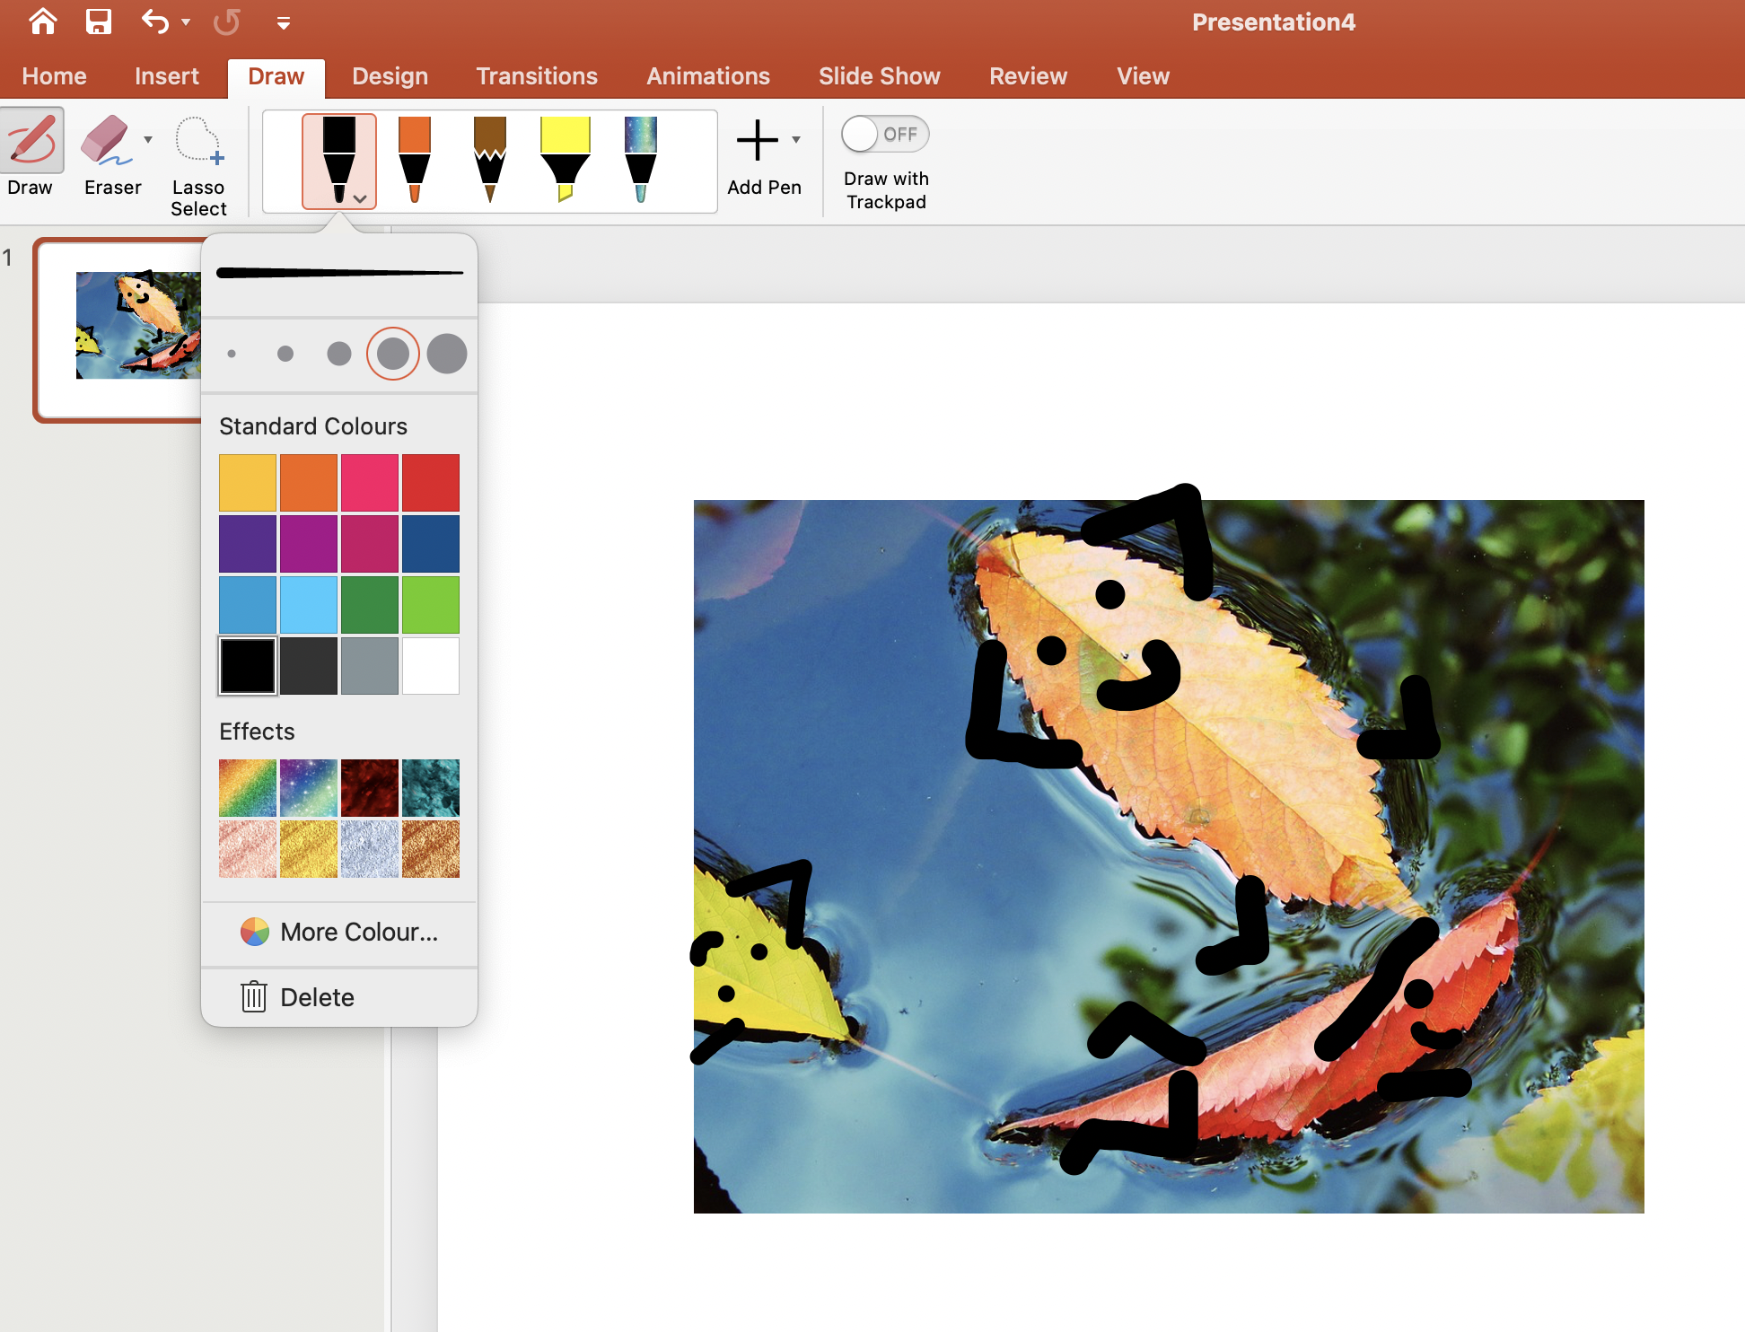
Your turn!
Step 2 - Import your photo to PowerPoint or Print it out.
If you are using an iPad, watch the video on the next slide to draw straight onto your image.
Step 3 - Add in the features: arms, legs, face etc.
Top tips!
Remember to consider the emotions of your items. Are they happy, sad, excited or scared etc.
Notes:
You may decide to use any digital graphics software.
Online software: https://paintz.app/ (you can click and drag your photo on to the canvas).

Slide 30
Editing images using an iPad
Notes:
Play this video if your class are using iPads as this allows them to draw directly onto the image.

Slide 31
Famous artists - Stephen McMennamy
Stephen McMennamy makes what he calls ‘combophotos’.
He joins different photos together to make new and exciting images.
Here are some examples of his work:
What do you like about this work?
What do you dislike about it?
What does it make you think of?
CLICK HERE TO SEE PICTURES
How does it make you feel?
Notes:
https://www.youtube.com/supported_browsers?next_url=https%3A%2F%2F www.youtube.com%2Fwatch%3Fv%3DdOFUYR2iX4c&t=86s

Slide 32
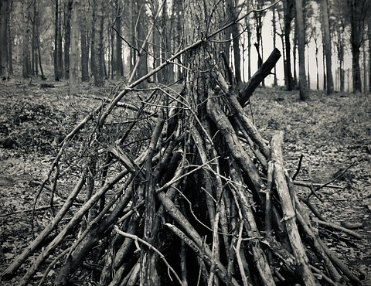
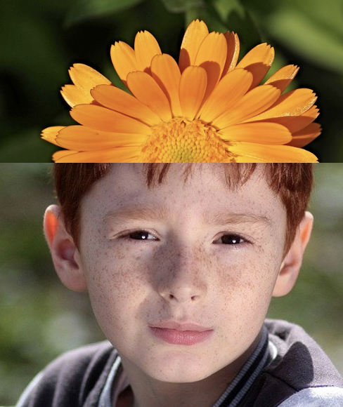
Your turn
We are going to make some “combophotos” of our own giving our selves some crazy hair styles!
Some examples:

Slide 33
Your turn
Step 1 - Take a photo of your partner.
Top tips!
Make sure the photo has the face in focus and is straight on.

Slide 34
Your turn
Step 2 - Take a photo of an item from around the grounds or in the classroom to use as some crazy hair or a beard.
Top tips!
Try and find something the same colour as your hair.
Make the colour of the backgrounds the same as this will match up better.

Slide 35
Your turn
Step 3 – Merge the two photos together, making sure the photos fit together. )
Use the cropping tool to cut them up and match them up!

Slide 36
Did you enjoy creating digital art?
Jobs you might like in this area are…
Photographer
Digital artist
Gaming artist
Film/ Video editor
VFX artist
Web Designer
… and so many more!

Slide 37
Did you enjoy creating digital art?
On the Archives of IT website you can watch short interviews with real digital artists and learn all about their jobs and how they got there.
Step 1: Follow the link https://archivesit.org.uk
Step 2: Click on Gallery in the education section of the homepage
Step 3: Click on interviews
Notes:
Careers- Talk through the various jobs learners can do if they enjoy digital art, all on our video which can be accessed via the link provided.

