Slide 1
Digital painting
Create a digital painting

Slide 2
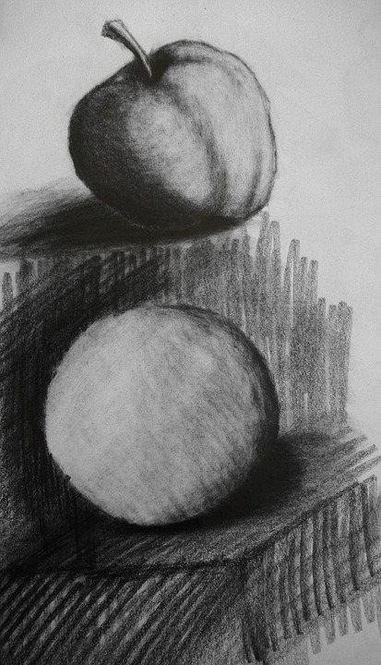
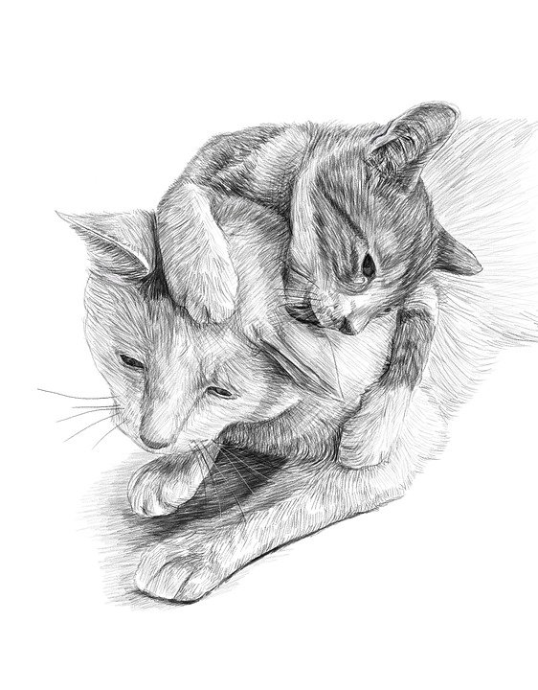
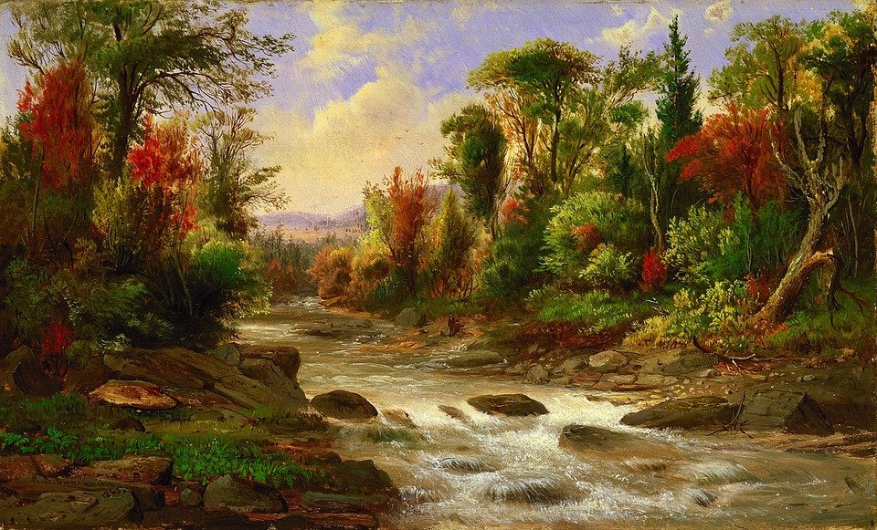
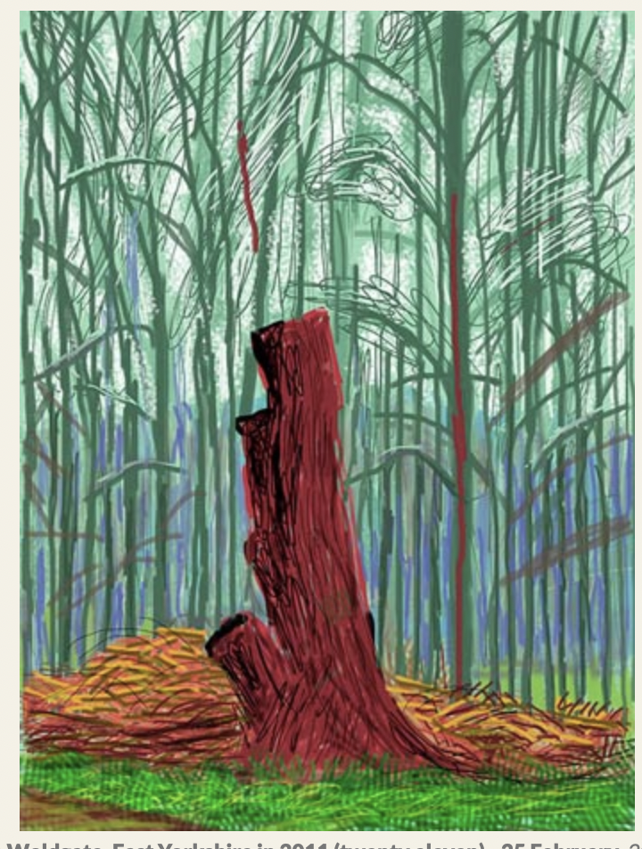
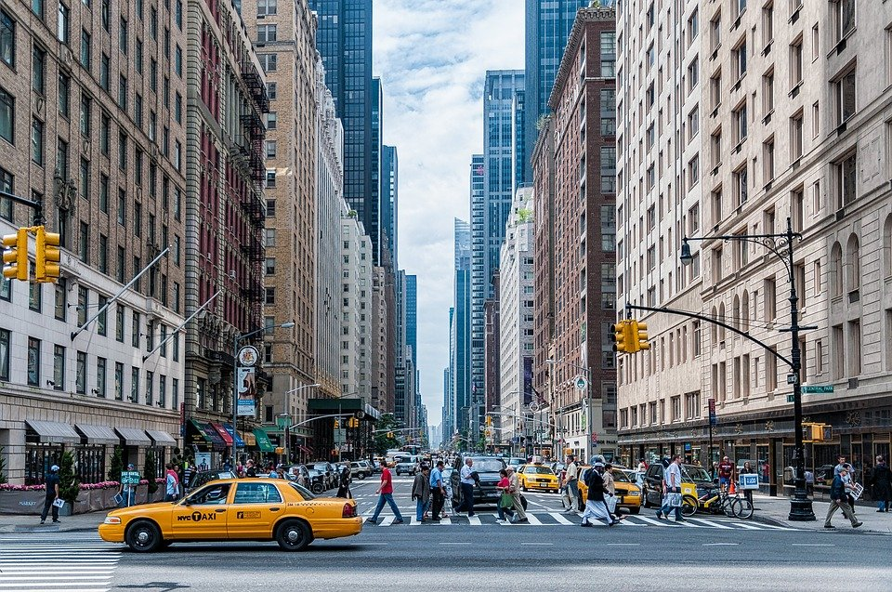
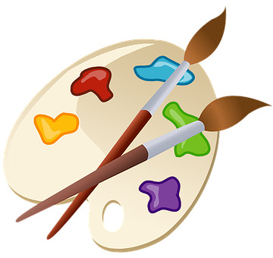
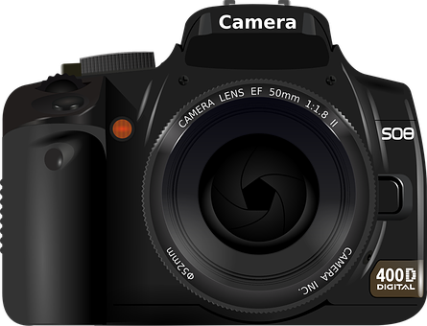
Look at these pieces of art.
How do you think they were created?
Match the art to the method!
Pencil (tonal)
Painting
Charcoal
Camera
iPad
Notes:
Go through each one (top row) and ask class which matches with one from the bottom row - answers on next slide

Slide 3
Did you get them all right?
Pencil (tonal)
Painting
Charcoal
Camera
iPad

Slide 4
Computer Art
Using IT to create art might seem like a very new idea, but actually it has been happening for many years!
Watch this video to learn about some of the very first digital artists displaying their work over 50 years ago!
See separate video files in the download area for this resource.
Notes:
Watch short video about the history of digital art

Slide 5
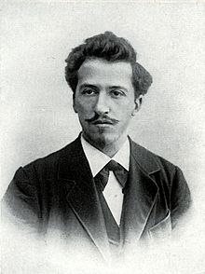
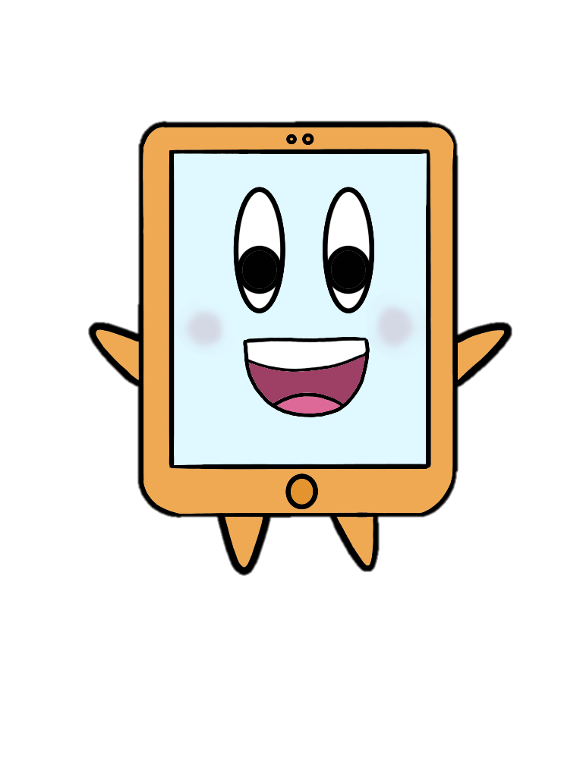
Our turn!
We are going to turn some famous artwork into digital art.
Our inspiration will be a famous Dutch artist called Piet Mondrian.
He was one of the first artists who created abstract art, using very geometric designs.
What is abstract art?
Abstract art does not represent images in our everyday world, like objects or living things.

Slide 6
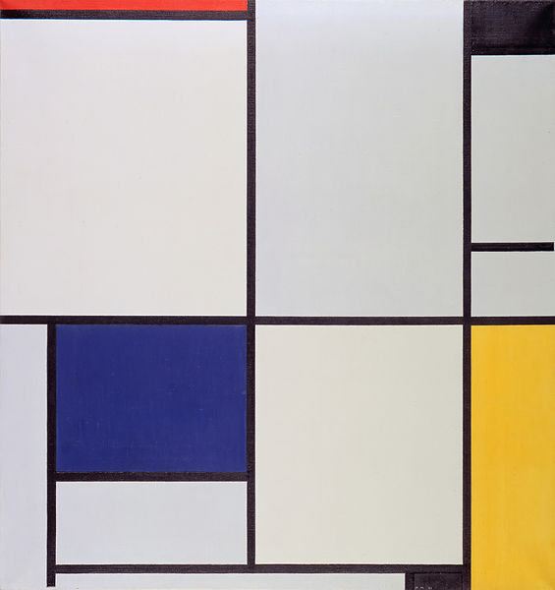
Famous artists: Piet Mondrian
What do you like about this work?
What do you dislike about this work?
What does it make you think of?
How does it make you feel?
Notes:
Talk through pieces and the learners’s opinions. Remind them it is okay to not like something as long as they can justify why

Slide 7
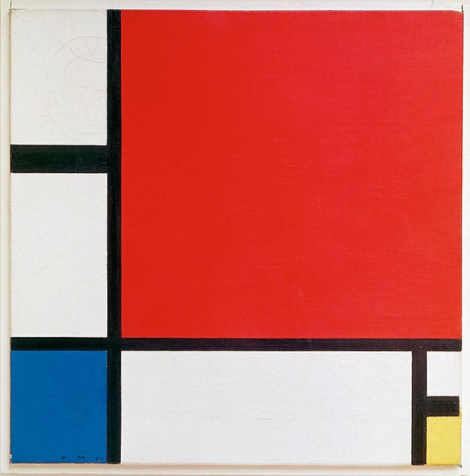
Famous artists: Piet Mondrian
What do you like about this work?
What do you dislike about this work?
What does it make you think of?
How does it make you feel?
Notes:
Talk through pieces and the learners’s opinions. Remind them it is okay to not like something as long as they can justify why

Slide 8
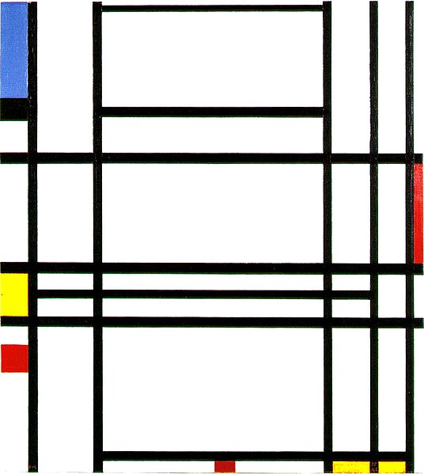
Famous artists: Piet Mondrian
What do you like about this work?
What do you dislike about this work?
What does it make you think of?
How does it make you feel?
Notes:
Talk through pieces and the learners’s opinions. Remind them it is okay to not like something as long as they can justify why

Slide 9
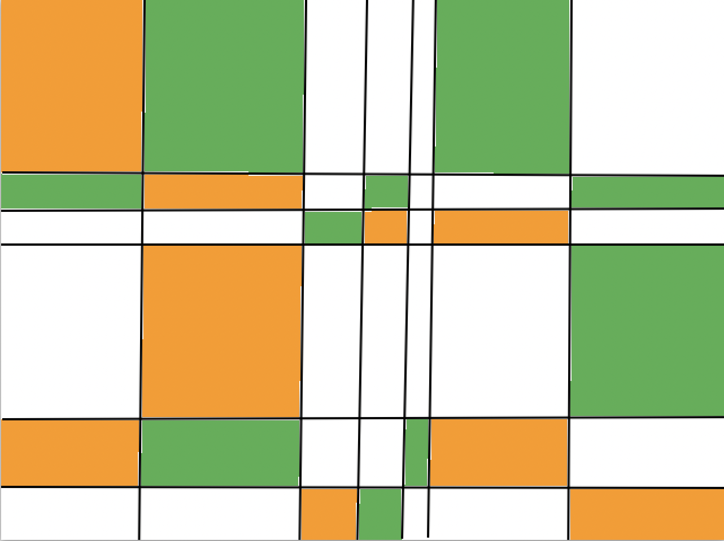
Your turn!
Some examples:

Slide 10
Understanding Paint
 | What does the tool do? | Is it better than real life? | Why? Why not?
Notes:
Get the students to play around on paint to see what the different tools do. Talk through the different tools and what they do. Spend a maximum of ten mins on this. Answers on next slide

Slide 11
Understanding Paint
 | What does the tool do? | Is it better than real life? | Why? Why not?
It is easier to draw a straight line
Straight line
Yes
Shapes
Colours
Fill in
Undo/ Redo
Erase
Notes:
Answers. This section is up to you and the learners as to whether they believe this is better or not, the answer here is an example.

Slide 12
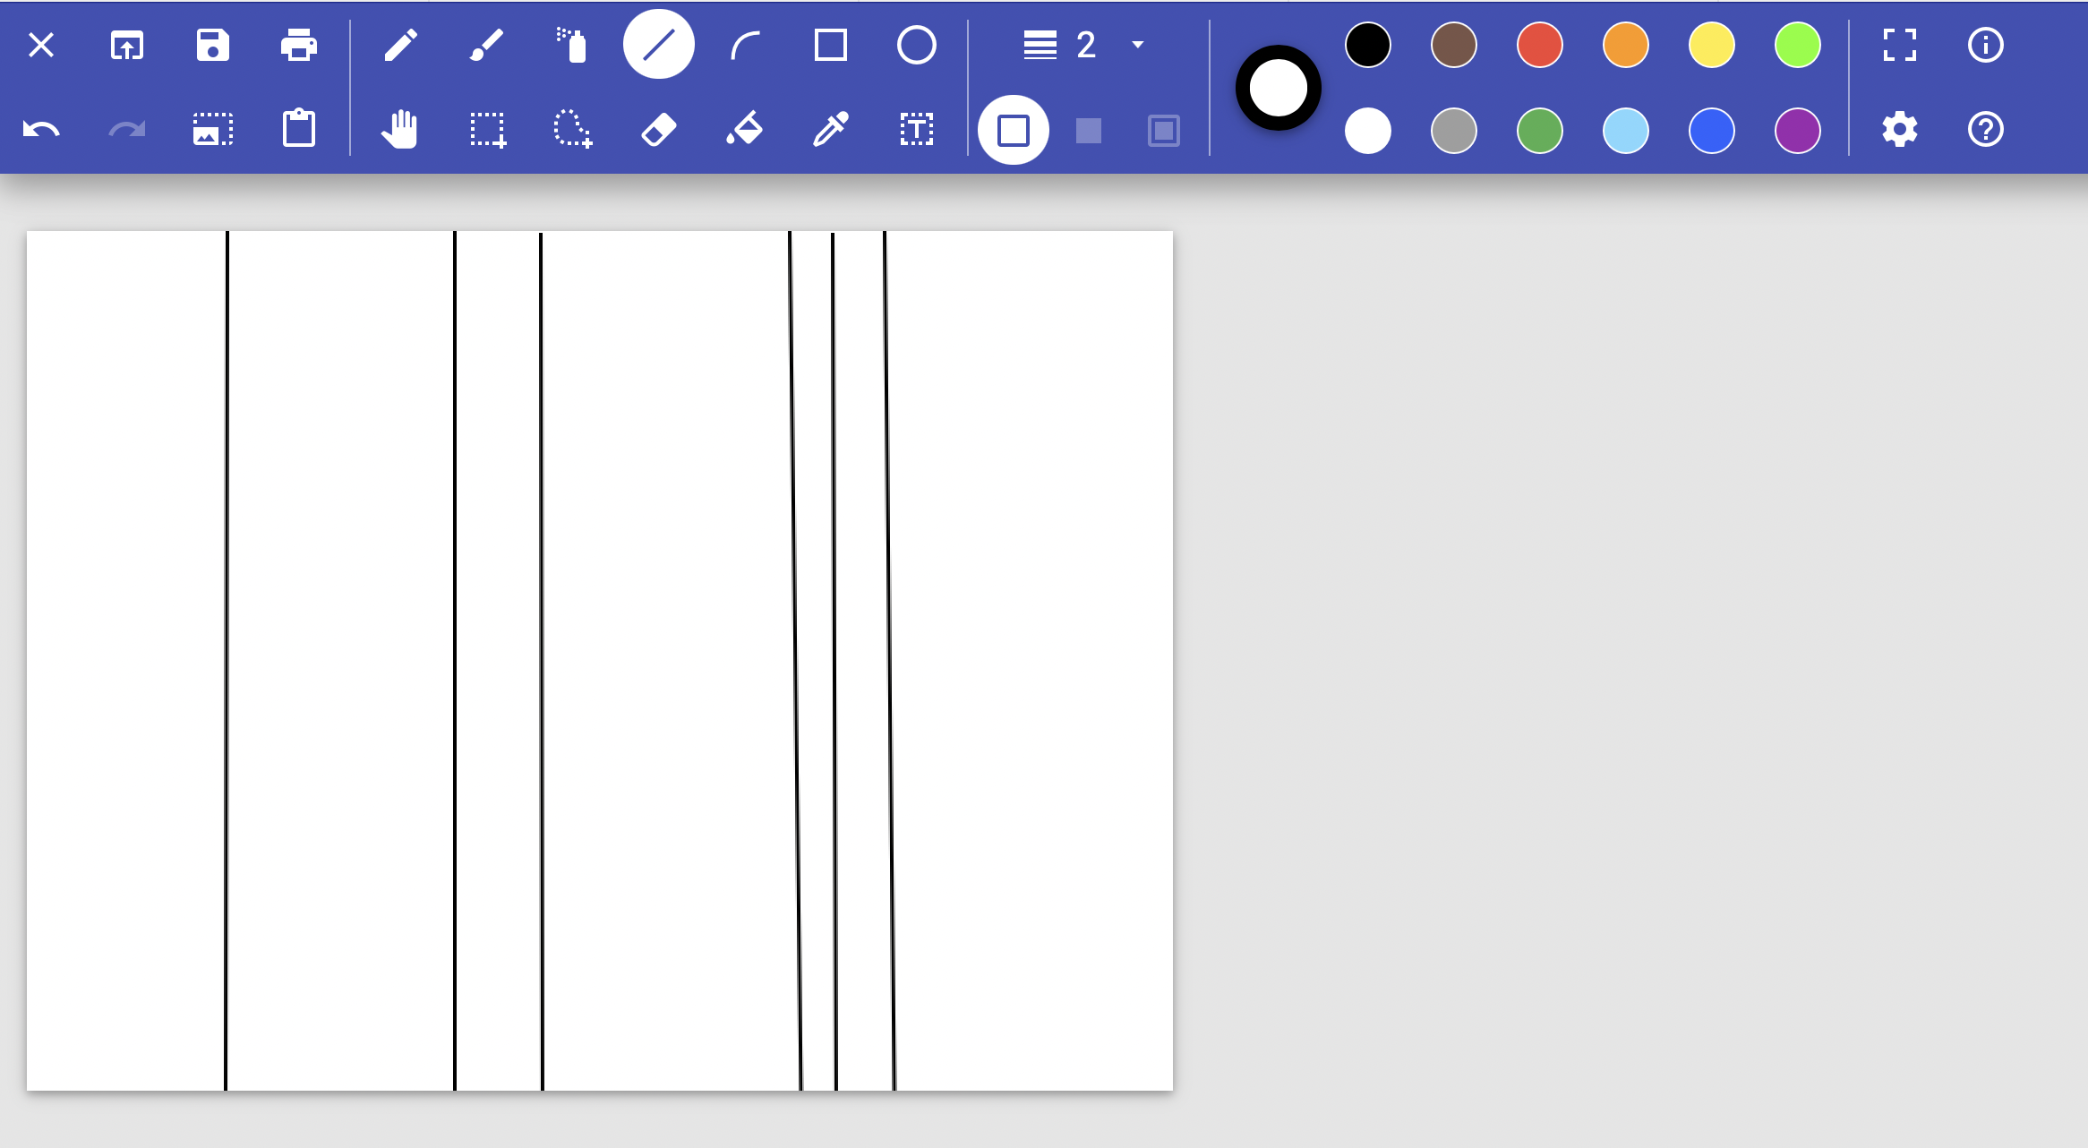
Your turn!
Step 1 - Draw your vertical lines. Piet Mondrian uses straight black lines in his pieces.
Top Tip:
Use different spacing to add more interest to your piece.
Notes:
Go through steps with learners of how to create a piece. It is up to you how structured you want this to be

Slide 13
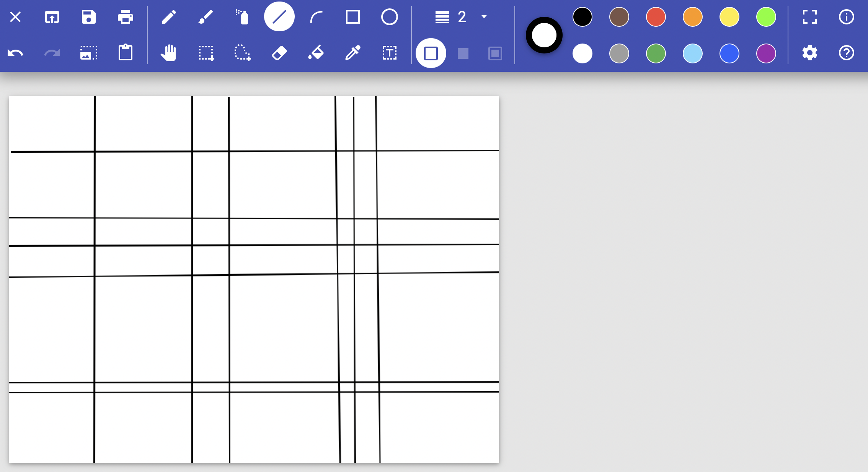
Your turn!
Step 2 - Draw your horizontal lines. Piet Mondrian uses straight black lines in his pieces.
Top Tip:
Use different spacing to add more interest to your piece.

Slide 14
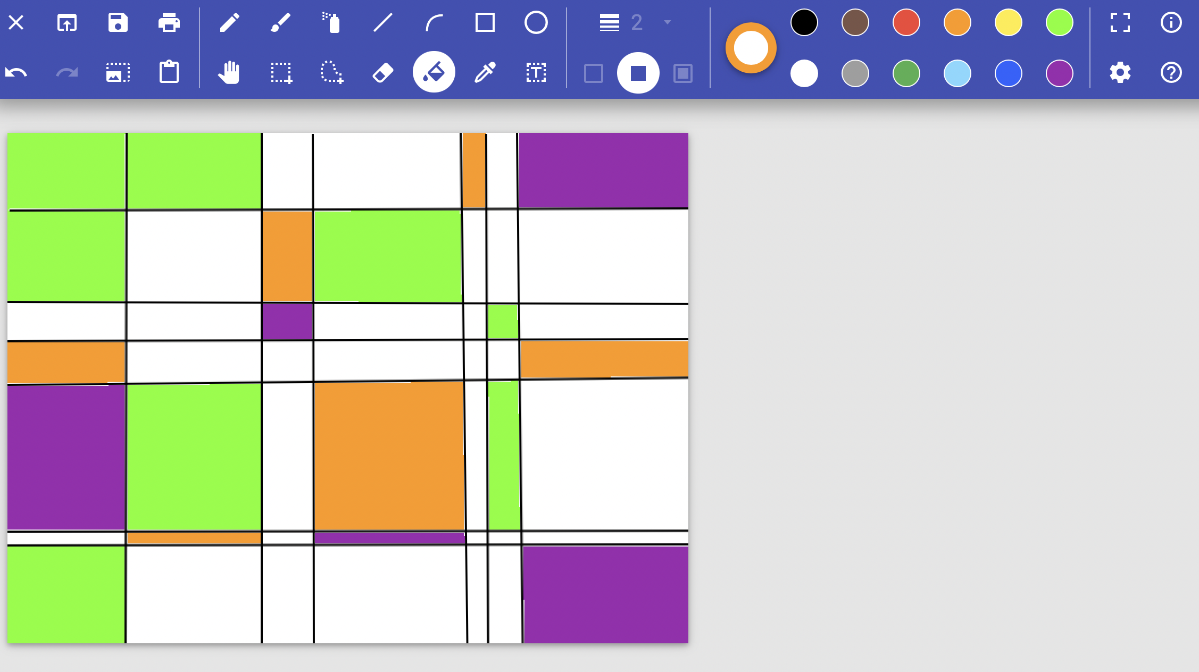
Your turn!
Step 3 - Fill in different blocks with different colours.
Top Tip:
Piet Mondrian only uses 2-5 different colours.
Notes:
Final slide. Ensure learners save their work at the end.

Slide 15
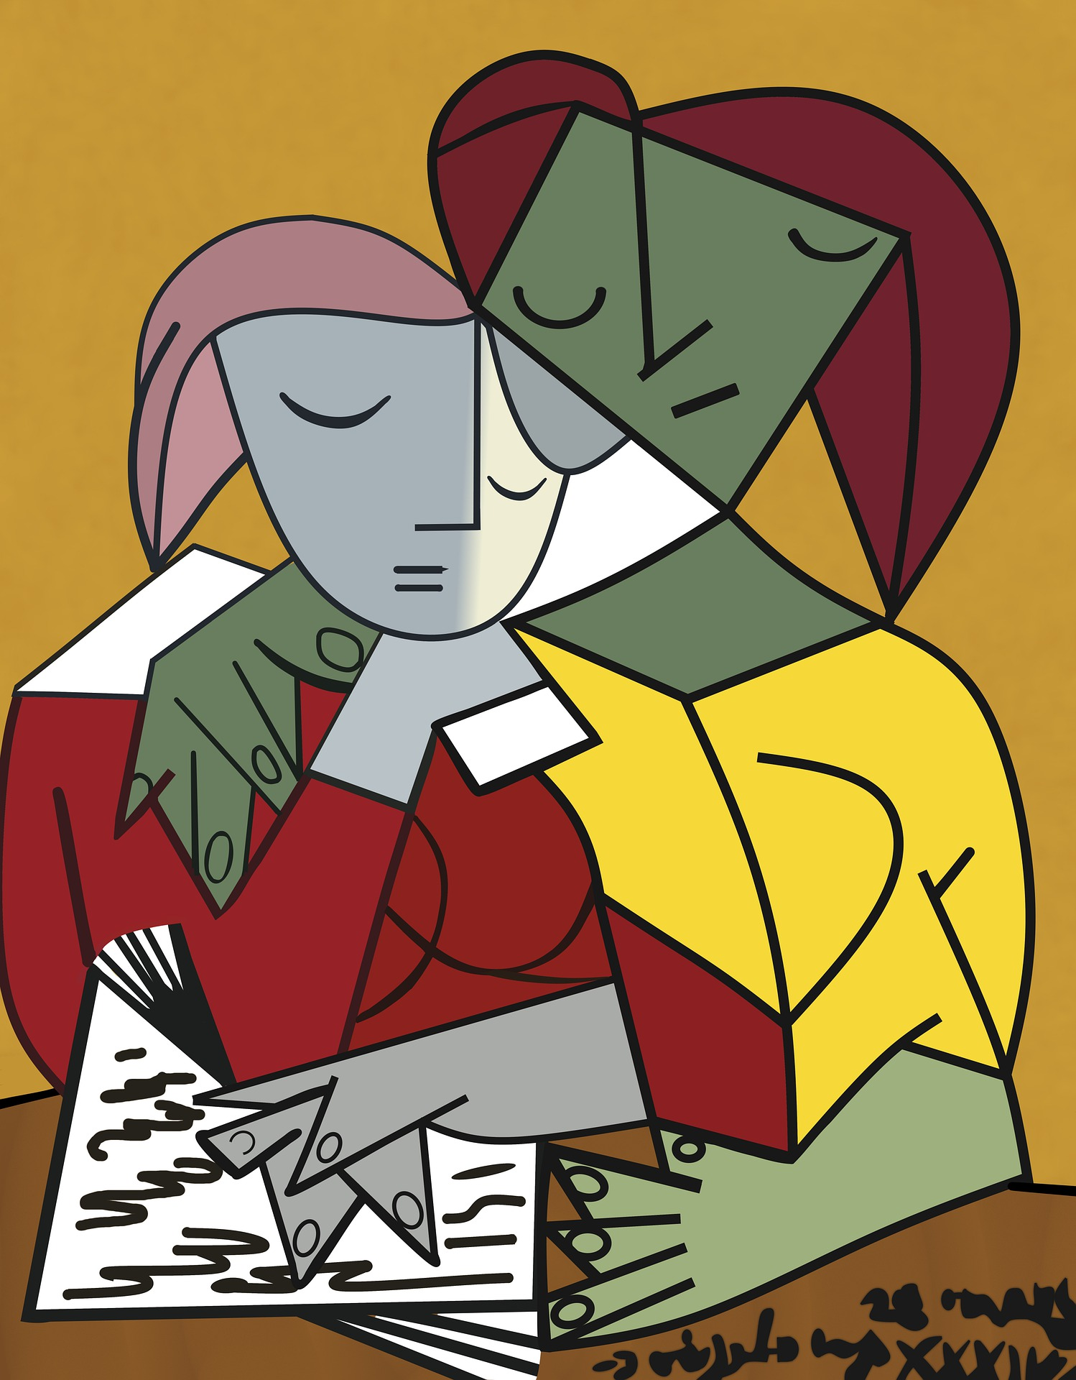
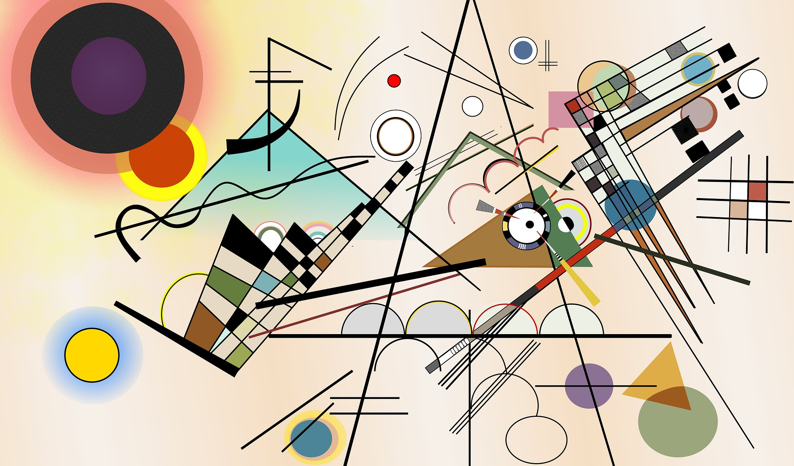
Finished?
Try using the different tools to see if you can create different effects.
Why not try and recreate work by other famous artists?
Pablo Picasso
Kandinsky
Notes:
Extension for any students who have finished.

Slide 16
Did you enjoy creating digital art?
On the Archives of IT website you can watch short interviews with real digital artists and learn all about their jobs and how they got there.
Step 1: Follow the link https://archivesit.org.uk
Step 2: Click on Gallery in the education section of the homepage
Step 3: Click on interviews
Notes:
Careers- Talk through the various jobs learners can do if they enjoy digital art, all on our video which can be accessed via the link provided.

