Slide 1
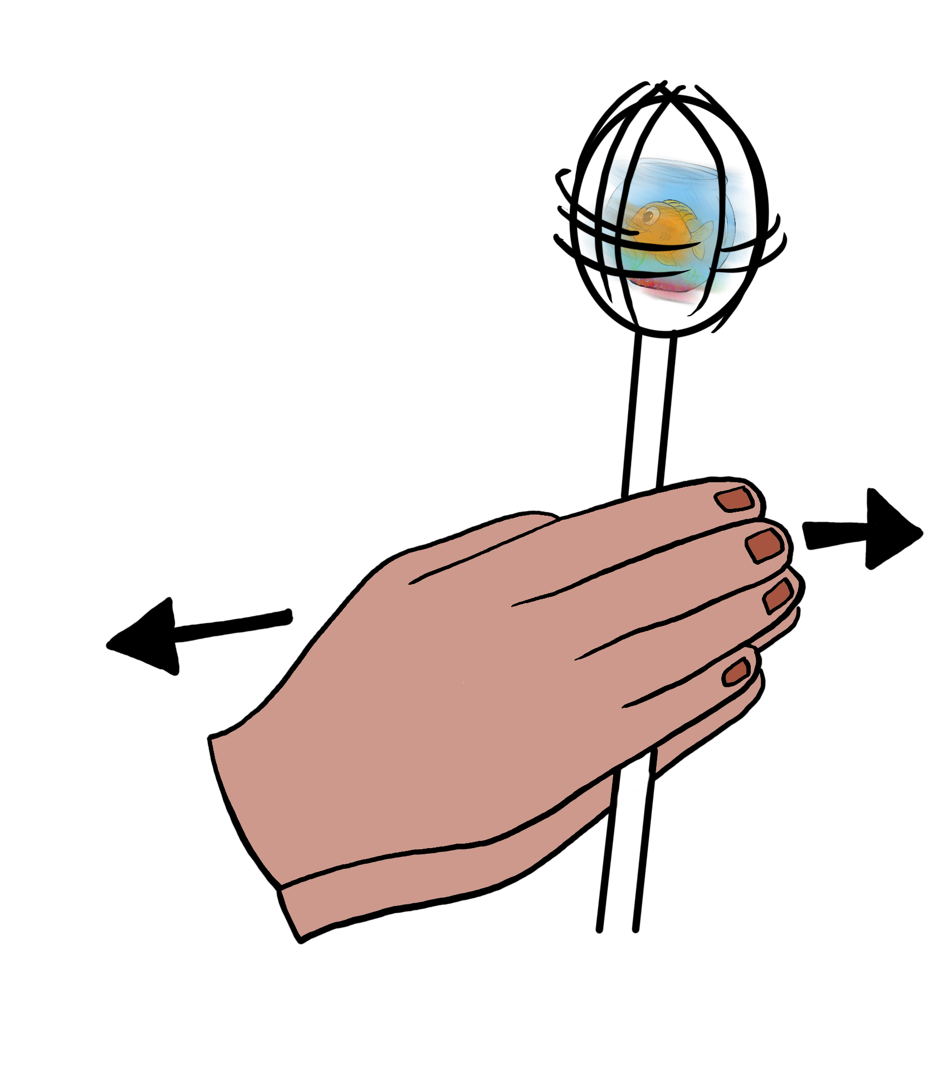
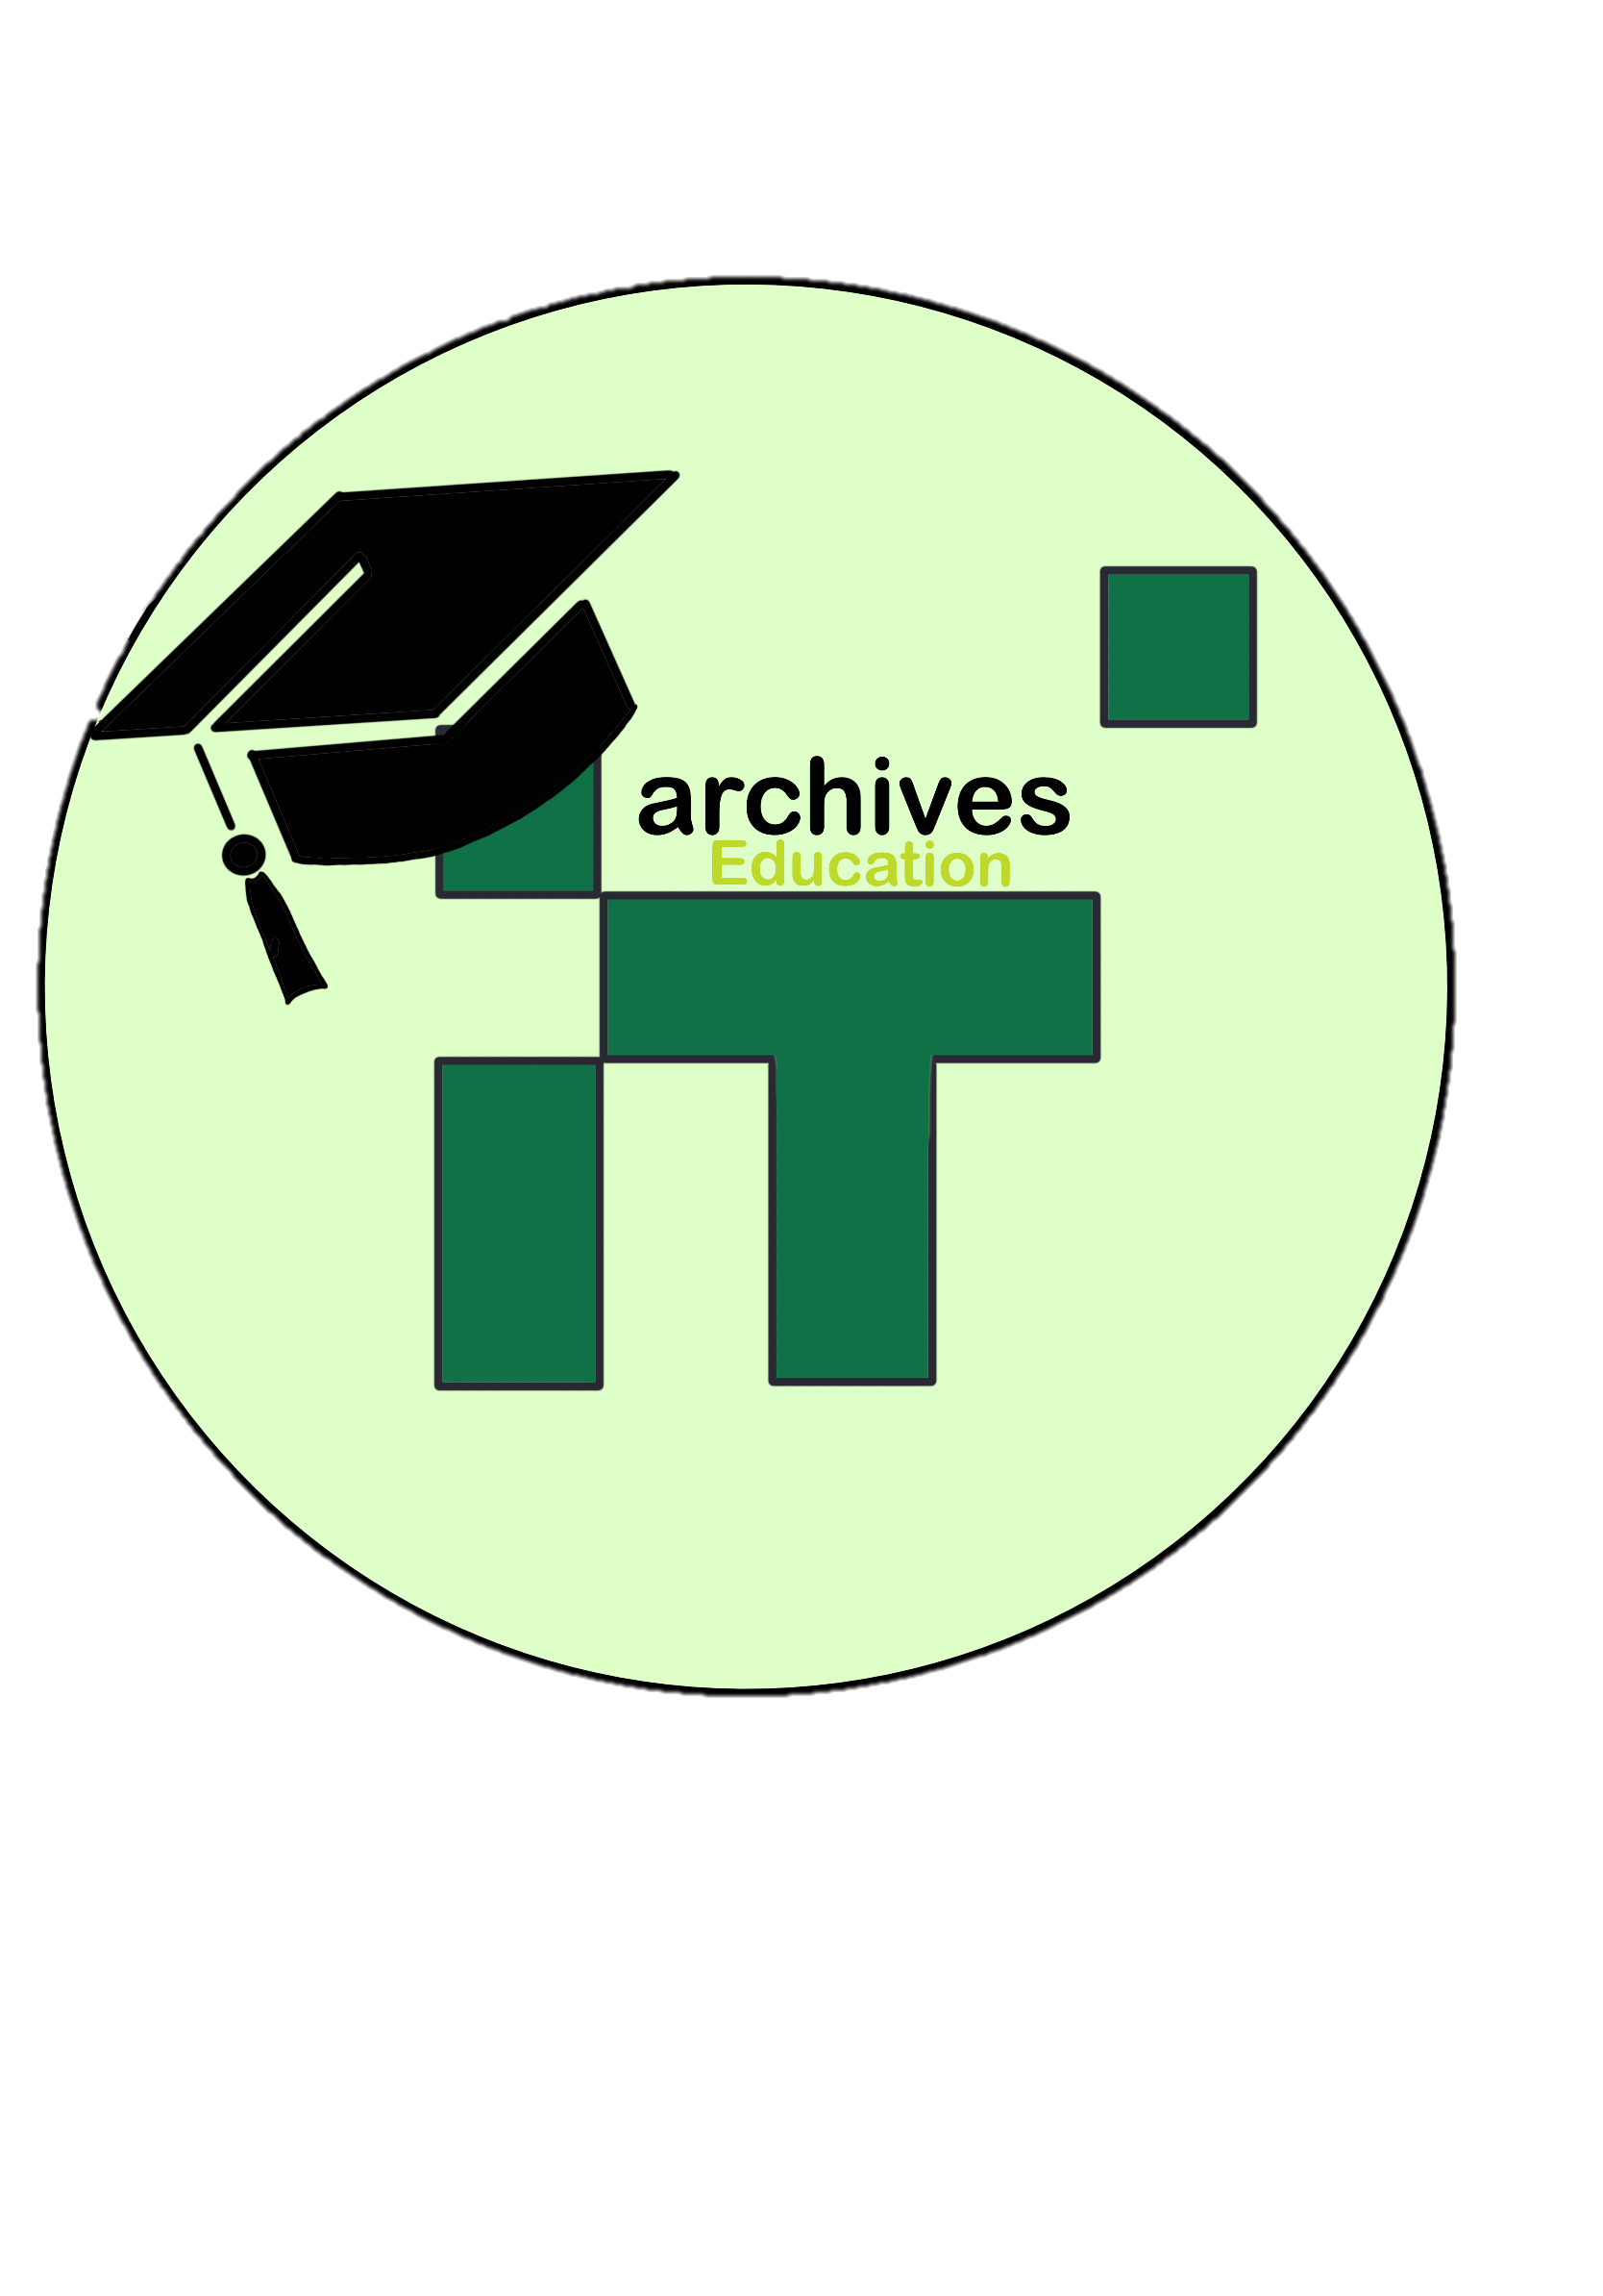
Animation
Making moving pictures

Slide 2
The first known Thaumatrope was created in Paris in 1824 by John Ayrton.
Thaumatropes are one of the earliest forms of animations.
They work by creating an optical illusion of motion, as the drawings appear to blend into one another when spun.
Thaumatrope
Notes:
Explain what these are, how they work and how they helped pave the way for the animations we see today.

Slide 3
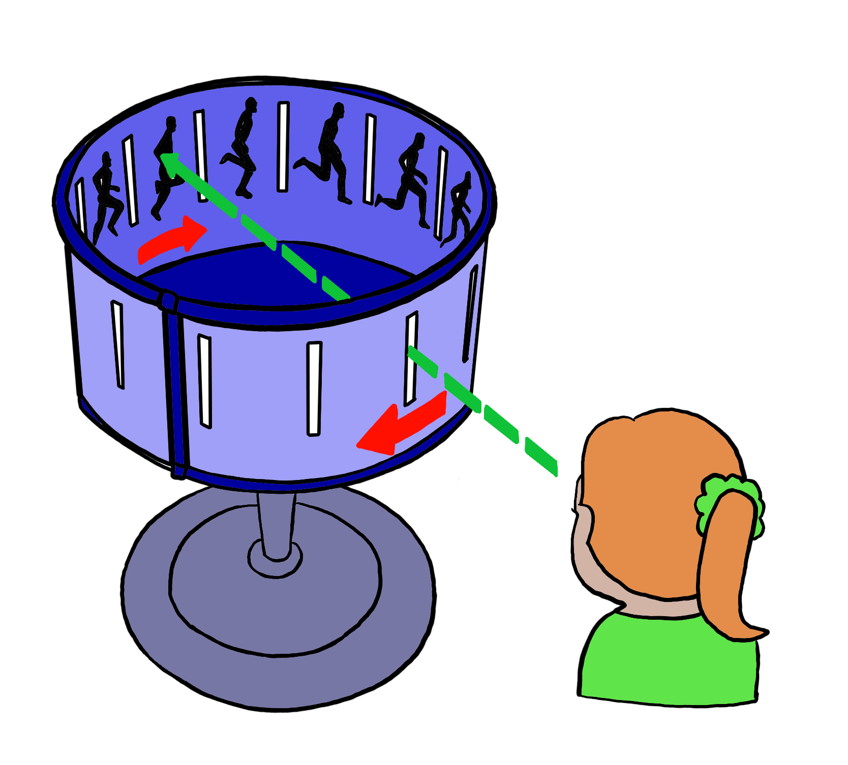
Zoetrope
Zoetropes were also popular in Victorian times.
These were originally invented by William George Horner.
However it was Émile Reynaud who, in 1876, adapted them into a form that could be projected to a theatrical audience.
Click this link to watch it in action!
Notes:
Explain what these are, how they work and how they helped pave the way for the animations we see today.

Slide 4
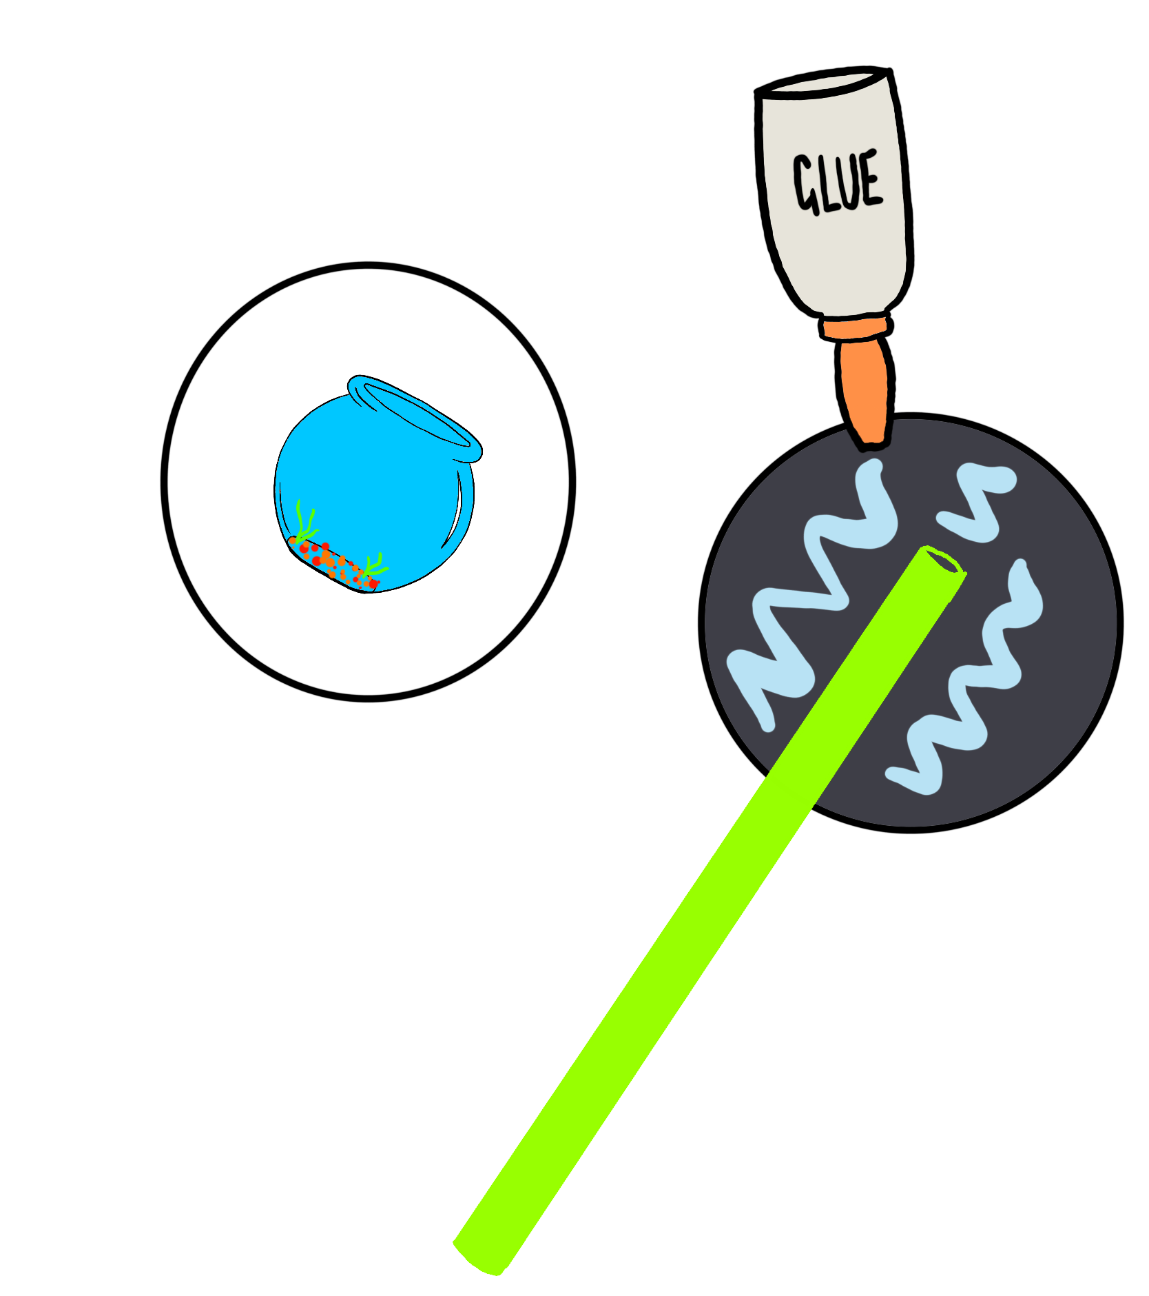
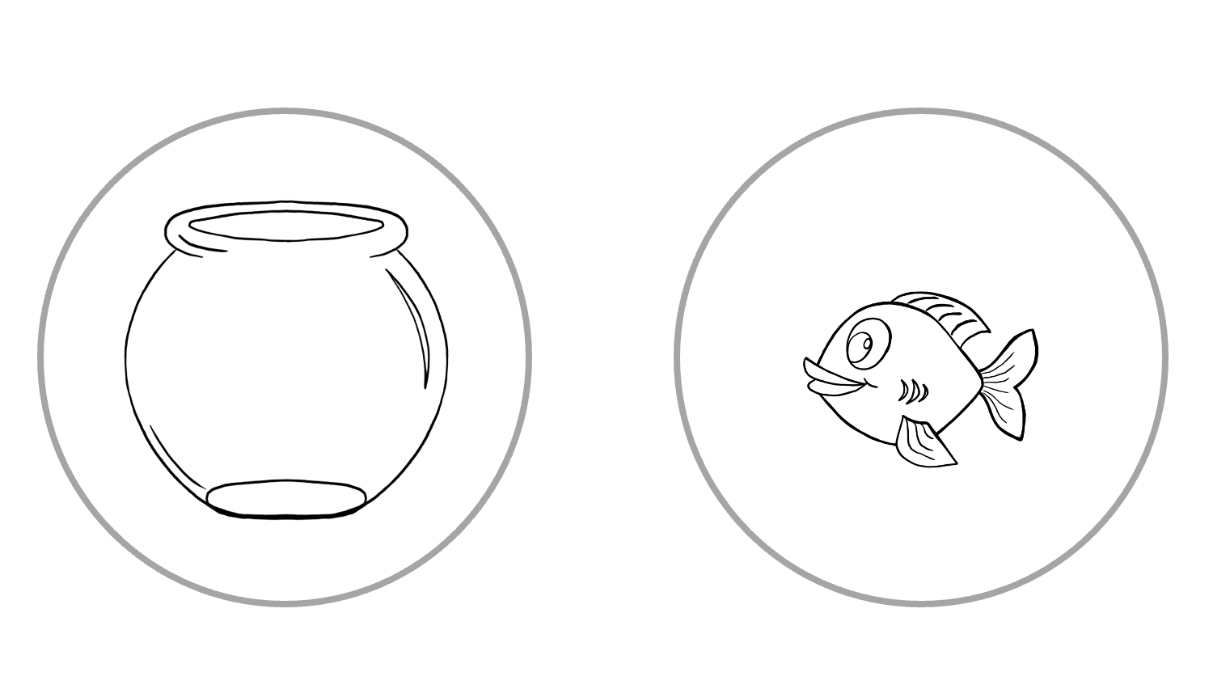
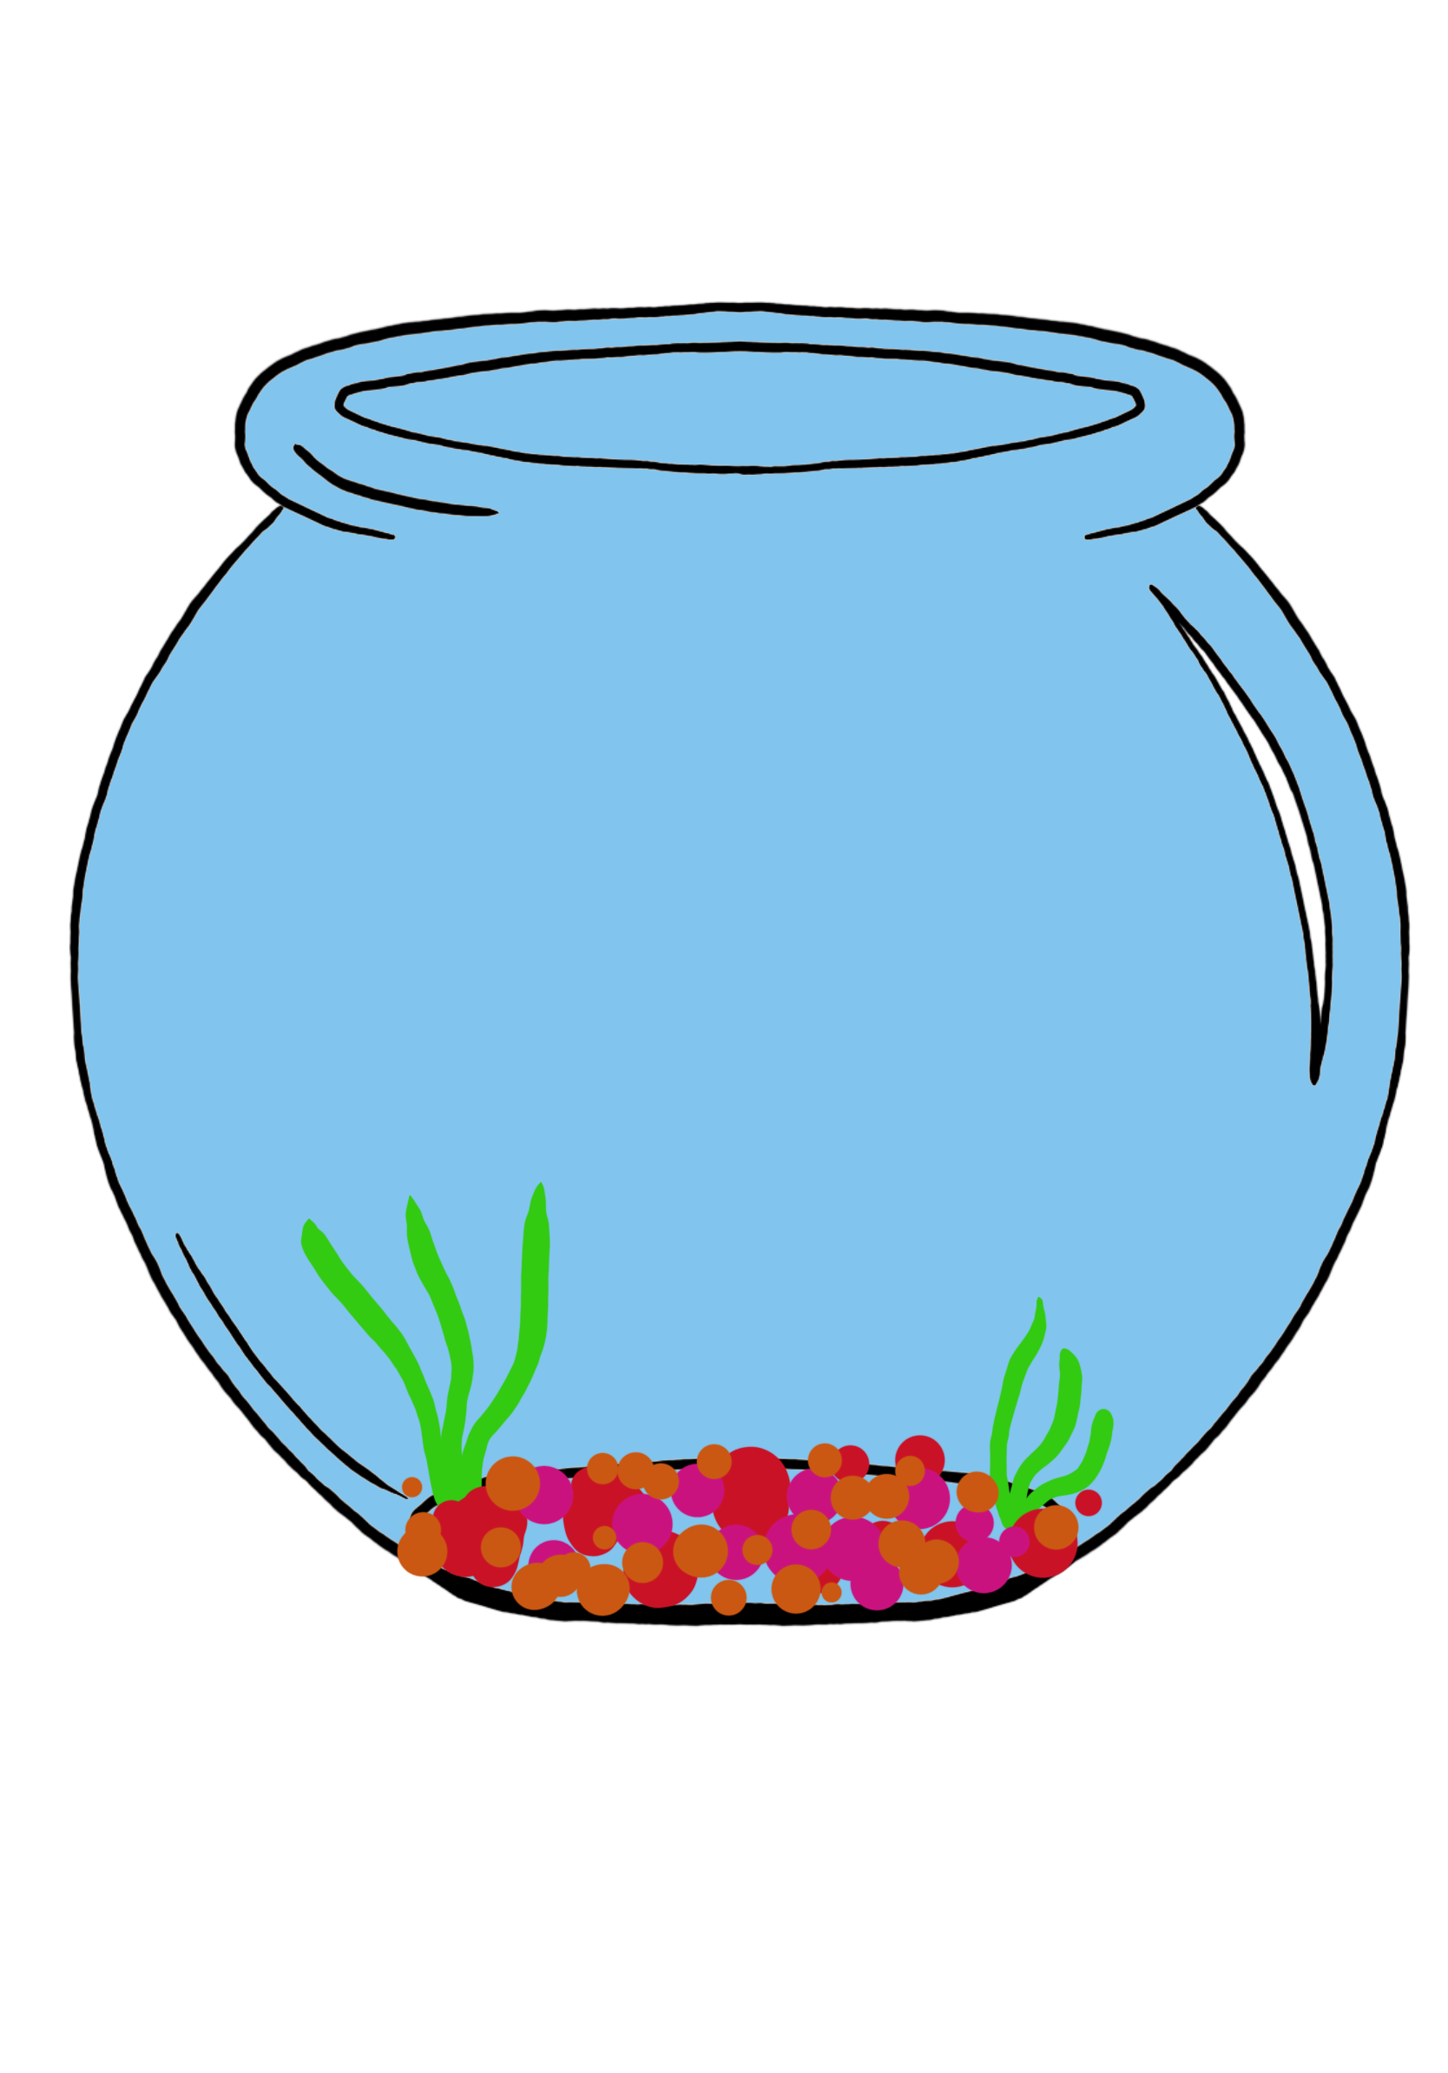
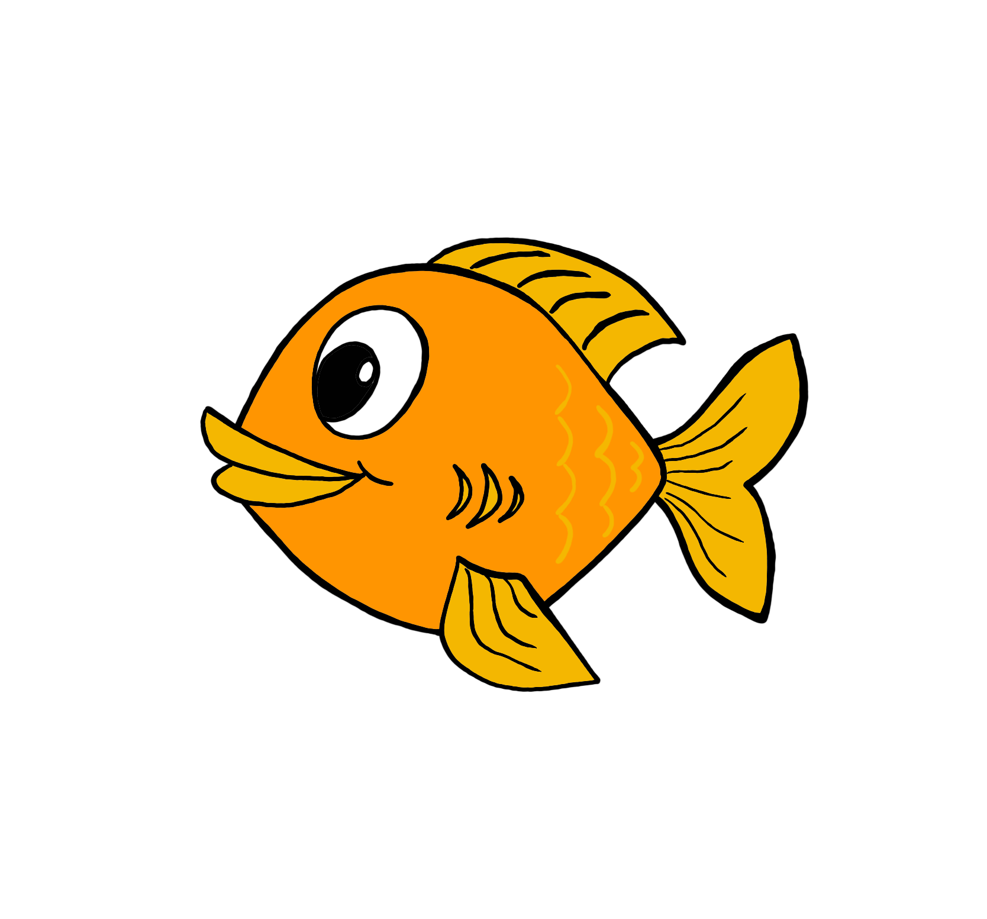
Make your own thaumatrope
Cut
Colour
Stick
Spin!
Finished? Why not try designing your own!
Notes:
Give the learners the sheets to make a thaumatrope. Any learners finished can design their own. Sheets for this with instructions are provided.

Slide 5
The history of animation
Soon we will be using technology to create our own art, but first let’s discover how technology has helped to change the way we make art today!
1824
Thaumatrope’s are invented
1893
The Kinetoscope is invented
1937
The first Disney animated movie released
1860s
Flipbooks are invented
1932
Technicolour Animation is invented
1993
3D animated films are invented

Slide 6
Watch this video!
Click here to activate link
Do you know what this kind of animation is called?
Notes:
Follow link to watch video clip on stop motion animation, see what learners know about it before moving onto the next slide

Slide 7
Stop Motion Animation
Stop motion animation is a filming technique that captures one frame at a time, similar to flipbooks.
During each take the object is moved and when it is played back it looks like it’s moving.
Click on the link to watch a video explaining more!
As well as a super film, this animation teaches us about the move from the Stone Age to the Bronze Age. Can you use animation to teach people all about science?
Click here to activate link
Notes:
Watch this short clip to help explain to learners what stop motion is and how it works.

Slide 8
Our turn!
What science topic are you going to choose for your animation? Here are some ideas:
Showing how magnets work
Animals’ skeletons and muscles
The functions of different parts of a plant
What do plants need to grow
The life cycle of a plant
Digestive system
Notes:
It is up to you if you want to decide on a specific topic for the learners to animate. We recommend these science topics. Look at next slide for our example of a simple animation on the life cycle of a plant. IF you are deciding beforehand, you may wish to delete this slide.

Slide 9
Our turn!
See separate video files in the download area for this resource.
Notes:
Watch our example video. We use a mix of playdough and paper cutouts to film ours. It is up to you which media you would like your learners to use.

Slide 10
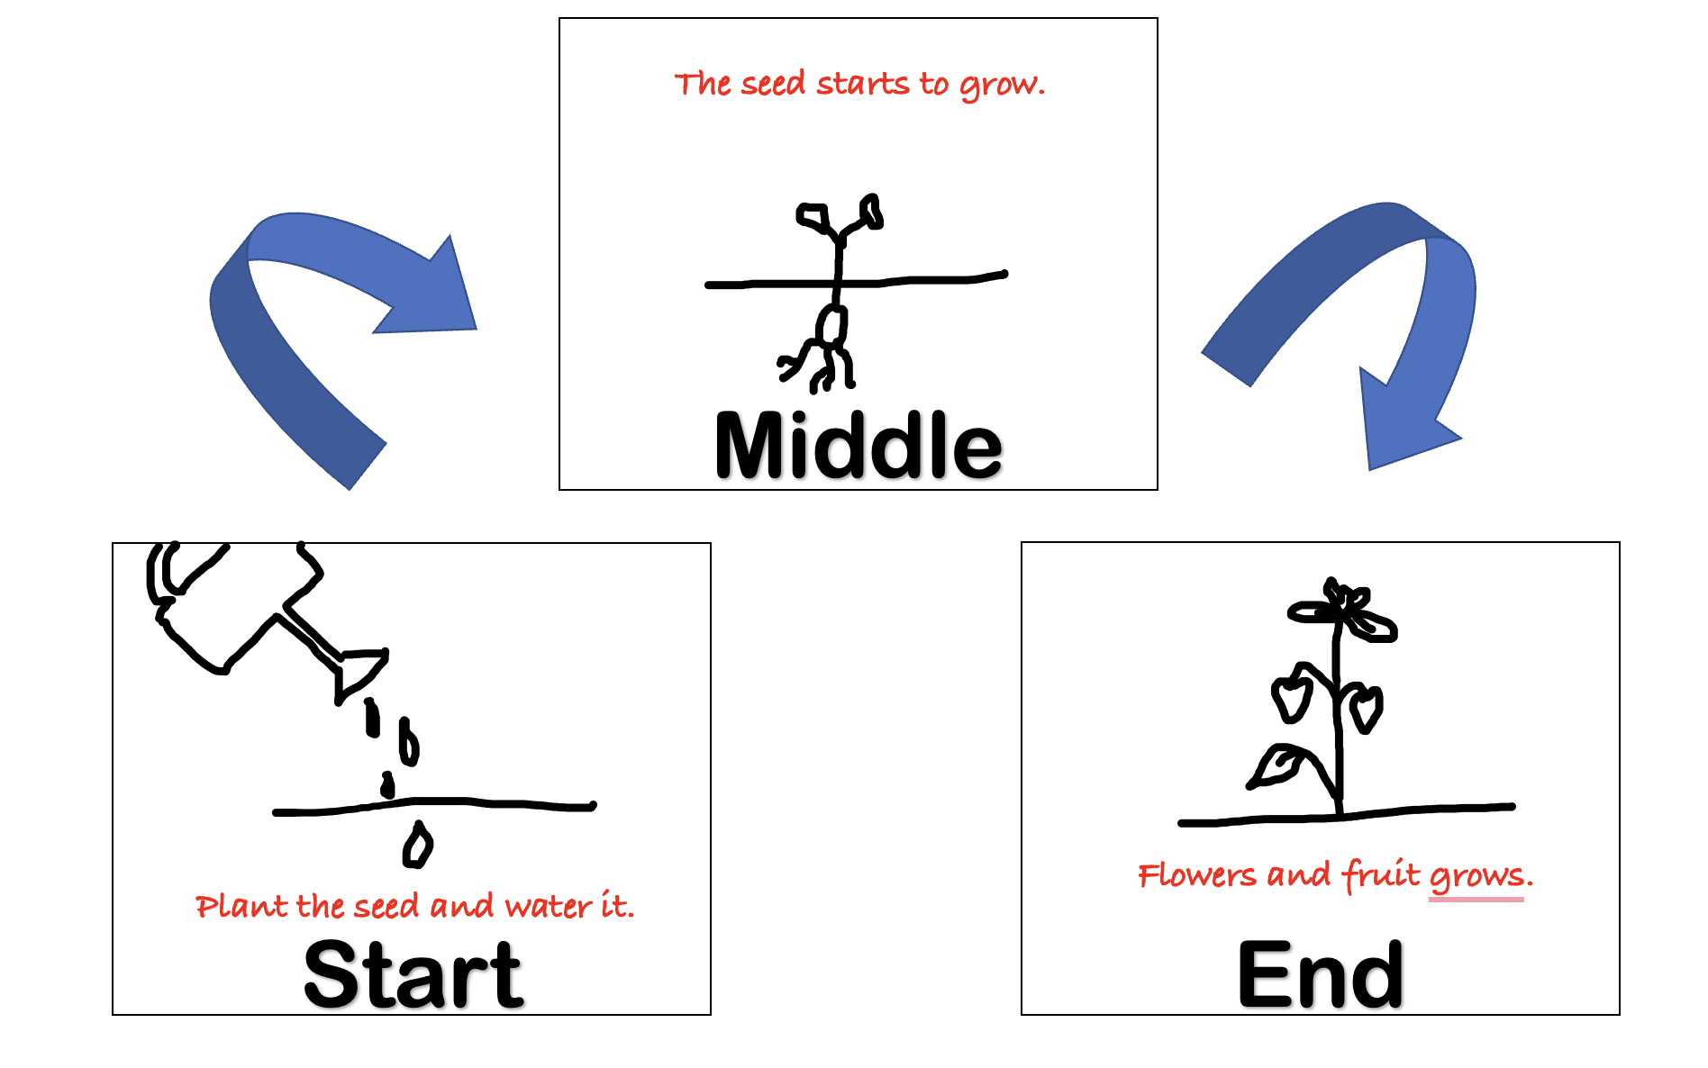
Our turn!
Step 1:
Use the story mountain to plan your story.
Remember to keep it short as it can take a lots of frames to make a small amount of action.
Notes:
Put the learners into small groups of about 3 or 4 to make their own animation. Use story mountain sheets provided.

Slide 11
Our turn!
Step 2:
Record your action.
Remember to move or draw things a little bit at a time and take the photos in between movements.
See separate video files in the download area for this resource.
Top Tips!
Always take more shots of the frame than you need. You can always cut them out but it is much trickier to retake them when you have finished.
Make sure everyone knows when the photo is being taken so that there are no hands in the frame!
Notes:
Play video before the learners start filming their animations. We used the free app stop motion animation

Slide 12
Our turn!
Step 3:
Watch your mini movie back through and write your script.
Remember you will also need one or two people on sound effects as well as the narrator.
Notes:
Play this instruction video when the learners have written their script and are ready to add audio.

Slide 13
Our turn!
Step 4:
Watch your animation back carefully and edit it where needed
Remember it is very tricky to retake a frame as everything must be placed exactly where it was before, so try not to delete frames unless it is absolutely necessary.
Watch the video in step 2 if you need reminding how to delete frames.
Notes:
Get the learners to watch through a final time and edit their final clip

Slide 14
Did you enjoy creating digital art?
On the Archives of IT website you can watch short interviews with real digital artists and learn all about their jobs and how they got there.
Step 1: Follow the link https://archivesit.org.uk
Step 2: Click on Gallery in the education section of the homepage
Step 3: Click on interviews
Notes:
Careers- Talk through the various jobs learners can do if they enjoy digital art, all on our video which can be accessed via the link provided.

