Slide 1
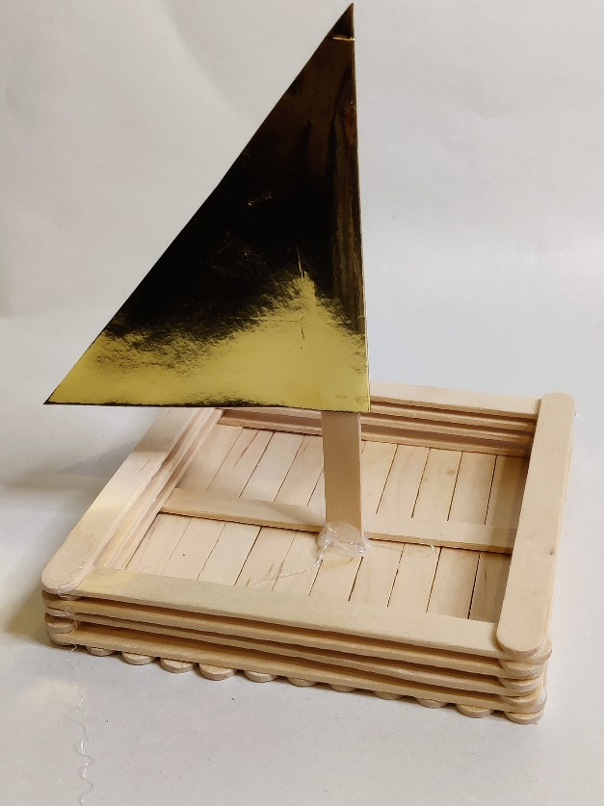
How to build a small sail boat
Making a model of a sail boat out of craft sticks and testing it

Slide 2
Stay safe
Whether you are a scientist researching a new medicine or an engineer solving climate change, safety always comes first. An adult must always be around and supervising when doing this activity. You are responsible for:
ensuring that any equipment used for this activity is in good working condition
behaving sensibly and following any safety instructions so as not to hurt or injure yourself or others
Please note that in the absence of any negligence or other breach of duty by us, this activity is carried out at your own risk. It is important to take extra care at the stages marked with this symbol: ⚠

Slide 3
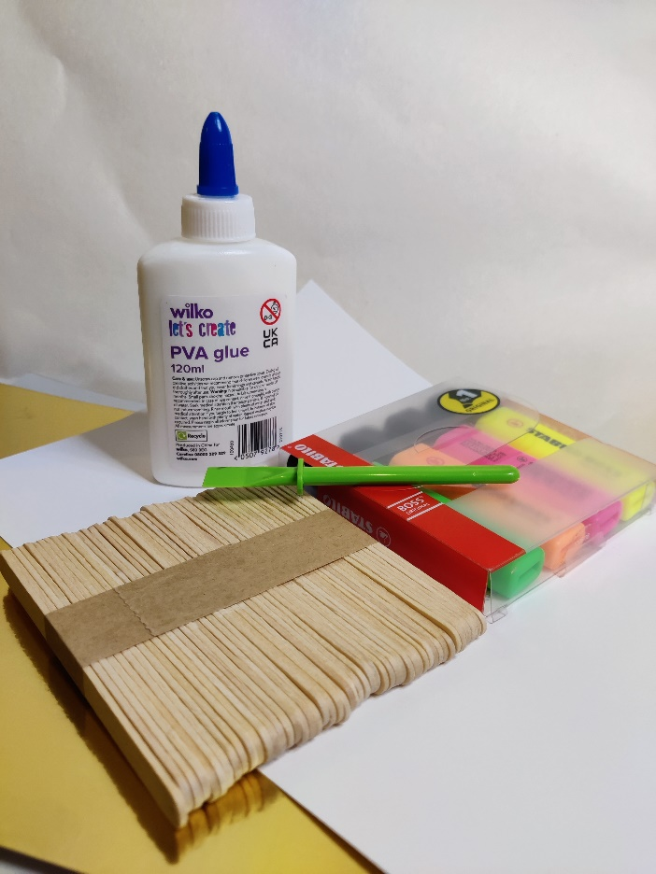
Equipment and resources
PVA glue
Glue spreader
Craft sticks
Highlighter pens or paints
Material for the sail e.g. paper or card

Slide 4
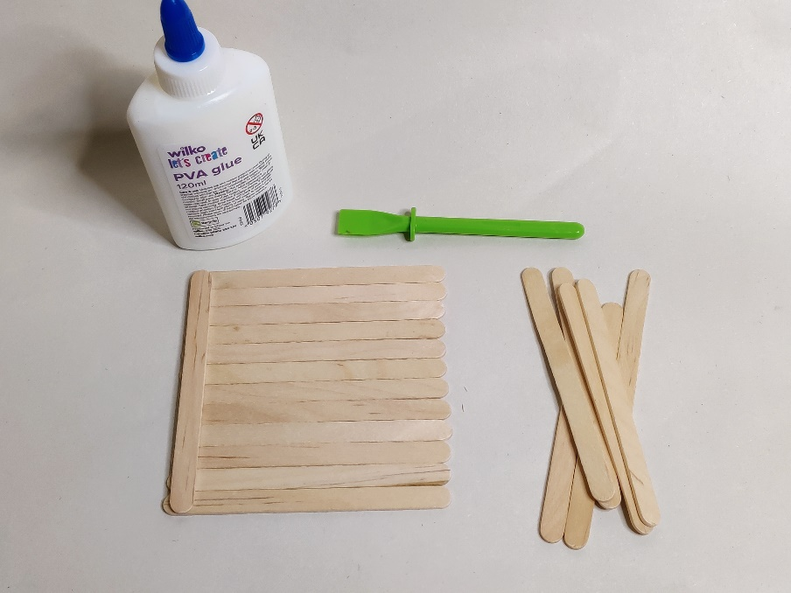
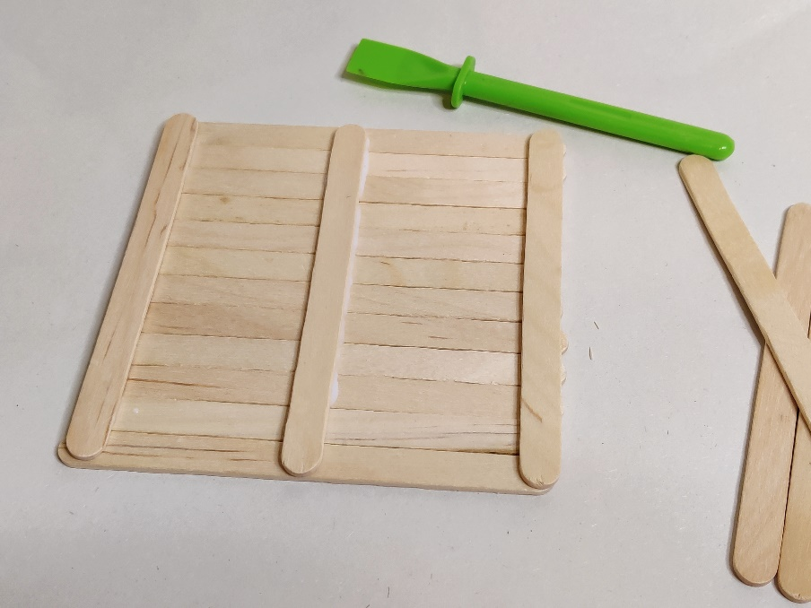
Step 1 – Making the base
⚠
Lay twelve craft sticks down in a straight row. This forms the base.
Glue three sticks to the base - one on the left side, one on the right and one in the middle
Notes:
Use a glue spreader to get an even spread of glue. The craft sticks used are the same as standard lollipop sticks. The three sticks glued on top of the first line of sticks will hold them together and give stability to the boat.

Slide 5
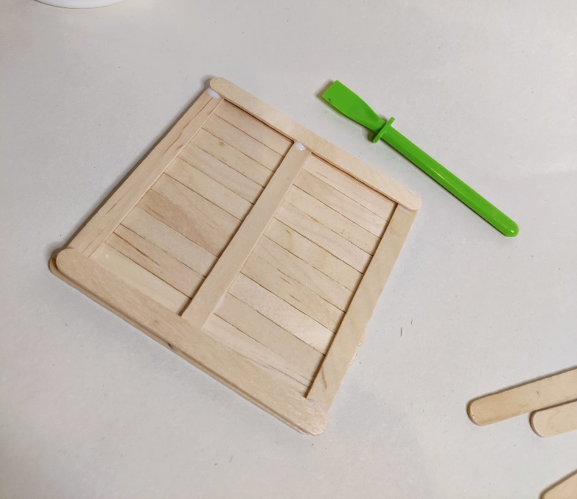
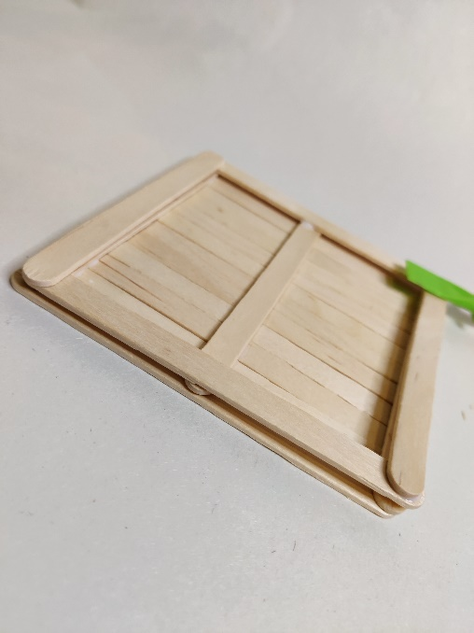
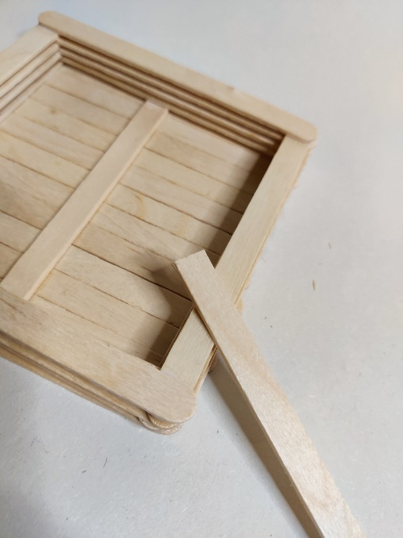
Step 2a – Building the sides of the boat
⚠
Build up the side layers of the boat by gluing sticks across the corners

Slide 6
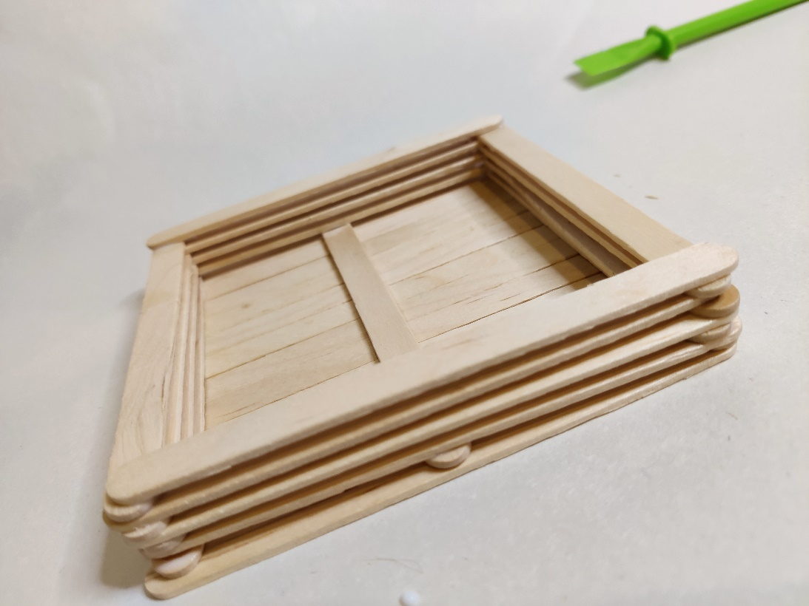
Step 2b – Building the sides of the boat
⚠
Keep layering sticks on the sides until you have about five layers
Notes:
Although five layers are recommended, more could be added so long as this doesn't make the boat too heavy to float!

Slide 7
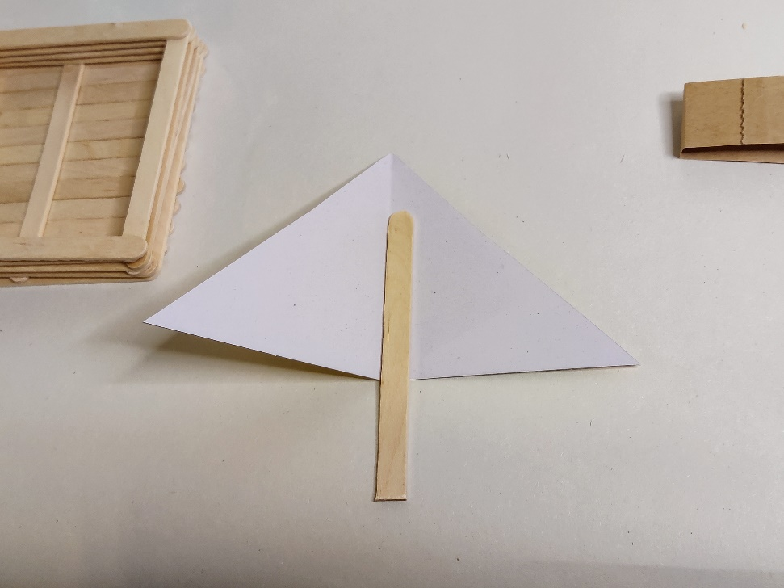
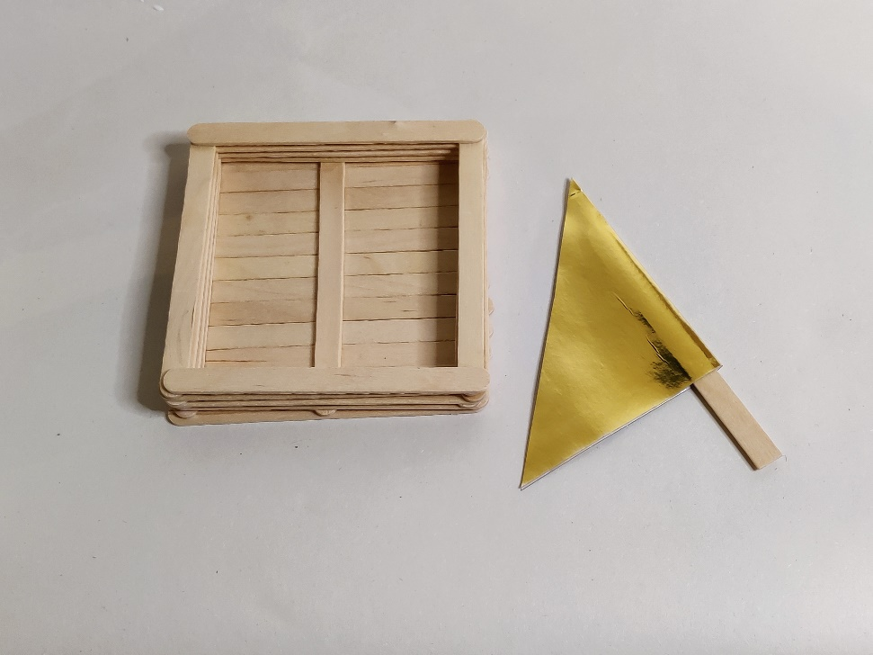
Step 3 – Making the sail
⚠
Cut a triangular shape out of card or paper for the sail
Glue a craft stick halfway up and in the middle as shown
Fold the card over to create the sail
Notes:
Learners could use coloured card or paper for improved visual appeal.
As an extension they could design different sail shapes and see which works best when testing.

Slide 8
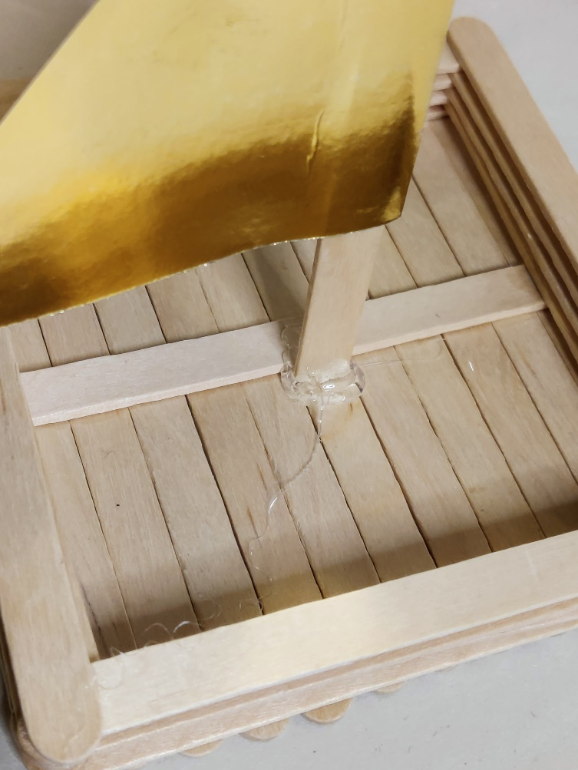
Step 4 – Adding the sail
⚠
Use a glue gun to join the stick holding the sail to the base of the boat
Use enough glue so that it will not move
Allow the glue to dry
Notes:
The end of the craft stick to be glued may need to be cut so it is straight. Teacher could discuss with learners the best position for the sail. What effect would moving it have?

Slide 9
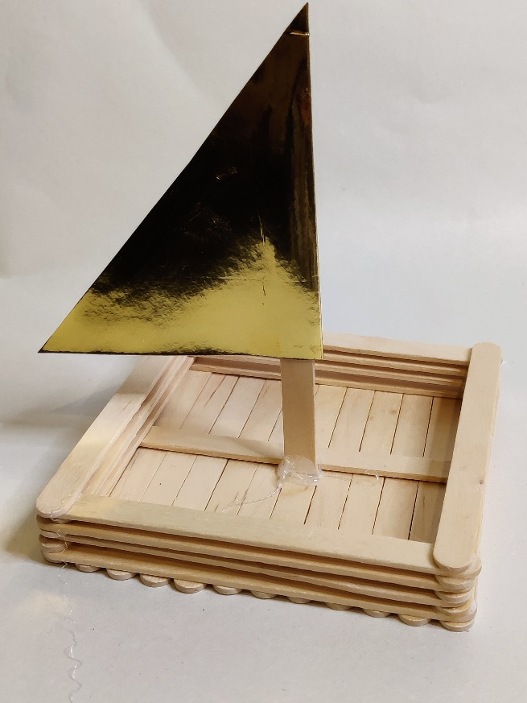
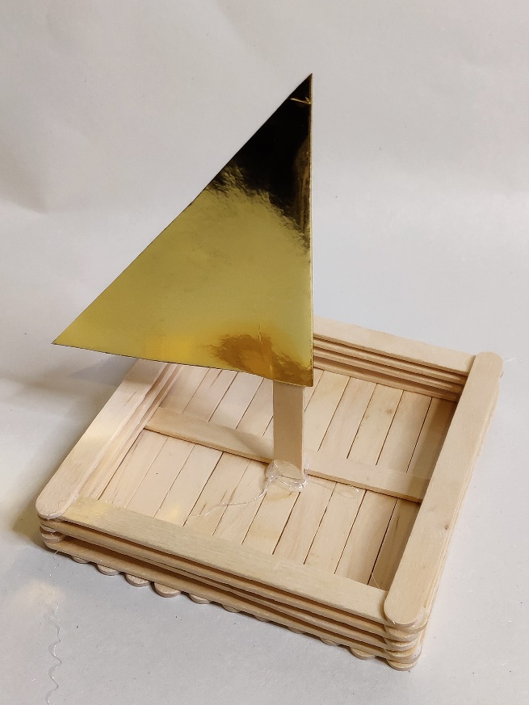
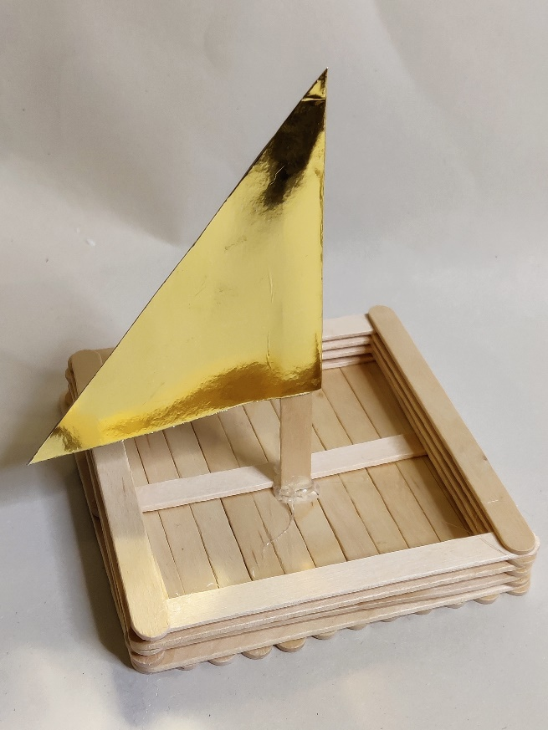
Example of finished sail boat
Notes:
An example of a completed boat to aid learners.
As an extension learners could colour the boat or redesign it to a more aerodynamic shape.

Slide 10
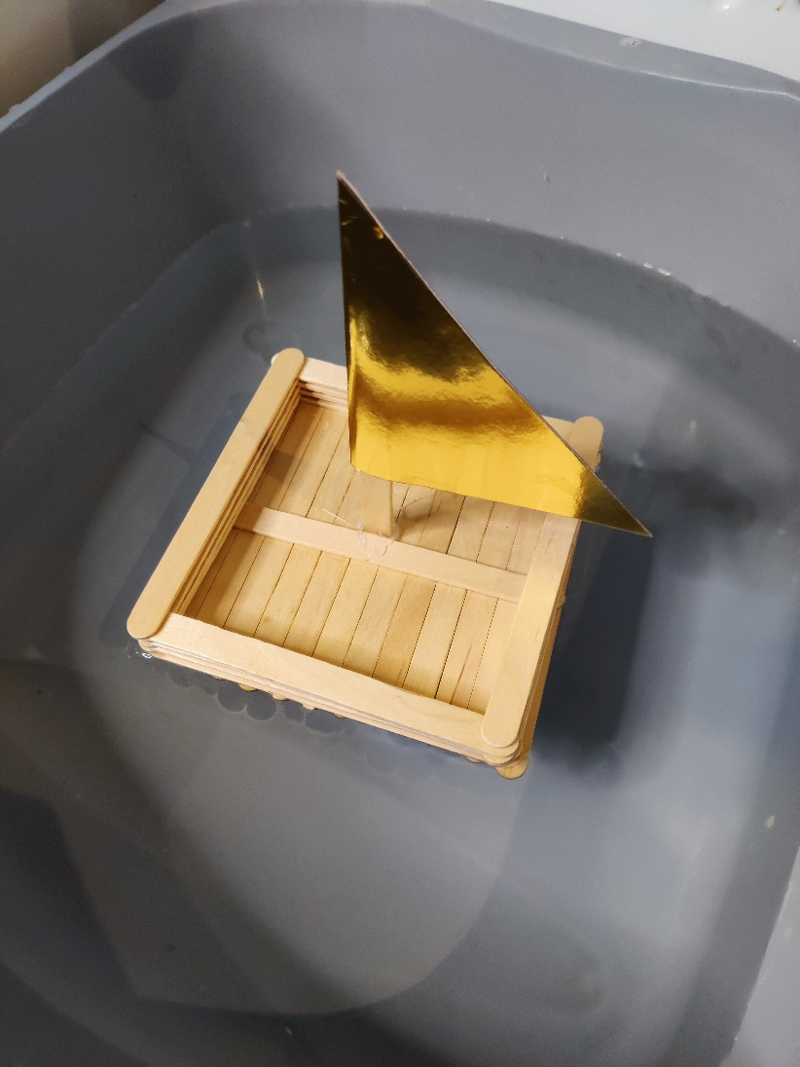
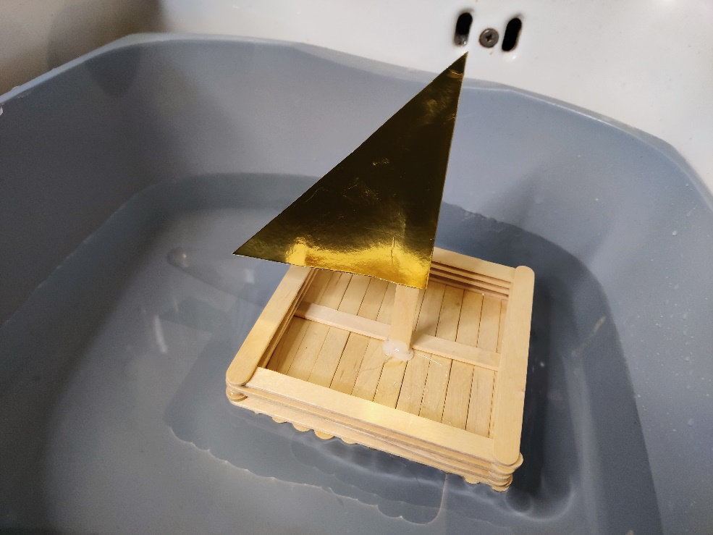
Testing the boat
Place your boat in water and see if it floats!
Notes:
A half full washing up bowl could be used for testing. Learners could blow on the sail to see if it makes the boat move.
As an extension learners could make different sail shapes to see which works best.

