Slide 1
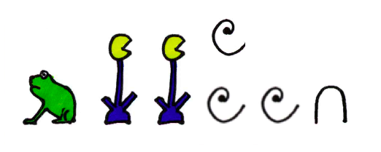
Count using hieroglyphics
Using Egyptian math hieroglyphics to work out problems

Slide 2
Stay safe
Whether you are a scientist researching a new medicine or an engineer solving climate change, safety always comes first. An adult must always be around and supervising when doing this activity. You are responsible for:
ensuring that any equipment used for this activity is in good working condition
behaving sensibly and following any safety instructions so as not to hurt or injure yourself or others
Please note that in the absence of any negligence or other breach of duty by us, this activity is carried out at your own risk. It is important to take extra care at the stages marked with this symbol: ⚠

Slide 3
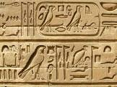
What are Hieroglyphics?
The Egyptians didn’t use letters like we do
They wrote using pictures called hieroglyphics, this applied also to numbers as well as letters.
In Greek:
‘hiero’ means ‘holy’
‘glyphics’ means ‘writings’
so hieroglyphics means holy writings
The Egyptians used Hieroglphics for their numbers too

Slide 4
Maths Hieroglyphics
The Egyptians used a decimal system using 7 different symbols

Slide 5
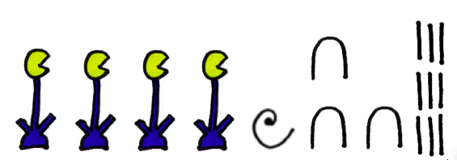
Reading Hieroglyphic Numbers
When writing the symbols the highest number is always written first and the reader starts at the top of the group
= 4139
Here are some examples:
= 102,310

Slide 6
Maths Hieroglyphics
Using the symbols, write down three numbers with values between 1,000 and 10,000,000
Swap your numbers with someone else
Can they tell you the correct values of your numbers?
Can you tell them the correct values of their numbers?

Slide 7
Fractions
Fractions are shown using the following hieroglyphic symbols:
= 2/3
= 1/3
= 1/10
= 3/4
= 1/2
Using these symbols, write down three maths problems that involve fractions

