Slide 1
Notes:
Presentation: Depending on timings, you can complete / use one or all four activities
Action: Add your photograph on Slide 2 & introduce yourself, your job title and organisation and please introduce CIHT.
Activity 1: How could these disruptions and changes affect you, the local transport infrastructure and your travel routine / journey to school? Slides 4 – 8 are the slides you need for this activity. There is an A4 Disruption map and four disruption cards (flood, snow, sinkhole and storm) on each slide. You can print slide 7 to give to the children in pairs. They can cut out the disruption cards or you can download and print them as a separate resource from the STEM Learning website.
Activity 2: Discussion: What transport do we find at different scales? What else needs to be transported? Who is involved in providing our transport and what are their roles? Slides 10 – 15 are the slides required for this activity. Complete the activity by going through the questions and feedback on slide 16.
Activity 3: Discussion: How is global warming predicted to affect the UK’s weather? What challenges does this bring to transport systems? Slides 19 – 25 are the slides needed for this activity. Complete the activity by going through the questions and feedback on slide 26.
Activity 4: Discussion: Who does what? Slides 28 to 38 are needed for this suggested activity. Complete the activity by going through the questions and feedback on slide 39.
Conclusions and How do you become a transport professional? Slides 40 to 41
Optional Activity What Else Needs to be Transported? Slides 42 – 44
So far, we have talked about journeys that people make. But can you think of anything else that needs to be transported? Ask what food they eat, and how do they think food gets from the fields to the shops?

Slide 2
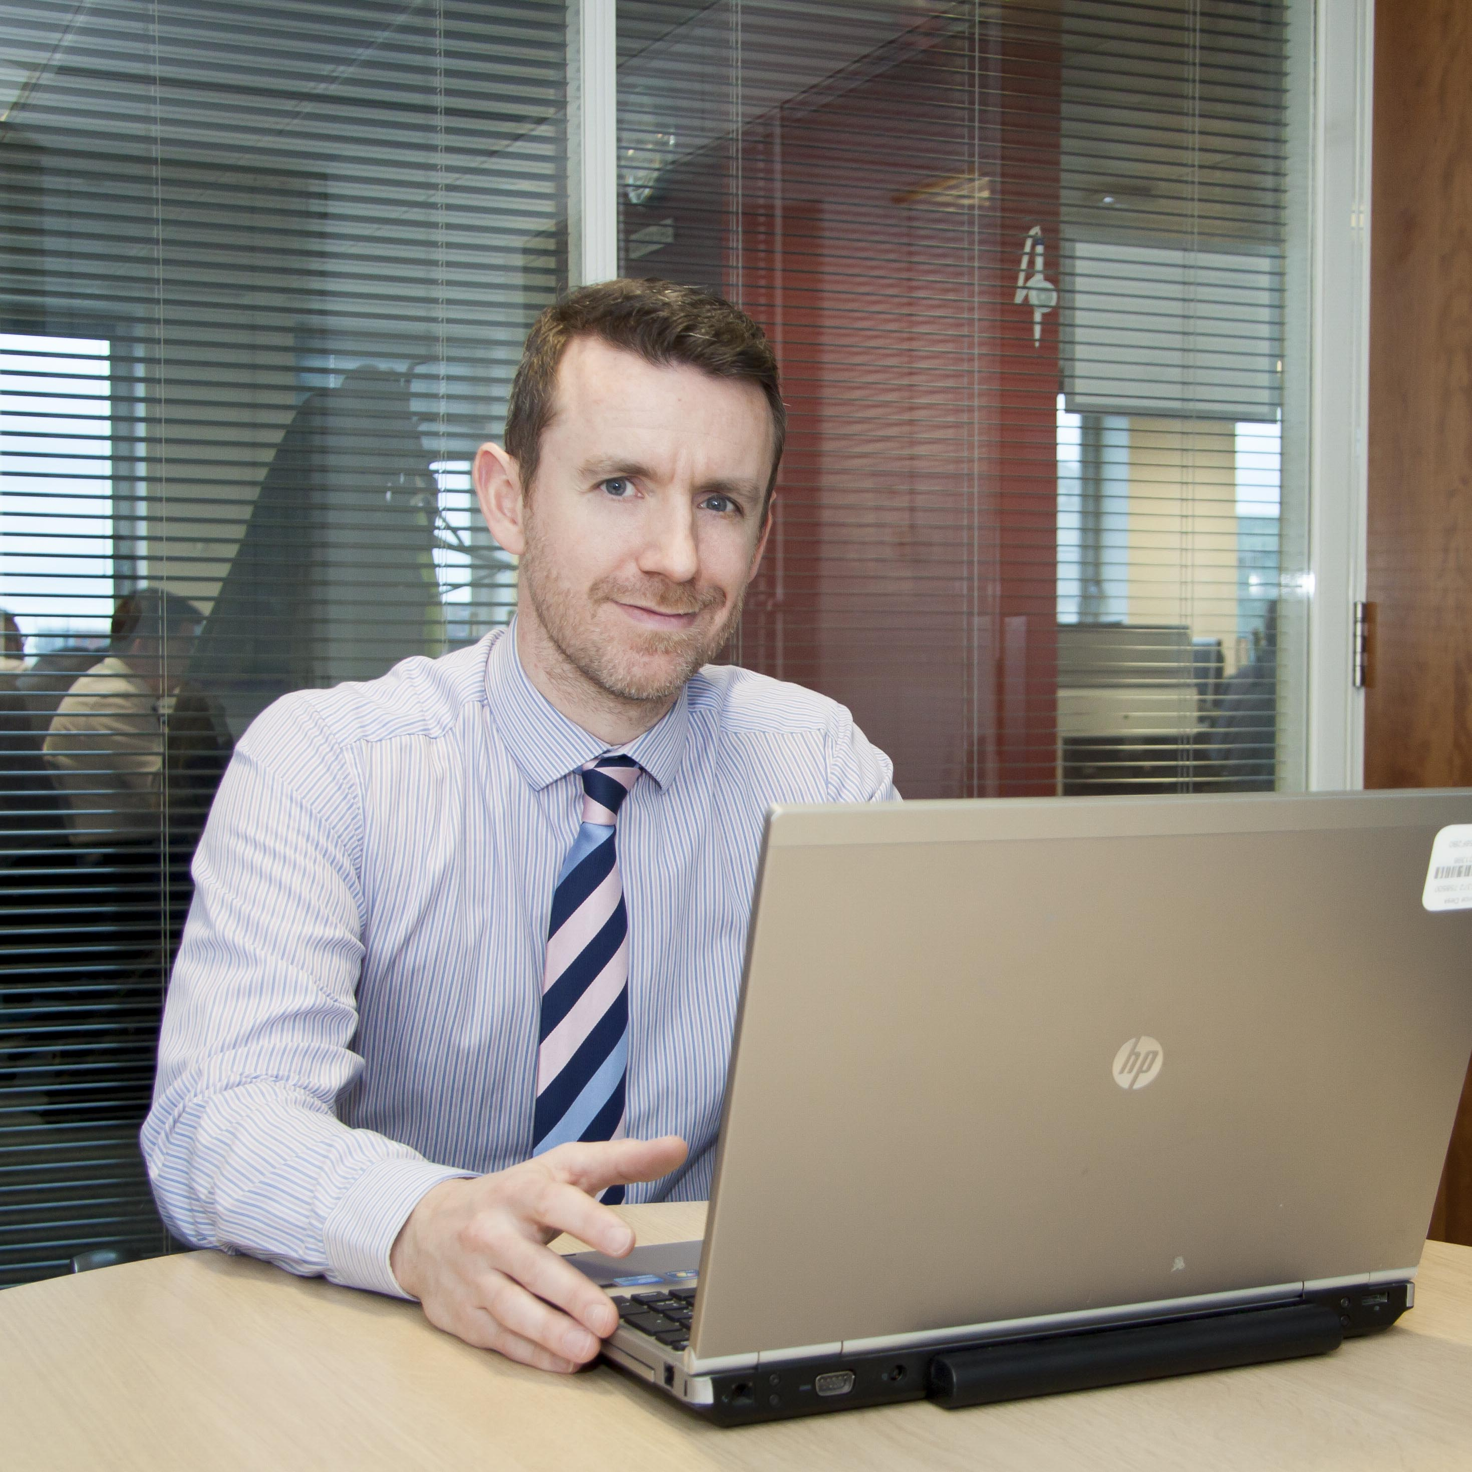
About me & CIHT
Replace with custom image
Insert Name
Insert Job Title
Insert Organisation
Notes:
Slide – About me & CIHT (and inform the children about Transport Infrastructure)
Instructions
Introduce yourself:
Say which organisation you work for.
Mention a couple of the exciting transport-related projects that your organisation is involved with to motivate the audience.
Why they chose to work in transport
Introduce CIHT:
The Chartered Institution of Highways and Transportation (CIHT) is the leading professional body for people who work in the transport industry.
The role of a professional institution is to support and advance a particular profession, the interests of those working in that profession and the public interest.
They work with government, industry, academia and a range of other bodies to represent, promote and support the profession and those working within it.
Whether someone is just starting out in their career or they are an experienced professional, joining a professional institution will help to further their career.
CIHT supports its members’ professional aspirations by providing routes to professional qualifications, networking opportunities and professional development events. CIHT also works to promote the importance of the transport industry to government and to society.

Slide 3
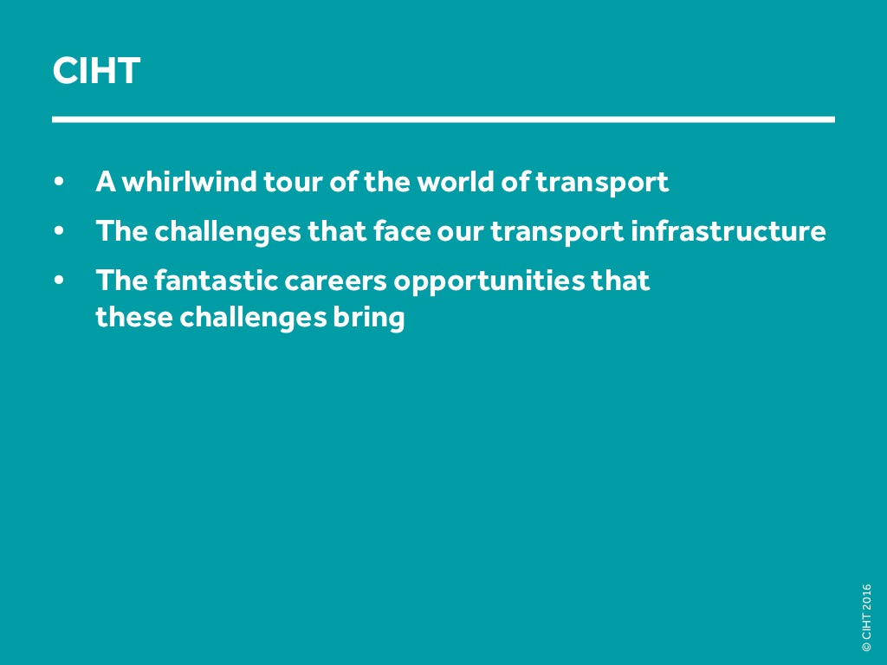
Notes:
Depending on the time you have, you can do one activity, or all of them.
Explain
Over this session, you will be taken on a whirlwind tour of the exciting world of transport infrastructure. We will talk about:
How transport infrastructure joins us together
How we depend on it
The interesting and challenging careers open to you in the transport sector.

Slide 4
Activity 1: Disruption Cards
Discuss: How do certain types of disruption affect transportation infrastructure.
Discuss: How do certain types of disruption affect your journey to school?
Action: As the students to use the disruption cards and the map on the slides 5 – 8, to demonstrate how different types of disruption affect their journey to school
Notes:
Use the cards and the map on the next slides to demonstrate to the students how different types of disruption affect their journey to school. More instructions are in the notes on slide 5

Slide 5
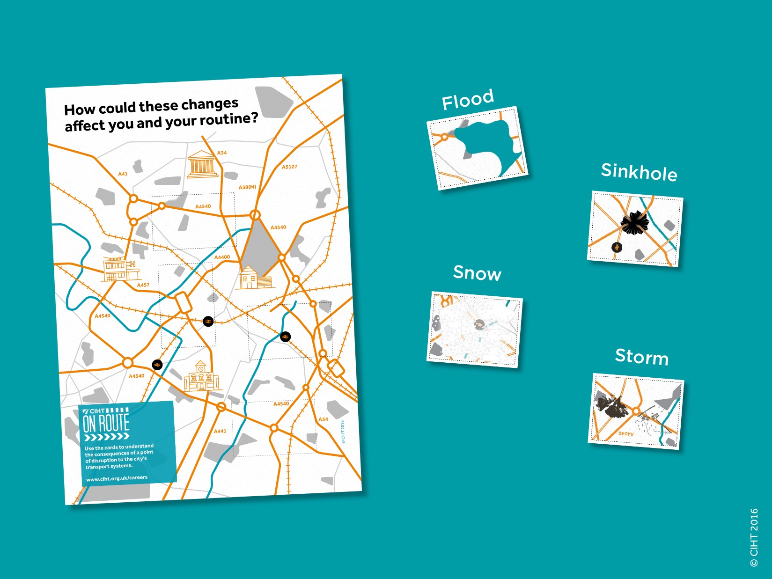
Notes:
Outline
Display on screen the map (slide 6) showing routes between a house and different destinations. Print off a few copies of the map and the disruption cards (slide 7) and hand them to the students. The students will need to cut out the cards from the sheet to use them. The aim of this activity is to get the students thinking about how we all depend upon different modes of transport. Repeat the activity at the end of the lesson, to demonstrate to the students how much more they understand about the highways and transport sector.
Instructions
Put the students in groups and hand out one printed map and four of the disruption cards to each group. There are four unique cards for each map. Ask the students (in groups) to place the disruption cards on the map to show how disruption to the transport infrastructure impacts on journeys.
Explain
Each group has a map in front of you (or on screen).
Point out the key destinations on the map (house, hospital, school and library).
Ask the students to work out what route they would use to get to each of the destinations on the map.
Now tell them to lay down the four disruption cards on the map
Ask for volunteers to say how their journeys to specific destinations were affected, and how could they get to their destinations.
Key points to make:
This exercise begins to show us how we depend on transport infrastructure.
Today we will look at
The different types of transport that exist
The people that design, build and operate our transport networks
The challenges that face our transport infrastructure

Slide 6
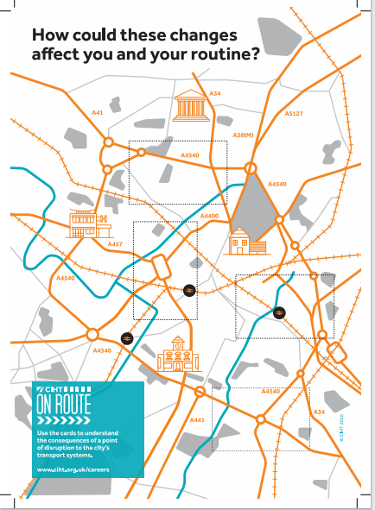
Notes:
Story – starting point and end point!
Print out the destruction map from the STEM activity pack and give one two each two children. Working in teams, they need to decide where the destruction cards go on the map. One at a time, show them the next four slides (which show the destruction cards). Ask the teams to decide which section of the map the destruction cards go.

Slide 7
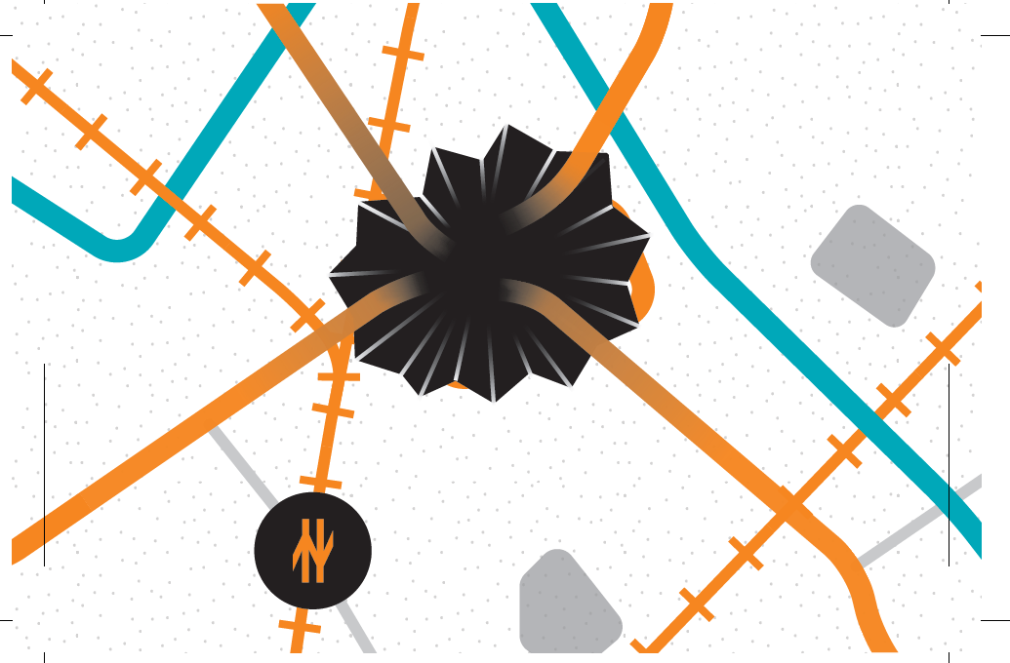
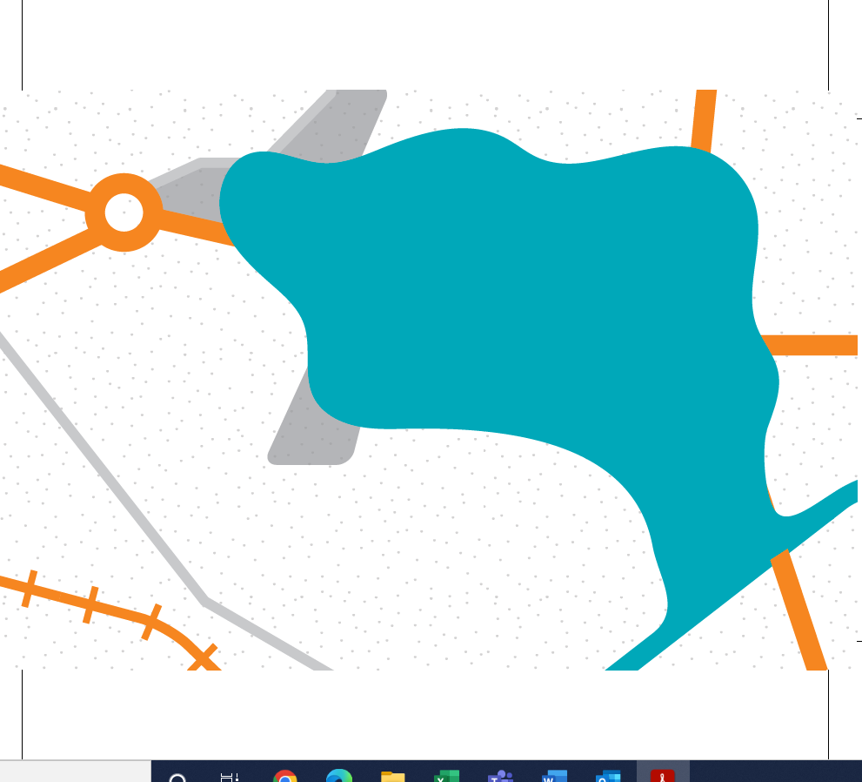
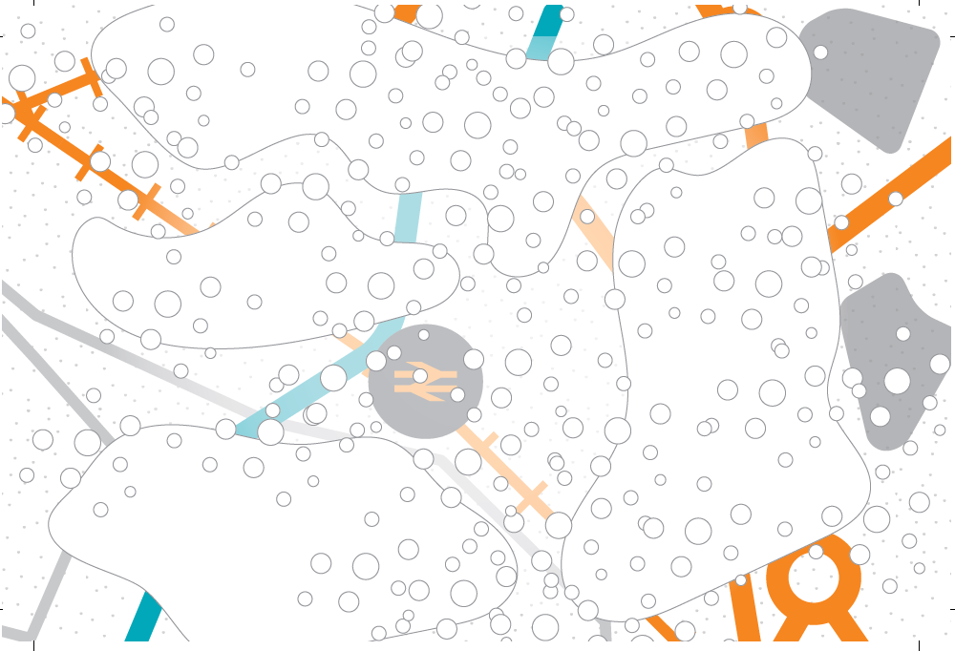
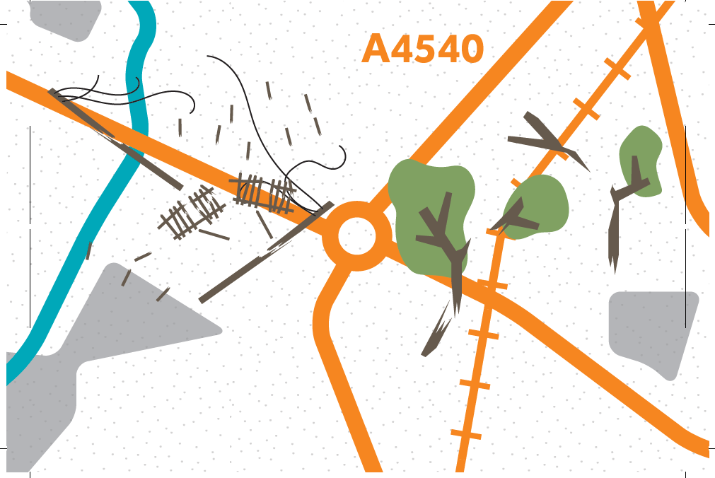
Flooding Card
Sinkhole Card
Snow Card
Storm Card

Slide 8
Activity 1: Summary, Questions & Feedback
Can I have some volunteers to say how their journeys to specific destinations were affected by the disruption cards, and how you could get to your destinations following a different route.
How could you clear or fix the obstruction, what would you do and how would you do it safely with no risk to yourself or the public

Slide 9
Notes:
END SLIDE
Thank you. For more information you can go to CIHT website: www.ciht.org.uk/careers

Slide 10
Activity 2: Discussion
What Transport do we find at different scales?
This activity will make you aware of the different modes of transport that exist and what infrastructure is needed to support them. You will be shown four maps which zoom in on certain points in a city. There are maps of 1km scale, 10km scale, 100 km scale and finally 1000 km scale.
What sorts of journeys do you make at each scale?
Notes:
This is a great opportunity to talk about different types of transport we use, and our dependency on it.

Slide 11
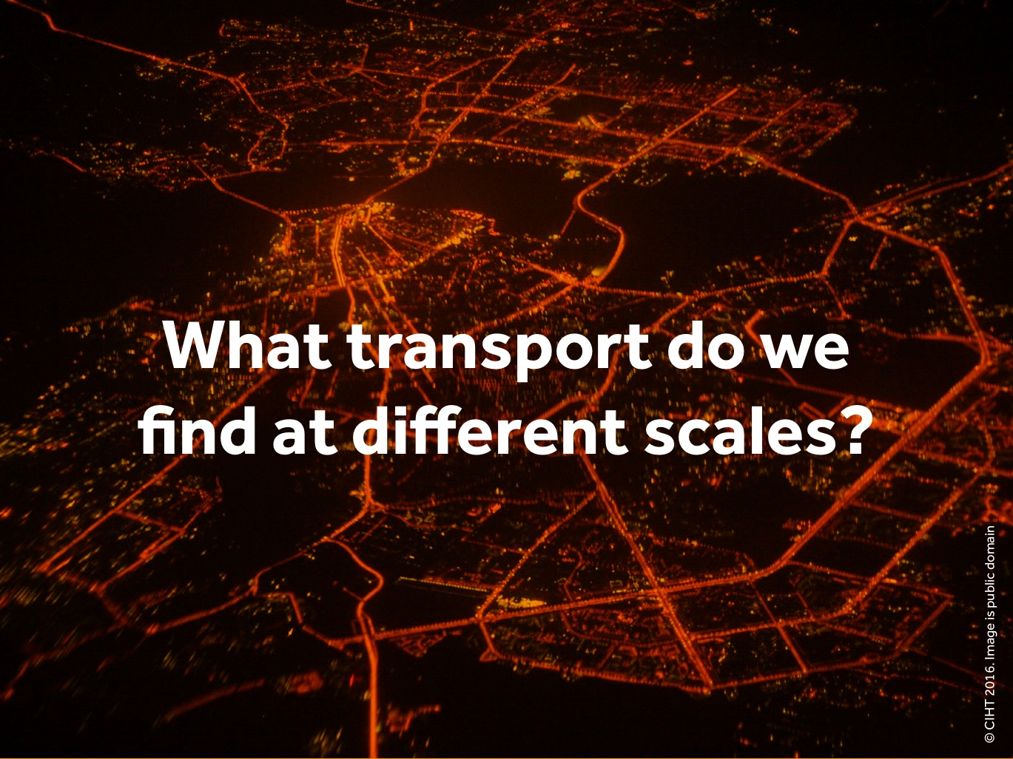
Notes:
Slide – What transport do we find at different scales on a Map?
This part is to make students aware of the different modes of transport that exist, what infrastructure is needed to support them, and what journeys are undertaken at different scales.
Explain:
You have all probably have seen google maps. You can zoom in and zoom out on the area covered.
You begin by showing a map which zooms in on a certain point in a city. This map is of a 1km scale (slide 12). You talk about the sorts of journeys you would make that are 1km long, what modes of transport you could use, and what infrastructure is needed to support transport at that scale.
You then zoom out to a 10km scale map, then 100km scale map, and finally a 1000km scale map. Each scale is an opportunity to talk about different types of transport, and to highlight our dependency on it.

Slide 12
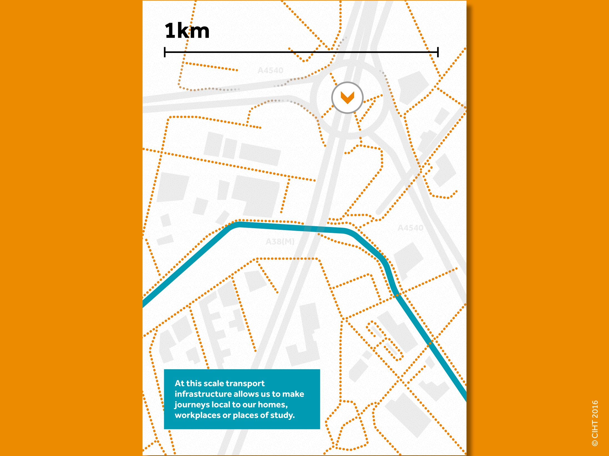
Notes:
Explain
Here we are looking at a 1km-scale map of an urban area.
Point out the arrow marker at the centre of the map.
Ask what sort of journeys you would make that are around 1km long. Suggestions are:
A trip to the shops
Visiting a friend
Walking to school
Talk about what transport infrastructure is and how it is needed to support transport at this scale. Explain that roads are an example of transport infrastructure. Ask them to name different types of transport infrastructure. E.g. Traffic lights, roundabouts etc. Ask them to shout out answers.
Explain that we are now going to zoom out to see more of the city.

Slide 13
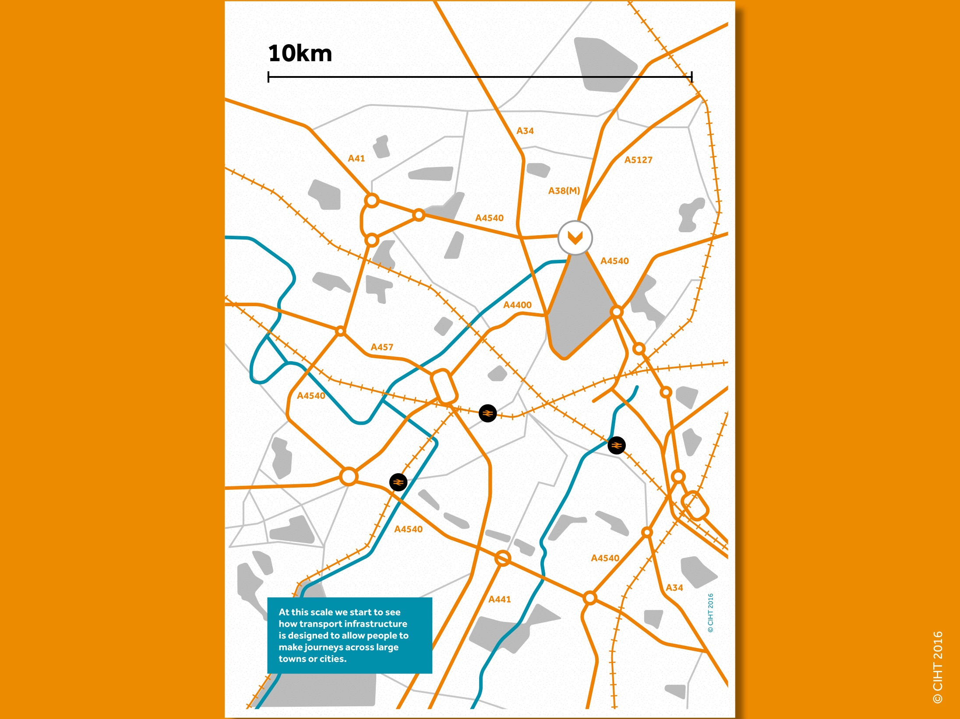
Notes:
Slide – 10km-scale map
Explain
We have now zoomed out. Show the point that marks where we were looking at the previous map. At this scale we can see a whole town, or a large area of a city.
Ask
What sorts of transport infrastructure we can see at this stage?
Major roads
Local rail/Underground lines
Canals/rivers
Ask
What sorts of journeys would you make that are 10km along and what infrastructure would you use?
Examples: Journeys to school, supermarkets, into the centre of the town/city, or to work.
Examples: By car, by train, by bike, by bus, using the infrastructure that we have mentioned.
Ask:
Can you name other types of transport infrastructure that are needed to support transport at this scale?
Now we are going to zoom out even more.

Slide 14
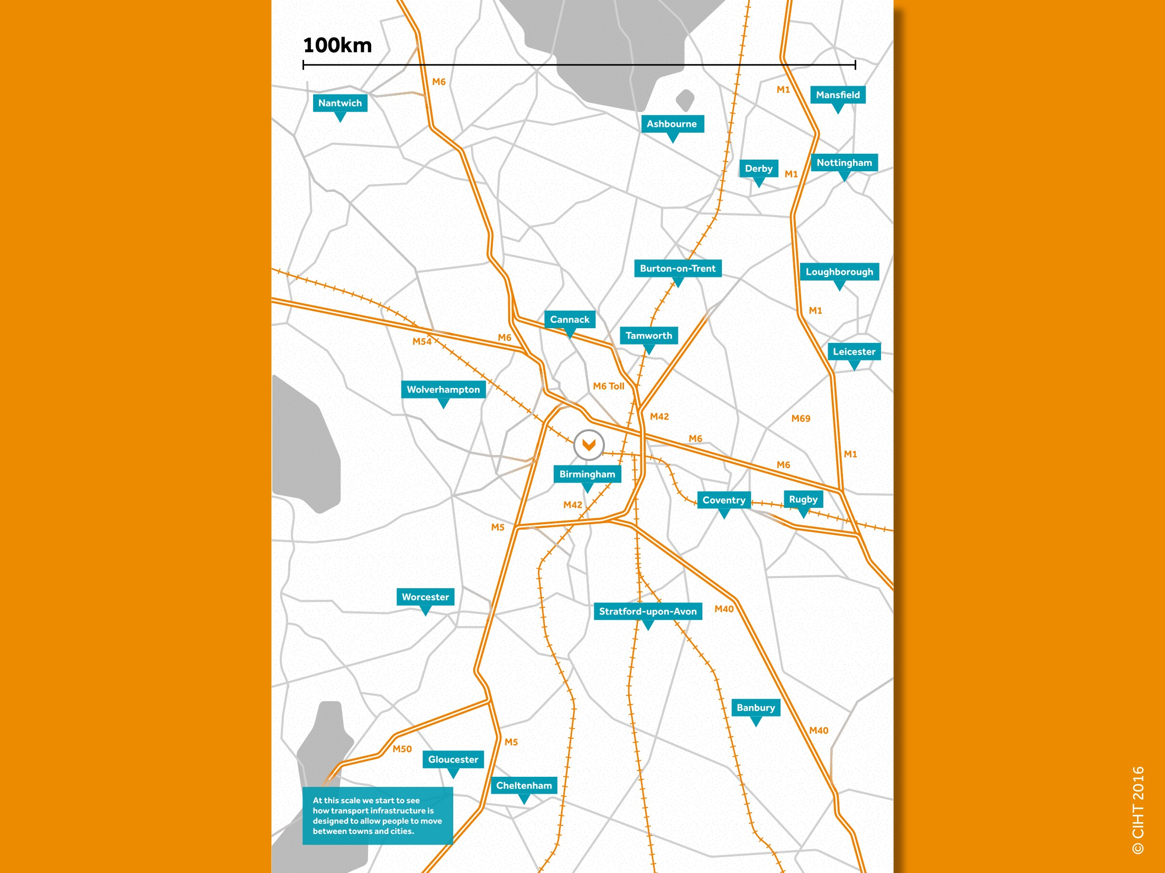
Notes:
Slide – 100km-scale map
Explain
We have now zoomed out even more. We are still centred on the same point as previously. At this scale we can see whole towns and cities.
Ask what sort of transport infrastructure can we see at this scale?
Motorways
Main roads
Long-distance rail
Ask what sorts of journeys you would make which are this long?
Visiting friends/family in other towns and cities.
Day trips.
Holidays.
Point out how at this scale you start to see how we join different types of transport infrastructure together to get to where we want to go. E.g.:
We travel on minor roads that lead to main roads which then take us to the motorway.
We walk to the metro station and travel to the main railway station to get the long-distance train.
We are now going to zoom out one more time.

Slide 15
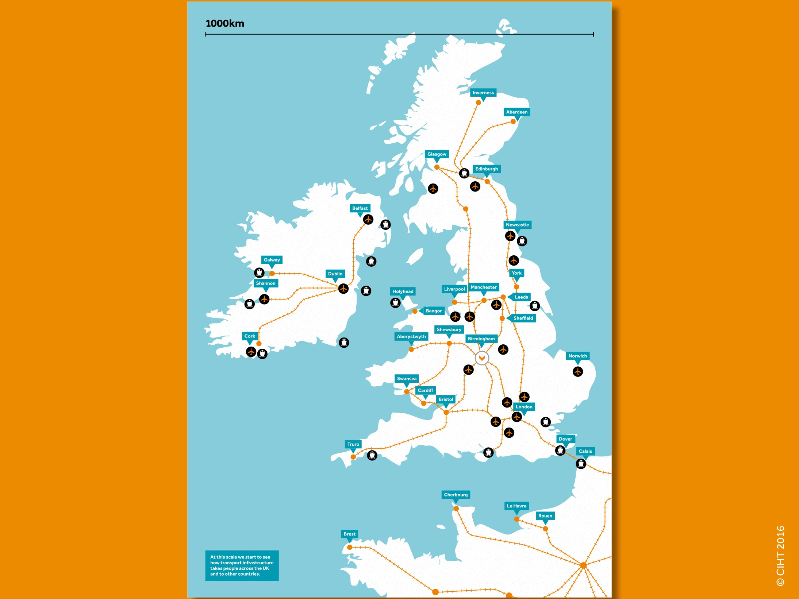
Notes:
Slide – 1000km– scale map
Explain
We have now zoomed out so that we can see 1000km. Again, we are still centred on the same point as before. At this scale we can see the whole country, and some other countries as well.
Ask what sort of infrastructure can we see at this scale?
Long-distance/international rail routes
Airports
Ports
Point out how transport infrastructure can move us right the way across the country, and also to other countries.
Ask:
Have learned something new today?
Shout out... etc. Push them into an answer.

Slide 16
Activity 2 Questions and Feedback
What modes of transport exist?
What sorts of journeys do you make that are 1km long, 10km long, 100km long and a 1000km long?
Talk about different types of transport, and our dependency on it.
Who is involved in providing our transport and what are their roles?
What infrastructure is needed to support our transport at each of these scales?

Slide 17
Notes:
END SLIDE
Thank you. For more information you can go to CIHT website: www.ciht.org.uk/careers

Slide 18
Activity 3
What are the expected impacts of climate change on transport infrastructure?
Let's look at the interesting challenges that people working in highways and transportation face and how they will have to find a way to overcome these challenges.
Doing this will show you the possible roles that you can do in the sector that make positive impacts on communities, peoples quality of life and the economy.

Slide 19
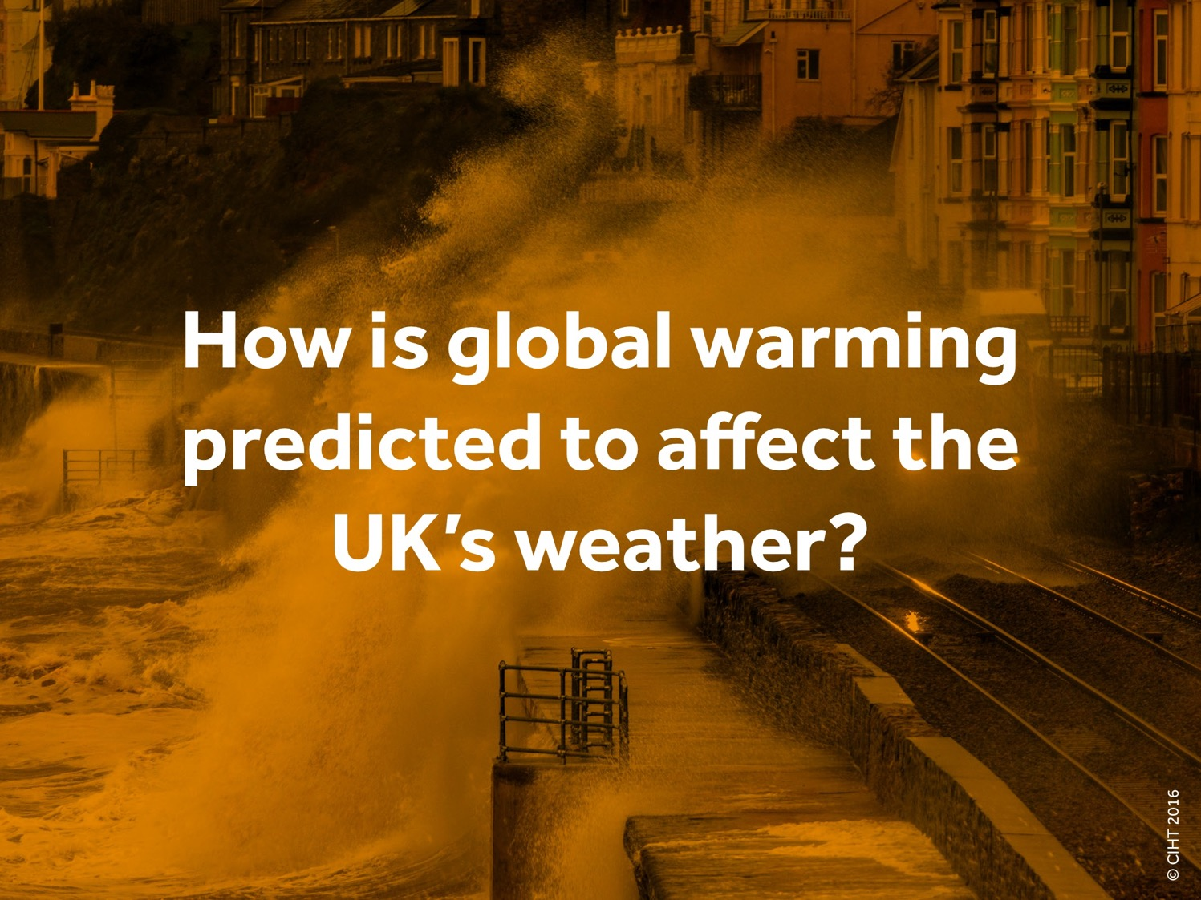
Notes:
Outline
In this part we look at the expected impacts of climate change on transport infrastructure and we look at the interesting challenges that people working in the three roles identified will have to find a way to overcome. Doing this relays possible roles that students may aspire to with positive impacts on communities, quality of life and the economy.
Slide – How is global warming predicted to affect the UK’s weather?
Explain:
A new challenge facing Transport Planners, Transport Engineers and Asset Managers is climate change.
State (or draw out) that in the UK climate change is expected to lead to more extreme weather: increased rainfall, more snow and more prolonged periods of drought.
The impact of this extreme weather is likely to be more flooding inland and from the sea and changing ground conditions.

Slide 20
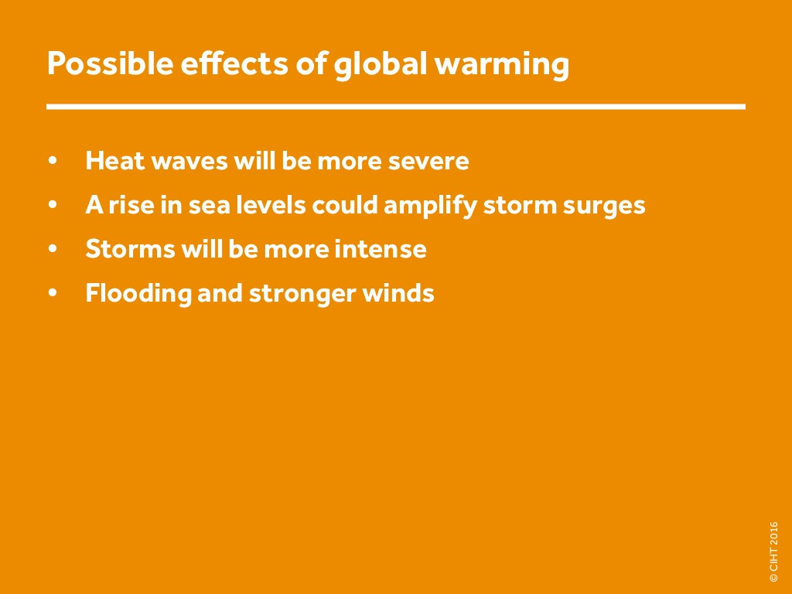
Notes:
Slide – Possible effects of global warming [Answers]

Slide 21
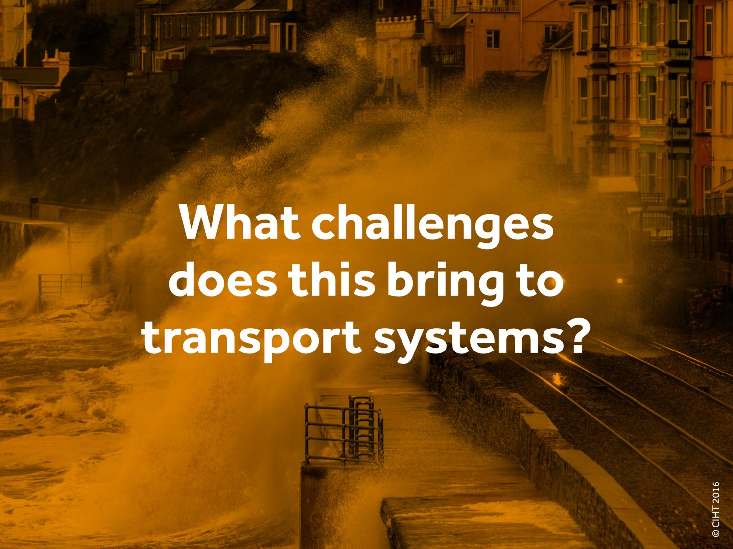
Notes:
Slide – What challenges does climate change bring to transport systems?
Ask – what challenges does climate change bring to transport systems?
Draw out answers then show the following sequence of slides and check that these examples have been mentioned.
Answers on next slide are as follows:
Possible disruption to construction activities
Increased maintenance as pavements soften and expand
Disruption to traffic, weakening of soils that support tunnels, roads etc. due to heavier rainfall
Shortened life expectancy of roads and highways due to extreme snow events
Coastal infrastructure will flood more frequently and possibly permanently

Slide 22
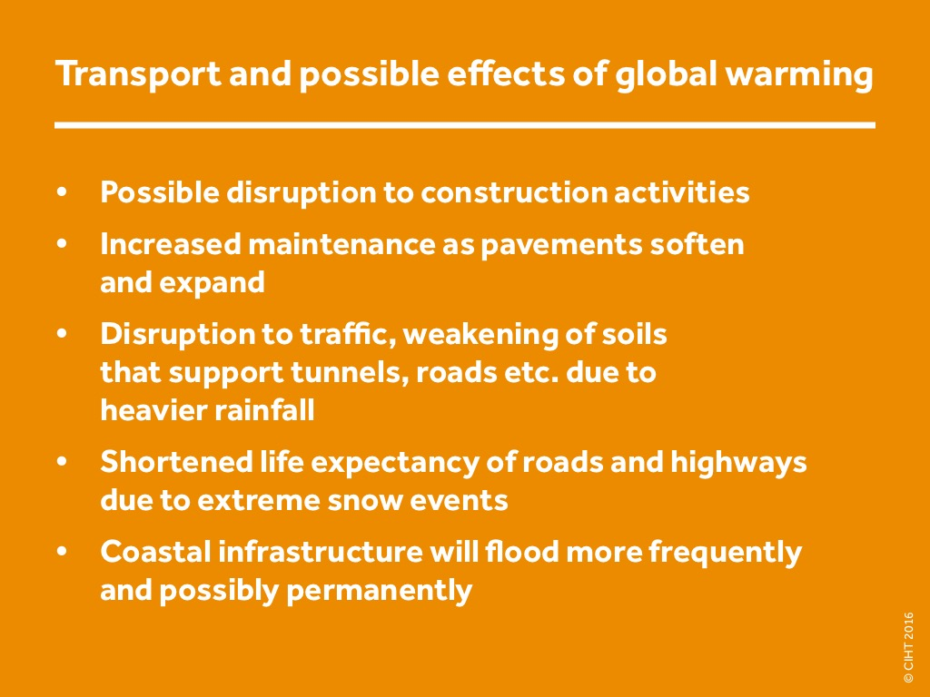
Notes:
Slide – Transport and possible effects of global warming

Slide 23
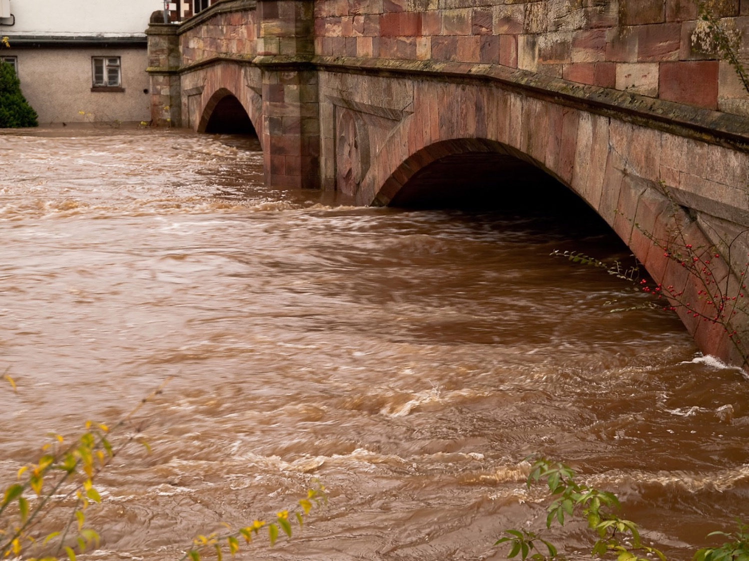
Notes:
Slide – Damage to bridges due to increased rainfall

Slide 24
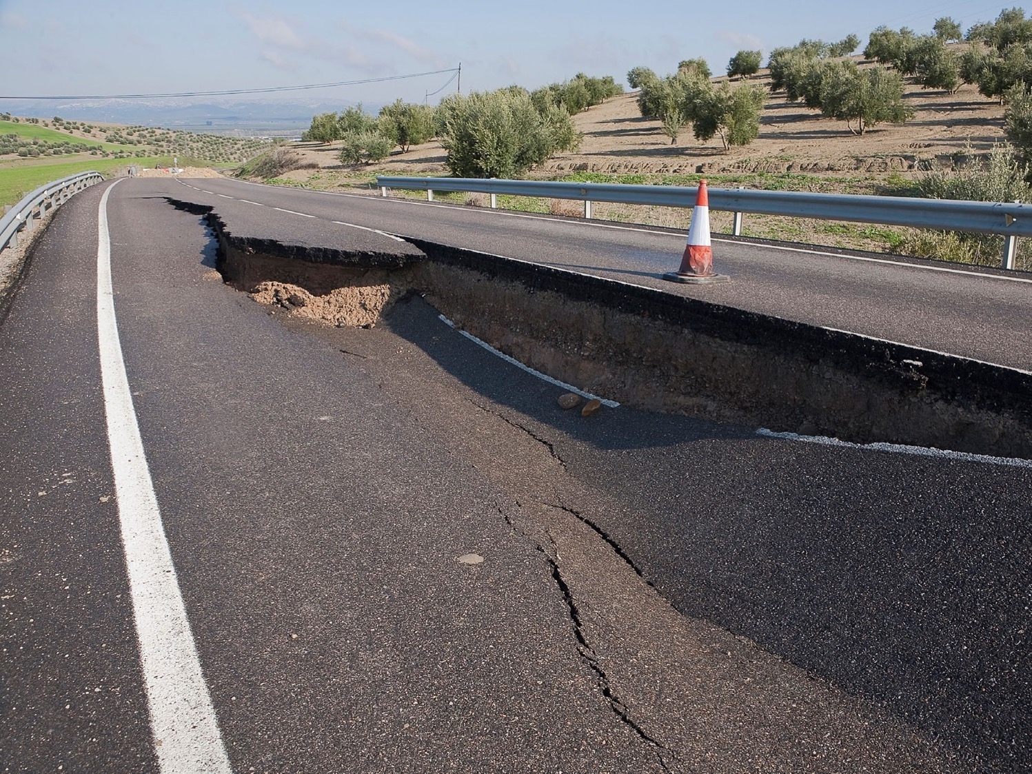
Notes:
Slide – Weakening of soils that support tunnels, roads etc. due to heavier rainfall

Slide 25
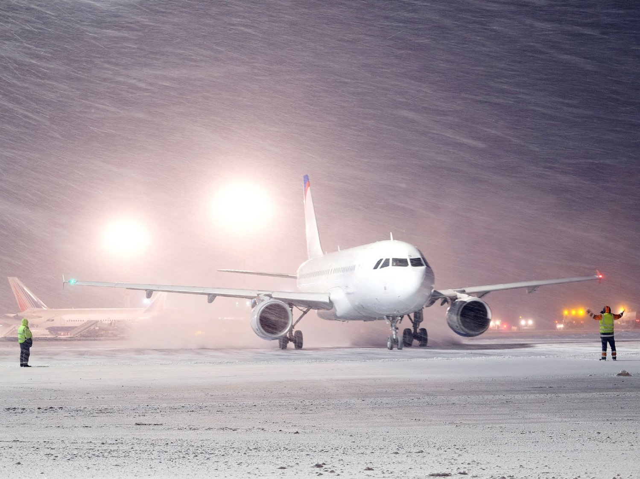
Notes:
Slide – Disruption due to snow

Slide 26
Activity 3 Questions and Feedback
Discuss how could global warming impact on Britain's transportation infrastructure?

Slide 27
Notes:
END SLIDE
Thank you. For more information you can go to CIHT website: www.ciht.org.uk/careers

Slide 28
Activity 4:
Who does what?
This activity focuses on three transport professionals and how these people will need to take climate change into account in their work.
There is a Transport Planner, a Transport Engineer and an Asset Manager. We will start with the Transport Planner.
Notes:
Print off slide 36 and give the sheet to the students in pairs. Use the following slides as prompts for the students to complete the task, joining up the statements on either side, to their job roles in the middle.

Slide 29
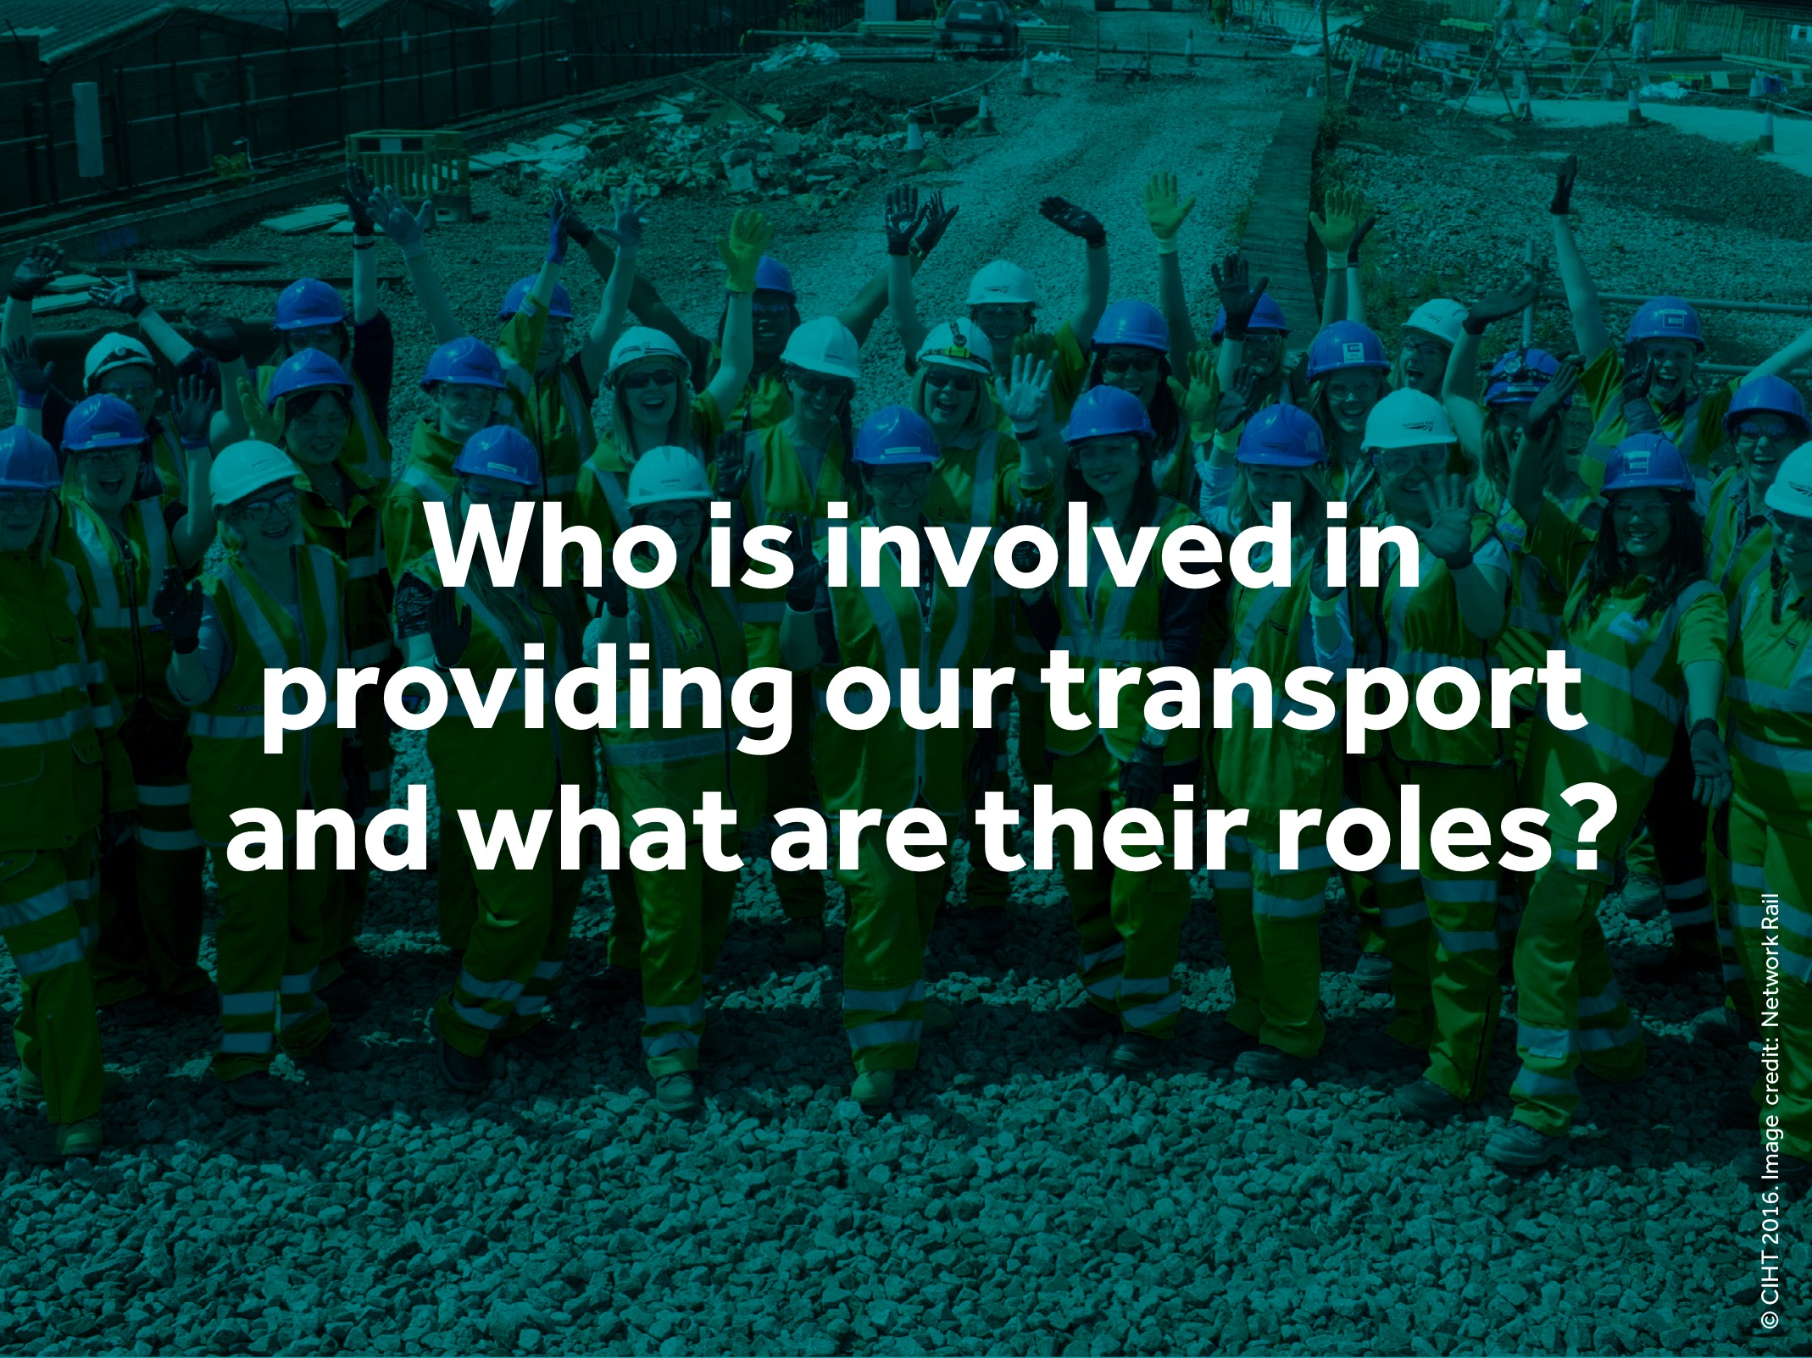
Notes:
Slide – Who is involved in providing our transport and what are their roles?
In this part we introduce key jobs in the transport sector so that students can start to think about the careers that they would like to pursue.
So far we have talked about all the different types of transport infrastructure that exist, and how we use it.
Now we will meet some of the people that are responsible for designing, building and running it.

Slide 30
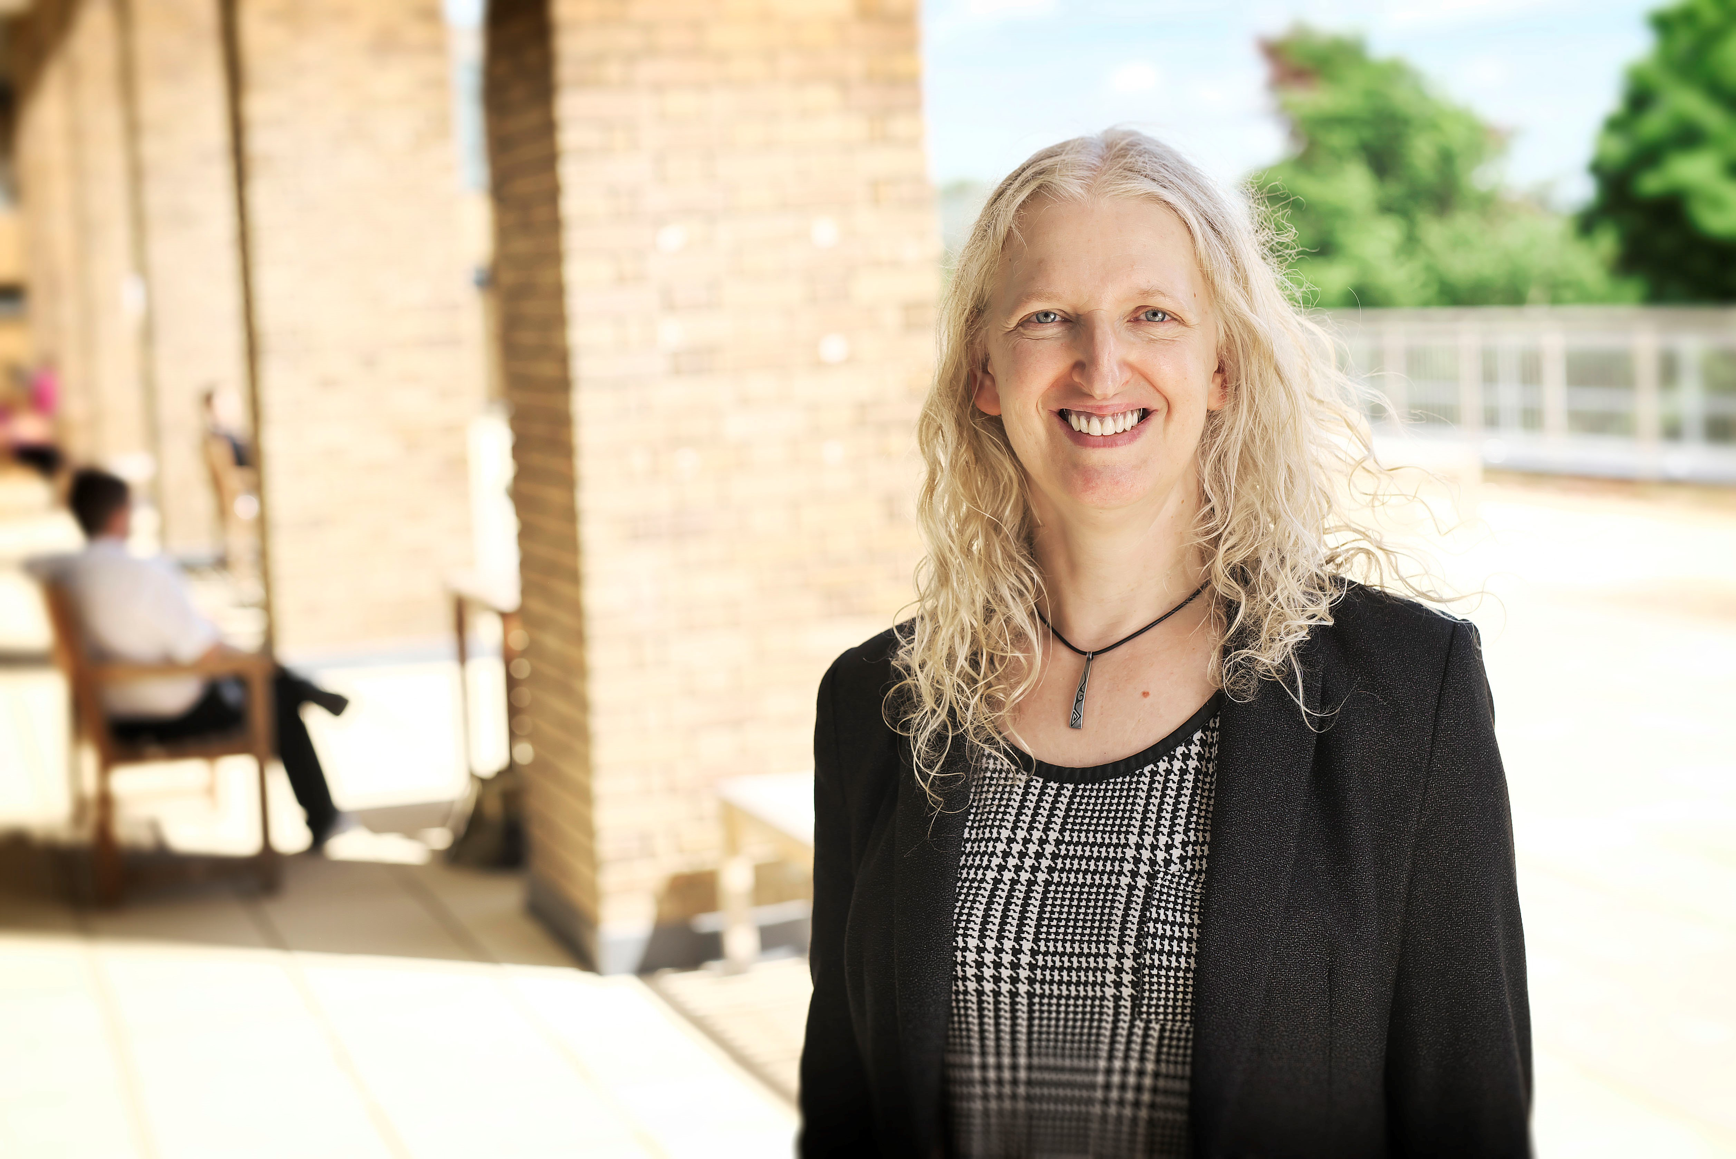
What is a Project Director?
Meet:
Joanna Lyon
Notes:
Ask:
What do you think a Project Director does
Explain
Project Directors lead large teams of people working on major, multi-disciplinary schemes and nationally significant infrastructure projects.
They help clients with the challenges they face in terms of transport and highways and develop options / solutions
They help secure funding where appropriate to enable them to put in place schemes which will be there for decades to come.

Slide 31
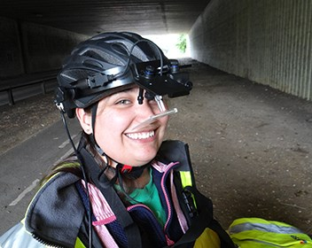
What is a Head of Lighting?
Meet:
Kim Bartlett
Notes:
Ask:
What do you think a Head of Lighting is?
Explain:
A Head of Lighting works on lighting assessment and design for all facets of the built environment.
Projects span highways and transportation hubs, amenity areas, ports, warehousing, buildings (inside and out), Dark Sky Parks, and everything in between.
Supports a team of designers in their work and development and search for new and exciting projects to get involved in

Slide 32

What is a Network Impact Manager
Meet:
Amelia Williamson
Notes:
Ask:
What do you think a Network Impact Manager?
Explain:
A Network Impact Manager, manages and mitigates the impact of projects on the Road Network
They examine the impacts on projects on Bus network operations
They analyze, understand and report back on the impact of projects to invested stakeholders

Slide 33
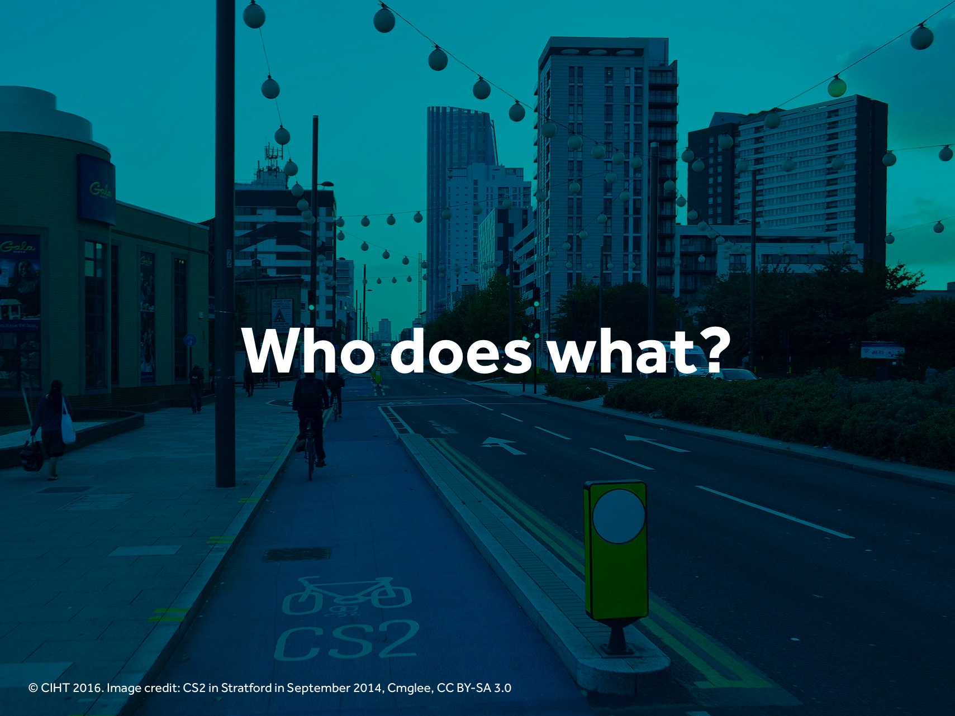
Notes:
Slide – Who does What?
Explain
This activity focusses on three highways and transport professionals. There is a Project Director, a Head of Lighting and Network Impact Manager
Ask
How will these people be able to take climate change into account in their work.

Slide 34
Who does what?
Join the relevant statements to the job roles below and see if you understand how these roles in the Highways and Transportation sector can positively impact climate change
Project Director
Predict demands on climate change on transport infrastructure and planning for future needs
Lead teams of people working on major, multi-disciplinary schemes and infrastructure projects, developing solutions to climate change.
Secure funding where appropriate.
Design roads, railway and other transport infrastructure, while planning for future needs
Head of Lighting
Create lighting assessments and designs for all facets of the built environment.
Supports teams of designers in their work and development of products that positively impacts climate change
Work out how transport infrastructure needs to be maintained differently to consider weather conditions
Network Impact Manager
Mitigates impact of projects on the Road, rail and bus Networks and their operations. Analyze, understand and report back on the impact to the environment to invested stakeholders
Notes:
Ask the participants to work out which statement belongs to which job title and which other statement on the opposite side of the page

Slide 35
Project Director
Joanna Lyon
Notes:
Ask:
How might a Project Director like Joanna Lyon, take climate change into account in her work?
Example;
Social Considerations
Environmental implications
Decarbonization
Path to present:
Joanna took a 4-year Master’s degree course in Engineering Science at Oxford University, where she learned about all types of engineering: civil, mechanical, electrical, thermodynamics, fluid mechanics, computing and material science. Her studies enables her to discover what she didn’t enjoy, as well as those areas of engineering that she liked the most.

Slide 36
Head of Lighting
Kim Bartlett
Notes:
Ask:
How might a Head of Lighting like Kim Bartlett, take climate change into account in her work?
Example;
Social Considerations
Environmental implications
Decarbonization
Path to present:
Kim did a Level 3 apprenticeship studying Electrical and Electronic Engineering on day release. Working and learning was the best option for me and she is sure that she would probably not be as successful as she is today, without having the benefit of applying her learning on the job and cementing the knowledge. She continued studying through day release right the way through to the completion of her HND.

Slide 37
Network Impact Manager
Amelia Williamson
Notes:
Ask:
How might a Network Impact Manager like Amelia Williamson, take climate change into account in her work?
Example;
Social Considerations
Environmental implications
Decarbonization
Path to present:
Amelia became a level 3 Apprentice Transport Planner in the Highways and Transportation sector which is linked to the Engineering Technician professional qualification and requires the completion of a BTEC, Amelia chose this career because she wanted to have a career where she could make a difference in the real world and see the direct result of her work benefitting others.

Slide 38
Who does what?
Join the relevant statements to the job roles below and see if you understand how these roles in the Highways and Transportation sector can positively impact climate change
Project Director
Create lighting assessments and designs for all facets of the built environment.
Supports teams of designers in their work and development of products that positively impacts climate change
Predict demands and develop transport infrastructure solutions on climate change while planning for future needs
Monitor the impact on roads, railway and other transport infrastructure, while planning for future needs
Head of Lighting
Mitigates impact of projects on roads, rail and bus networks and their operations. Analyze, understand and report back to invested stakeholders on the impact to the environment
Work out how designs and development of transport infrastructure need to be maintained differently to consider weather conditions
Network Impact Manager
Lead teams of people working on major, multi-disciplinary schemes and infrastructure projects, developing solutions to climate change.
Secure funding where appropriate.
Notes:
Example:
This slide demonstrates which statement belong to which job role and which other statement.
Your participants may select different statements belongs to job titles etc,

Slide 39
Activity 4 Questions and Feedback
What does a Transport Planner do
What does a Transport Engineer do?
What does an Asset Manager do?
Who is involved in providing what service to our transport and what are their roles?
What infrastructure is needed to support these three transport professionals so they can take climate change into account in their work?

Slide 40
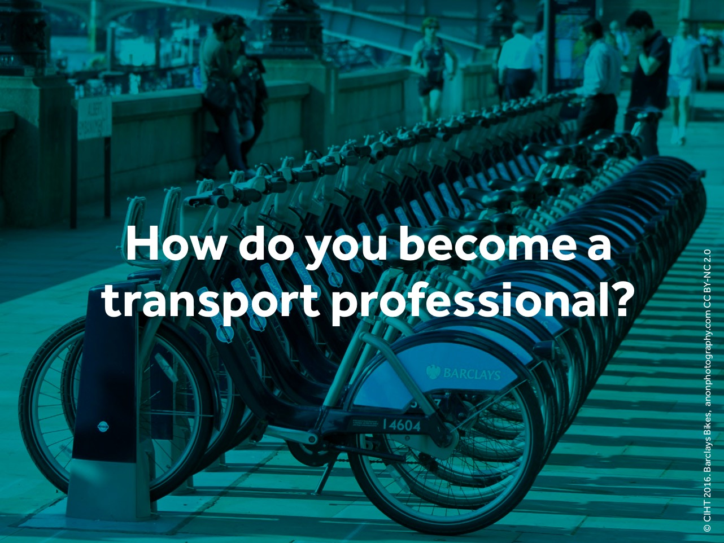
Notes:
Slide – How do you become a transport professional?
Ask, how do you think you can become a transport professional?
Study hard – Maths, English, Geography and Science are all important.
You can then train via an apprenticeship route, working for one of the large or small organisations that design, build, operate and maintain our transport infrastructure.
Or you can apply to study at universities subjects like Civil Engineering to be an Infrastructure Engineer or Geography to be a Transport Planner.

Slide 41

Notes:
Slide - Conclusions
Explain:
Today we have looked at the many different types of transport infrastructure that exist.
We have looked at how we are dependent on transport infrastructure in lots of different ways.
We have talked about three different types of transport professionals.

Slide 42
Optional Activity
STEM is filled with enjoyable subjects. Ask the students to draw, on a piece of paper, two local landmarks that they are very familiar with and then draw the route from one landmark to another.
Now they are more familiar with transport infrastructure, ask them to draw what transport infrastructure they see along the way from one landmark to another. Ask them who they think put that infrastructure there, who maintains it and what you seen when you take that journey that's caused disruption.

Slide 43
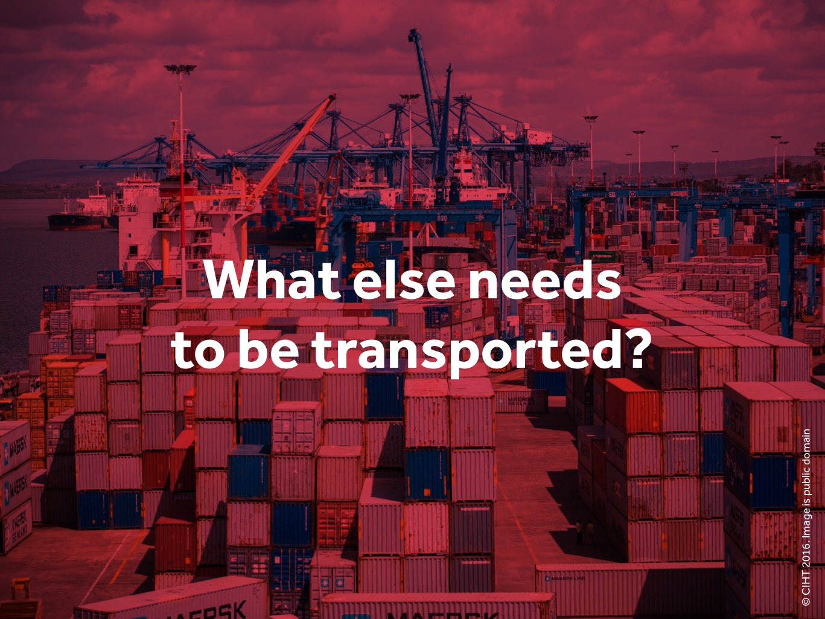
Notes:
Slide – What else needs to be transported?
Explain
So far, we have talked about journeys that people make. But can you think of anything else that needs to be transported? Ask what food they eat, and how do they think food gets from the fields to the shops? Try to draw out the following answers:
Food
Fuel (coal, oil etc.)
Construction materials
Things we buy online
Medical supplies.
Key point – transport systems are fundamental to our economy!
Ask:
How many of your parents buy something from Amazon next day delivery. Point out that online next-day delivery only works if parts of the transport network work together.

Slide 44
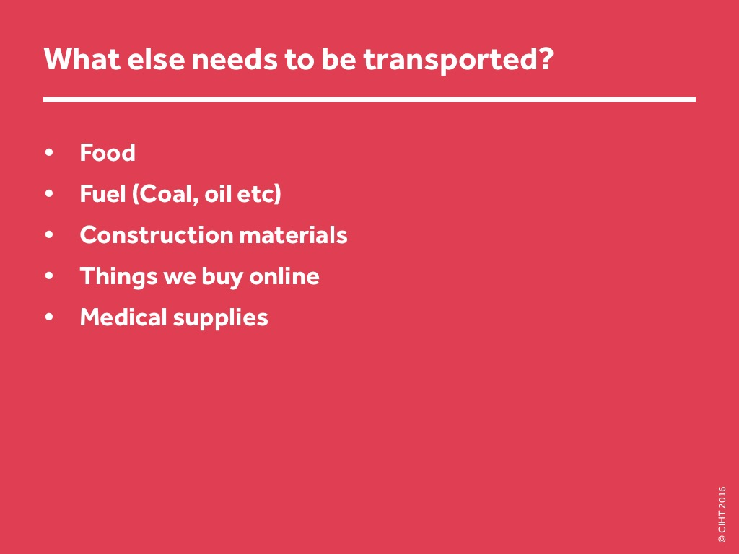
Notes:
Slide – What else needs to be transported? [suggested answers]

Slide 45
Notes:
END SLIDE
Thank you. For more information you can go to CIHT website: www.ciht.org.uk/careers

