Slide 1
Notes:
Instructions: KS1 STEM Education Pack - Ages 5 – 7.
The activities contained within this education pack are aimed at children aged 5 – 7 years of age, so please pitch the information within appropriately.
Depending on how much time you have, you can deliver one of the below activities, or all four of them. There is no time limit for each activity, but they are designed to last around 30 minutes each. The length of time each activity takes to complete, greatly depends on the engagement you receive.
Title Slide – If possible, have this displayed when students walk into the room.
Action: Add your photograph to Slide 2 & introduce yourself, your job title and organisation. Please also introduce CIHT.
Activity 1: How did you get to school today?
Slides 3 – 22 are transport cards showing the different types of transport available. You can have some fun with the students and show them all the ways they could get to school. More instructions on how to deliver this activity are on slide 4.
Activity 2: Getting from A to B.
In this exercise, please get three student volunteers to navigate their way across the room you are in, while trying to avoid each other. It is an opportunity to talk about the work that Transport Planners and Engineers do to design safe road networks. Instructions on how to deliver activity 2, are on slide 25
Activity 3: As a follow up to activity 2, print and use the Stick on Map and Cut-out Sheet Activity on Slides 29 to 31. The pupils will need to cut out the shapes on the cut-out sheet and place them on the Stick-on map where they think they need to go. The idea is that they stick down the shapes in the correct position on the map and then you can discuss the types of engineers and transport planners who would be involved in building, maintaining and terraforming.
Activity 4: Fun Facts
Use Slides 33 to 37 to discuss and inform the children with some fun facts & finally ask what do you think is the best thing about working in transport?

Slide 2



THIS IS ME: I am a STEM Ambassador
Me:
My Company:
My Journey: How I got here
My Day: What I do at work and how that helps others
My Skills: What skills I need to be good at what I do
Notes:
Slide – About Me & CIHT
This first part is a chance to introduce yourself and to capture the attention of your audience. Please introduce yourself, say which organisation you work for and mention a couple of the exciting transport-related projects that your organisation is involved with to motivate the audience.
Introduce CIHT:
The Chartered Institution of Highways and Transportation (CIHT) is the leading professional body for people who work in the transport industry.
The role of a professional institution is to support and advance a particular profession, the interests of those working in that profession and the public interest.
CIHT members plan, design, build, operate and maintain best-in-class transport systems and infrastructure.
The Institution supports its members’ professional aspirations by providing routes to professional qualifications, opportunities to strengthen their professional network and meet interesting people, and access to excellent professional development events.
CIHT also works to promote the importance of the transportation industry to government and to society.
CIHT’s knowledge and understanding of the highways and transportation makes it a clear choice for those working in the industry.
Membership of CIHT is FREE for students studying a relevant course.
If you want to know more about how the Institution has helped to further the careers of its members, search ‘CIHT journeys’ online.

Slide 3
Activity 1 – How did you get to school today
Let's have some fun by looking at all the ways you could get to school.
Some of these you know, some of them you might not know, and others are just plain silly.
Discuss how you get to school and how you would like to get to school.

Slide 4
Notes:
This first exercise is to get the students thinking about all the different types of transport they use, or they could use. You can get them to focus the conversation by discussing the various types of transport available and engaging them by asking questions. Use the flash cards in slides 5 through 22 to get the conversation going.
Instructions
Explain:
First of all I want to find out about how you travelled to school today. There are lots of ways that you can travel to school. Show the first three slides (slides 5 to 7) and ask for a show of hands who came to school by bus, who walked and who came by car
There are many other different ways to travel, I am now going to show you some slides with pictures of the different ways that you can travel
Take a look at the first one (slide 8) and put your hands up if you recognise the picture. Hands up if you have ever used this form of transport before? Anyone know what it is? How would these be used on the road.
Show the rest of the cards and ask the same questions. Explain that they can now see there are lots of different types of transport. How would you want to travel to school? Would you fly if you could?!

Slide 5
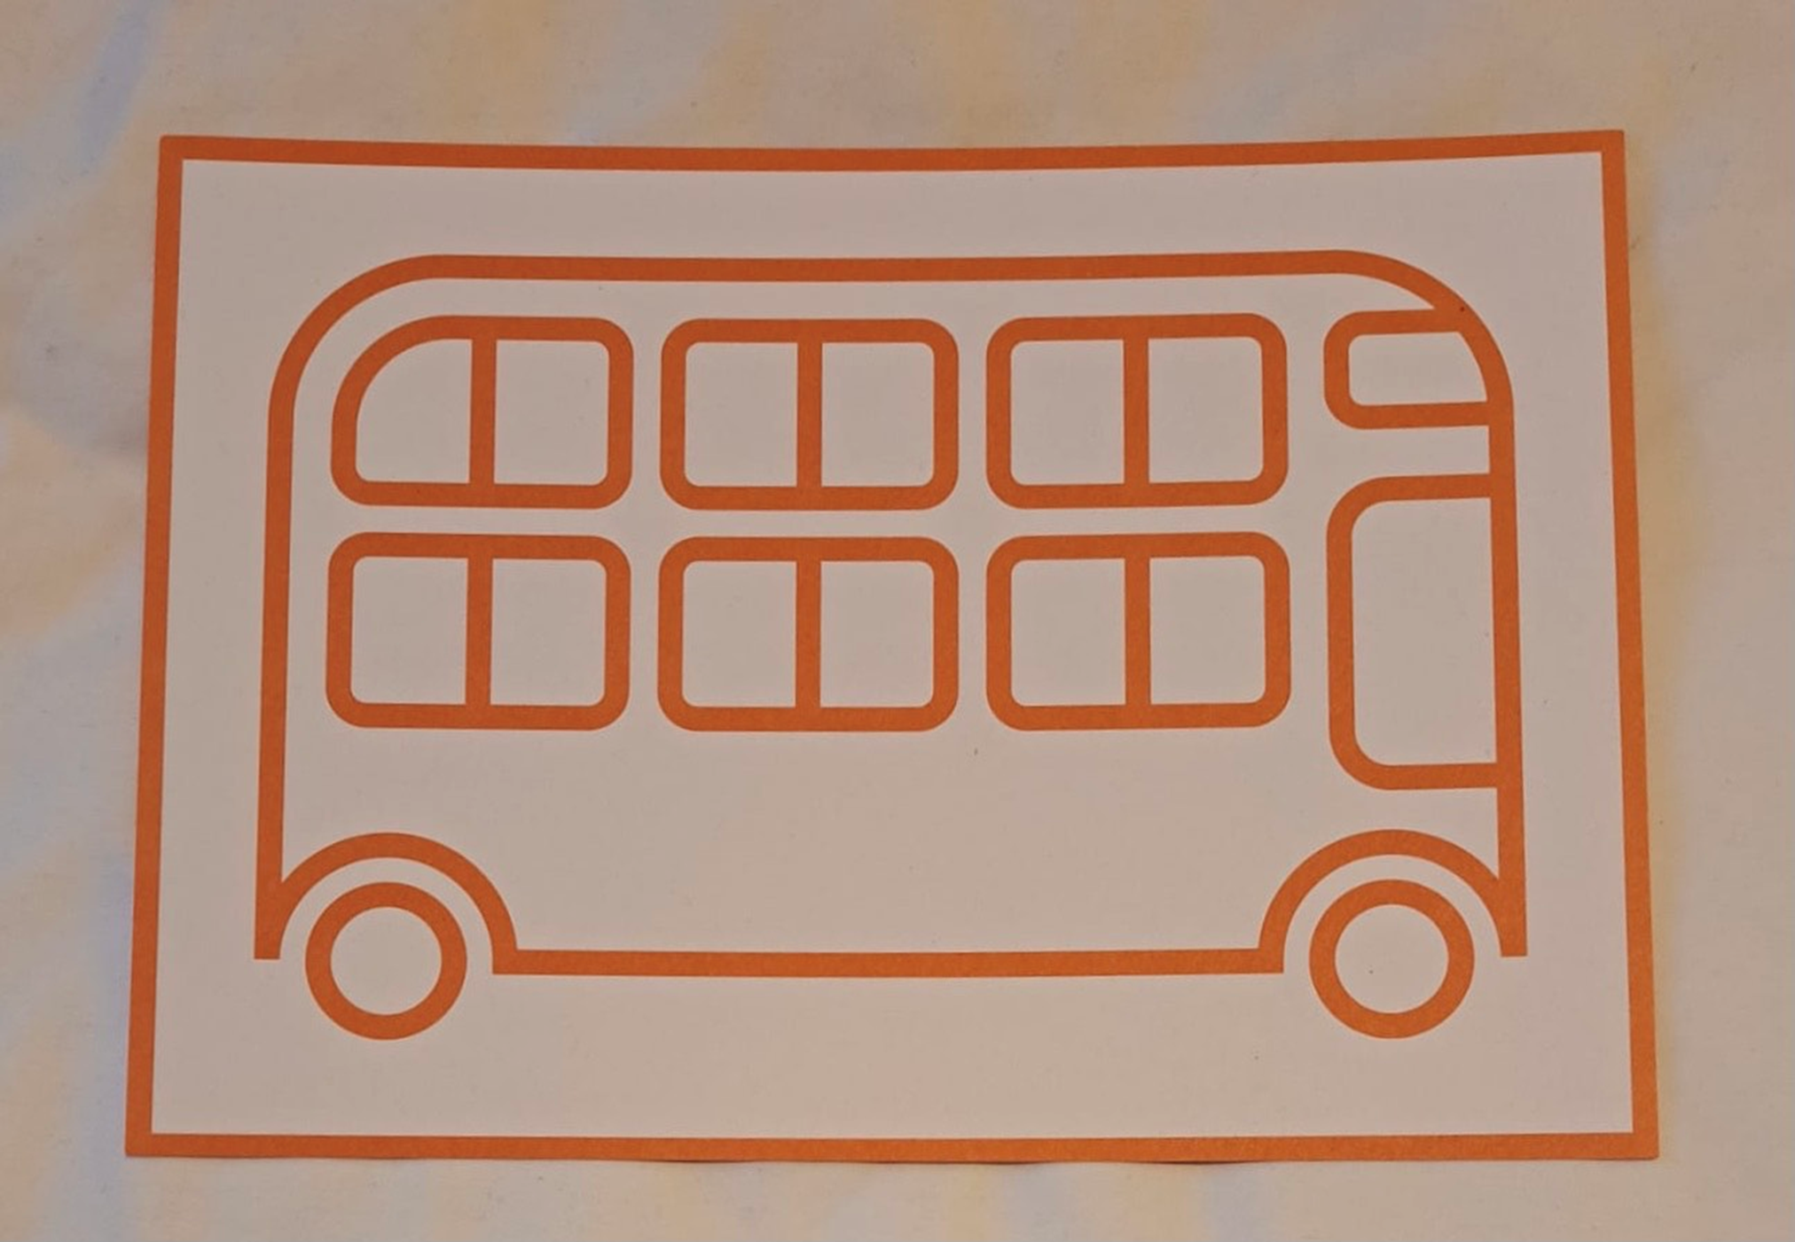

Slide 6
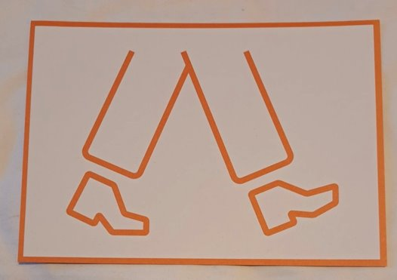

Slide 7
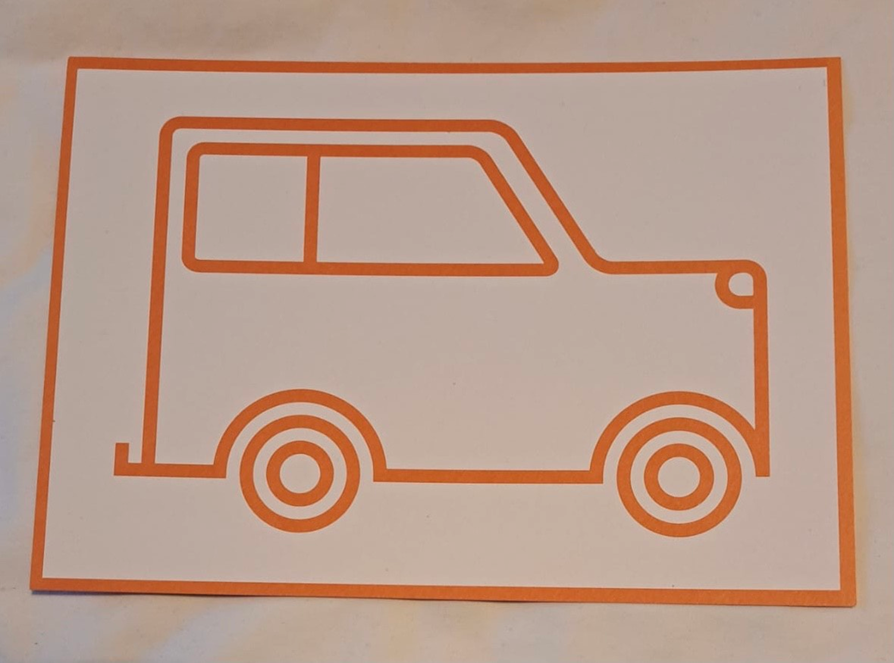

Slide 8
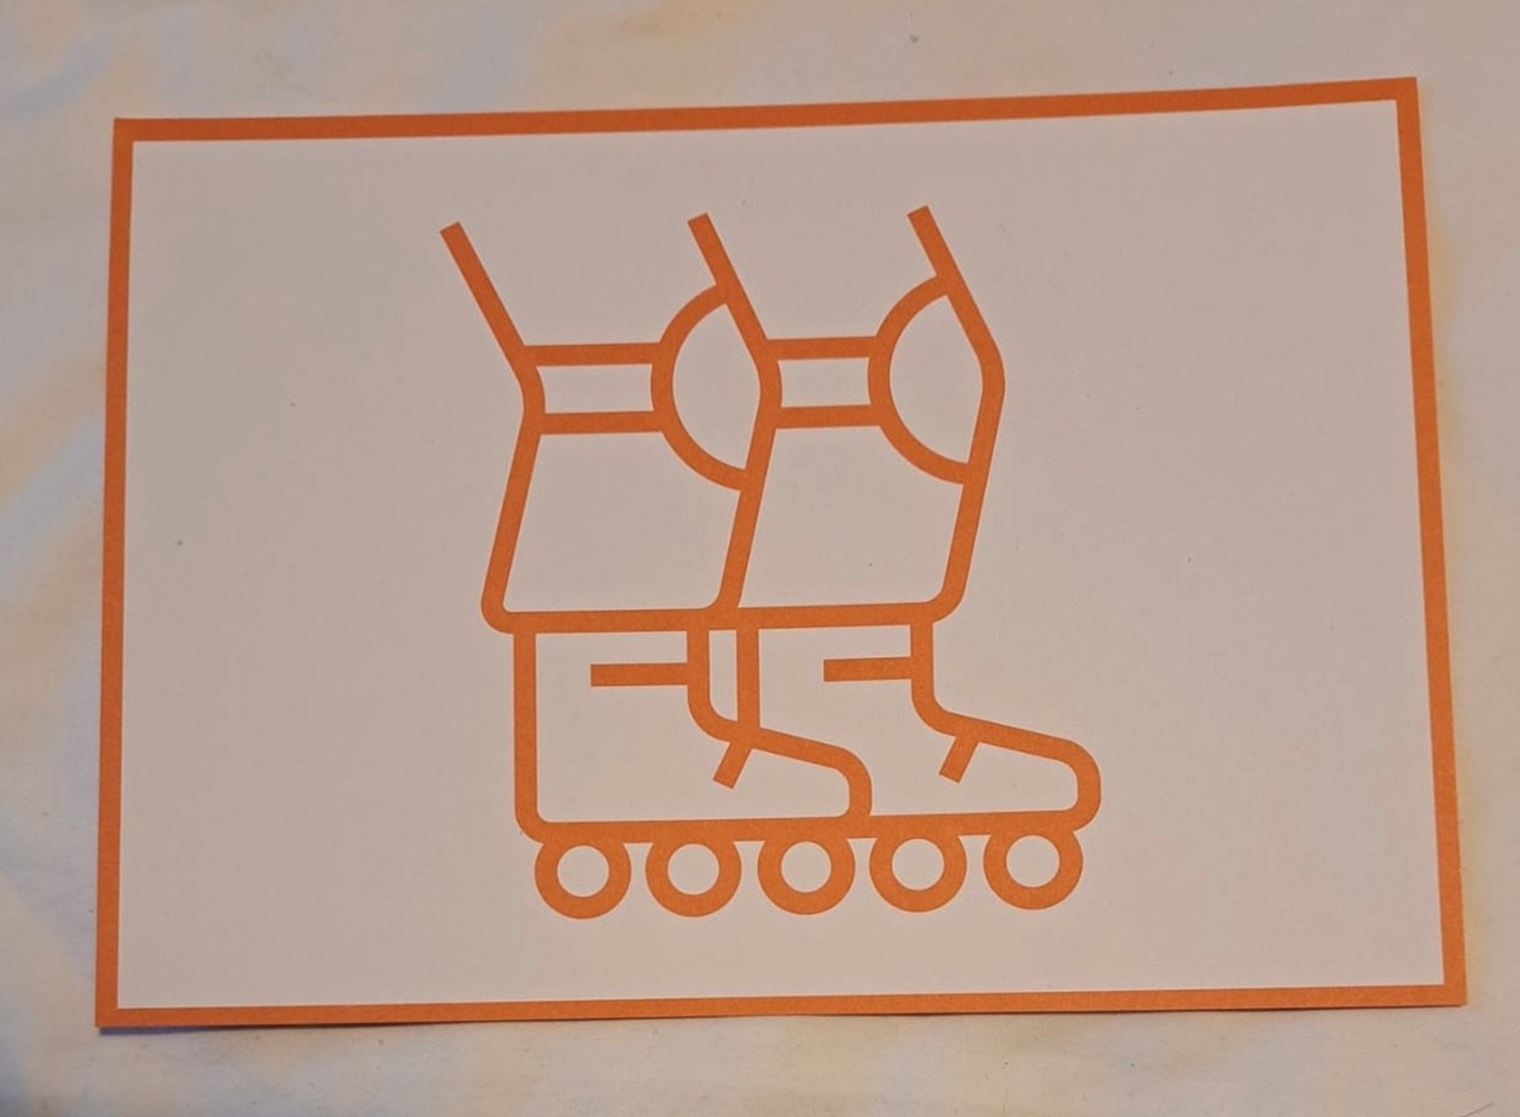
Notes:
Skating

Slide 9
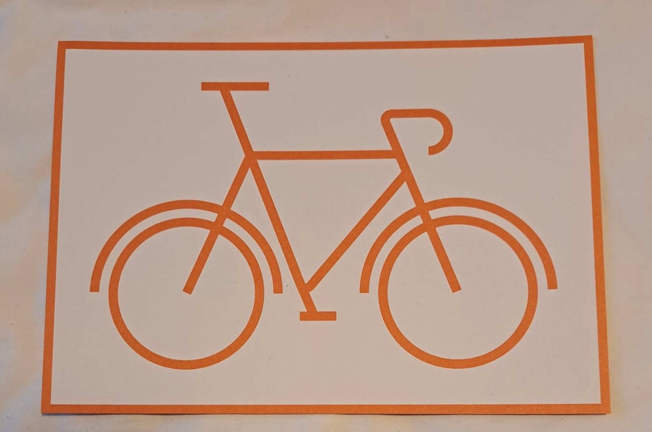

Slide 10
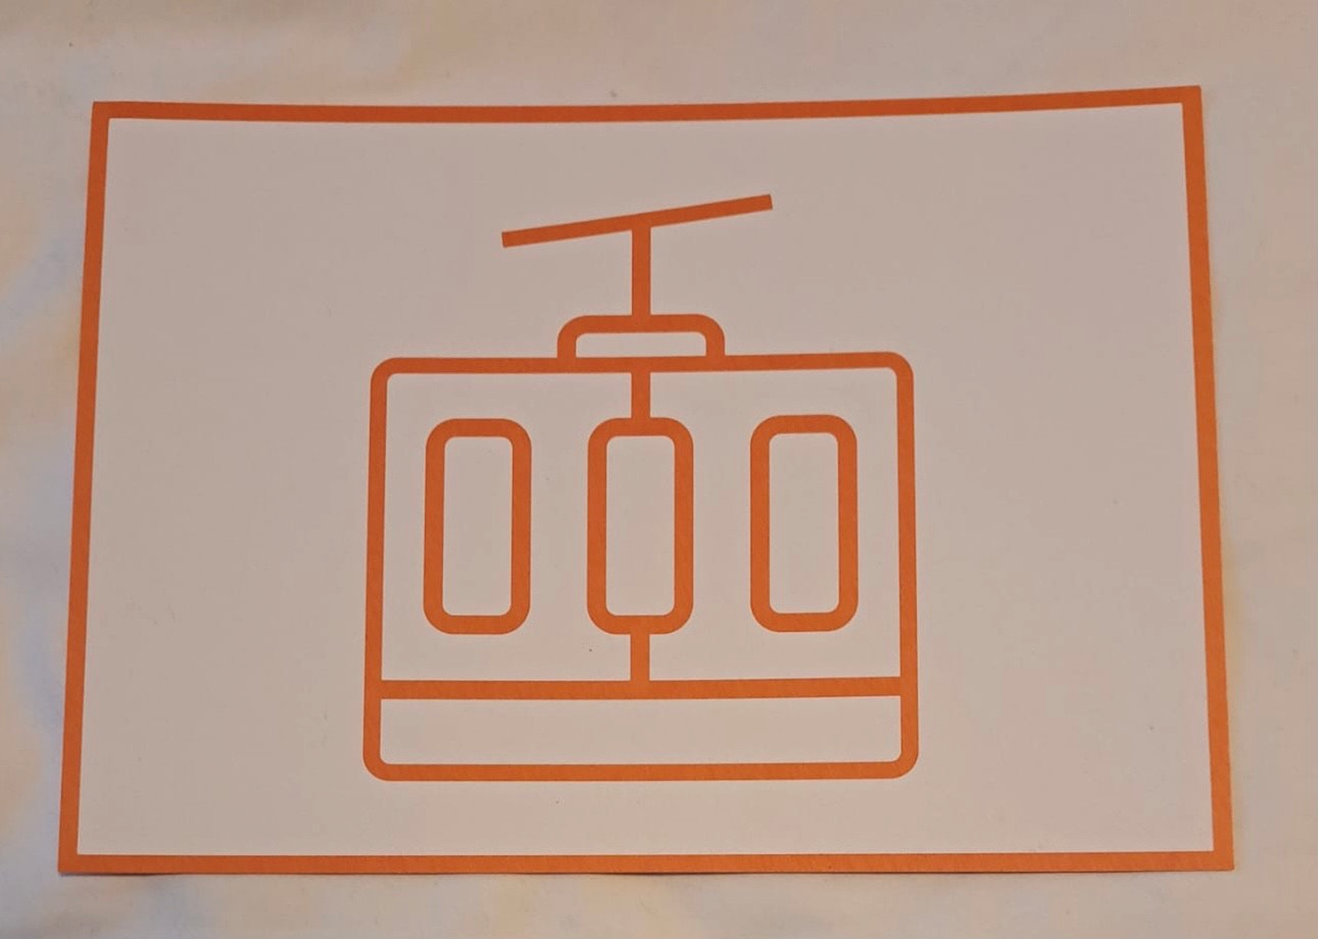
Notes:
Cable Car

Slide 11
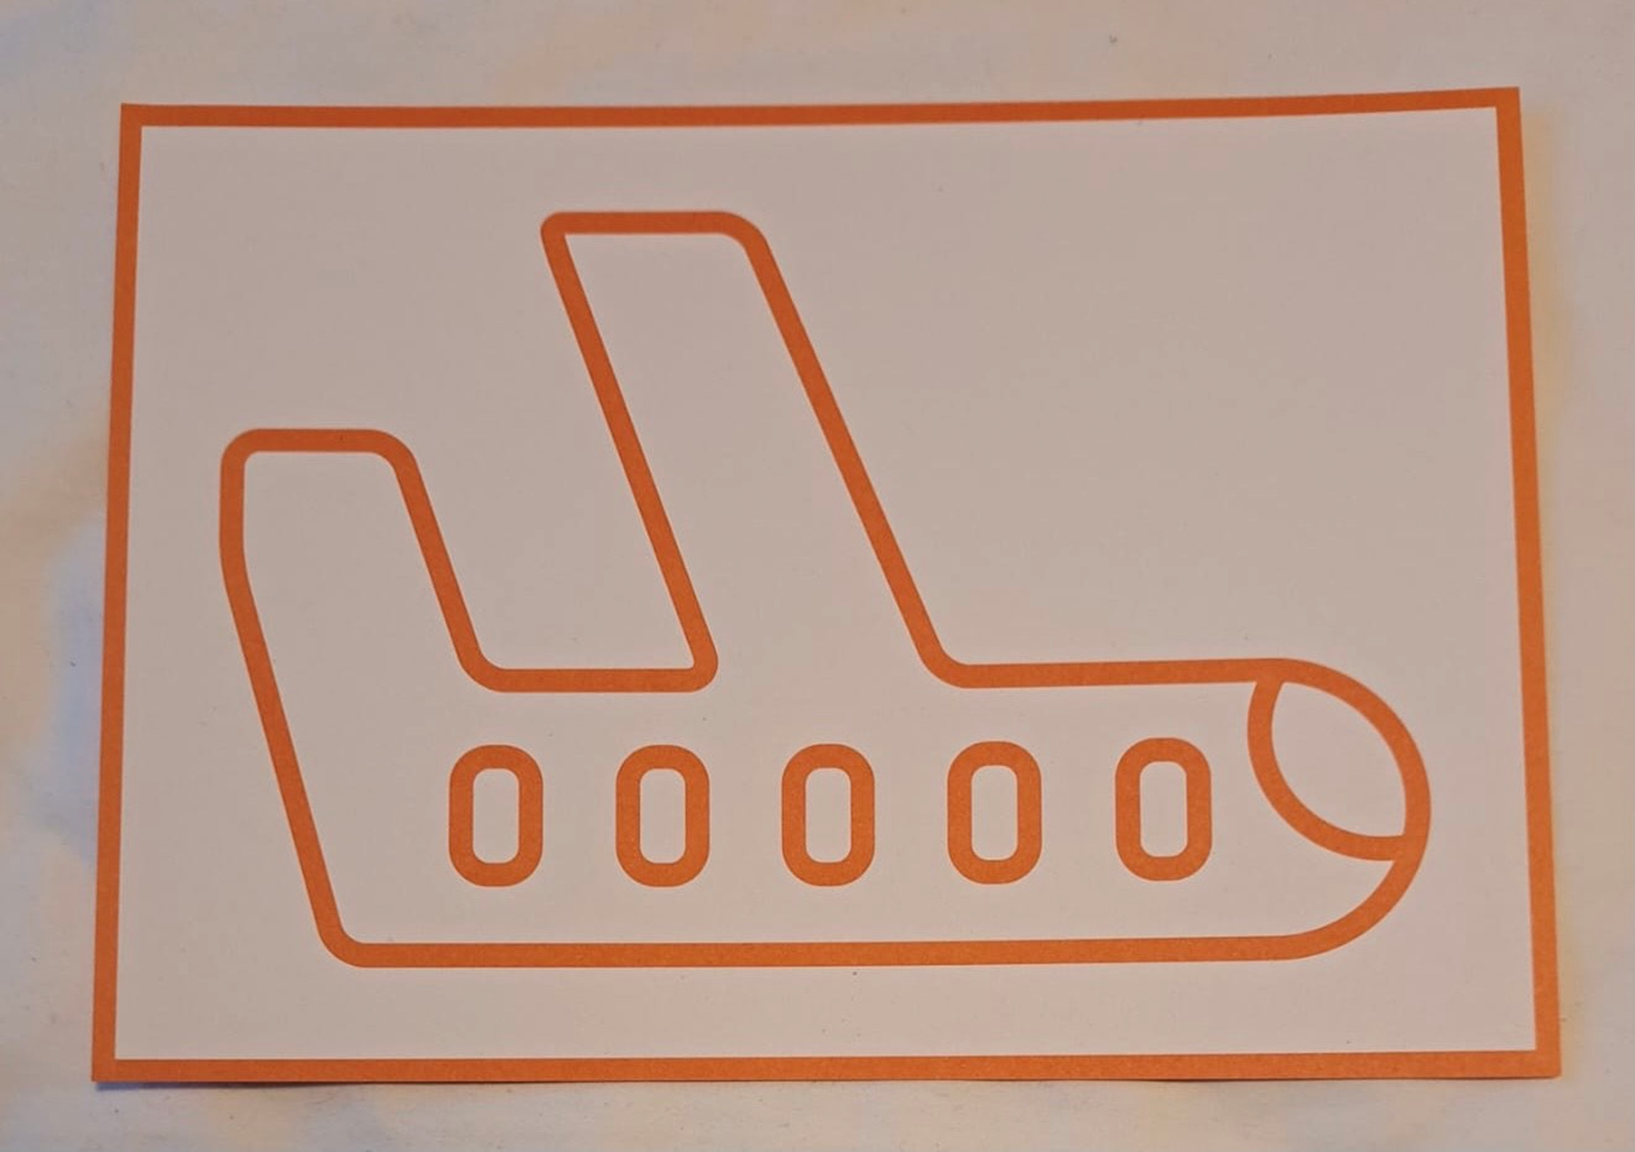
Notes:
Plane

Slide 12
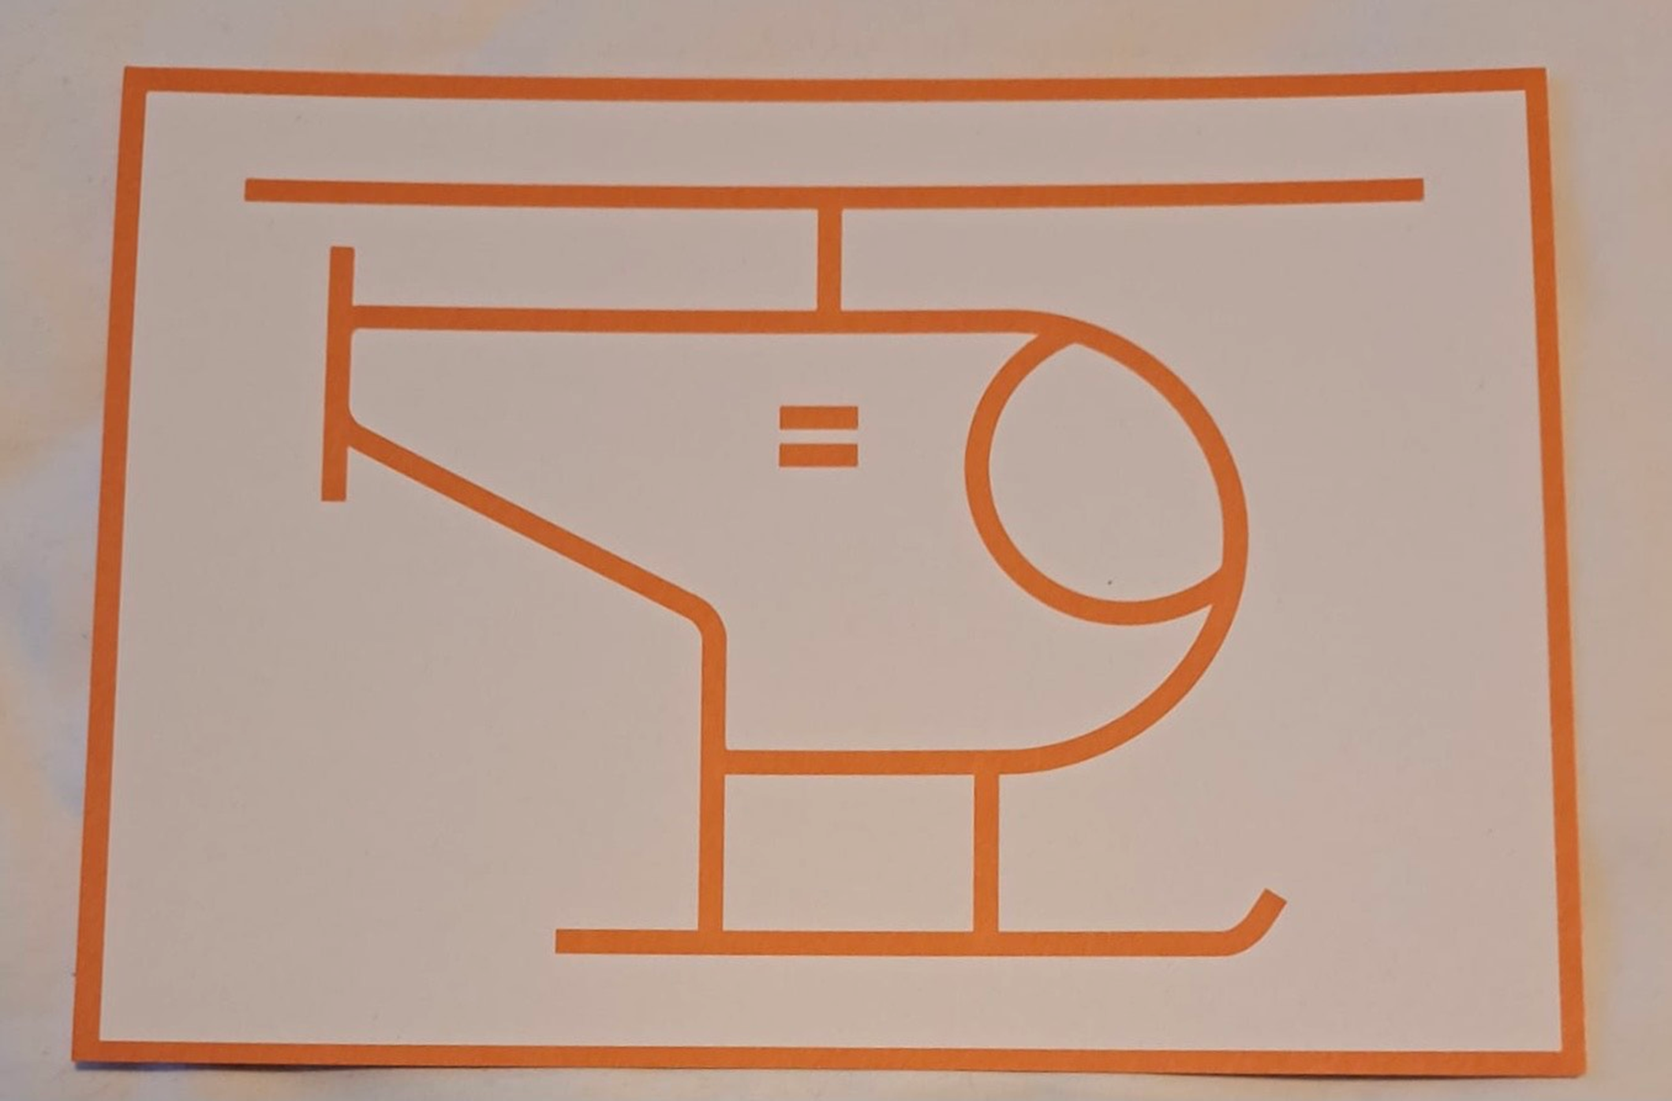
Notes:
Helicopter

Slide 13
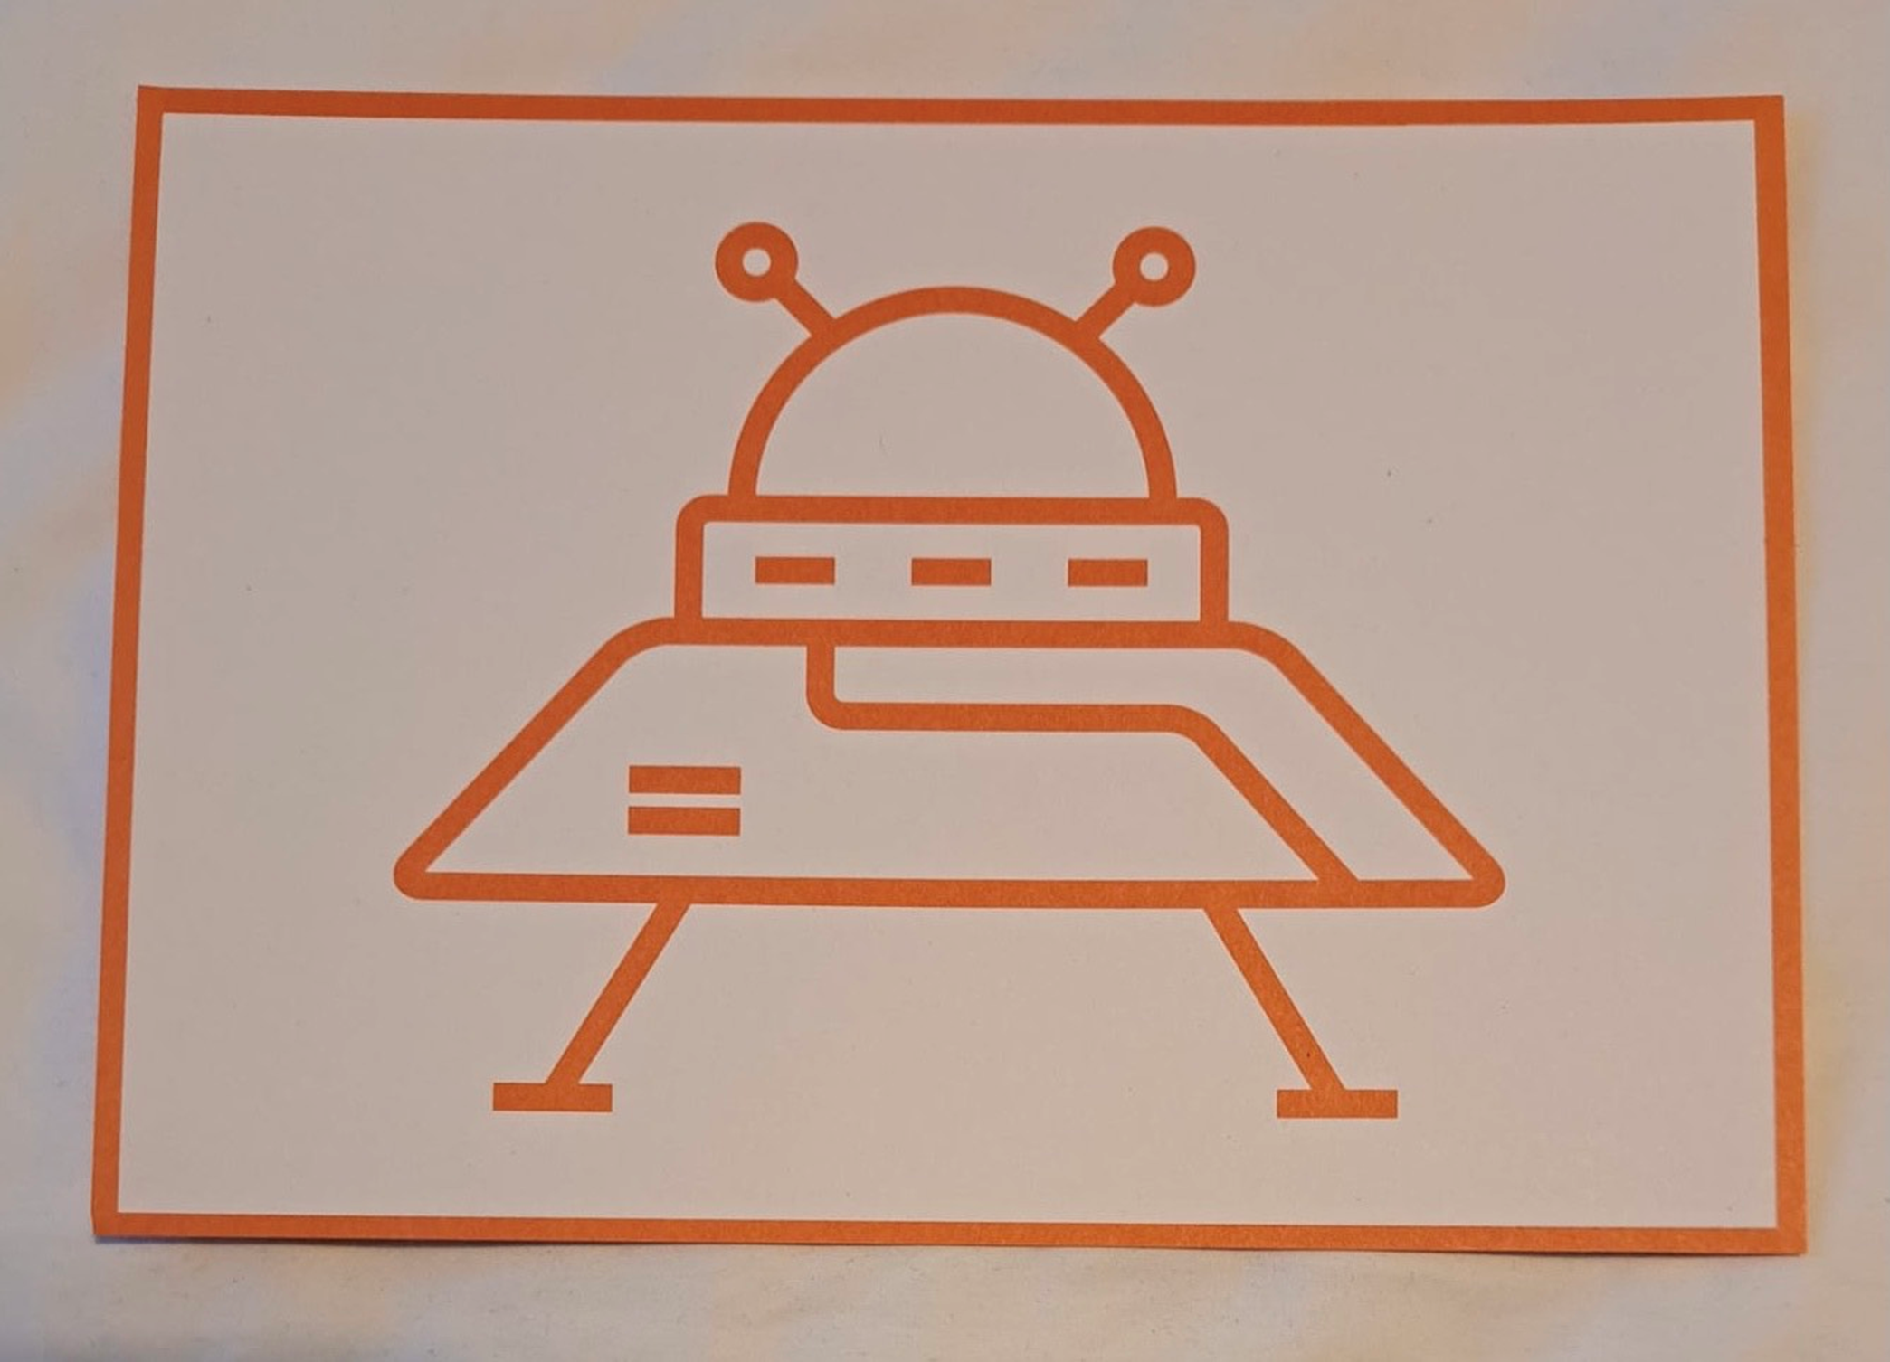
Notes:
Spaceship

Slide 14
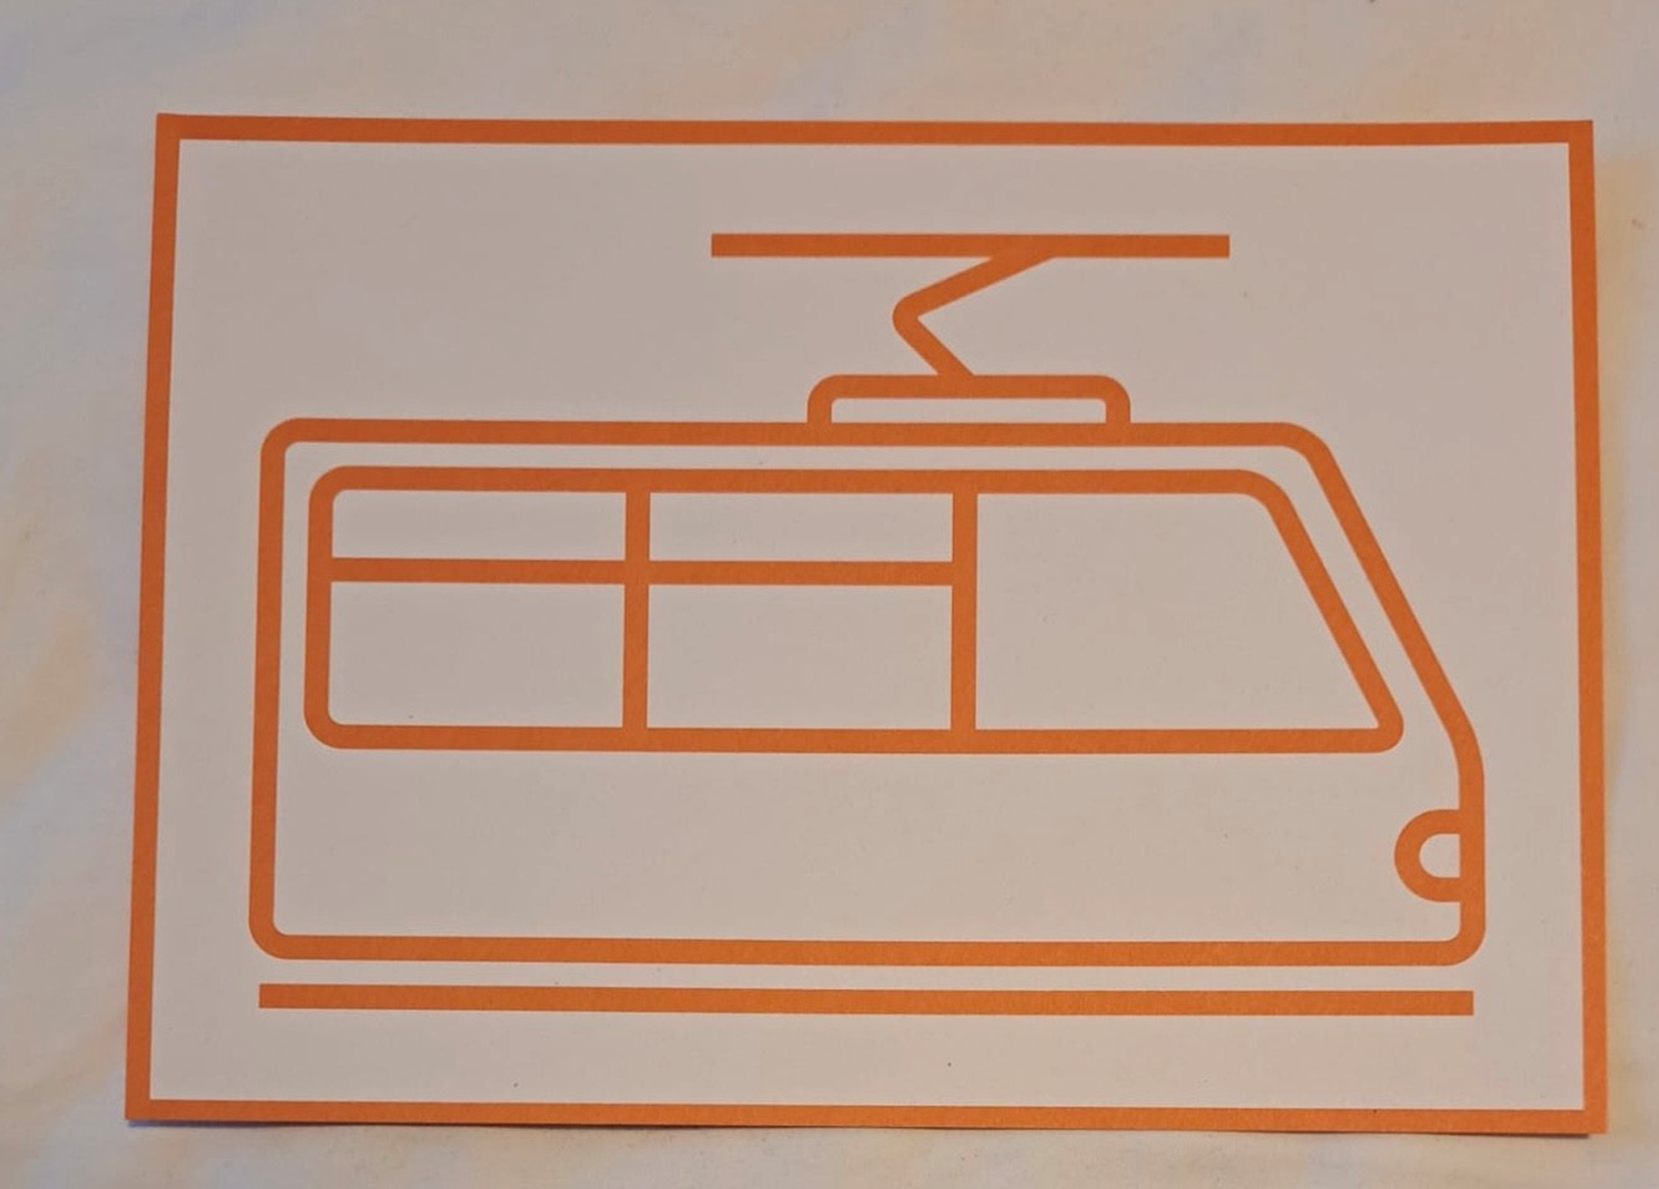
Notes:
Tram

Slide 15
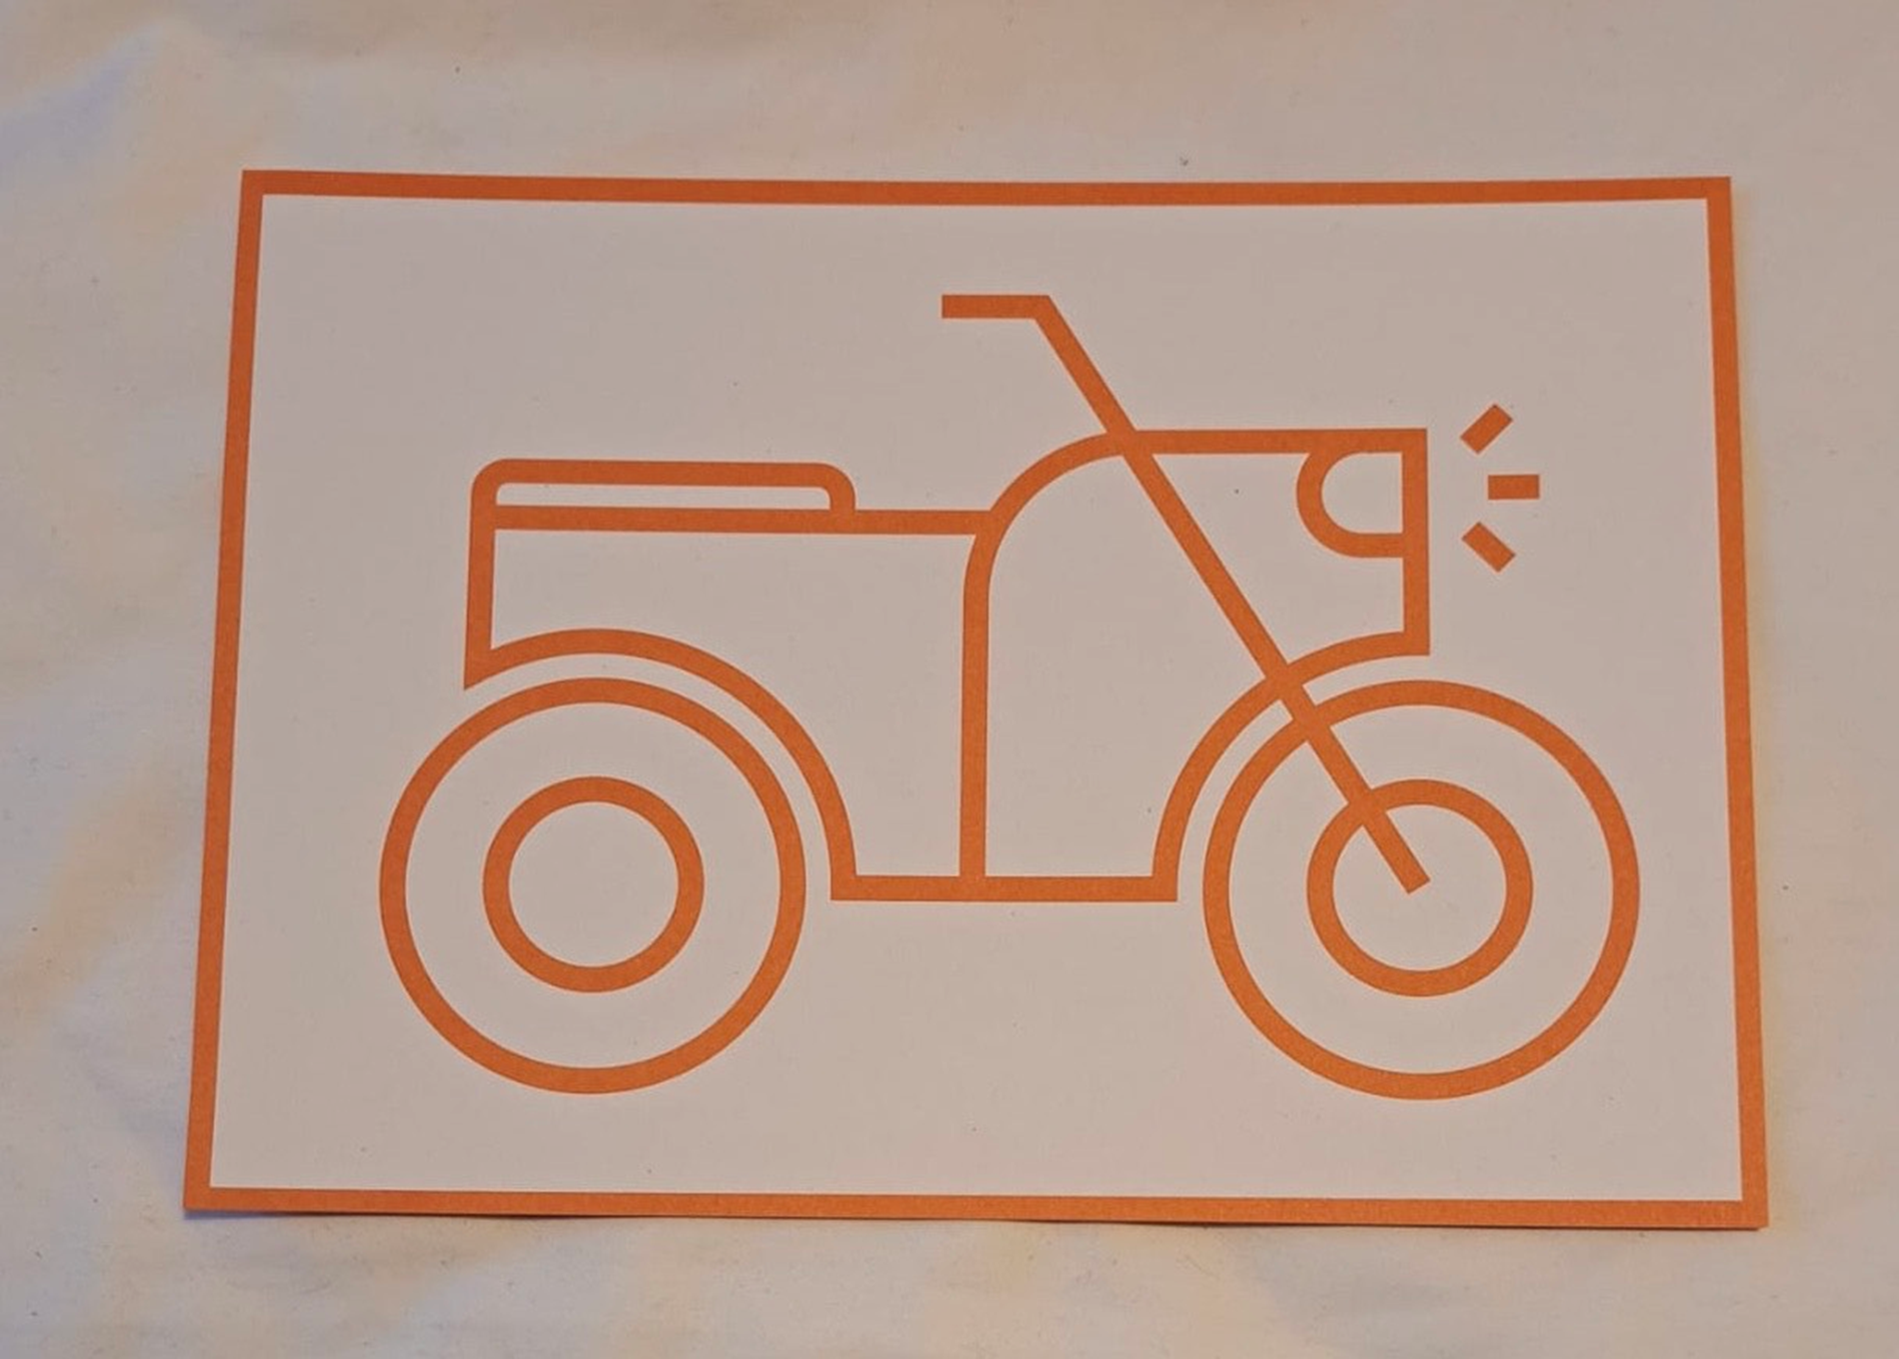
Notes:
Motorbike

Slide 16
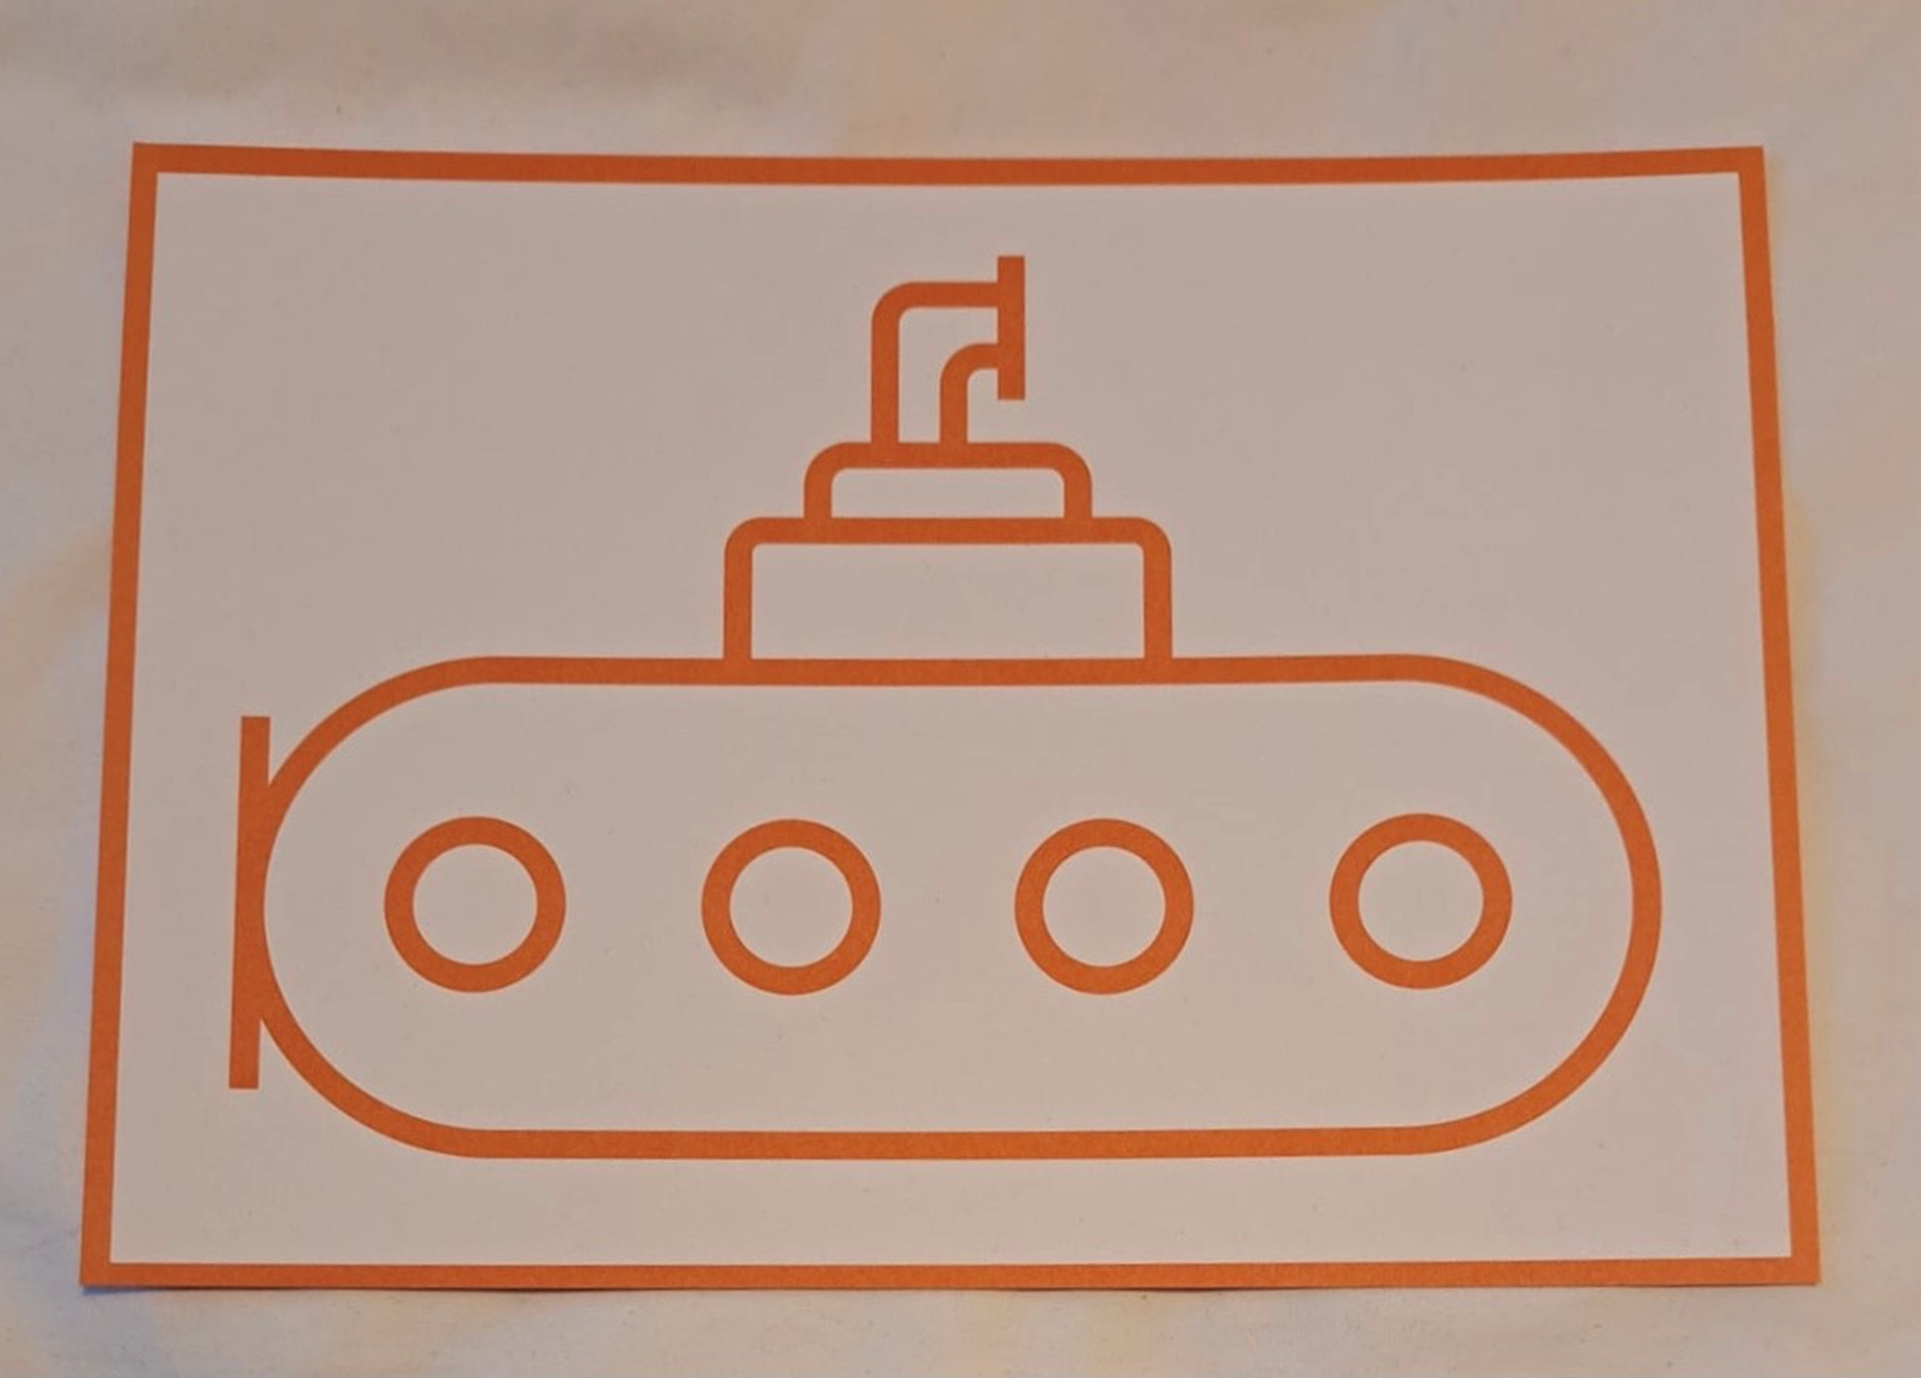
Notes:
Submarine

Slide 17
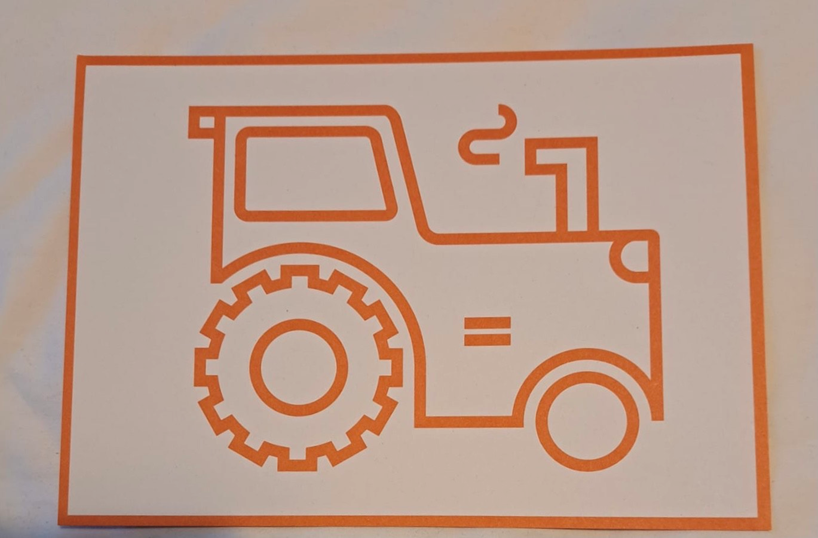

Slide 18
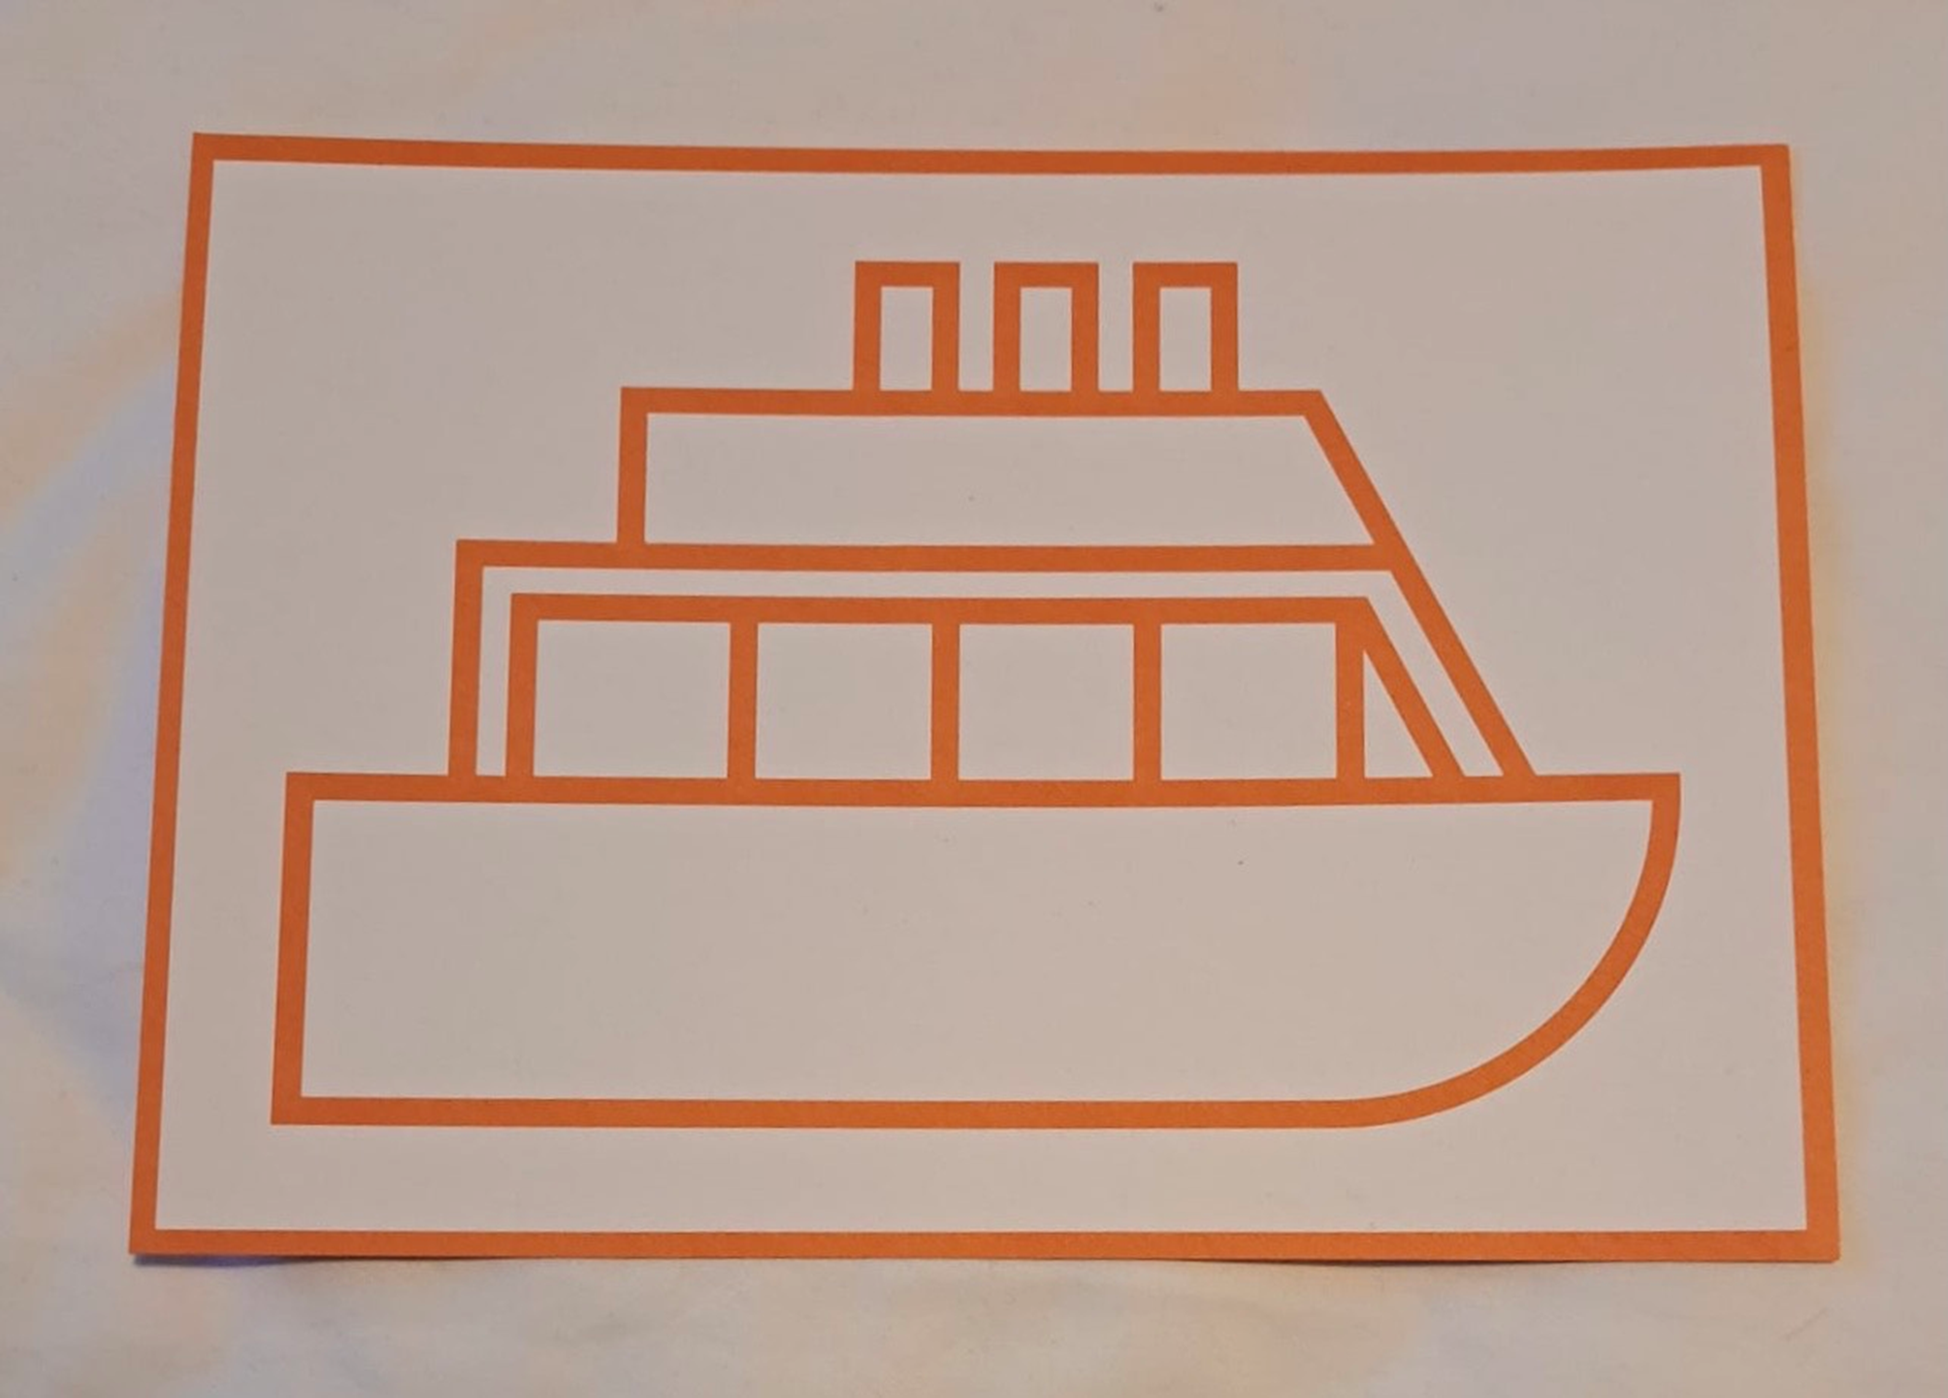

Slide 19
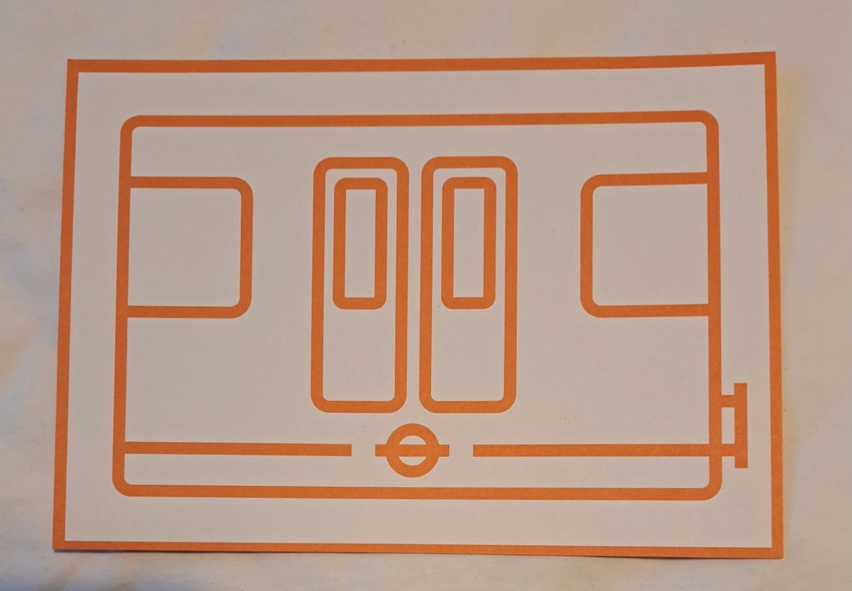

Slide 20
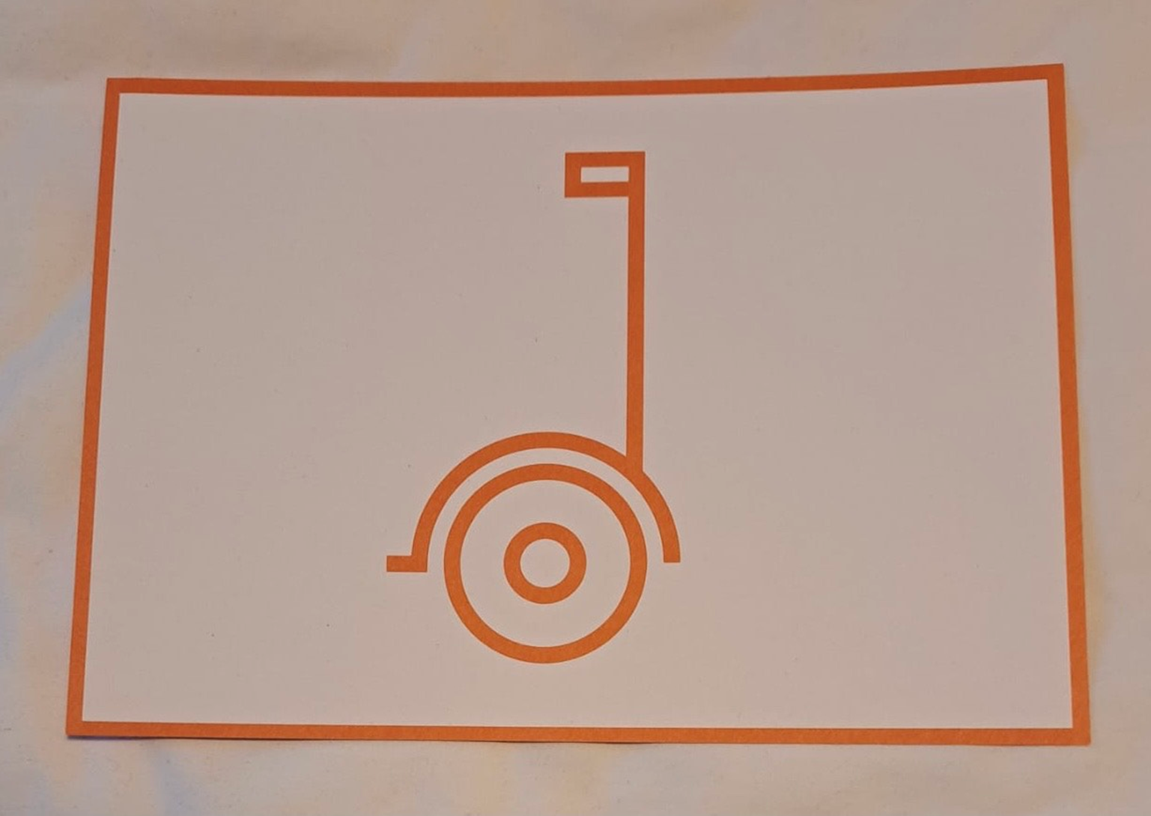
Notes:
Segway

Slide 21
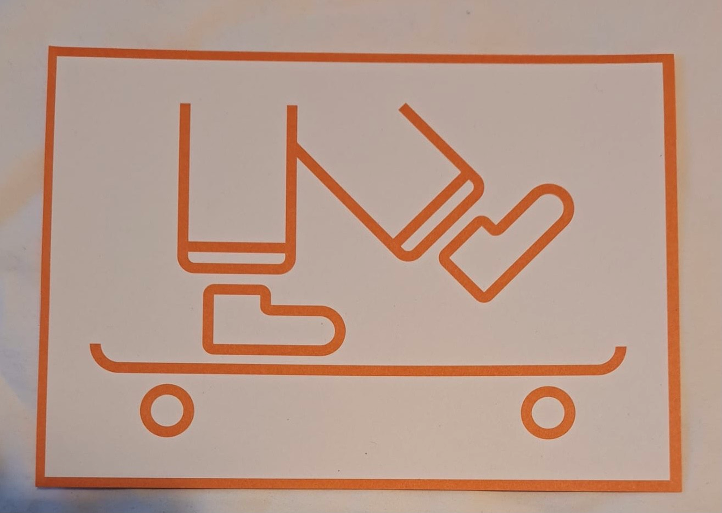

Slide 22
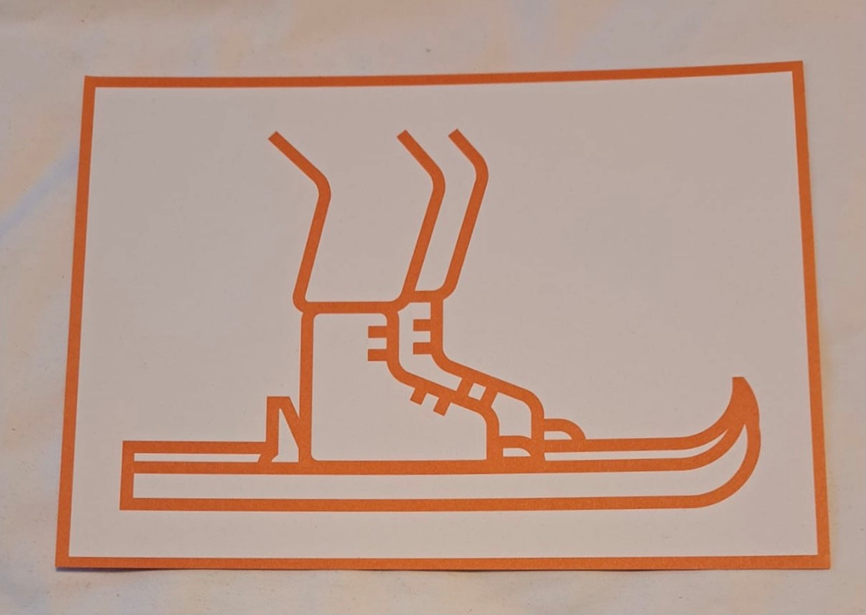

Slide 23
Notes:
PRESENTATION END
Thank you.

Slide 24
Activity 2
Without transport systems, it would be very difficult getting where we need to go.
Sometimes it can be difficult to work out how to create transport systems for a city, especially if there are mountains, rivers or other challenges to avoid.
People called Transport Planners and Engineers help us solve these problems. Let's do an exercise and have look at how they do it!

Slide 25
Notes:
In this exercise you get three volunteers to move carefully across the room you are in; navigating their way between tables and trying to avoid each other. It is an opportunity to talk about the work that Transport Planners and Engineers do to design safe road networks.
This activity does depend on the room in question, so you may need to set up obstacles for them to avoid, or if the room is empty, perhaps use the other pupils in the room to act as obstacles, such as mountains or buildings (ask them to use hand gestures to pretend to be a mountains or a rivers). This will keep them engaged and let them have some fun.
Slide – Getting from A to B
Instructions
Print the (A & B) slides (26 and 27) or write A & B on two pieces of paper and place them at opposite sides of the room.
Activity 1:
Hands up if you would like to help me with an experiment? [Choose one pupil]
I would like you to stand by piece of paper A, and carefully travel to piece of paper B at the opposite side of the room [Point to the opposite side]. Choose any route that you would like across the room without touching anything.
[Now choose another pupil] Please could you now stand by piece of paper A. Do you think that there is only one route or path that you can take to paper B? [Elicit response]. Can you find a different route across to piece of paper B?
[Choose a third pupil and a different starting point, but one where they will have to use some of the same route as one of the previous pupils] Did you use any of the same routes or paths as either one of your peers?
Remember EDI – not all children will be as mobile as each other. Bear that in mind....
Explain
Now you can show the pupils all the other ways and routes they could have taken, explaining to them that all the roads connect and work together to help us travel to where we want to go safely. Explain the way that roads are put together allows us to have lots of cars on the road at the same time, but with the help of traffic lights, all the cars can use the roads without crashing into one another! Explain that someone has the interesting job of planning how these roads work together and they can do this as a job when they get older.
Activity
Imagine there is a mountain in our way. What would we do to go around it, through it or over it. What would we need to do to go through it? [correct response would be to build a tunnel]
What would we do if there was a river in our way? [Correct response would be to build a bridge]
Explain that someone needs to build all these roads, tunnels or bridges but someone else also needs to decide how they are going to look. These people are called Transport Planners, designers and Engineers and they all work within Highways and transportation

Slide 26
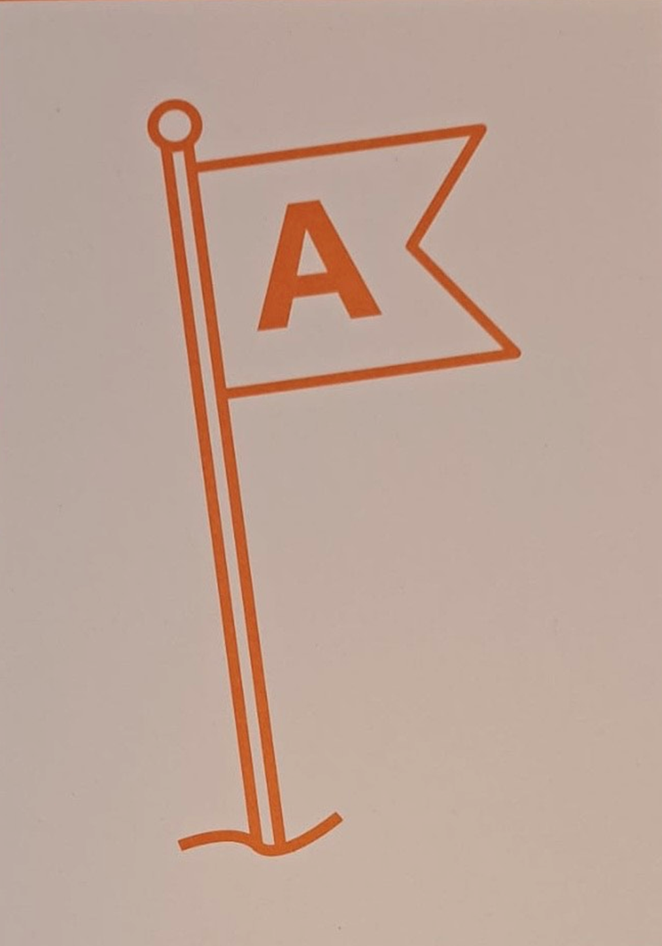

Slide 27
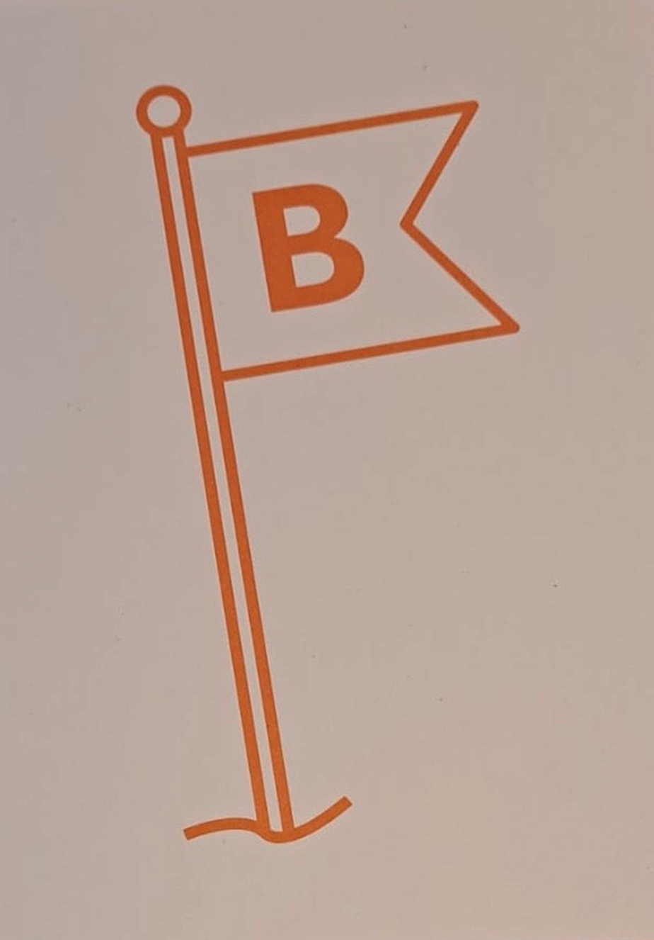

Slide 28
Activity 3
Following on from Activity 2
Let's use the Stick-on Map and Cut-out Sheet to cut out the shapes and place them on the Stick-on map where you think they need to go.
Notes:
Scissors and glue needed for this activity.
As a follow up to activity 2, print and use the Stick-on Map and Cut-out Sheet Activity on Slides 29 to 31. The pupils will need to cut out the shapes on the cut-out sheet and place them on the Stick-on map where they think they need to go. The idea is that they stick down the shapes in the correct position on the map and then you can discuss the types of engineers and transport planners who would be involved in building, maintaining and terraforming.

Slide 29
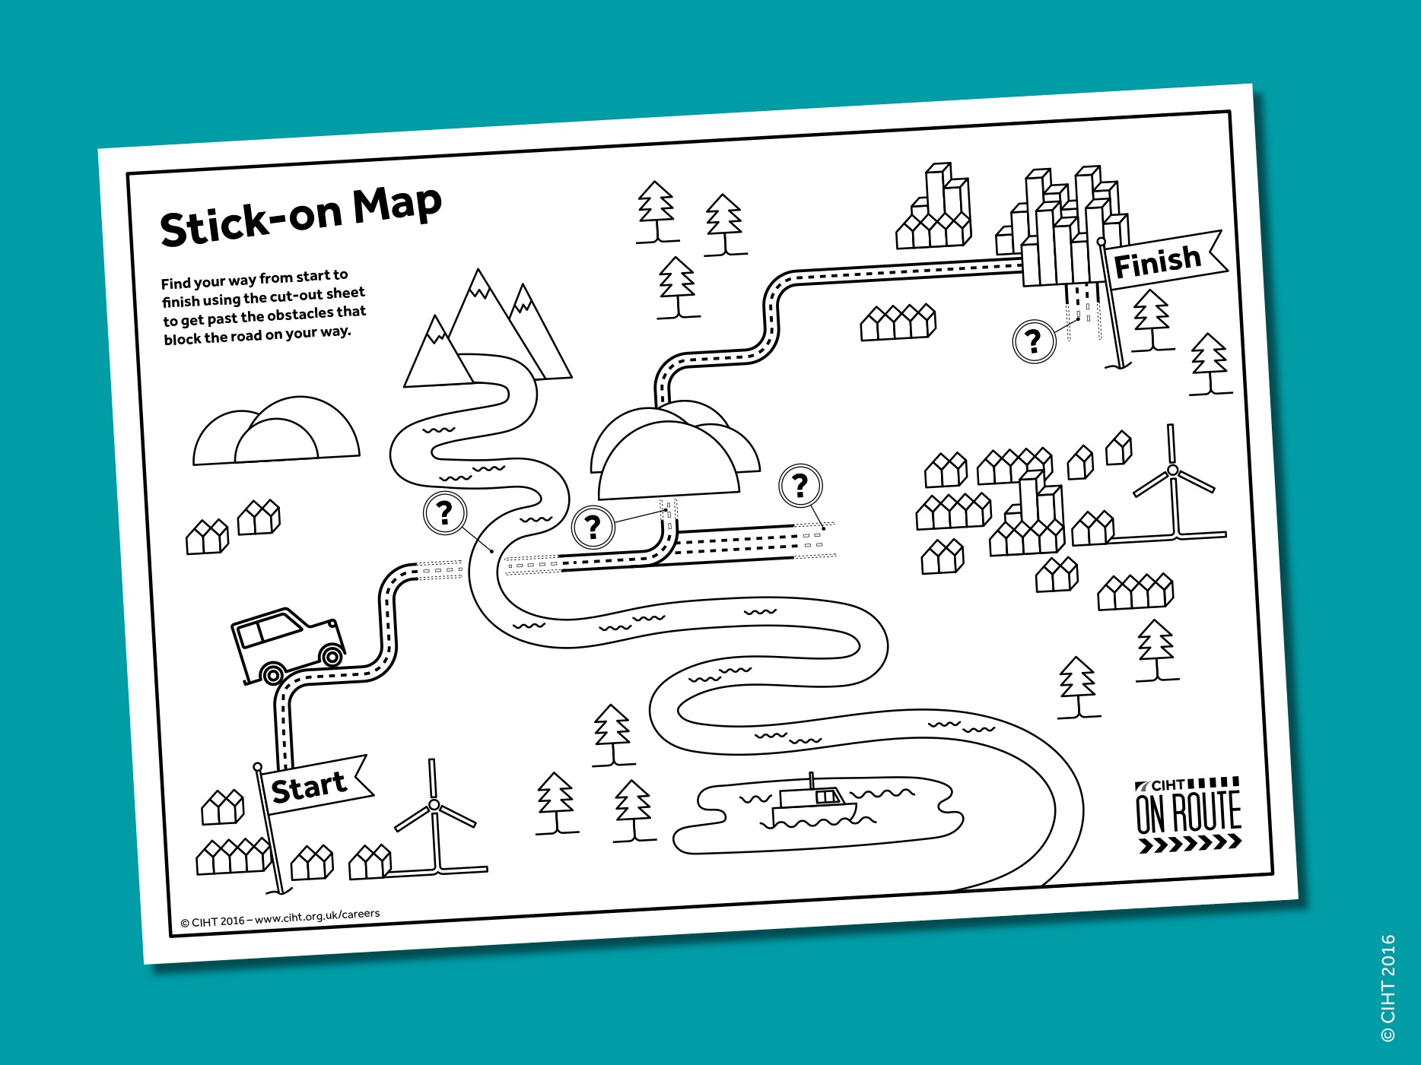
Notes:
If the School engages you as the Ambassador / Presenter, the school should print all the required pages. If you approach the school, you as the ambassador can print it.
Outline – KS1 version
In this exercise you pair up the pupils and give each pair a stick on map, showing a road going from start to finish, with key pieces of transport infrastructure missing. Their task, is to draw in the pieces of transport infrastructure that will enable travelling to get from start to finish. Alternatively, if appropriate, the children can use the cut out sheet on slide 30.
Slide – KS1 Stick-on map.
Instructions
Hand out the stick-on-map and cut-out sheet. Explain on your tables you will find some maps. Ask the pupils to complete the stick-on map (they will need to either cut out and stick down the transport structures from the cut-out sheet and the stick-on map).
Explain:
Here is a map. I am parked here [point to the start] and I want to travel to here [point to finish].
Use a pointer to follow the road and talk about the obstacles that need to be avoided e.g. there is a big hill here, we could go over the hill, around the hill or maybe through the hill. [These are positional words and sometimes difficult to understand so it is important that you use your hand or pointer to demonstrate].
Ask:
In pairs, imagine you are driving along the road, when you reach an obstacle. Try to think about what a transport engineer would build or do to avoid or defeat that obstacle.

Slide 30
Notes:
Print Out - Cut Out Sheet
Print out and use this cut out sheet for the groups of children. Ask them to use scissors (carefully) to cut out the shapes and place them on the drawing shown on slide 5 of this presentation.

Slide 31
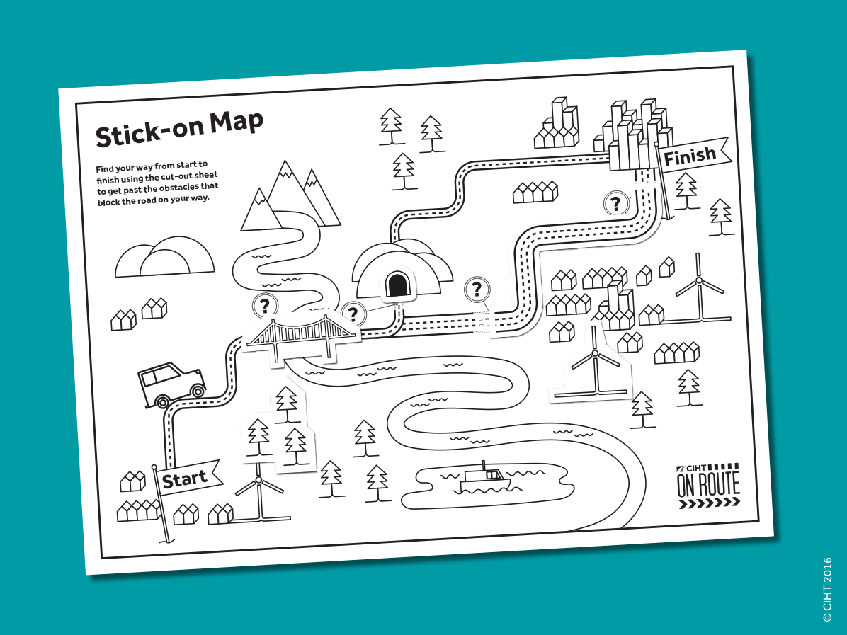
Notes:
Outline – KS1 version
Complete the map exercise and use it to find out if anyone is interested in designing any of these types of transport infrastructure.
Instructions
Slide – [successfully completed map]
Ask the audience: Hands up if you found two things that you have to build to keep moving. Keep your hand up if you found three etc. Well done for placing the two/three transport structures correctly.
Someone has to design all these things and decide what they would look like.

Slide 32
Notes:
PRESENTATION END
Thank you.

Slide 33
Activity 4
Fun facts
Notes:
Use Slides 34 to 37 to discuss with and inform the children about some fun facts & finally ask what do you /they think is the best thing about working in transport?

Slide 34
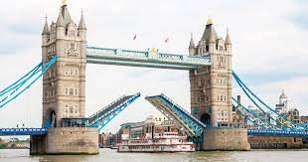
Notes:
Slide – [a bridge]
And ask the audience: Are there any notable bridge in your area? Have you ever crossed over a bridge before?
Interesting fact: Many bridges are made using triangles to make them strong as shown in the picture of the bridge [point to the slide].
Fun Fact: The tallest road bridge in the world is the Chenab Rail Bridge in India.
Fun Fact: Tower Bridge is the only bridge over the Thames that can be raised. It opens and closes several times a day and if you go to London you may see it moving

Slide 35
Notes:
Slide – [a tunnel]
Let the audience know an interesting and fun fact (I.e., the Channel Tunnel goes below the sea and since 2000, over 3 million dogs and cats have travelled through the Channel Tunnel.

Slide 36
Notes:
Slide – [a motorway]
Let the audience know an interesting and fun fact (I.e., motorways are multiple lanes wide and there are service stations on the motorway where you can eat, drink and rest if you get tired from driving long distances.

Slide 37
Notes:
Slide – Challenge: What do you think is the best thing about working in transport?
Ask the children to tell you what they think is the best thing about working in transport?

Slide 38
Notes:
PRESENTATION END
Thank you.

