Slide 1
Notes:
Presentation: Depending on how much time you have, you may be able to deliver just one activity and discussion, or all of them.
Action: Add your photograph to Slide 2 & Introduce yourself, your job title and organisation. Please also introduce CIHT.
Activity 1: The aim of this activity is to communicate the idea that transport infrastructure exists on many scales, and that we use different modes of transport depending on the scale of our journeys. You start the activity by displaying slide 5 on the screen, which is the first map, set to the scale of 1km. More maps on slides 6, 7 and 8 reveal a map of the UK at increasing scales, zooming out from 1km to 1000km. You will use each scale map to identify the types of infrastructure that enable us to make journeys at that scale. Explain that you are now going to explore the range of scales on which transport infrastructure exist.
Activity 2: What issues will affect transport infrastructure in the next 30 years? Slides 9 to 17.
Discussion 1: What new technologies and initiatives might help us overcome these challenges? Slides 18 to 22
Discussion 2: What’s new and what’s on the horizon and conclusions - Slides 23 to 26

Slide 2



THIS IS ME: I am a STEM Ambassador
Me:
My Company:
My Journey: How I got here
My Day: What I do at work and how that helps others
My Skills: What skills I need to be good at what I do
Notes:
Slide – About Me & CIHT
This first part is a chance to introduce yourself and to capture the attention of your audience. Please introduce yourself, say which organisation you work for and mention a couple of the exciting transport-related projects that your organisation is involved with to motivate the audience.
Introduce CIHT:
The Chartered Institution of Highways and Transportation (CIHT) is the leading professional body for people who work in the transport industry.
The role of a professional institution is to support and advance a particular profession, the interests of those working in that profession and the public interest.
CIHT members plan, design, build, operate and maintain best-in-class transport systems and infrastructure.
The Institution supports its members’ professional aspirations by providing routes to professional qualifications, opportunities to strengthen their professional network and meet interesting people, and access to excellent professional development events.
CIHT also works to promote the importance of the transportation industry to government and to society.
CIHT’s knowledge and understanding of the highways and transportation makes it a clear choice for those working in the industry.
Membership of CIHT is FREE for students studying a relevant course.
If you want to know more about how the Institution has helped to further the careers of its members, search ‘CIHT journeys’ online.

Slide 3
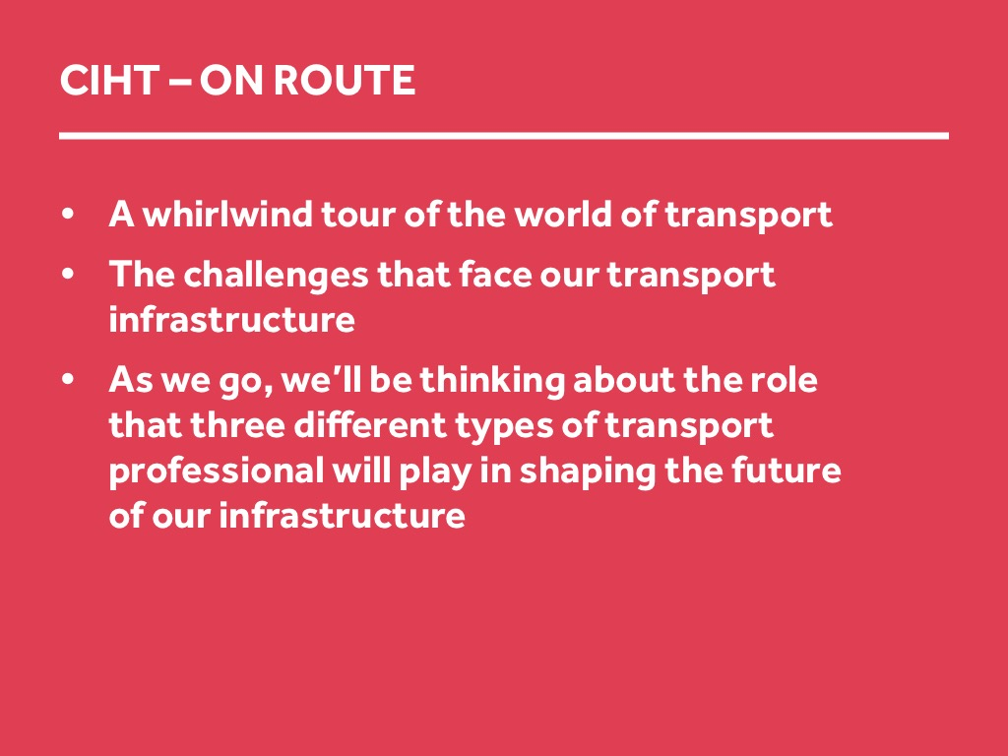
Notes:
Explain
During this activity, you will be taken on a whirlwind tour of the exciting world of transport infrastructure, where we will be looking at the challenges that face our transport infrastructure.
As we go on this journey, we will be thinking about the role that three different types of transport professional will play in shaping the future of our infrastructure.
We will meet three of these professionals now.

Slide 4
Activity 1
Transport infrastructure exists on many scales, and that we use different modes of transport depending on the scale of our journeys.
Notes:
Explanation:
The aim of this activity is to communicate the idea that transport infrastructure exists on many scales, and that we use different modes of transport depending on the scale of our journeys.
Instructions:
You start the activity by either displaying slide 10 on the screen, which is the first map, set to the scale of 1km. More maps on slides 11, 12 and 13 reveal a map of the UK at increasing scales, zooming out from 1km to 1000km. You will use each scale map to identify the types of infrastructure that enable us to make journeys at that scale.
Explain that you are now going to explore the range of scales on which transport infrastructure exist.

Slide 5
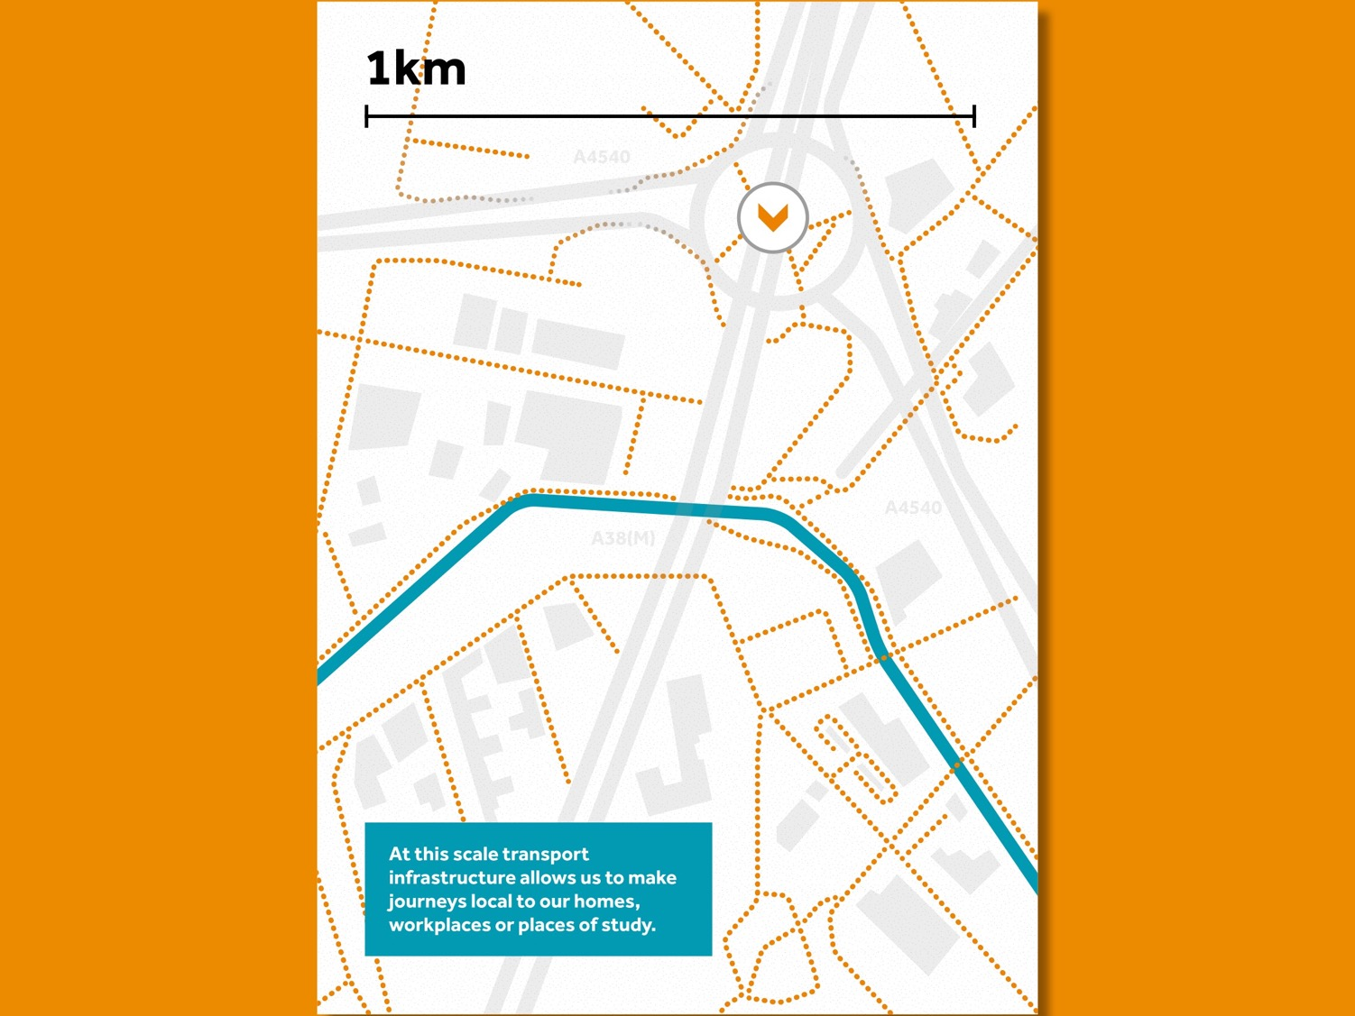
Notes:
Slide – 1km scale map
Explain – here we are looking at a 1km-scale map of an urban area.
Ask – what sort of journeys do we make that are 1km long?
Possible answers - journey to school, local shops, see friends, journeys around campus
Ask – what mode of transport do we use to make these journeys?
Possible answers:
Foot
Bike/scooter
Ask – what transport infrastructure makes these journeys possible?
Answers to draw out:
Pavement
Minor roads and cycle paths.
Point out on the map the minor roads highlighted in orange that allow journeys at this scale.
Now reveal the next scale of map on slide 10.

Slide 6
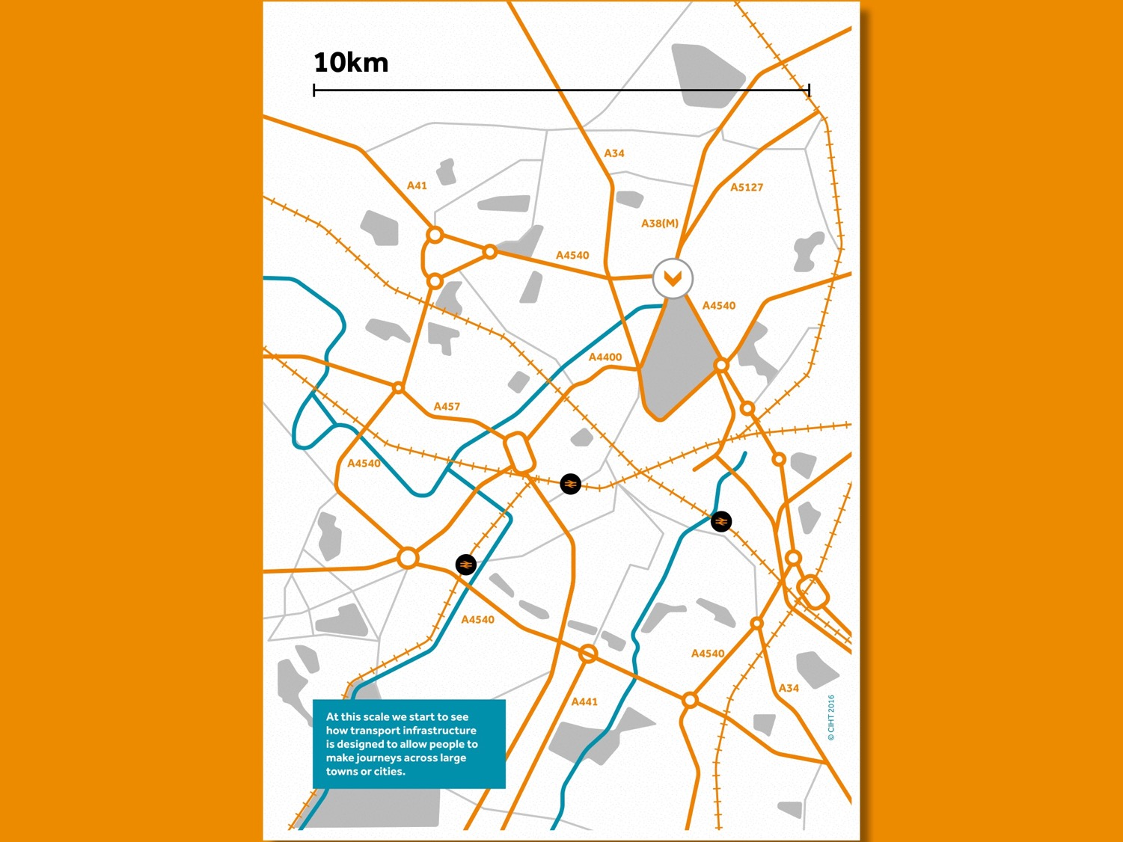
Notes:
Slide – 10km scale map
Explain
We have now zoomed out. Show the point that marks where we looking at the previous map (which is the greyed out area of the map). At this scale we can see a whole town, or a large area of a city.
Ask
What types of transport infrastructure we can see at this stage:
Major roads
Local rail/Underground lines
Canals/rivers
Ask
What types of journeys would you make that are 10km along and what infrastructure would you use
Journeys to school, supermarkets, into the centre of the town/city, or to work.
By car, by train, by bike, by bus, using the infrastructure that we have mentioned.
Ask if you would make this sort of journey by foot – probably not.
Now we are going to zoom out even more to 100km on slide 11.

Slide 7
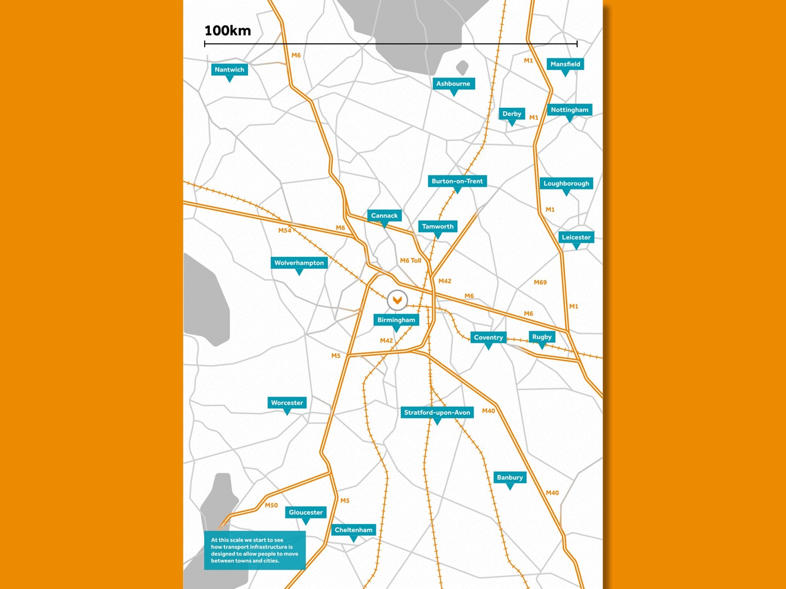
Notes:
Slide – 100km map
Explain
We have now zoomed out even more to a distance of 100km. We are still centred on the same point as previously. At this scale we can see whole towns and cities.
Ask
What sort of transport infrastructure can we see at this scale?
Motorways
Trunk roads
Long-distance rail
Ask
What sorts of journeys you would make which are this long?
Visiting friends/family in other towns and cities.
Day trips.
Holidays.
Point out how at this scale you start to see how we join different types of transport infrastructure together to get to where we want to go. E.g.:
We travel on minor roads that lead to trunk roads which then take us to the motorway.
We walk to the metro station and travel to the main railway station to get the long-distance train.
We are now going to zoom out one more time to a distance of 1,000km.

Slide 8
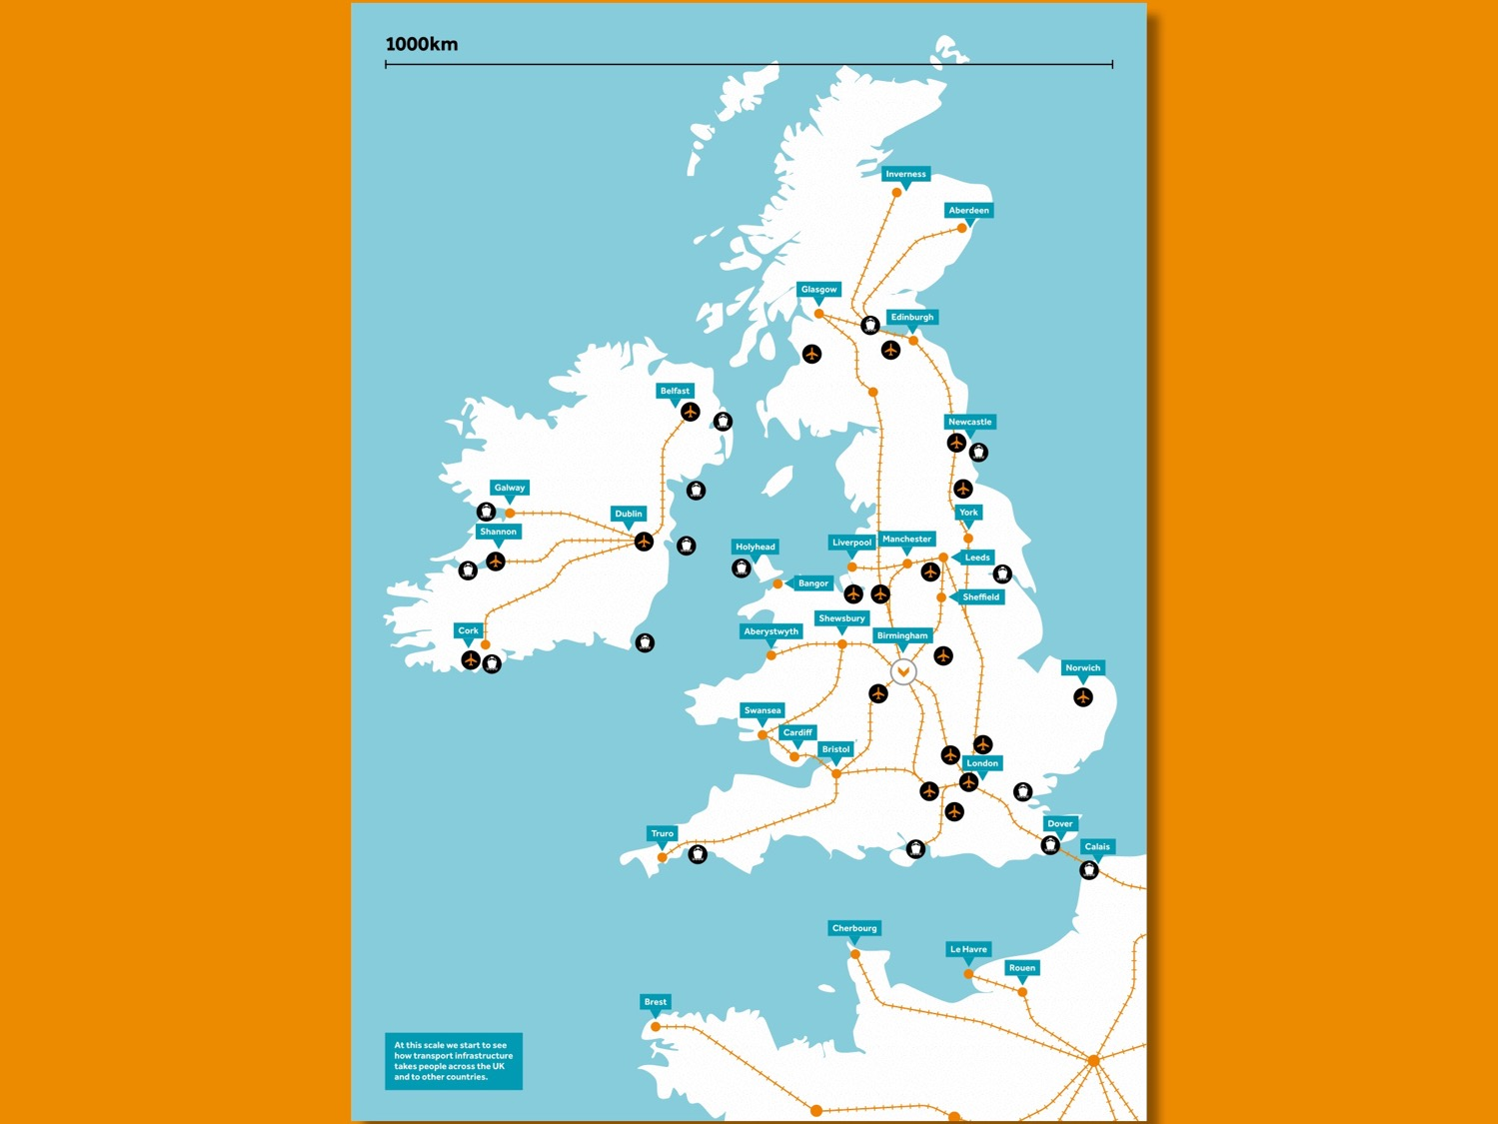
Notes:
Slide – 1000km map
Explain
We have now zoomed out so that we can see 1000km. Again, we are still centred on the same point as before. At this scale we can see the whole country, and some other countries as well.
Ask
What sort of infrastructure can we see at this scale?
Long-distance/international rail routes
Airports
Harbours
Point out how transport infrastructure can move us right the way across the country, and also to other countries.

Slide 9
Activity 2
What issues will affect transport infrastructure in the next 30 years

Slide 10
Notes:
Explanation
Explain that we are going to look at how our transport infrastructure has to adapt to many different social, environmental and economic issues. The aim of this session is to demonstrate that the transport infrastructure is constantly changing and evolving. It should also demonstrate that Asset Managers, Transport Engineers and Transport Planners work to solve real problems and issues that affect our own lives as well as society as a whole.
In this session:
You will focus on climate change and the impacts this may have on different types of transport infrastructure.
You will then open the discussion to groups and ask them what other factors will have an impact on transport infrastructure.
You will then show a list of possible technologies or developments that may help us deal with these challenges.

Slide 11
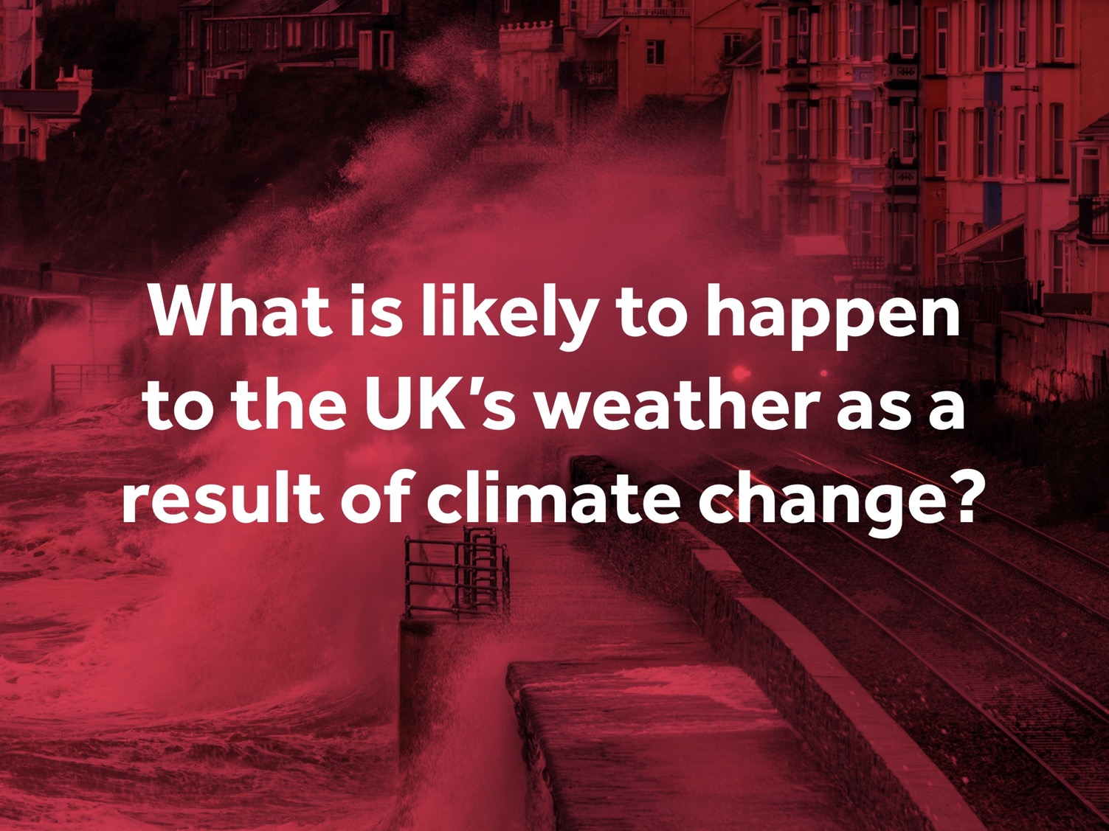
Notes:
The first question to ask is “What is likely to happen to the UK’s weather as a result of climate change?”
Invite participants to call out answers.
Reveal next slide with answers

Slide 12
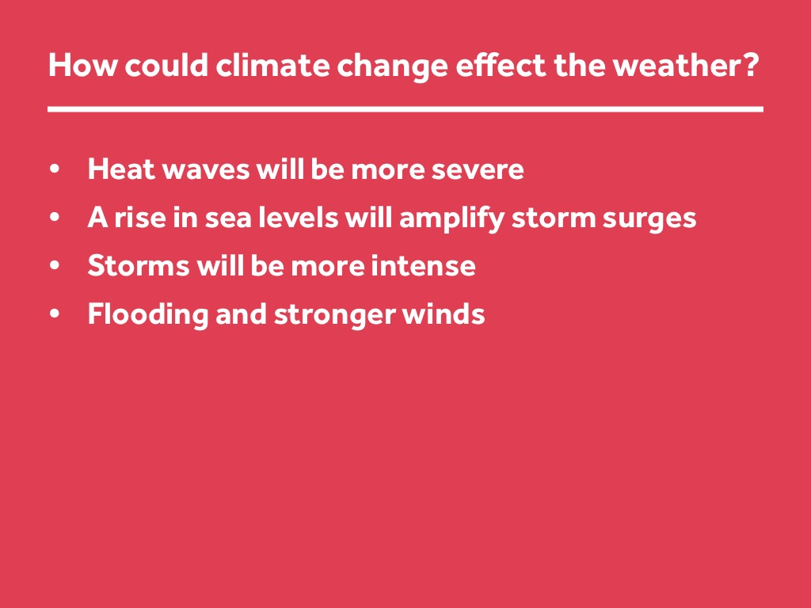
Notes:
Slide – How could climate change effect the weather?
Read out the bullet points on the screen:
Heat waves will be more severe
A rise in sea levels will amplify storm surges
Storms will be more intense
Flooding and stronger winds
Explain – now we are going to think about the impact of these changing weather patterns on different types of transport infrastructure.

Slide 13
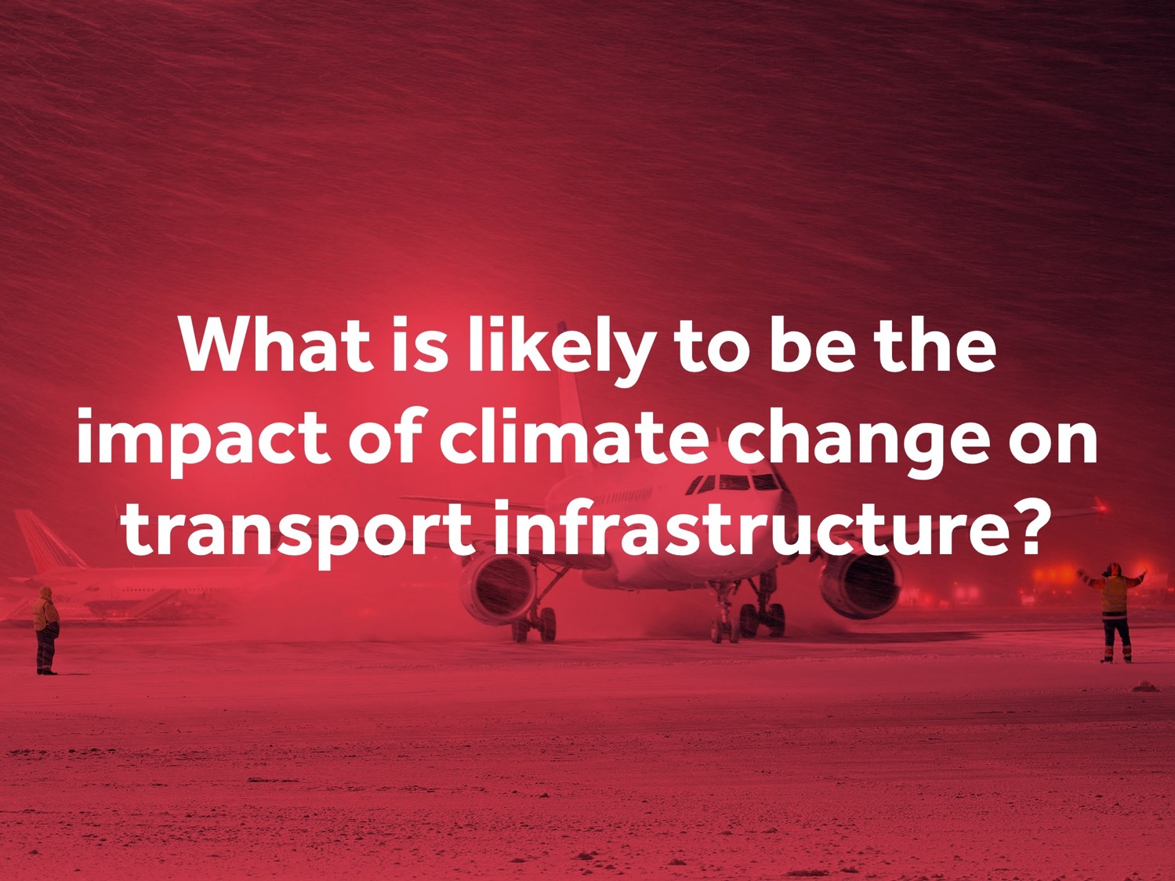
Notes:
Slide – What is likely to be the impact of climate change on transport infrastructure?
Invite participants to call out answers, suggesting that they could look at their maps to get some ideas.
Then reveal the next slide with answers.
Answers on the next slide are as follows:
Weakening of soils that support tunnels, roads and runways etc due to heavier rainfall
Shortened life expectancy of roads and highways due to extreme snow events
Coastal infrastructure will flood more frequently and possibly permanently
Expansion and buckling of rail tracks in extreme heat
Increase in debris on tracks from storms
Closure of airports due to storms

Slide 14
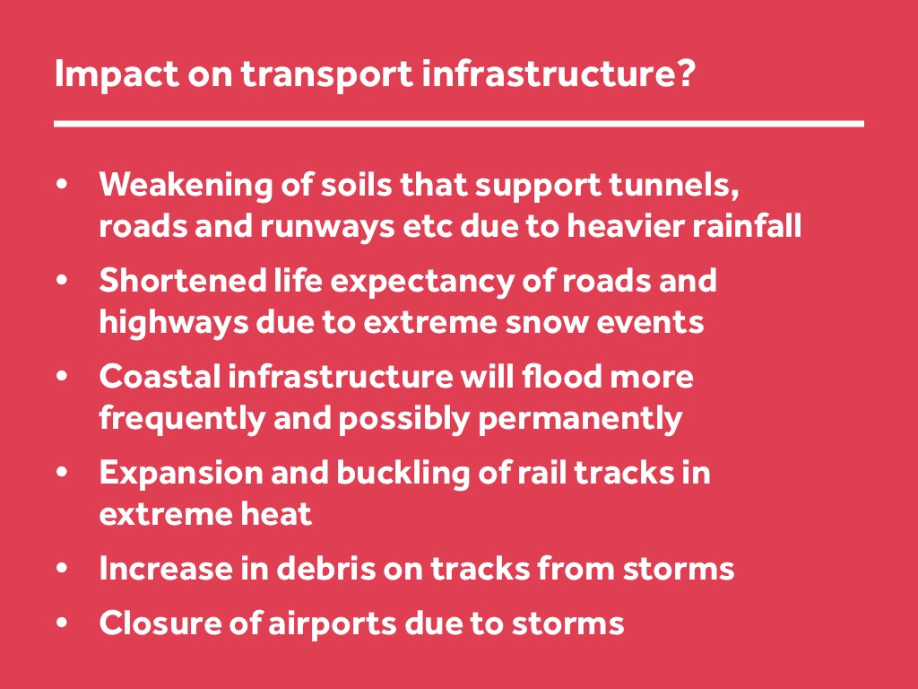
Notes:
Slide – Impact on transport infrastructure?
Weakening of soils that support tunnels, roads and runways etc due to heavier rainfall
Shortened life expectancy of roads and highways due to extreme snow events
Coastal infrastructure will flood more frequently and possibly permanently
Expansion and buckling of rail tracks in extreme heat
Increase in debris on tracks from storms
Closure of airports due to storms

Slide 15
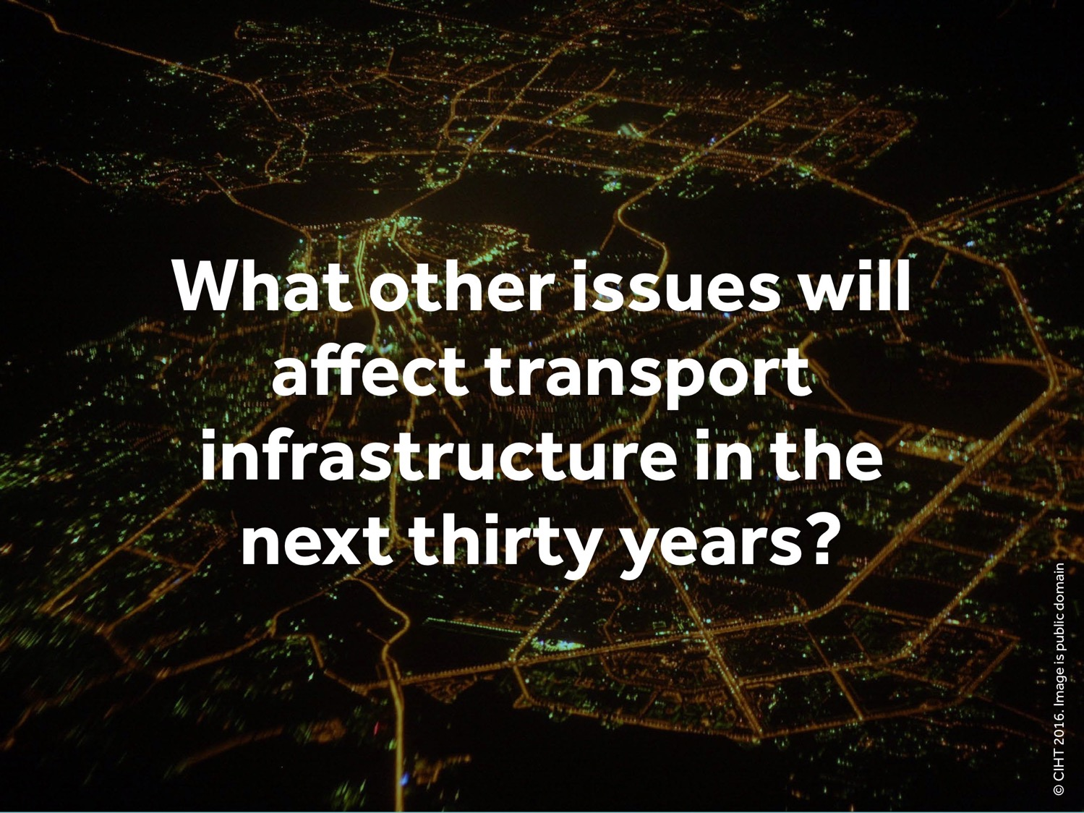
Notes:
Slide – What other issues will affect transport infrastructure in the next thirty years?
Ask the students to raise their hands if they can think of any other issues that are likely to affect our transport systems in the future.
Answers on next slide.

Slide 16
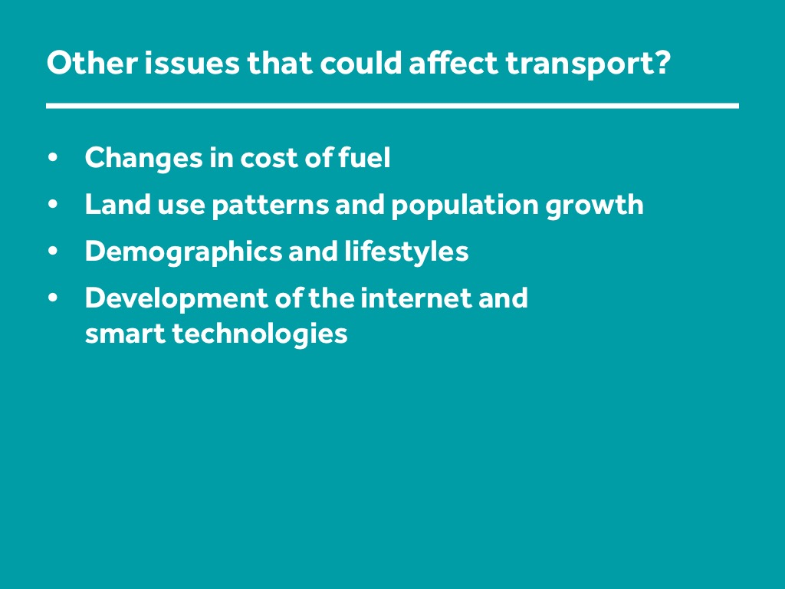
Notes:
Slide – Other issues that could affect transport infrastructure?
Check to see that the following points have been covered by the students and if not, make them yourself.
Changes in cost of fuel
A reduction in availability e.g. fewer new oil fields being identified
Possible taxes to reflect the ‘externalities’ in the cost of fossil fuels
Land use patterns and population growth
Expansion of industry into rural areas
Cities becoming bigger and more congested
Homes being built on green belt
Demographics and lifestyles
More home-working
Increase in leisure and tourism
More ageing population
More international work travel
Development of the internet and smart technologies
Need for systems such as smart tickets
Need to improve communications with passengers including availability of information
More direct deliveries of goods ordered online
24 hour working

Slide 17
Discussion 1
What new technologies and initiatives might help us overcome these challenges?

Slide 18
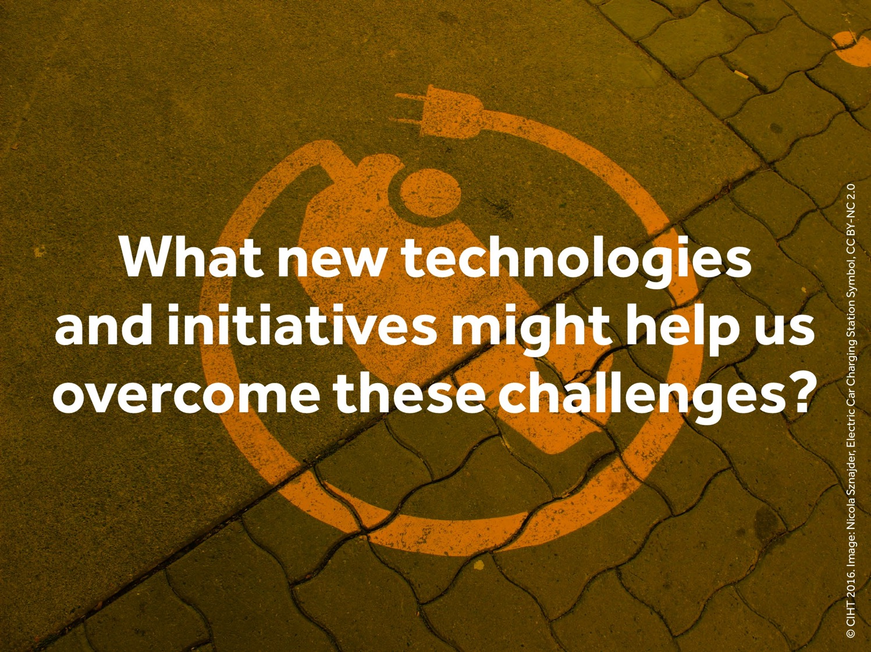
Notes:
Ask participants to call out any new technologies and initiatives that might help us to overcome these challenges?
After participants have called out a few answers, show next slide with possible answers.
Answers on next slides are as follows:
Electric cars
Vehicle sharing
Autonomous cars
Smart technologies
Toll roads
Cycling
Cycle hire scheme
Nuclear power
Maglev
More efficient mass transit
Satellite cities
Advanced signalling
Rejuvenated waterways

Slide 19
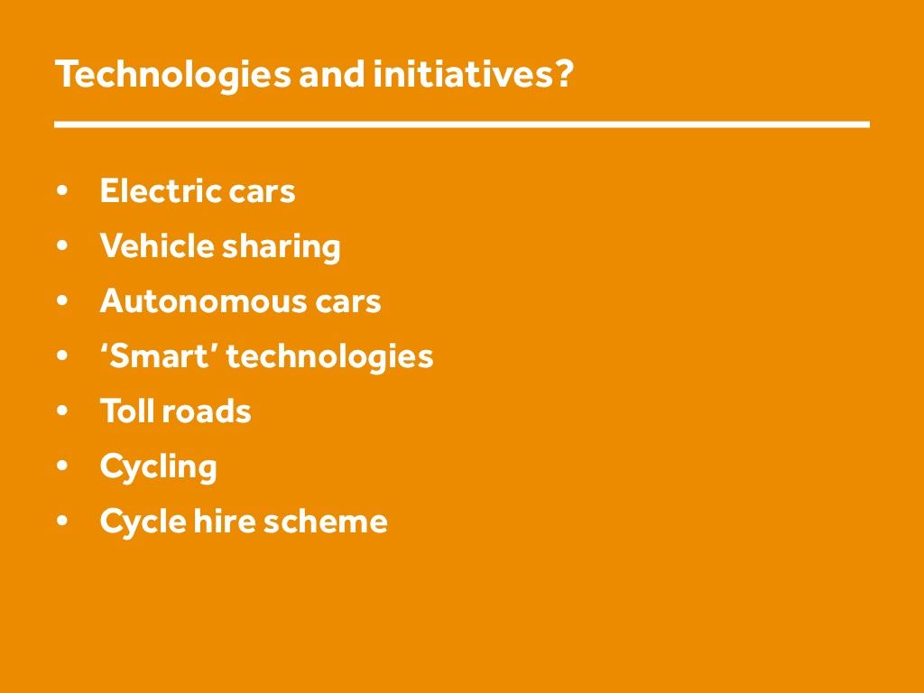
Notes:
Slide – Technologies and initiatives?
Electric cars
Vehicle sharing
Autonomous cars
Smart technologies
Toll roads
Cycling
Cycle hire scheme

Slide 20
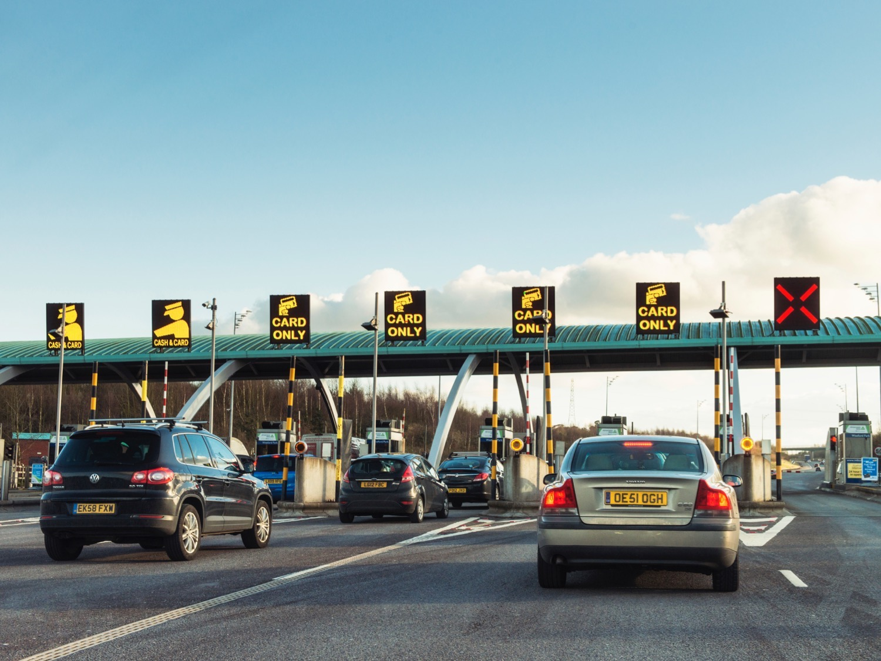
Notes:
Slide - Example of toll road initiatives. M6 Toll.

Slide 21
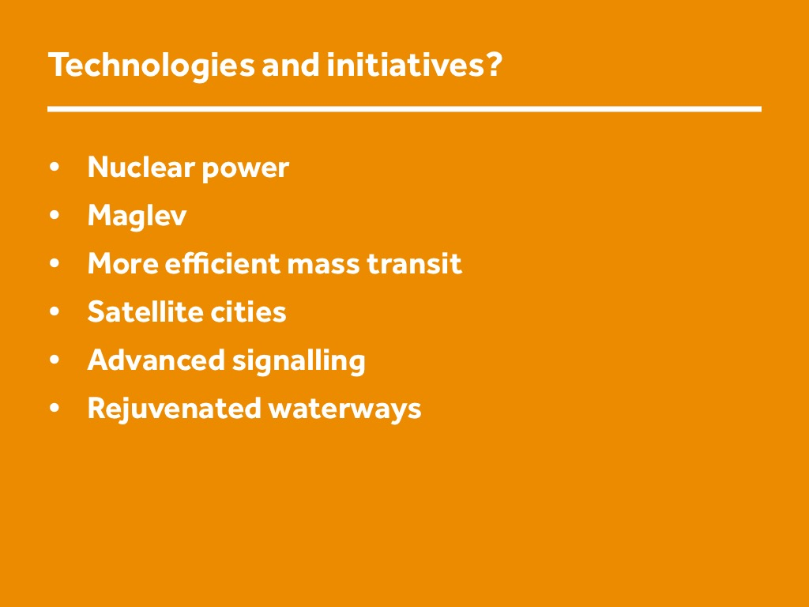
Notes:
Slide – More technologies and initiatives?
Nuclear power
Maglev
More efficient mass transit
Satellite cities
Advanced signalling
Rejuvenated waterways

Slide 22
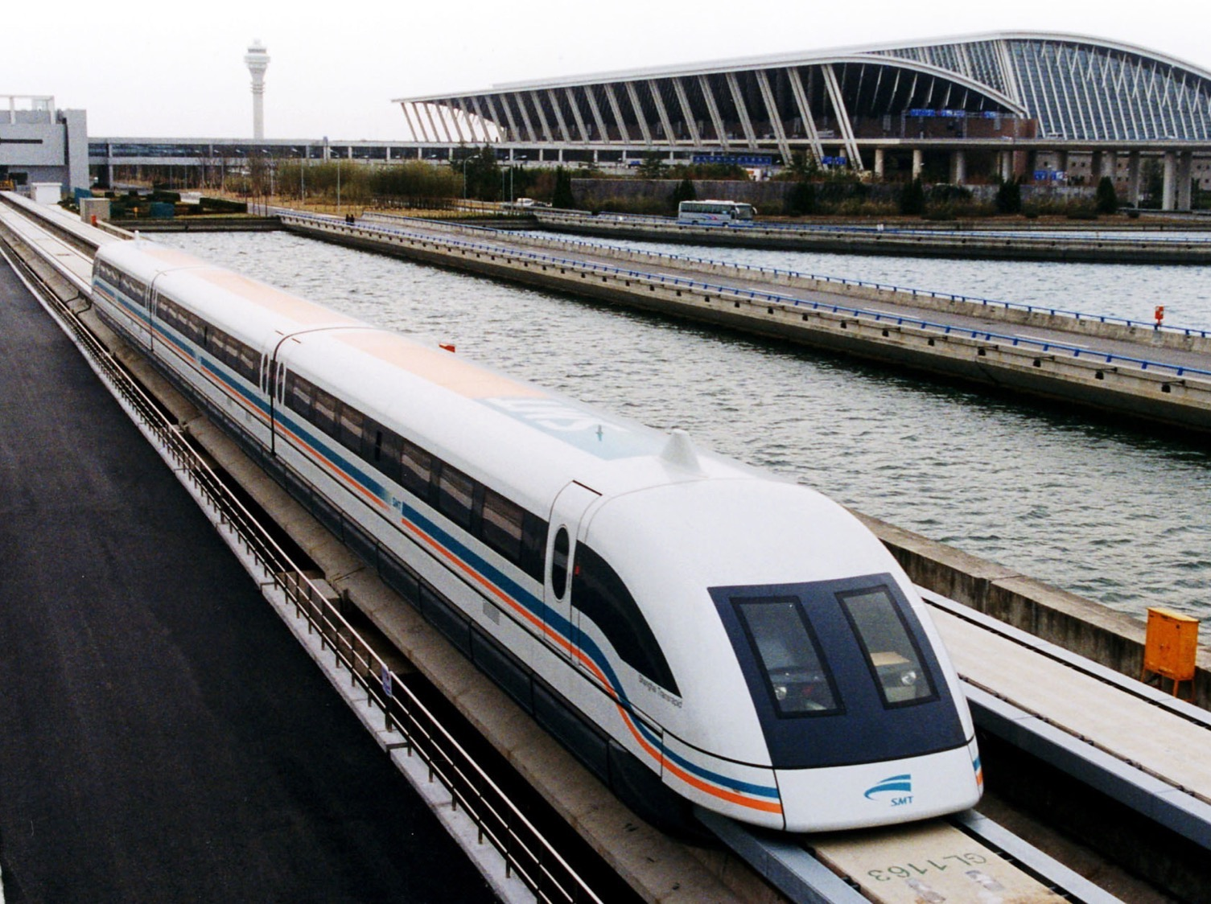
Notes:
Slide - Example of Maglev technology. Shanghai Maglev Train, Pudong International Airport.

Slide 23
Discussion 2
What's new and on the horizon
Notes:
This is an optional activity / discussion.
Action:
To undertake this discussion, you will first need to undertake a little research on one or two big transport projects that are either taking place now, or that are on the horizon. Begin the discussion with the students giving a brief summary of those projects.

Slide 24
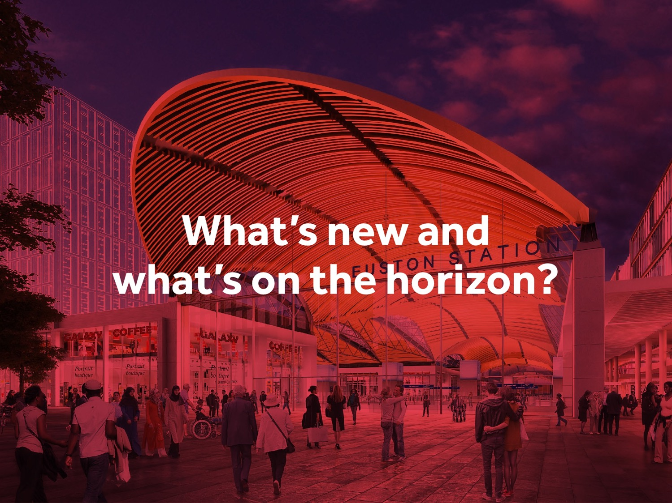
Notes:
Explain
In this part of the session you will be shifting to think about exciting new projects, and how these address some of the challenges identified.
there are major infrastructure projects being delivered all the time to meet our changing needs.
We are now going to have a look at what transport projects are on the horizon.
Explain that all of these projects represent opportunities for exciting work for highways and transportation professionals
Discussion:
What jobs do you think are needed to fulfil the roles and meet the needs of these projects?

Slide 25
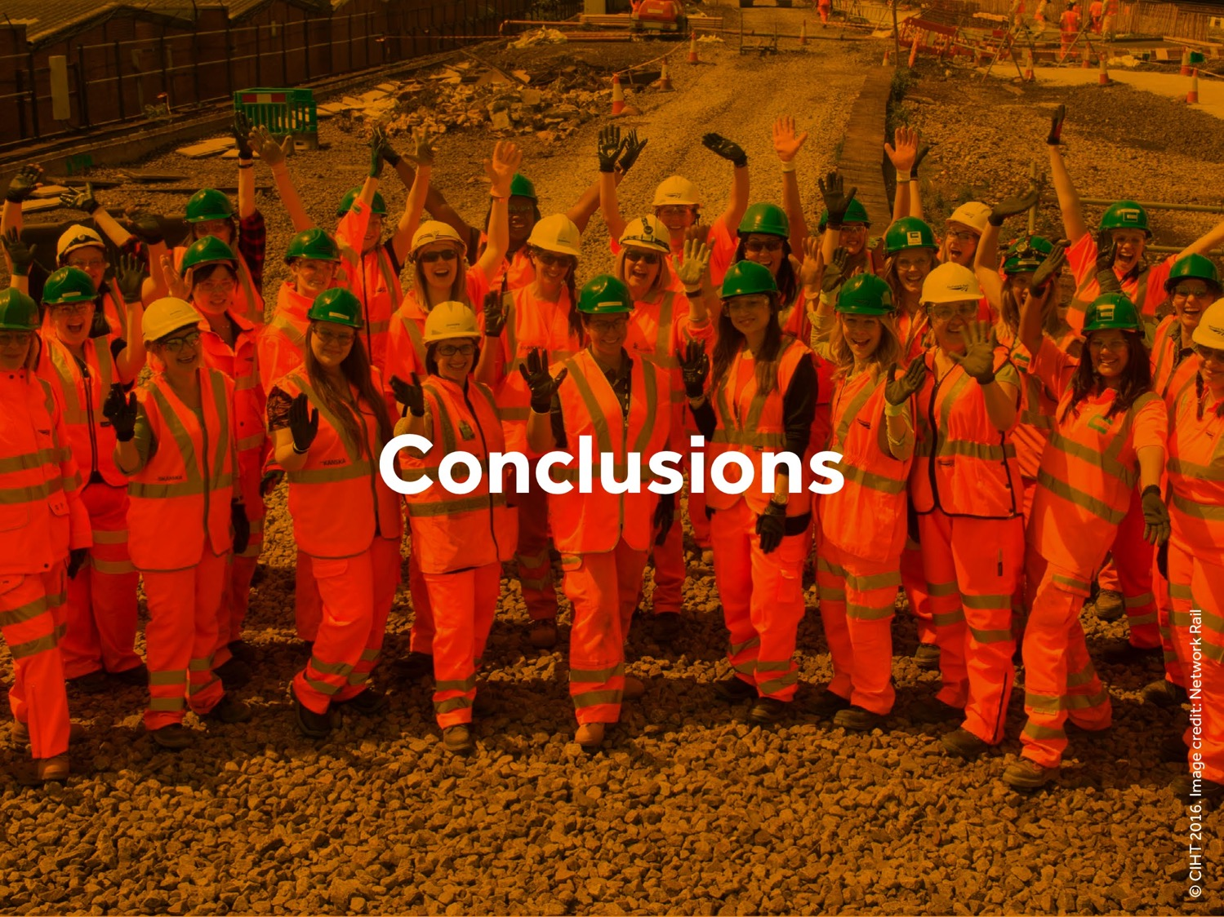
Notes:
Explanation
Summarise the key points from the session, making the link with the possible job roles. Explain about career routes.
Slide – Conclusions
Explain:
Now we have finished our whirlwind tour.
On-route we have discovered that transport infrastructure exists at a large range of scales.
That we are dependent on transport infrastructure for our quality of life, for getting around and for goods and services.
That transport infrastructure faces a range of challenges in future.
We are also going to be building a huge amount of infrastructure in the future.
All of which means there are exciting job opportunities for Transport Planners, Transport Engineers and Asset Managers.

Slide 26
Notes:
END SLIDE
Thank you. For more information you can go to www.ciht.org.uk/careers

