Slide 1
Where is my food from?

Slide 2
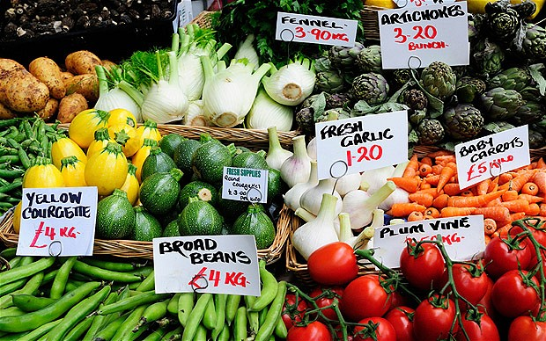
Food provenance
Food provenance means where ingredients and the foods made from them originally come from.
Many consumers want to know where their food originated.

Slide 3
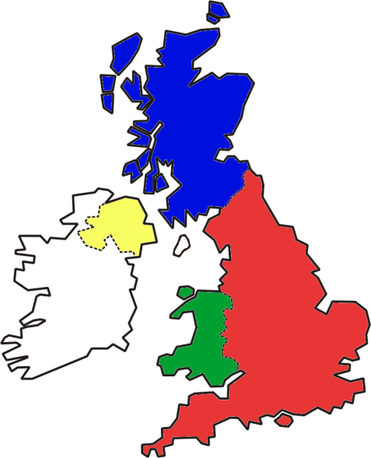
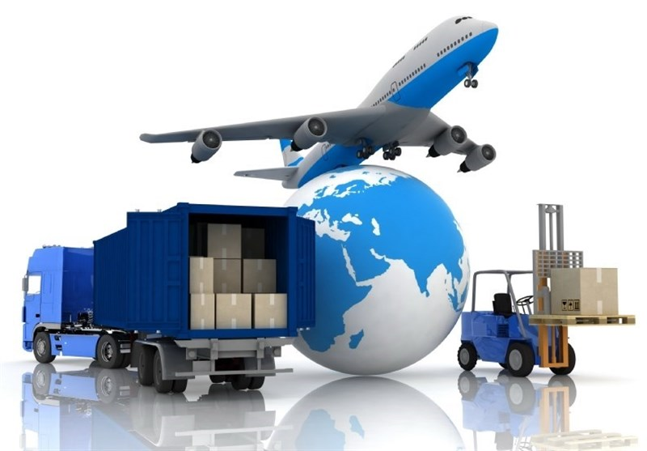
Where does our food come from?
Many ingredients and foods we eat are grown, reared or caught in the UK.
Name some familiar foods from the UK.
Some foods are imported from other parts of the world.
Name five foods that are imported.

Slide 4
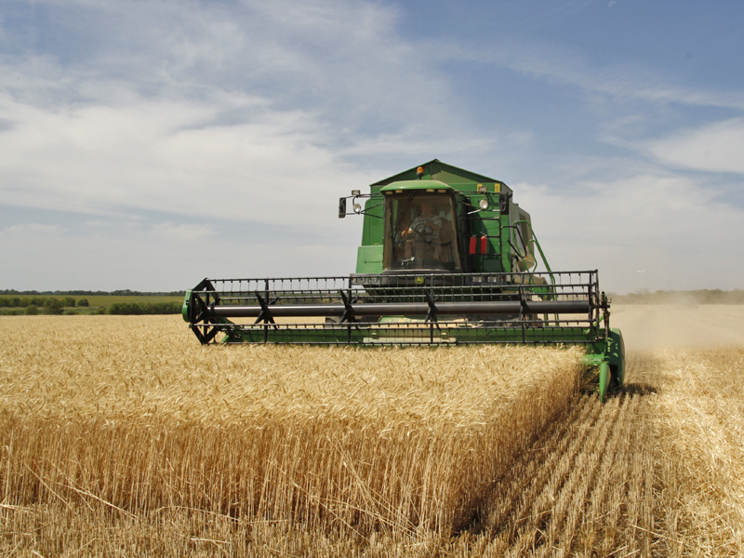
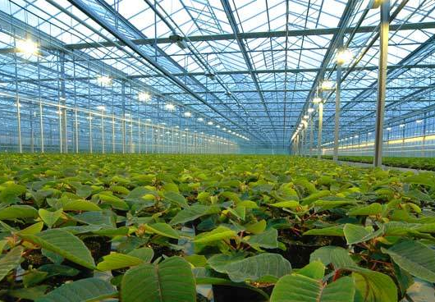
Growing food
Many types of food from plant sources are grown all over the world. These include:
cereal crops;
fruits;
vegetables;
nuts;
herbs and spices.
Food can be grown in gardens, allotments, greenhouses, orchards and fields.

Slide 5
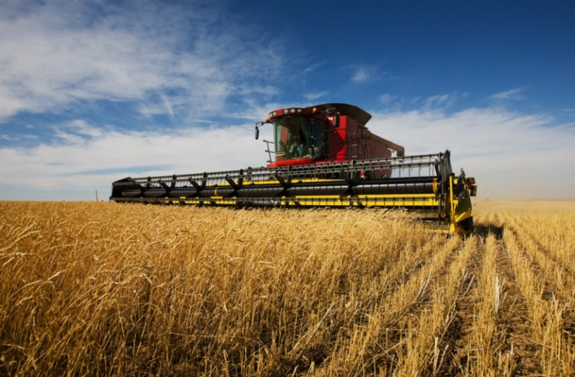
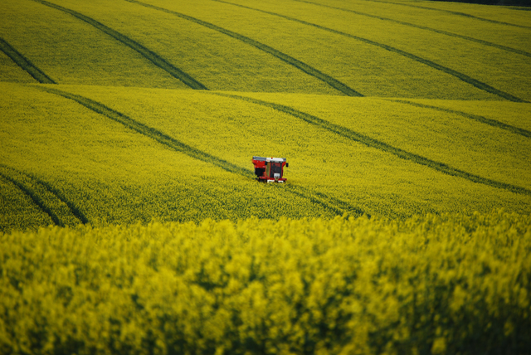
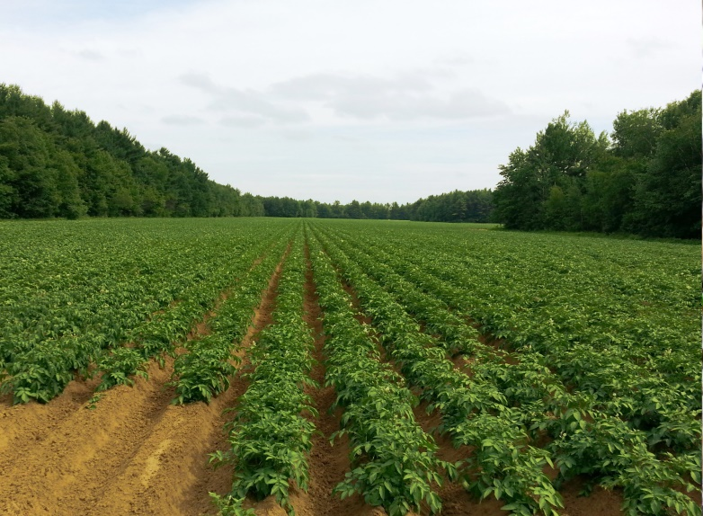
Food grown in the UK
Many plant crops are grown in the UK. They are an essential part of our food supply.
Some are grown on a large scale, this is called intensive farming.
What crops are grown on a large scale in the UK?
Wheat
Oil seed rape
Potatoes

Slide 6
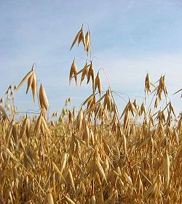
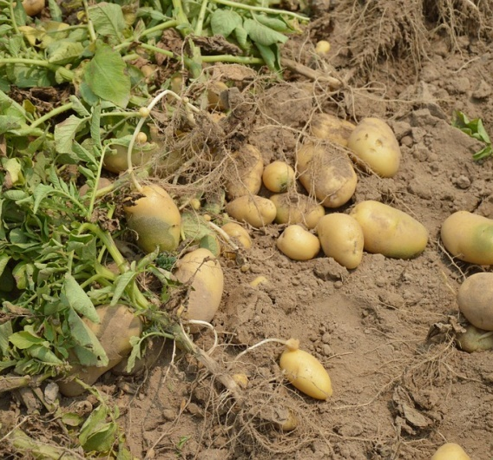
Food grown in the UK
Different types of plant crops grow in different regions of the UK.
The principle crops are:
wheat;
barley;
oats;
potatoes;
sugar beet;
vegetables;
oil seed rape;
fruits.
Did you know?
Oats are the UK’s third largest home-grown cereal crop, behind wheat and barley.
Source: AHDB

Slide 7
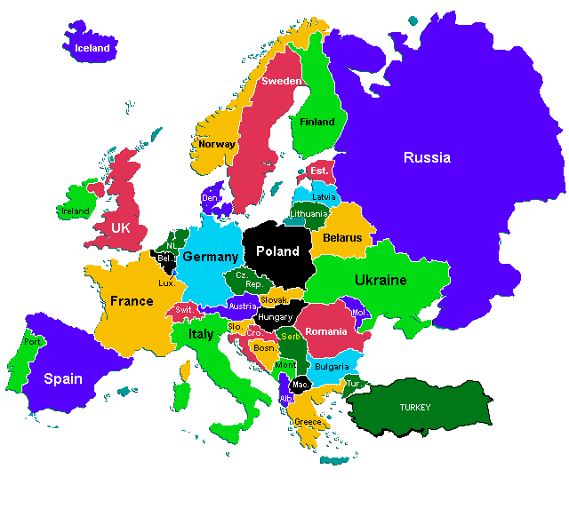
Food grown in Europe
There is a great variety of foods grown all over Europe. The type of farming is partly determined by the climate and geography of the country or region.

Slide 8
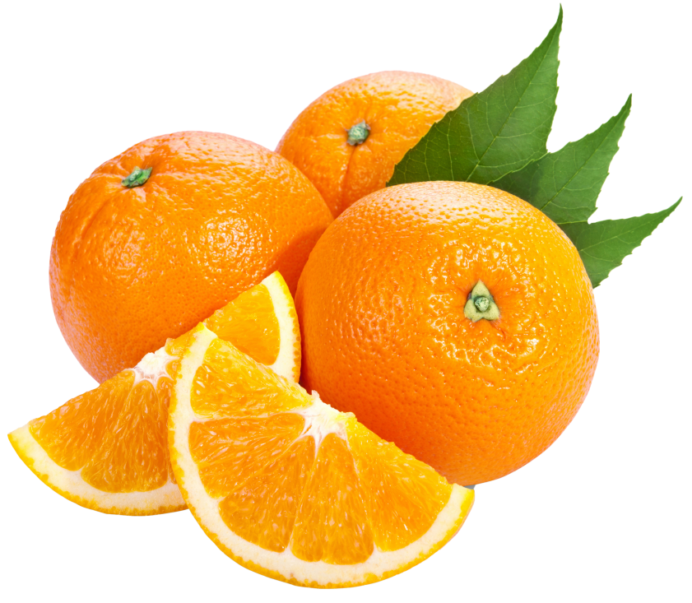
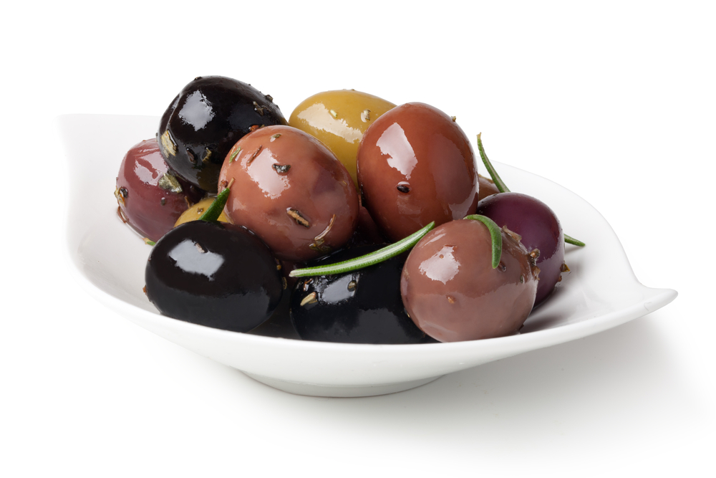
Where in Europe do you think these foods are grown?
Southern Europe – Spain, Italy, Greece, Portugal, Turkey
Spain, Italy, Greece, France
Why do these foods grow successfully in these regions?

Slide 9
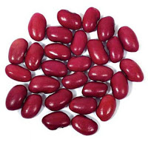
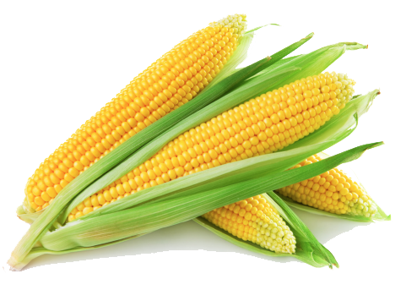
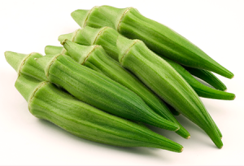
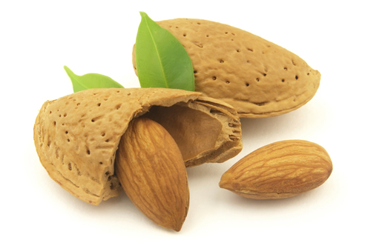
Food grown in the rest of the world
The variety of ingredients and foods that are now readily available have been introduced to the UK over a long period of time.
Many are imported from other countries giving access to ingredients and foods that would not normally grow in the UK.
The availability of these ingredients and foods gives us a wide choice throughout the year.
What other examples can you name?

Slide 10
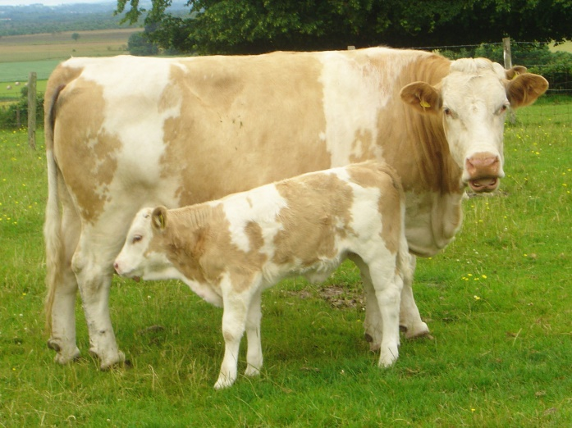
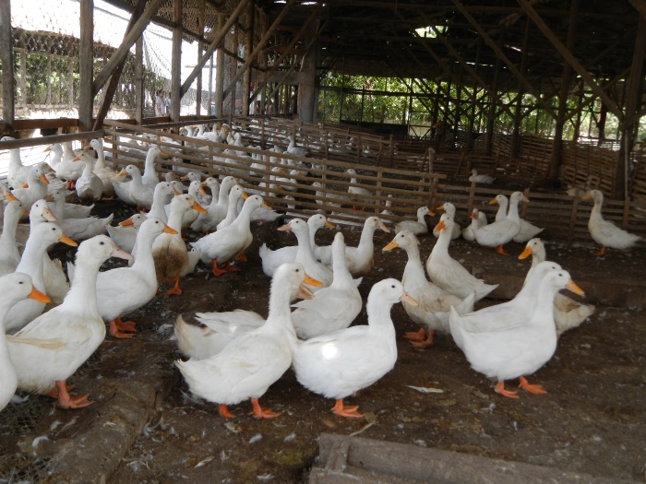
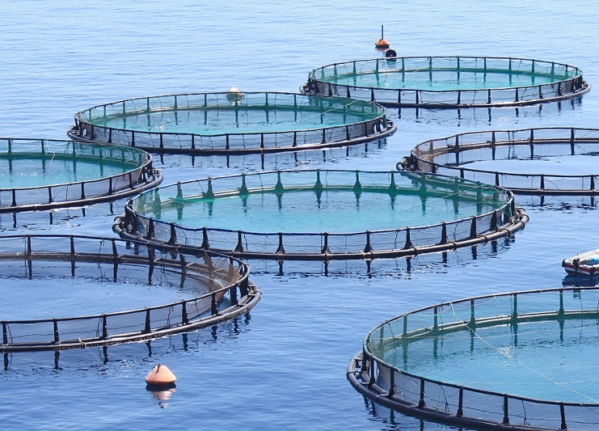
Rearing livestock
Animals are reared for their meat and their products.
This includes cattle, pigs, sheep and poultry (e.g. chicken), fish such as farmed salmon and products such as eggs and milk.

Slide 11
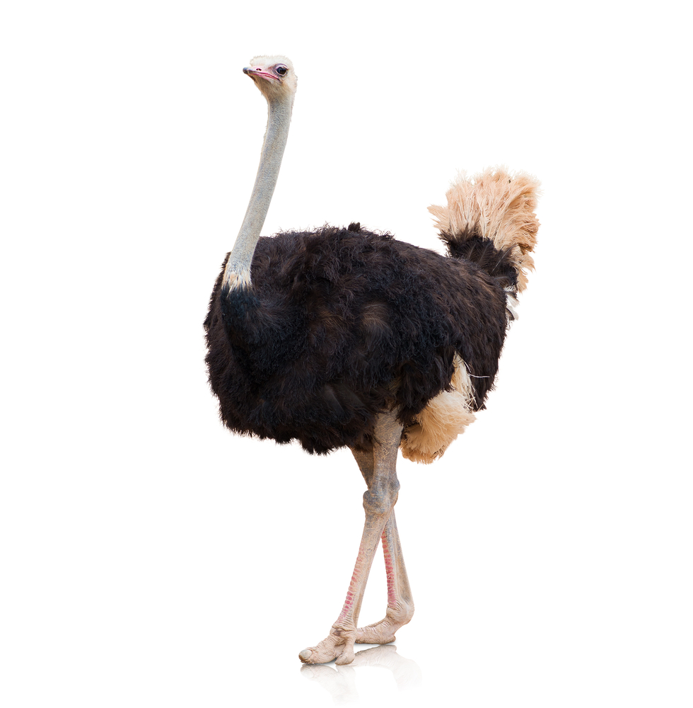
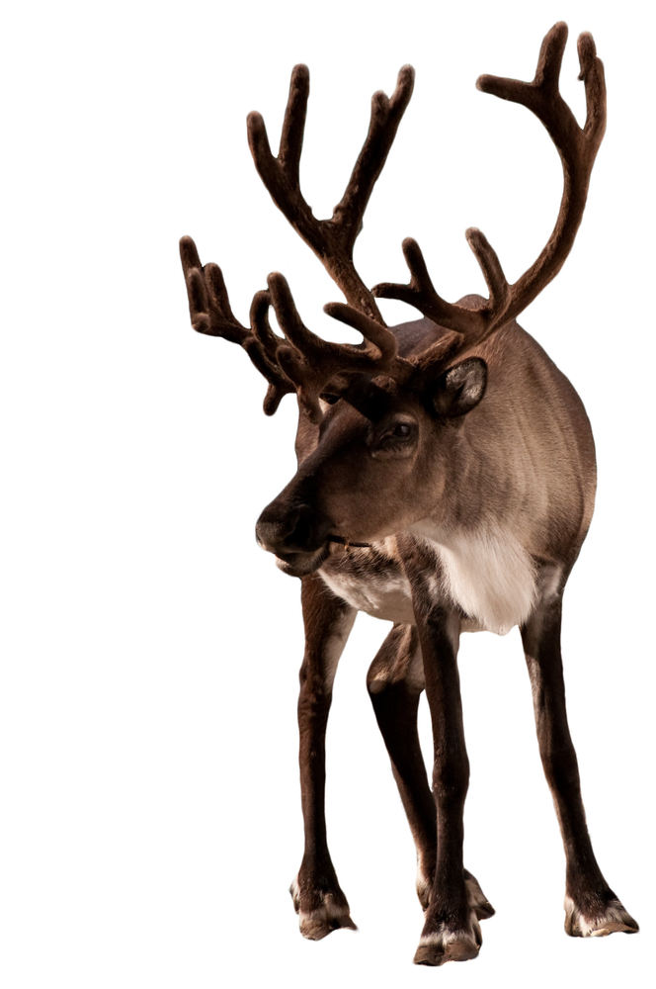
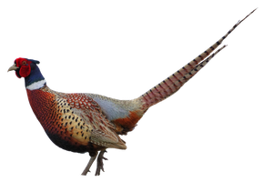
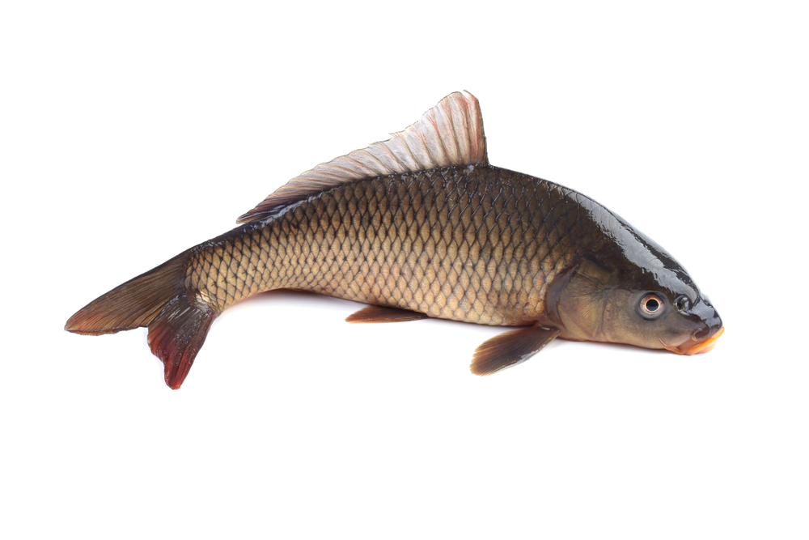
Reared livestock
Ostrich
Around the world other animals, birds and fish are reared for consumption.
Examples include:
Animals
Goat
Buffalo
Horse
Caribou
Llama
Guinea pig
Venison (deer)
Birds
Turkey
Geese
Duck
Ostrich
Game birds
Pheasant
Grouse
Quail
Fish
Salmon
Tilapia
Carp
Caribou
Pheasant
Carp

Slide 12
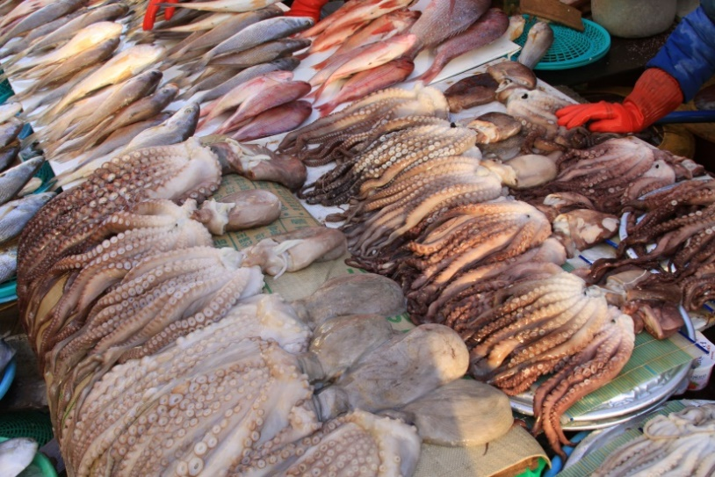
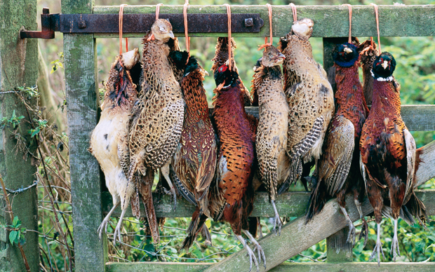
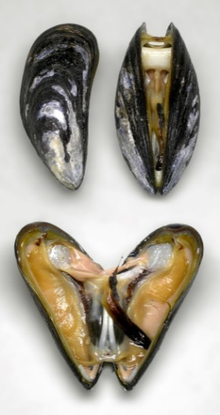
Catching food
Fish and seafood are caught from the wild for eating.
Some wild animals and birds may also be hunted and caught such as boar, venison, pheasant and grouse.
Fish and seafood are caught all over the world and provide many people with their main source of protein. There are fresh and salt water species.

Slide 13
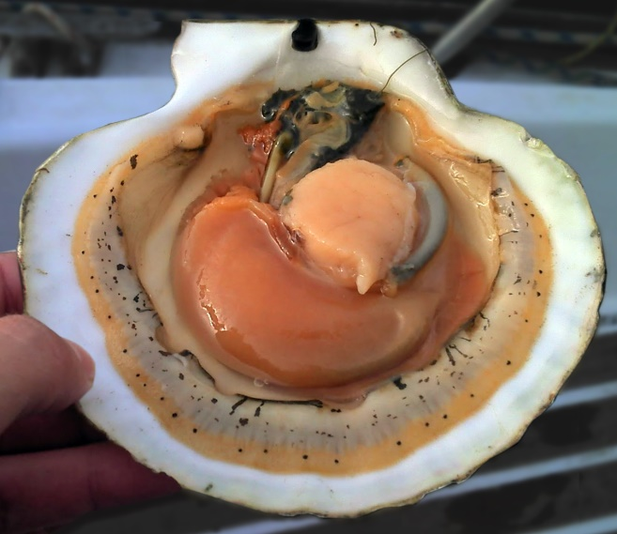
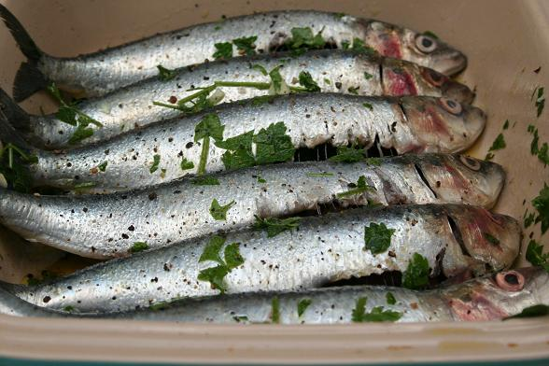
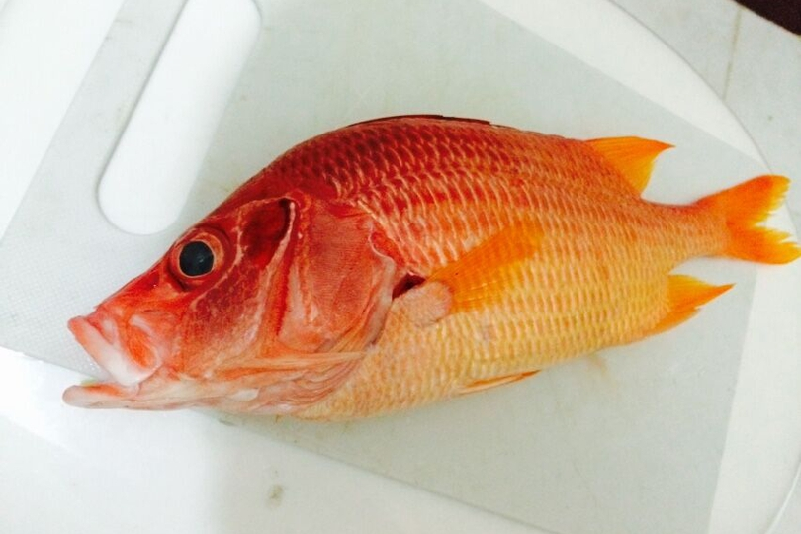
Caught food – fish and seafood
What these? Where in the world are they caught?
Scallops
Scotland
Sardines
Mediterranean
Red snapper
Mexico & Caribbean

Slide 14
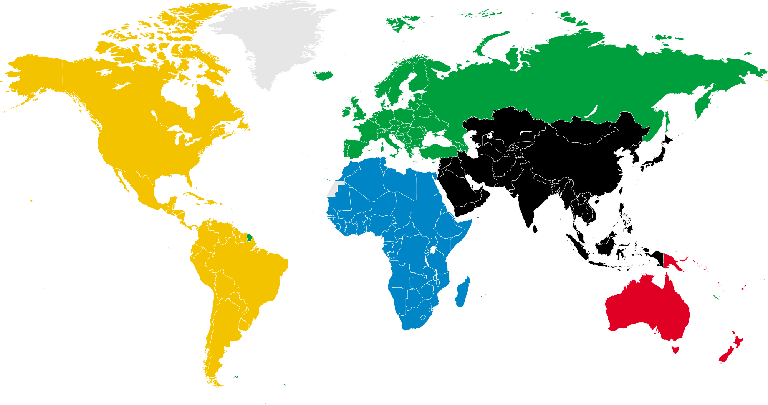
Where in the world?
Where do you think the following ingredients and food are from?

Slide 15
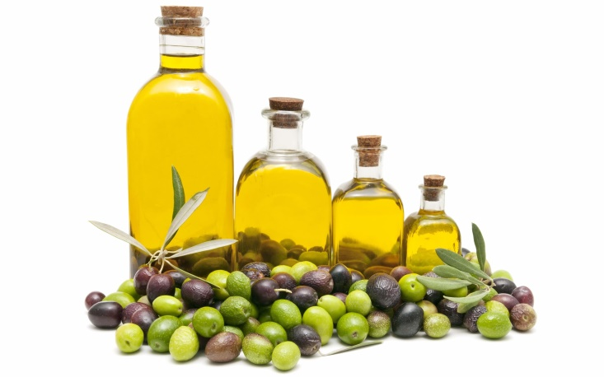
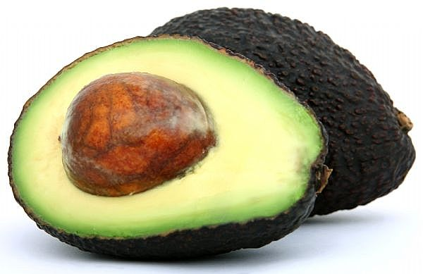
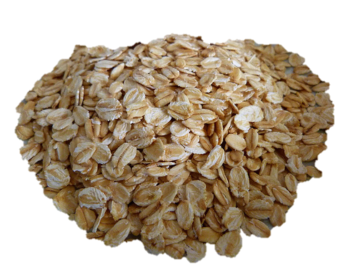
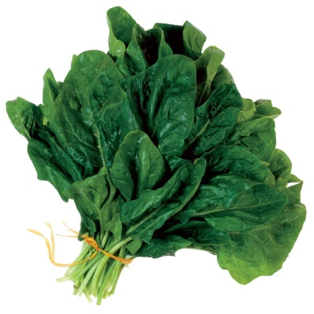
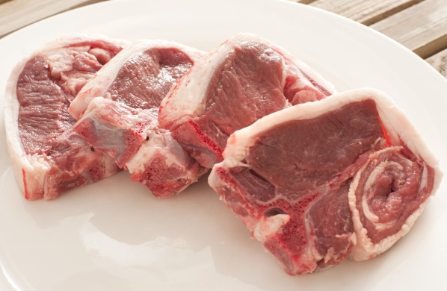
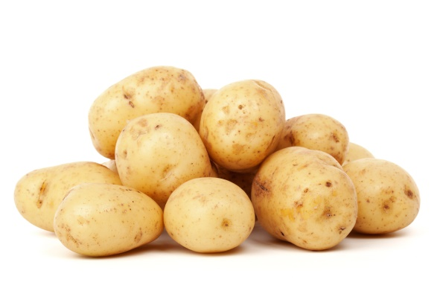
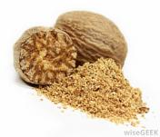
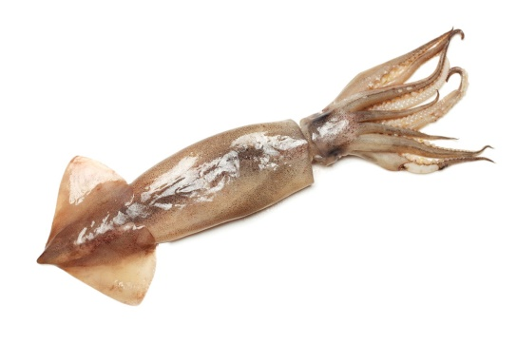
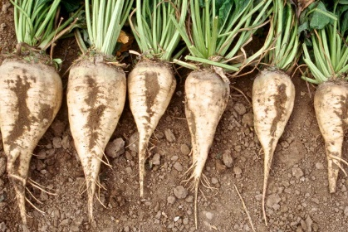
Spain, Italy, Greece
Mexico, USA
UK, Europe, Canada
Olive oil
Avocado pear
Oats
China, USA, Japan
UK, China, New Zealand
UK, Europe, North America
Spinach
Lamb
Potatoes
Indonesia and West Indies
North Atlantic, California, Hawaii
UK, Ireland, Europe, Russia
Nutmeg
Squid
Sugar beet

Slide 16
Where is my food from?
For further information, go to:
www.foodafactoflife.org.uk

