Slide 1
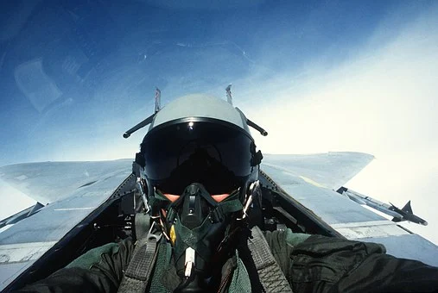
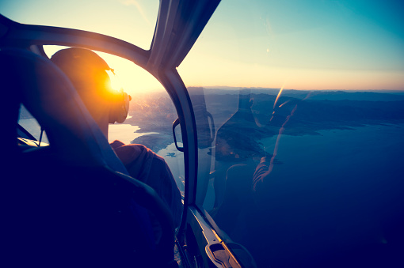
Wearable cockpit
Using modern technologies to enhance flight

Slide 2
Stay safe
Whether you are a scientist researching a new medicine or an engineer solving climate change, safety always comes first. An adult must always be around and supervising when doing this activity. You are responsible for:
ensuring that any equipment used for this activity is in good working condition
behaving sensibly and following any safety instructions so as not to hurt or injure yourself or others
Please note that in the absence of any negligence or other breach of duty by us, this activity is carried out at your own risk. It is important to take extra care at the stages marked with this symbol: ⚠

Slide 3
Design brief
Modern technologies, such as artificial intelligence (AI), augmented reality (AR) and virtual reality (VR), have the potential to completely change how pilots interact with and control their aircraft.
Your task is to design a helmet that acts as a ‘wearable cockpit’ for aircraft pilots. You must design the layout of the controls and show how modern technologies would be used.
Notes:
Explain what is meant by a virtual cockpit and the supporting technologies, such as AI (artificial intelligence), AR (augmented reality) and VR (virtual reality). The following weblink shows work that BAE are doing in this area and is useful for context: https://www.imeche.org/news/news-article/the-'wearable-cockpit'-could-change-fighter-jet-controls-forever

Slide 4
Specification
Produce a specification for the controls needed
How you integrate these into the wearable cockpit is up to you
Think about how each these controls would be used to control the aircraft
Wearable cockpit controls
Eye Tracking
Voice Controls
Gesture Control
Throttle
Joystick
Notes:
Points for discussion during the activity:
How would the pilot interact with the controls?
Could the pilot’s gaze cause a display to enlarge when looked at?
Could their gesture make something happen?

Slide 5
Mind map
Eye Tracking
Voice Controls
VR Helmet
Gesture Control
Joystick
Throttle
Notes:
Learners could produce a mind map of the controls needed to assist with their design thinking. A template for this is given on the activity sheet.

Slide 6
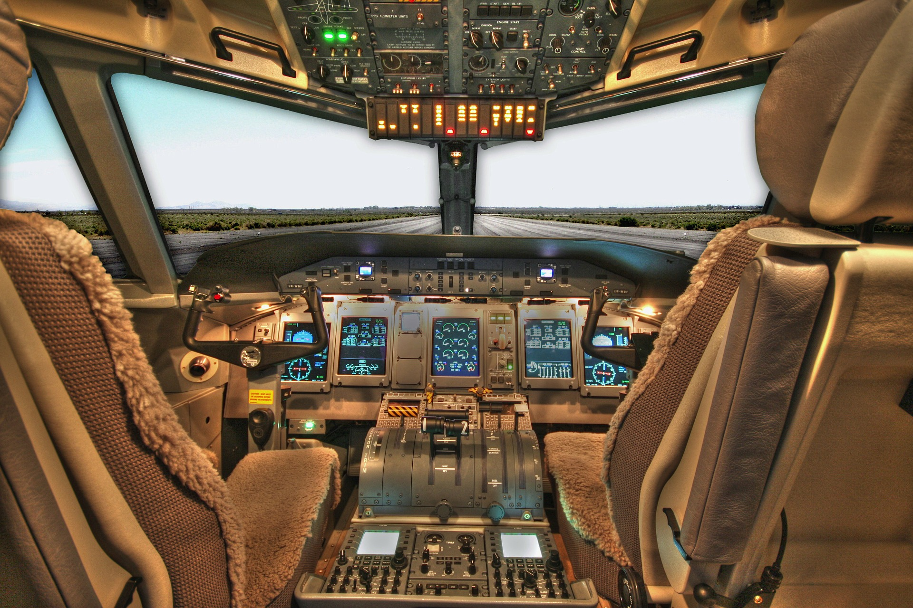
Points to consider – virtual display
What will the display look like?
Have all the controls been included?
How will the pilot interact with the controls?
What are the other key features you need to think about?

Slide 7
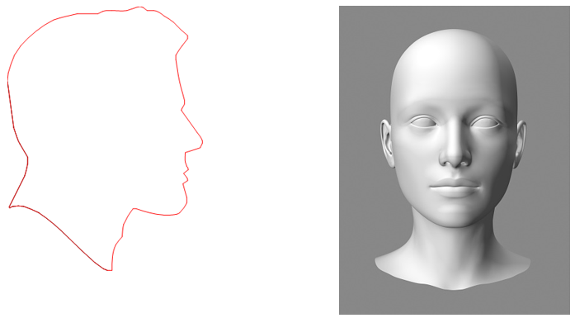
Points to consider - helmet
Does the cockpit helmet need to cover the whole head?
Could you use ergonomics and anthropometric data?
What are the other key features you need to think about?
Use the templates to help your designing
Notes:
As an extension, learners could produce a card model of their design.

Slide 8
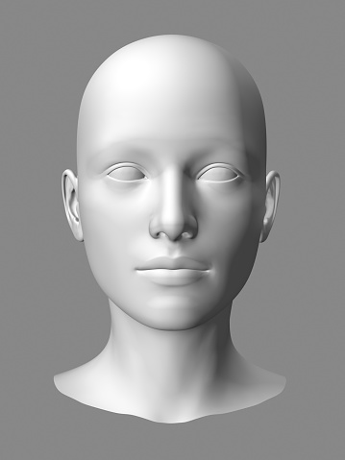
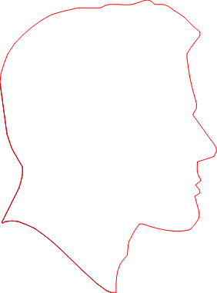
Initial helmet ideas design template
Notes:
Learners could use the template on the activity sheet to sketch initial ideas for a wearable cockpit helmet.
There is also space provided on the activity sheet for producing a final, neat and fully labelled design sketch.

Slide 9
Evaluation of design
Check your design ideas against your specification
Answer all the questions on the activity sheet
Have you managed to cover all of the points?
How could you improve your design?
Is there anything else you added?
Specification point | Included (✓ or ✗) | Reason
Joystick
Throttle
Eye Control
Gesture Control
Voice Control
Notes:
Explain that the success of a design is usually measured against the original specification, so it is important to evaluate against this.
This is a good opportunity to include peer/self assessment, as learners could evaluate each other’s designs.
The activity sheet gives a set of questions and a table that can be filled in to assist with this task.

