Slide 1
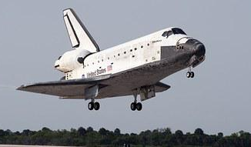
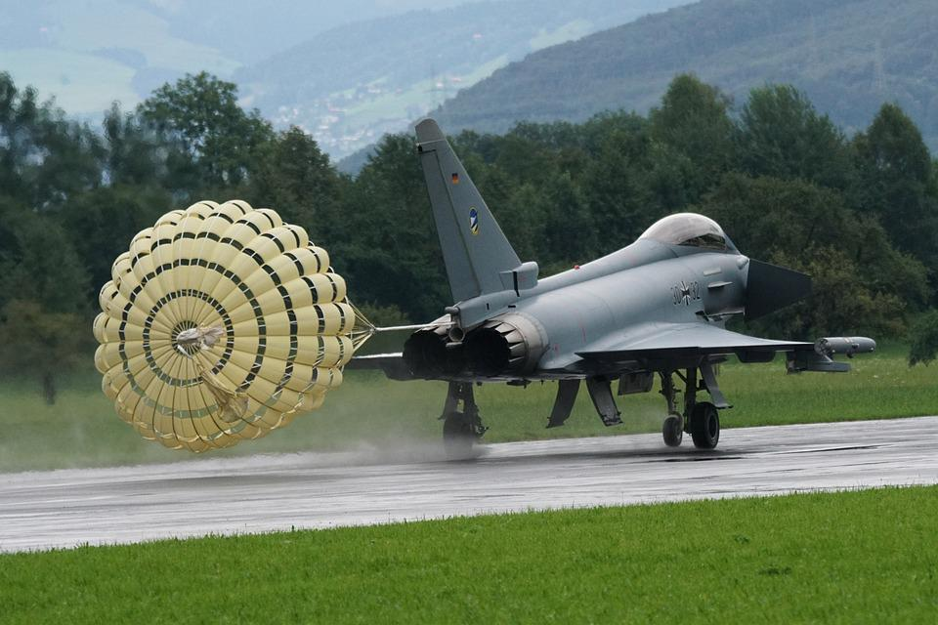
Stop it!
Developing a parachute-type system to slow a landing spacecraft

Slide 2
Stay safe
Whether you are a scientist researching a new medicine or an engineer solving climate change, safety always comes first. An adult must always be around and supervising when doing this activity. You are responsible for:
ensuring that any equipment used for this activity is in good working condition
behaving sensibly and following any safety instructions so as not to hurt or injure yourself or others
Please note that in the absence of any negligence or other breach of duty by us, this activity is carried out at your own risk. It is important to take extra care at the stages marked with this symbol: ⚠

Slide 3
Situation and context
When spacecraft and jet aircraft land on the ground they are travelling very fast
A method is needed to reduce their speed so they can stop without overshooting the runway
A parachute can be used as this is very effective at increasing drag
Notes:
Explain that the space shuttle used to land at about 220 miles per hour (354 kph).
Explain that parachutes have a very large surface area but pack away really small.

Slide 4
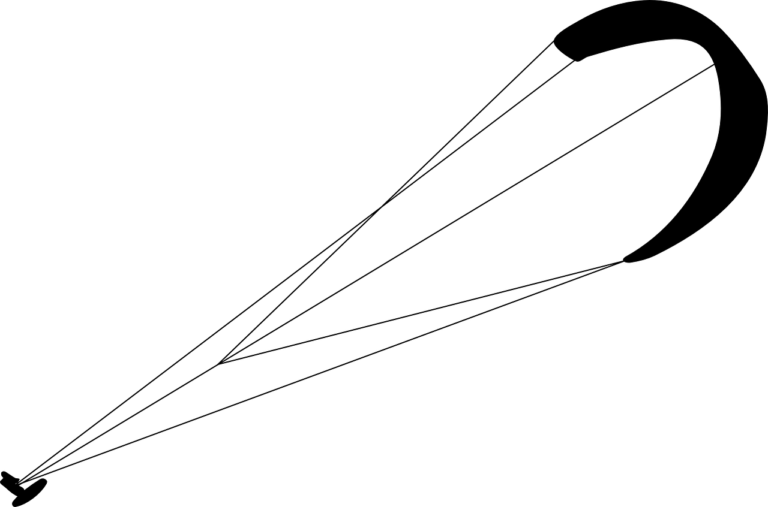
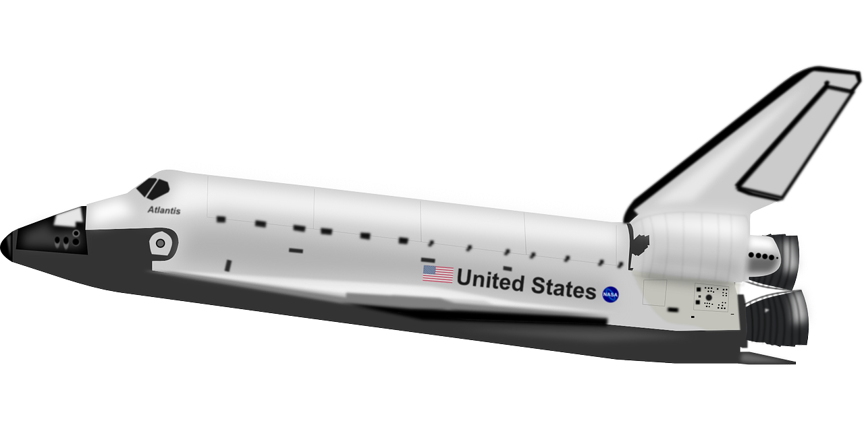
Design brief
Your task is to make a prototype of a parachute system that could slow a landing spacecraft
You will also test the prototype you make to see how well it works

Slide 5
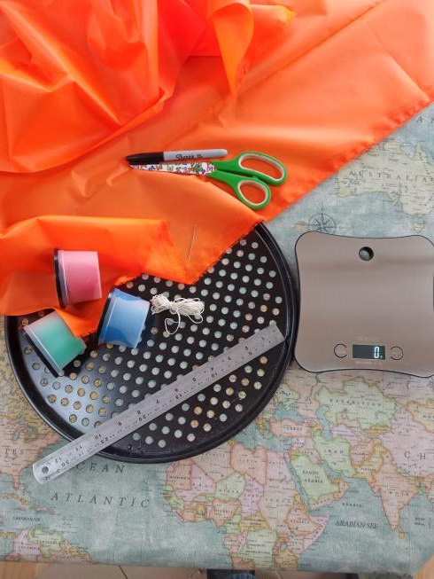
Resources
Thin fabric e.g. rip stop nylon
Thin string or thread
A marker pen
A weight or piece of clay
Scales
Scissors
A sewing needle
A ruler
Notes:
These resources listed and the following slides are for an example of a prototype parachute that could be made as starting point for weaker learners who are struggling to produce their own designs.

Slide 6
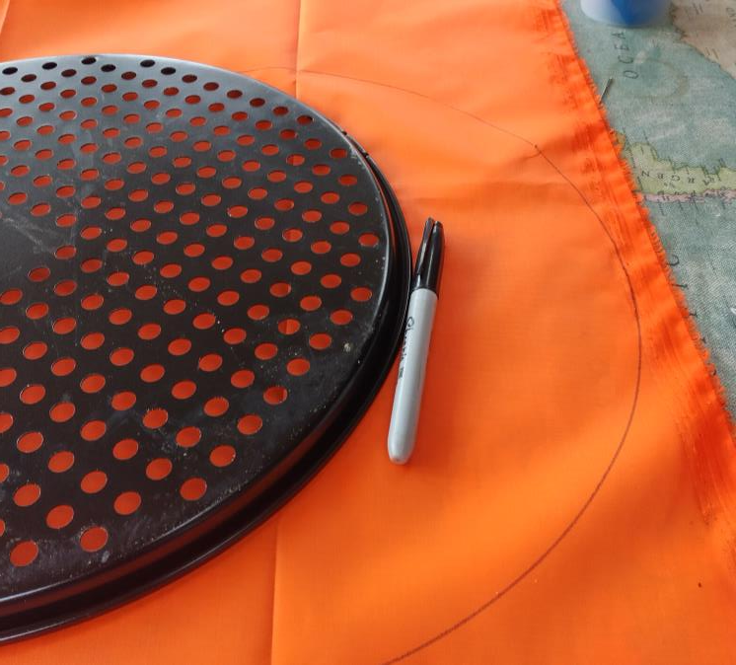
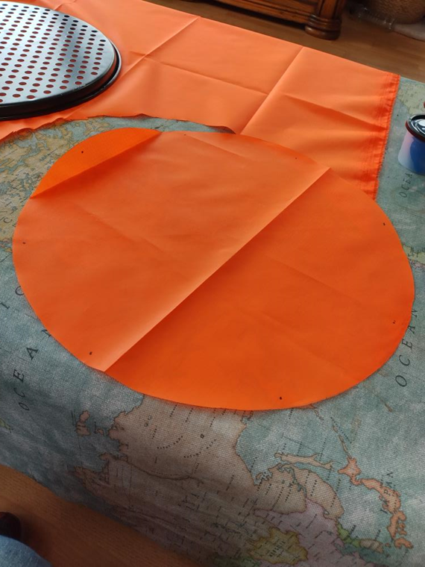
Making step 1 ⚠
Decide what shape you are going to make your parachute
Draw the shape on the fabric
Cut out the shape from the fabric
Notes:
A 36 cm pizza tray could be drawn around to create the shape.
Take care when using scissors.

Slide 7
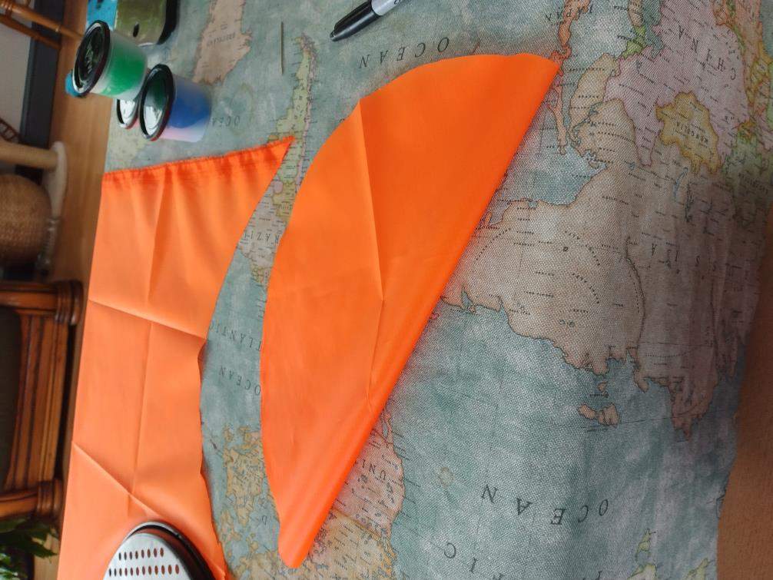
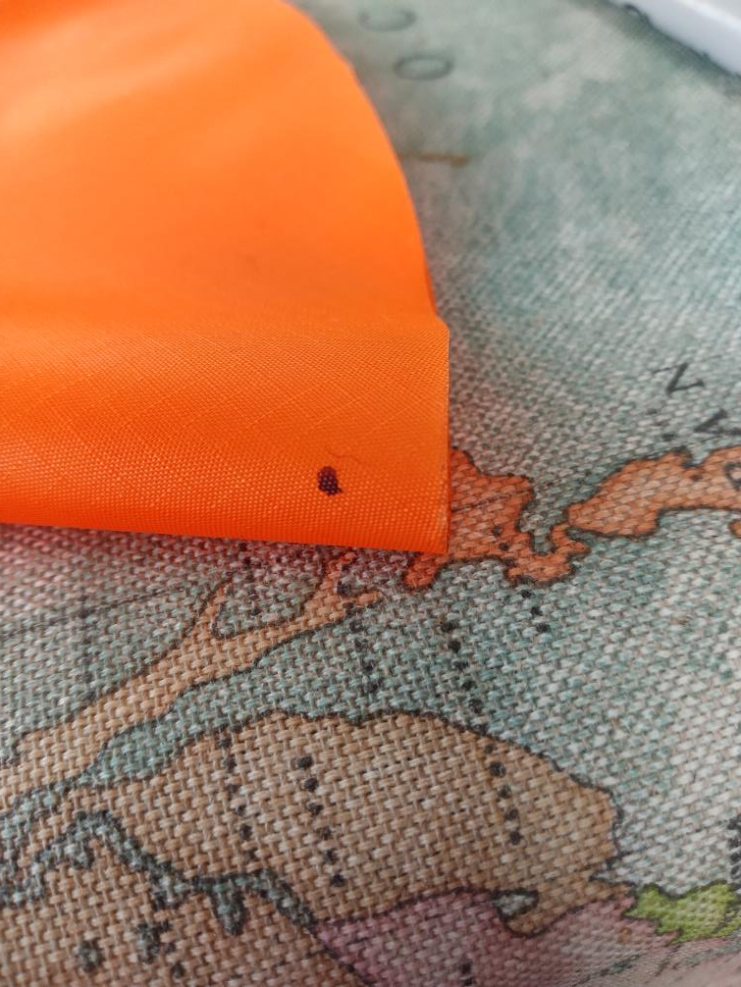
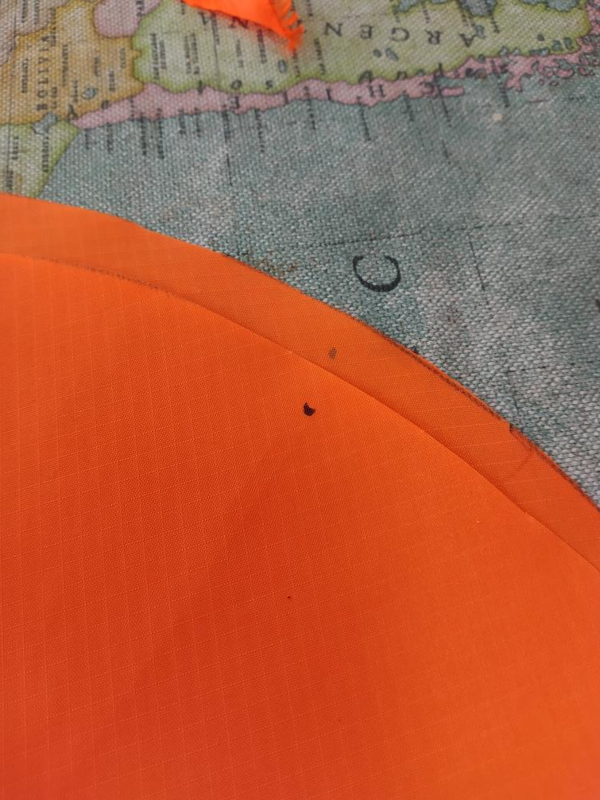
Making step 2
Decide how many strings you want, e.g. eight
Fold the circle in half and half again to mark out four points
Fold again to find the points in between
Mark each point with a clear dot. Make each dot 6 mm in from the edge

Slide 8
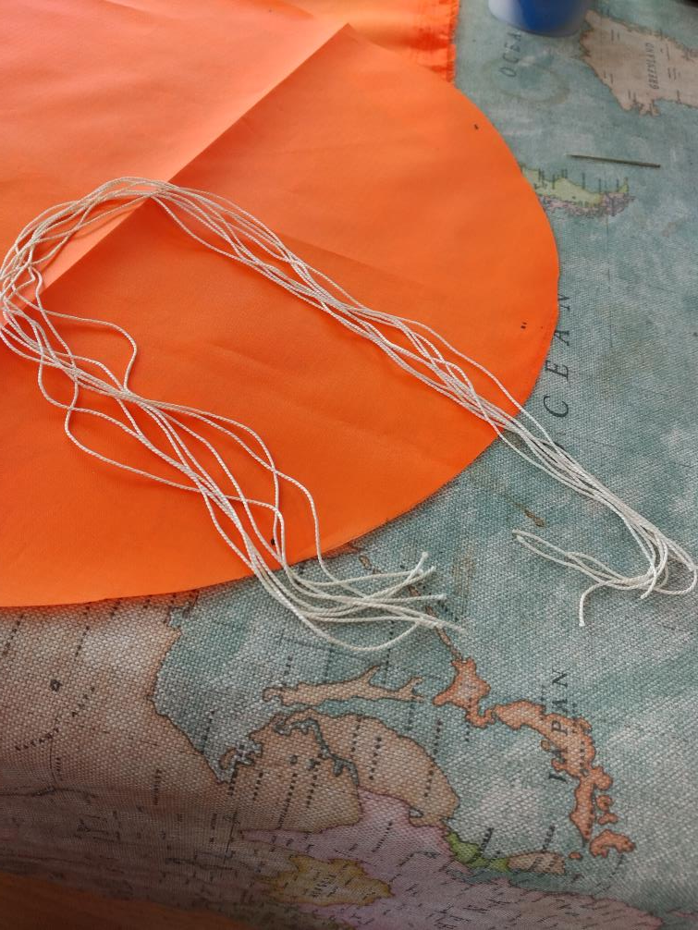
Making step 3 ⚠
Cut string lengths that are at least as long as your shape is wide
Notes:
String length could be 40 cm for a 36.5 cm circle.
Take care when using scissors.

Slide 9
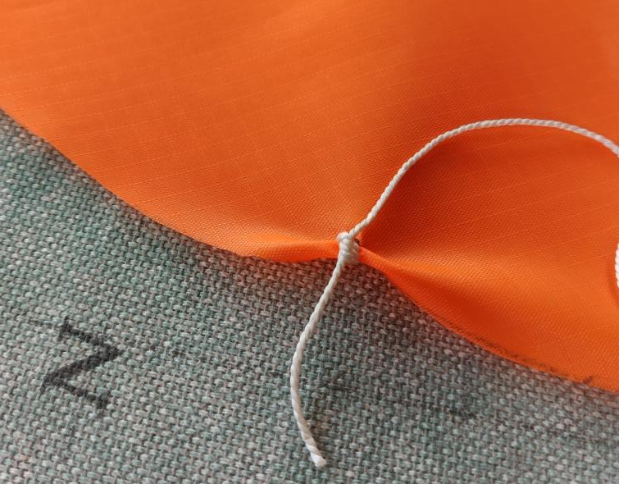
Making step 4 ⚠
Sew a string to each dot
Knot the strings securely, leaving as long a bit as you can on one end
Notes:
Take care when using sewing needles.

Slide 10
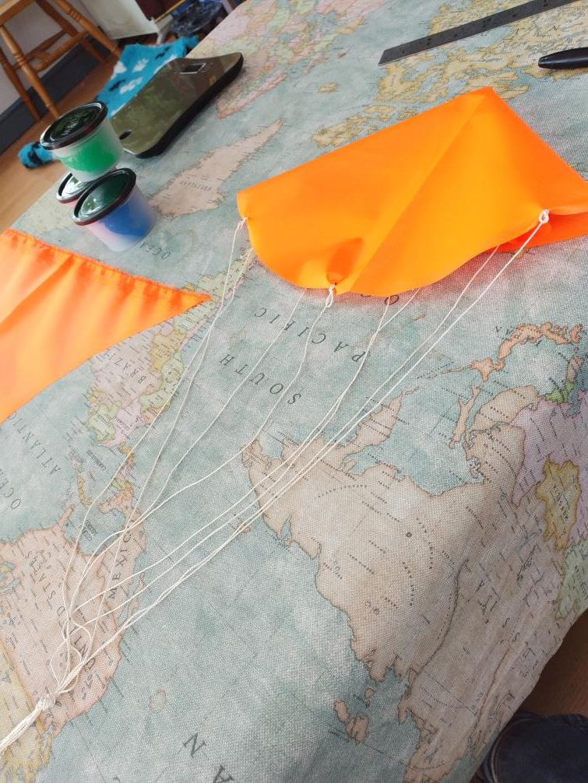
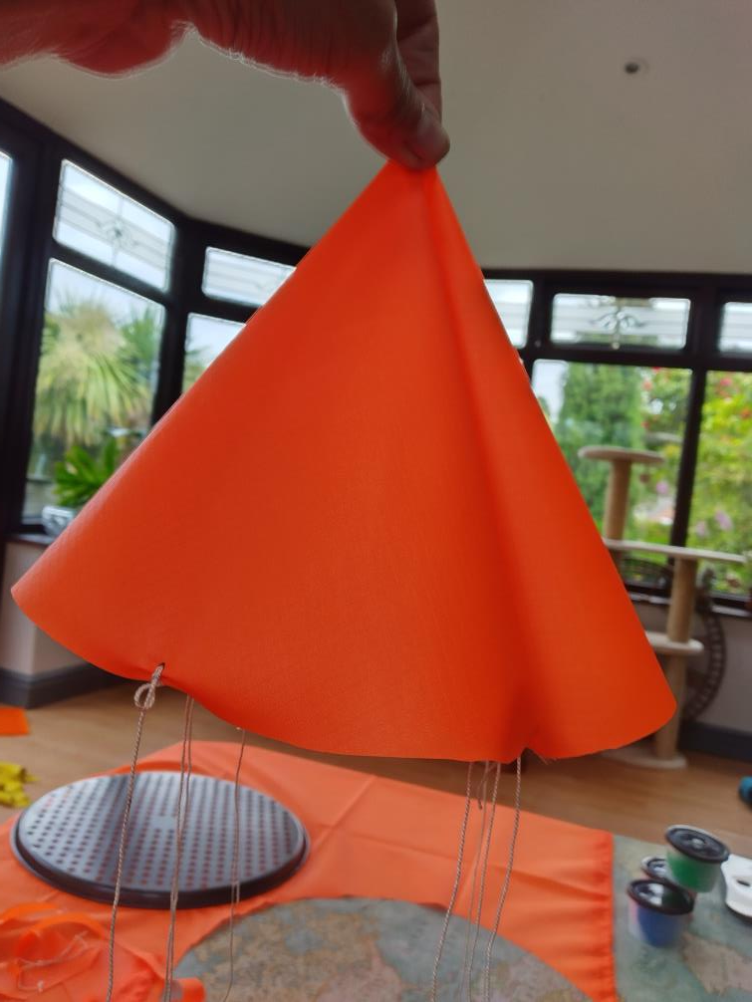
Making step 5
Gather the strings together and tie a knot
Leave enough string to tie the payload to the bottom

Slide 11
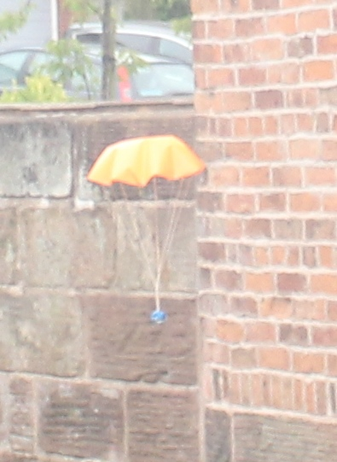
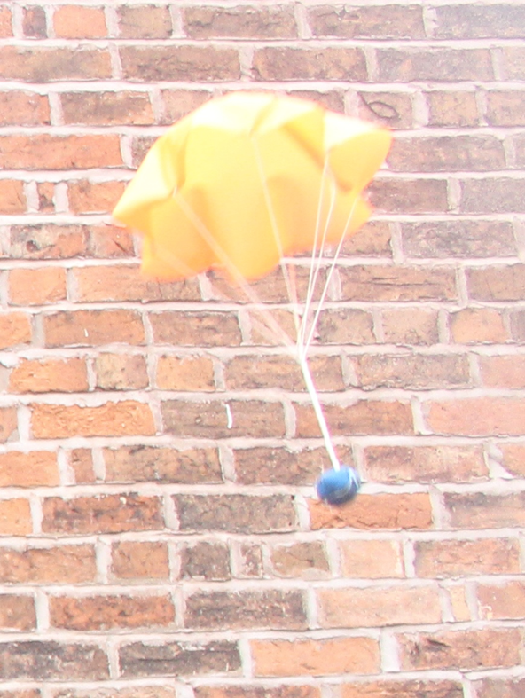
Testing ⚠
Attach your payload to the big knot
Hold your parachute from a high spot and let it go
Time how long it takes to reach the ground
How well did your parachute work?
How could it be modified to slow a spacecraft when landing?
Notes:
A small lump of play dough weighing around 30 g could be used for the payload.
Always take care when working from heights. Teacher must ensure appropriate risk assessments are followed.
Discuss how well the parachute worked – how well dd it slow the fall, did the materials used work well, did it avoid tearing or other damage on landing?

Slide 12
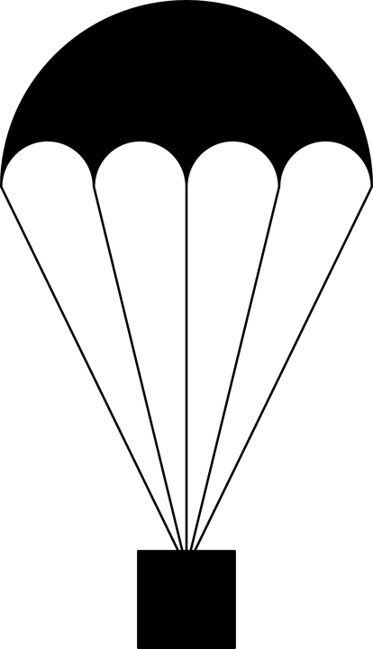
Extension
Try different shapes of parachute
Try different weights of payload
Do not change more than one variable at a time!
Notes:
This could be used as an extension task for more able learners.
Explain the issues that can be caused by changing more than one variable at a time.

Slide 13
Extension - Maths exercise
If you change the shape of the parachute then you have to be careful not to change the area of the parachute
So, If your first parachute is round and your second is square, what calculations do you need to do to keep the area the same?
Discuss this with a partner
The next slide shows one way of working this out
Notes:
This could be used as an extension task for more able learners.

Slide 14
Circle to square
Area of a square is L² where L is the side of the square
r
Area of a circle is π r² where r is the radius of the circle
L
If the areas are the same then L² = π r²
Rearranging this L = √(π r²)
Notes:
This could be used as an extension task for more able learners.
This example calculation is based on a circle of 36 cm diameter (the size of a pizza pan), therefore the radius is 18 cm.

Slide 15
Circle to square
Now you know the side of the square you can mark and cut out a square the same area as the circle to make a new parachute
You’ll only need 4 strings this time
Test it - does it slow down a payload of the same weight as well as the circular one, worse or better?
Try other shapes, but don’t forget to make all the areas the same
Notes:
This could be used as an extension task for more able learners.

