Slide 1
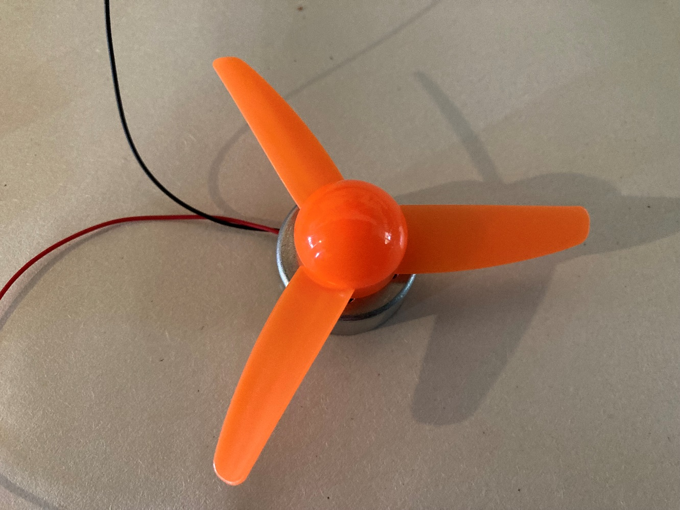
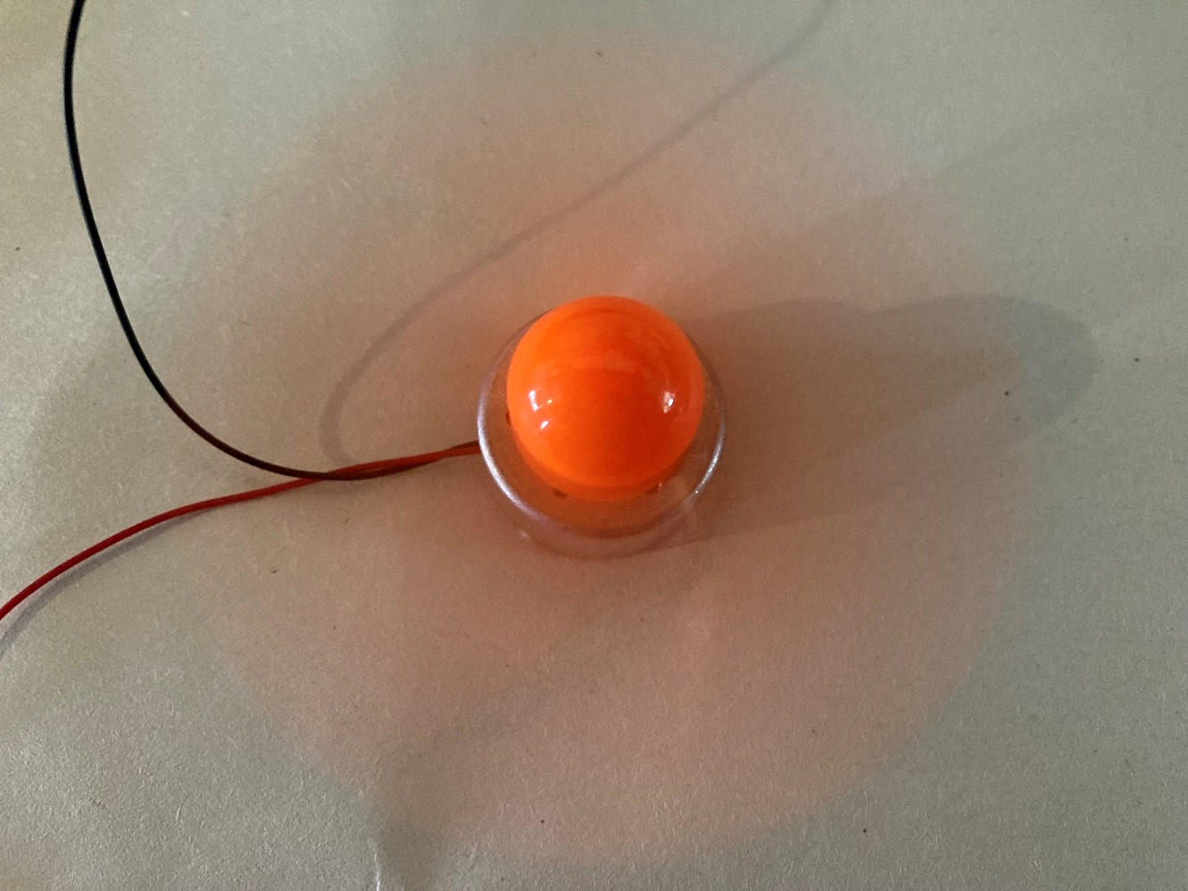
Solar powered engine
Making a model of an electric aircraft engine and calculating for how long this could power an aircraft

Slide 2
Stay safe
Whether you are a scientist researching a new medicine or an engineer solving climate change, safety always comes first. An adult must always be around and supervising when doing this activity. You are responsible for:
ensuring that any equipment used for this activity is in good working condition
behaving sensibly and following any safety instructions so as not to hurt or injure yourself or others
Please note that in the absence of any negligence or other breach of duty by us, this activity is carried out at your own risk. It is important to take extra care at the stages marked with this symbol: ⚠

Slide 3
Brief
Jet engines used on aircraft are produce a lot of carbon emissions.
They are therefore a large contributor to global warming.
Your task is to make a working model of an electric aircraft engine and calculate for how long this could power an aircraft.
Your engine must run off batteries that can be charged using solar energy

Slide 4
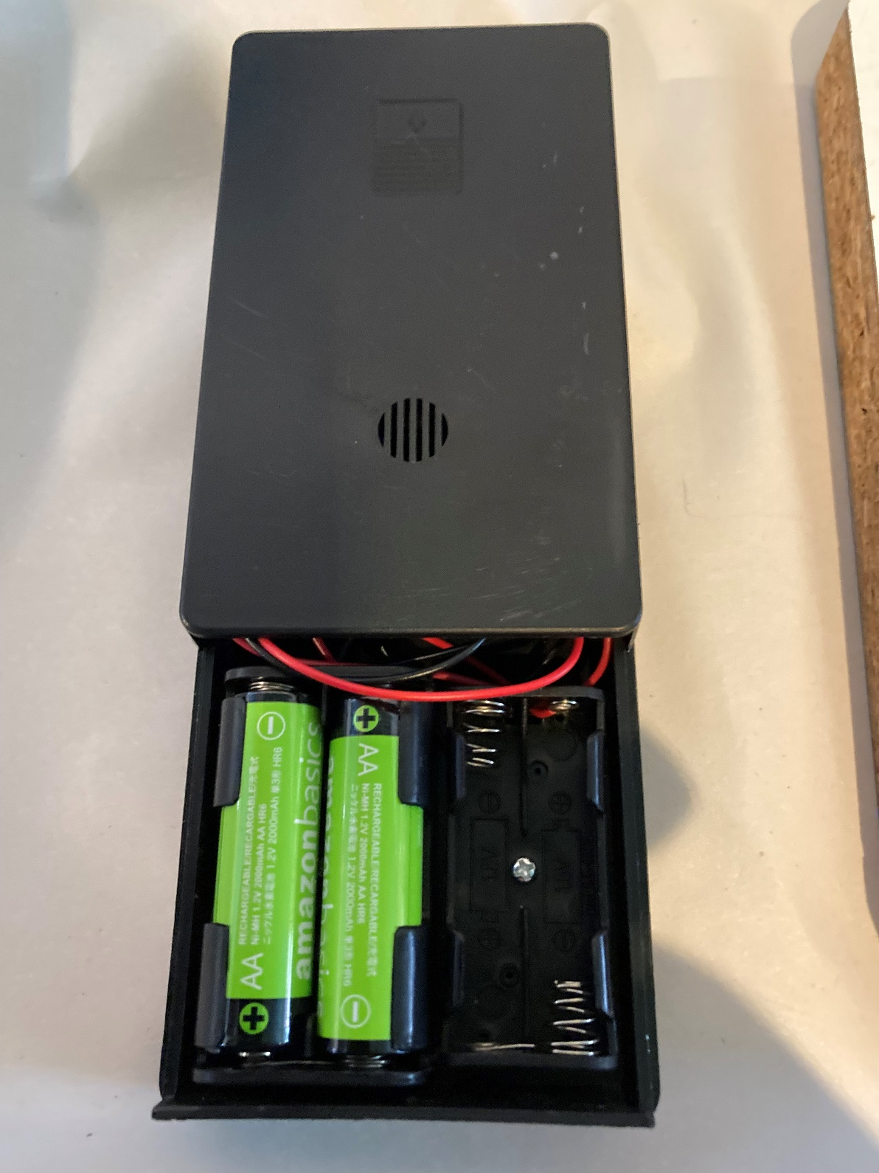
Resources
Solar AA battery charger
2 x rechargeable AA batteries
AA batteries connector/holder
Red and black crocodile clips
Slide or toggle switch
Electric solar motor
Notes:
A solar charger such as this could be used: https://www.amazon.co.uk/gp/product/B073W8VLTN
The motor must be appropriate to the power supply voltages used. For example, a low inertia solar motor, such as the below, would work with two AA batteries. https://kitronik.co.uk/products/2546-low-inertia-solar-motor-1000-rpm?gclid=CjwKCAjw3K2XBhAzEiwAmmgrAv7Bv_lKz-z9DWuAiOtcbbDhqhaFqkvDc4D5erxWcYOzAMZMbZhHORoC53MQAvD_BwE

Slide 5
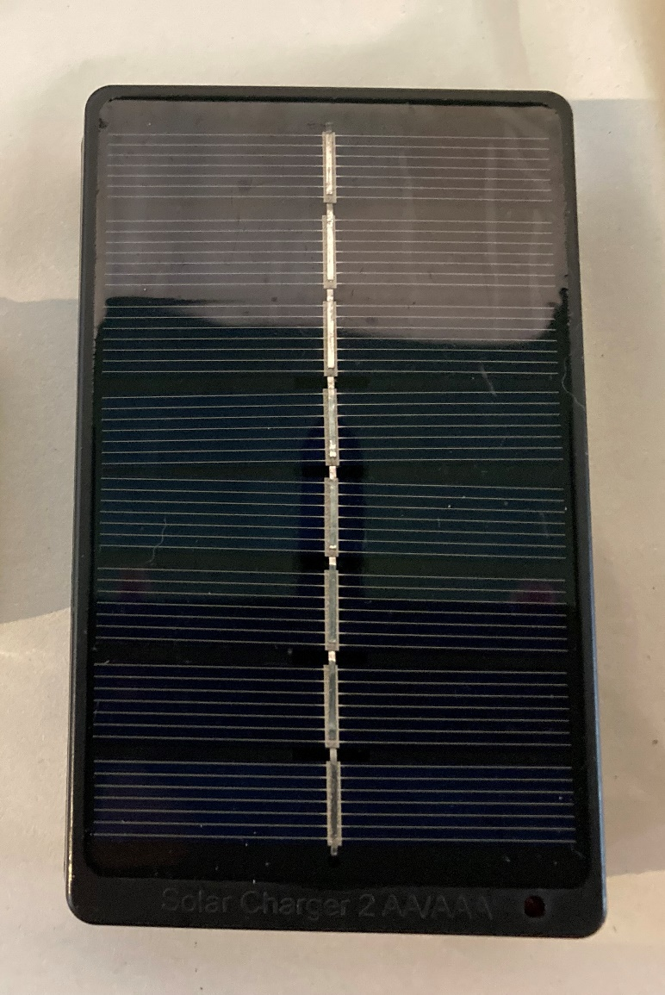
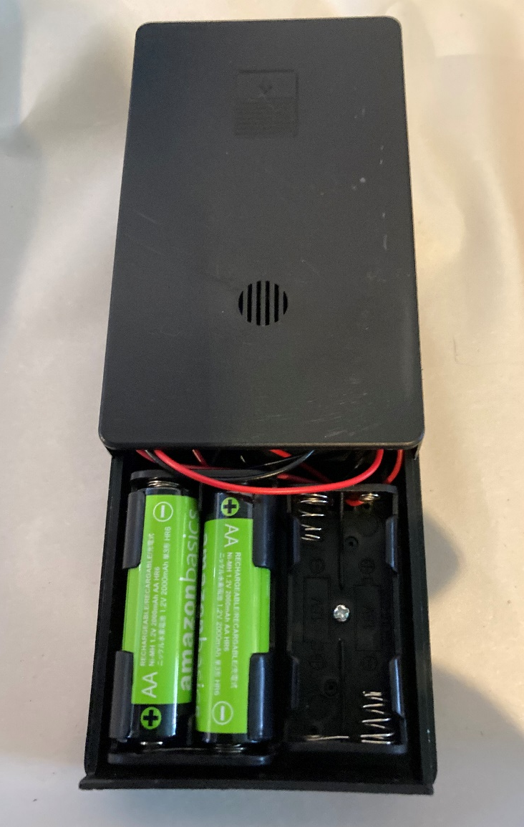
Step 1 – Charging the batteries
⚠
Fit the two rechargeable AA batteries into the solar charger.
Place the charger outside in direct sunlight.
Wait for the batteries to become fully charged.
Notes:
Safety note – never connect a solar cell directly to a battery unless there is also an overcharge circuit present. Without this current will still be supplied even when the battery is fully charged and could cause excessive heat, fire or even an explosion. For this reason it is strongly recommended to use a commercially available solar battery charger with built-in overcharge protection, and to charge the batteries separately before inserting them into the main circuit. Rechargeable batteries appropriate to the type of charger must be used.
The time taken to charge will vary depending on the amount of sunlight received, but typically this could be anything from a few hours to a full day. This step could therefore be done the day before the rest of the activity to give sufficient charging time, or the batteries could be pre-charged by the teacher. It is important however that learners understand how solar charging works and therefore this should still be shown to them.

Slide 6
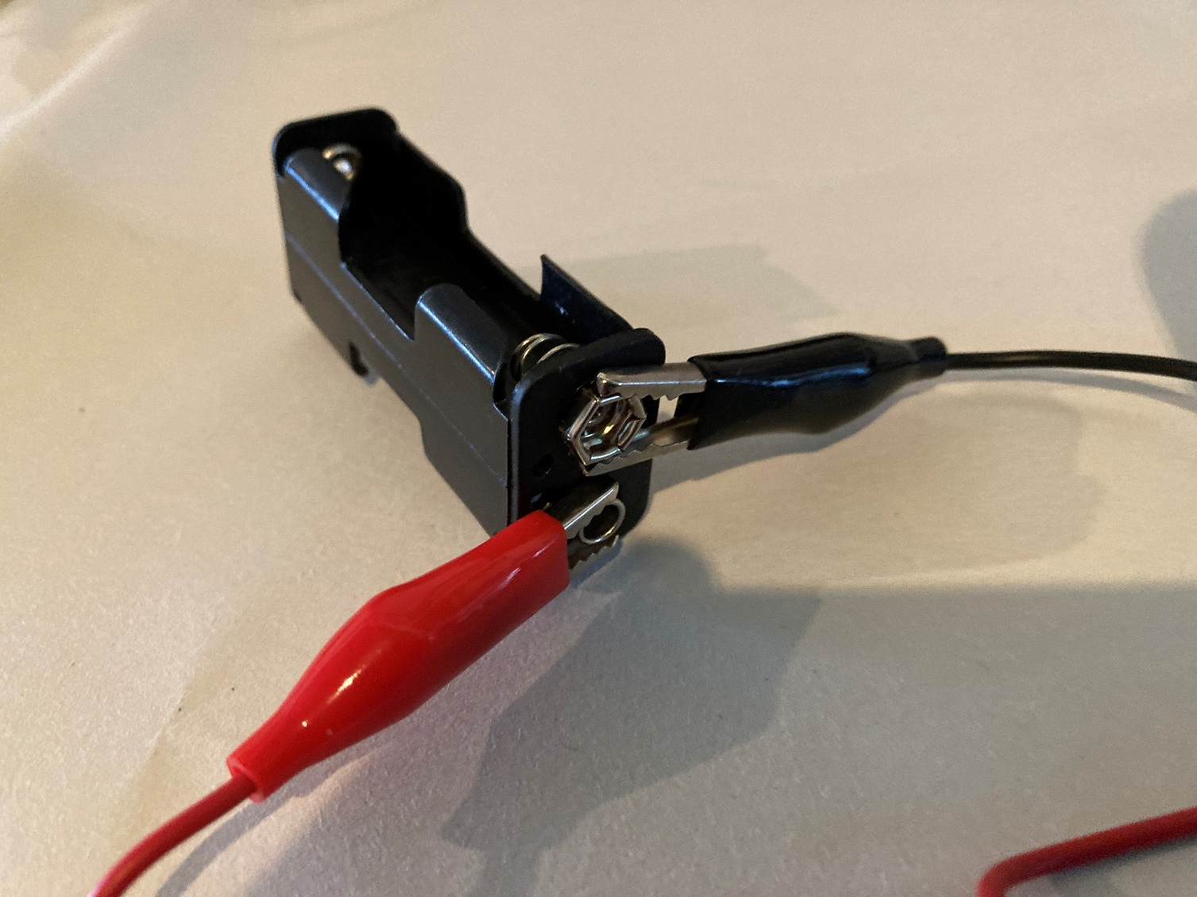
Step 2 – Connecting the battery leads
⚠
Connect one end of a black crocodile clip to the negative connector on the battery holder
Connect one end of a red crocodile clip to the positive connector
Notes:
Colour coding of the crocodile clips helps with the understanding of the completed circuit and any necessary fault finding.
Ensure these connectors are the right way around as shown. Ensure they are not touching each other.

Slide 7
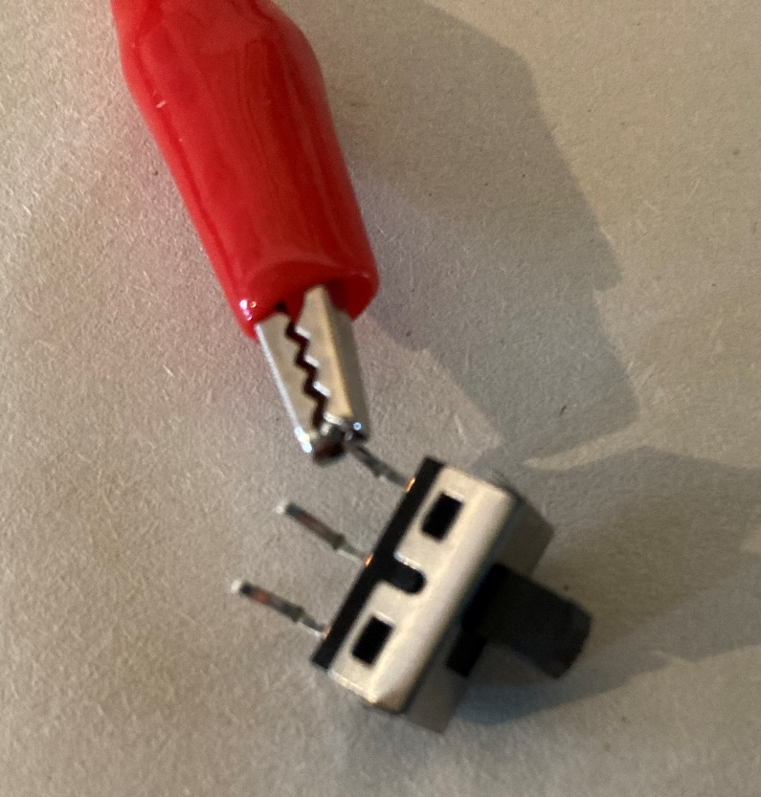
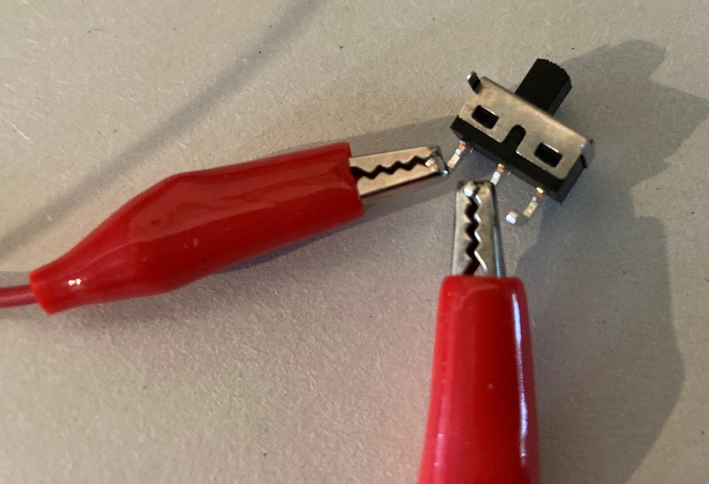
Step 3 – Connecting the switch
⚠
Connect the other end of the red crocodile clip (the one that is connected to the battery) to an outside pin of the switch.
Connect one end of a different red crocodile clip to the middle pin of the switch.
Make sure the two clips are not touching each other.
Notes:
Ensure the two connectors are not touching each other, as this will mean the switch is permanently on.
Any outside pin can be used for the red clip.

Slide 8
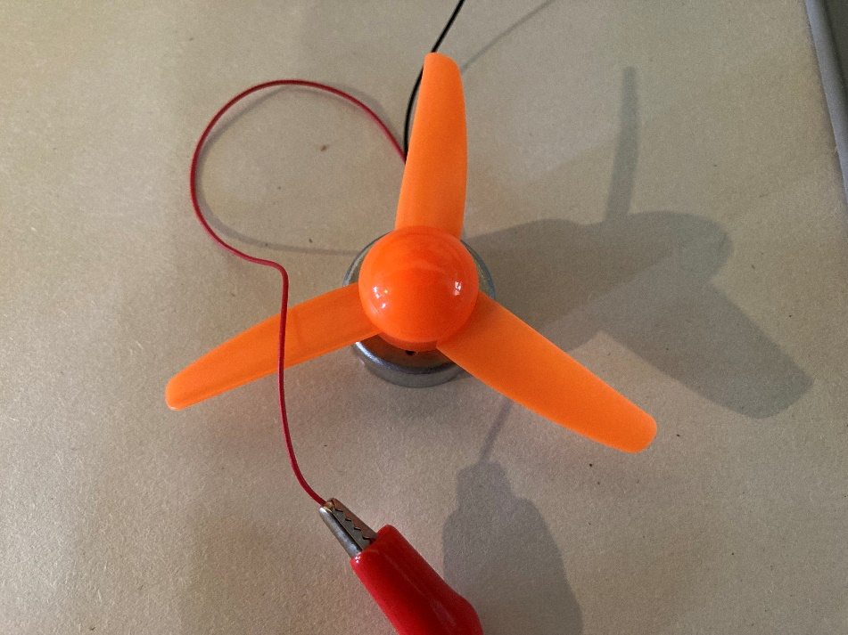
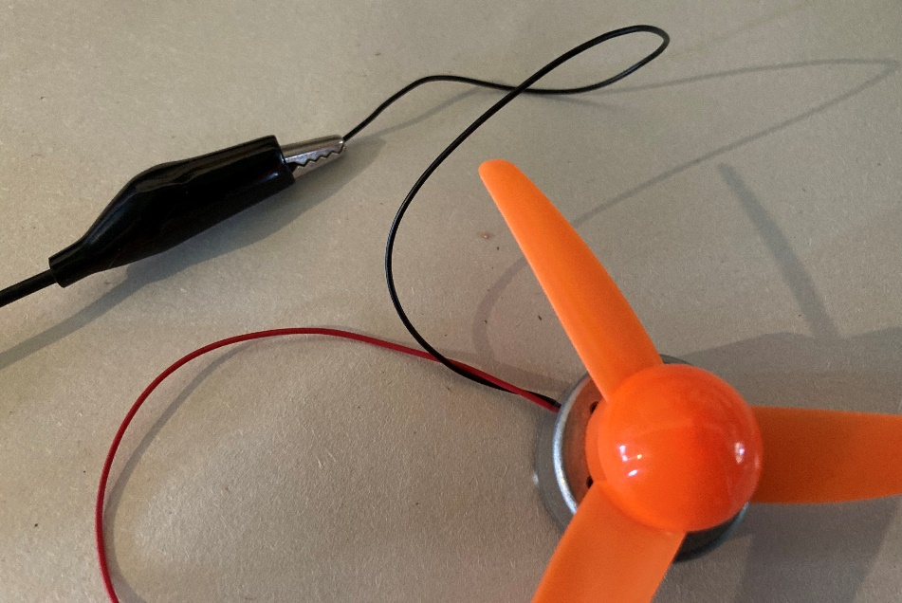
Step 4 – Connecting the motor
⚠
Connect the other end of the red crocodile clip (the one that is connected to the middle of the switch) to the red motor wire.
Connect the other end of the black crocodile clip that is connected to the battery holder to the black motor wire.
Notes:
A propeller such as that shown can be fitted to the motor for added authenticity!

Slide 9
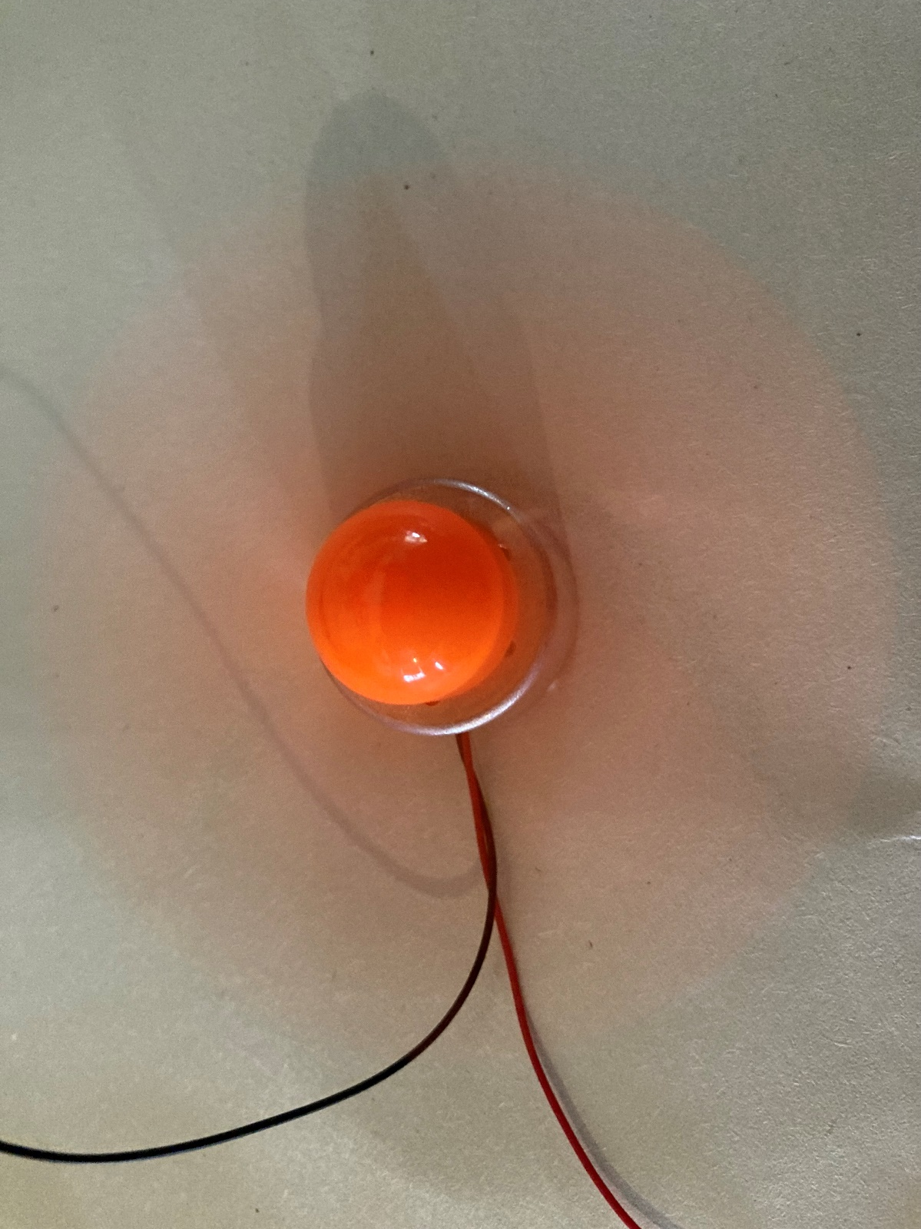
Testing
Place the charged batteries into the battery holder
Turn the switch ‘on’
Notes:
When the batteries are connected and the switch turned on, the motor should create rotary movement. The engine is therefore ‘on’.

Slide 10
Calculations
Time for each charge:
Time (hours) = Capacity (amp-hours) / Current (amps)
Time = 3 Ah (AA battery capacity) / 0.1 A (current drawn by motor)
Time = 30 hours, per battery, on a single charge
With two batteries this would give 60 hours worth of range before recharging would be needed
Extension:
How could you calculate the distance that an aircraft could travel in this time?
Notes:
The above is an example range calculation – the exact numbers can be changed depending on the exact power supplies, motors etc used. This information can be found on the relevant datasheets at the point of purchase.
The example is based on 2 x 1.5 V AA batteries and a motor current draw of 0.1 A.
Numbers could also be changed to calculate for a real, full size aircraft.

