Slide 1
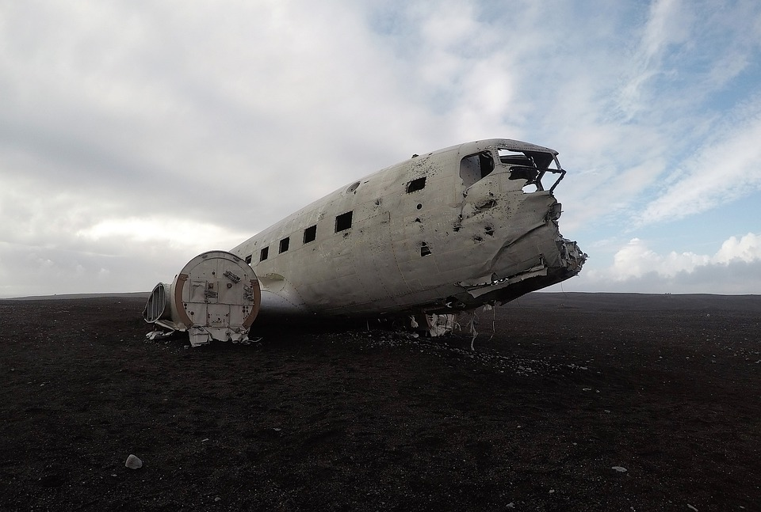
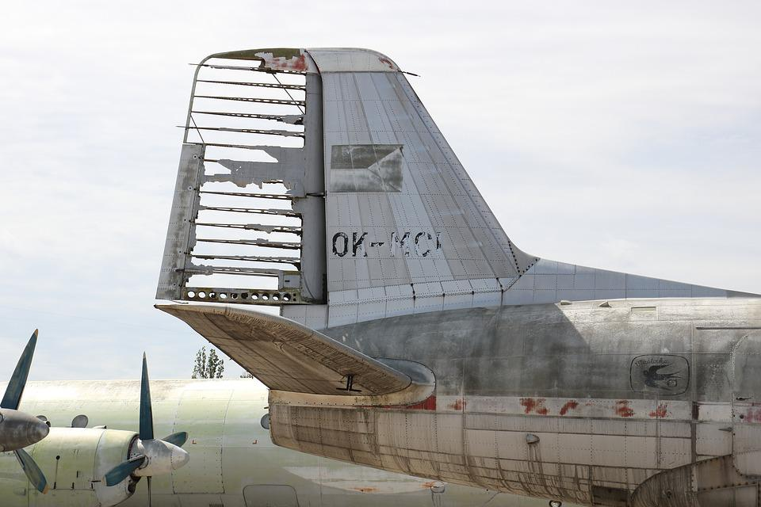
Aircraft chic
Creating a presentation suggesting how a company could re-use aircraft or parts of aircraft

Slide 2
Stay safe
Whether you are a scientist researching a new medicine or an engineer solving climate change, safety always comes first. An adult must always be around and supervising when doing this activity. You are responsible for:
ensuring that any equipment used for this activity is in good working condition
behaving sensibly and following any safety instructions so as not to hurt or injure yourself or others
Please note that in the absence of any negligence or other breach of duty by us, this activity is carried out at your own risk. It is important to take extra care at the stages marked with this symbol: ⚠

Slide 3
Brief
Once aircraft reach a certain age they are sent to large outdoor scrapyards
These take up huge amounts of space and many valuable parts of the aircraft are left unused
An airline company wants to improve on how they dispose of aircraft and have asked for your help
Your task is to create a presentation for the board of the company suggesting how they could re-use aircraft, or parts of aircraft, being retired from their fleet
Notes:
Aircraft scrapyards are often nicknamed boneyards or graveyards, so learners may have heard these terms before. Discuss the environmental issues with sending aircraft here rather than re-using more of their parts.

Slide 4
Producing your presentation
Your presentation should include:
An introduction to the problem and why it is an issue
A list of the different aircraft parts that could be recycled or re-used
Research into the types of products that could be made from old aircraft parts, including existing products. E.g. lamps, furniture, shelter, items for transport or play grounds or even tourist attractions
Sketches, drawings or models of possible new products that could make use of the different parts
Notes:
Encourage learners to consider both the larger and smaller parts of the aircraft. E.g. what could they do with seats, instruments, trolleys, food trays etc as well as the big parts like wings, fuselage and engines. E.g. the top deck of a retired British Airways Boeing 747 is to be used as part of a tourist attraction in Salford, Greater Manchester. This could be a useful discussion or starting point. https://www.manchestereveningnews.co.uk/whats-on/whats-on-news/british-airways-boeing-747-arriving-24712658
It may help learners to sketch some ideas for what these products could look like or produce simple models.

Slide 5
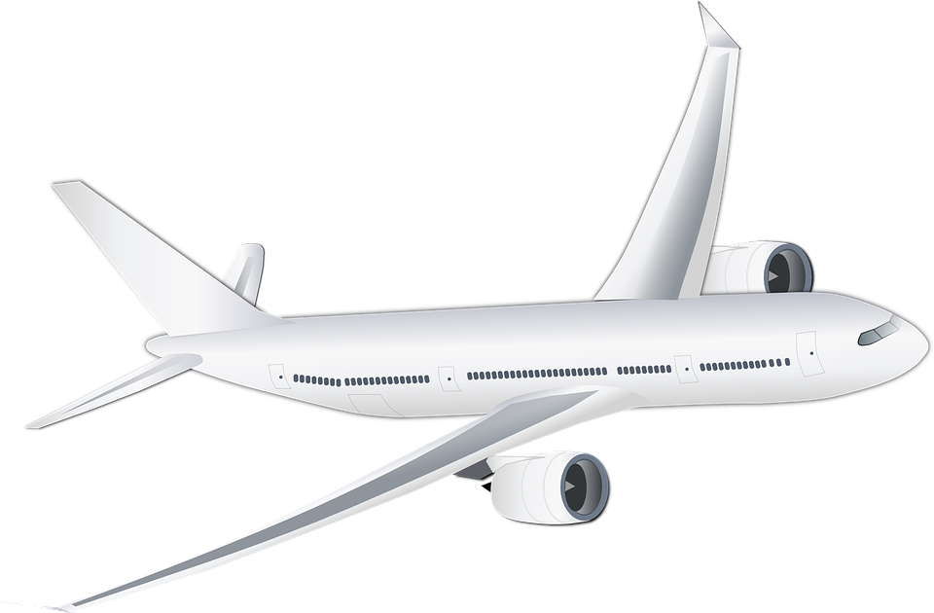
Parts of an aircraft
Fuselage Aileron Wing Leading Edge Wing-tip Tail-Plane Elevator Engine Cockpit Window
Notes:
This slide could be used as a starter to get learners thinking about the different parts of a plane and how they could be re-used. It could also be used to support the main activity.
Answers are given on slide 6.

Slide 6
Parts of an aircraft
Wing-tip
Tail-Plane
Fuselage
Wing Leading Edge
Aileron
Elevator
Window
Cockpit
Engine
Fuselage Aileron Wing Leading Edge Wing-tip Tail-Plane Elevator Engine Cockpit Window
Notes:
These are the answers for slide 5.

