Slide 1
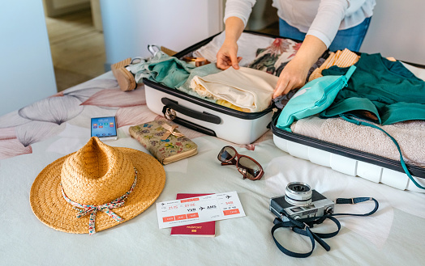
Luggage of the Future
Designing a new way of carrying things

Slide 2
Stay safe
Whether you are a scientist researching a new medicine or an engineer solving climate change, safety always comes first. An adult must always be around and supervising when doing this activity. You are responsible for:
ensuring that any equipment used for this activity is in good working condition
behaving sensibly and following any safety instructions so as not to hurt or injure yourself or others
Please note that in the absence of any negligence or other breach of duty by us, this activity is carried out at your own risk. It is important to take extra care at the stages marked with this symbol: ⚠

Slide 3
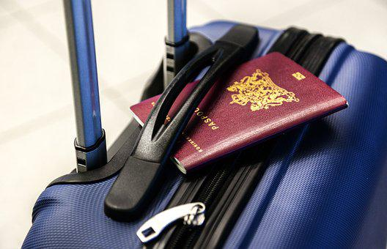
Why do we need luggage?
For a family holiday
For a business person to take
away for work trips
For a young person going to University
Or another reason of your choice
Notes:
Discuss with learners.

Slide 4
What needs to go in luggage?
If I was going on holiday I would pack:
Swimming shorts
Towel
Flip flops
Wash bag
Sunglasses
Sun cream
Shorts and t-shirts
Notes:
Discuss the items that would need to fit in luggage for a holiday.

Slide 5
Design criteria
You will need:
This luggage is for……
Where are you going?
What will you need?
Notes:
Learners to write a list of design criteria for their luggage of the future design. They should think about who it is for, where it will need to go and what will need to be included within it. They should also consider how it will be moved.

Slide 6
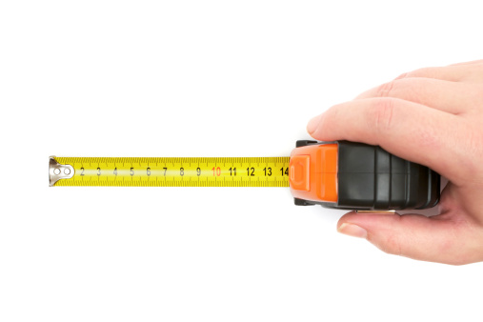
Step 1 – Measuring the contents
Measure what you want to go in your luggage
Record the results
Notes:
A tape measure or ruler could be used to take measurements of dimensions. Responses should be listed on the activity sheet.

Slide 7
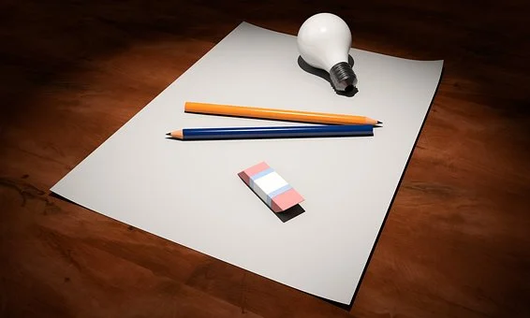
Step 2 – Designing the luggage
Design a new item of luggage to hold the items for travel
It doesn’t need to be a rectangular – be creative
Think about how it will meet the design criteria
What other features could it have?
Notes:
Designs could be produced on the activity sheet, or on A3/A4 paper if required.

Slide 8
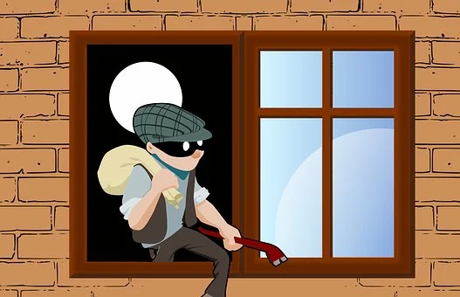
Making the design safe and secure
Think about how you could stop your luggage from being stolen:
Could it make a noise?
Flashing lights?
Sensors?
Something else?
Be creative!
Notes:
Discuss options with learners and encourage them to include these ideas in their design.

