Slide 1
Balloon Rockets
A project to measure the velocity of balloon rockets

Slide 2
Stay safe
Whether you are a scientist researching a new medicine or an engineer solving climate change, safety always comes first. An adult must always be around and supervising when doing this activity. You are responsible for:
ensuring that any equipment used for this activity is in good working condition
behaving sensibly and following any safety instructions so as not to hurt or injure yourself or others
Please note that in the absence of any negligence or other breach of duty by us, this activity is carried out at your own risk. It is important to take extra care at the stages marked with this symbol: ⚠

Slide 3
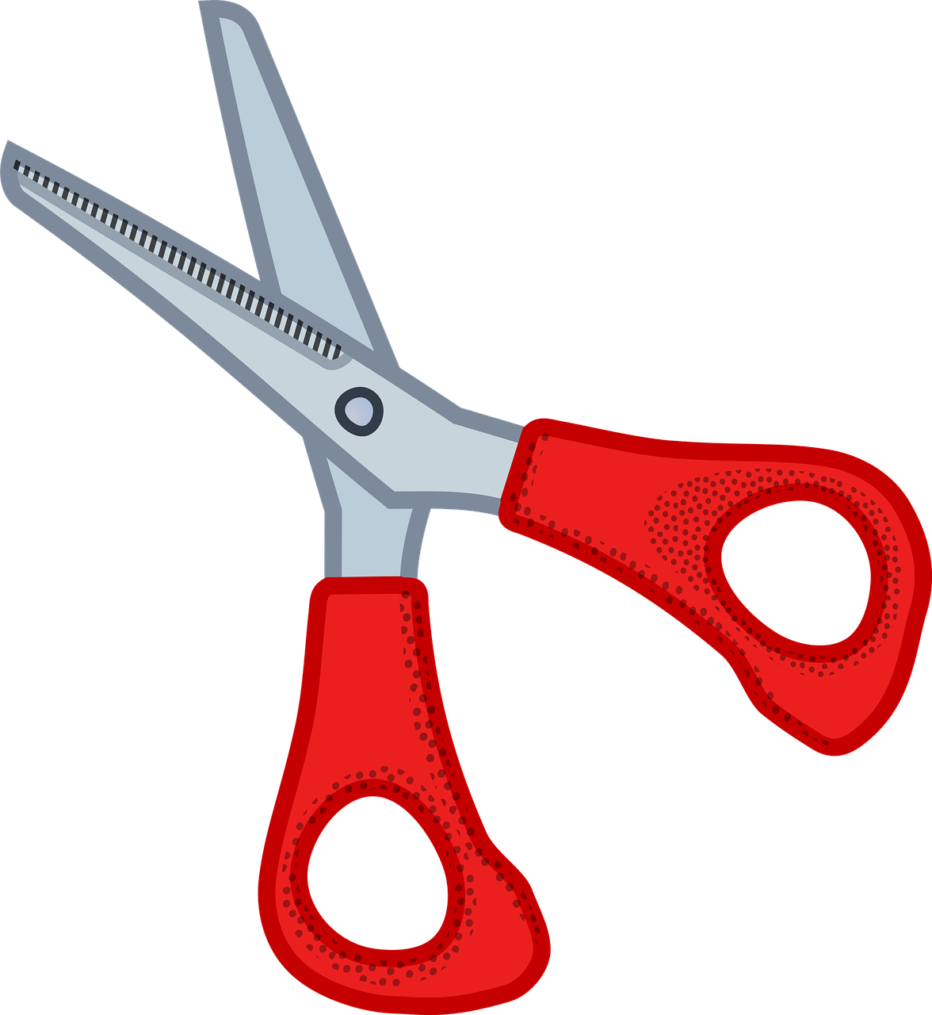
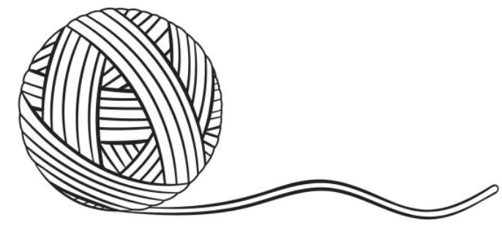
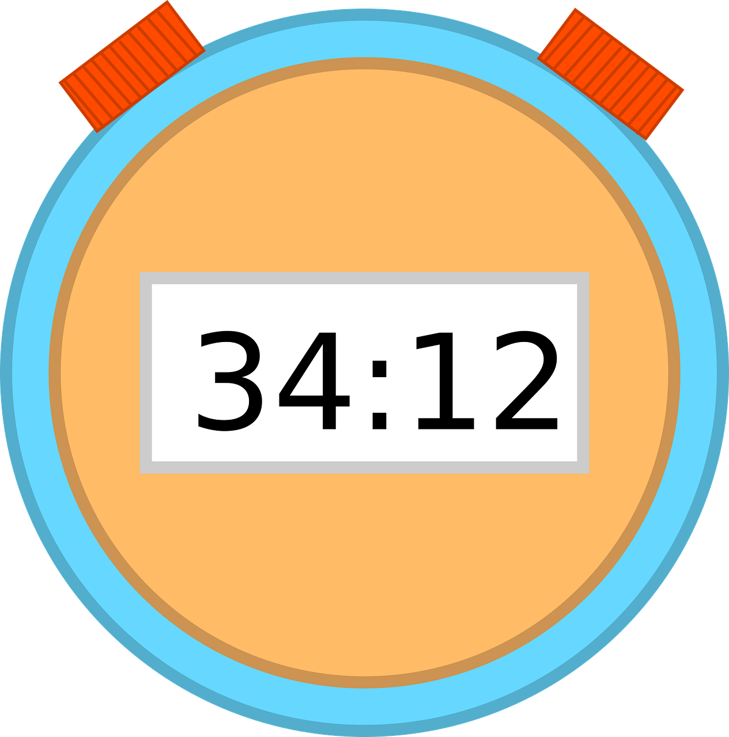
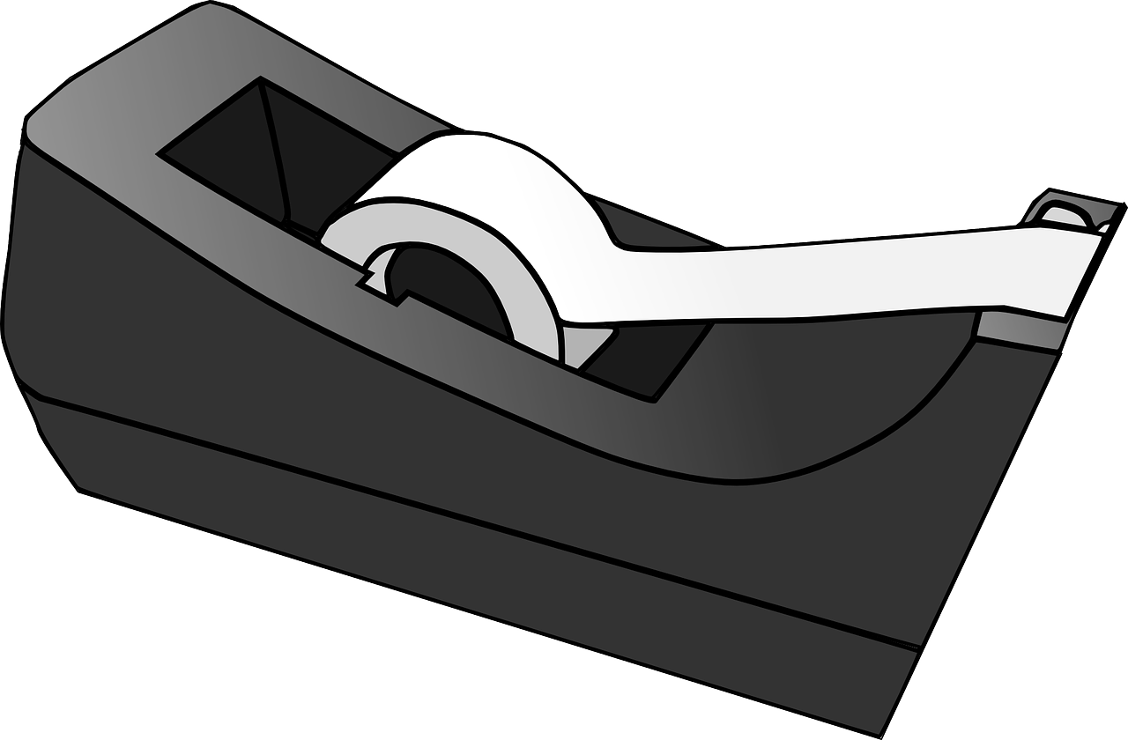
1. Equipment you will need
Balloons
Pencil
Scissors
String
Sticky tape
Sheet of paper
Timing device
Measuring tape (5 m)

Slide 4
2. Rocket line ⚠
Carefully cut 3 m of string
Attach one end of the string to fixed point

Slide 5
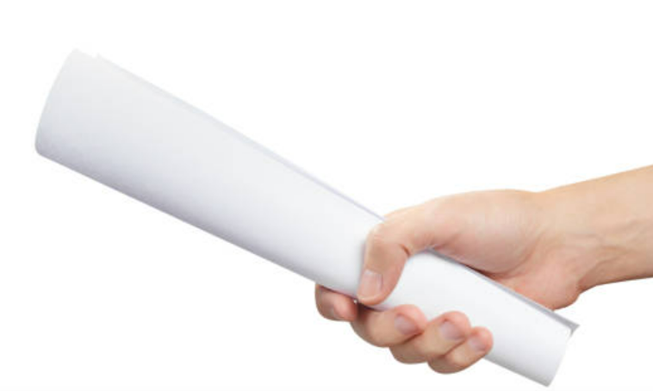
3. Prepare the balloon slider
Roll a piece of paper into a tube
Secure with sticky tape
Sticky tape

Slide 6
4. Connect the slider
Feed the string through the paper tube slider
Fix the other end of string to a fixed object
Measure the string distance. Check for 3 m.
3 m

Slide 7
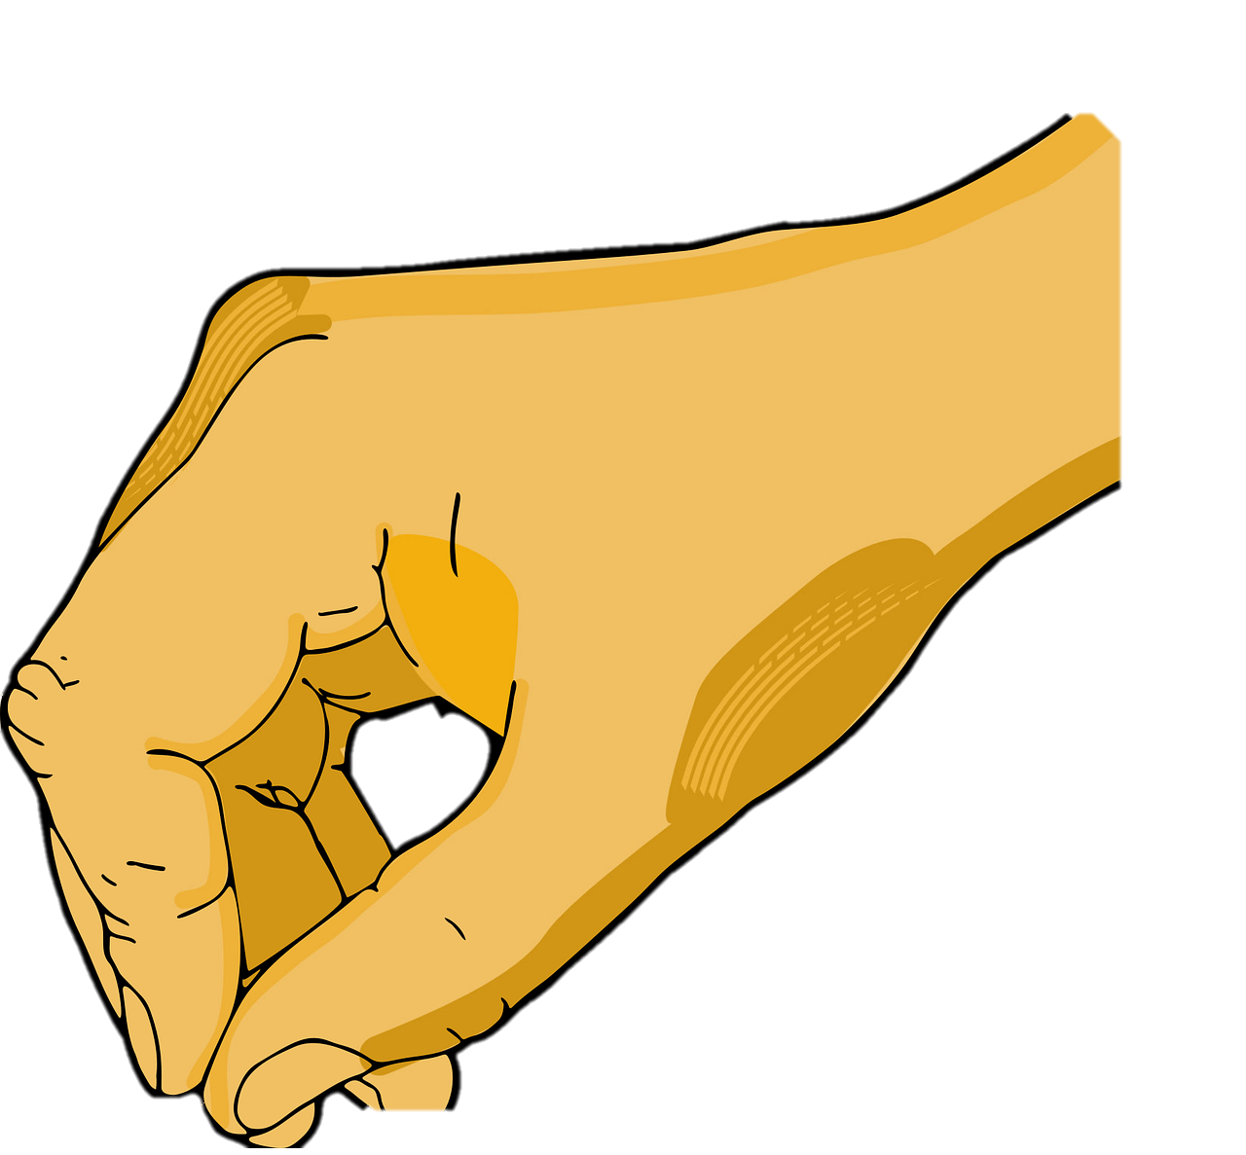
5. Connect the balloon
Blow up a balloon and pinch the end
Use sticky tape to connect the balloon to the slider
3 m

Slide 8
6. Time the balloon rocket
Slide the balloon to the start of the string
Get someone to operate the stopwatch
On a count of 3 release the balloon and start the stopwatch
00.00
3 m

Slide 9
7. Time the balloon rocket
When the balloon gets to the end of the string
Stop the stopwatch and record the time
Repeat
01.50
3 m

Slide 10
8. Work out the velocity of the balloon
Velocity (Speed) = Distance
Time
For example:
Velocity = 3 m
1.5 sec
Velocity = 2 m/sec
2 x 3,600 (Secs in one hour)
Velocity = 7,200 m/hr
Velocity = 7.2 km/h

Slide 11
Extension
Try increasing the distance of the string i.e. 4 m, 5 m etc. Does the velocity stay the same?
What is the furthest distance you can get the balloon rockets to travel?
Try different shaped balloons. Why are some balloons faster than others? Other than the shape, what other things could affect the speed?

