Slide 1
Micronutrients

Slide 2
Micronutrients
Micronutrients are needed in the body in tiny amounts. They do not provide energy, but are required for a number of important processes in the body.
There are two main groups of micronutrients:
vitamins;
minerals and trace elements.
Micronutrients are measured in milligrams (mg) and micrograms (μg) with 1mg = 0.001g and 1μg = 0.001mg.

Slide 3
Micronutrients
People have different requirements for each micronutrient, according to their:
age;
gender;
physiological state (e.g. pregnancy).

Slide 4
Vitamins
Vitamins are nutrients required by the body in small amounts, for a variety of essential processes.
Most vitamins cannot be made by the body, so need to be provided in the diet.
Vitamins are grouped into:
fat-soluble vitamins;
water-soluble vitamins.

Slide 5
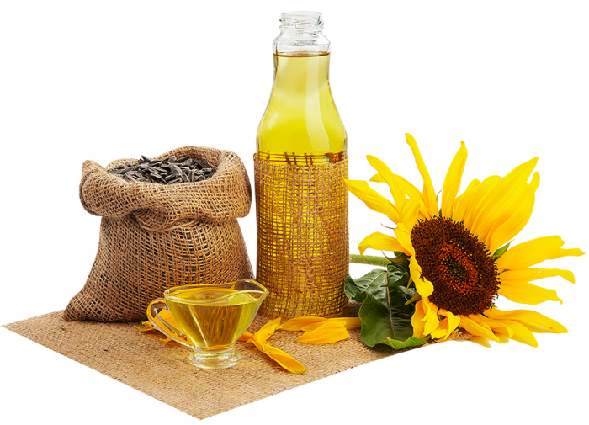
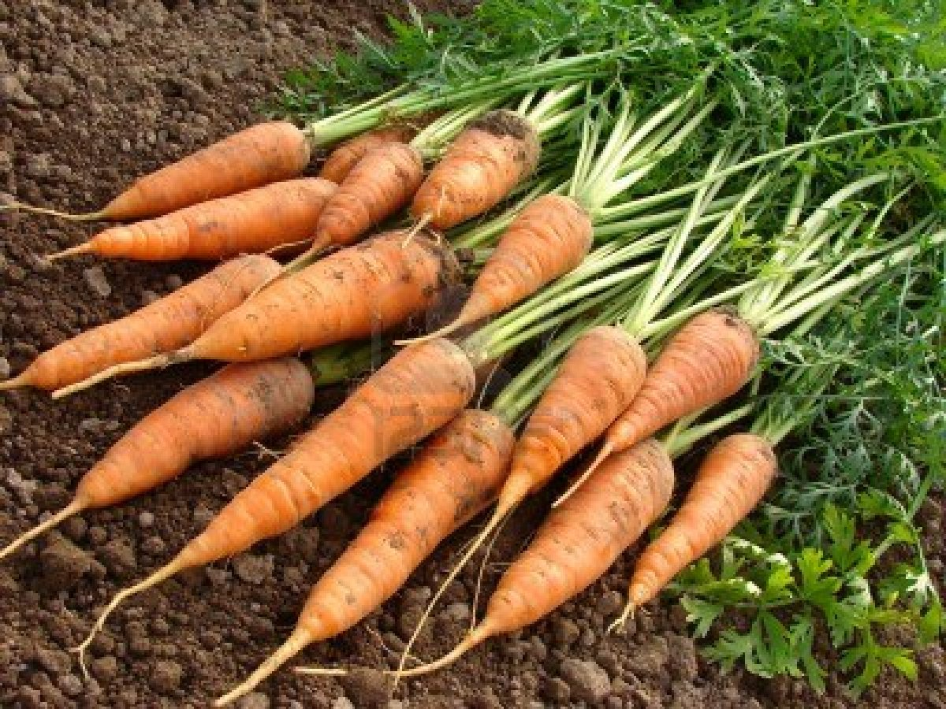
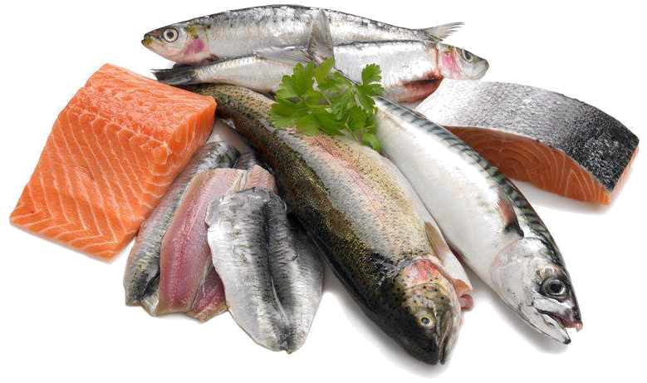
Fat-soluble vitamins
Fat-soluble vitamins can be stored in the body, i.e. vitamins A, D, E and K.

Slide 6
Vitamin A
Vitamin A is needed for:
the maintenance of normal skin and mucous membranes (in eyes, lungs and the digestive system);
the maintenance of normal vision;
the normal function of the immune system.

Slide 7
Vitamin A
Vitamin A (retinol) can be obtained in two forms:
ready-made, as retinol from animal sources;
carotenoids (e.g. beta carotene) from plant sources, from which retinol can be made in the body.
Vitamin A concentration is usually expressed as retinol equivalents (RE).
Some carotenoids can be converted to retinol in the body.
6µg of beta carotene is equivalent to 1µg of retinol.

Slide 8
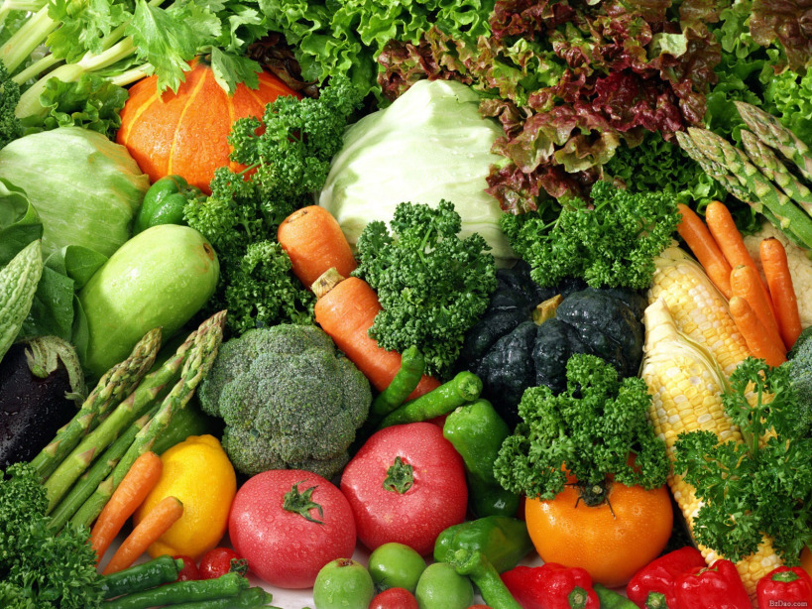
Vitamin A sources
Vitamin A is found pre-formed in liver and whole milk.
It can also be produced from beta-carotene provided by dark green leafy vegetables, carrots and orange coloured fruit.
Vitamins A and D are also often voluntarily added to reduced fat spreads.

Slide 9
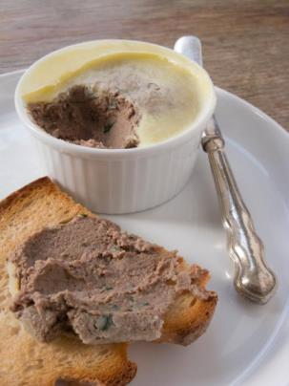
Vitamin A deficiency
Severe vitamin A deficiency in the UK is rare. It can lead to night blindness (unable to adapt to low-intensity light) and ulceration of the eye which may cause total blindness.
Large intakes of vitamin A (>1500µg of RE/day) can be toxic and may cause bone damage. The RNI for vitamin A is 600µg/d for females (11+) and 700µg/d for males (15+).
Pregnant women should not consume liver and liver pâté as high levels of retinol may be present. Excess retinol during pregnancy can lead to birth defects.

Slide 10
Vitamin D
Vitamin D is needed for:
the absorption and use of calcium and phosphorus;
normal blood calcium levels;
the maintenance of normal bones and teeth;
the maintenance of normal muscle function;
the normal function of the immune system.

Slide 11
Vitamin D
Vitamin D is a pro-hormone in the body. It can be obtained in two forms:
ergocalciferol (vitamin D₂);
cholecalciferol (vitamin D₃) formed by the action of sunlight.
Vitamin D is only required in very small amounts and is measured in micrograms.

Slide 12
Vitamin D sources
According to national surveys in the UK, across the population approximately 1 in 5 people have low vitamin D levels.
The main source of vitamin D is synthesis in the skin following exposure to sunlight however, the Recommended Nutrient Intake (RNI) for all people aged 4 and above is 10 µg/day.
Did you know?
The wavelength of UVB during the winter months in the UK does not support vitamin D synthesis.

Slide 13
Vitamin D sources
Sources of vitamin D include:
oily fish (such as salmon, trout, mackerel, sardines, pilchards, herring, kipper);
meat;
eggs;
fortified breakfast cereals and margarine/spreads;
supplements.
Dietary sources are relatively insignificant for most people because the main source is synthesis in the skin following exposure to sunlight during the summer months in the UK (April – October).

Slide 14
Vitamin D
People who have darker skin, wear concealing clothing or are housebound make much less vitamin D and are at greater risk of vitamin D deficiency.
There is evidence of poor vitamin D status across the UK population, especially during the winter months.
A lack of vitamin D in the body causes rickets in children, where leg bones become weakened and bent, and a related condition called osteomalacia in adults.
Poor vitamin D status has also been linked to increased falls in elderly people, thought to be linked to an adverse effect on muscle.

Slide 15
Vitamin D supplementation
The Recommended Nutrient Intake (RNI) proposed by SACN for all people aged 4 and above is 10 µg/day. SACN have also produces supplementation advice.
Between late March/early April and September, the majority of people aged 5 years and above will probably obtain sufficient vitamin D from sunlight when they are outdoors, alongside foods that naturally contain or are fortified with vitamin D. As such, they might choose not to take a vitamin D supplement during these months.
From October to March everyone over the age of five will need to rely on dietary sources of vitamin D. Since vitamin D is found only in a small number of foods, it might be difficult to get enough from foods that naturally contain vitamin D and/or fortified foods alone. So everyone, should consider taking a daily supplement containing 10 micrograms of vitamin D.
https://www.nutrition.org.uk/nutritioninthenews/new-reports/983-newvitamind.html

Slide 16
Vitamin D supplementation
There are further recommendations that:
People with very little or no sunshine exposure and p eople from minority ethnic groups with dark skin should take a daily supplement containing 10 micrograms vitamin D throughout the year.
All breastfed infants 0 – 1 years - as a precaution, it is recommended that infants from birth to one year of age, whether exclusively or partially breastfed, should be given a daily supplement containing 8.5 to10 micrograms of vitamin D.
Infants fed infant formula should not be given a vitamin D supplement unless they are receiving less than 500mls (about a pint) of formula a day.
All children aged 1 to 4 years of age should be given a daily supplement containing 10 micrograms of vitamin D.
https://www.nutrition.org.uk/nutritioninthenews/new-reports/983-newvitamind.html

Slide 17
Vitamin E
Vitamin E is an antioxidant and is required to protect cells against oxidative damage. Generally, good sources of vitamin E are those that also provide a large amount of polyunsaturated fatty acids, for example:
plant oils such as sunflower, soya, corn and olive oils and their spreads;
nuts;
seeds.
This is because vitamin E is present naturally in these foods to prevent oxidation.
Vitamin E helps maintain healthy skin and eyes and strengthen the immune system.

Slide 18
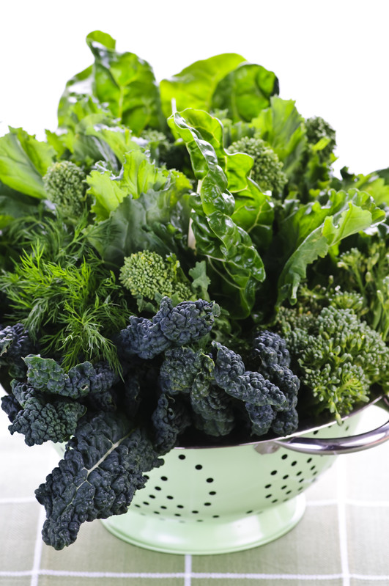
Vitamin K
Vitamin K is needed for:
normal blood clotting;
the maintenance of normal bones.
Sources of vitamin K include green leafy vegetables, meat, dairy products and eggs.
Deficiency of vitamin K is considered to be very rare as it is widely available in the diet and produced to some extent in the gut by bacteria.
Babies up to 6 weeks may have very low vitamin K levels and so it is usual to give a vitamin K injection to all newborn infants.

Slide 19
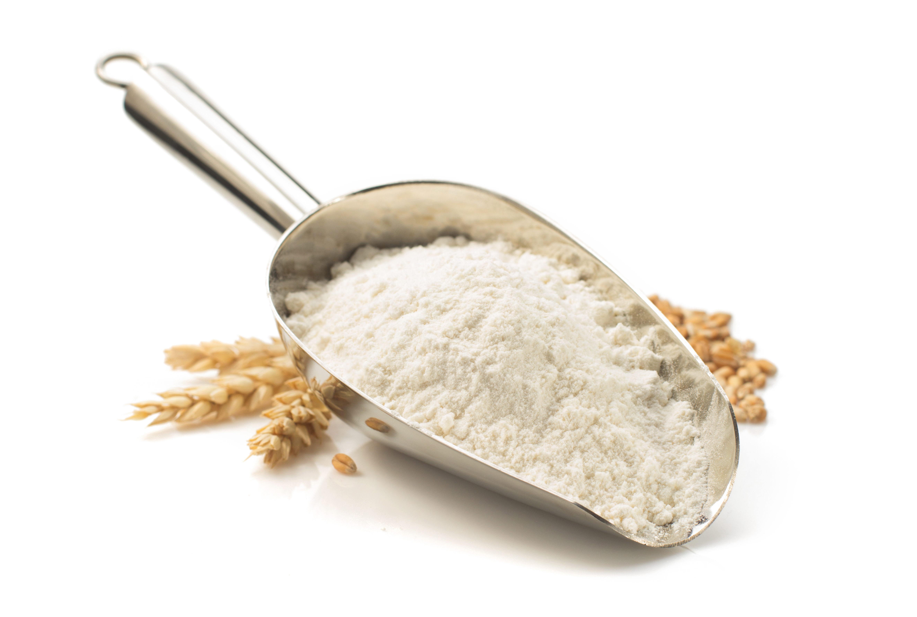
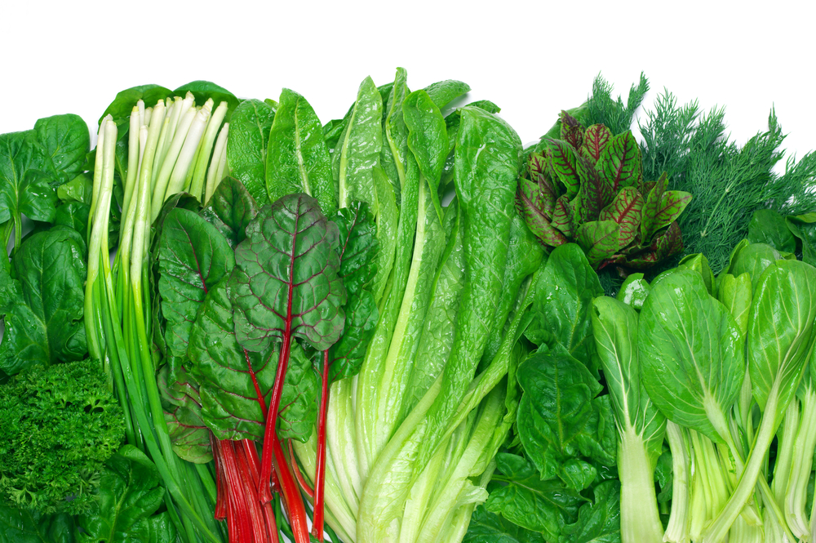
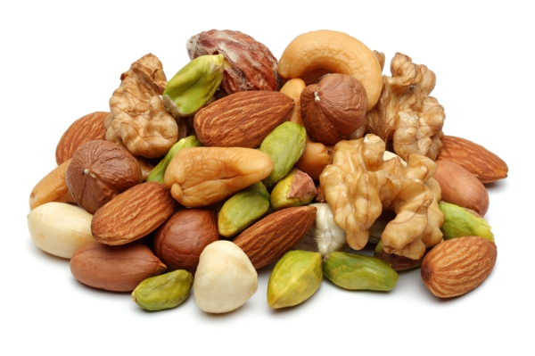
Water soluble vitamins
Water-soluble vitamins cannot be stored in the body and are therefore required daily, i.e. B vitamins and vitamin C.

Slide 20
B vitamins
There are a number of B vitamins. Regular intake of each is essential as each has specific functions in the body. These are:
Thiamin (vitamin B₁);
Riboflavin (vitamin B₂);
Niacin (vitamin B₃);
vitamin B₆;
vitamin B₁₂;
folate/folic acid (vitamin B₉);
pantothenic acid (vitamin B₅);
biotin (vitamin B₇).

Slide 21
Thiamin (vitamin B₁)
Thiamin is needed for:
the release of energy from carbohydrate;
normal function of the nervous system and heart.
Deficiency of thiamin causes the nervous system disease beri-beri, although this is rare in the UK.

Slide 22
Thiamin (vitamin B₁) sources
Sources of Thiamin (vitamin B₁):
whole grains;
nuts;
meat (especially pork);
fruit and vegetables;
fortified breakfast cereals.
Did you know?
In the UK, white and brown bread flour are fortified with thiamin by law (and also with calcium, iron and niacin).

Slide 23
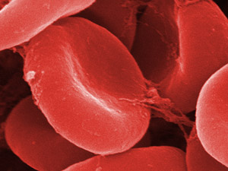
Riboflavin (vitamin B₂)
Riboflavin is needed for:
the release of energy from protein, carbohydrate and fat;
maintenance of mucous membranes and normal skin;
keeping red blood cells healthy;
transport and use of iron in the body.

Slide 24
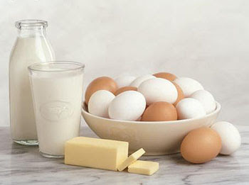
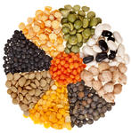
Riboflavin (vitamin B₂) sources
Sources of riboflavin include:
Milk and milk products;
eggs;
fortified breakfast cereals;
liver;
Some oily fish (e.g. mackerel and sardines);
legumes;
mushrooms and green vegetables.
Deficiency of riboflavin is characterised by dryness and cracking of the skin around the mouth and nose, and a painful tongue that is red and dry (magenta tongue), but this is rare in the UK.
There is evidence of low intakes and poor status in teenagers and young adults, especially teenage girls.

Slide 25
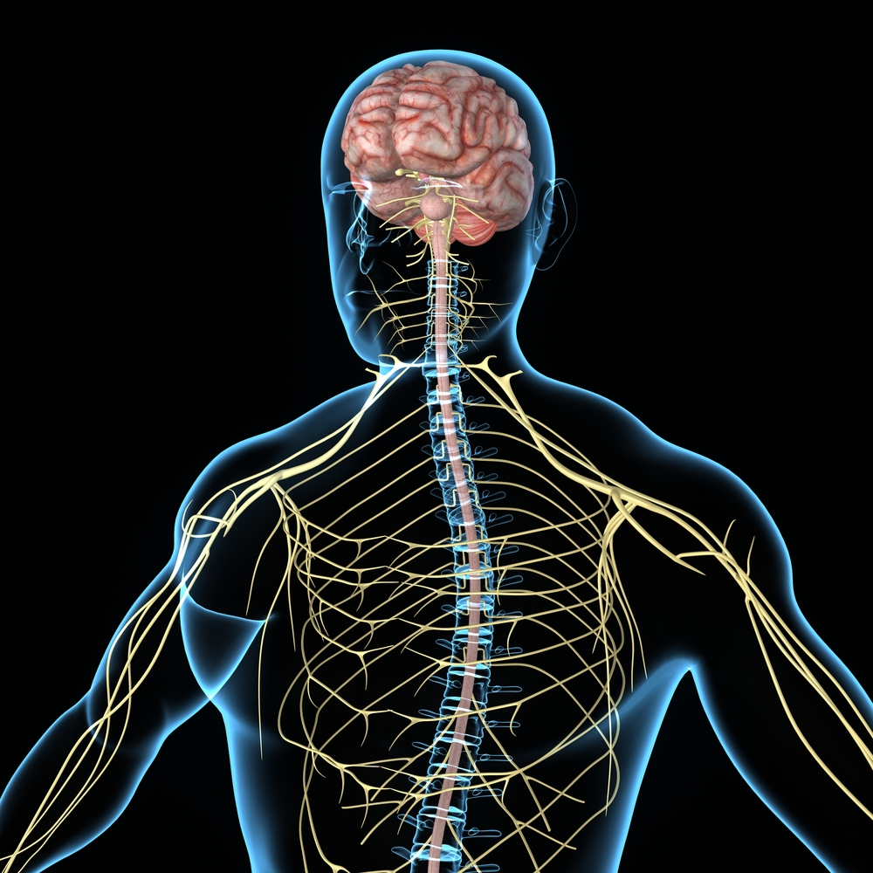
Niacin (vitamin B₃)
Niacin (vitamin B₃) is needed for:
the release of energy from food;
the normal functioning of the nervous system;
the maintenance of normal skin and mucous membranes.

Slide 26
Niacin (vitamin B₃) sources
Sources of niacin include:
meat;
wheat flour;
eggs;
dairy products;
yeast.
White and brown flour in the UK are fortified with niacin.
Deficiency of niacin is characterised by sun-sensitive skin known as pellagra, but this is rare in the UK.

Slide 27
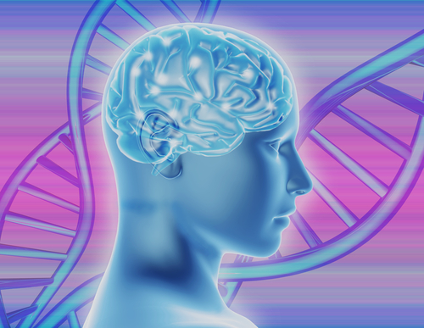
Vitamin B₆
Vitamin B₆ has many functions.
It contributes to:
metabolism of amino acids;
the breakdown of glycogen;
formation of red blood cells;
metabolism and transport of iron;
the regulation of hormonal activity.

Slide 28
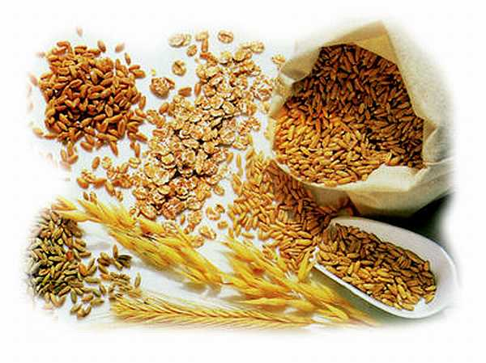
Vitamin B₆ sources
Together with folate and vitamin B₁₂, vitamin B₆ is required for the maintenance of normal blood homocysteine levels.
Sources of vitamin B₆ include poultry, white fish, milk, eggs, whole grains, soya beans, peanuts and some vegetables, e.g. peppers and cauliflower.
Deficiency of vitamin B₆ is rare because it is widely distributed in foods; but it can occur as a complication of disease or prolonged administration of certain drugs.

Slide 29
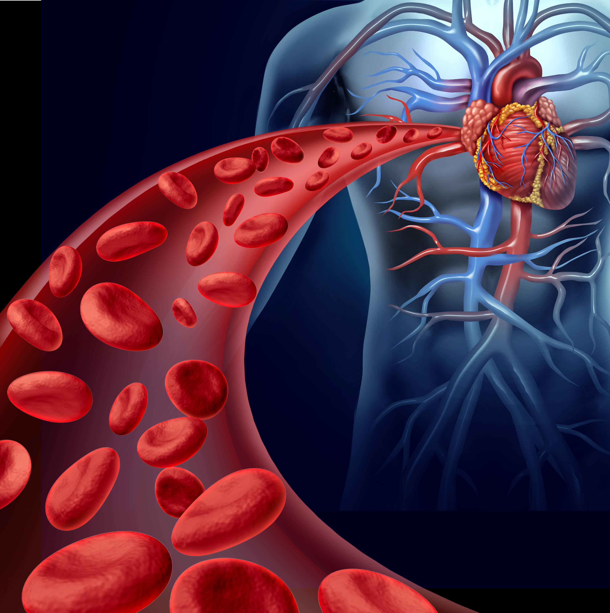
Vitamin B₁₂
Vitamin B₁₂ is needed for:
the producing of energy;
the metabolism of folate;
formation of red blood cells;
normal function of the immune system and nervous system.
Together with folate and vitamin B₆, vitamin B₁₂ is required for the maintenance of normal blood homocysteine levels.

Slide 30
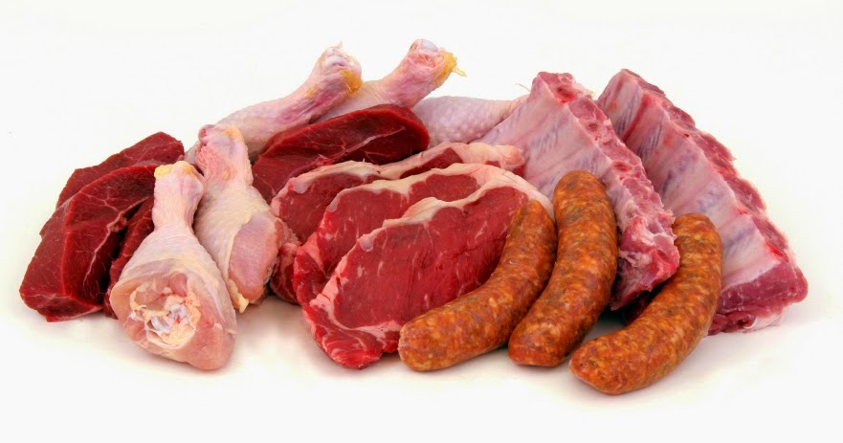
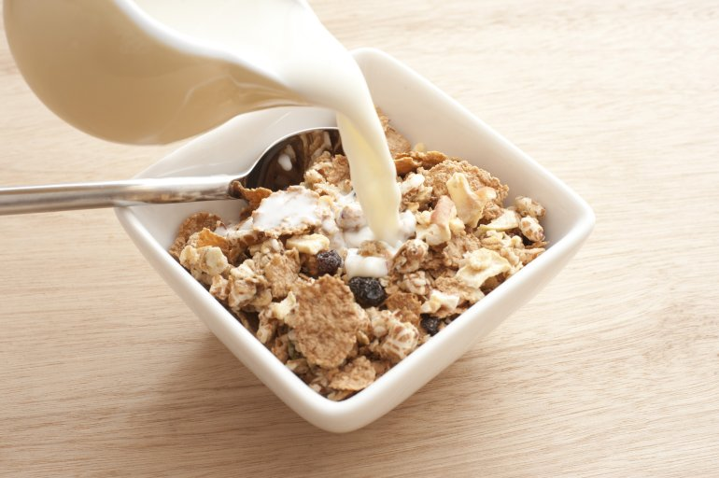
Vitamin B12 (Cyanocobalamin) sources
Sources of vitamin B₁₂ include food of animal origin and through fortification of food. These include meat, fish, milk, cheese, eggs, yeast extract and fortified breakfast cereals.
Dietary deficiency of vitamin B₁₂ in young people is rare and usually occurs only in strict vegans. However, blood levels of vitamin B₁₂ (vitamin B₁₂ status) can be low because of poor absorption, especially in older people.
Severe vitamin B₁₂ deficiency results in pernicious anaemia, in which red blood cells are enlarged, and peripheral nerve damage develops, e.g. in the legs.

Slide 31
Folate/Folic acid
Folate is needed for:
production of normal red blood cells;
normal cell division;
normal development of the neural tube (which develops into the spinal cord and skull) in the embryo.
Did you know?
Folic acid is the synthetic form of folate. It is used in supplements and for food fortification.

Slide 32
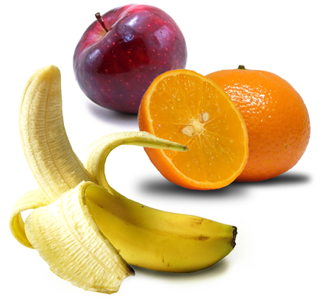
Folate/Folic acid sources
Folate is found naturally in green leafy vegetables, brown rice, peas, oranges and bananas.
There is some evidence of low intakes in teenage girls and in elderly people.
Poor folate status results in neural tube defects in newborns and megaloblastic anaemia, characterised by the release of immature red blood cells into the blood stream.
This is due to impairment in the normal process of blood cell maturation in the bone marrow.

Slide 33
Vitamin C (ascorbic acid)
Vitamin C is needed for:
formation of collagen for normal blood vessels, bones, cartilage, gums, skin and teeth;
the healing process;
the protection of cells from oxidative stress;
the normal structure and function of blood vessels;
neurological function.
Did you know?
Vitamin C can help with the absorption of iron from plant foods when they are consumed at the same meal.

Slide 34
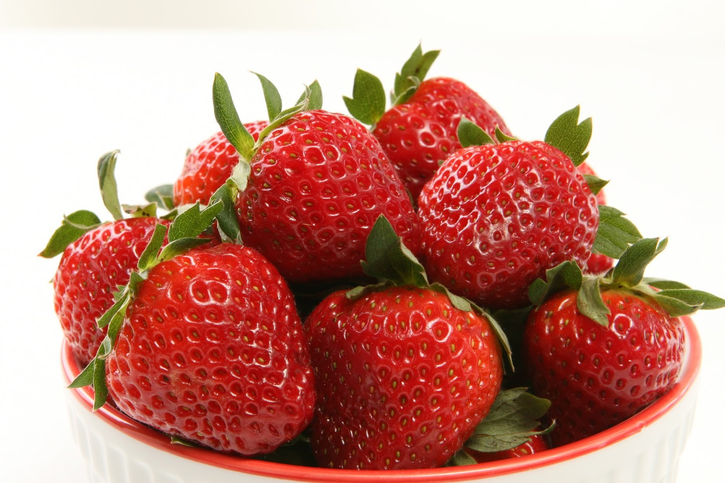
Vitamin C (ascorbic acid) sources
Sources of vitamin C include citrus fruits and berries, green vegetables, peppers, tomatoes and potatoes (especially new potatoes).
Name six citrus fruits
Lime, orange, grapefruit, tangerine, lemon, clementine.
Name six types of berries
Blackberries, blackcurrants, strawberries, raspberries, blueberries, cranberries.
Severe deficiency of vitamin C can cause scurvy, which is characterised by the bleeding of gums and poor wound-healing. It is also associated with fatigue, weakness, aching joints and muscles.

Slide 35
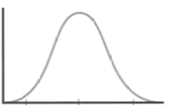
Recommendations for vitamins
The recommendations for vitamins are based on the Reference Nutrient Intake (RNI).
The RNI is the amount of a nutrient that is enough to ensure that the needs of nearly all the group (97.5%) are being met. The RNI is used for recommendations on protein, vitamins and minerals.
No. of
people
RNI
Requirements

Slide 36
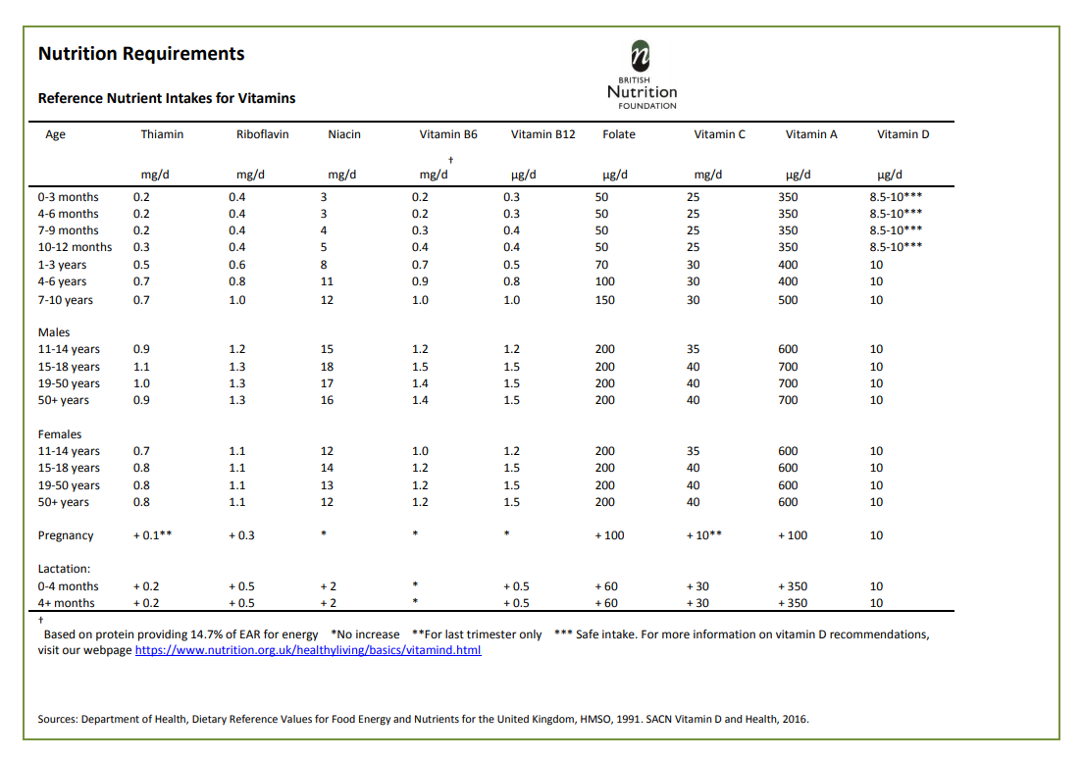
Reference Nutrient Intakes for vitamins
For more information on the RNIs, click here.

Slide 37
Minerals
Minerals are inorganic substances required by the body in small amounts for a variety of different functions.
The body requires different amounts for each mineral.
Some minerals are required in larger amounts, while others are needed in very small amounts and are called ‘trace elements’.

Slide 38
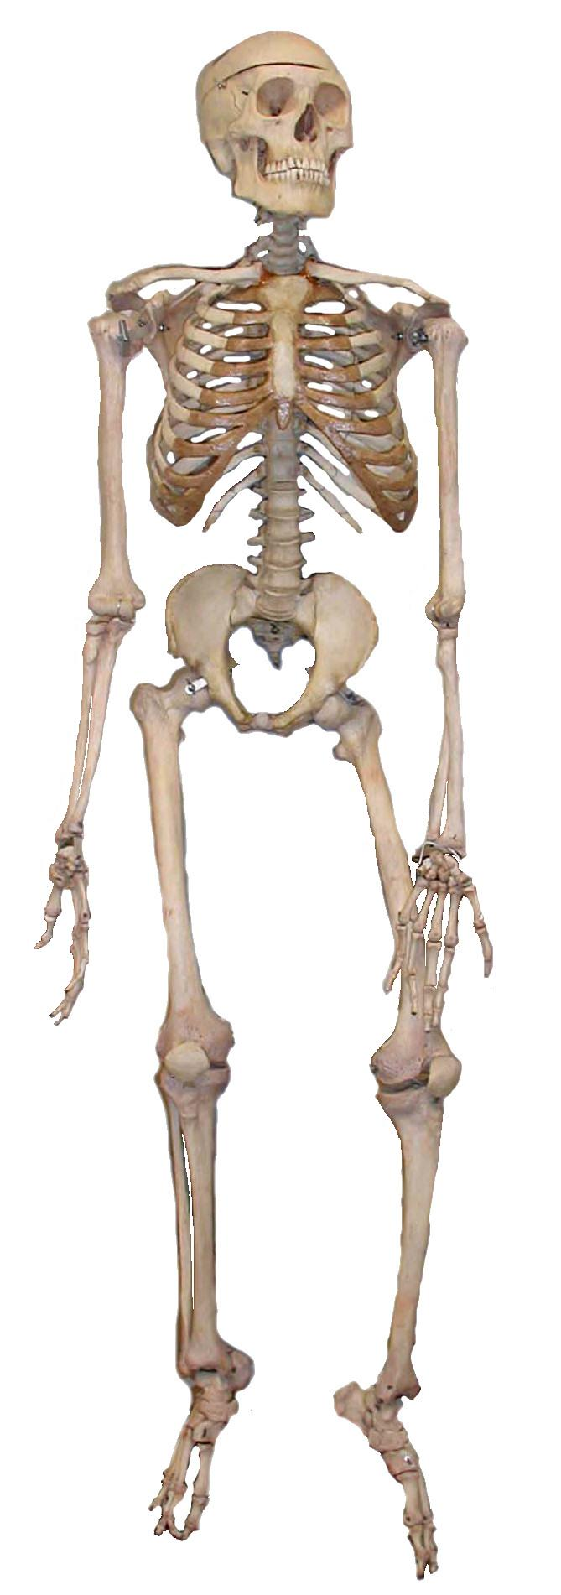
Calcium (Ca)
The body contains more calcium than any other mineral. It is essential for a number of important functions, including:
the maintenance of normal bones and teeth;
normal blood clotting;
normal muscle and nervous system function.
Did you know?
The skeleton contains about 99% of the body’s calcium with approximately 1kg present in adult bones.

Slide 39
Calcium (Ca) sources
Sources of calcium include:
milk and dairy foods;
edible soft bones of fish (e.g. in canned salmon);
green leafy vegetables;
fortified soya bean products;
bread (white and brown flour are fortified with calcium in the UK).

Slide 40
Calcium (Ca)
Did you know?
The calcium level in blood is carefully regulated by hormones, including vitamin D, to keep it within narrow limits. This means that calcium balance can be maintained at different levels of calcium intake.
If calcium intake is too low, calcium is withdrawn from bones to maintain blood levels. So, a poor supply of dietary calcium can lead to low bone density. Over time, this will lead to osteoporosis, characterised by weak, brittle bones.
This condition may also reflect a lack of vitamin D, which is involved in calcium absorption.
There is evidence of low calcium intakes in teenage girls in particular.

Slide 41
Phosphorus (P)
Phosphorus is needed for:
healthy bone and teeth structure;
the production of energy;
normal function of cell membranes.
Sources of phosphorus include red meat, milk and dairy foods, fish, poultry, bread, rice and oats.
Phosphorus is unlikely to be in short supply in UK diets because it is present in many foods.

Slide 42
Iron (Fe)
Iron is needed for:
the formation of haemoglobin in red blood cells;
transport of oxygen in the body;
production of energy;
function of the immune system;
reduction of tiredness and fatigue.

Slide 43
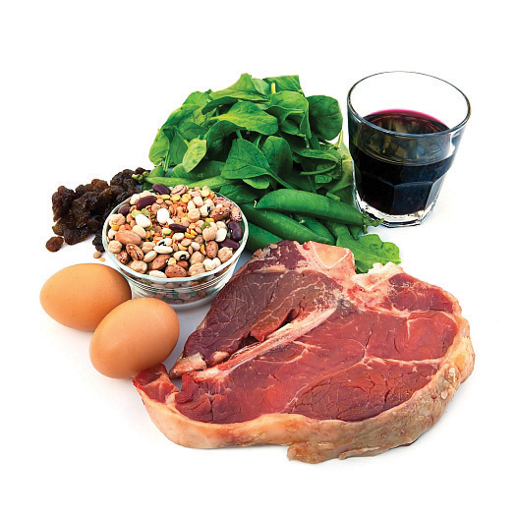
Iron (Fe) sources
Did you know?
There are two types of iron; one from animals sources (haem iron) and the other from plant sources, fortified foods and supplements (non-haem iron).
Haem iron is readily absorbed by the body. Vitamin C helps the absorption of non-haem iron when eaten at the same time.
Sources of iron include cereals, vegetables, nuts, eggs, fish and meat.

Slide 44
Iron (Fe)
Teenage girls and women of childbearing age need more iron than males of the same age.
Over half of teenage girls in the UK do not consume enough iron and intakes are also low in a large proportion of young women. A lack of iron may lead to iron deficiency anaemia.
Did you know?
More than 2 billion people worldwide suffer from iron deficiency anaemia, making it the most common nutritional deficiency.

Slide 45
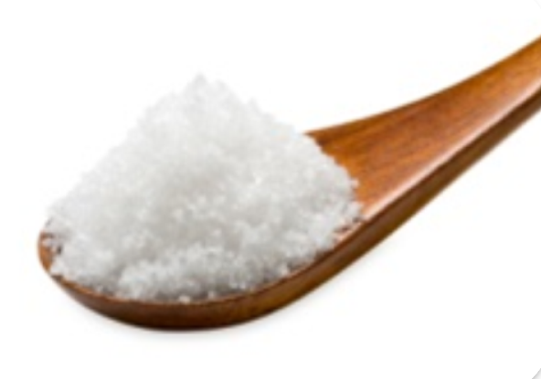
Sodium (Na)
Sodium is needed for:
regulating body water content and electrolyte balance;
the absorption of certain nutrients and water from the gut.
Sodium levels in the body are under homeostatic control and are regulated by the kidneys.
Did you know?
Sodium is a component of common salt, known as sodium chloride (NaCl).

Slide 46
Sodium (Na)
Sodium intakes in the UK are higher than the recommended levels.
High intakes of sodium are linked to high blood pressure (hypertension), which increases the risk of stroke and coronary heart disease.
Did you know?
It is recommended that adults have a maximum of 6g salt per day. Children under 11 years should eat less.

Slide 47
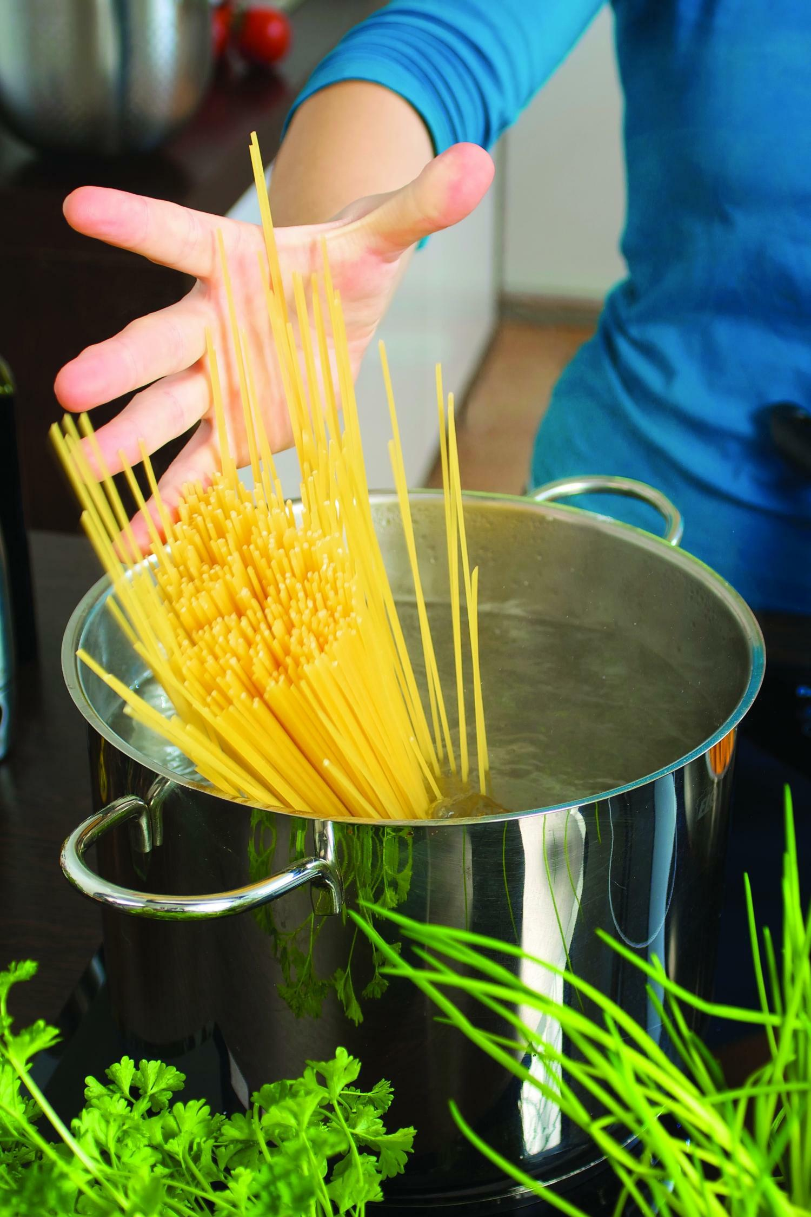
Sodium (Na)
Most raw foods contain very small amounts of sodium chloride (salt).
Salt is often added during the processing, preparation, preservation and serving of foods. Reductions in sodium levels in foods have been happening across the UK food industry.
About 20% of salt we eat is added at home during cooking and at the table.
How can we reduce salt when preparing and cooking food?

Slide 48
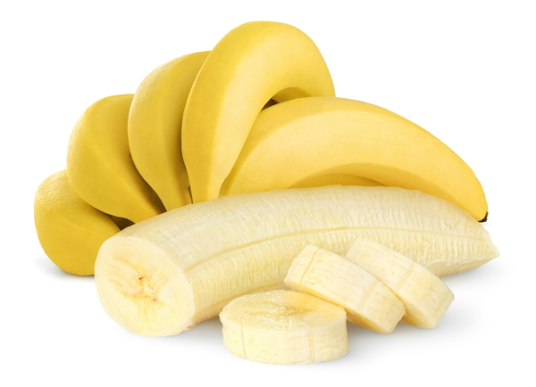
Potassium (K)
Potassium is needed for:
the normal functioning of the nervous system;
water and electrolyte balance and the normal functioning of cells;
the maintenance of normal blood pressure.
Sources of potassium include fruit and vegetables (especially bananas), meat, fish, shellfish, nuts, seeds, pulses and milk.
Low blood potassium levels can be a result of severe diarrhoea. Symptoms include weakness, mental confusion and, if extreme, heart failure. Low dietary potassium intakes have been found in the UK, particularly among women.

Slide 49
Fluoride (F)
Fluoride is needed for:
the mineralisation of bones and teeth;
protection of teeth from dental caries (tooth decay).
Fluoride is now added to most toothpastes but is also found in fluoridated water, tea and fish.
The addition of fluoride to toothpaste is important in those areas where the water supply is low in fluoride.

Slide 50
Recommendations for minerals
The recommendations for minerals are also based on the Reference Nutrient Intake (RNI).
No. of
people
RNI
Requirements

Slide 51
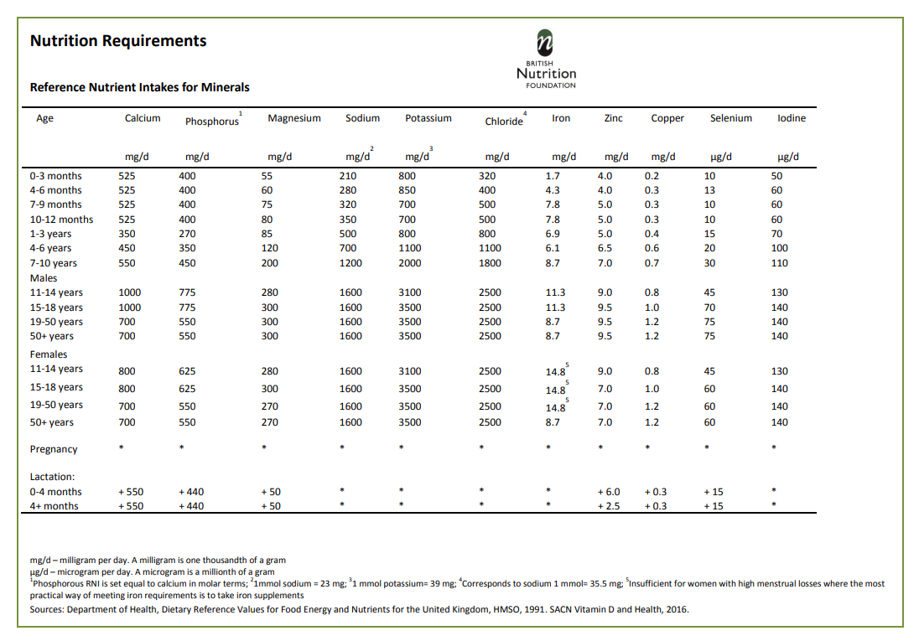
Reference Nutrient Intakes for minerals
For more information on the RNIs, click here.

Slide 52
Low intakes of micronutrients
When looking at low intakes of micronutrients, the Lower Reference Nutrient Intake (LRNI) is used. This is the amount of a nutrient that is enough for only the small number of people who have low requirements (2.5%). The majority of people need more.
No. of
people
LRNI
Requirements

Slide 53
Low intakes of micronutrients
This table shows the percentage of people, in different age groups, with micronutrient intakes below the LRNI.
There are some groups with a high proportion of people with low intakes of certain micronutrients, such as iron intake in girls 11-18 years old.
 | Male |  |  |  |  | Female
Age, years | 4-10 | 11-18 | 19-64 | 65-74 | 75+ | 4-10 | 11-18 | 19-64 | 65-74 | 75+
Vitamin A | 13 | 19 | 16 | 6 | 5 | 11 | 24 | 10 | 7 | 10
Riboflavin | 0 | 13 | 6 | 1 | 3 | 1 | 26 | 14 | 7 | 13
Folate | 0 | 3 | 3 | 0 | 3 | 1 | 15 | 6 | 3 | 8
Iron | 0 | 12 | 2 | 0 | 2 | 3 | 54 | 27 | 8 | 12
Calcium | 2 | 11 | 7 | 0 | 4 | 1 | 22 | 11 | 11 | 10
Magnesium | 0 | 27 | 14 | 6 | 22 | 3 | 50 | 11 | 11 | 27
Potassium | 0 | 18 | 11 | 4 | 16 | 0 | 38 | 23 | 22 | 34
Iodine | 6 | 14 | 9 | 2 | 4 | 4 | 27 | 15 | 6 | 9
Selenium | 1 | 26 | 25 | 34 | 39 | 1 | 45 | 47 | 57 | 76
Zinc | 9 | 18 | 7 | 5 | 8 | 14 | 27 | 8 | 3 | 12

Slide 54
Summary
Micronutrients do not provide energy but are required in small amounts for health.
There are two main types of micronutrients: vitamins and minerals.
Intakes of some micronutrients are low in the UK.

Slide 55
Quiz - Kahoot
Open the link below on the main screen and get students to log onto kahoot.it on their tablets or smartphones.
They can then enter the code (that will come up on the main screen when you start the game) and their own nickname.
They can then play along with the quiz choosing the multiple choice answers that correspond with the questions on the main screen. There will then be a leaderboard of the scores after each question and at the end.
https://create.kahoot.it/share/micronutrients/6c7b9601-18ab-4b28-85e9-561f80f0620f

Slide 56
Micronutrients
For further information, go to:
www.foodafactoflife.org.uk

