Slide 1
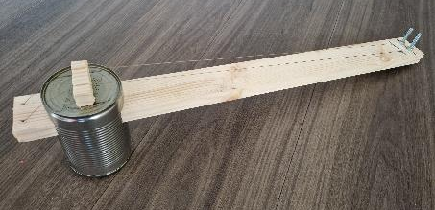
Making an Erhu
Making a traditional Chinese two-stringed instrument

Slide 2
Stay safe
Whether you are a scientist researching a new medicine or an engineer solving climate change, safety always comes first. An adult must always be around and supervising when doing this activity. You are responsible for:
ensuring that any equipment used for this activity is in good working condition
behaving sensibly and following any safety instructions so as not to hurt or injure yourself or others
Please note that in the absence of any negligence or other breach of duty by us, this activity is carried out at your own risk. It is important to take extra care at the stages marked with this symbol: ⚠

Slide 3
What is an Erhu?
The erhu is a Chinese two-stringed bowed musical instrument
It is used as a solo instrument as well as in small ensembles and large orchestras
It can imitate many natural sounds such as birds and horses

Slide 4
You will need
Tools needed
Hacksaw or multi-tool
Drill with bits
Hot glue gun
Wood saw
1 tin can
Wood – 500 x 40 x 20 mm
2 x M5 machine screws
4 x M5 nuts
1.2 m of fishing line
Small bit of wood
Notes:
This will be a challenging activity for some learners. It is recommended for safety reasons that learners are directly supervised whilst completing the activity. E.g. on a one-one basis. Take care around any sharp edges, such as on the tin can.

Slide 5
Step 1 – Making the tuners ⚠
For each machine screw, cut along the slot with a hacksaw until it goes through the head
Try not to cut too deeply as it will weaken the screw, and might break when tightening
(Screw upside down to show depth of cut)
Notes:
If equipment is not available to make tuners then these could be purchased. For example – pack of 6 guitar tuners https://www.amazon.co.uk/NATUCE-Acoustic-Wear-Resistant-Enclosed-Electric/dp/B07XCMJP7X/
If using bought in tuners the diameter of the holes drilled in step 4 may need to be altered depending on the diameter of the tuners purchased.
Take care when using cutting equipment and follow all safety precautions, including keeping hands away from the blade.

Slide 6
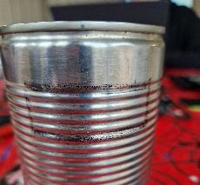
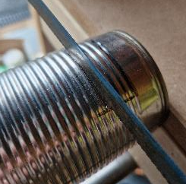
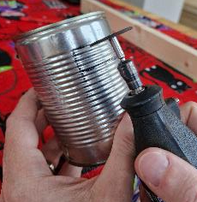
Step 2 – Cutting the can ⚠
Mark two rectangular slots the same size as your stick
Start about 15 mm from the end
Use a hacksaw or multi-tool to cut straight across until the stick fits
Cut the small ends carefully
Notes:
Take care when using cutting equipment and follow all safety precautions, including keeping hands away from the blade.

Slide 7
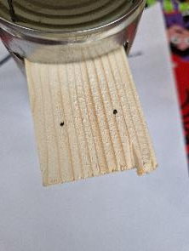
Step 3 – Holes for the strings ⚠
Make two marks on one end of the stick as shown – 15 mm from the end and 10 mm in from each side
Drill a 2 mm diameter hole straight through each mark – these will be for the fixed end of the strings
Notes:
Take care when using drilling equipment and follow all safety precautions, including keeping hands away from the drill bit.
The strings themselves are to be attached in step 6 – only the holes need to be marked and drilled at this point.

Slide 8
Step 4 – Holes for the tuners ⚠
Make two marks on the other end of the stick – 15 mm from the end and 10 mm in from each side
Drill a 5 mm hole straight through each mark – these will be for the tuners
Mark again 15 mm down from each of the first two holes
Drill a 2 mm hole straight through each mark – these will be for threading through the other end of the strings
Notes:
Take care when using drilling equipment and follow all safety precautions, including keeping hands away from the drill bit.
The strings themselves are to be attached in step 6 – only the holes need to be marked and drilled at this point.

Slide 9
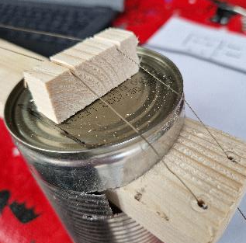
Step 5 – Making the bridge ⚠
You will need a small piece of wood about 10 mm tall and the same width as your stick
Cut two small grooves, about 3 mm in depth, 10 mm from each side
Glue the bridge to the can
Notes:
Take care when using cutting tools and hot glue gun.

Slide 10
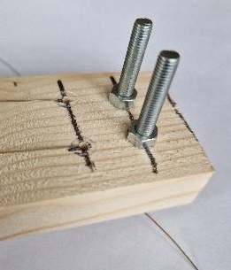
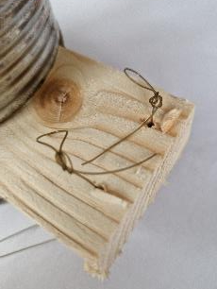
Step 6 – String it up! ⚠
Insert the tuners with the heads to the BACK of the Erhu
Tie fishing line to the bottom end of the stick and glue in place
Run it over the bridge, through the top holes and into the tuners
Notes:
Take care when using hot glue gun.

Slide 11
The finished Erhu
Wrap the line around the tuners and tighten the screw to trap the line between the head and the nut
This will pull the line tight and in tune
Notes:
This is an example of the finished product.

Slide 12
“Oh When the Saints”…!
Use the music on the worksheet to play along with
Have fun and enjoy your Erhu!
Written by Nat - thanks!

