Slide 1
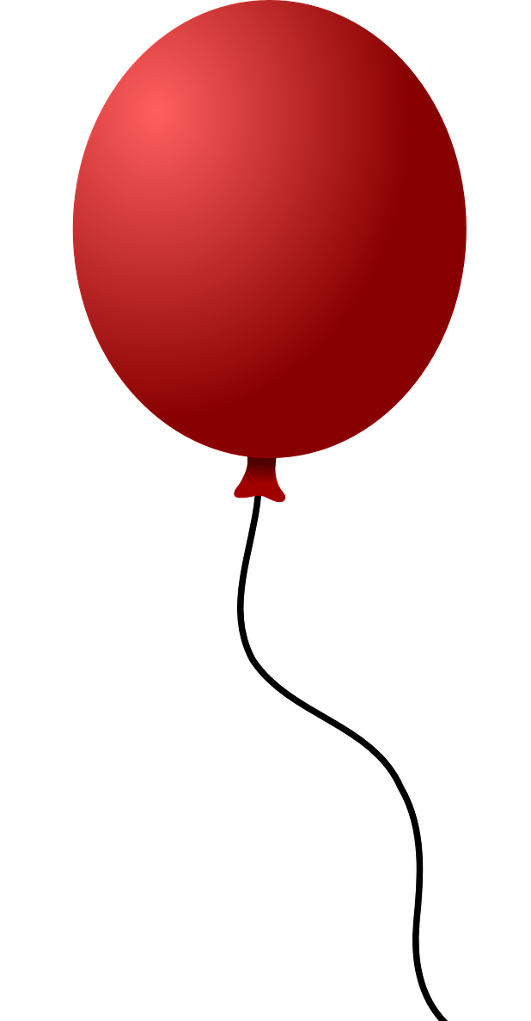
How high will it go!
Finding the height achieved by a flying object using trigonometry

Slide 2
Stay safe
Whether you are a scientist researching a new medicine or an engineer solving climate change, safety always comes first. An adult must always be around and supervising when doing this activity. You are responsible for:
ensuring that any equipment used for this activity is in good working condition
behaving sensibly and following any safety instructions so as not to hurt or injure yourself or others
Please note that in the absence of any negligence or other breach of duty by us, this activity is carried out at your own risk. It is important to take extra care at the stages marked with this symbol: ⚠

Slide 3
Using trigonometry to find height
Trigonometry is a branch of mathematics that deals with the relationship between the sides and angles of a triangle
Pythagoras’ theorem allows calculations based on triangles if two sides are known.
Engineers don’t always know the length of two sides
Other methods are needed for calculations related to triangles

Slide 4
Identifying the sides of a triangle
The hypotenuse is always the longest side in a right angled triangle.
Hypotenuse
Opposite
θ
Adjacent
The opposite is always opposite the angle being used for calculations
The adjacent is always next to the angle being used for calculations

Slide 5
Tangent
Opposite
θ
Adjacent
Tangent θ = Opposite ÷ Adjacent
Notes:
.

Slide 6
Tangent
41
Tangent θ = Opposite ÷ Adjacent
= 41 ÷ 30 = 1.367
θ
30
If you know the tangent θ you can find the angle:
On the calculator tan⁻¹ 1.367 = 53.8º
If you know the angle you can find the tangent:
On the calculator tan 53.8 = 1.367
Notes:
.

Slide 7
Tangent
Tangent θ = Opposite
Adjacent
Opposite
θ
Adjacent
Opp
Tan
Adj

Slide 8
Tangent example
Opp
X
Tan
Adj
50º
1.15 m
From the diagram you need to calculate the length X
Using the formula triangle, hold your finger over the “ Opp” to indicate the calculation (tan θ x Adj)
The tan of 50º is 1.192 (from calculator)
X = Opposite = 1.15 x 1.192 = 1.37 m

Slide 9
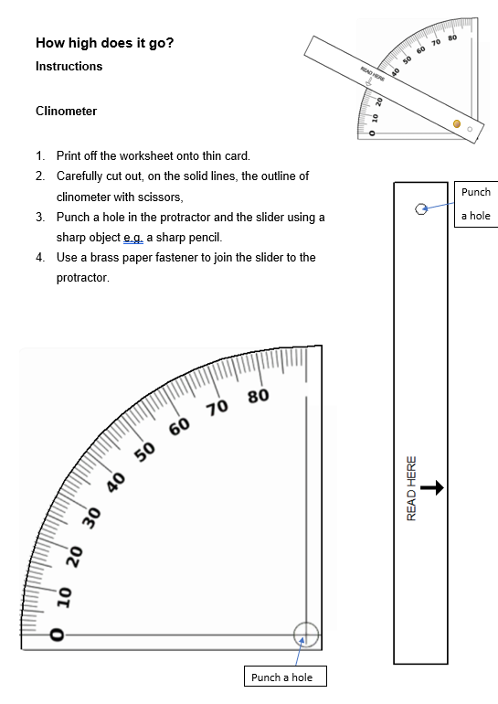
Clinometer ⚠
Print out the worksheet onto thin card
Carefully cut out the protractor and the slide
Punch two holes using a sharp pencil with an eraser behind the card ⚠
Attach the protractor and slider with a brass paper fastener

Slide 10
Measure the height experiment
Work with a partner
One of you inflates and holds the balloon at head height
The second holds the clinometer level with the balloon
Stand a set distance apart e.g. 5 m

Slide 11
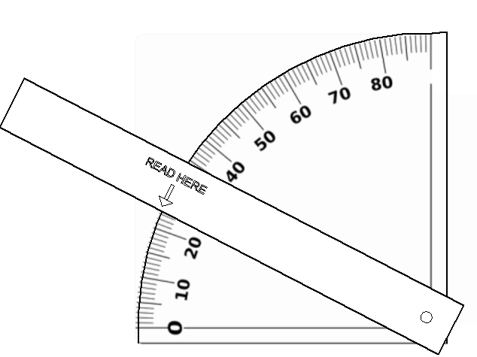
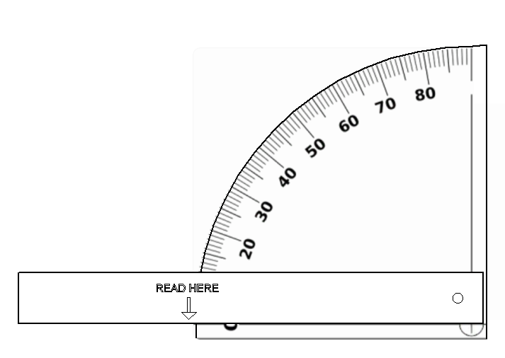
Ready for balloon release
Level
5 m
Notes:
Discuss the brief and design criteria with learners.

Slide 12
What’s the angle?
23 degrees
Release the balloon
Raise the slider on the clinometer to match the balloons height
Record the angle

Slide 13
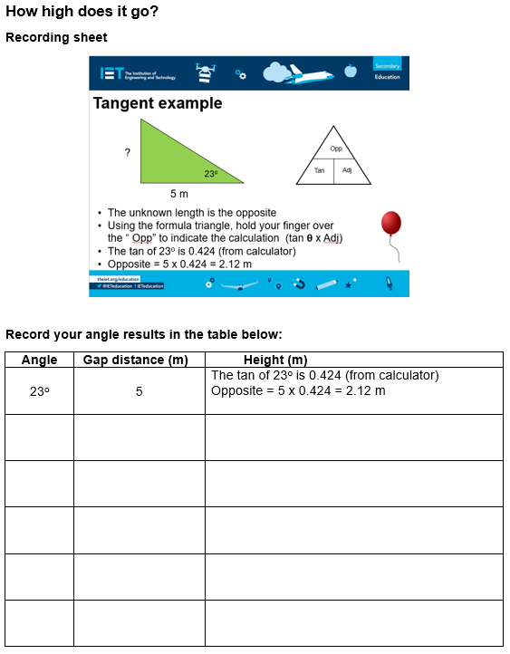
Record the angle
Print off the recording sheet
Record the angle
Calculate the height

Slide 14
Tangent example
?
Opp
23º
Tan
Adj
5 m
The unknown length is the opposite
Using the formula triangle, hold your finger over the “ Opp” to indicate the calculation (tan θ x Adj)
The tan of 23º is 0.424 (from calculator)
Opposite = 5 x 0.424 = 2.12 m

Slide 15
Additional questions
Calculate the unknown side:
Opp
1.
Tan
Adj
?
2.
22º
158 mm
128 mm
35º
?
Notes:
Answers: Q1 63.8 mm; Q2 182.8 mm

