Slide 1
Food labels

Slide 2
Food labels
Food labels provide information which helps people to know when to eat food, and how to store it safely.

Slide 3
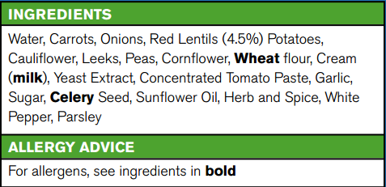
Food labels
The following eight pieces of information must appear by law on food labels:
name of food or drink;
list of ingredients (including additives and allergens);
weight or volume;
date mark;
storage and preparation conditions;
name and address of the manufacturer, packer or seller;
country of origin and place of provenance;
nutrition information.
Additional information may also be provided, such as cooking instructions or serving suggestions.

Slide 4
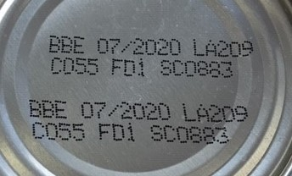
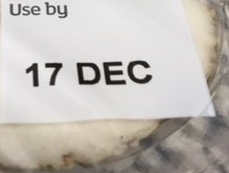
Date marks
Date marks show by when food should be eaten. There are two types:
‘use by’
‘best before’.

Slide 5
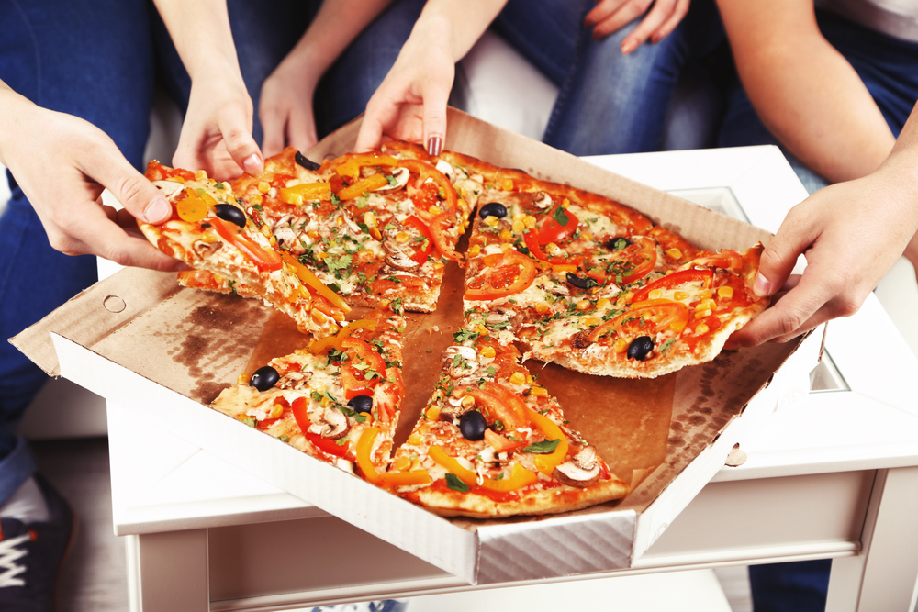
‘Use by’
This is used on foods such as milk, cheese, meat and ready made pizzas.
It shows the day/month, e.g. 8 Feb.
After this date, the food is not safe to eat.

Slide 6
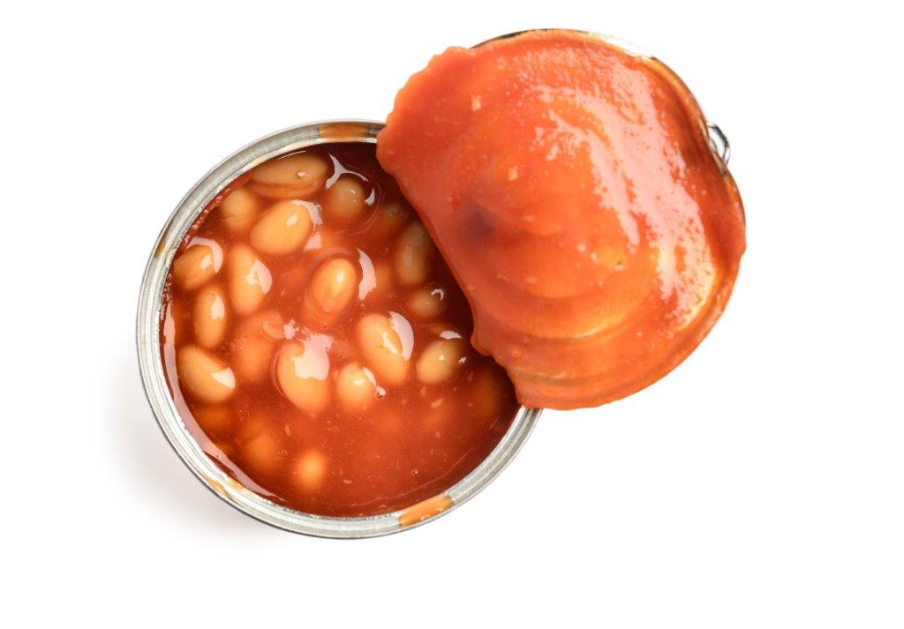
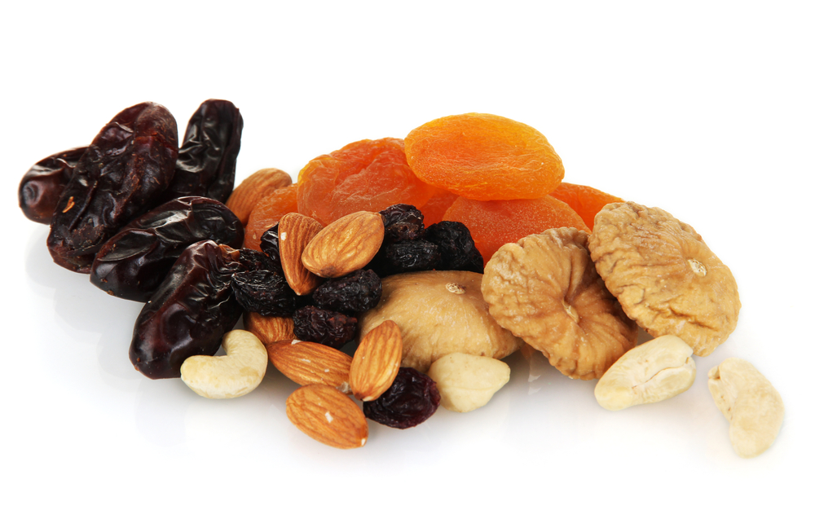
‘Best before’
This is used on foods such as canned beans, dried fruit, breakfast cereals and frozen peas.
It shows the month/year, e.g. Feb ’20.
After this date, the food will probably be safe to eat, but may not look or taste as good.

Slide 7
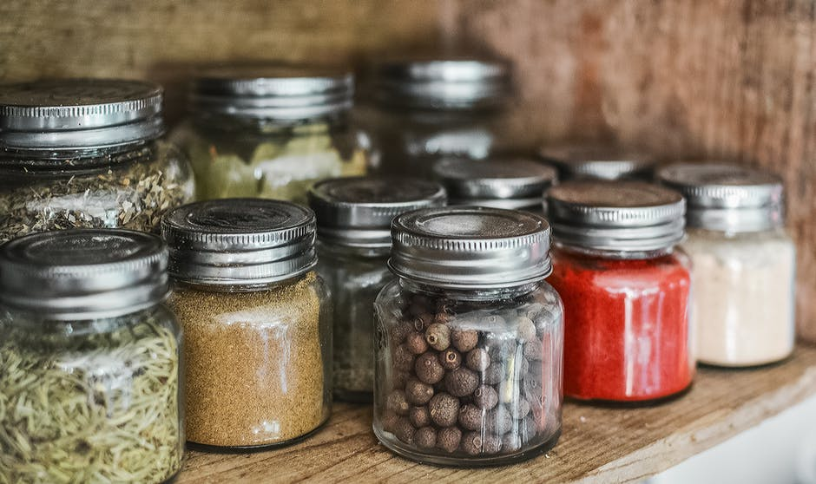
Storage instructions
Labels show how best to store the food to keep it safe. For example:
cool, dry place (cupboard);
refrigerated (in the fridge);
frozen (in the freezer).

Slide 8
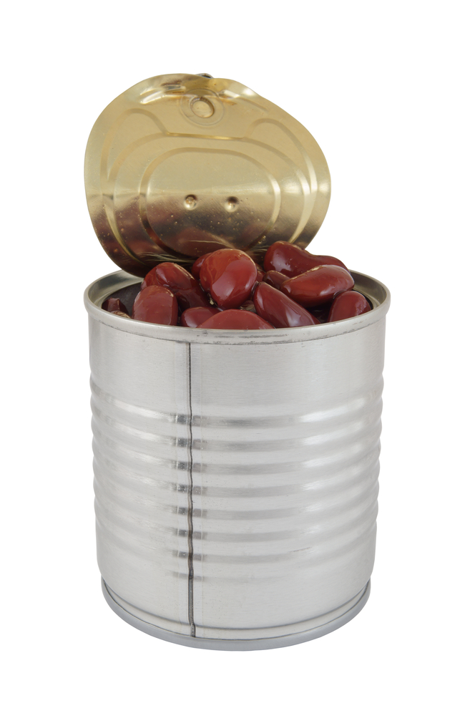
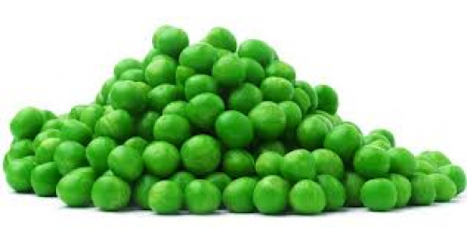
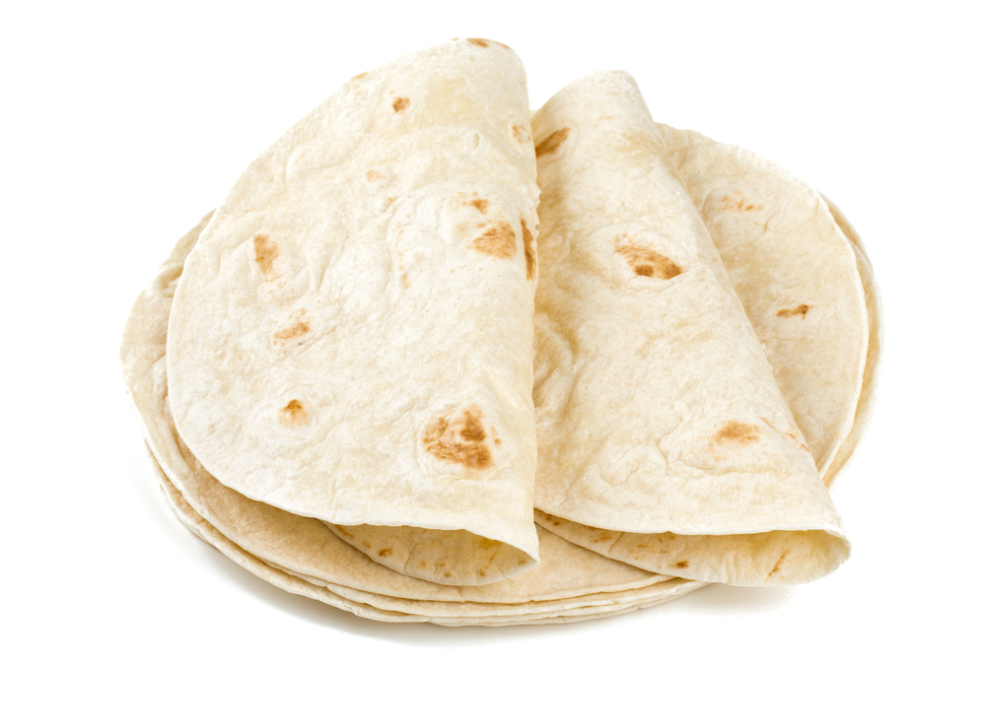
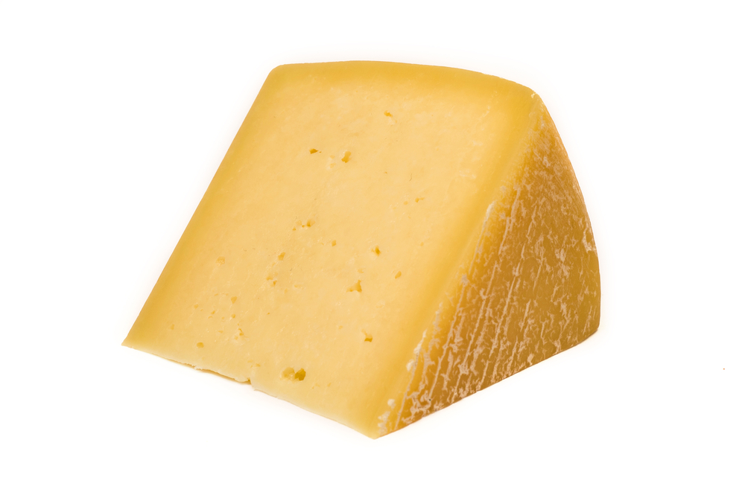
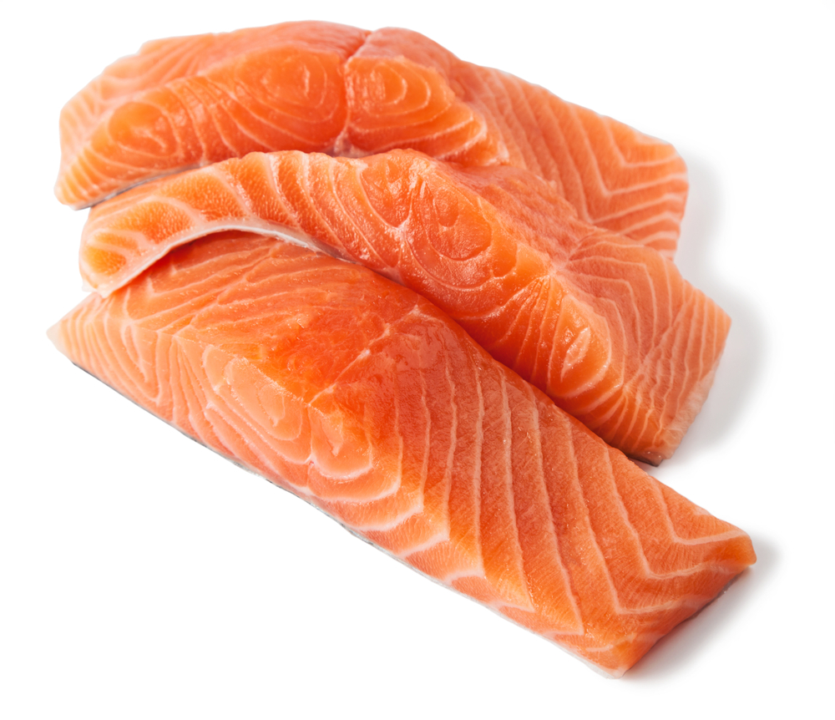
Where should these foods be stored?
cupboard
freezer
fridge

Slide 9
Ingredients
Ingredients should be listed on a label in descending order (i.e. greatest to least).
Food additives must be shown clearly in the list of ingredients, either by the additive’s name or E number.
Allergens must also be identified in the ingredients list. They may appear in bold, italics or be underlined.
If there is a chance that a food may also contain minute amounts of an allergen because it is produced on the same line or in the same factory as other products that contain ingredients known to cause allergy, an additional voluntary statement with the word ‘also’ may follow, for example:
Also, not suitable for customers with peanut allergy
Also, may contain soya and egg
May also contain nuts

Slide 10
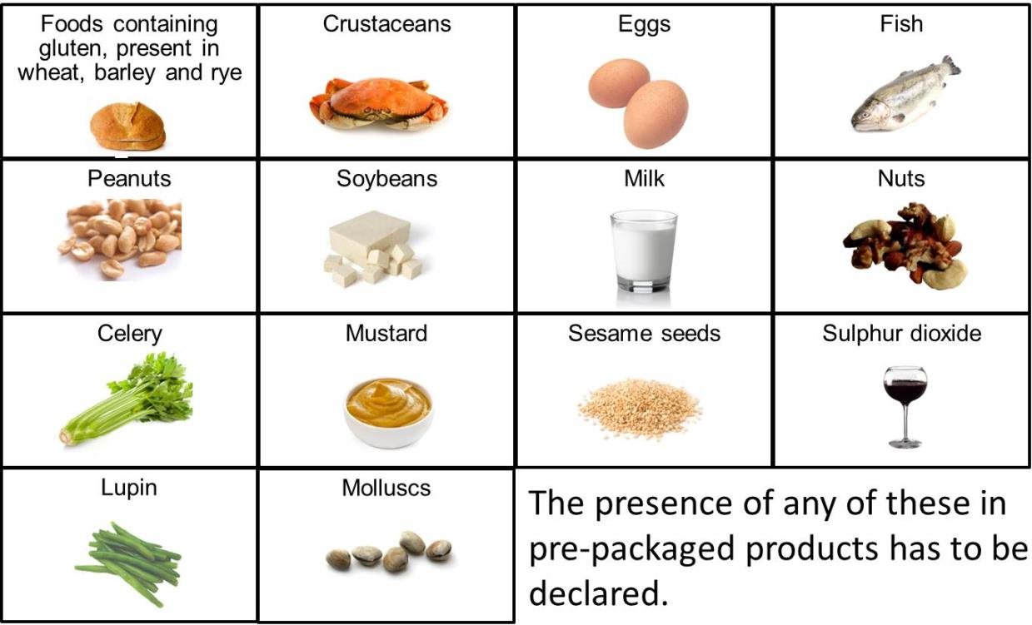
The most common allergens are present in:

Slide 11
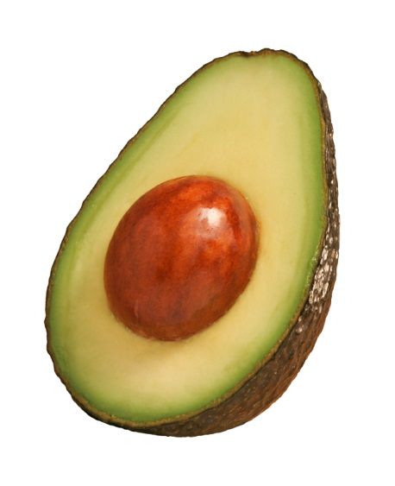
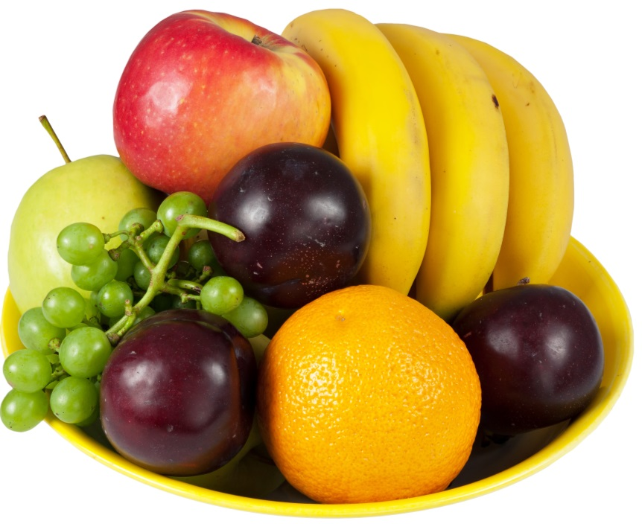
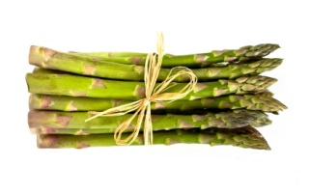
Foods that do not have labels
Lots of the food we buy (or grow) does not have labels.
Examples include:
Name three more examples of food that we buy that does not have labels.

Slide 12
Food labels
For further information, go to:
www.foodafactoflife.org.uk

