Slide 1
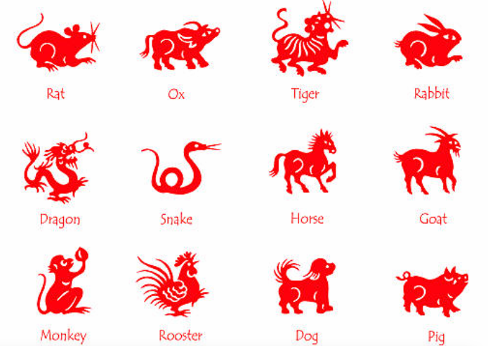
Chinese Zodiac Code Breaker
Code breaking using math calculations

Slide 2
Stay safe
Whether you are a scientist researching a new medicine or an engineer solving climate change, safety always comes first. An adult must always be around and supervising when doing this activity. You are responsible for:
ensuring that any equipment used for this activity is in good working condition
behaving sensibly and following any safety instructions so as not to hurt or injure yourself or others
Please note that in the absence of any negligence or other breach of duty by us, this activity is carried out at your own risk. It is important to take extra care at the stages marked with this symbol: ⚠

Slide 3
Chinese New Year
Chinese New Year, also called Lunar New Year, is an annual 15-day festival observed in China and Chinese communities around the world
It corresponds to the new moon that occurs between January 21 and February 20
Each year is based on one of twelve animal zodiac signs.

Slide 4
Chinese New Year - Zodiac Animals

Slide 5
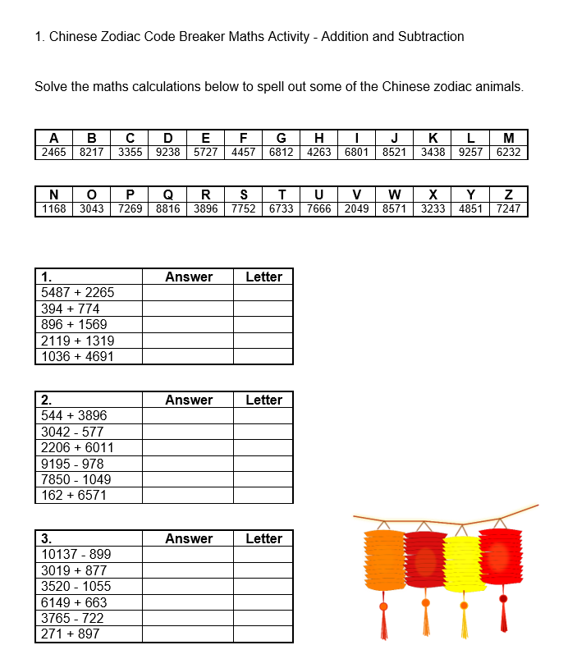
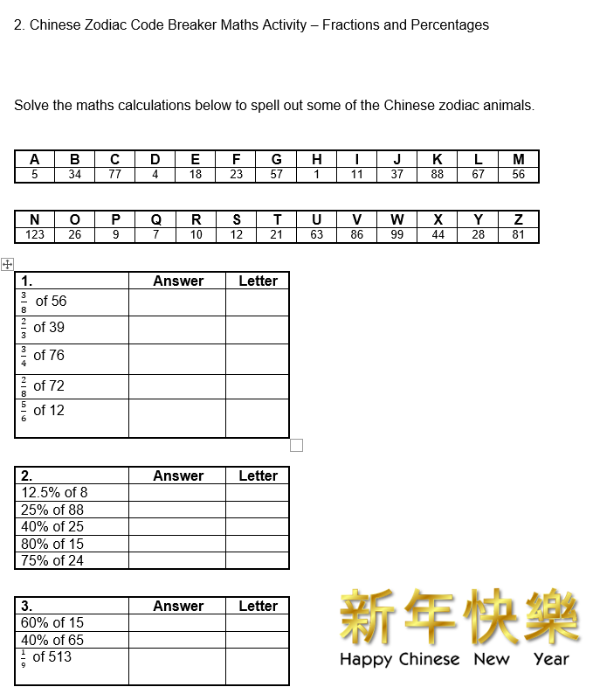
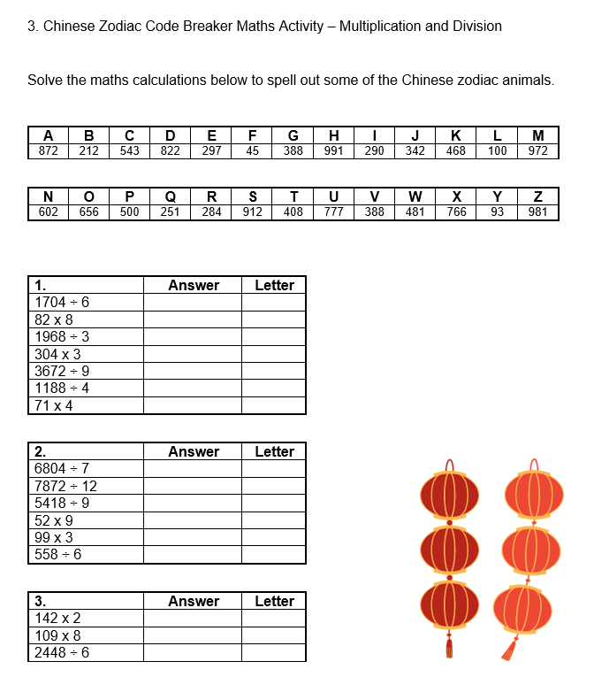
Code Breaking Activity
Solve the maths calculations to spell out some of the Chinese zodiac animals:
1. Addition and Subtraction
2. Fractions and Percentages
3. Multiplication and Division

Slide 6
Code breaking - Extension
Activity
Create your own code breaker activity based using different math calculations

