Slide 1
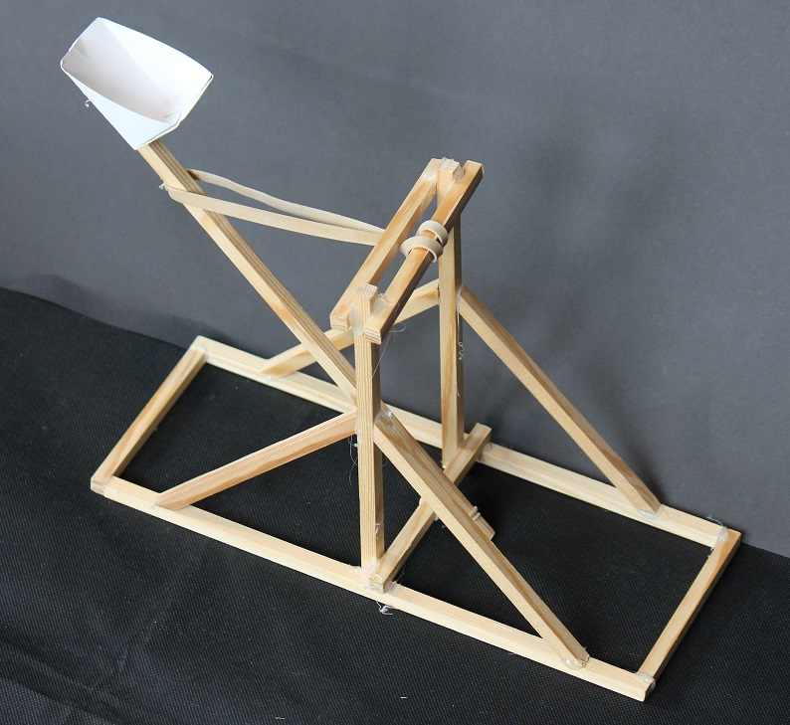
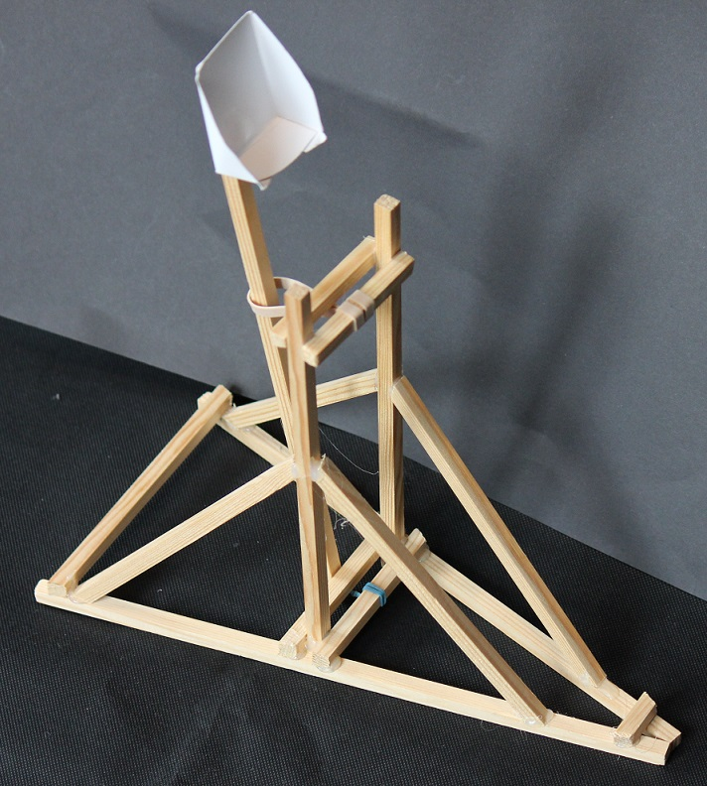
Marshmallow Catapults for kids

Slide 2
Making the Marshmallow Holder
fold line
Cut out the outline of the net
Fold the net along the dotted lines (so the dotted lines are on the inside of the fold)
Use glue on the tabs to stick it together
cut line
tab

Slide 3
Making the Wood Structure
Mark the wood where it needs to be cut (by holding it against the design)
Ensure the wood is held securely. Use a saw to cut the pieces of wood. If you can, use angles where needed.
Use the glue gun to stick the structure together

Slide 4
Rules for using Glue Guns
Always treat a glue gun as if it is hot
When not being used, always stand the glue gun up
Always use a board underneath what you are gluing
Only one person can use a glue gun at a time
Never touch anything with the hot end except for what is being glued
Never touch the glue – it could still be hot

Slide 5
Now try this…
Set up a target (a piece of A3 paper on the floor).
Fire your marshmallow and see where it lands.
Can you tilt the catapult and how much force you apply, so that it hits the target?

Slide 6
Examples of Pupils Catapults
Based on suggested design
Pupils own design

Slide 7
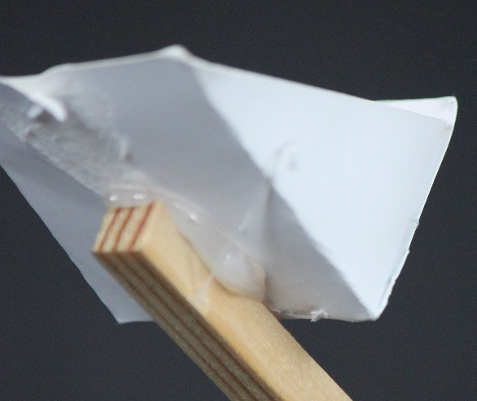
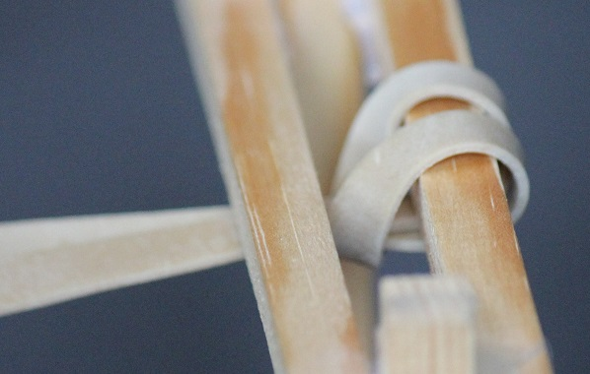
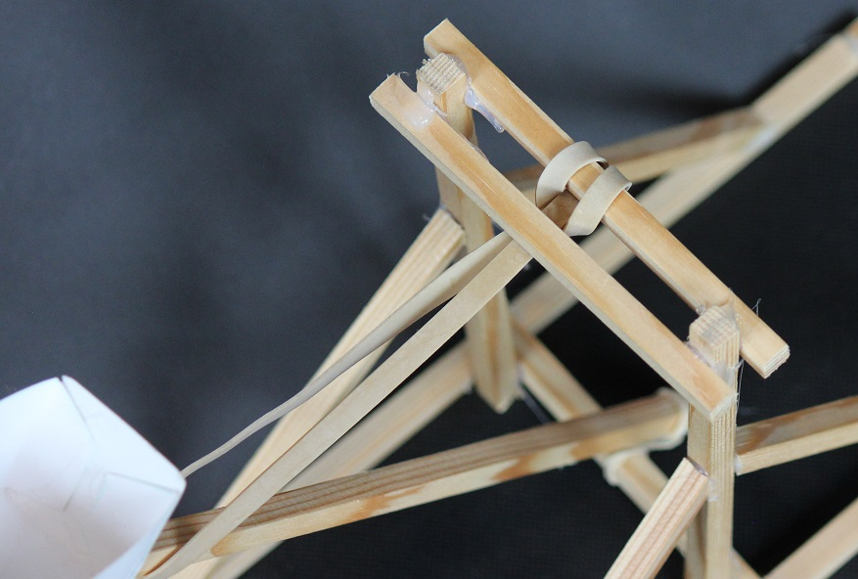
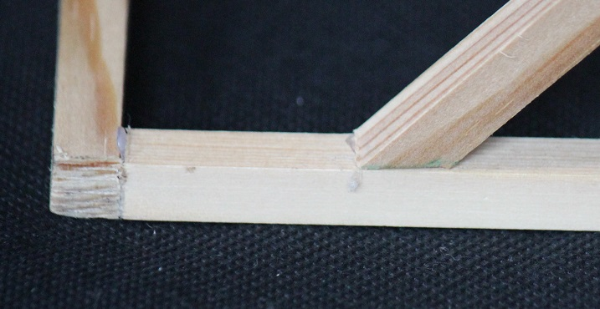
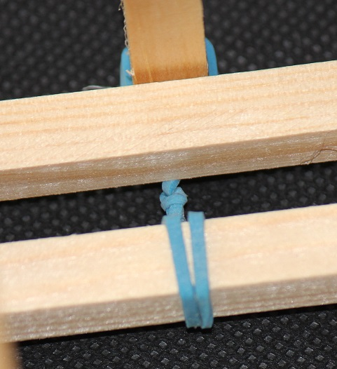
Example of a Pupil Catapult – detail views
Elastic band looped round
Holder glued on
Two cross pieces
Angled edge
Elastic band pivot

Slide 8
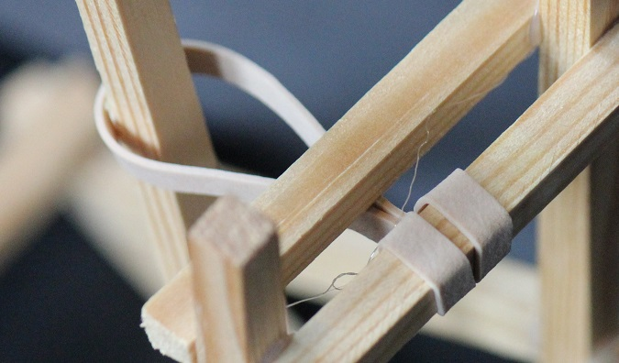
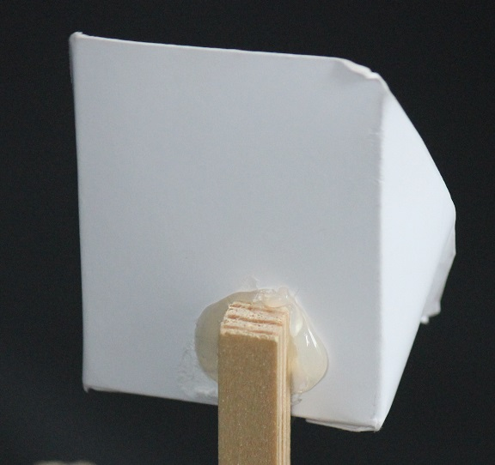
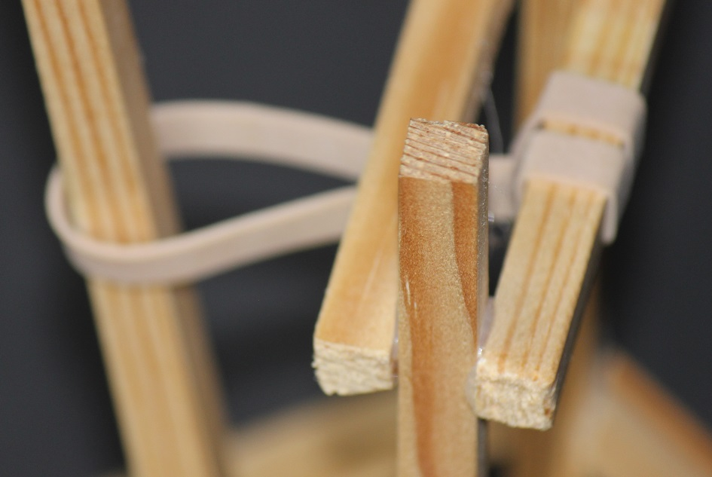
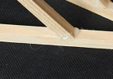
Example of a Pupil Catapult – detail views
Elastic band looped round
Holder glued on
Two cross pieces
Angled edge
Elastic band pivot

