Slide 1
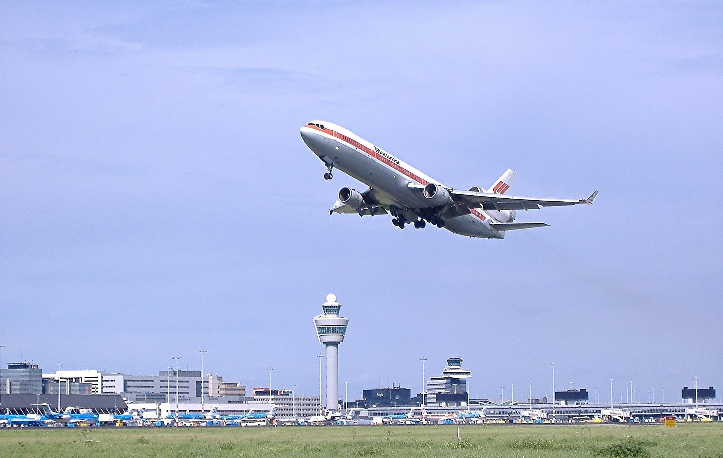
Air traffic control communication
Learning about the importance of clear communication for
air traffic controllers

Slide 2
Stay safe
Whether you are a scientist researching a new medicine or an engineer solving climate change, safety always comes first. An adult must always be around and supervising when doing this activity. You are responsible for:
ensuring that any equipment used for this activity is in good working condition
behaving sensibly and following any safety instructions so as not to hurt or injure yourself or others
Please note that in the absence of any negligence or other breach of duty by us, this activity is carried out at your own risk. It is important to take extra care at the stages marked with this symbol: ⚠

Slide 3
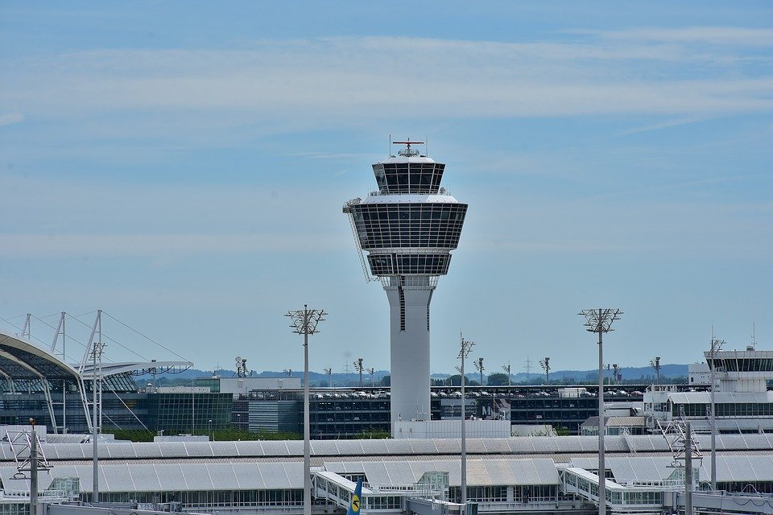
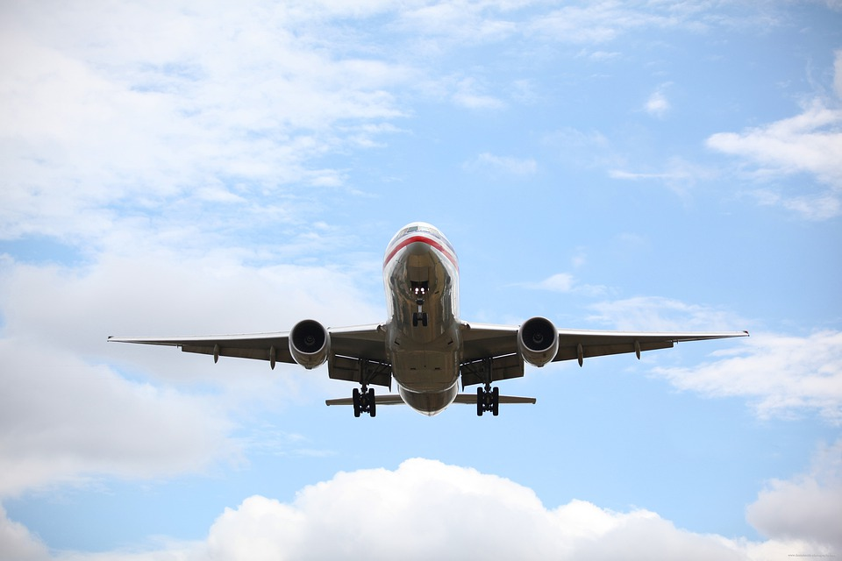
Situation
Air traffic controllers make sure that aircraft can fly safely without hitting each other!
They give instructions to pilots, telling them where they can and cannot fly
It is very important that they can communicate clearly with pilots, even if they cannot see the same things
Notes:
Discuss the context/situation with learners. How important are air traffic controllers and the giving of clear information to pilots?
A possible example of what can happen if communication between controllers and aircraft is not clearly understood is the Tenerife air disaster, although discretion should be used if using this example with learners due to the large loss of life involved. This resulted in changes to how information is given that would prevent such an accident happening again. https://www.historynet.com/disaster-on-tenerife-historys-worst-airline-accident/

Slide 4
Task
Get into groups of three or four
One person in the group will be the air traffic controller. Their task is to explain how to make each shape using the cards.
The other people in the group must not be allowed to see the shape! Their task is to create each shape using only the instructions and cards given.
Notes:
Explain the task to learners and split them into groups of three or four. One member of the group will be the controller, the others will follow the instructions given to create each shape.

Slide 5
Shape cards
Notes:
Print this slide, cut out the shape cards and give one set to each group. The slide can be upscaled to A3 paper if the teacher wishes to increase the size of the cards.

Slide 6
Shape 1 - House
Notes:
This is a simple two card shape.

Slide 7
Shape 2 – Arrow spinner
Notes:
This is a more complex three card shape.

Slide 8
Shape 3 - Spacecraft
Notes:
This is the most complex shape, requiring the use of four cards.

