Slide 1
Egypt COP27 and Road Building

Slide 2
https://youtu.be/9R2VgnZoXjU
https://unfccc-cop26.streamworld.de/webcast/closing-plenary-of-the-cop-followed-by-cmp-and-c-2

Slide 3
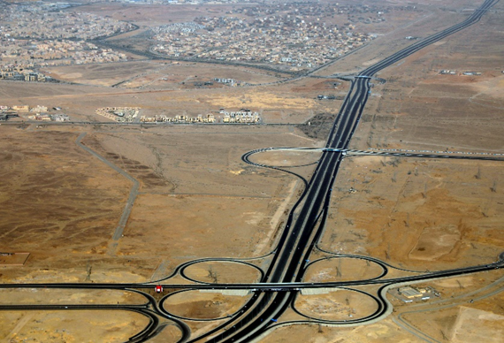
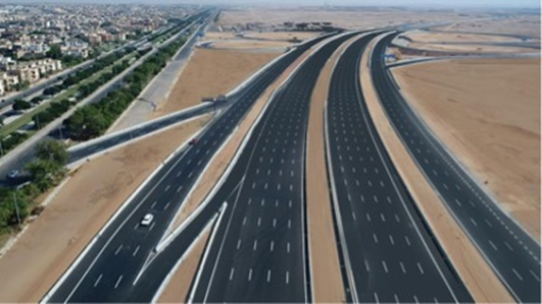
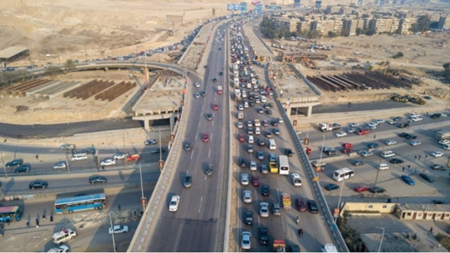
https://scoopempire.com/where-to-%EF%BB%BFegypt-launches-a-series-of-road-and-construction-projects-to-link-up-cities-far-and-wide/
What are the advantages and disadvantages of building new roads?
https://www.reuters.com/world/middle-east/egypts-road-building-drive-eases-jams-leaves-some-unhappy-2021-05-14/
What do you wonder?
https://scoopempire.com/where-to-%EF%BB%BFegypt-launches-a-series-of-road-and-construction-projects-to-link-up-cities-far-and-wide/

Slide 4
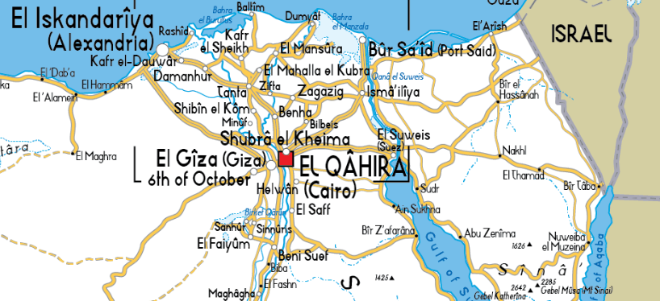
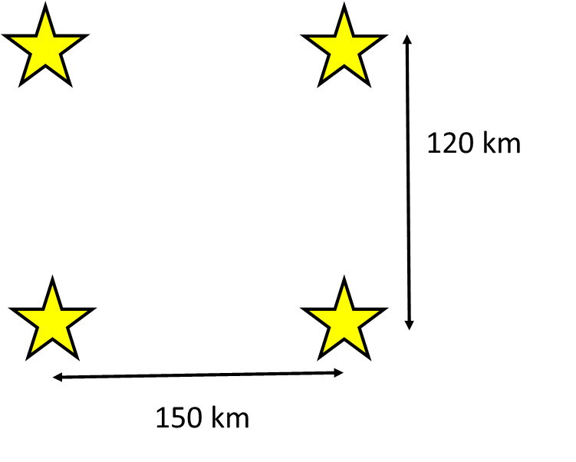
Cairo
Suez
Beni Suef
Zaafarana
https://www.worldometers.info/maps/egypt-road-map-full/

Slide 5
Have a Go!

Slide 6
?

Slide 7
120°

Slide 8
https://www.youtube.com/watch?v=dAyDi1aa40E

